Slide 1


NASA 2026 Cost & Schedule Symposium
RiskMAP in Action
Leveraging Risk Management as an Early Warning System
for Cost and Schedule Baselines
Notes:
Good afternoon, everyone! I know what you might be thinking: “I'm a cost and schedule analyst, why am I listening to a presentation on a risk management app?” My goal today is to bridge that gap.
I want you to rethink how you look at risks, not a tool for risk and project managers, but as an early warning radar for your cost and schedule baselines.

Slide 2

Agenda
The Intersection of Risk, Cost, & Sched.
Why risk data is your earliest leading indicator for variance.
The RiskMAP Ecosystem
Moving from fragmented data to a single source of truth.
The "So What?" for C & S Analysts
Defending schedule margin and preserving cost reserves.
RiskMAP in Action: Inside the App
The User Interface: Standardizing how we track risks.
Questions & Discussions
Open forum on RiskMAP

Slide 3

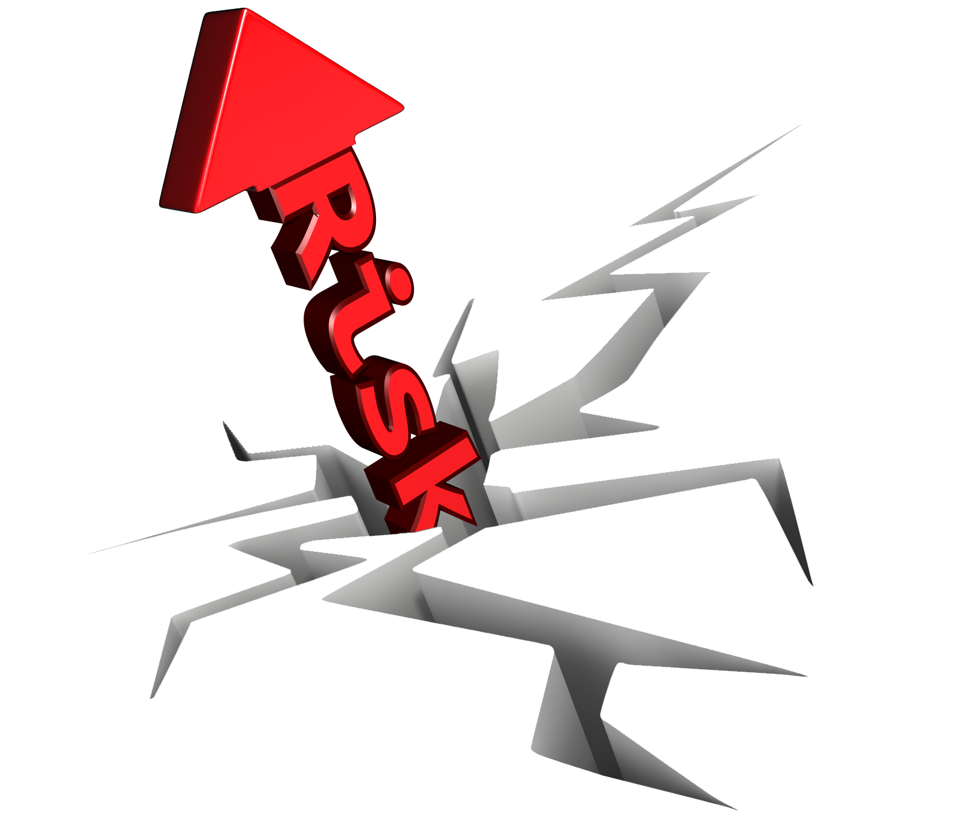

The Intersection of Risk, Cost, & Schedule
A perfect schedule and budget only exists until reality hits. What is "reality"? It's risk.
Risk managers, schedulers, and cost analysts often work in silos. Risks are tracked in one place, while the impacts are felt in the Master Schedule and the budget.
Transforming raw risk data into actionable insight is the key to protecting the critical path and cost baselines.
Notes:
As analysts, you build incredible baselines. But the reality is that those baselines are under constant threat. Traditionally, risk managers work in one silo, and cost/schedule analysts work in another. The problem is that when a risk is realized, it lands right in your lap as a schedule delay or a cost variance. By integrating our data, we can start playing offense instead of defense.

Slide 4
What Is RiskMAP?
The Before:
No centralized repository for capturing or managing risks.
Data trapped in static formats (Excel at best, PowerPoint at worst).
Result: Poor visibility, version control nightmares, and data that cannot be easily analyzed or modeled.
The Solution:
A single, centralized application for all risk management.
Standardized data entry and consistent risk scoring.
Result: Visibility and structured data ready for analysis and dashboards.
Notes:
To put it plainly, our risk data was messy. It was buried in fifty different Excel spreadsheets or locked inside a bullet point on a monthly PowerPoint slide. You can’t run trend analysis on a PowerPoint slide. What we’re trying to do is force risks into a structured format, and turn static text into more dynamic, analyzable data.
Pain Point: I don't have to tell a room full of cost and schedule analysts how frustrating it is when critical project data is locked inside a PowerPoint. You can't run a trend analysis on a PowerPoint slide.
Why: Excel is great, but when everyone has their own spreadsheet, we have 50 versions of the truth. We built RiskMAP because we needed one single source of truth that leadership, risk managers, and you analysts could all look at simultaneously.
Cost/Schedule: By moving risks out of PowerPoint and into a structured database like RiskMAP, we suddenly have data that we can export, track over time, and eventually overlay with your cost and schedule metrics.

Slide 5
The "So What?" for Cost & Schedule Analysts
How does good risk data help them do their jobs better?
Better JCLs (Joint Cost and Schedule Confidence Levels): Garbage in, garbage out. High-quality, centralized risk data makes modeling much more accurate.
Defending Estimates: When stakeholders ask why a project needs so much schedule margin, analysts can point to the data in RiskMAP.
Proactive vs. Reactive: Shifting the conversation from "Why did we go over budget last month?" to "How do we fund this mitigation next month to stay on budget?"
Notes:
Because we capture the data cleanly, we can feed it directly into Power BI. Leadership can now see aggregate risk across the board. But here is the most important part for you: Escalation. When a risk is growing, we use this data to escalate it and request external mitigation funding, like CESO funding. If we can secure funding to mitigate a risk today, we don't have to touch your project's internal management reserves tomorrow.

Slide 6
RiskMAP in Action: Inside the App
  Demo: https://oneplace.nasa.gov/risk_mgmt
    Anyone with NASA credentials can access the app
  Note: The application uses role-based access control to protect sensitive risk data and restricts visibility to authorized project team members.
Notes:
**RiskMAP in Action: Turning Data into Insight**
Visualizing the Threat: Show the app. Explain how leadership uses these dashboards to see aggregated risks.
The Escalation Pathway: Walk through a scenario. A risk is identified -> It is tracked in RiskMAP -> The data shows it's growing -> It gets escalated to the Center/Enterprise level to secure mitigation funding (CESO).

Slide 7
Questions & Discussions
Thank You
for the opportunity
to present to you today!

