Slide 1
Disaggregation – An Approach to Estimating the Cost of New Ways of Doing Business
Richard Webb
KAR Enterprises

Slide 2
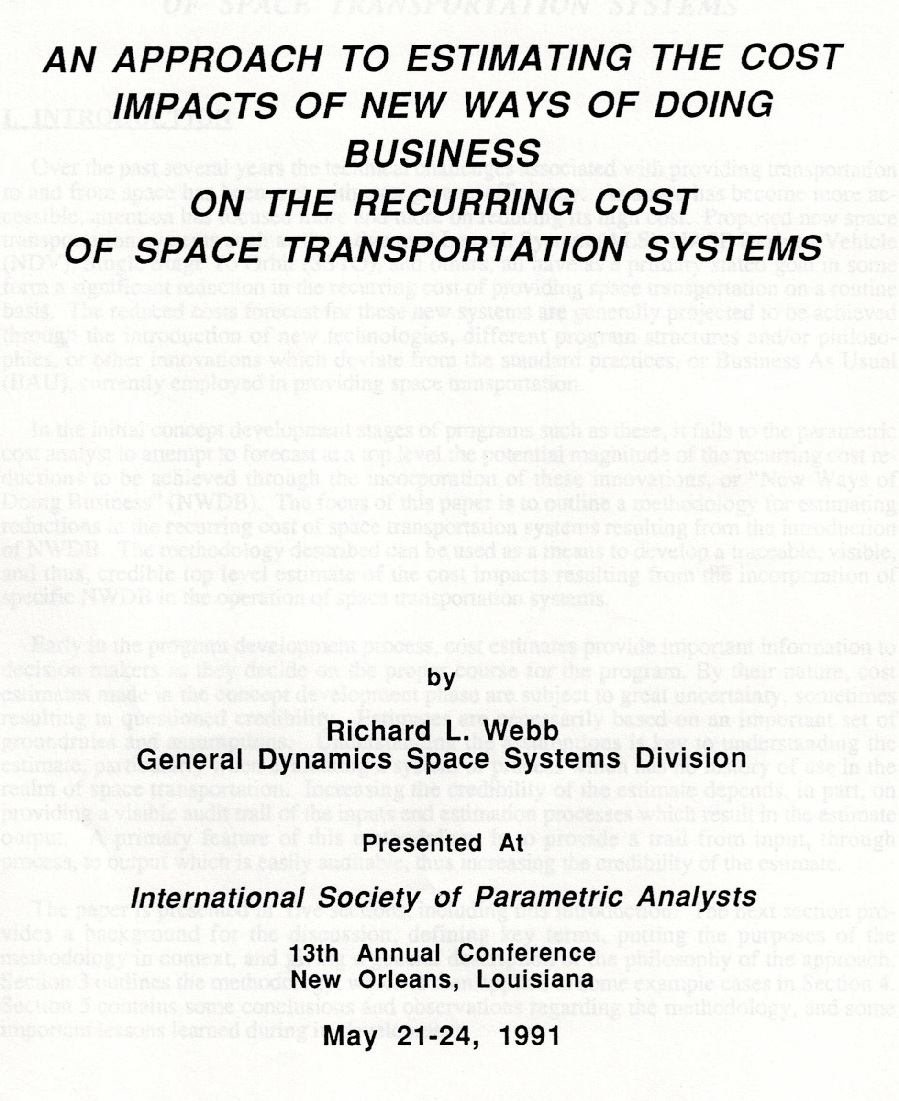
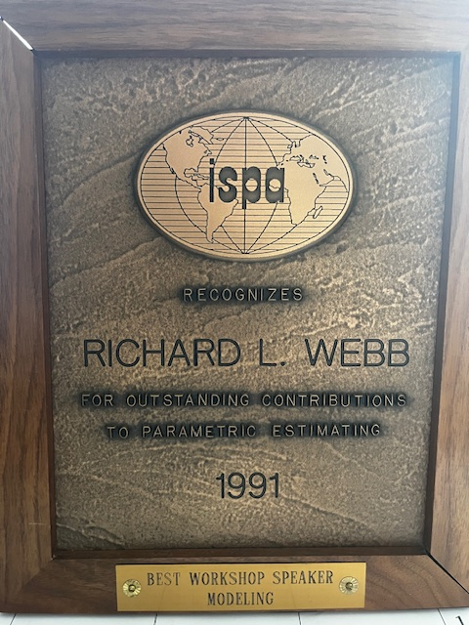
Introduction & Outline
INTRODUCTION
  Ways to credibly estimate the cost of what are often called “New Ways of Doing Business” (NWODB) has been and continues to be an important topic for cost estimating community.
  Effectively implementing approaches to estimating the cost impacts of NWODB necessarily involves the quantification of those impacts relative to a baseline often called “Business As Usual” (BAU) in a way that provides credible results.
  This presentation provides a methodology for applying the quantified potential cost reduction benefits in a method that is traceable, defendable, and (thus) credible.
  Originally presented at ISPA Conference 1991; Developed further by Manufacturing Cost Working Group with ECO personnel circa 2006; Utilized on various SLS and other analyses
OUTLINE
  What are NWODB?
    Examples
  Disaggregation
    Context – Measurement, the WBS cube
    Methodology – Process flow
    Examples
  Issues
  Conclusions

Slide 3
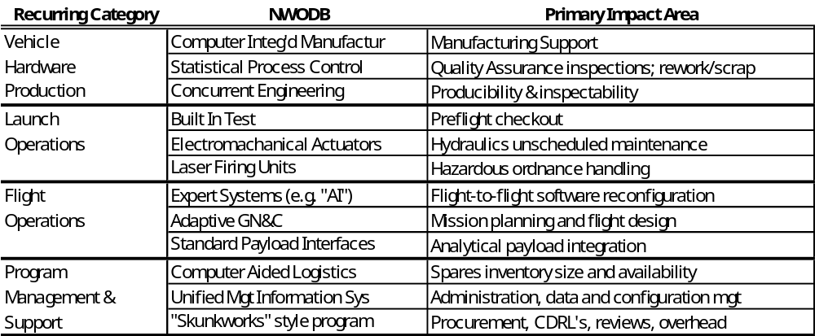
New Ways of Doing Business - Defined
New systems or process that, when incorporated, are expected to improve cost, schedule, and/or performance for (for our purposes) space transportation or spacecraft relative to BAU systems or processes.
  Can impact non-recurring development and/or recurring production and operations
  Often manifests as spending non-recurring investment to obtain a new system or process to impact recurring production and operations
  Can include new technologies/processes AND new (or different) program management processes and systems and/or acquisitions strategies.
Examples
Applied at different levels of depth
  Higher – Programmatic/Organizational
    Organization “Approaches”
      Space X, Skunk Works
    Alternate Acquisition Approaches
      Contract Type, OTA’s
  Lower – Subsystem/Function
    Production Automation
    Inspection Requirements

Slide 4
NWODB – Measurement & Application
Measurement
  The estimated (“advertised”) cost reductions using NWODB are typically quantified as % reductions from a BAU approach.
    “Introduction of a new automated circumferential friction stir weld machine will reduce touch labor and quality assurance labor hours (cost) by 50%.”
    “Using a vertically integrated organization structure reduces system cost by 60% by changing make/buy decisions from buy to make for components typically bought under BAU approaches, including avionics boxes, propellant feed lines, engine nozzles and combustion chambers, etc.”
Cost reductions typically estimated using the following formula:
Key Consideration: what is the BAU base being reduced?
  Important to select the correct BAU base against which the Cost Reduction Factor (CRF) is to be applied.
    Example: an automated welder that reduces touch labor 75% should be applied to a base of touch labor, not overall production cost.
      Touch labor is often <20% of total production cost.
Cost including NWODB = BAU $ x 1-Cost Reduction Factor %
Cost Reduction Savings % = (NWODB $ - BAU $) / BAU $

Slide 5
Methodology - Disaggregation
“Disaggregation”
  Five step process to credibly estimate cost including introduction of NWODB
  Involves understanding what we’re getting for our money
    Breakdown (“disaggregate) the estimate to identify product and services necessary to produce the end item being estimated
  Breaks end-item (usually) parametric estimate down by percentage to functions; varies by end-item (tanks vs. avionics) and non-recurring vs. recurring phases
    E.g. Propellant Tank Production $ = Σ direct labor (touch, production support, QA, program mgt, etc.) + indirect labor (HR, Finance, Contracts, etc.) + materials and subcontracts (material, purchased parts, subassemblies, etc.) + wraps (fringe, overhead, G&A, COM, etc.)
Correlation vs. Causality: a distinction with a difference?
  Metrics (i.e. independent variables) for most characteristic-based cost estimating methods (e.g. parametric models) are end-item oriented
    Weight, Power, Thrust, Source Lines of Code
  Characteristics are correlated to cost, not necessarily causative
  End item cost is “caused” by the value added in form of products and services required to produce the item

Slide 6
Dimensions of Cost – the WBS Cube
The “Cost Cube”: Cost database can be organized/accounted for in several different dimensions
  The sum of the cost of each dimension is equal to the sum of the cost of each of the other dimensions
Program Life Dimension
Schedule Orientation
Time Phasing/Schedule
Prototype
Full Scale Development
Production
Operations
Parametrics
WBS Dimension
End Item Oriented
Hardware
Software
Facilities
Operations
$
$
$
$
Elements of Cost Dimension
Financial Orientation
Labor Hours/Headcount
By Skill
Material/Subcontracts
Overhead
Labor Overhead, Fringes, G&A, etc.
Subdivisions of Work Dimension
Functional/Process Oriented
Engineering Manufacturing
Tooling Quality Assurance
Test Operations Administration

Slide 7
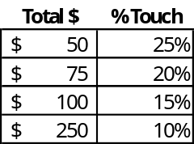
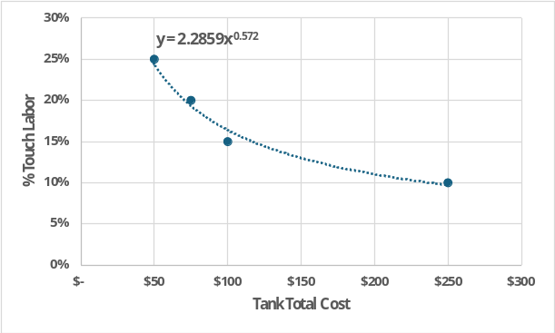
Dimensions of Cost – the WBS Cube
Utilizes “ratio analysis” - historical ratios of relative cost contributors to end-item cost
  Ratio analysis is used in many ways/settings
    Home loan “PITI” Index, Financial statements analysis, etc.
Provides visibility into all functions being provided for a given end-item
Costs which disappear with reductions in resources required
  E.g. Manpower : Wages and Fringe Benefits
Costs which remain
  E.g. Overhead functions: contracts, finance, HR, etc.
Quantifies relationship between end-item cost to products and services provided to produce end-item
  Essentially a “Functional Estimating Relationship”
    Independent variable is end-item cost (or hours/other)
    Dependent variable is percentage for specific function
    relative to total end-item cost
      E.g. Propellant Tank Touch Labor % = 2.29 x Tank $ ^{-.572}

Slide 8
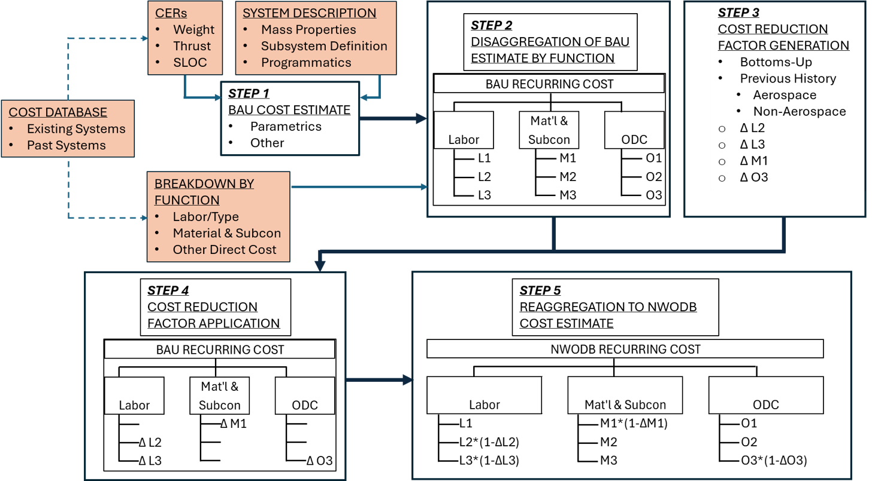
Analysis Process Flow
5 Step Disaggregation Process Flow

Slide 9
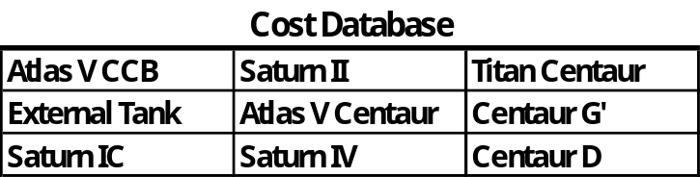
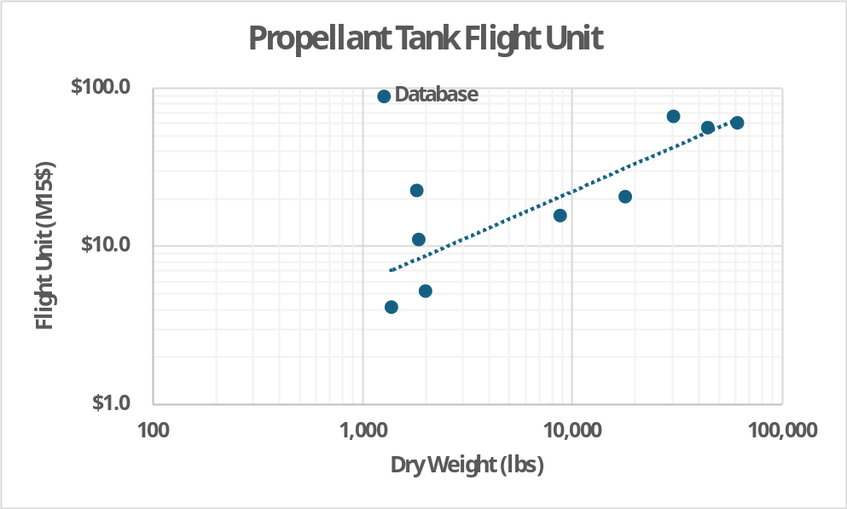
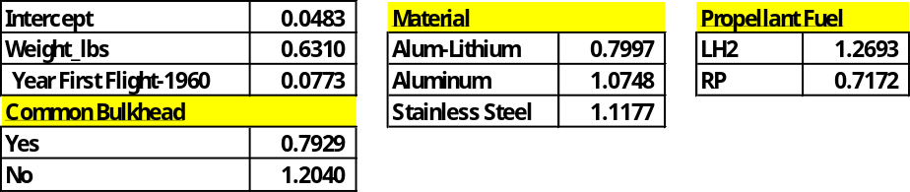
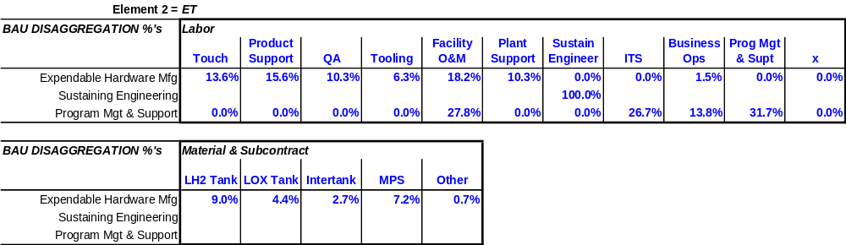
Example 1 – Propellant Tank (1 of 5)
Example 1 – Propellant Tank – Source Data Set
  Cost Database
    Parametric: Multi-variate CER
      From Bayes Regression Analysis
    Functional Disaggregation
      From ET analysis, POP 04 (MCWG 2006)

Slide 10
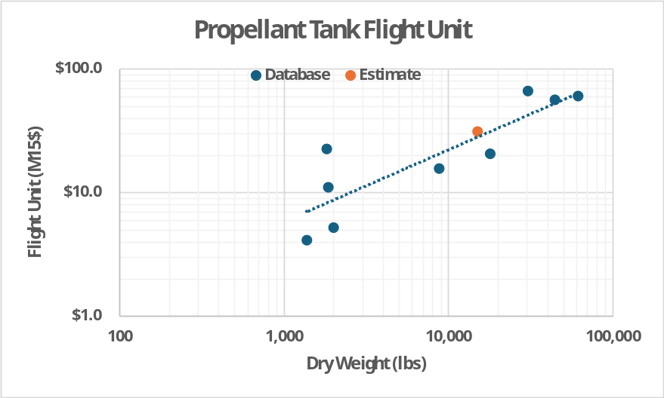
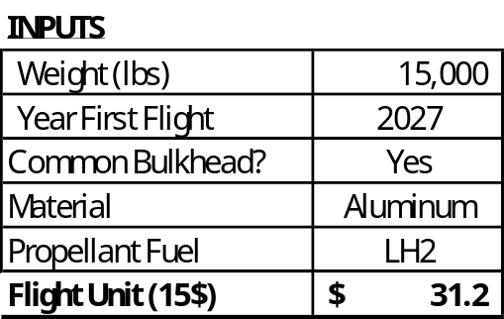

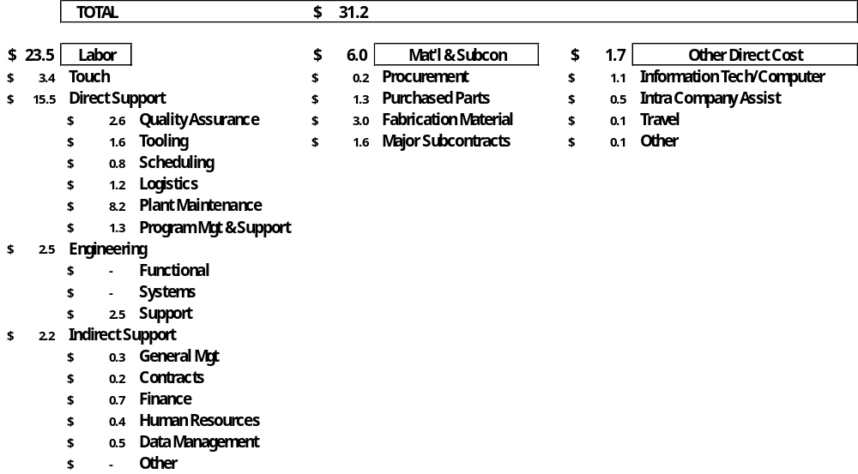
Example 1 – Propellant Tank (2 of 5)
STEP 1 – BAU Estimate-Parametric
Flight Unit = $31.2M
STEP 2 – Disaggregation to Functions

Slide 11
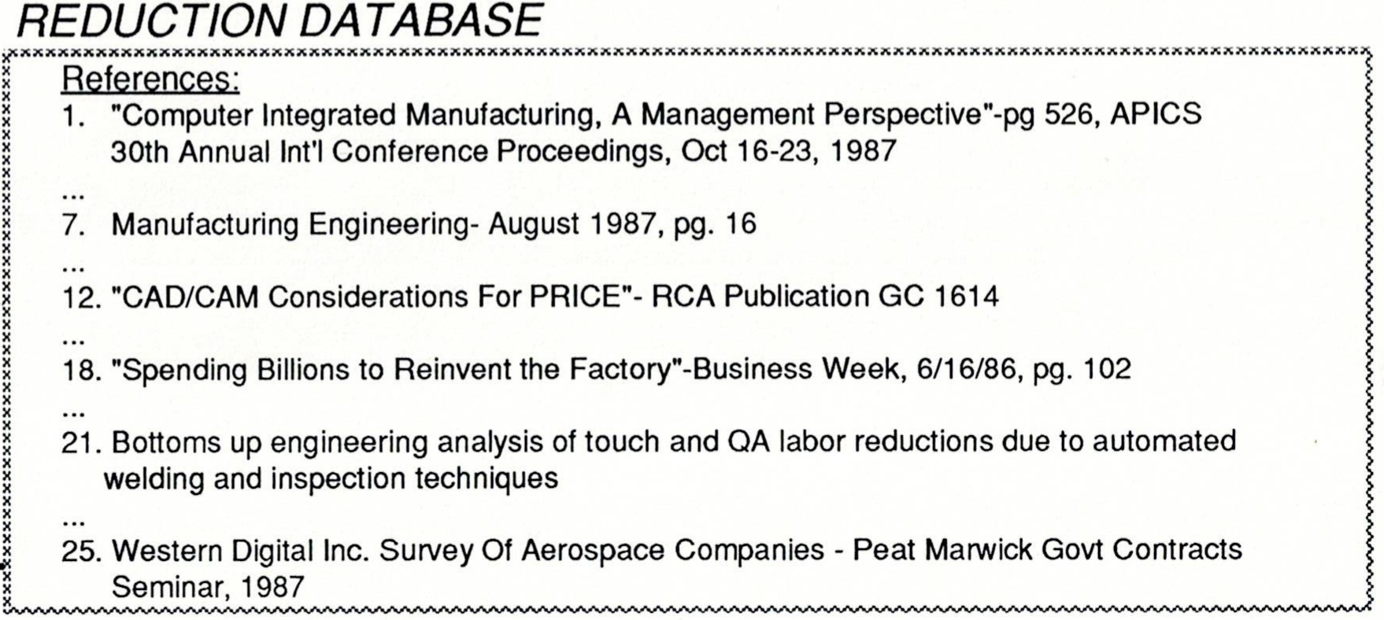
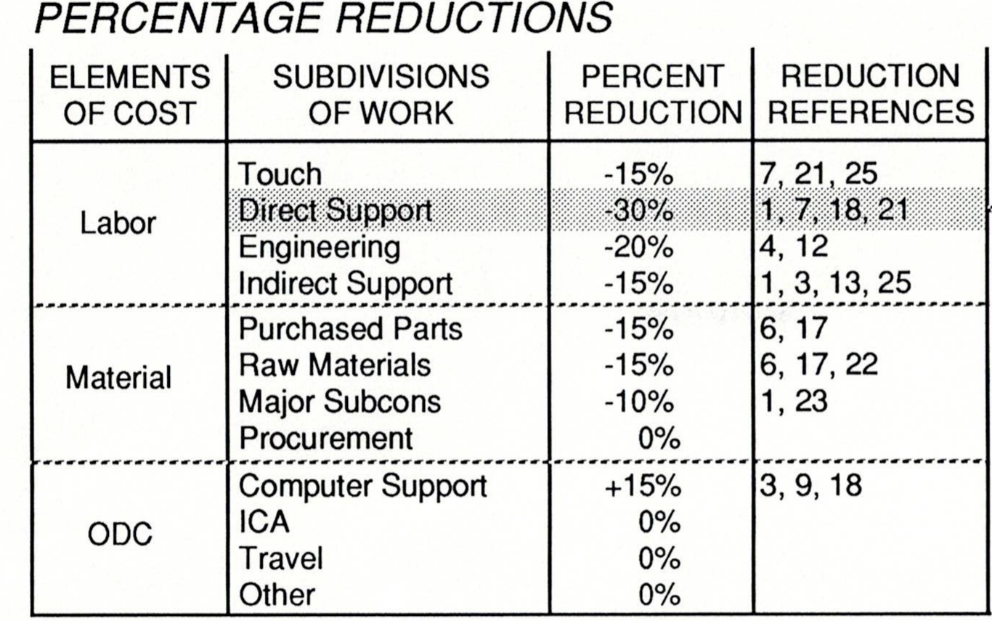
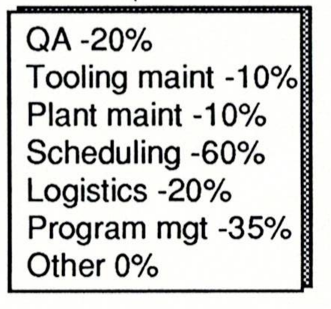
Example 1 – Propellant Tank (3 of 5)
STEP 3 – Cost Reduction Factors – Computer Integrated Manufacturing (CIM)
Note that introduction of CIM INCREASES Computer Support Cost

Slide 12
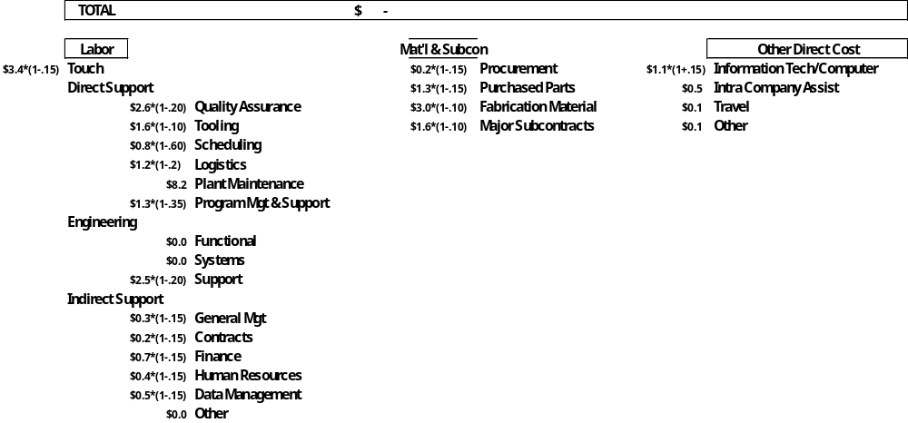
Example 1 – Propellant Tank (4 of 5)
STEP 4 – Cost Reduction Factor Application
Cost including NWODB =
BAU $ x 1-Cost Reduction Factor %

Slide 13

Example 1 – Propellant Tank (5 of 5)
STEP 5 – Reaggregation to NWODB Estimate
NWODB Estimate = $27.6M
BAU Estimate = $31.2M
Savings = $ 3.7M
% Cost Reduction = 11.7%
Number Tanks/Yr = 10
$ Savings/Yr = $37.0M
NOTES: Some possible other savings based on disaggregated BAU estimate cost contributors (See Step 2)
The single largest contributor is Plant Maintenance – a reduction in plant footprint could result in significant savings
Fabrication Material is most likely Aluminum; looking into block buy savings may offer additional savings.

Slide 14
Example 2 – Multiple NWODB (1 of 4)
Example 2: Incorporate Multiple NWODB
  Estimate unit cost savings given introduction of multiple actions to reduce recurring cost of a large core stage – LOX/LH2, integrated subsystems; production rate = 1 per year
  NWODB List
    Redesign expensive/obsolete heritage hydraulic Thrust Vector Control (TVC) subsystem
      Estimated savings: 50% unit cost reduction
  Re-organize plant footprint and operations to reduce plant O&M
    Estimated savings: 15% cost reduction per year
  Fixed Price/Tailored Contract Requirements
    Net reported effect = 18% average reduction to “total value added” (i.e. contractor labor) cost - Cost reduction factors taken from Coopers & Lybrand Study
  Reduce NASA insight/oversite; reduce non-prime labor (i.e. NASA FTE and WYE)
    ~= 60% to 70% reduction in NASA labor and ODC
  Consolidate contracts
    Reduce contractor G&A rate to no more than 20% of value-added cost
      No IRAD, minimal B&P, more labor direct vs. indirect
NOTE: Any resemblance to projects or programs (living or dead) is purely coincidental.

Slide 15
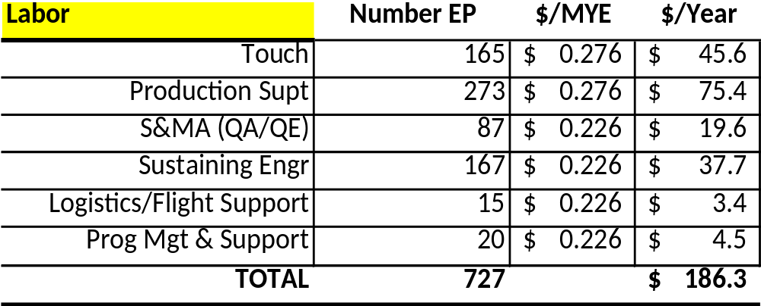
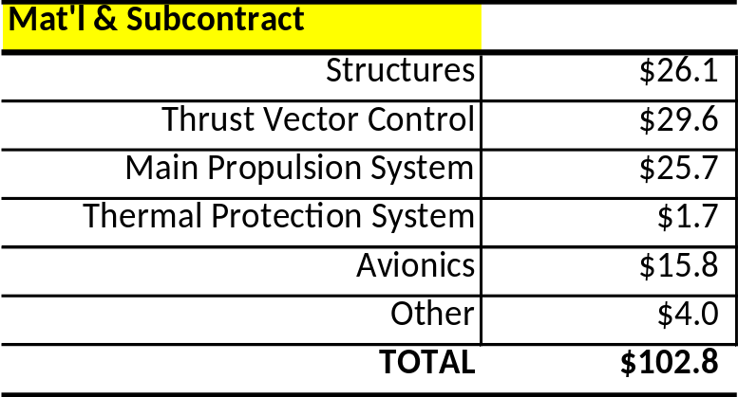
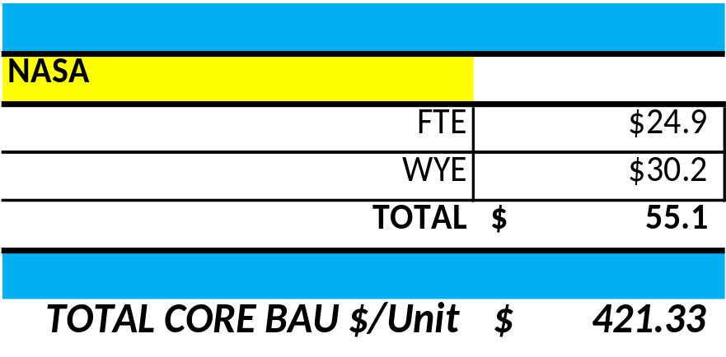
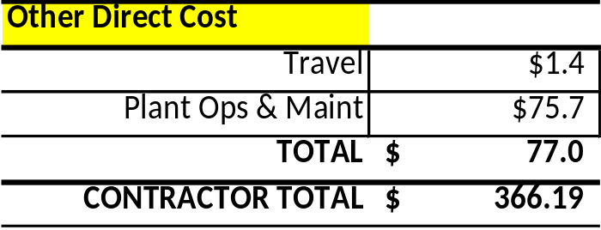
Example 2 – Multiple NWODB (2 of 4)
  BAU estimate
    Basis is current “actuals”, not a parametric estimate
NOTE: all numbers shown are example-only

Slide 16
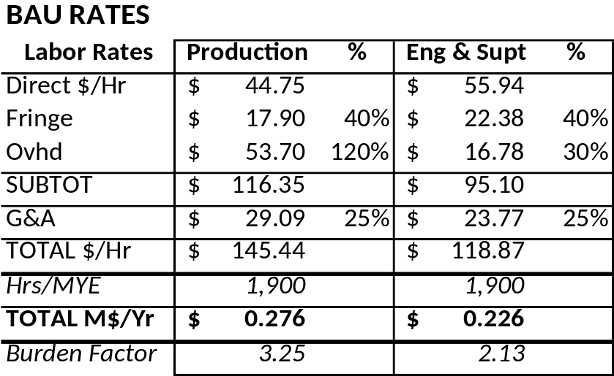
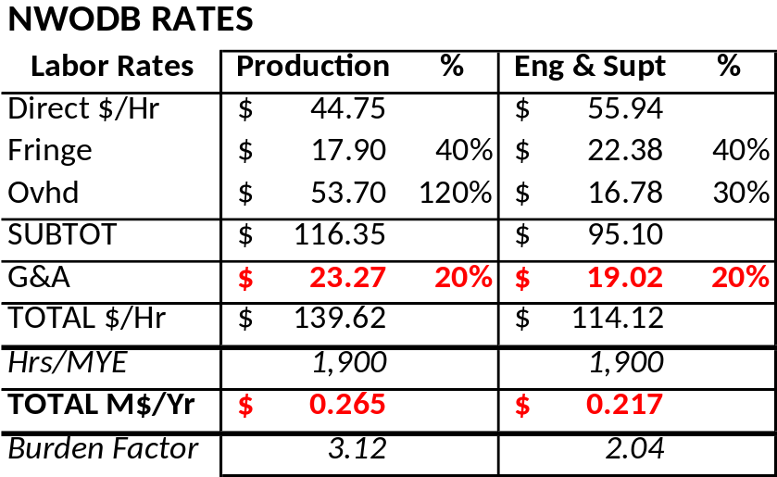
Example 2 – Multiple NWODB (3 of 4)
Labor Rates
  Calculate Labor Rates using NWODB cost reduction factor for G&A
    General & Administrative (G&A) rate pool typically includes contractor Independent Research and Development (IRAD) and Bid & Proposal (B&P) cost
    Consolidating to one contract could essentially eliminate IRAD and B&P; may also move some previously indirect labor categories to direct (e.g. Admin Support, Finance, Human Resources, etc.)
    Assumption for this analysis is G&A rate will be no more than 20%
    As applied to “Value Added” G&A base (not including Material & Subcontract)
    Use simplified “typical” tiered application of G&A to base of Direct Labor + Fringe + Labor Overhead
NOTE: all numbers shown are example-only

Slide 17
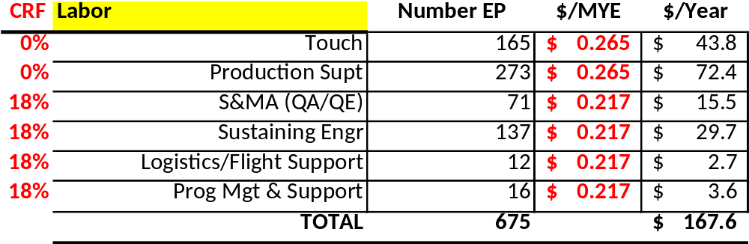
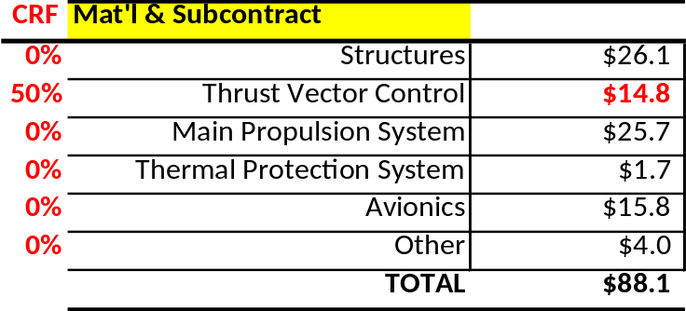
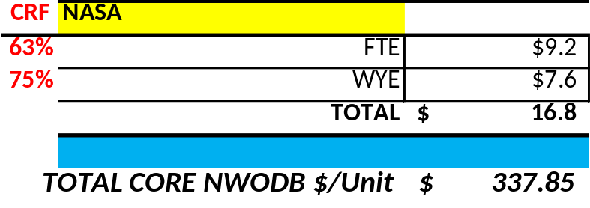
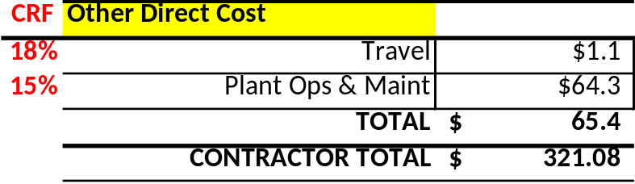
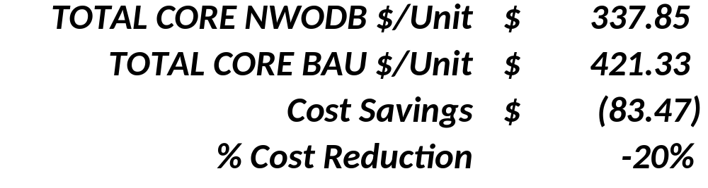
Example 2 – Multiple NWODB (4 of 4)
NWODB estimate with Cost Reduction Factors
NOTE: all numbers shown are example-only
20% reduction is net of 12% Contractor cost and 70% NASA cost reductions

Slide 18
Issues
Things to consider
  Importance of rate assumptions – particularly when analysis is being applied to a base of cost per unit
    Can make or break cost benefits of NWODB
    Mix of fixed cost per year vs. variable cost per unit must be considered when production rate is greater than 1 per year
  Time value of money
    Investment required to obtain NWODB capability can skew answers
    Analysis may need to include considerations of Discounted Cash Flow metrics (IRR and NPV)
    Example: a CAM-I (Consortium for Advanced Management-International) study found that there is often a mismatch between relative cost contributors and focus of reduction efforts
      Touch labor ~ 10% of product cost; Touch labor = 75% of focus of resources spent to reduce cost
Applied disaggregation %’s most likely often not linear
  Will definitely vary by system (e.g. engines vs. avionics), rate, and other factors
    E.g. Is QA always 10% of total production cost?

Slide 19
Conclusions
After 40+ years of doing these types of analysis:
  There is no single magic “cure-all” NWODB which will substantially reduce cost
  Significant cost reductions will result from combination of many “small” NWODB
  And/Or . . . be developed by organizations that do not consider the time value of money in their investment decisions
  Cannot rely on technology alone to reduce cost
  Achievement of large cost reductions will require application of NWODB in non-technical areas (e.g. “culture”)
Forward Work(?) – Expand functional database
  Develop CERs for functions (as function of end-item?)
  E.g. QA as function of end-item cost for structures, avionics, etc.
Using the 5-step disaggregation process (or variations thereof) provides greater understanding of why things cost what they do …
Which leads to appropriate application of reduction estimates to relevant effected areas …
Which leads to traceable, defendable, credible (“better”) cost estimates

Slide 20
Questions?
Contact Information:
Richard Webb
KAR Enterprises
richard.webb@karenterprises.net
richard.l.webb@nasa.gov

