Slide 1
Managing the Unknowns
Practical Risk Management for Complex Programs
2026 NASA Cost & Schedule Symposium
Lana Thompson — ClearPlan Consulting
ClearPlan Proprietary
info@clearplanconsulting.com
Notes:
Welcome, and thanks for being here. I'm going to spend the next few minutes on something every program deals with and almost nobody does consistently well: managing the things we can't see coming.
Quick introductions - I'm here from ClearPlan, and we've spent a lot of time inside risk registers that looked great on paper and did absolutely nothing for the program.
That's really the theme today. Not risk management as paperwork, but risk management as something that actually changes decisions.

Slide 2

A Balancing Act
Hello, Cleveland.
Because the goal isn’t to have fewer risks. The goal is to have fewer surprises.
ClearPlan Proprietary
info@clearplanconsulting.com
Notes:
Re-evaluated. Revised. Reapplied.
The goal isn’t to have fewer risks. The goal is to have fewer surprises.
RISK MANAGEMENT IS NOT A DOCUMENT

Slide 3
NCSS Abstract
Risk management is often well-documented, but inconsistently executed.
Too often, risk registers become static artifacts rather than dynamic tools that inform decisions.
This session bridges that gap — turning risk management into an integrated, decision-support capability for cost & schedule analysts.
ClearPlan Proprietary
info@clearplanconsulting.com
Notes:
Here's the honest problem statement. Most programs I walk into have a risk process. It's documented, there's a policy, somebody owns it. What's missing is execution.
What tends to happen is the register gets built during proposal or startup, and then it sits. It becomes a compliance artifact that gets dusted off before a review instead of a living tool.
My goal today is to close that gap - to show you how risk data can feed your schedule and your cost forecast so it becomes genuine decision support, not a checkbox.

Slide 4
Agenda
01 | What is Risk/Uncertainty
02 | Risks vs Issues
03 | Risk Integration with Schedule
04 | Risk Integration with Cost
05 | Takeaways
ClearPlan Proprietary
info@clearplanconsulting.com
Notes:
Here's where we're headed. We'll start with the basics - what uncertainty actually is and where it comes from. Then we'll draw a hard line between risks and issues, because that confusion causes more damage than anything else I see.
From there we get practical: how risk connects to your schedule, and how it connects to your cost forecast and EAC.
We'll close with the takeaways you can act on Monday morning. Feel free to stop me with questions as we go - this works better as a conversation.

Slide 5
Taxonomy (Sources of Uncertainty)
Sources of risks, issues, and opportunities — brainstorm for opportunities too, not just threats.
ORGANIZATION
Project / Portfolio Risk
Operational / Functional
Enterprise
External Stakeholders
CONTRACTS
Ground Rules & Assumptions
Contract Geometry (CPIF, FFP)
Regulatory Compliance
International Trade
Negotiation Loss
PROGRAM OBJECTIVES
Cost / Schedule
Technical / Requirements
Safety, Quality, Environment
Security
Customer Satisfaction
PROGRAM LIFECYCLE
Proposal
Development
Production
Sustainment
Major Milestones
METHODOLOGICAL
Waterfall
Agile
Hybrid
MATERIAL & SUBCONTRACTS
Supply Chain Logistics
Supplier Performance
Single-source
Diminishing Resources
Obsolescence / Depreciation
ClearPlan Proprietary
info@clearplanconsulting.com
Notes:
Before you can manage uncertainty, you have to go find it. This is a prompt list - a way to jog your thinking so you're not just writing down the same three risks everyone always writes down.
Look across all of it: your organization, your contract type, your program objectives, where you are in the lifecycle, how you're executing, and your supply chain. Sole-source suppliers and obsolescence alone will keep you busy.
Two things I'd stress. First, brainstorm for opportunities too - most registers are all threats, and that's leaving value on the table. Second, put these sessions on the calendar regularly so the register doesn't go stale.
Good prompts sound like: if we suddenly had to do this two weeks faster, what miracles would need to happen? Or simply - what are you counting on to make this date? Watch out for myopia, and for the team that's either wildly optimistic or reflexively pessimistic.

Slide 6
Types of Uncertainty
Two kinds of uncertainty — and they are handled in completely different ways.
01
Event-Driven
A discrete event that either happens or it doesn't.
02
Duration-Based
No event — we simply don't know how long the work will take.
Handled with risk and opportunity management
Handled in a Schedule Risk Assessment (SRA)
Today's focus: event-driven uncertainty.
ClearPlan Proprietary
info@clearplanconsulting.com
Notes:
There are two flavors of uncertainty, and they get handled very differently.
Event-driven uncertainty is the discrete stuff - the thing that either happens or it doesn't. The supplier misses, the test fails. That's what risk and opportunity management is built for.
Duration-based uncertainty is different. Nobody's saying an event occurs - we just genuinely don't know if that task takes six weeks or ten. That's schedule-focused, and it gets handled in a Schedule Risk Assessment.
Today we're focused mostly on the event-driven side, though we'll touch the SRA when we get to schedule.

Slide 7
What is Project Risk?
RISK
An event, which may or may not happen, that could negatively impact program objectives.
OPPORTUNITY
An event, which may or may not happen, that could positively impact program objectives.
ISSUE
An event which is certain to occur, or is currently happening.
WHAT ELEMENTS ARE NECESSARY?
UNCERTAINTY
Can be a risk or an opportunity
Uncertainty in occurrence
A specific program objective
ClearPlan Proprietary
info@clearplanconsulting.com
Notes:
Let's get the vocabulary right, because everything downstream depends on it.
A risk is an event that may or may not happen and would hurt your objectives. An opportunity is the mirror image - may or may not happen, but would help you.
Two elements have to be present. There has to be genuine uncertainty about whether it occurs, and it has to tie to a specific program objective. If it's not uncertain, it's not a risk. If you can't say what it threatens, you can't size it.
And then issues. An issue is something that's certain to happen or is happening right now. The uncertainty is gone. That's the distinction we're building the next few slides on.

Slide 8

Understanding Issue Management
Issues often get treated as risks
54% of sampled program managers do not have the correct definition of a project issue versus a risk.
For the 8% of projects that report having an issue management process, only 40% report following that process.
Source: Mossalam, A. (2018). Projects’ issue management. HBRC Journal, 14(3), 400-407. https://doi.org/10.1016/j.hbrcj.2017.12.001
Separate your issue log from risk register
Have an issue management policy or process
ClearPlan Proprietary
info@clearplanconsulting.com
Notes:
Here's why I keep hammering on that distinction - the data says we're mostly getting it wrong.
In this study, more than half of the program managers sampled couldn't correctly define an issue versus a risk. And only eight percent of projects even reported having an issue management process. Of that eight percent, only forty percent actually followed it.
So the recommendation is pretty simple. Keep your issue log separate from your risk register - they answer different questions and they drive different actions. And write down an actual issue management process, because clearly most programs don't have one.

Slide 9

Issues and Project Controls
Reluctance to acknowledge events as issues
Issue management is REACTIVE
Recognize issues in the project forecast
  Not held as MR/Contingency
  Update work package ETCs
  Update early finish dates (remaining duration)
ClearPlan Proprietary
info@clearplanconsulting.com
Notes:
Why does this go wrong so often? Honestly, it's human. Calling something an issue means admitting it's real, and that's an uncomfortable conversation with a customer.
The other thing to internalize: issue management is reactive by nature. The event already happened. You're not mitigating probability anymore, you're absorbing impact.
And here's the project controls piece - issues have to show up in the forecast. They're not covered by MR or contingency, because MR is for handling plans on things that might happen. Instead, update the ETC on the affected work packages and update your remaining durations and early finish dates. If your forecast doesn't move when an issue lands, your forecast isn't telling the truth.

Slide 10
Risks, Opportunities, and Project Controls
Turning the register into schedule & cost decisions
ClearPlan Proprietary
info@clearplanconsulting.com
Notes:
Now let's flip to the other side - risks and opportunities, and what project controls actually does with them.
This is the handoff point. Risk management identifies and quantifies. Project controls translates that into schedule and dollars. When those two functions aren't talking, you get a beautiful register and a forecast that ignores it.
The next few slides walk through exactly how that translation should work - first in the schedule, then in cost.

Slide 11
Integration with Schedule
Traceability between the risk register and the IMS
Common practice: Add the Risk ID to a field in the IMS
BETTER practice: build two-way traceability between the register and the schedule
RISK-AFFECTED ACTIVITIES
The work that gets hurt if the risk occurs
• Update risk factors
• Schedule margin
• Tag with the Risk ID
HANDLING STEPS
The mitigation work you actually perform
• Discrete activities in the IMS
• Tag with the Step ID from the register
• Status with all other schedule activities
Best practice: one-way feed of data — Risk System ➔ IMS ➔ Cost
Don't confuse risk-affected activities with handling steps.
ClearPlan Proprietary
info@clearplanconsulting.com
Notes:
Start with traceability. You want to be able to look at a risk and find it in the IMS, and look at an activity in the IMS and find the risk behind it.
Common practice is a one-way tag - drop the Risk ID into a field in the schedule. Better practice is two-way, so the register points back at the activities too. That's what makes analysis possible instead of anecdotal.
Now the distinction people trip on. Risk-affected activities are the work that gets hurt if the risk hits - you update risk factors on them, you may protect them with schedule margin, you tag them with the Risk ID. Handling steps are different: those are the real, discrete activities you're doing to mitigate. They belong in the IMS as actual tasks, tagged with the step ID from the register, and statused like any other work.
And keep the data flowing one direction - risk system feeds schedule, schedule feeds cost. Once you have data flowing both ways you can't tell what's true anymore.

Slide 12

Use of Schedule Margin
“Schedule Margin duration should be the Program Manager's assessment of the amount of remaining schedule risk/uncertainty to the subsequent event. The duration should be justifiable and part of the program’s risk management process.” NDIA PASEG
Schedule Margin is owned by the Program Manager
Providing management visibility into potential event impacts
Not the same as slack (float)
Schedule Margin tasks should immediately precede key events, tasks, or milestones
Margin tasks should be maintained during regular program schedule status cycle
ClearPlan Proprietary
info@clearplanconsulting.com
Notes:
Schedule margin. The PASEG language here is worth reading closely: margin duration should be the program manager's assessment of remaining risk to the next event, and it has to be justifiable and tied to the risk process.
Three things follow from that. Margin is owned by the PM - it's a management tool, not something buried in a control account. It is not slack. Float falls out of your network logic; margin is a deliberate placement. And it goes immediately in front of the key event, task, or milestone you're protecting.
Last point, and it's the one that slips: status your margin tasks every cycle like everything else. Margin you never look at is just padding with a nicer name.

Slide 13
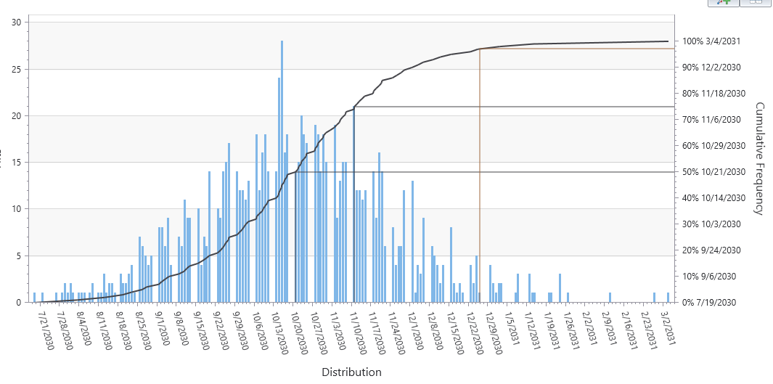
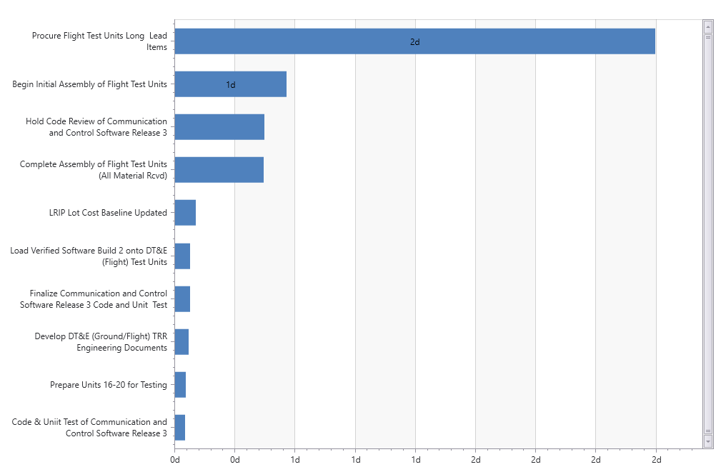
SRA Data and the Risk Register
May or may not include discrete risk events, depending on software
Use Histogram data to justify schedule margin duration
Risk Drivers (Tornado) Chart: Consider adding a discrete risk event to the register
ClearPlan Proprietary
info@clearplanconsulting.com
Notes:
This is where the SRA earns its keep - it gives you the evidence for the number you put in that margin task.
The histogram tells you the confidence story. If you're at a fifty percent date and the customer expects eighty, the distance between those is your justification for margin duration. Now it's analysis instead of a gut feel.
The tornado chart shows what's actually driving the spread. And here's a nice feedback loop: if a driver shows up big on the tornado and it isn't in your risk register, that's a signal to go add it as a discrete risk event.
One caveat - depending on your tool, the SRA may or may not include discrete risk events, so know what your software is doing before you interpret the output.

Slide 14
Integration With Cost
Commonly Confused Concepts:
Risk Exposure vs Handling Cost
  Risk Exposure = how much will it cost if the risk event occurs unmitigated?
  Cost to mitigate = what additional resources (Time, money, personnel, material) are needed to execute the handling plan?
Factored Risk Value vs Net Factored Risk
  Factored Risk Score = Quantitative Impact x Probability
  Net Factored Risk = Sum of all quantitative impacts x their respective probabilities
ClearPlan Proprietary
info@clearplanconsulting.com
Notes:
Moving to cost, and starting with two pairs of terms that get mixed up constantly.
First pair. Risk exposure is what it costs you if the event happens and you did nothing about it. Cost to mitigate is what you spend on the handling plan - the time, money, people, and material to reduce the probability or the impact. Very different numbers, very different funding sources.
Second pair. Factored risk value is a single risk - impact times probability. Net factored risk is the whole portfolio - the sum of every risk's impact times its probability.
Keep these straight and the MR conversation gets a lot easier, which is exactly where we're going next.

Slide 15
Notes on MR and EAC
Management Reserve
Incorporating Risk with EAC
MR is distributed for the execution of handling plans NOT to cover risk exposure
CAMs must not hold their own separate reserve
Net Factored Risk (NFR) is used for Best/Worst Case EAC
Issues get acknowledged in EAC
  For realized risks (issues) you can decrement NFR and increase EAC
  Values do not have to balance
ClearPlan Proprietary
info@clearplanconsulting.com
Notes:
So how does this connect to management reserve and the EAC?
On MR - it gets distributed to execute handling plans. It is not there to cover raw exposure. And control account managers should not be holding quiet little reserves of their own. That's a hidden buffer, and it destroys visibility.
On EAC - net factored risk is what you use to build your best and worst case estimates. Issues are different: an issue is real, so it goes into the EAC directly.
Here's a subtlety worth calling out. When a risk becomes an issue, you can decrement net factored risk and increase the EAC. Those two numbers do not have to balance - the risk was probability-weighted, the issue is the actual cost. Don't let anyone force them to tie.

Slide 16
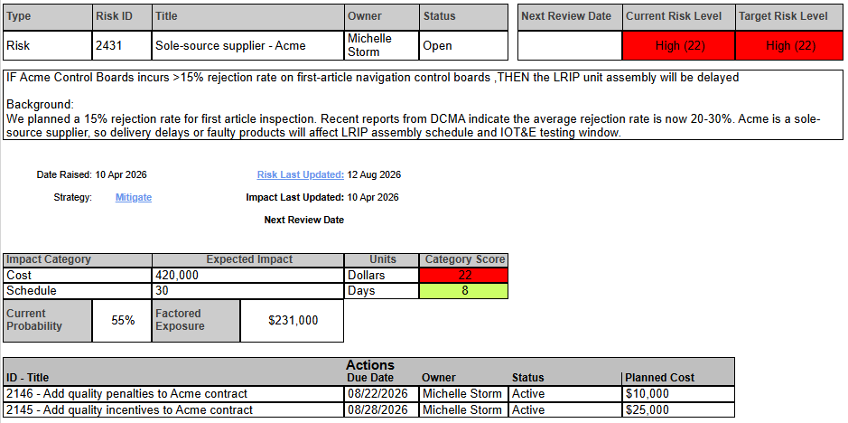
EXAMPLE
Factored Risk Value (Exposure)
$420K
x 55%
$231K
ClearPlan Proprietary
info@clearplanconsulting.com
Notes:
Let's make it concrete. Take the sole-source supplier risk.
If it hits and we do nothing, it costs us four hundred twenty thousand dollars. That's the exposure. We assess the probability at fifty-five percent.
Multiply them and you get two hundred thirty-one thousand. That's the factored risk value for this single risk - what it's worth in expected terms today.
That number is what belongs in your risk-adjusted forecast. The full four hundred twenty is what belongs in your worst case.

Slide 17
EXAMPLE
Factored Risk Exposure
Handling Cost
ClearPlan Proprietary
info@clearplanconsulting.com
Notes:
Same risk, now with the handling plan on top.
The exposure is the number we just calculated - what we're carrying if we do nothing. The handling cost is what we'd spend to actually reduce it: maybe qualifying a second supplier, maybe buying ahead.
The comparison is the decision. If handling costs a fraction of the exposure and meaningfully drops the probability, that's an easy yes. If it costs nearly as much as the exposure, you're probably accepting the risk and watching it.
This is exactly the kind of question your PM needs an answer to - and this is the math that answers it.

Slide 18
Net Factored Risk
Factored Risk Score = Quantitative Impact x Probability
Net Factored Risk = Sum of all quantitative impacts x their respective probabilities
Exercise: calculate the program’s Net Factored Risk
Title | Status | Current Risk Level | Exposure | Probability | Cost if Realized | Factored Risk
Risk - Sole-source supplier - Acme | Draft | High: 22 | Threat | 55 | $420,000.00 | $231,000.00
Risk - Flight Test Loss Event | Draft | Moderate: 19 | Threat | 35 | $650,000.00 | $227,500.00
Risk - Excessive failures during integration ground testing | Draft | Moderate: 10 | Threat | 40 | $0.00 | $0.00
Net Factored Risk: $458,500
ClearPlan Proprietary
info@clearplanconsulting.com
Notes:
Let's put the whole portfolio together. Quick exercise - take thirty seconds and work out the program's net factored risk from this register.
You've got the sole-source supplier at fifty-five percent on four hundred twenty thousand. The flight test loss event at thirty-five percent on six hundred fifty thousand. And the integration testing risk - notice that one has no quantified cost impact, so it contributes zero dollars.
Add up the factored values and you land at four hundred fifty-eight thousand five hundred.
One thing to notice: the second risk has a lower risk level but a bigger dollar impact than the first. That's a good reminder that your scoring matrix and your dollars can tell different stories - so look at both.

Slide 19

Management Use of Data
How much confidence (uncertainty) is built into my forecast?
  Issues vs Risks
  Net Factored Risk
  Best/Worst Case Estimates
To what risks/opportunities should I allocate resources (budget, time, headcount)
  Issues vs Risks
  Factored Risk Values
Do I have enough MR?
  Handling Costs
  Net Factored Risk
ClearPlan Proprietary
info@clearplanconsulting.com
Notes:
Step back for a second. All of this only matters if it answers questions someone actually has.
How much confidence is in my forecast? That comes from separating issues from risks, from net factored risk, and from your best and worst case estimates.
Where should I put my next dollar or my next person? That's factored risk values - they rank the portfolio for you.
Do I have enough MR? Compare remaining MR against your handling costs and your net factored risk. If MR is below net factored risk, you have a conversation to go have, and now you have the data to have it.
Three questions. Everything we've built today feeds one of them.

Slide 20
Summary: Key Takeaways
Four things to take back to your program.
01
02
03
04
DEFINITIONS
Know the difference between issues and risks / opportunities.
— Issues are certain — risks are not
— Acknowledge issues in the forecast
SCHEDULE
Integrate risk with schedule.
— Traceability between IMS and Risk Register
— Margin duration must be justified
COST
Integrate risk with cost.
— Risk Exposure vs Cost to Mitigate
— Factored Risk Value vs Net Factored Risk
— Distribute MR to cover cost to mitigate
— Remaining MR > Net Factored Risk
MANAGEMENT USE
Everything you build should answer a real question.
— Data should have a purpose
— Know what your PM needs to decide
Risk management earns its keep when it changes a decision.
ClearPlan Proprietary
info@clearplanconsulting.com
Notes:
Let me pull it together.
Start with the definitions - issues versus risks and opportunities. Everything else breaks if that's fuzzy. And when something is an issue, acknowledge it and get it into the forecast.
On schedule: build real traceability between the IMS and the register, and make sure your margin duration can be justified with analysis.
On cost: keep exposure separate from cost to mitigate, and factored risk value separate from net factored risk. Distribute MR to cover handling costs, and keep your remaining MR above your net factored risk.
And the one that ties it all together - everything you build should have a purpose. Know what questions your PM needs answered, and build the data to answer them.

Slide 21
Resources
GET IN TOUCH
ClearPlan Consulting
Michelle Storm
michellestorm@clearplanconsulting.com
Lana Thompson
lanathompson@clearplanconsulting.com
FURTHER READING
The Standard for Risk Management in Portfolios, Programs, and Projects
Project Management Institute
Risk, Issue, and Opportunity (RIO) Management Guide for Defense Acquisition Programs
U.S. Department of Defense
Thank you — questions welcome.
ClearPlan Proprietary
info@clearplanconsulting.com
Notes:
That's what I have. Here are the sources if you want to go deeper.
The PMI standard for risk management across portfolios, programs, and projects is a solid foundation. And the DoD RIO guide is genuinely practical - especially if you're working defense acquisition programs.
My contact info is on the slide - please reach out, I'm happy to talk through what this looks like on your specific program.
Thank you for your time. Let's take questions.

Slide 22

External NDIA Industry Study:
This survey is part of a research effort to better understand operational challenges, improvement opportunities, and effective practices across our industry.
Your feedback will help identify areas for efficiency and innovation. Participation is voluntary and confidential.

