Slide 1
Sound Check:
A Mock Integrated Baseline Review (IBR)
NASA Cost & Schedule symposium
August 24-28, 2026
Notes:
Welcome and framing.
Good morning, and welcome to Sound Check: A Mock Integrated Baseline Review. I'm Daniel Goldsmith, with ClearPlan.
Before any performance, the band runs a sound check: everyone plays their part, the levels get tuned, and problems get found while there's still time to fix them. That's exactly what an IBR should be for your program.
Over this session we'll walk through what an IBR is, how to prepare for one, and then we'll put you in the room for a live mock review (mini) — including the questions a CAM should expect to answer.

Slide 2
The Sound Check
Reframing the IBR as a high-value rehearsal — not a compliance exercise.
The problem
Too often the IBR is treated as a box to check — missing the chance to validate plan realism, align stakeholders, and expose risk early.
The reframe
“The Sound Check” treats the IBR as a structured rehearsal before execution begins — a chance to tune the baseline before the main stage.
This session
A mini-mock IBR grounded in real program scenarios, showing how leading teams prepare for, conduct, and extract value from the review.
For program managers, CAMs, schedulers, cost analysts, and Government counterparts.
Notes:
The problem, the reframe, and what this session delivers.
Let's start with the honest problem. Too many teams treat the IBR as a box to check — a compliance drill to survive rather than a chance to learn something. When that happens, the program loses its single best early opportunity to validate plan realism, align stakeholders, and expose risk while it's still cheap to fix.
So we're reframing it. The Sound Check treats the IBR as a structured rehearsal before execution begins — tune the baseline before you're on the main stage in front of an audience.
This session is a mock IBR grounded in real program scenarios. We'll show how strong teams prepare for the review, run it, and pull lasting value out of it.
Whether you're a program manager, a CAM, a scheduler, a cost analyst, or a Government counterpart — there's something here for your seat at the table.

Slide 3
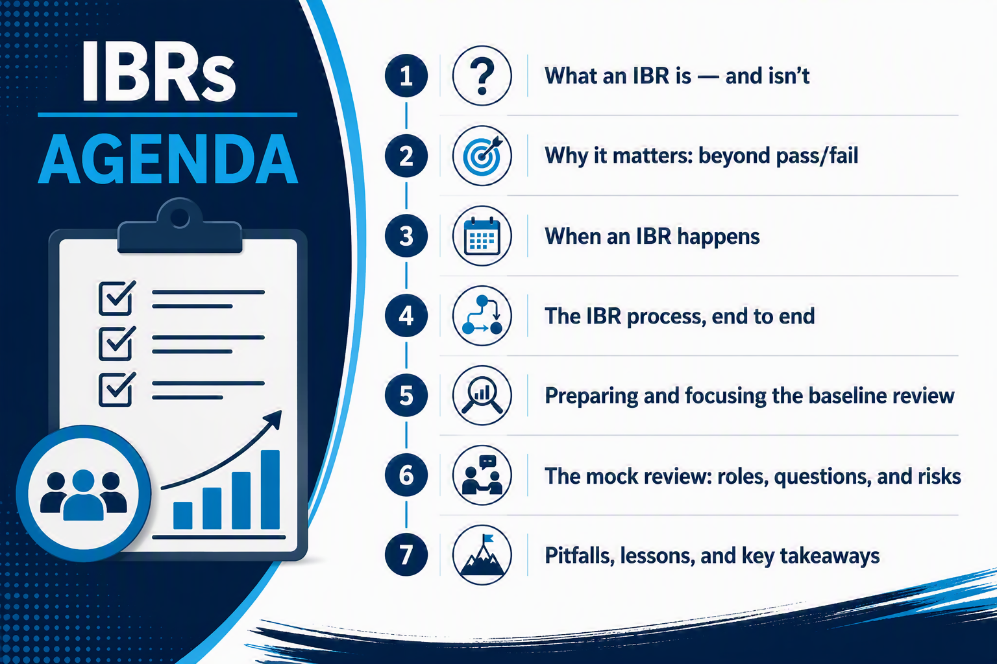

3
Notes:
Roadmap for the session.
Here's where we're headed.
What an IBR is - and isn't
Why it matters: beyond pass/fail
When an IBR happens
The IBR process, end to end
Preparing and focusing the baseline review
The mock review: roles, questions, and risks
Pitfalls, lessons, and key takeaways
The first half builds the foundation; the second half is where we put it into practice with the mock review.

Slide 4
What is an IBR?
A joint review confirming the Performance Measurement Baseline is realistic, resourced, and executable — not a pass/fail audit.
To Establish a Technical Baseline for the Project
Confirms Scope
The PMB covers the entire technical scope of work in the contract.
Validates Schedule
Work is realistically sequenced and accurately time-phased.
Reviews Risk
Risks (and Opportunities) are surfaced and understood early.
Right Resources
The proper amount and mix of resources are assigned to the work.
The IBR is a continuing process of collaboration and mutual understanding — not a one-time compliance event.
Notes:
Definition and the four things an IBR confirms.
At its core, an IBR is a joint review — Government and contractor together — confirming that the Performance Measurement Baseline is realistic, resourced, and executable. Note what it is not: it is not a pass/fail audit, and it is not a compliance inspection.
The review establishes a technical baseline for the project across four dimensions.
Scope: does the PMB actually cover the entire technical scope of work in the contract? Nothing missing, nothing extra.
Schedule: is the work realistically sequenced and accurately time-phased — not just laid out to fit the end date?
Risk: are risks, and opportunities, surfaced and understood early enough to do something about them?
Resources: is the right amount and the right mix of resources assigned to the work?
And the key point to land: this is a continuing process of collaboration and mutual understanding, not a one-time event. The conversations you start here should keep running all through execution.

Slide 5
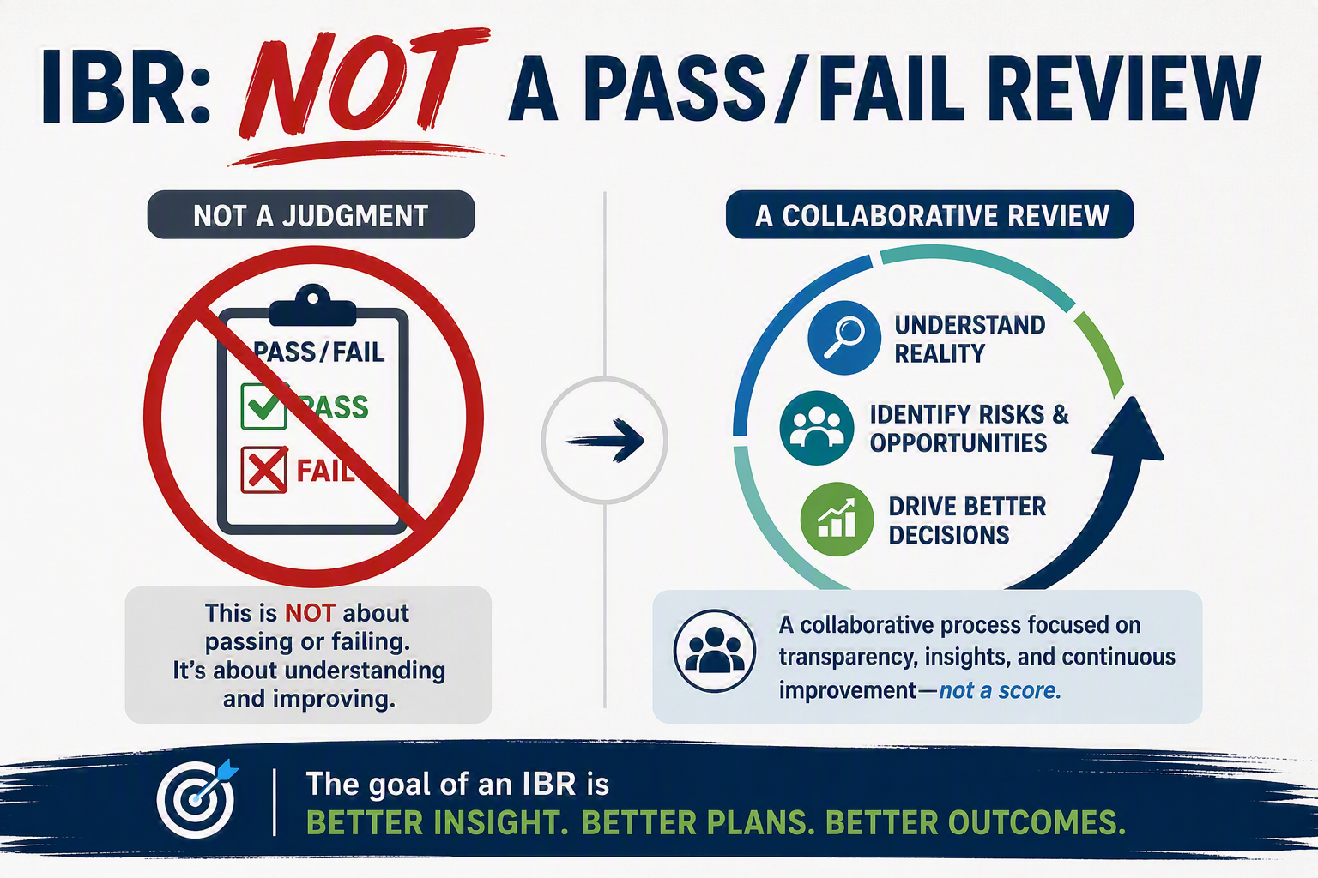
Why It Matters: Beyond Pass/Fail
Notes:
Why the IBR matters — what a strong one actually delivers.
Not pass/fail. An IBR may surface disagreements, but it is a shared assessment - not a grade. The goal is mutual understanding of the baseline and the risks inside it.
So what does a strong IBR deliver?
Shared understanding of the Performance Measurement Baseline across Customer and Supplier
Early identification - and mitigation - of program risks and opportunities
Confidence the baseline is realistic and executable
Meaningful, reliable performance measurement from day one
An early-warning system that flags problems before they grow
That last one is the real payoff. If the baseline is sound, every variance report you produce afterward means something. If it isn't, you're measuring against fiction for the life of the contract.

Slide 6
When an IBR Happens
An IBR is triggered by contract events — and repeated when major baseline changes occur.
Post-Award
The traditional trigger — conducted within six months of contract award, once the PMB is in place.
Significant Change
Major PMB changes — scope, funding shifts, OTB/OTS, or acquisition-strategy changes — can prompt a new review.
NDAA FY2025 §823 requires an IBR whenever EVMS applies — for contracts valued at $50M and above.
Notes:
The triggers for an IBR.
IBRs aren't scheduled by preference — they're triggered by contract events.
The traditional trigger is post-award: conducted within six months of contract award, once the PMB is in place.
But it doesn't stop there. A significant change can prompt a new review — major PMB changes, scope shifts, funding changes, an Over Target Baseline or Over Target Schedule, or a change in acquisition strategy. If the baseline you reviewed no longer resembles the baseline you're executing, it's time to look again.
And note the current requirement: NDAA FY2025 Section 823 requires an IBR whenever EVMS applies — for contracts valued at fifty million dollars and above. That has widened the population of programs that will see one.

Slide 7
The IBR Process: Five Phases
The IBR is a continuous process, not a single meeting — five phases carry it from kickoff to closure.
1
Initiating Event
A contract award or major program milestone kicks off the IBR.
2
Readiness Checkpoint 1
Build the IMS and PMB; assemble artifacts and the review teams.
3
Readiness Checkpoint 2
Confirm entrance criteria and make the joint Go/No-Go call.
4
IBR Event
PM and CAM discussions probe technical, schedule, cost, resource, and risk areas.
5
IBR Closure
Capture actions, handle risks, and fold results into ongoing management.
Notes:
The five phases — the IBR is a process, not a meeting.
This is the slide to remember: the IBR is a continuous process, not a single meeting on the calendar. Five phases carry it from kickoff to closure.
One, the initiating event — a contract award or major program milestone starts the clock.
Two, Readiness Checkpoint 1 — build the IMS and the PMB, assemble your artifacts, and stand up the review teams on both sides.
Three, Readiness Checkpoint 2 — confirm entrance criteria and make the joint Go/No-Go call. Joint is the operative word.
Four, the IBR event itself — PM and CAM discussions probing technical, schedule, cost, resource, and risk areas.
Five, closure — capture actions, handle the risks you found, and fold the results into ongoing program management.
Most of the work — and most of the value — lives in phases two and three, long before anyone sits down in the review room.

Slide 8
Setting the Stage: Preparation
Preparation is the foundation of a successful IBR — assemble the artifacts, then focus the review.
Core baseline artifacts
PMB and time-phased Control Account Plans
Integrated Master Plan and Integrated Master Schedule (IMS)
Contract Work Breakdown Structure and dictionary
Responsibility Assignment Matrix (RAM)
Risk and Opportunity register
Quantifiable Backup Data (QBD)
Where to focus the review
High-to-moderate technical risk
High dollar or labor-hour value
Tasks on the critical path
Work already flagged in the risk register
Target roughly 80% of PMB dollar or labor-hour value for on-site review.
Notes:
Preparation: the artifacts and where to focus.
Preparation is the foundation. Assemble the artifacts first, then focus the review.
Your core baseline artifacts: the PMB and time-phased Control Account Plans; the Integrated Master Plan and Integrated Master Schedule; the contract WBS and its dictionary; the Responsibility Assignment Matrix; the risk and opportunity register; and Quantifiable Backup Data.
You can't review everything, and you shouldn't try. Focus where the exposure is: high-to-moderate technical risk, high dollar or labor-hour value, tasks on the critical path, and work already flagged in the risk register.
A practical rule of thumb — target roughly eighty percent of PMB dollar or labor-hour value for on-site review. That gets you meaningful coverage without turning the event into an endurance test.

Slide 9
The Readiness Check: Go / No-Go
Readiness Checkpoint 2 supports one decision — a joint Go / No-Go to conduct the IBR.
Entrance criteria — are we ready?
PMB and IMS completion dates are set
Data submittals and formats are specified
The detail-planning horizon is defined
Team training is complete
Initial risks and opportunities are identified and handled
Exit criteria — did we succeed?
Risks and opportunities captured and handled
Actions, recommendations, and suggestions documented
Corrective-action plans developed and accepted
The out-brief has been conducted
Notes:
Readiness Checkpoint 2 — the Go/No-Go decision.
Readiness Checkpoint 2 exists to support exactly one decision: a joint Go/No-Go to conduct the IBR. Not a status meeting — a decision point.
Entrance criteria — are we ready? PMB and IMS completion dates are set. Data submittals and formats are specified. The detail-planning horizon is defined. Team training is complete. And initial risks and opportunities are identified and being handled.
Exit criteria — did we succeed? Risks and opportunities captured and handled. Actions, recommendations, and suggestions documented. Corrective-action plans developed and accepted. And the out-brief conducted.
Worth saying plainly: a No-Go here is not a failure. Holding a review against a baseline that isn't ready wastes everyone's time and produces false confidence.

Slide 10




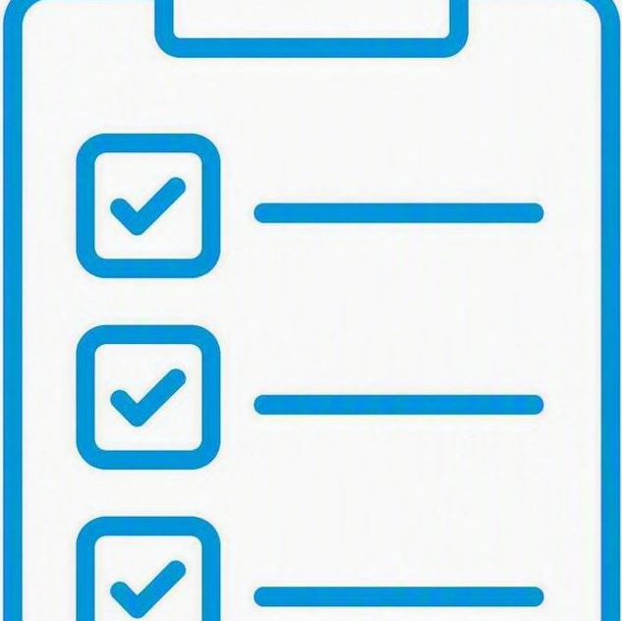
Five Key Risk Areas
Every CAM discussion tests the baseline across five dimensions of risk.
Technical
Is the scope fully defined, decomposed, and achievable?
Schedule
Is the IMS logic sound, with a credible critical path?
Cost
Are budgets and estimates realistic and time-phased?
Resources
Are the right skills staffed at the right time?
Management
Are EVM processes and change control disciplined?
Notes:
The five risk areas every CAM discussion tests.
Every CAM discussion tests the baseline across five dimensions. Keep these in your head — they're the spine of the mock review we're about to run.
Technical: is the scope fully defined, decomposed, and achievable?
Schedule: is the IMS logic sound, with a credible critical path?
Cost: are budgets and estimates realistic and properly time-phased?
Resources: are the right skills staffed at the right time?
Management: are EVM processes and change control disciplined?
A weakness in any one of these undermines the other four — an unstaffed plan doesn’t support a credible schedule, and having undefined scope doesn’t support a complete budget.

Slide 11
Who’s On Stage: Roles
An IBR is a team performance — each role brings a distinct part of the baseline to the review.
Program Manager
Sets strategy, owns the baseline, and manages risk and management reserve.
Control Account Manager
Owns their control accounts and defends the plan, budget, and estimate.
Scheduler / Planner
Maintains the IMS, critical path, and schedule risk assessments.
Cost Analyst
Integrates cost and schedule and analyzes variances at completion.
Government Counterpart
Confirms scope and funding and builds mutual understanding.
Notes:
The roles in the room.
An IBR is a team performance. Each role brings a distinct part of the baseline to the review.
The Program Manager sets strategy, owns the baseline, and manages risk and management reserve.
The Control Account Manager owns their control accounts and defends the plan, budget, and estimate. This is the person on stage for most of the review.
The Scheduler or Planner maintains the IMS, the critical path, and schedule risk assessments.
The Cost Analyst integrates cost and schedule and analyzes variances at completion.
And the Government counterpart confirms scope and funding and builds the mutual understanding that makes the whole thing worthwhile.
Everyone should know their part before the review — that's what rehearsal is for.

Slide 12
The CAM Discussion
The CAM discussion is the heart of the IBR — a structured conversation, not an interrogation.
How it works
Reviewers walk a CAM through their control account to test whether the plan is real, resourced, and truly understood.
The tone is collaborative — the aim is shared confidence in the baseline, not a gotcha!
Focus falls on high-risk, high-value, and critical-path accounts.
Typical Questions
Walk me through the scope of this control account.
How did you build the budget and estimate to complete?
What drives the sequence and duration of this work?
Which risks worry you most — and what is your mitigation?
How will you measure and earn performance objectively?
Notes:
How the CAM discussion works — and the tone it should have.
The CAM discussion is the heart of the IBR. It is a structured conversation, not an interrogation.
Here's how it works: reviewers walk a CAM through their control account to test whether the plan is real, resourced, and genuinely understood by the person who owns it.
The tone is collaborative. The aim is shared confidence in the baseline — not a gotcha. And focus falls on high-risk, high-value, and critical-path accounts.
Typical questions run like this: walk me through the scope of this control account; how did you build the budget and the estimate to complete; what drives the sequence and duration of this work; which risks worry you most and what's your mitigation; and how will you measure and earn performance objectively.
That last question separates a defensible plan from a hopeful one.

Slide 13
Mock IBR
Notes:
Transition into the live mock review.
Alright — that's the theory. Now let's do it.
For the next stretch we're going to run a mini-mock IBR. We'll put a CAM in the chair, ask real questions, and show you what a good response looks like — including the artifacts a CAM should have at hand.
Watch for two things as we go: the substance of the answer, and the evidence behind it. In a real review, both matter.

Slide 14
The CAM Discussion: Question 1
Lets talk scope
Question
How do you ensure all of your scope of work is covered and effective internal control is maintained within the Work Breakdown Structure (WBS) for your Control Accounts (CAs)?
Note on the Response
This question is designed to ensure nothing in the contract SOW is left unplanned. At the program level, all paragraph numbers from the SOW should be present in the WBS Dictionary and all items in the dictionary should be traceable to a SOW paragraph. CAMs need to navigate to the contract Statement of Work (SOW) and highlight what work is done in their WBS. Show the Work Breakdown Structure (WBS) dictionary and trace the SOW paragraphs to your WBS.
Artifacts:
Statement of Work (SOW)
Work Breakdown Structure (WBS) dictionary
Notes:
Mock question 1 — scope.
Let's talk scope. The question: how do you ensure all of your scope of work is covered, and effective internal control is maintained within the WBS for your control accounts?
What this question is really designed to do is ensure nothing in the contract SOW is left unplanned. At the program level, every paragraph number from the SOW should appear in the WBS dictionary, and every item in the dictionary should trace back to a SOW paragraph.
A strong CAM doesn't just describe this — they demonstrate it.
Navigate to the contract Statement of Work, highlight what work is done in your WBS, then show the WBS dictionary and trace the SOW paragraphs to it.
Artifacts to have open: the Statement of Work, and the WBS dictionary.

Slide 15
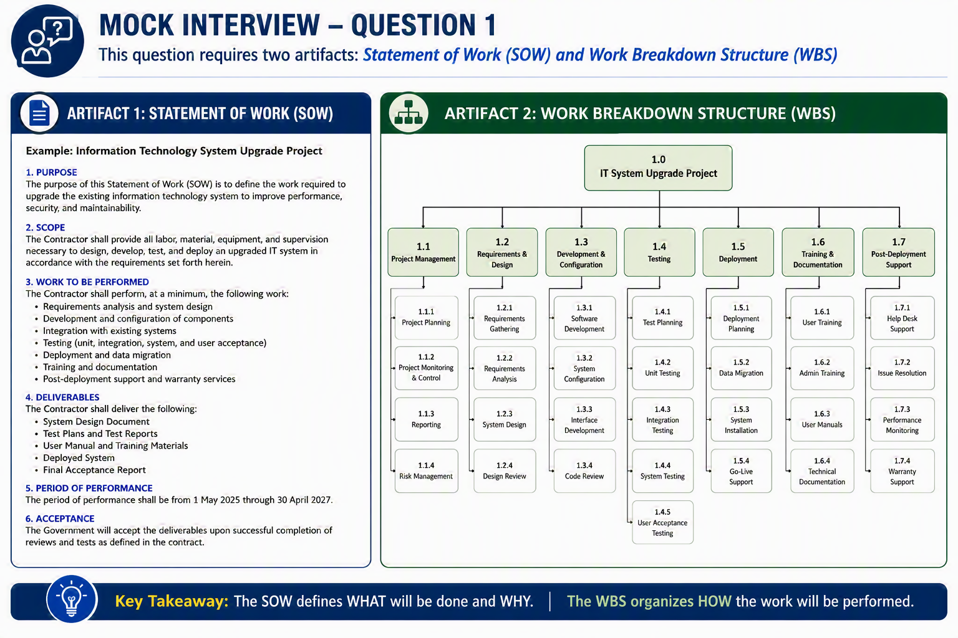
15
Notes:
Walking the artifacts for question 1.
Here's what that trace actually looks like in practice.
Walk the group from the SOW paragraph through to the WBS dictionary entry, and show the coverage is complete in both directions — nothing in the contract unplanned, nothing in the plan unauthorized.
This is the moment where preparation shows. A CAM who has to hunt for the document has already answered the question.

Slide 16
The CAM Discussion: Question 2
The Schedule
Question
How do you ensure all your work is represented in the Integrated Master Schedule?
Note on the Response
First describe the process such that you use the WBS Dictionary, RAM, and Control Account Plans to verify ownership and prevent gaps or overlaps. Internal controls are maintained through formal work authorization, baseline change control, and monthly reviews of schedule, cost, technical performance, and earned value metrics. This disciplined approach ensures all scope is covered, unauthorized work is prevented, and baseline integrity is maintained.
Having already established your list of accounts in your RAM/CAP, this question calls for a comparison of your list of WP/PP to what is found in the IMS. From the IMS, show a grouping of activities aggregated by work package/planning package. Demonstrate that all WP/PP from your CAP can be found in the IMS. An interviewer may have a specific WP/PP that they will want to trace.
Artifacts:
EV Cost Data
Integrated Master Schedule (IMS)
Control Account Plan (CAP)
Notes:
Mock question 2 — the schedule.
Question two is about the schedule: how do you ensure all your work is represented in the Integrated Master Schedule?
Start with the process. Use the WBS dictionary, the RAM, and the Control Account Plans to verify ownership and prevent gaps or overlaps. Internal controls come from formal work authorization, baseline change control, and monthly reviews of schedule, cost, technical performance, and earned value metrics. That discipline is what ensures all scope is covered, unauthorized work is prevented, and baseline integrity holds.
Then prove it. Having already established your list of accounts in the RAM and CAP, compare your list of work packages and planning packages to what's in the IMS. From the IMS, show a grouping of activities aggregated by work package and planning package, and demonstrate that every WP and PP from your CAP can be found there. Expect the interviewer to pick a specific one and ask you to trace it.
Artifacts: EV cost data, the IMS, and the Control Account Plan.

Slide 17
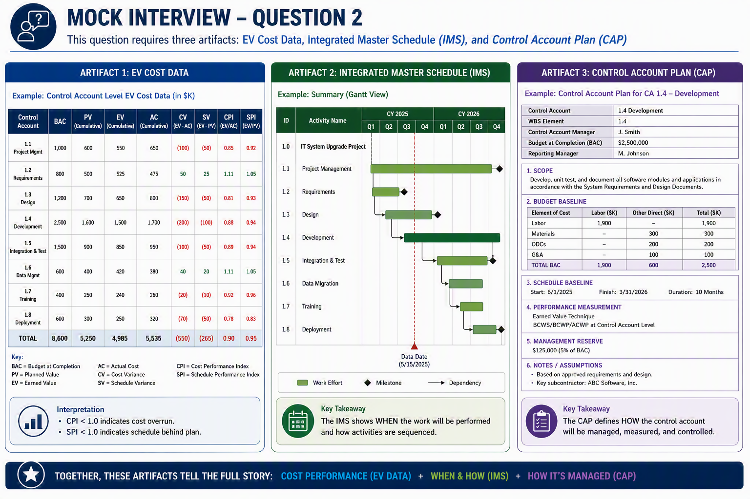
17
Notes:
Walking the artifacts for question 2.
And here's that schedule trace in practice.
Show the grouping by work package, then trace an individual package end to end. The point isn't that the schedule is pretty — it's that the logic is real and the coverage is complete.
If the reviewer picks a package at random and it's there, with sound predecessors and successors, you've answered the question.

Slide 18
The CAM Discussion: Question 3
The Risk
Question
Do you have any risks or identified opportunities?
Note on the Response
Describe the process used for assessing risk and opportunities for the scope of work in question. Is there a program formal risk and opportunity management process? If so, describe the process.
If there are identified risks or opportunities show where and how they are documented, evaluated, and tracked. Identify if any other teams (e.g. the technical team, program controls, program management) are involved in developing mitigation plans.
Describe how the risks and opportunities associated with Control Accounts are reviewed regularly and if they are considered when developing ETCs, EACs, corrective actions, and recovery plans.
Notes:
Mock question 3 — risk and opportunity.
Question three: do you have any risks or identified opportunities?
Start with process. Describe how risk and opportunity are assessed for this scope of work. Is there a formal program risk and opportunity management process? If so, walk through it.
Then get specific. Where identified risks or opportunities exist, show where and how they're documented, evaluated, and tracked. Identify who else is involved in developing mitigation plans — the technical team, program controls, program management.
And close the loop: describe how risks and opportunities tied to control accounts are reviewed regularly, and how they factor into ETCs, EACs, corrective actions, and recovery plans.
A risk register that never touches the estimate at completion is a document, not a management tool.

Slide 19
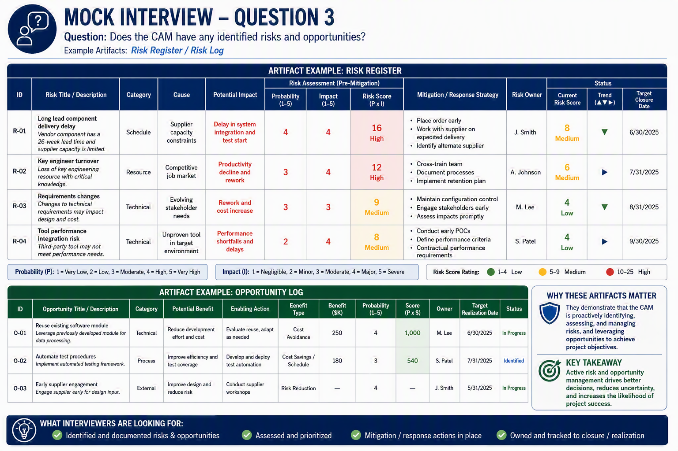
19
Notes:
Walking the artifacts for question 3.
This is what a living risk and opportunity register looks like.
Show the documentation, the evaluation, the mitigation owner, and the link back to the estimate. That connection — from identified risk to funded mitigation to EAC — is what reviewers are listening for.

Slide 20
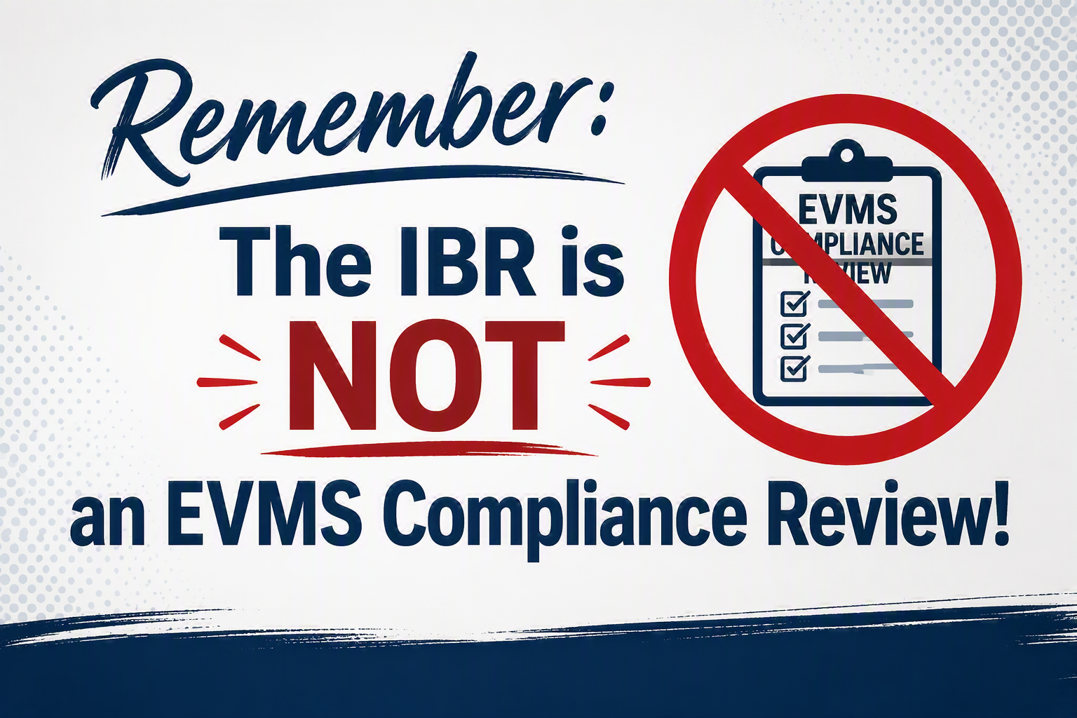
Common Pitfalls & Lessons Learned
The difference between passing and performing comes down to preparation.
Common pitfalls
-Treating the IBR as a compliance checkbox
-A baseline no one on the team can explain
-Optimistic schedules with no logic or margin
-Risks named but never resourced
-Surprises saved for the event itself
Lessons learned
-Prepare early — preparation is the whole game
-Make CAMs fluent in their own plans
-Build schedules with real logic and reserve
-Fund and track mitigation for every key risk
-Rehearse — no surprises on the main stage
Notes:
Pitfalls and lessons learned.
Let's bring it home. The difference between passing and performing comes down to preparation.
The common pitfalls we see: treating the IBR as a compliance checkbox; a baseline no one on the team can actually explain; optimistic schedules with no logic and no margin; risks that get named but never resourced; and surprises saved for the event itself.
The lessons that follow: prepare early — preparation is the whole game. Make CAMs genuinely fluent in their own plans. Build schedules with real logic and real reserve. Fund and track mitigation for every key risk. And rehearse — no surprises on the main stage.
Every one of these is fixable weeks before the review, and nearly impossible to fix during it.

Slide 21
Key Takeaways & Questions
Key takeaways
The IBR is a rehearsal, not a grade — prepare to perform, not just to pass.
A credible baseline is realistic, resourced, and understood by the team that owns it.
Surface and fund risk early — the IBR is your program’s early-warning system.
Value comes from mutual understanding — align industry and Government before the main stage.
Questions?
Notes:
Key takeaways and open the floor.
Four things to take with you.
The IBR is a rehearsal, not a grade — prepare to perform, not just to pass.
A credible baseline is realistic, resourced, and understood by the team that owns it.
Surface and fund risk early — the IBR is your program's early-warning system.
And value comes from mutual understanding — align industry and Government before the main stage.
Run your sound check, and the performance takes care of itself.
With that, we'd love to take your questions. Daniel Goldsmith and Michelle Storm, ClearPlan — thank you.

