Slide 1
Introduction SSI’s New SRA Tool
Presented by: Jason Berg
2026 NASA Cost & Schedule Symposium

Slide 2
Introduction
SSI's Schedule Risk Analysis Tool leverages existing schedule logic, coded duration estimates and specific schedule risk/opportunities to perform Schedule Risk Assessments and Sensitivity Analyses.
Schedulers can perform SRAs and Sensitivity Analyses in seconds without ever needing to leave Microsoft Project.
Today I will show how SSI Tools can be used to create an efficient SRA process and produce meaningful results

Slide 3
Agenda
A little History
Practical Guide
  Preparing for an SRA
  Running an SRA
Q&A

Slide 4
A Brief History

Slide 5
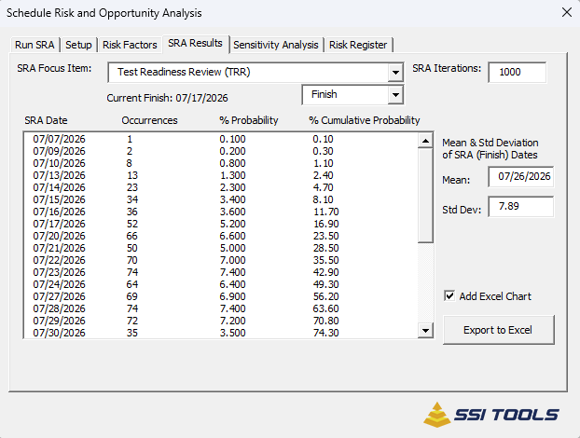

Slide 6
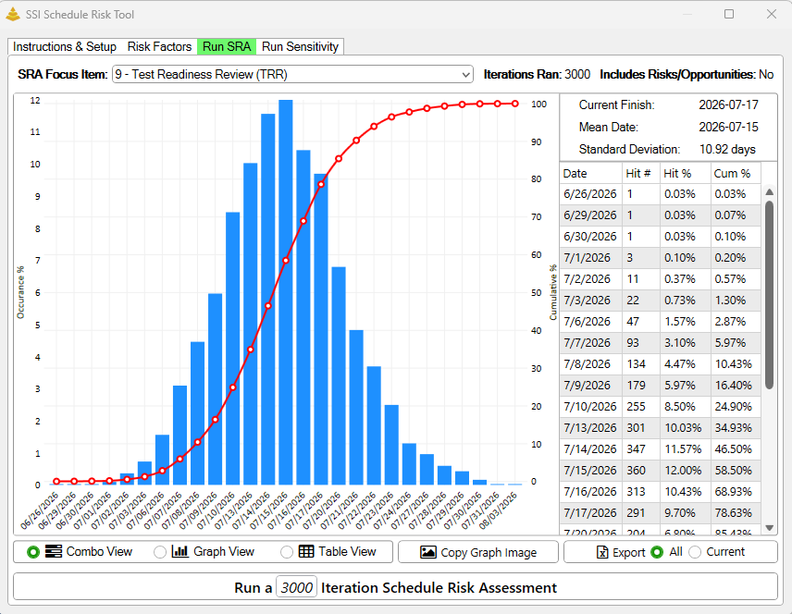

Slide 7
From Humble Beginnings
SSI's Schedule Risk Analysis Tool started as a good ol’ fashioned VBA Macro.
It performed risk analyses by literally changing the durations of tasks and the having Microsoft Project recalculate the project.
These analyses were slow and the only option to view the SRA graph or the Sensitivity Analysis Tornado Chart was by exporting the results to Excel.

Slide 8
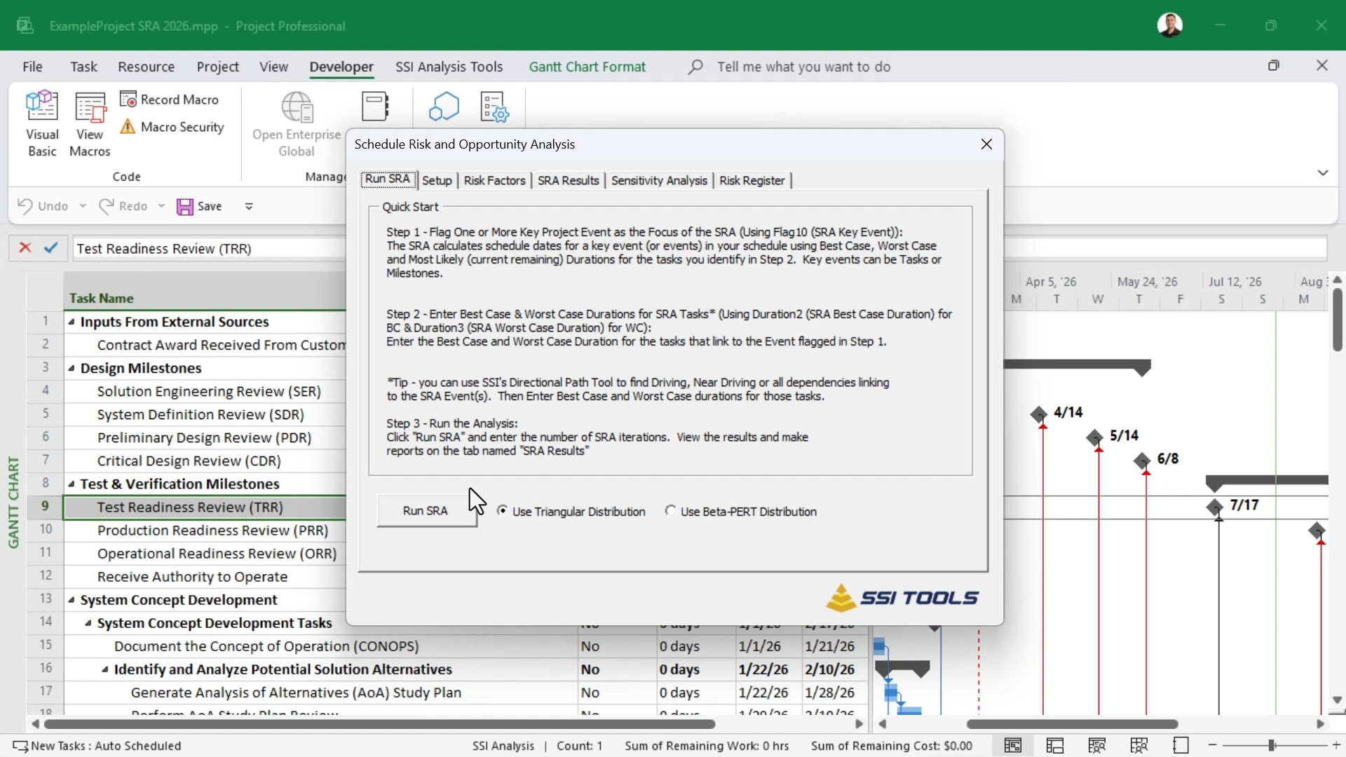

Slide 9
The tool was too slow. Improving the speed was our #1 priority

Slide 10
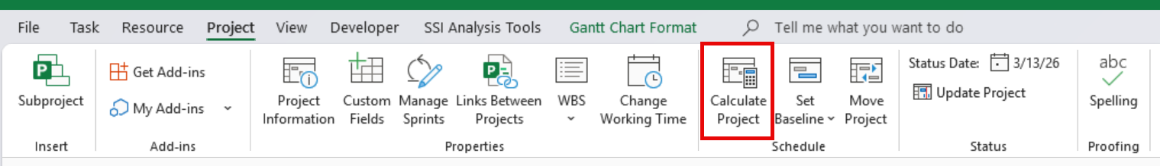
The Bottleneck
Our primary performance bottleneck was that we relied on Microsoft Project’s calculation function to recalculate the schedule after durations to tasks were changed.

Slide 11
Calculating Microsoft Project
Each time Microsoft Project recalculates, it processes far more than just the task network, including:
  Custom field formulas
  Time-phased work and cost
  Gantt chart visualization
  And much more

Slide 12
To achieve our goal, we needed to develop our own scheduling algorithm.

Slide 13
Building a Scheduling Algorithm
We believed we could improve performance by developing an algorithm focused solely on recalculating task dates, nothing else.
The algorithm needed to match Microsoft Project’s scheduling calculations exactly.
A few months of development and testing…

Slide 14
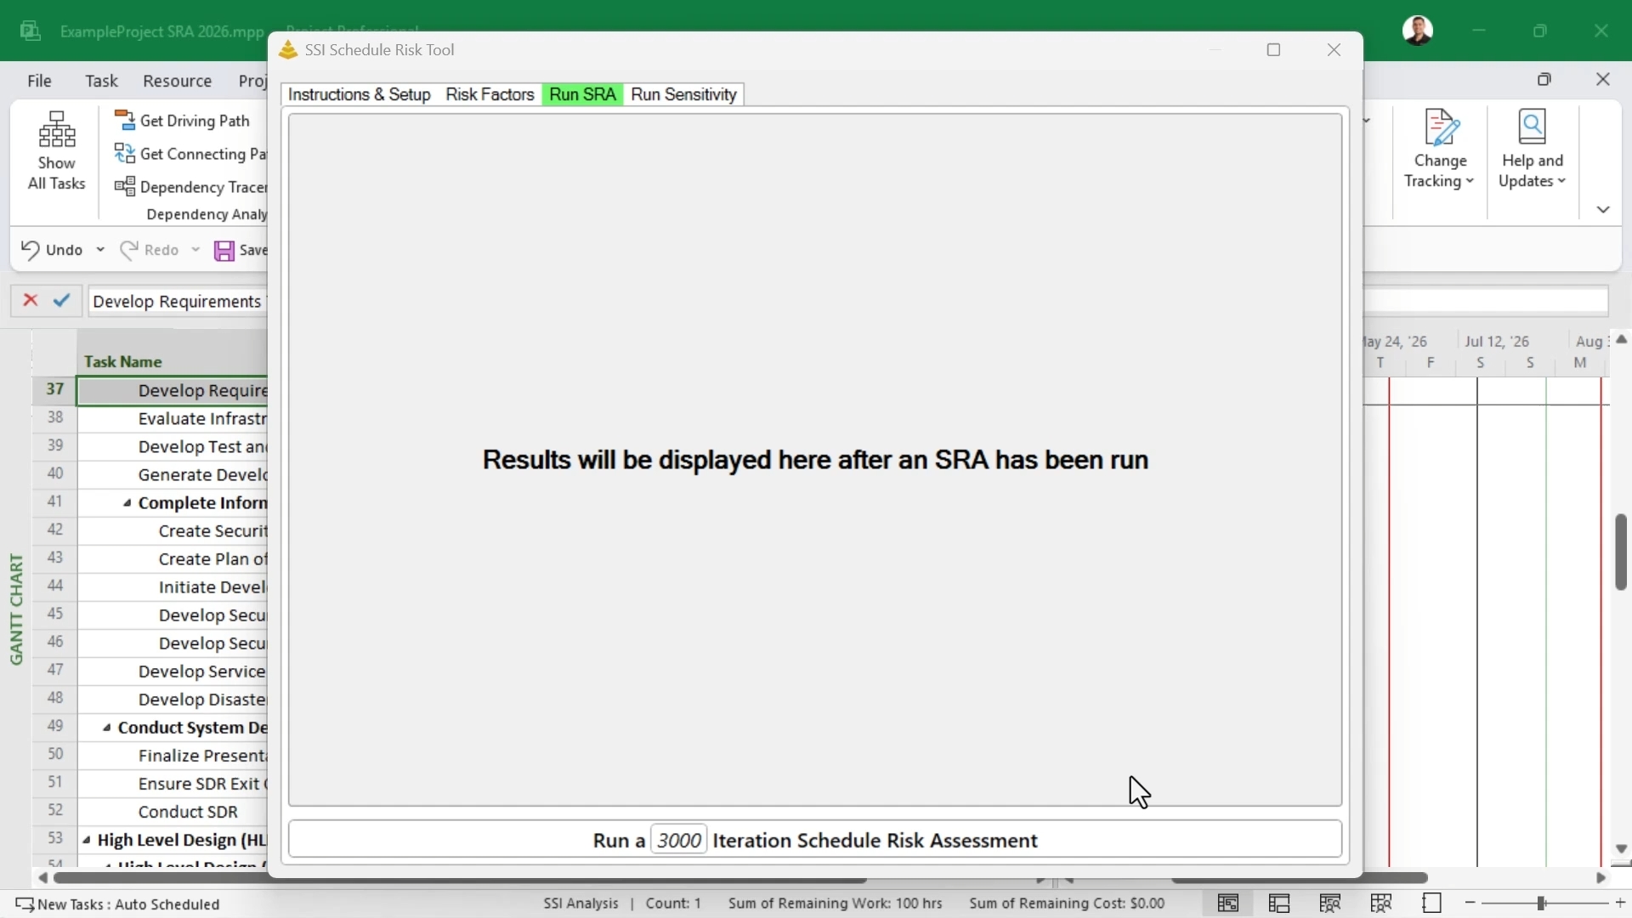

Slide 15
A Practical Guide to Performing SRAs with SSI Tools

Slide 16
SRA Process
Schedule Quality Verified
SRA Inputs Established
SRAs Run

Slide 17
SRA Process
Schedule Quality Verified
SRA Inputs Established
SRAs Run

Slide 18
Schedule Quality is the Foundation
The real work to perform an SRA happens before the tool is ever opened or a Best/Worst Case duration is entered.
SSI’s SRA tool operates directly within Microsoft Project and uses the schedule’s established logic and relationships when performing its calculations.
Before running an SRA, a schedule should be audited for any quality control issues.

Slide 19
Prerequisite Audits
SSI recommends schedules be checked, and necessary corrective actions be taken for the following conditions:
Missing Dependencies
Dangling Finishes
Dependencies on Summary Tasks
Out-of-Sequence Relationships
Hard Constraints
Unnecessary Soft Constraints
Constraints on Summary Tasks
Manually Scheduled Tasks
Invalid Status
Resources Assigned to Summary Tasks
Resources with Incorrect Calendars

Slide 20
The quality of a schedule determines the quality of its SRA results.

Slide 21
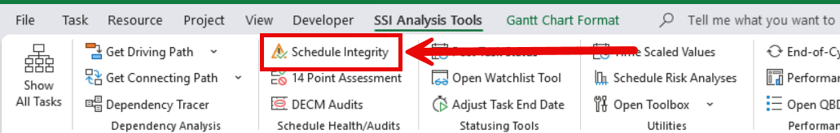
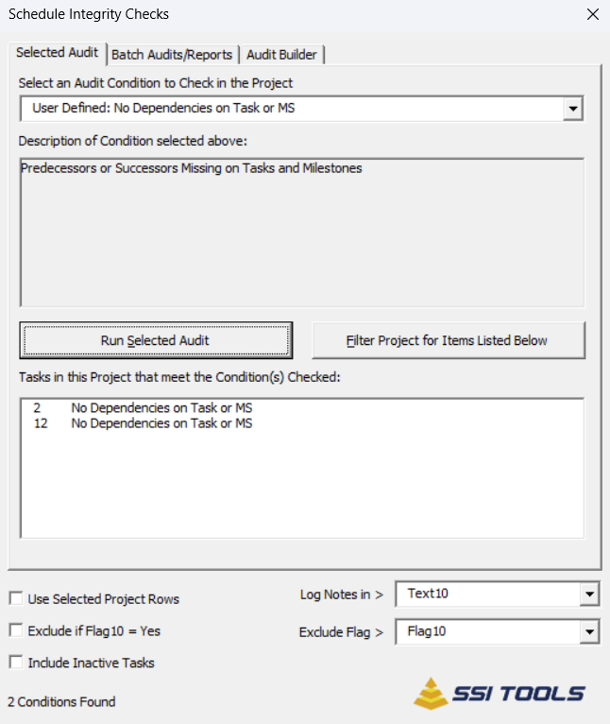

Slide 22
SRA Process
Schedule Quality Verified
SRA Inputs Established
SRAs Run

Slide 23
Schedule Quality is the Foundation
Inputs for the SRA Tool will be coded on tasks in Microsoft Project
  Best- and Worst-Case Durations
  Risks and Opportunities
  Distribution Modes
For time purposes, presentation will only focus on assigning Best and Worst-Case Durations
Which tasks do you need to spend time collecting information on?

Slide 24
2026
08
09
10
11
12
Task A
Task C
Task D
Deliver
Task B
Task F
Timeline
Task
Milestone

Slide 25
2026
08
09
10
11
12
Task A
Task C
Task D
Deliver
Task B
Task F
Timeline
Task
Milestone

Slide 26
2026
08
09
10
11
12
Task A
Task C
Task D
Deliver
Task B
Task F
Timeline
Task
Milestone

Slide 27
2026
08
09
10
11
12
Task A
Task C
Task D
Deliver
Task B
Task F
Timeline
Task
Milestone

Slide 28
2026
08
09
10
11
12
Task A
Task C
Task D
Deliver
Task B
Task F
Timeline
Task
Milestone

Slide 29
2026
08
09
10
11
12
Task A
Task C
Task D
Deliver
Task B
Task F
Timeline
Task
Milestone

Slide 30
2026
08
09
10
11
12
Task A
Task C
Task D
Deliver
Task B
Task F
Timeline
Task
Milestone

Slide 31
2026
08
09
10
11
12
Task A
Task C
Task D
Deliver
Task B
Task F
Timeline
Task
Milestone

Slide 32
2026
08
09
10
11
12
Task A
Task C
Task D
Deliver
Task B
Task F
Timeline
Task
Milestone

Slide 33
2026
08
09
10
11
12
Task A
Task C
Task D
Deliver
Task B
Task F
Timeline
Task
Milestone

Slide 34
2026
08
09
10
11
12
If Deliver is my SRA focus point, Which tasks should I spend the time getting duration estimates on?
Task A
Task C
Task D
Deliver
Task B
Task F
Timeline
Task
Milestone

Slide 35
2026
08
09
10
11
12
Task A
Task C
Task D
Deliver
Task B
Task F
Timeline
Task
Milestone

Slide 36
Only the task that are logically connected to the Key Event require 3-point duration estimates

Slide 37
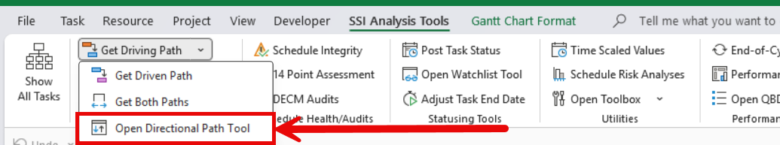
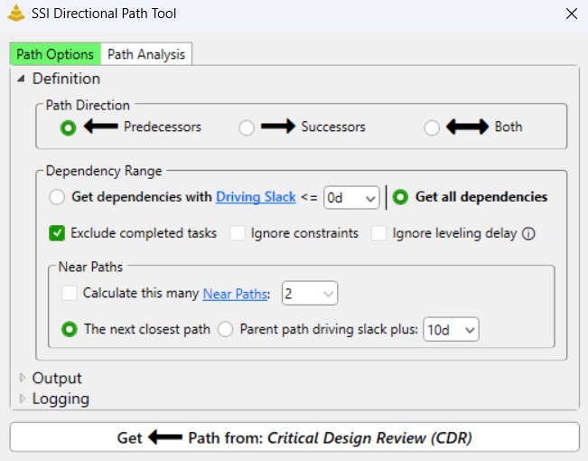

Slide 38
SRA Process
Schedule Quality Verified
SRA Inputs Established
SRAs Run

Slide 39
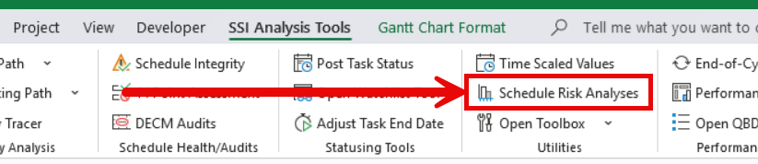

Slide 40
Q&A

Slide 41
Thank you!
Jason.berg@ssitools.com

