Slide 1

Performance Drives Compliance Not the Other Way Around
Introducing the
Ubiquitous EV Mindset
Luis Contreras
August 2026

Slide 2
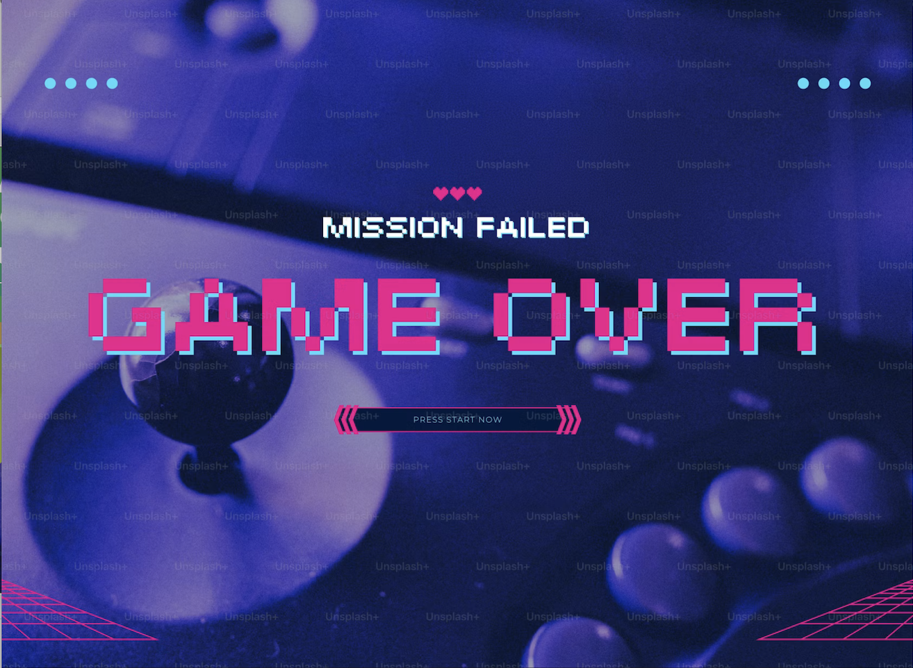
What if EV Was Always
a Game and we
Ruined it?
2

Slide 3
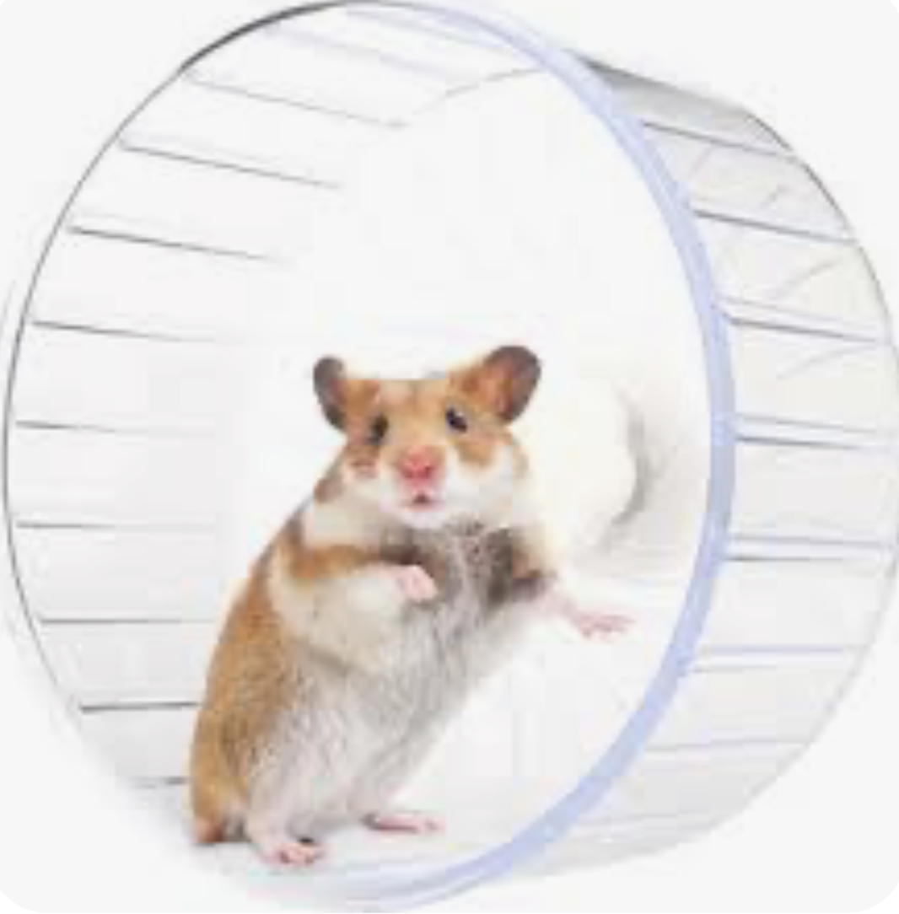

Or even….
3

Slide 4
Is it the inputs?
Or the mindset?
Loyalty
Versus
COMPLIANCE SURVIVAL
ENABLING
PERFORMANCE
Loyalty
l
SOLVABLE MINDSET PROBLEM

Slide 5


Notes:
Siloed tools to orchestrated workflows

Slide 6


Notes:
Monthly survival to simply always audit-ready

Slide 7


Notes:
Right-sized as a buzzword to truly scaled for complexity

Slide 8


Notes:
From surprises from monthly reports to confidently betting on what our performance will be

Slide 9


Notes:
Alphabet soup to a shared natural language

Slide 10

UBIQUITOUS EV
So how do we do that?
10

Slide 11

The Power of Not YET

Slide 12
Plus Five Tenets
1
2
3
Performance 1st
Engaging
Natural Flow
When the CAM Succeeds the
Project Succeeds
Transparent
4
5
Page
12

Slide 13

Occupy a
Growth Mindset…
and let
Performance
Drive
Compliance
13

Slide 14

Prizes!
Your feet will thank you
14

Slide 15
Tenet #1: Performance 1st
\
1. Prioritize performance over compliance metrics
Is your answer in Luis’ top three?
2. Focus on leading versus lagging metrics
3. Foster an accomplishment culture

Slide 16
Tenet #2: Engaging
\
1. CAM buddy system
Is your answer in Luis’ top three?
2. CAM-friendly System Description
3. Reduce the fear of Compliance

Slide 17
Tenet #3: Natural Flow
\
1. Drag & drop EVM
Is your answer in Luis’ top three?
2. Gamify to honor the EV cadence
3. Real time, integrated updates

Slide 18
Tenet #4: Transparent
\
1. Reward early alerters
Is your answer in Luis’ top three?
2. Share preliminary flash reports
3. Make IBR artifacts continually accessible

Slide 19
Tenet #5: If the CAM Succeeds the Project Succeeds!
\
1 . Build processes & tools for CAMs
Is your answer in Luis’ top three?
2. No interrogation of CAMs at IBRs
3. Protect CAM hours

Slide 20



Performance-Driven Compliance:
An Approach
1. Performance 1st
2. Engaging
UBIQUITOUS EV
3. Natural Flow
4. Transparent
Shifting the Mindset
5. If the CAM Succeeds the Project succeeds
You can do this too!

Slide 21
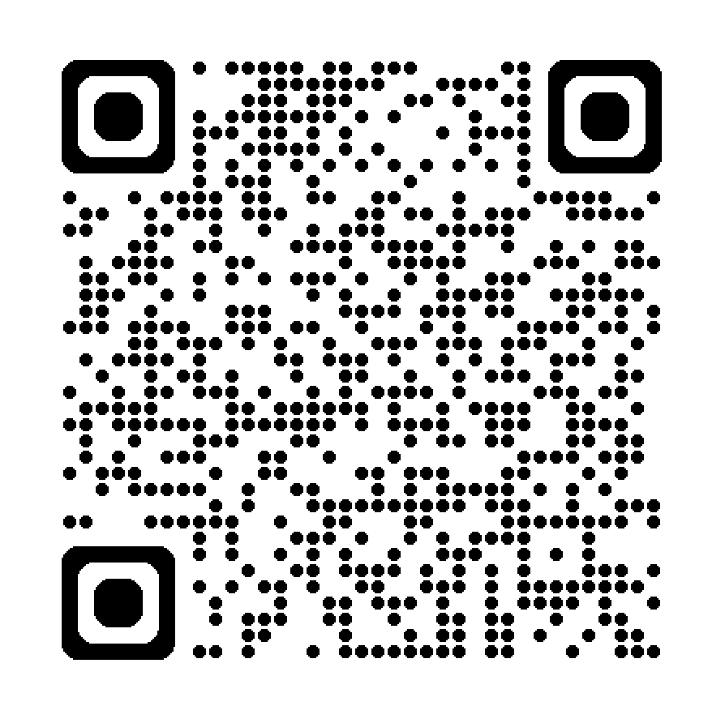
Ubiquitous EV Diagnostic
You mean in the past, we didn’t put performance first?
Get Ready to scan
on the next page
I can’t believe I’m saying this, but EV is kinda fun!
Imagery that feels off brand:
Serious, too dark
Corporate
Canned, emotionless, fake
Staged
Trite or cliche
Standard technology
Cheap
Anything too perplexing
Jargony

Slide 22

Thank you!
Luis Contreras
AzTech International, Inc.
Luis@goAzTech.com
+1 (949) 842.1193
22

