Slide 1
PCEC Updates for Crew and Space Transportation Systems (CASTS) and Robotic Missions
NASA Cost and Schedule Symposium 2026
Marshall Space Flight Center
Shawn Hayes, Mark Jacobs, Nathan Snyder & Richard Webb

Slide 2
PCEC Outline
Overview of PCEC
Crew and Space Transportation Systems (CASTS) Model
  Data Collection Additions
Robotic Spacecraft Model
  Database Updates
  High Level S/C CER
Conclusion

Slide 3
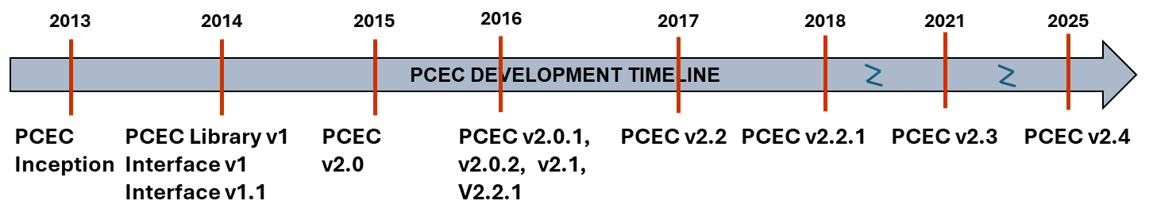
What is PCEC?
Summary Description
PCEC is a CAPABILITY including parametric cost models and supporting data
  Developed and maintained by the MSFC Engineering Cost Office (ECO)
  Replaced the NASA Air Force Cost Model (NAFCOM) circa 2013-2014
Excel Add-in
  Provides Full Visibility into all Calculations, Code, and Statistics
  Meets all NASA Information Technology Security Requirements
Two primary ‘models’, provided as part of a single, integrated tool
  Robotic Spacecraft (Robotic SC)
  Crewed and Space Transportation Systems (CASTS)
Source and supporting data, normalizations, and CER workbooks are stored in MSFC REDSTAR and ONCE database (NASA users)

Slide 4
Why PCEC?
PCEC Model Philosophy
BEFORE: Model Centric
Focus is on how to use the model
Model gets all the credit (or blame) for the estimate
Evaluation of the present rather than prediction of the future.
AFTER: Data Centric
Use the best data possible.
Transparent data analysis and CER development.
Focus is on the relationship of the data to the estimating problem.
Puts onus for the quality of the estimate on the estimator.
PCEC
Traceable
Defensible
Credible

Slide 5
Crewed and Space Transportation Systems (CASTS)

Slide 6
CASTS - Overview
Ver. 2.4.2 Released 2026
Based on data from 30 historical launch vehicle stages, crewed vehicles, and related space transportation systems/subsystems
  Plus 16 Liquid Rocket Engines (LRE) and 50+ Solid Boosters/Motors (SRM)
Includes Prime contract cost (excludes Civil Service, non-prime Support); CY 2015 $M
One set of CERs for estimating subsystem-level costs of Design and Development (D&D) and Flight Unit (46 CERs)
  Primarily single-variable power function CERs; some multivariable power CERs
  Plus set of power CERs for estimating support costs (e.g., PM, ground support equipment, tooling) at the spacecraft level (9 CERs)
Fixed/Variable equation estimates
  Production cost per year as f(rate & learning)
Add-on Models (available as separate spreadsheets)
  Propulsion Cost Model Ver. 1.0 – released 2025
    Three separate spreadsheet models - similar to CASTS: DDTE + FU M2015$’s
      Liquid Rocket Engines (LRE) + Solid Rocket Motors (SRM) + Nuclear Thermal Propulsion (NTP)
  Operations Cost Model – released ca. 2006
    Estimates recurring Earth-To-Orbit launch vehicle cost not covered by hardware-based models (Launch & Flight/Mission Ops+); fixed/variable cost estimates

Slide 7
CASTS - Documentation
User Guides + Virtual Black Books + CER Documentation
  Restricted and Unrestricted versions
Integrated collection of accessible source information
Available online through REDSTAR
PCEC CASTS DOCUMENTATION in REDSTAR
CASTS Virtual Black Books
PCEC Library v2.4
User’s Guides
CER Documentation
Apollo Command Module
Saturn IC (SIC)
Unrestricted
Adapters
Saturn II (SII)
Restricted
Avionics
Saturn IVB (SIVB)
…
Shuttle Orbiter
For Each System Element
Cost Analysis Workbook: Excel workbook with calculations and derivations to get source data to CER input data
Technical Resume: PDF file with summary technical descriptions & schedules
REDSTAR Bibliography: List of source documents and “cream of the crop” references in REDSTAR
Shuttle External Tank
Atlas I, II, IIA, IIAS, V
…

Slide 8
CASTS – Data Collection Additions
NEW: Added significantly to historical data collection – REDSTAR
  Multiple SLS-related cost studies: Results + Source Documents + Working Papers
  “Collections” of Shuttle Operations and EELV Results + Source Documents + Working Papers
    100’s of documents organized into multiple categories based on specific subject matter
SHUTTLE OPERATIONS DATA COLLECTION
Total Shuttle System Cost and Cost per Flight
Flight Operations/Johnson Space Center
Launch Operations/Kennedy Space Center
Solid Rocket Booster/Motor
External Tank
Orbiter
Space Shuttle Main Engines
Space Flight Operations Contract/United Space Alliance
Systems/Sustaining Engineering
Workforce Transition/Shutdown
Shuttle Upgrades/Safety & Performance Upgrades
Miscellaneous
EVOLVED EXPENDABLE LAUNCH VEHICLE (EELV) DATA COLLECTION
EELV Program Summaries
EELV DOD/NRO Budgets
EELV Prices and Contract Awards
EELV General History
Atlas V & III Specific Cost, Schedule, Technical
Delta IV & III Specific Cost, Schedule, Technical
Delta IV & Atlas V Production Operations
Delta IV & Atlas V Launch Operations – CCAS and VAFB
EELV ULA Joint Venture Agreement & Formation Information
EELV ULA Company History & Headcounts
EELV RFP/RFI History.
Boeing – Delta IV EELV Violations

Slide 9
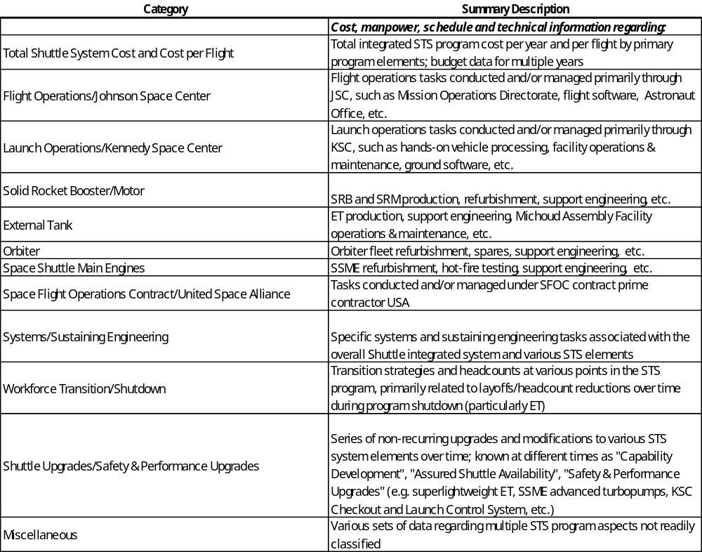
CASTS – Shuttle Ops Collection
Shuttle and EELV Collections include “read me” files describing contents of each category in each collection
  Shuttle Ops Collection Example

Slide 10
Robotic Missions

Slide 11
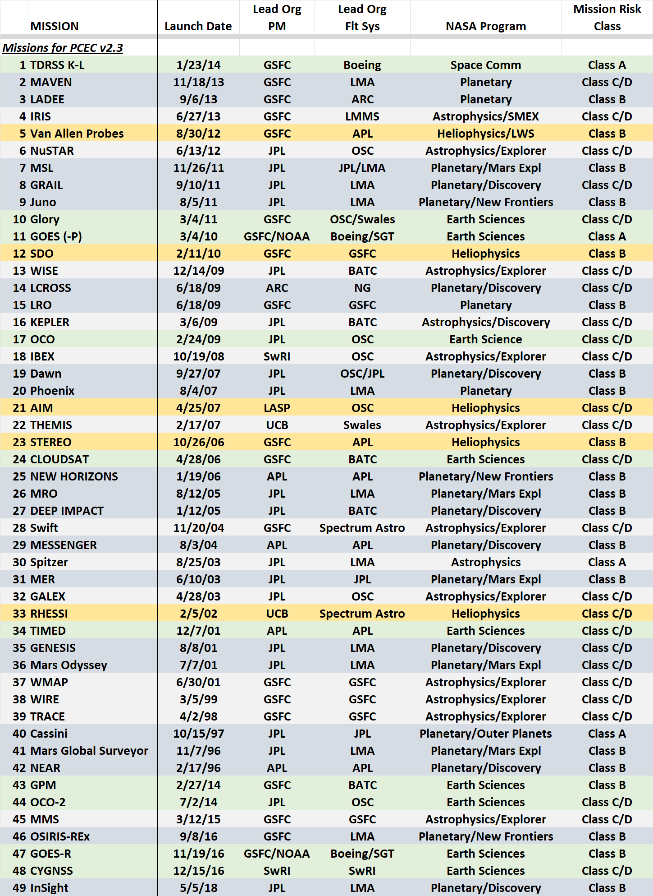
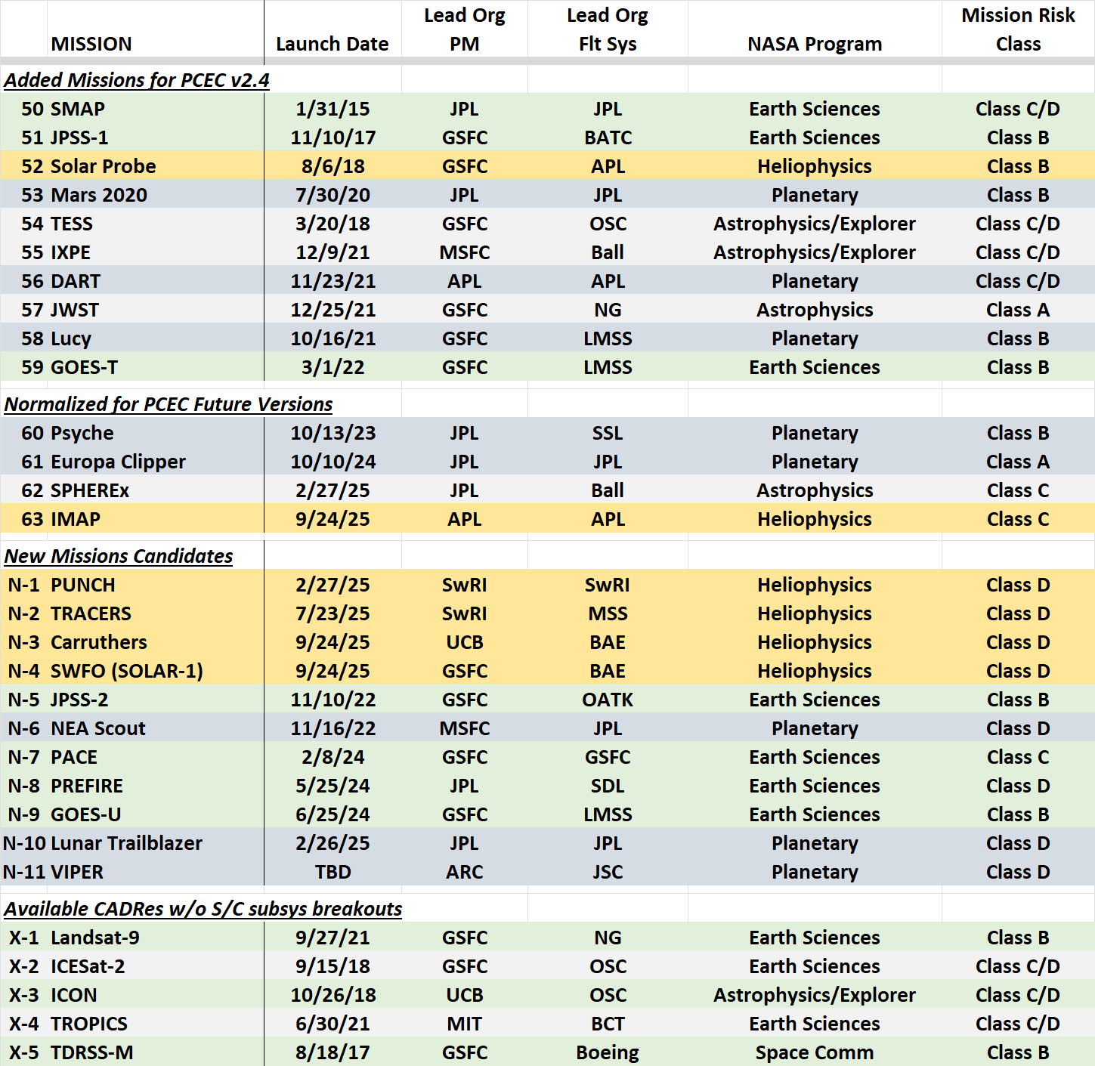
PCEC Robotic Mission Database
There are 63 normalized missions for PCEC
  Covers 74 separate flight elements (multiple elements on Mars landed missions and Deep Impact)
  10 additional missions have been added for the S/C High-level CERs

Slide 12
High-level S/C CER Objectives
Objective 1: Develop a high-level spacecraft CER to support estimating situations where subsystem-level data are unavailable
  Simplify PCEC to support early formulation efforts, concept studies, and assessments of FFP contracts (where PCEC inputs may be unknown)
  Multiple options have been developed
Objective 2: Include additional RSDO/FFP data points
  Added 4 RSDO mission s/c and 6 additional missions (that didn’t have supporting s/c subsystem data for PCEC integration)
Objective 3: Perform independent variable statistical testing
  Performed multiple independent variable tests to identify key drivers and understand CER sensitivities

Slide 13
High-level S/C CER Approach
3 different approaches have been developed:
1) Ordinary Least Squares (OLS)
Approach used for PCEC CERs
Results in a single multi-variable CER covering WBS 6 (S/C) and WBS 10 (I&T)
2) Bayesian Regression
Uses Bayesian techniques to develop probabilistic cost estimates
Results in a probabilistic cost assessment covering WBS 6 (S/C) and 10 (I&T)
CERs can be extracted from the process for a selected confidence level (=50% for comparisons to OLS)
3) Bayesian-PCEC
Uses Bayesian techniques to develop probabilistic estimates of PCEC inputs for WBS 6/10
Uses PCEC input estimates from Bayes with the PCEC CERs to estimate costs for WBS 6 (S/C) and 10 (I&T)
These approached will be further described in a separate presentation
Combining WBS 6 & 10 costs significantly improved data consistency
  Initial data reviews highlighted inconsistencies in book-keeping I&T in WBS 6/10

Slide 14
High-level CER Input Candidates
Input candidates included High-level Mission Characteristics, S/C & Payload Metrics, and Other Considerations
  Attempted to focus on inputs that would be known early in formulation
Input candidates were taken through a process to identify key drivers of cost differences (key drivers shown here)
High-level Mission Characteristics
Mission Target/Type
NASA Program & SMD Division
Mission Risk Class
Orbit/Environment
Project & S/C Lead Organization Type
Specific S/C organization
S/C and Payload Metrics
Payload Mass & Power
S/C mass
Flight System Heritage Rating
Flight System Parts Rating
Other Considerations
Contract Type: Fee-type or Fixed Price
Multi-Element: Y/N; Captures missions with cruise stage + entry system + lander/rover
RTG?: Y/N; Captures impacts from use of RTG power

Slide 15
Additional Data Points Used
10 additional data points were combined with the 63 missions currently normalized for PCEC
  The additional missions lack s/c subsystem detail to support integration into PCEC
  Mars landed missions and Deep Impact include multiple flight systems
The full dataset includes 6 RSDO/FFP missions
  It would be awesome if future FFP projects required s/c subsystem cost breakouts!
Added Data
PUNCH
Carruthers
SWFO
JPSS-2
PACE
PREFIRE
Landsat-9
ICESat-2
ICON
TROPICS
* Blue = RSDO

Slide 16
High-level S/C CER Input Findings
Payload characteristics (mass/power) seemed critical to CER performance
  It doesn’t seem credible to generate s/c cost estimates without payload info
Tried to eliminate all inputs for the s/c (but couldn’t)
  Flight System Heritage and Parts Ratings from PCEC were consistently showing up as cost drivers
  Some inputs showed strong correlation (like Mission Life & Parts Rating)
The RSDO/FFP input candidate did not show up as a significant cost driver
  Could be due to being represented by only 6 of 73 data points

Slide 17
High-level S/C Estimate – OLS & Bayes
The OLS CER has 4 inputs and 3 Yes/No questions
  Inputs:
    Payload Mass, kg
    Payload Power, W
    Flight System Heritage Rating
    Flight System Parts Rating
    Mission Target = Mars? (Y/N)
    Orbit Environment = LEO? (Y/N)
    Project Lead Org = NASA? (Y/N)
The Bayes CER has 3 Inputs and 3 “Type” selections
  Inputs:
    Payload Mass, kg
    Flight System Heritage Rating
    Mission Life, months
    NASA Program – Directed, New Frontiers, Discovery, MIDEX or Earth, SMEX/EV
    Flight System Type – Flyby, Orbiter, Lander, Rover
    Power Type – Solar, RTG
  This version is for the 50% confidence level (cl)

Slide 18
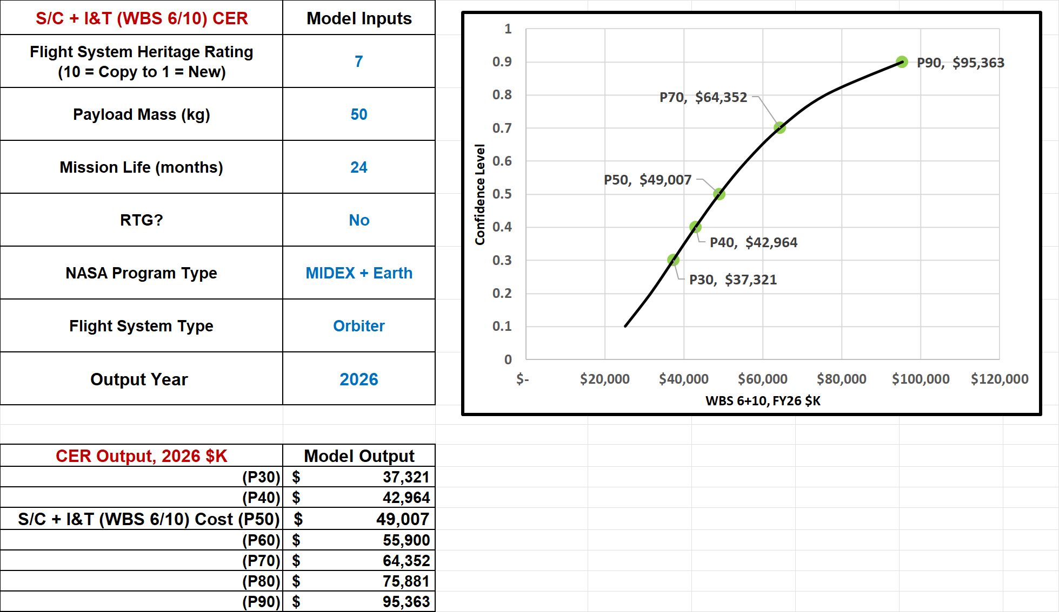
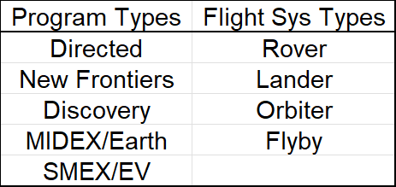
High-level S/C Model - Bayes
The Bayes approach generates a probabilistic output
  Project estimates are typically for the 50% cl
  This approach provides options for taking more/less risk

Slide 19
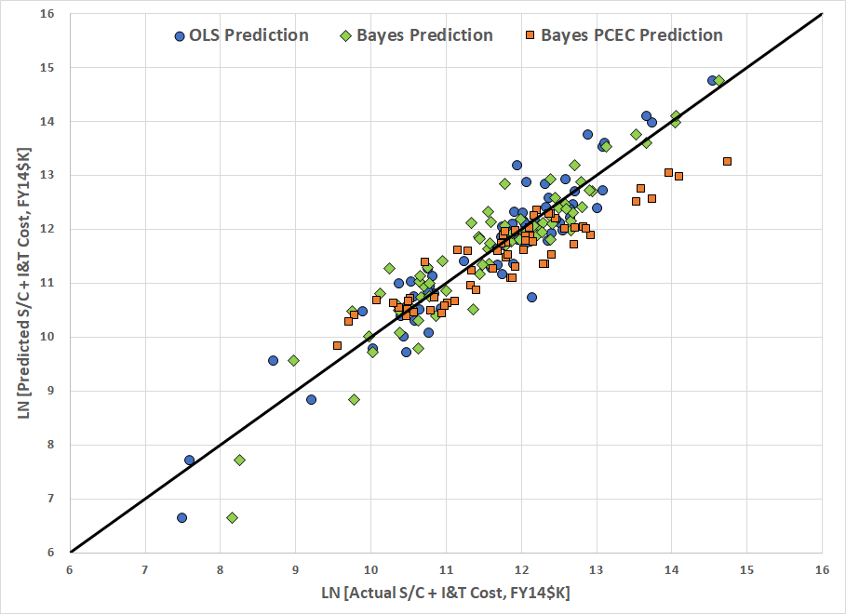
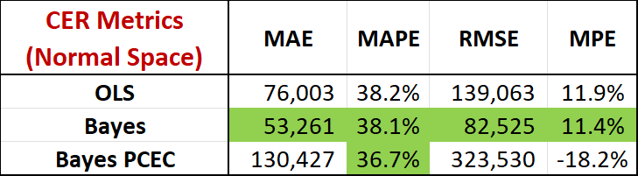
High-level S/C CER Performance
The OLS and Bayes approaches show similar performance
  Although the Bayes regression seems a little better than OLS
The Bayes PCEC approach has more error but provides lower-level inputs to run and refine a PCEC run
  Allows greater flexibility to capture implementation inputs

Slide 20
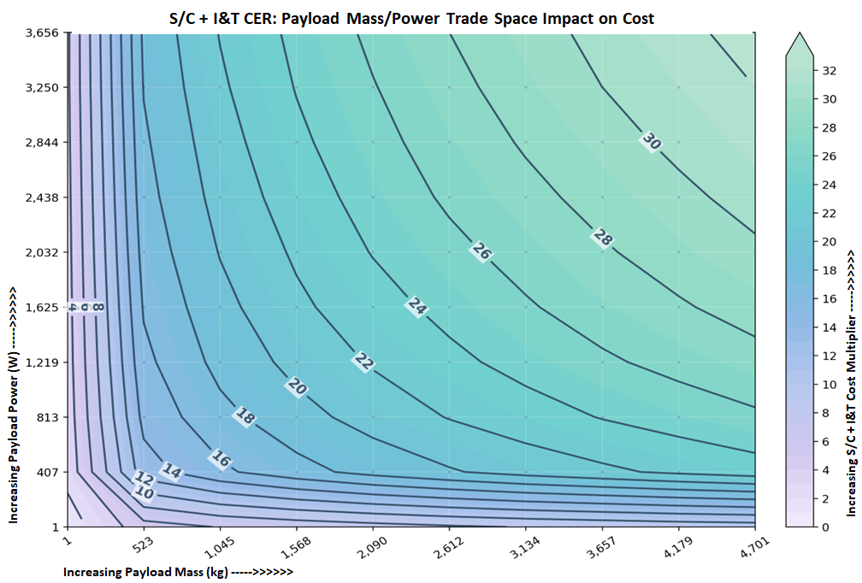
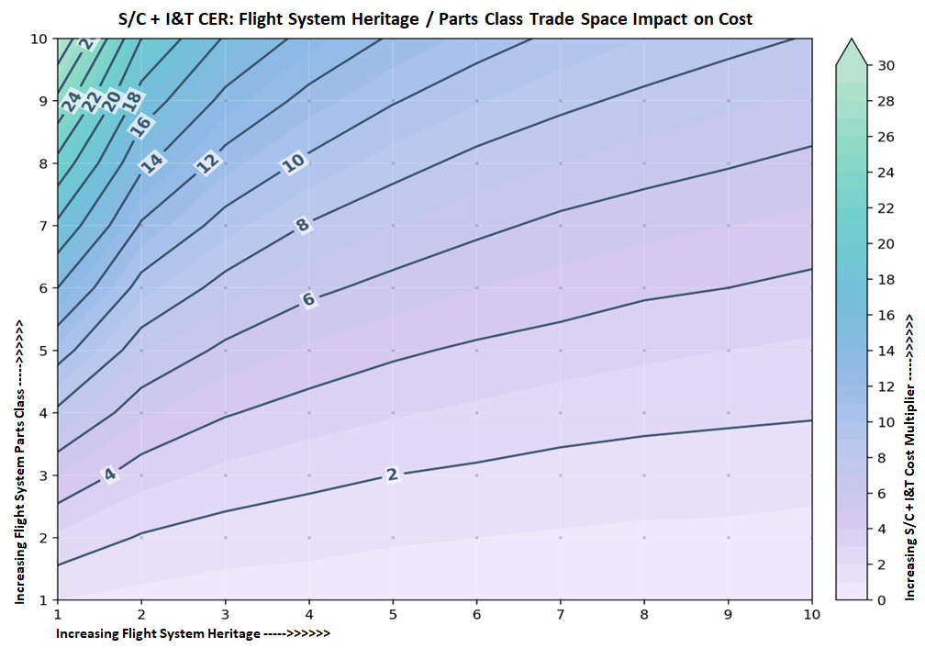
High-level S/C Model – Input Testing
Inputs have been tested to verify reasonable contributions to CER performance (examples shown here)
“Contour” plot showing impact of Payload Mass and Power
“Contour” plot showing impact of Flight Sys Heritage & Parts Ratings
Ratings Scale
Heritage: 1=Low, 10=High
Parts Quality: 1=Low, 10=High

Slide 21
PCEC Status - Today
PCEC v2.4.2 is the latest version available (released in August 2026), which includes bug fixes from v2.4.
The general public can obtain PCEC (with some export restrictions) via the NASA Software Repository
  DoD, Prime Contractors, Universities, citizens of many foreign countries
Where/How to get PCEC
Contact Information:
PCEC Email Contact: MSFC-PCEC@mail.nasa.gov
Application Website: https://software.nasa.gov/ , search for PCEC
Nathan Snyder (Primary)
NASA MSFC
256-544-1842
nathan.j.snyder@nasa.gov
Stanley McCaulley
NASA MSFC
256-226-0218
stanley.c.mccaulley@nasa.gov
Mark Jacobs
Space Systems Analysts, LLC
813-839-5476
mark.jacobs@ssanalysts.com
Shawn Hayes
Space Systems Analysts, LLC
630-797-5018
shawn.hayes@ssanalysts.com
Richard Webb
KAR Enterprises, LLC
661-547-7632
richard.webb@karenterprises.net

