Slide 1
Overview of CADRe Online Entry Capability for 2026 NASA Cost & Schedule Symposium
James K. Johnson, PPS Branch Chief
2026.8.12

Slide 2
Agenda
Summary
ONCE Numbers & QA Activities
CADRe Online Entry Capability Features
Current Status
Screenshots: Part B, Part C, and Dashboards
Online Entry Support for Internal Review
Submit Process
CADRe Part A Narrative Document
Conclusion

Slide 3
Summary
HQ OCFO SIB, PPS Branch, owns the CADRe data collection requirement and leads the ONCE database initiative for NASA
  CADRe provides the entire Agency with valuable data on NASA Projects
In 2026, MD/Program/Project is responsible for completing the CADRe data collection requirement
  Transition from OCFO and Memo from SMD
To assist with this transition, PPS Branch created a streamlined approach to CADRe that utilizes an Online Entry capability for CADRe Part B and CADRe Part C, and collaborated with SMD on multiple streamlining activities
  Reduce time and effort required with completing CADRe
  Increase data quality for community with automated data validation
  Modernize CADRe data collection utilizing available cloud solutions (O365, AWS, etc.)
The Online Entry capability is operational
  Pilots with Contractor teams are underway (or already completed)
  Streamlining activities are also underway (or already completed)
  SMD & OCFO are executing an FY-incremental approach to CADRe development
  15 New CADRe’s have been completed using the Online Entry capability

Slide 4
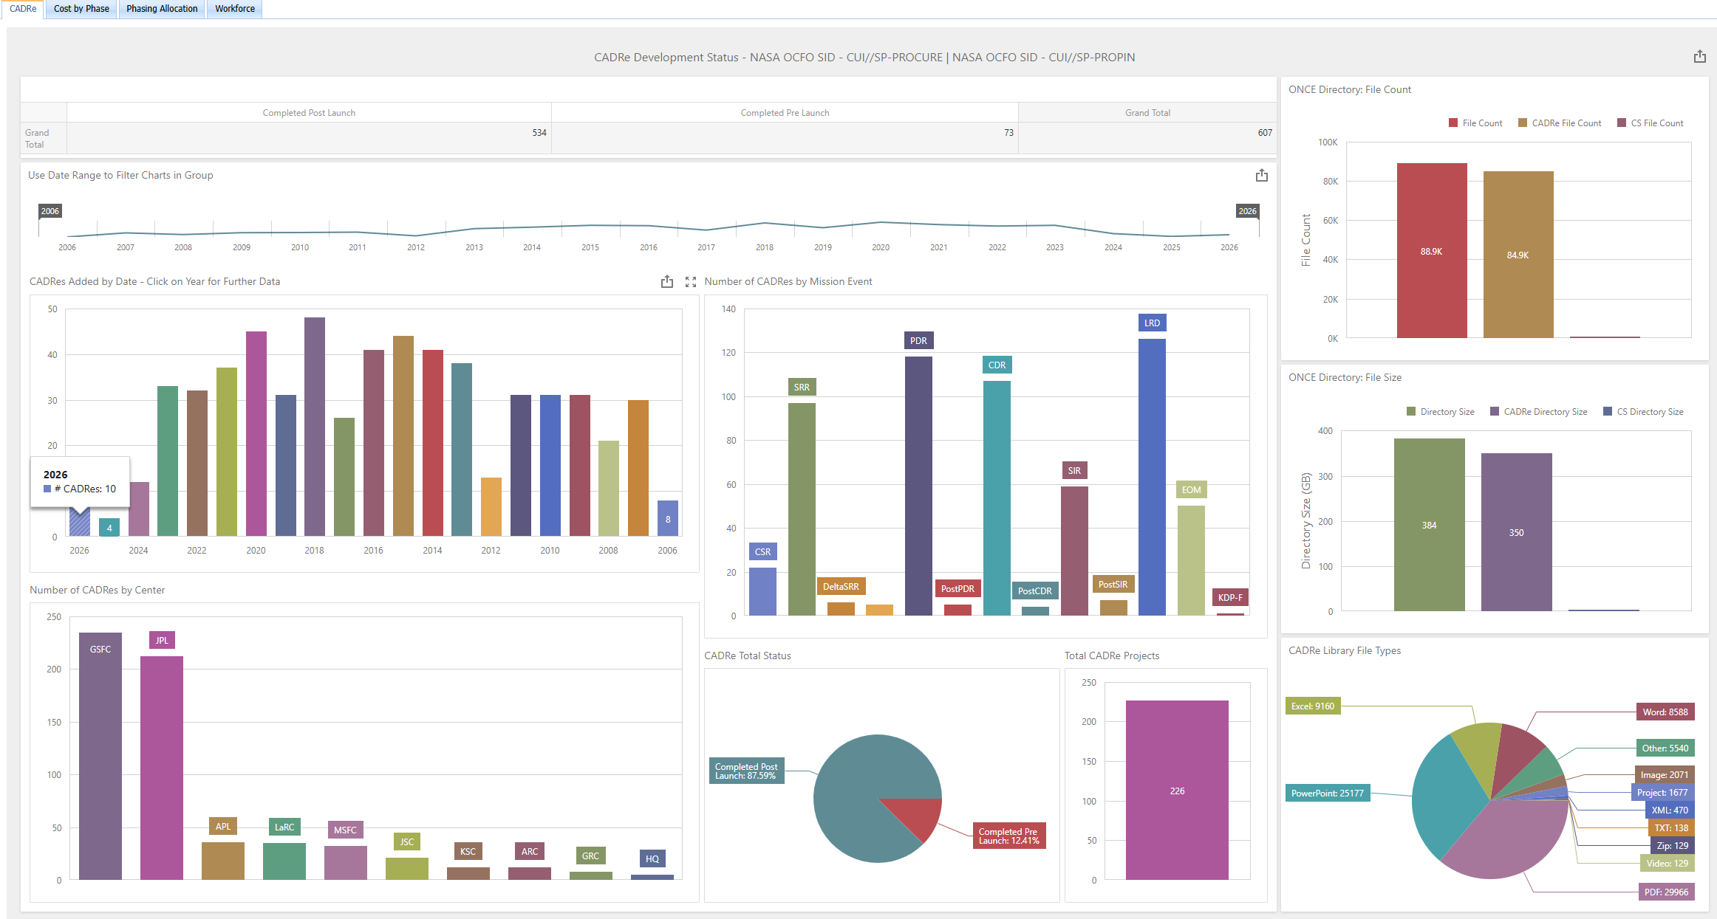
ONCE Numbers
226 Unique Projects
Over 600 completed CADRe’s
2006-2026
385 GB
87K Files
Over 700 Users
21 Total Models
3 Online Models
+10 CADRe in 2026

Slide 5
ONCE QA & Other Activities
Quality Assurance & Improvement
Model/Tool & Other
Updated the New Design/Flight Heritage inputs and definitions
Detail review and improve for Launch Vehicle, Solar Cell Type, Insulation Type, Battery Type, Processor Type, LCS, HGA Material, Insulation Type, and Conductive Structures Material
Expanded technical data for User Reports (all fields)
  143 → 287 fields now available
Source file cleanup
CADRe Status improvements
Updated landing page
Propulsion Cost Model (PCM)
aView v2025
ONSET v4.1 w/ASCoT & COMPACT
Acumen Fuse updates
ACEIT/JACS License
NRO SEM & EMC tools
Schedule Repository update
Symposium Library update
NNSI update
Public website update

Slide 6





CADRe Online Entry Capability Features
Online entry of Part B & Part C data via website utilizing O365 format
  Modern forms, spreadsheet entry, ribbon, etc.
Save and Resume with Auto-Save
Automatic data validations with error highlights
Dashboards for Submitters & Administrators
Source file manager with batch upload and config/control
Field definitions and standard drop-down selections
ONCE Standard WBS selections
“Copy-Forward” to reuse prior submittals
Support for copy/paste from source (excel, word, etc.)
Comments & Notes fields (incl in db)
Automated data transfer to ONCE for users with backups
Development and Progress metrics for oversight/insight
Role-based permission structure
NASA “ATO” with full NAMS/IdMax integration and PIV Card for access

Slide 7
Current Status
CADRe entries are In-Progress using live data
All Sprints complete and testing successful
  3 Sprints each with detailed work packages and test plans
All major features are complete
Capability is being actively used Gov & Contractor users
  As of August, 15 CADRe’s have been created utilizing Online Entry
Available to new Users as of March 2026
  Continuing to work on Pilots and communications
  “This is easy to use” (actual feedback received – stunned us too)
Previous Work Completed
Requirements Development
Architecture Selection & Setup
Functional Test & Check
CADRe Data Streamline
We Are Here!
Sprint 1
Sprint 2
Sprint 3
Internal Pilot
Rollout
Aug-Oct ‘24
Test &
Plan
Jan-Apr ‘25
Test &
Plan
July-Sep ‘25
Test &
Plan
Nov ‘25-Feb ‘26
Mar-Now ‘26

Slide 8
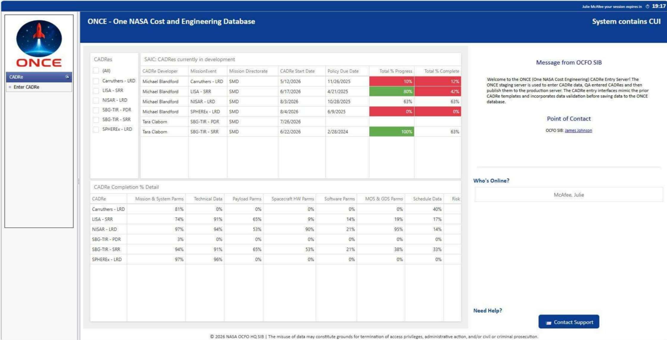
User Home Screen
User Home Screen has left hand navigation
Main panel is tables
Left Hand Nav, “Enter CADRe” to Start or Continue a CADRe (1)
Status of CADRe’s in Development (2)
CADRe Data Completion (3)
2
1
3

Slide 9
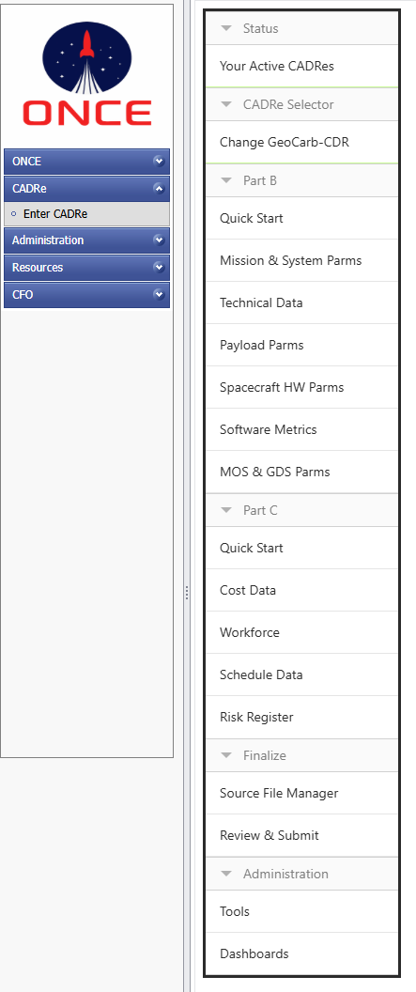
Left Hand Nav Menu
Start Here
Submitter visits website
“Enter CADRe” menu item
  Linked to Submitter permissions
Part B entry menu items
  Quick Start Guide
Part C entry menu items
  Quick Start Guide
Finalize
  Source File Manager
  Review & Submit
Administration
  Tools
  Dashboards

Slide 10
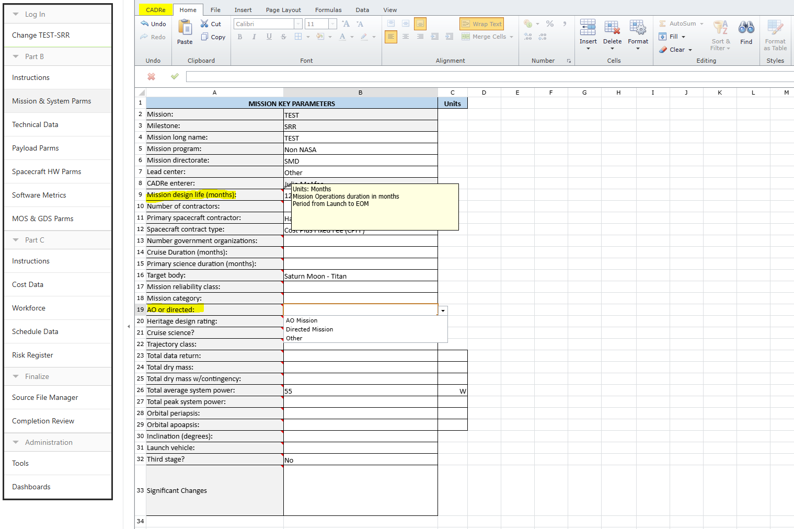
Part B Entry
Part B Entry Screen for Mission & System Parameters shown
O365-style Spreadsheet
  Ribbon with buttons, etc.
Fields include definitions
Fields include drop-downs for standard selections
Standard data entry or copy/paste from source
Each Part B section on a specific entry screen
  6 entry screens

Slide 11
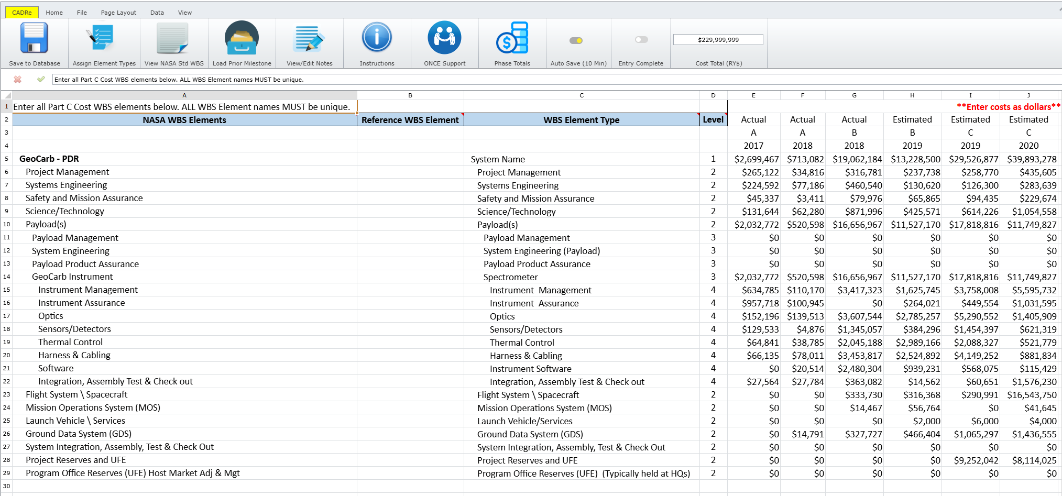
Part C Entry
Part C Entry Screen for Cost
Ribbon highlights:
  “Load Prior Milestone”
  “Auto Save”
  Cost Total
Standard data entry or copy/paste from source
Actual/Estimate
Fiscal Year
Mission Phase
WBS Indent & Level

Slide 12
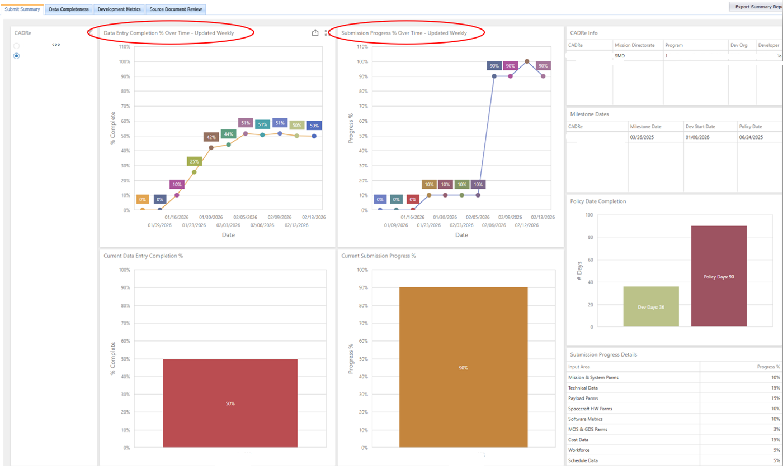
Dashboards (Progress & Completeness)
Progress Dashboards for Submitter & Administrator
Percent Complete by CADRe
  Entry Progress
  Data Fields
Line Chart measures progress over time by CADRe
Submitter can review completion progress before finalization
Team Leads and Administrator can view and generate reports for oversight/insight

Slide 13
Process with Team Internal Review (Example)
Internal Review Activities
CADRe Starts
One or more team members assigned to CADRe(s)
Team Lead Oversight
View all team members and CADRe in-progress
Internal Review
Prior to HQ Submit
Online Submit
Verification and move to Production
Examine field-level entries on every interface
View the completeness and progress metrics
Check the Notes/Comments
View the list of Source Files
Export a report
View the Review & Submit Dashboards
Check Part C Totals
Check WBS Elements
Compare against previous milestones

Slide 14
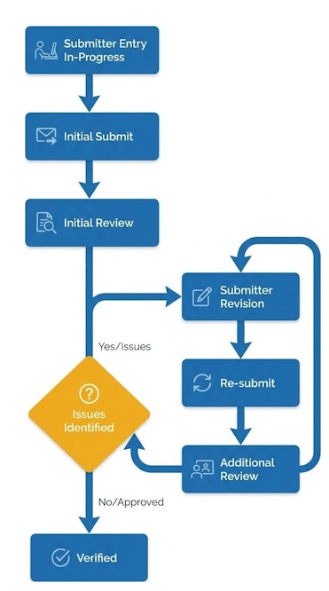
Online Entry Submit Process Overview
Final CADRe Submission Checklist
Before submitting your CADRe, please ensure the following steps are completed:
1. Entry Screens: All screens are fully completed, and ribbon toggles are set to “Complete”
2. Source Files: All relevant source files have been successfully uploaded
3. Data Completion Metrics: Review the Data Completion tab for any missing information and metrics in red
4. Prior Milestone Data: If available, review historical data on the Summary Review tab for comparison and to identify potential inconsistencies
5. Comments: Add comments on the submission to the Entry Notes tab (optional)
Once you’ve verified all items above, click the Submit button at the bottom of the page
What happens after submission:
· The ONCE Admins will be notified of the CADRe’s updated status, and the development end date will be recorded.
· A short review will be conducted. You will be contacted if any questions or issues arise. Issues will be tracked in the Entry Notes tab.
· Upon successful review, the CADRe will be marked as Verified and made available to ONCE users.
Internal Review

Slide 15
CADRe Part A Narrative Document
CADRe Online Entry Capability is focused on Part B and Part C data
  Technical, Cost, and Schedule data
This is the data imported into the database
  Data is available for query, report, and analysis
CADRe Part A Narrative Document is still a requirement
CADRe Part A file is uploaded using the Source File Manager
Online Entry Capability could support doing Part A before, after, or during entry
  Teams/Submitters ultimately determine their workflow
  SMD and OCFO are encouraging innovation in the construction of Part A Narrative
Part B and C
Online Entry
Part A
Narrative
Done
Submit
Part A
Narrative
Part B and C
Online Entry
Done
Submit
Part A
Part B
Part C
Done

Slide 16
Future
Online Entry capability can offer opportunities in the future:
  Add/Delete/Revise fields and parameters (and definitions!)
  Cross-checks to promote consistency and detect errors
  New validations to improve data quality
  Update or create new standard selections
  Align priority data collection with needs of community
Got “the” parameter(s) we need to collect? (Engineer Shoe Size?!)
Want to improve the existing parameters?
Got some data we need to collect? (no ash & trash please!)
Contact Us: HQ-ONCESUPPORT@MAIL.NASA.GOV

Slide 17
Conclusion
CADRe Online Entry capability is operational
  Government and Contractor users have completed 16 CADRe’s
Online Entry can reduce time and effort for CADRe data collection
  Streamlined approach with focus on high priority data
  Easy data entry with field definitions, drop-downs, and copy/paste
  Modern approach to data collection with automatic data transfers
Data quality improvements
  Automatic data validation with error highlights
  Data integrity and consistency improvements
Progress Dashboards for oversight/insight
  Helps both Submitters, Teams Leads, and Administrators
OCFO & SMD collaboration on CADRe & ONCE
  Thank you SMD!

Slide 18
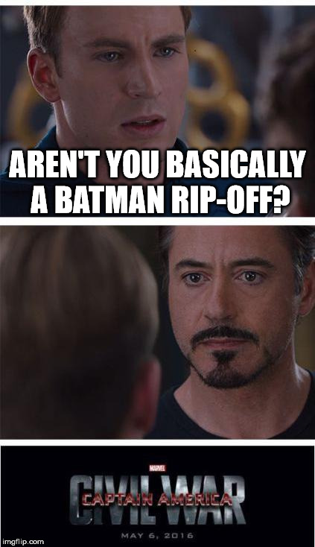
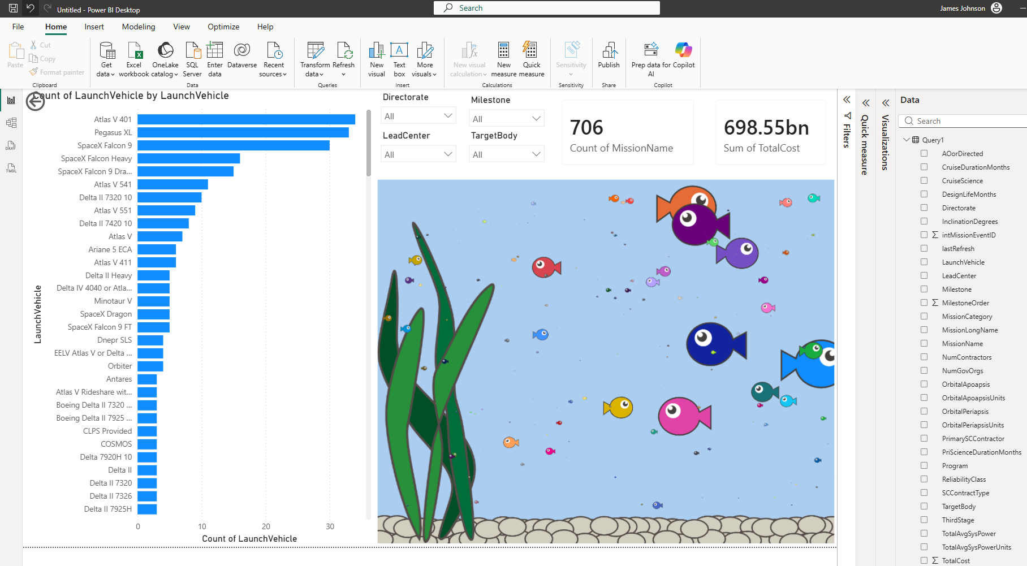
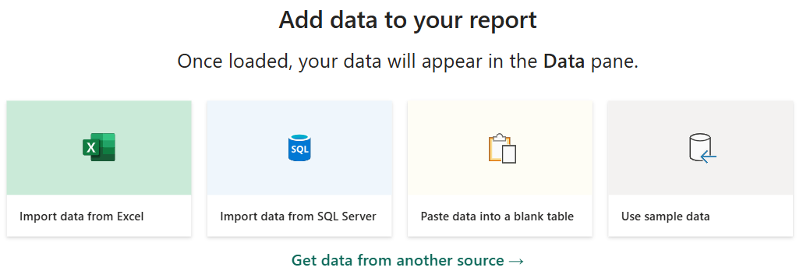
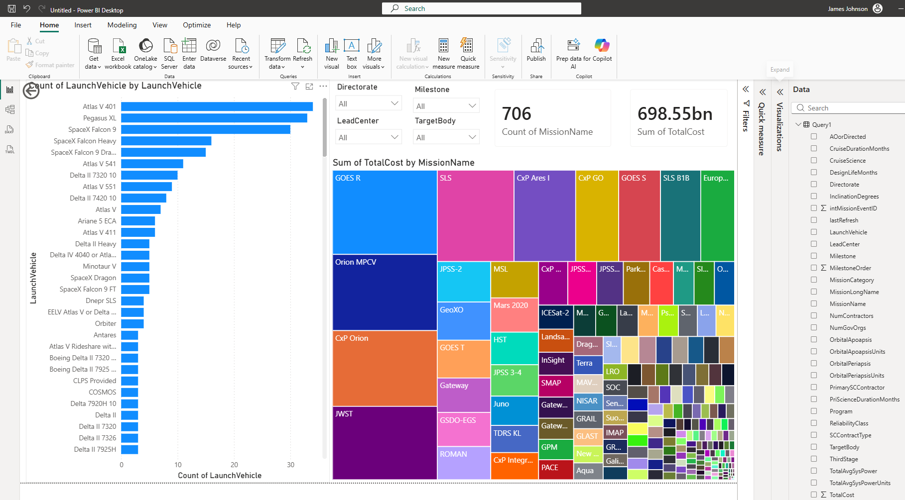
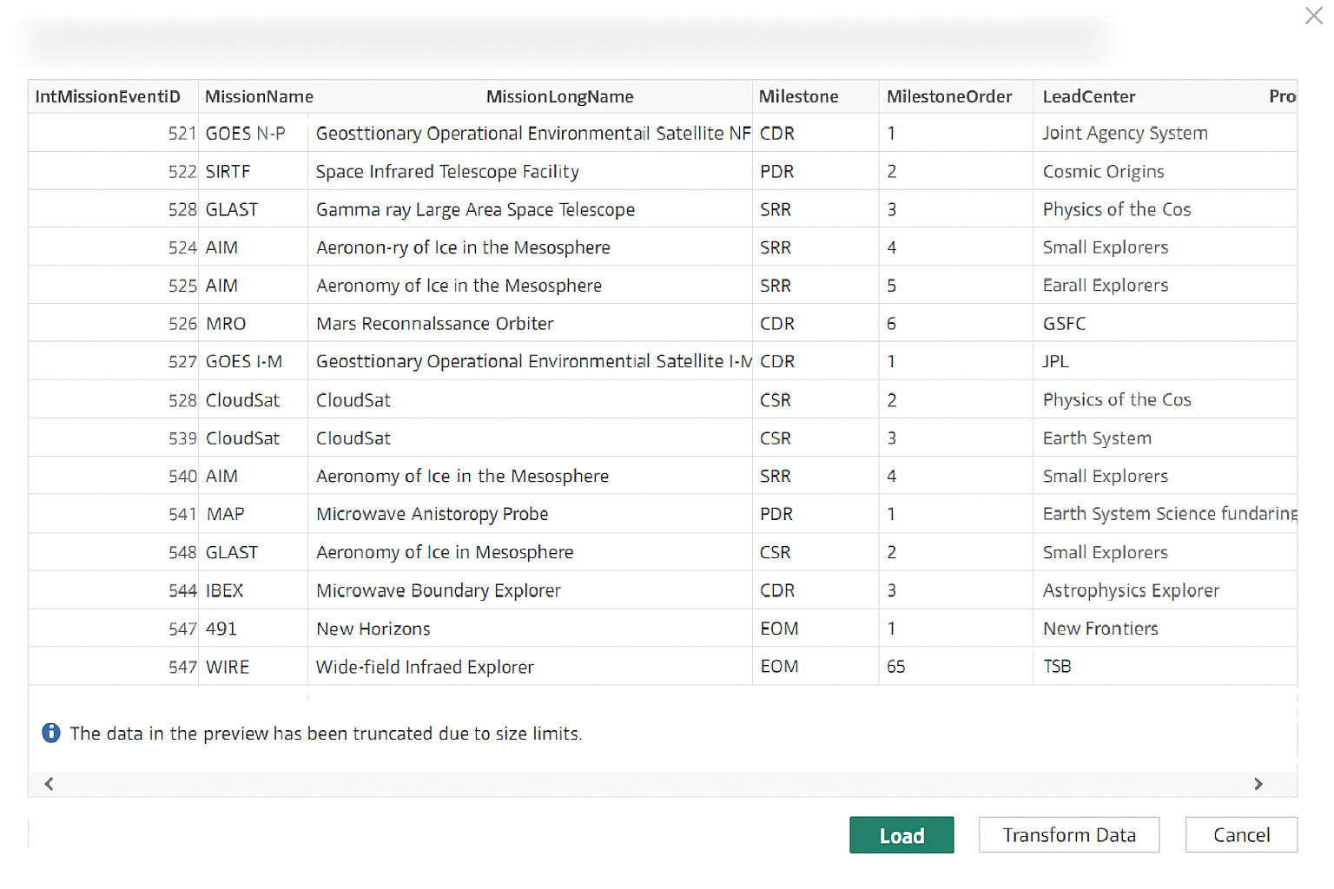
Final Stinger – API/LLM/PowerBI
We are working to release an API for ONCE
  This will support integration with AI/LLM
  Data source for PowerBI/Tableau/etc.
Online Entry helped with foundation
Stay tuned…

Slide 19
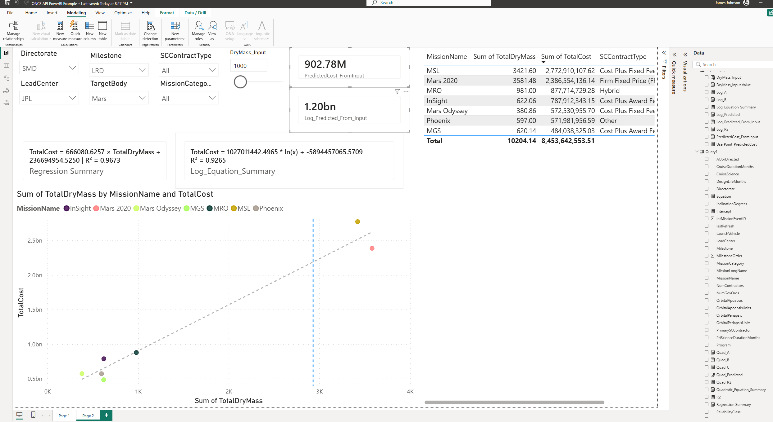
API = Choose Your Own Adventure
Model made as example PowerBI Adventure
Linear and Log Linear Regression
Live filters, data, results
User Input Estimates
Publish to Web, Teams, Sharepoint, etc.

Slide 20
API & AI/LLM
API can work with AI/LLM (multiple options)
Natural language requests, analysis, integrations, charts, images, agents, etc.
Security and permissions enforcement included
ONCE team focus now is the Parameterized API to enable
Feature | Approach A (APIs/Tools) | Approach B (Text-to-SQL)
Where is security enforced? | In your backend application code. | Inside SQL Server via Row-Level Security (RLS).
How does it filter data? | Backend injects the User ID into the query parameters. | App sets a DB Session Context; DB filters the rows automatically.
Risk of Prompt Injection? | Zero. AI cannot alter the hardcoded backend logic. | Zero (if RLS is configured correctly). DB Engine overrides AI requests.
Development Effort | Easy. Standard web development practices. | Harder. Requires a DBA to correctly configure RLS policies on tables.
SQL | AI/LLM
Specific Functions | YES!
Read Only | YES!
SELECT | Via Function
UPDATE | NO!
DROP TABLE | HELL NO!

Slide 21
BACKUP

Slide 22
ONCE Resources
Contact Us:
  HQ-ONCESUPPORT@MAIL.NASA.GOV
Public Website:
  https://www.nasa.gov/ocfo/ppc-corner/cadre-once-data-collection-and-database/
How to get access:
  ONCE Access Instructions (as of January 2026)
Links to CADRe Waiver/Tailoring:
  CADRe Waiver Memo
  Business Process Memo 24-01

Slide 23
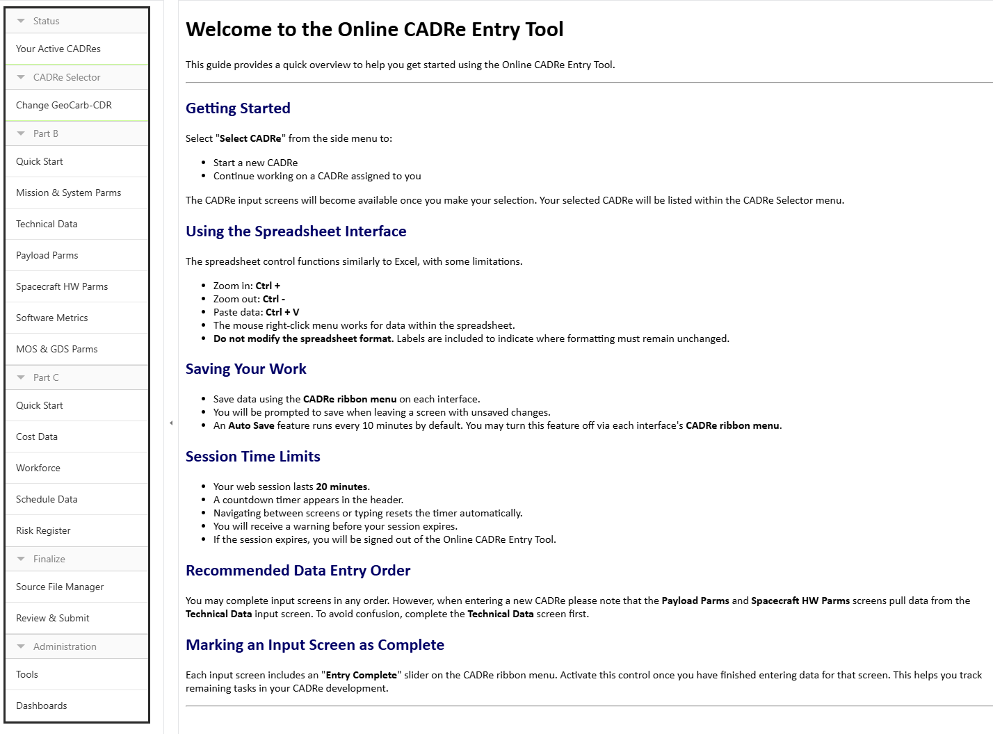
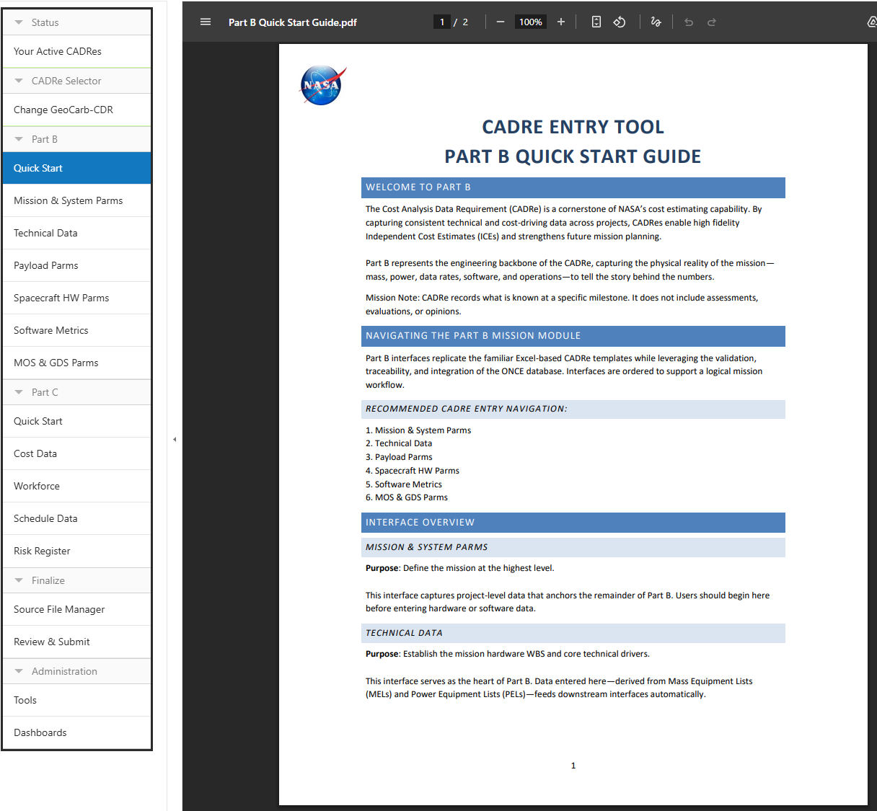
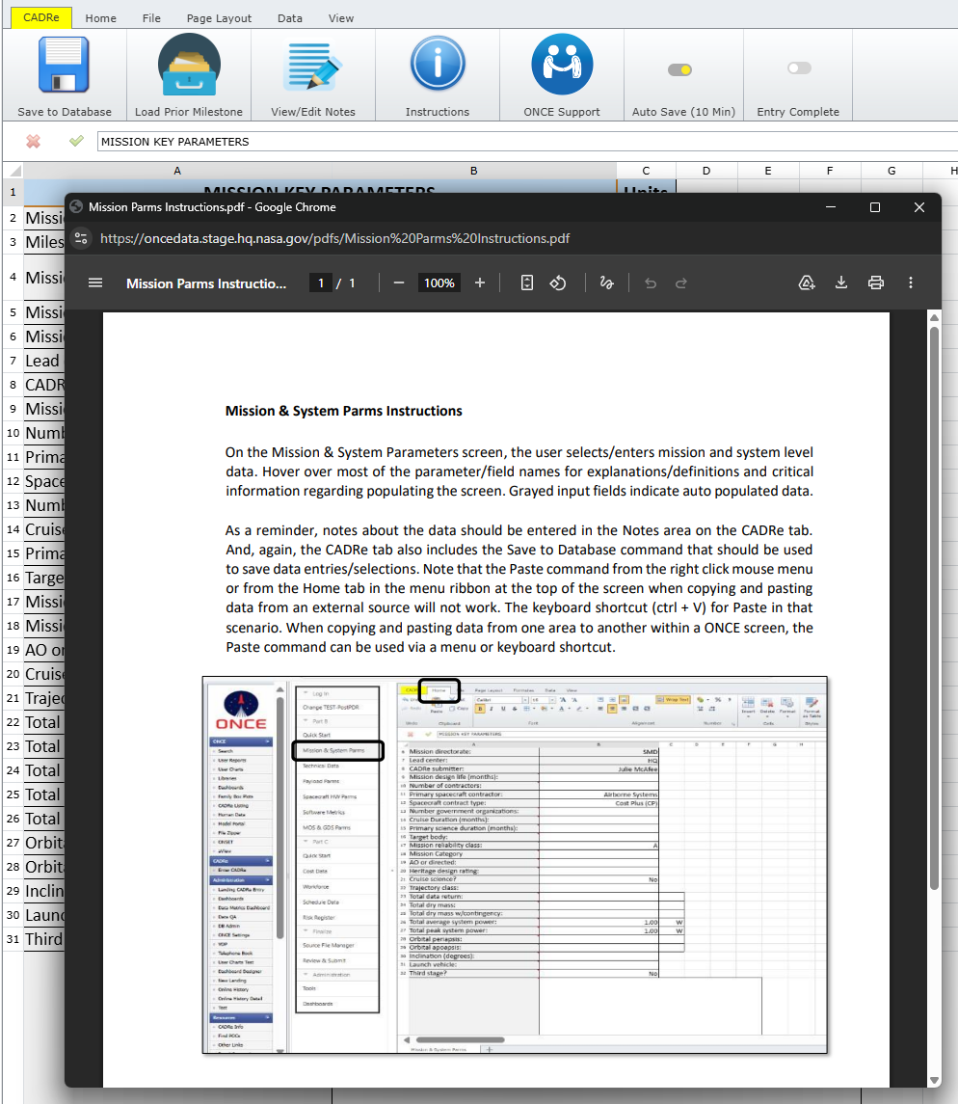
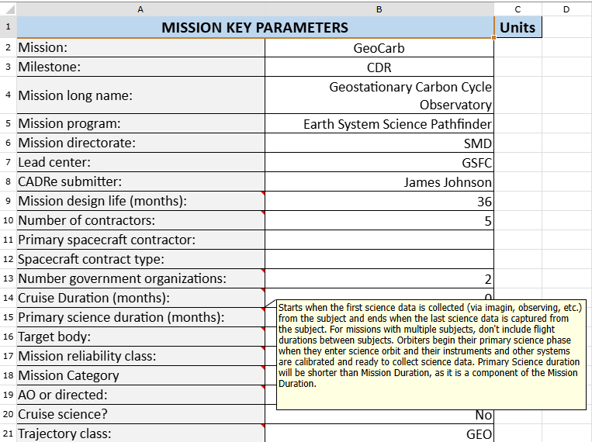
CADRe Online Entry Capability - Documentation
Getting Started
Quick Start Guide PDF for Part B and Part C
Detailed Instructions PDF for each interface
Fields have rollover definitions

Slide 24
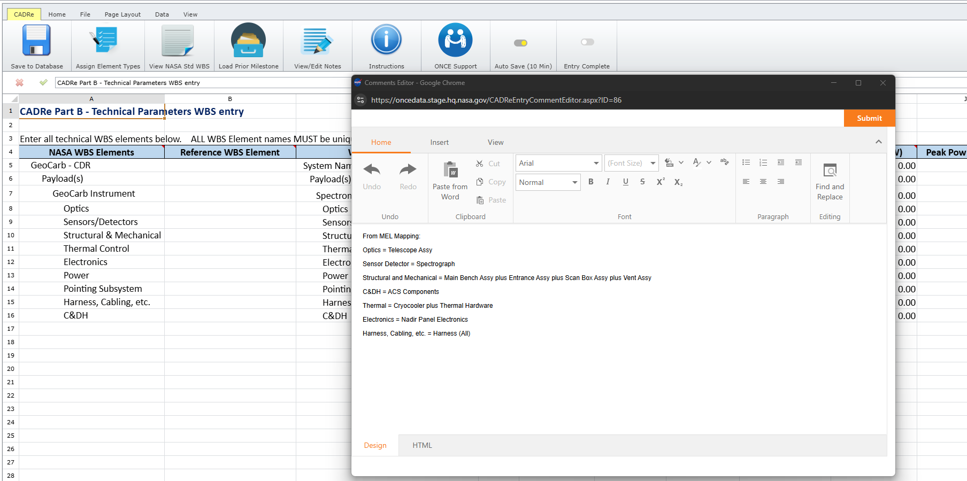
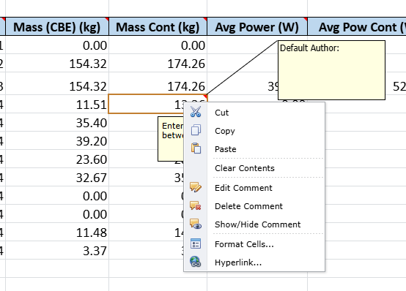
Adding Comments & Notes
Two features for adding Comments & Notes:
  Comments Editor = Ribbon button, spawns new window with document editor
  Cell Level Comment = Right Click on a cell, Add/Edit/Delete comment
Added benefit for users is these comments are saved to the DB
  Available for export, report, etc.
Comments Editor
Cell Comment

