Slide 1
Improving PCEC Cost Estimating Relationships Through Bayesian Regression
NASA Cost and Schedule Symposium 2026
Marshall Space Flight Center
Shawn Hayes, Mark Jacobs, Nathan Snyder & Richard Webb

Slide 2
Outline
Introduction / Background
Study Design
  Objectives
  Bayesian Methods
Case Studies
  Case Study 1: CASTS Tanks CERs
  Case Study 2: High Level S/C CER
Bonus App: Bayes PCEC Driver
Conclusions & Future Work

Slide 3
Introduction
The NASA mission portfolio is changing rapidly
  Missions are becoming increasingly diverse
  Historical cost databases remain relatively small
  Early lifecycle estimates are expected with greater accuracy
CERs continue to play a critical role in mission formulation, independent cost assessments, budget planning, and portfolio analysis
Can we improve CER development without fundamentally changing the process that cost analysts already use?

Slide 4
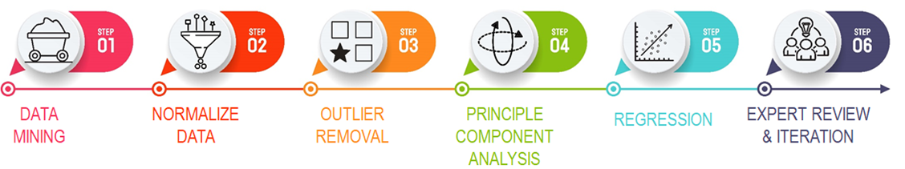
Current PCEC CER Development Process
Most of this fundamental workflow is sound and should remain unchanged.

Slide 5
Where Traditional OLS Begins to Struggle
Ideal OLS Conditions
Typical CER Datasets
  Larger datasets are available
  Predictors are independent
  Model assumptions are well satisfied
  9–20 historical observations
  Multiple categorical variables
  Correlated technical drivers
  Influential observations
  High predictor-to-observation ratios
VS
Coefficient estimates become unstable, increasing overfitting risk and reducing confidence in predictions.
The Result:

Slide 6


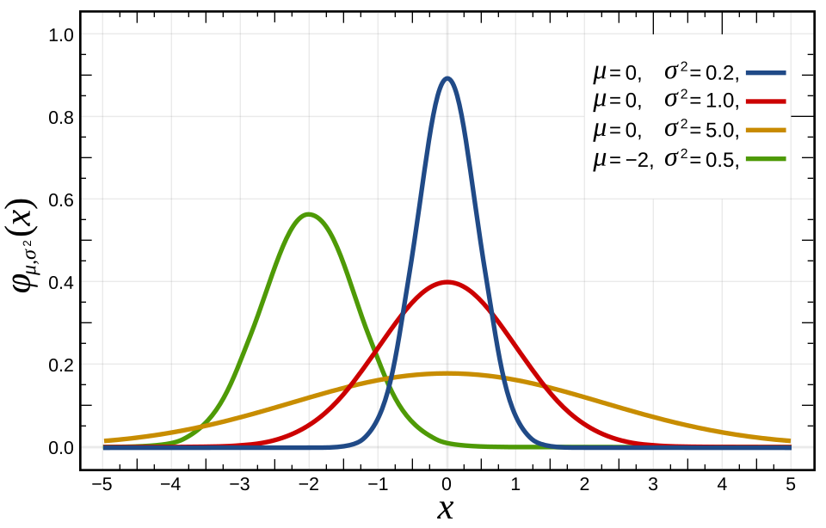
Why Bayesian?
Bayesian regression provides a framework for combining:
Flexibility in defining relationships to cost
  Replicate OLS results (with full statistical uncertainty)
  Test different uncertainty assumptions and model definitions
Historical Data
Engineering Judgement
Statistical Uncertainty

Slide 7
Study Design

Slide 8


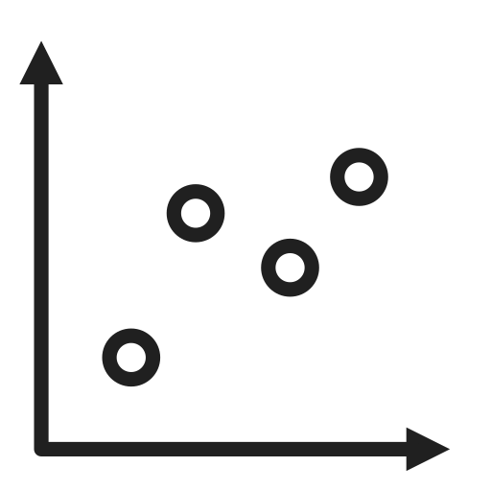

Study Objectives
Evaluate Bayesian regression for improving PCEC CERs while maintaining existing workflows.
Compare two independent Bayesian routines to the traditional OLS approach.
CER Areas of Comparison
Prediction Accuracy
Coefficient Stability
Robustness to Small Datasets
Resistance to Overfitting

Slide 9



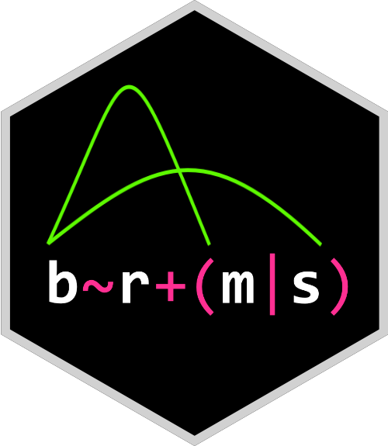

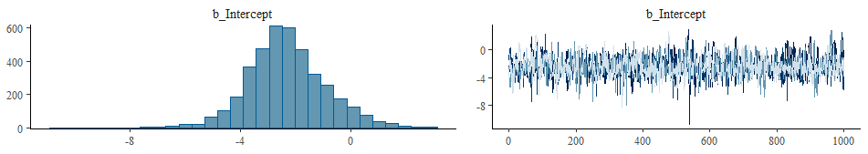
Bayesian Approach 1 - Nathan
# TFU_Cost_FY15M Weight_lbs
1 … …
2 … …
… … …
R:
brm(TFU_Cost_FY15M ~ Weight_lbs, data=logData,
family = skew_normal(),
prior = half_normal,
backend="cmdstanr")
STAN:
data{...}
parameters{...}
model{...}

Slide 10

Bayesian Approach 2 - Shawn
Bayesian MAP regression routine was developed using Python 3 and established scientific libraries (NumPy, pandas, scikit-learn)
Step 1: Data Preparation
  Check data for missing values, encode data, PCA /correlation to inform variable selection and log transform.
Step 2: Bayesian Regression
  Fit candidate predictor combinations using weakly informative Normal priors
  Apply regularization to limit weak or unstable predictors
    Allows the strongest relationships to drive the model
Step 3: Validate Performance & Select CER
  Use LOOCV to evaluate out of sample predictive performance
  Compare CER metrics and select best model that balances predictive performance, stability and complexity

Slide 11
Case Studies

Slide 12
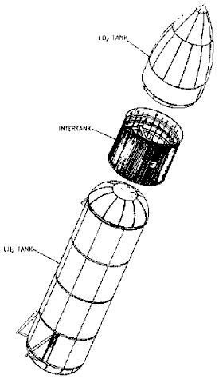
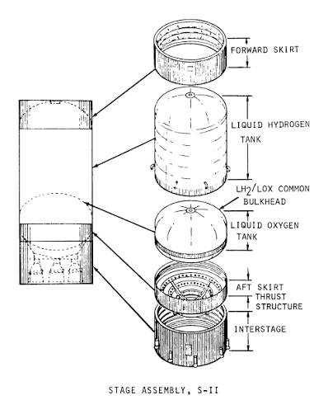
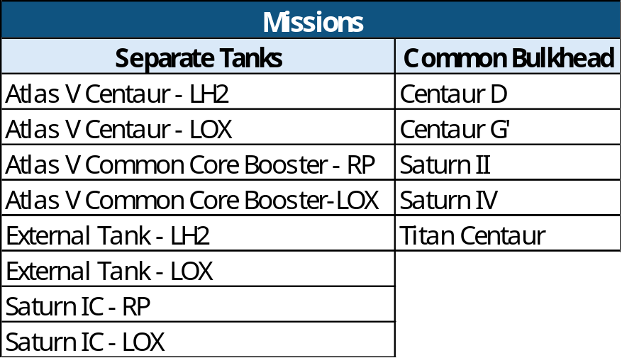
Case Study 1:
PCEC CASTS Tanks DD/TFU CERs
Independent Variables:
Weight (lbs) or Volume (ft³)
Propellant
Tank Material
Common Bulkhead?
Year of First Flight
Space Shuttle External Tank
Separate Tanks
Saturn II
Common Bulkhead

Slide 13
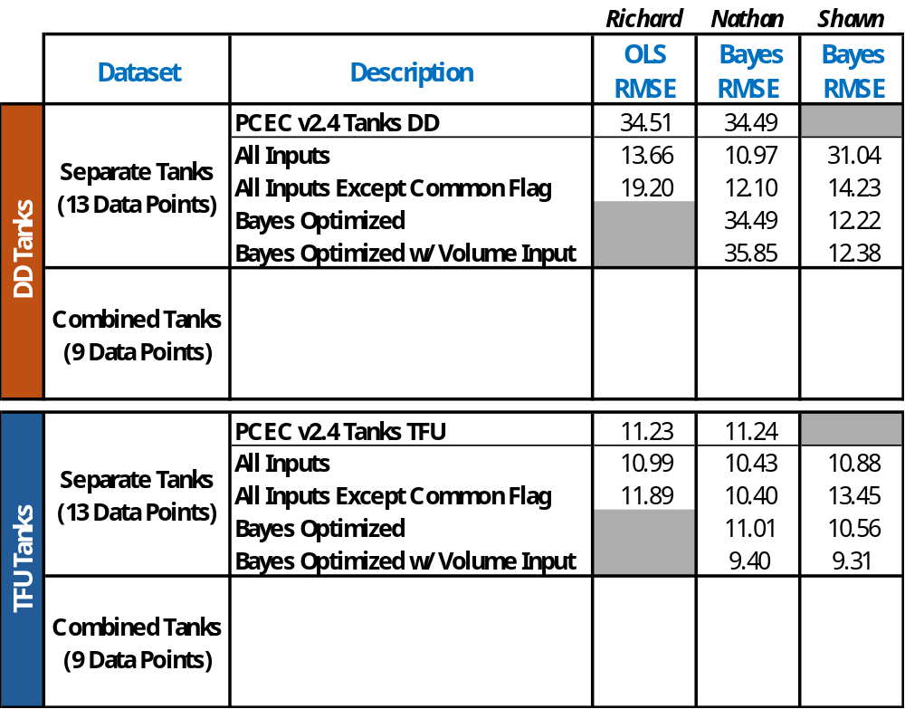
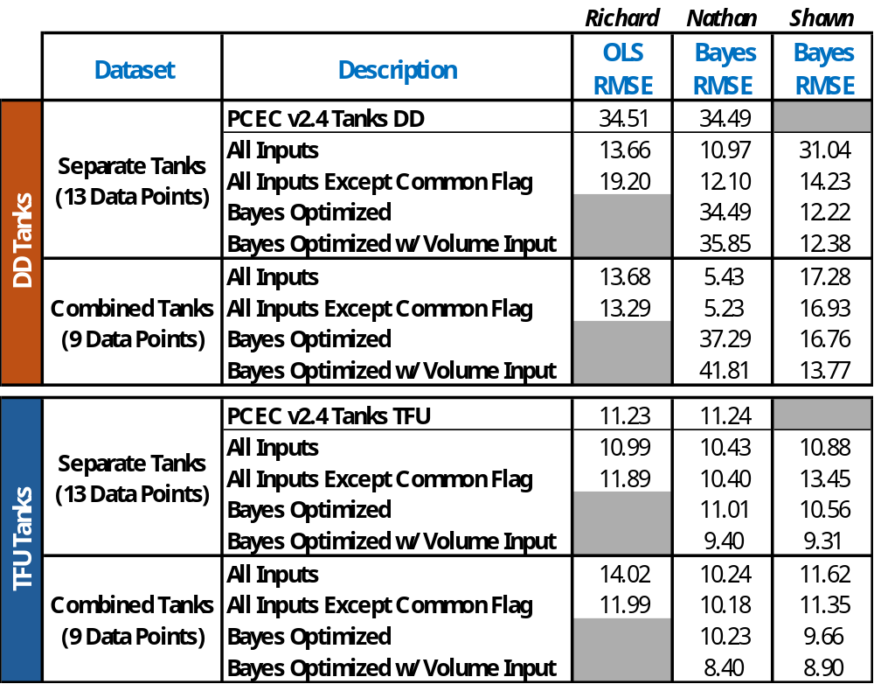
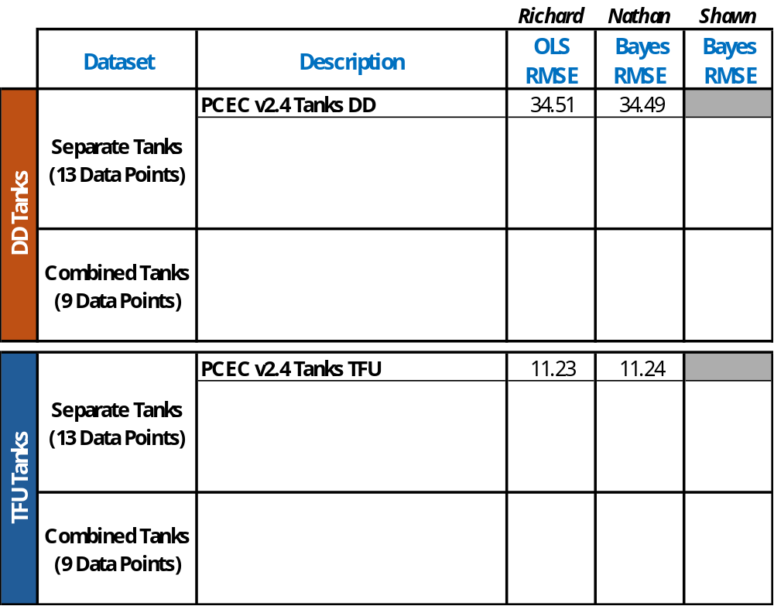
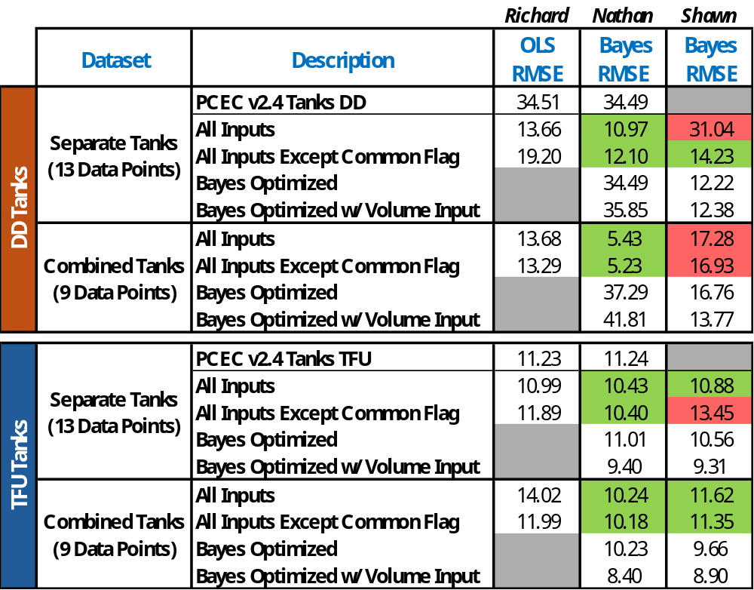
Case Study 1 Results
OLS "Replication"
  Bayesian methods were able to closely match OLS results
  Includes full probabilistic uncertainty
In & Out-of-Sample Error
  Shrinkage improves model stability
  Overfitting and multicollinearity are still a risk
Bayes performs equal or better in most cases.
  Still requires engineering judgement

Slide 14
Case Study 2: High Level Spacecraft Model
The main objective is to develop a high-level spacecraft CER to support estimating situations where subsystem-level data are unavailable
  Helpful in support of early formulation efforts, concept studies, and assessments of FFP contracts (where lower-level inputs may be unknown)
  CER estimates WBS 6.0 (Spacecraft) + WBS 10.0 (System I&T)
  Overall results covered in earlier PCEC presentation
Data set driving the analysis consists of 73 robotic missions across the entire portfolio from cubes (e.g. Prefire) to flagships (e.g. Europa Clipper)
  Added 4 RSDO mission s/c and 6 additional missions (that didn’t have supporting s/c subsystem data for PCEC integration)

Slide 15
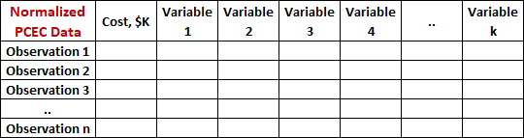

Case Study 2: High Level Spacecraft Model
Same data set, two separate approaches
Both methods independently identified the same underlying signal in two predictors
  The common predictors have similar coefficients in the same direction
OLS
Bayesian
Payload Power
Power Type
Flight System Parts Rating
Mission Life
Payload Mass
Flight System Heritage Rating
Mission Target = Mars?
Flight System Type
Earth Orbit = LEO?
NASA Program Type
Project Lead Org. = NASA?

Slide 16
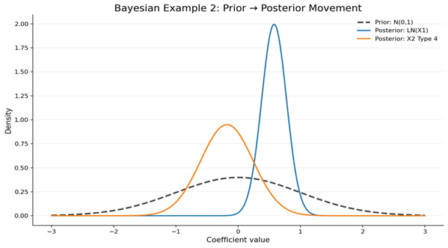
Case Study 2: High Level Spacecraft Model
OLS and Bayesian CER coefficients are derived from the data
  In OLS, CER coefficients are estimated directly from the data so weak or noisy relationships can have a large influence on the results
  In Bayesian, the coefficients are not just driven by the data but also with prior knowledge and regularization which moderates weak or unstable relationships
In this case study, weak informative priors were chosen
  This neutral starting point centered at zero does not impose strong beliefs about the size or direction of relationships.
  When data provides strong evidence,
  coefficients move away from the prior
  When data is weak or noisy, priors pull
  coefficients toward zero, reducing the
  influence of these relationships
Posterior: Mass
Posterior: Stainless
Prior: Normal

Slide 17
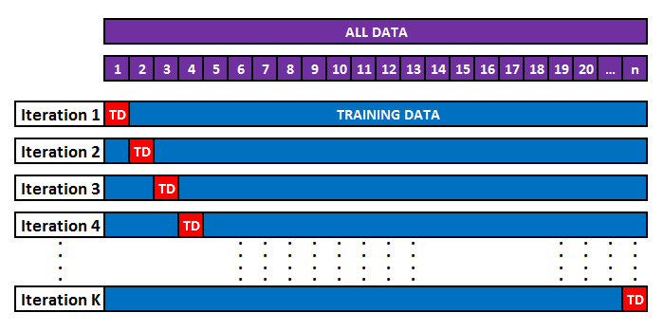
Case Study 2: High Level Spacecraft Model
Leave One Out Cross Validation (LOOCV) helps us assess and compare the regression approaches, using the coefficient behavior of the two common predictors (P/L Mass, F/S Heritage)
LOOCV is a subset of K-Fold cross validation with K = n (number of observations in the data set)
  To perform the validation, the total data set is divided into n subsets
  (1 observation each)
  In each of the k iterations, a single observation
  is retained as test data while the remaining
  Data is used to train the model. This process is
  repeated K = n times and the results are
  compared to the baseline CER

Slide 18

Case Study 2: High Level Spacecraft Model
The Bayesian approach exhibits less variability in the coefficients of the common predictors, compared to OLS
The Bayesian coefficients with the help of regularization are less sensitive to which observations were included in the sample, resulting in a more stable/robust model when compared to OLS

Slide 19
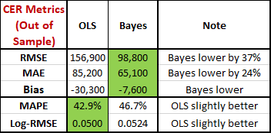
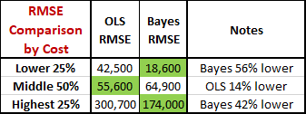
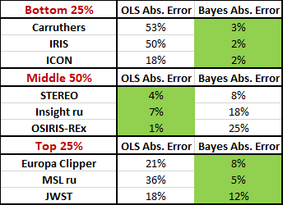
Case Study 2: High Level Spacecraft Model
Which model has better prediction accuracy?
  Overall, the Bayesian model wins this category with lower error and bias
  However, when the data set is split, OLS has a lower error in the middle of the range, but Bayesian does significantly better in the lower and upper extremes
Bayes does a great job capturing the extremes of the SMD portfolio where OLS has traditionally struggled on prediction accuracy

Slide 20
Implementation of Bayesian to the PCEC Framework
Incorporating Bayesian methods into the PCEC CER development process requires only one significant change:
  Use Bayesian regression routines in place of the existing OLS regression routines to drive variable selection and CER formulation
  All other steps in the CER development workflow remain unchanged
Given the flexibility of the PCEC framework, these new Bayesian CERs can coexist with existing and newly developed OLS CERs
  The OLS and Bayesian CERs can be used interchangeably when performing an estimate, giving analysts an alternate approach in their estimating toolbox
  Given that Bayes CERs produce a distribution of costs, analysts can more easily provide cost ranges and specify confidence levels as appropriate

Slide 21
Case Studies: Lessons Learned
Several practical lessons emerged from our exploration of Bayesian regression:
  Bayesian regression can be implemented using a variety of approaches
    Use of weakly informed priors can provide CERs that outperform their OLS counterparts in many aspects
    Would informing priors increase model performance without sacrificing efficiency?
  Highly correlated variables still require careful consideration; data preparation is key
  Engineering judgment remains essential
  Bayesian regression CERs integrate naturally into existing CER workflows and the PCEC framework
  Bayesian regression complements rather than replaces traditional CER development practices

Slide 22
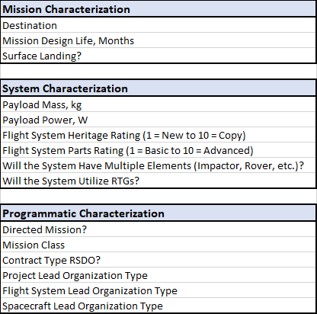
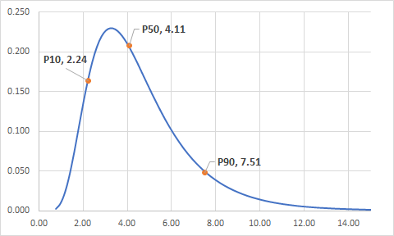
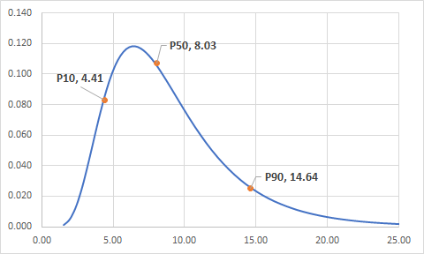
Bonus App: Bayes PCEC Driver
Structural Mass, kg
x33
Structure Design Duration, Months
15 user inputs were used to derive 33 unique estimating relationships (schedule, mass, etc.) using Bayesian regression techniques

Slide 23
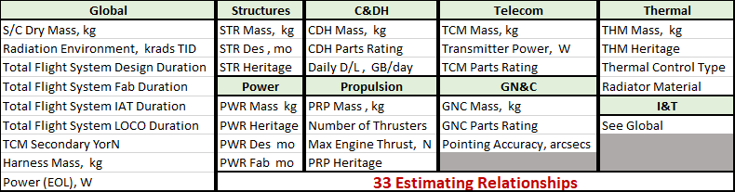
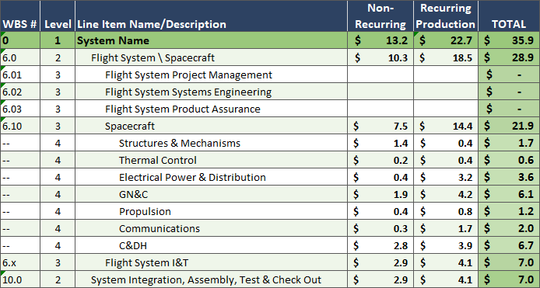
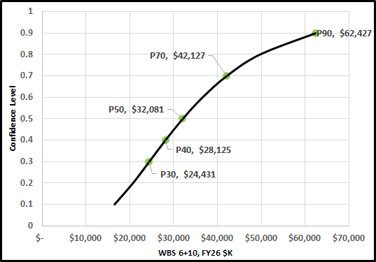
Bonus App: Bayes PCEC Driver
x33
The 33 estimating relationships are then used to drive a subsystem level probabilistic PCEC v2.4 estimate for Spacecraft (WBS 6.0) + Integration & Test (WBS 10.0)
  Includes Non-Recurring/Recurring split

Slide 24
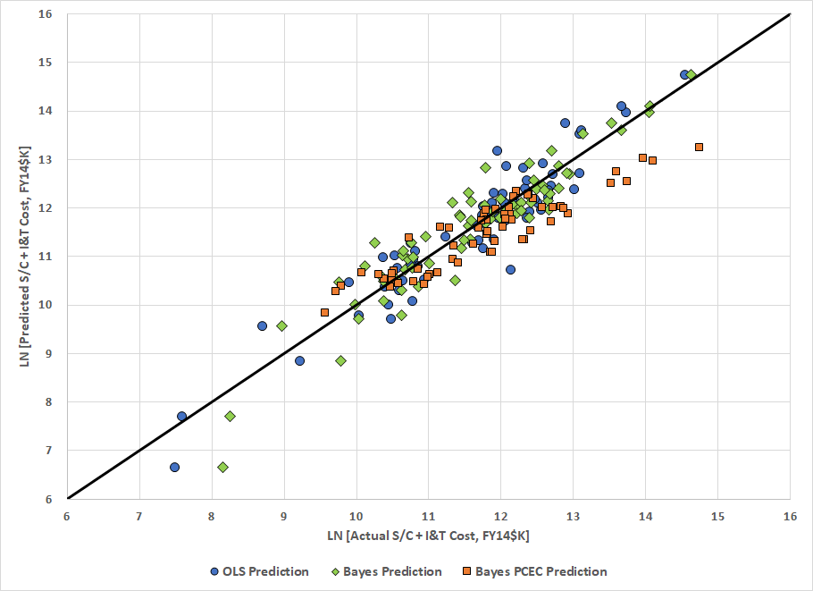
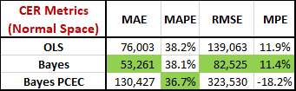
Bonus App: Bayes PCEC Driver
The Bayes PCEC model does not perform as well as the other models
  This was expected as it includes compounding errors from the 33 estimating relationships on top of the PCEC v2.4 CER errors. Also, dataset has 10 fewer observations due to lower-level data not being available
  However, the model is still useful as it allows a user to estimate early concepts with only 15 high level inputs and still obtain subsystem level results
  Gives users the ability to vary subsystem estimates by assigning confidence levels to each of the lower-level estimates being generated

Slide 25
Conclusions & Future Work

Slide 26
Conclusions & Future Work
This investigation demonstrated that Bayesian regression can serve as a practical enhancement to traditional CER development
Key findings:
  Improved predictive performance overall in representative case studies
  Greater coefficient stability
  Reduced sensitivity to small datasets and influential observations
  Compatible with existing CER development practices and the PCEC framework
Future Work:
  Develop a complete set of Bayesian CERs for PCEC (CASTS & Robotic)
  Refine PCEC Driver model and distribute to community
  Explore impact of informed priors on case studies – Is it worth the effort?

Slide 27
Questions?

Slide 28
Backup

Slide 29
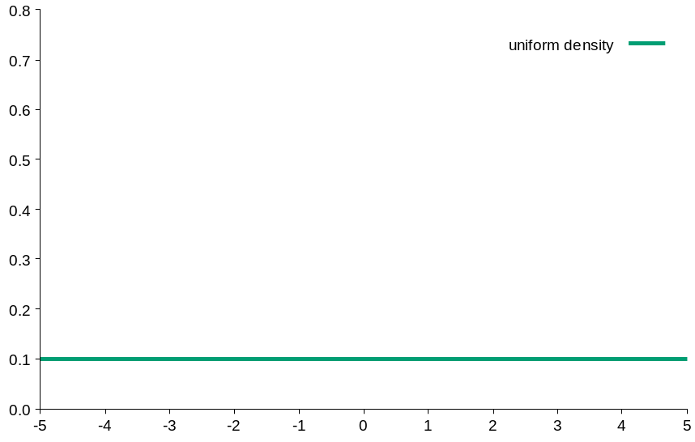
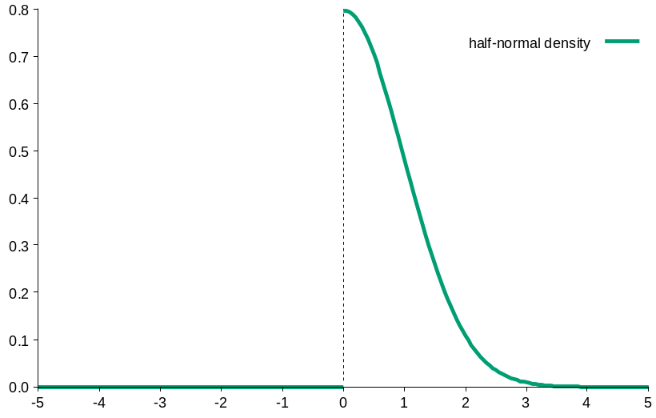
$$Cost= α × {weight}^{β}$$
OLS
Bayesian
No priors; approx. equal "flat priors"
  Uniform distribution from negative infinity to positive infinity
  Uninformative - all knowledge comes from the data
Freedom to define priors
  Can incorporate prior knowledge (e.g. expect weight exponent to be positive)
  Can also assume flat priors
β
β
* Uniform distribution reflects shape, not scale

