Slide 1
Early Warning Metrics for Programmatic Evaluation
The Aerospace Corporation
2026 NASA Cost and Schedule Symposium (NCSS)
August 26, 2026

Slide 2
Early Warning Metrics
Overview
Early Warning Metrics (EWM) provides a clear, visual snapshot of a project’s programmatic health
  Analyzes milestone completion and cost burn rate to gain insight into:
    Performance to date
    Potential future performance
    Ability to complete remaining work
  Minimal monthly data and effort required compared to traditional Earned Value Management (EVM) tracking
    Does not offer LCC or LRD/Delivery estimates, or provide insights into specific problem areas (e.g., elements, schedule issues)
Envisioned as a top-level, portfolio-wide, monthly overview provided for NASA Science Mission Directorate (SMD)
Follows from work in 2015-2016 between Aerospace and NASA Goddard Space Flight Center (GSFC) Flight Projects Directorate (FPD) on Early Warning Metrics that provided GSFC leadership with an independent indication of programmatic health of GSFC flight projects​
  Early Warning Metrics have been utilized for numerous NASA projects and more recently for Intelligence Community and Defense programs

Slide 3
Early Warning Metrics
Metric Definitions
Milestone data is obtained from project-reported milestone counts from SMD Flight Program Reviews (FPRs)
Milestones-to-Go Metric depicts the number of actual vs. planned milestones remaining until project completion
  Is the project completing all milestones in accordance with the plan?
  Is the project on a path to complete all milestones in time to finish?
Milestone Backlog Metric depicts the actual milestone backlog each month
  Is the milestone backlog growing or shrinking?
  What is the backlog trajectory? Is the project on a path to recover?
Schedule Runway Metric depicts the number of months needed to complete all remaining milestones, given the recent milestone completion rate, and compares to actual amount of time remaining
  Does the project have time to complete all remaining milestones?
  Does the project need to increase its milestone completion rate?
Cost Runway Metric depicts the calculated cost of remaining work based on average cost of milestones and the number of milestones remaining, relative to the Project budget, Management Agreement (MA), and Agency Baseline Commitment (ABC)
  Is the project spending money at an appropriate rate to finish at or under budget?
  Does the project need to modulate its spending rate?

Slide 4
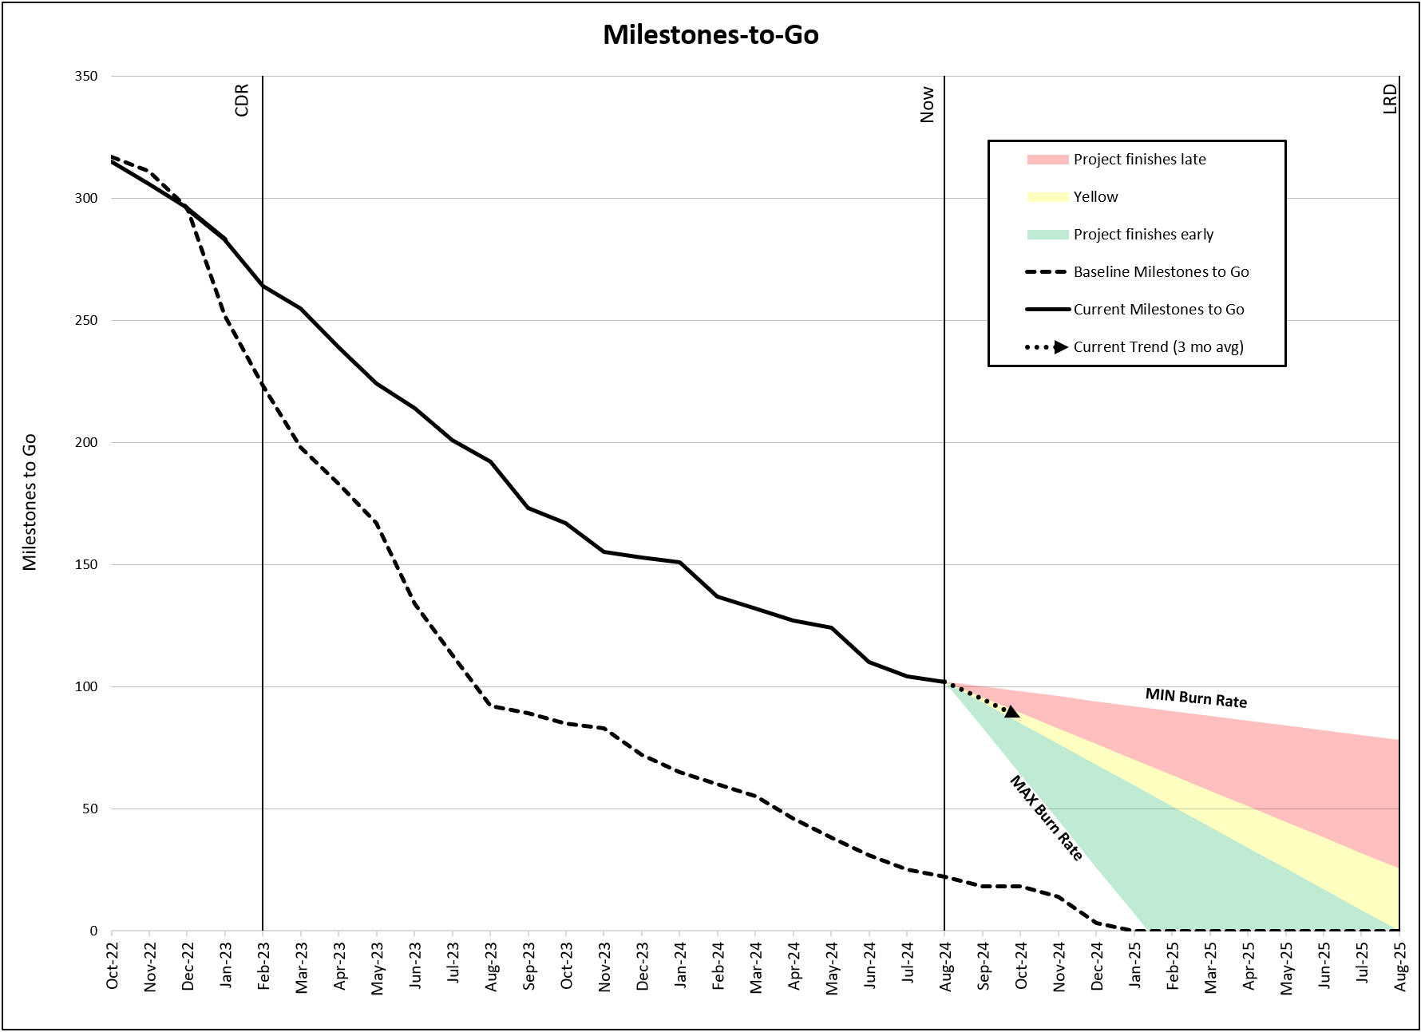
Milestones-to-Go
Details
Milestones-to-Go: Tracks the completion of project milestones relative to the planned milestone completion schedule
  Green Region: trending towards early finish
    Green region lower bound is project historical maximum burn rate
    Green region upper bound is the average required milestones over remaining months to meet LRD
  Yellow Region: trending towards marginally late finish
    Yellow region upper bound is a linear projection to 25% of the current remaining milestones at LRD
  Red Region: trending towards late finish
    Red region upper bound is project historical minimum burn rate
Example graph shows milestone completion rate remains behind plan and is trending behind milestone burn rate needed to meet August 2025 LRD

Slide 5
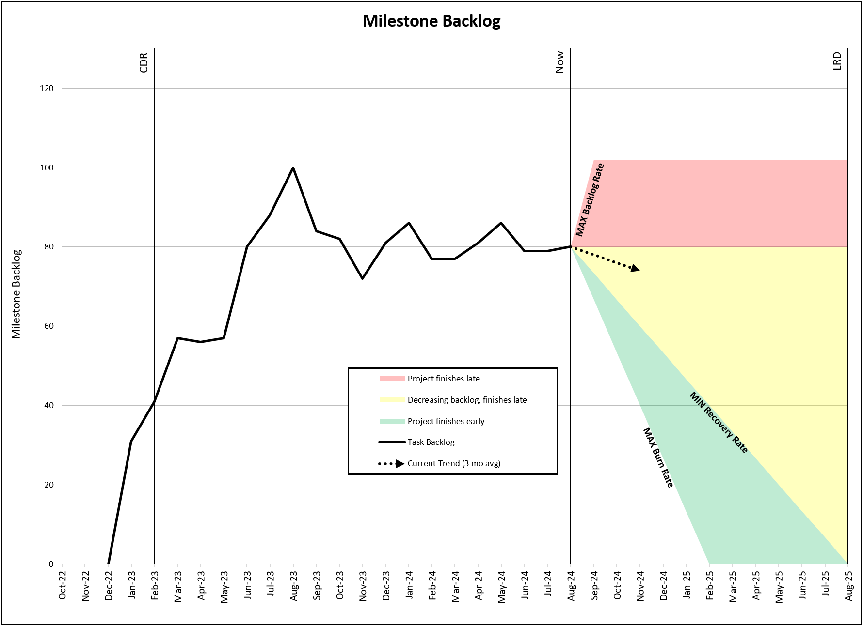
Milestone Backlog
Details
Milestone Backlog: Shows the buildup of uncompleted milestones and how the forward trend compares to the recovery rate needed to reach LRD/Delivery on schedule
  Green Region: trending towards decreasing backlog and early finish
    Green region lower bound is project historical maximum burn rate of milestone completion
    Green region upper bound is average burndown of required milestone backlog over remaining months to meet LRD
  Yellow Region: trending towards decreasing backlog, but not fast enough to finish on time
    Yellow region upper bound is no change in current milestone backlog
  Red Region: trending towards increasing backlog
    Red region upper bound is project historical maximum backlog rate, capped at the project’s current number of milestones-to-go
Example graph shows milestone backlog at 80 milestones this month, with a 3-month trend of decreasing backlog but not enough to finish on time
Notes:
Baseline milestones to go – current milestones to go

Slide 6
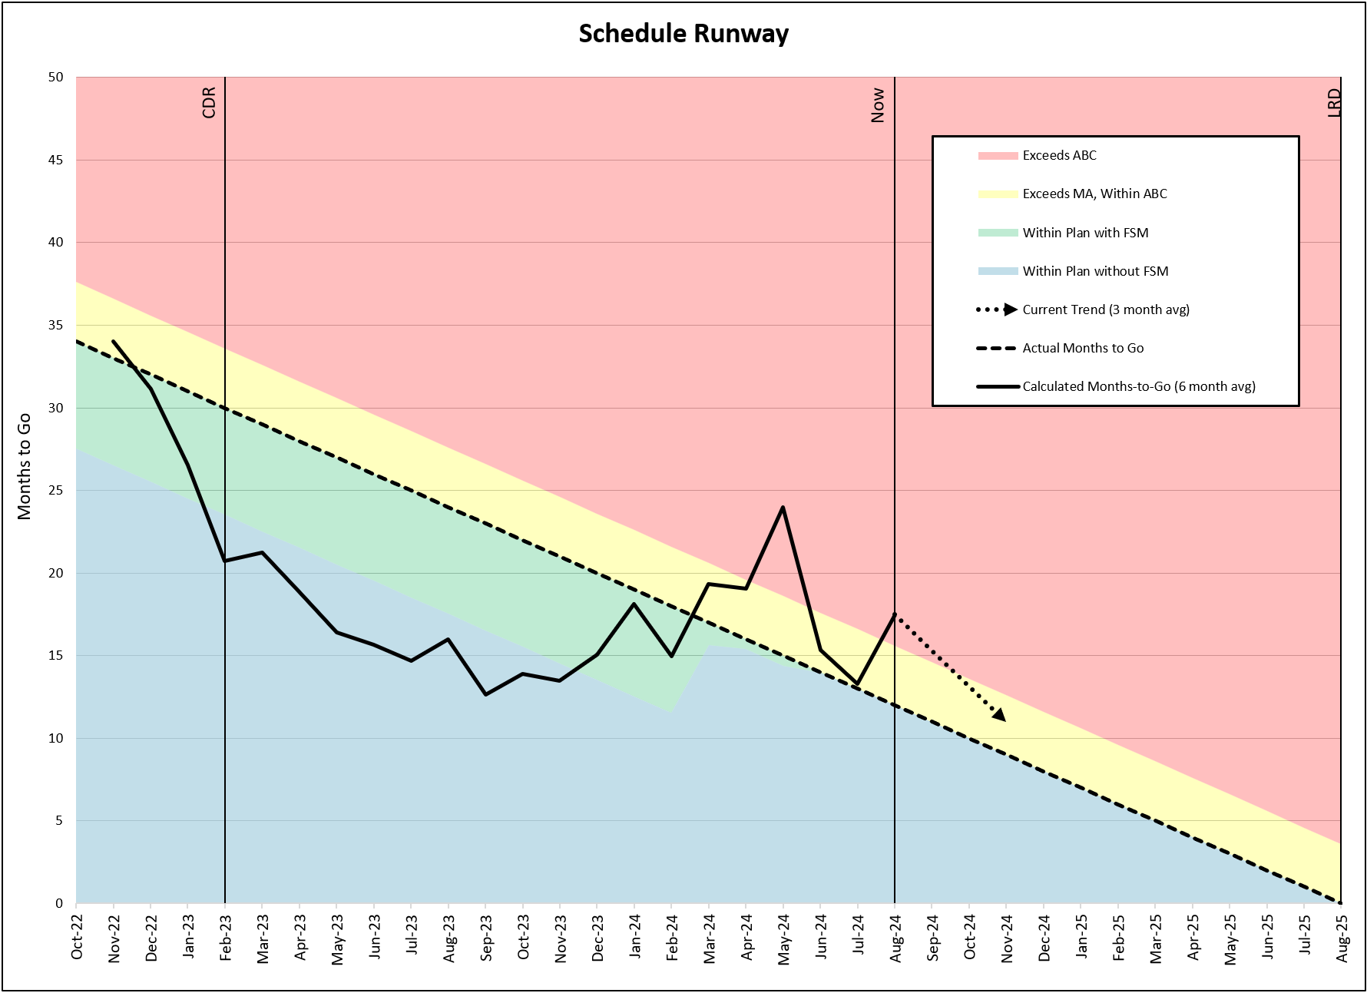
Schedule Runway
Details
Schedule Runway: Depicts the number of months needed to complete all remaining milestones, given the recent milestone completion rate, and compares to actual amount of time remaining
  Blue Region: indicates project is on path to take fewer months to complete than planned months to complete
  Green Region: indicates project is on path to take fewer months to complete than planned months to complete, with the use of Funded Schedule Margin
  Yellow Region: indicates project is on path to complete after the Management Agreement but before the Agency Baseline Commitment
  Red Region: indicates project is on path to take more months to complete and will exceed the Agency Baseline Commitment
Example graph shows average milestone burn rate is increasing and though the project is currently at risk of having insufficient time to complete all milestones, project is trending to recover
  Estimating 17 months to complete all remaining milestones at current average burn rate, with 12 months-to-go, putting the project at risk of exceeding the ABC
  Project has used all FSM and is currently at risk of exceeding the MA

Slide 7
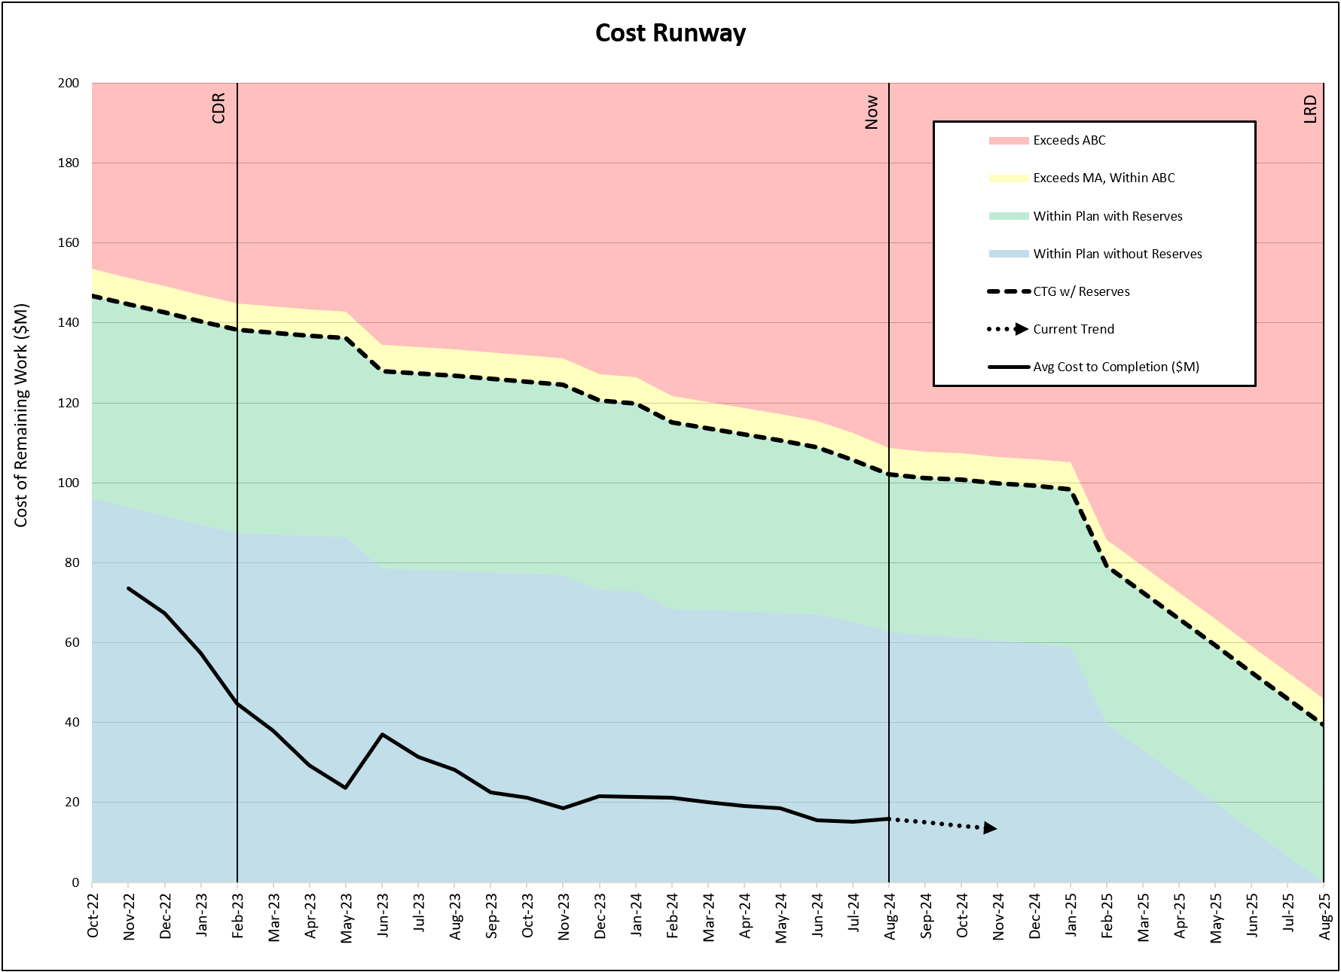
Cost Runway
Details
Cost Runway: Depicts the calculated cost of remaining work based on average cost of milestones and the number of milestones remaining, relative to the project budget (MA) and ABC
  Blue Region: indicates project is spending at a rate consistent with being able to finish within current cost of remaining work
  Green Region: indicates project is on a path to remain within project UFE
  Yellow Region: indicates project is spending too rapidly and the cost of remaining work is expected to exceed the Management Agreement but remain within the Agency Baseline Commitment
  Red Region: indicates project is spending too rapidly and the cost of remaining work is expected to exceed the Agency Baseline Commitment
Example graph shows the spend rate is stable and trending below the planned cost of remaining work. Project spend rate indicates project is trending to finish within current cost plan.

Slide 8
Shaded Region Thresholds
 | Blue | Green | Yellow | Red
Milestones-to-Go | N/A | Max Burn Rate < Remaining Milestones < linear projection The project is trending toward early finish | Linear projection < Remaining Milestones < 25% linear projection The project is trending toward marginally late finish | 25% linear projection < Remaining Milestones < Min Burn Rate The project is trending toward late finish
Milestone Backlog | N/A | Max Burn Rate < Backlog < linear projection The project is trending toward decreasing backlog and early finish | Linear projection < Backlog < Current Backlog The project is trending toward decreasing backlog, but not fast enough to finish on time | Current Backlog < Backlog < Max Backlog Rate The project is trending toward increasing backlog
Schedule Runway | Calculated Months-to-Go < Project plan without FSM Indicates project is on path to take fewer months to complete than planned months to complete | Project’s plan without FSM < Calculated Months-to-Go < Project plan with FSM Indicates project is on path to take fewer months to complete than planned months to complete, with the use of Funded Schedule Margin | Project’s plan with FSM < Calculated Months-to-Go < Agency Baseline Commitment Indicates project is on path to complete after the Management Agreement but before the Agency Baseline Commitment | Calculated Months-to-Go > Agency Baseline Commitment Indicates project is on path to take more months to complete and will exceed the Agency Baseline Commitment
Cost Runway | Cost of Remaining Work < Project plan without Project UFE indicates project is spending at a rate consistent with being able to finish within current cost of remaining work | Project’s budget without Project UFE < Cost of Remaining Work < Project plan with Project UFE Indicates project is on a path to remain within project UFE | Project’s plan with Project UFE < Cost of Remaining Work < Agency Baseline Commitment (Project plan + Project UFE + HQ UFE) Indicates project is spending too rapidly and the cost of remaining work is expected to exceed the Management Agreement but remain within the Agency Baseline Commitment | Cost of Remaining Work > Agency Baseline Commitment (Project plan + Project UFE + HQ UFE) Indicates project is spending too rapidly and the cost of remaining work is expected to exceed the Agency Baseline Commitment

Slide 9
Data Requirements

Slide 10
Data Requirements
Schedule
Required for Initial Set-up
  Baseline milestone cumulative monthly plan out to LRD / Delivery
    Requires baseline plan from the 6 previous months, at minimum
  Monthly milestone cumulative actuals through current month
    Requires at least 6 months of actuals, at minimum
  Cumulative forecast milestones at completion as of current month
  Funded Schedule Margin (FSM) remaining each month through current month
  Project current and historic LRD / Delivery, MA, ABC and/or Agency Total
Required for Monthly Updates
  Milestone cumulative actuals for current month
  Cumulative forecast milestone at completion for current month
  Remaining FSM for current month
  Project LRD / Delivery, MA, and ABC for current month
Baseline milestone cumulative monthly plan can be adjusted as needed

Slide 11
Data Requirements
Cost
Required for Initial Set-up
  Monthly development cost-to-go* without unencumbered UFE from development start through completion
    Requires cost-to-go from 6 previous months, at minimum
  Monthly project UFE from development start through current month
    Requires project UFE from 6 previous months, at minimum
  Monthly actual cost** through current month
    Requires monthly actual cost from 6 previous months, at minimum
  Timeline of available HQ UFE from development start through current month
    Requires HQ UFE from 6 previous months, at minimum
Required for Monthly Updates
  Monthly cost-to-go* without unencumbered UFE through completion of development for current month
  Remaining project UFE for current month
  Actual cost** for current month
  Remaining HQ UFE for current month
* Development baseline estimate minus cost incurred since development start excluding GFE (e.g., LV, MMRTG)
** Excluding GFE (e.g., LV, MMRTG)

Slide 12
EWM and Scope Changes

Slide 13
EWM and Scope Changes Overview
Programmatic Scope Changes
EWM has the capability of tracking history to show programmatic scope changes
Potential scope changes include
  Addition / removal of milestones
  Change in Project schedule LRD, MA, and Agency Total
  Change in future review dates
  Utilization of Project FSM and UFE
  Project cost growth due to changes in scope
  Release of HQ cost UFE
The following examples will show how programmatic scope changes are visually displayed
  Comparing a mission before and after scope changes

Slide 14
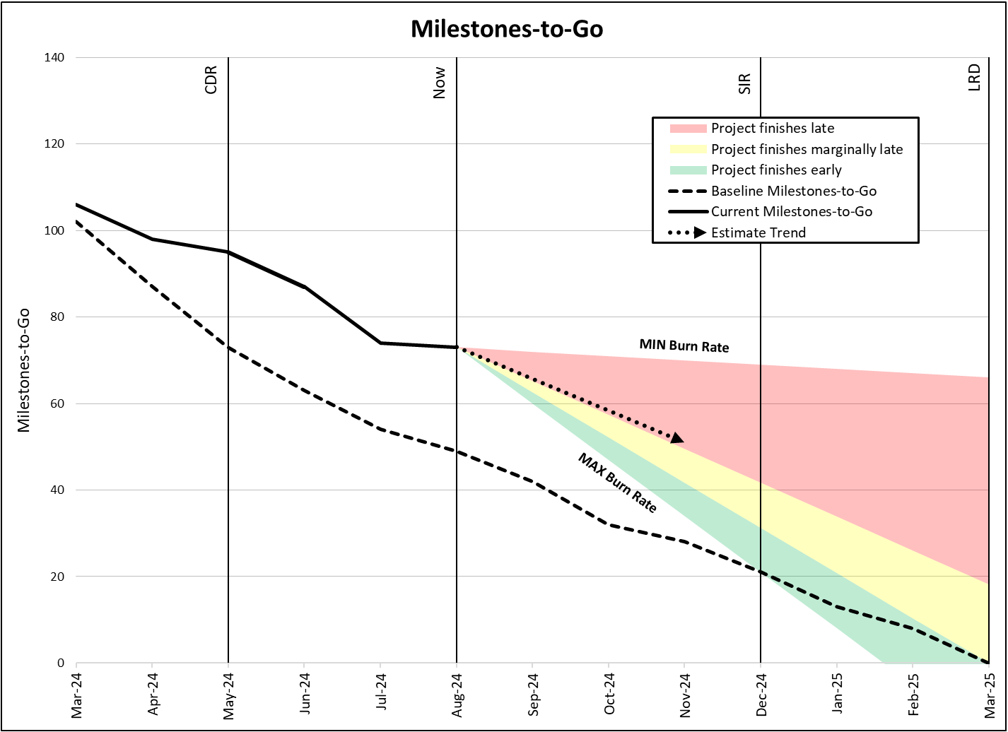
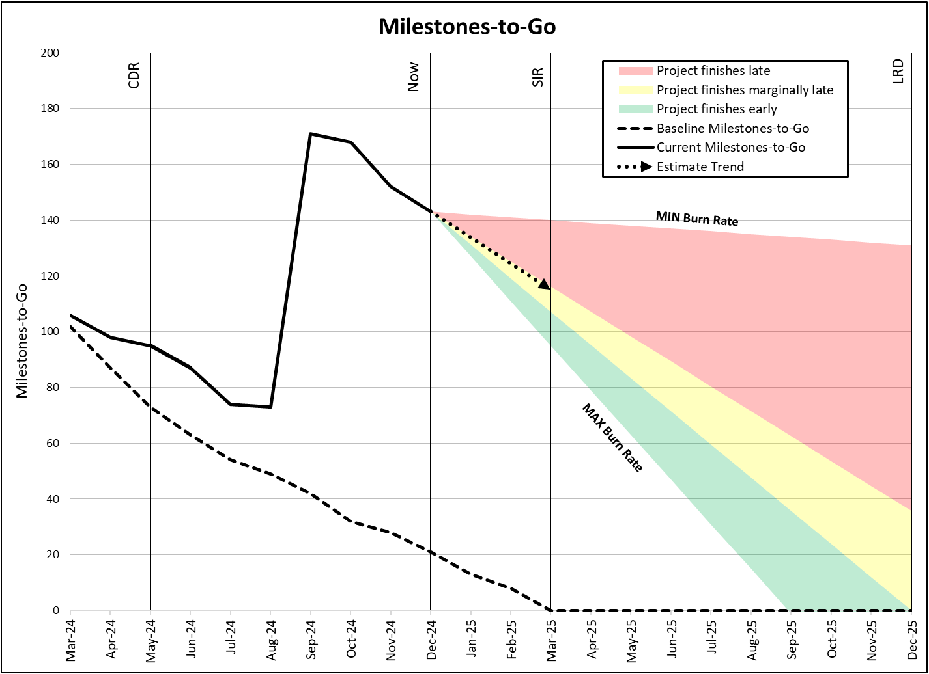
Project Programmatic Changes
Milestones-to-Go
Project LRD moved from March 2025 to December 2025
100 tasks added to Project plan in September 2024
  Increased Milestones-to-Go
Project SIR moved from December 2024 to March 2025
Original Project Scenario
Scope Change Scenario
100 Milestones Added to Plan
LRD Changed from Baseline Plan

Slide 15
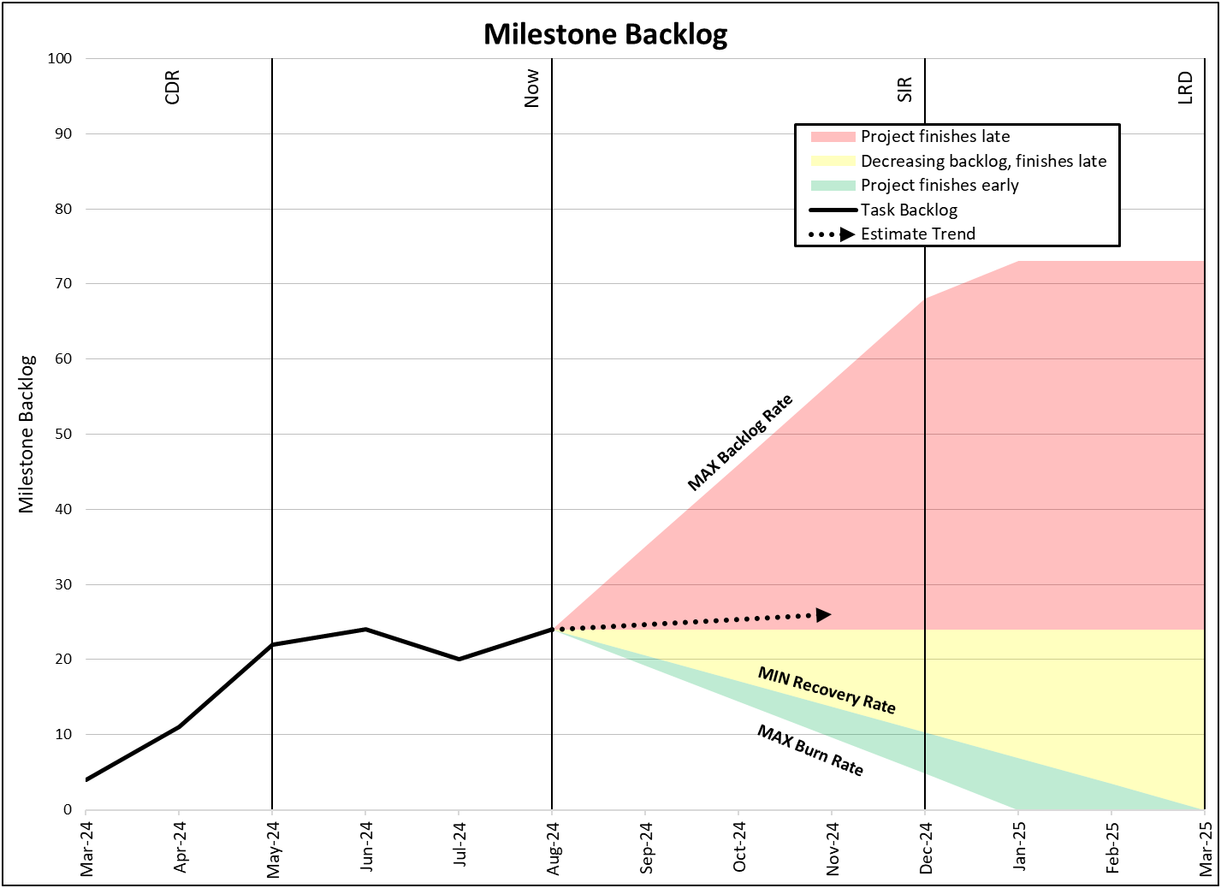
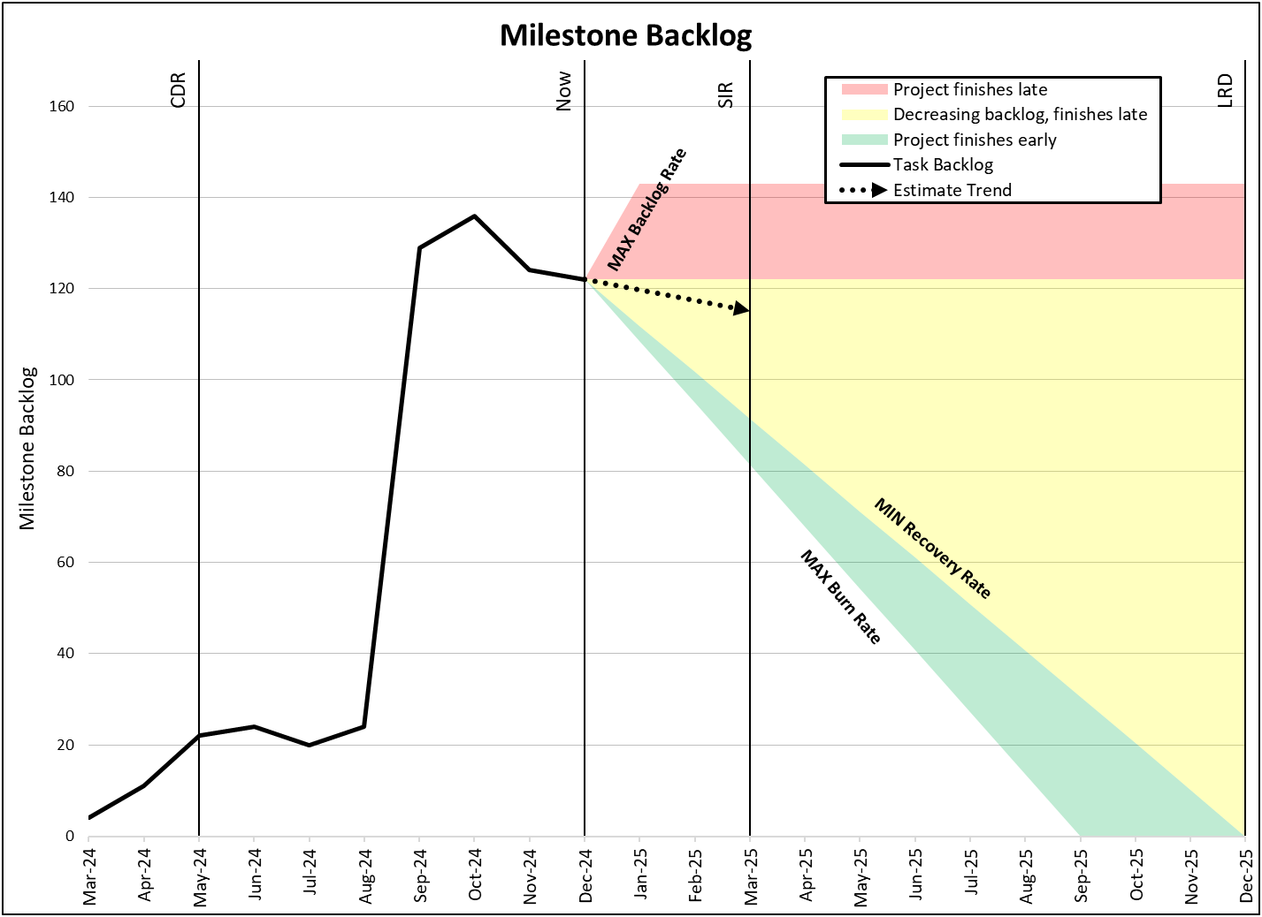
Project Programmatic Changes (cont.)
Milestone Backlog
Project LRD moved from March 2025 to December 2025
100 tasks added to Project plan in September 2024
  Increased Milestone Backlog
Project SIR moved from December 2024 to March 2025
Original Project Scenario
Scope Change Scenario
100 Milestones Added to Plan

Slide 16
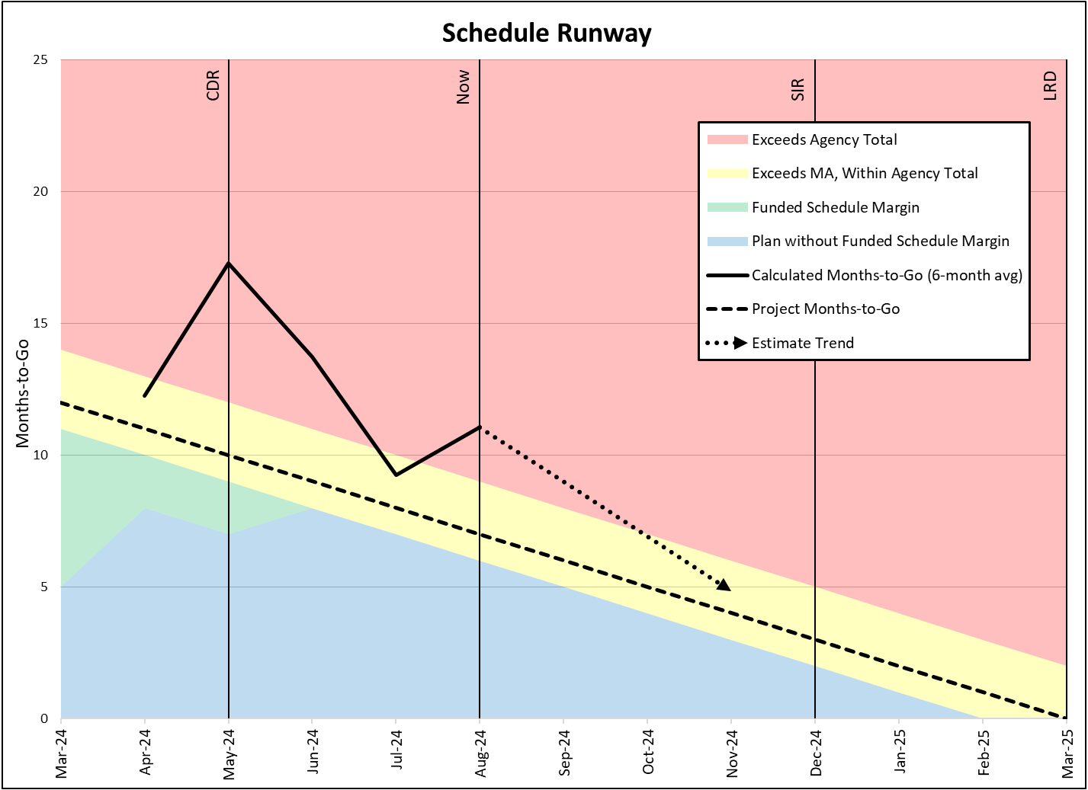
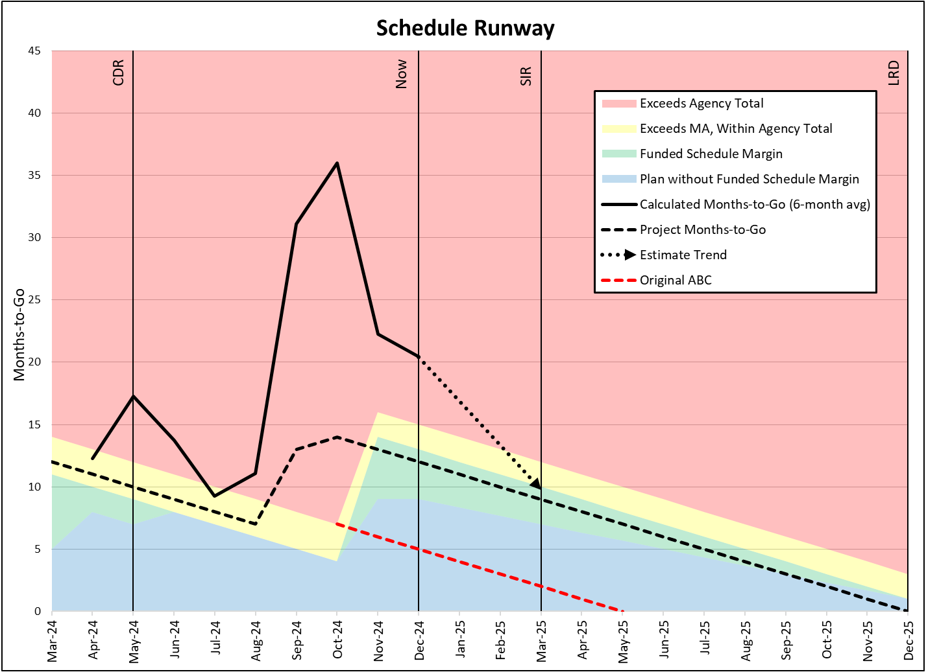
Project Programmatic Changes (cont.)
Schedule Runway
Project LRD moved from March 2025 to December 2025
100 tasks added to Project plan in September 2024
  Increased Months-to-Go estimate
Project SIR moved from December 2024 to March 2025
November 2024: Project sets a new MA and Agency Total
  FSM added to Project plan
  Original ABC now plotted
Original Project Scenario
Scope Change Scenario
100 Milestones Added
MA & Agency Total Change
FSM Added
LRD Slip
ABC

Slide 17
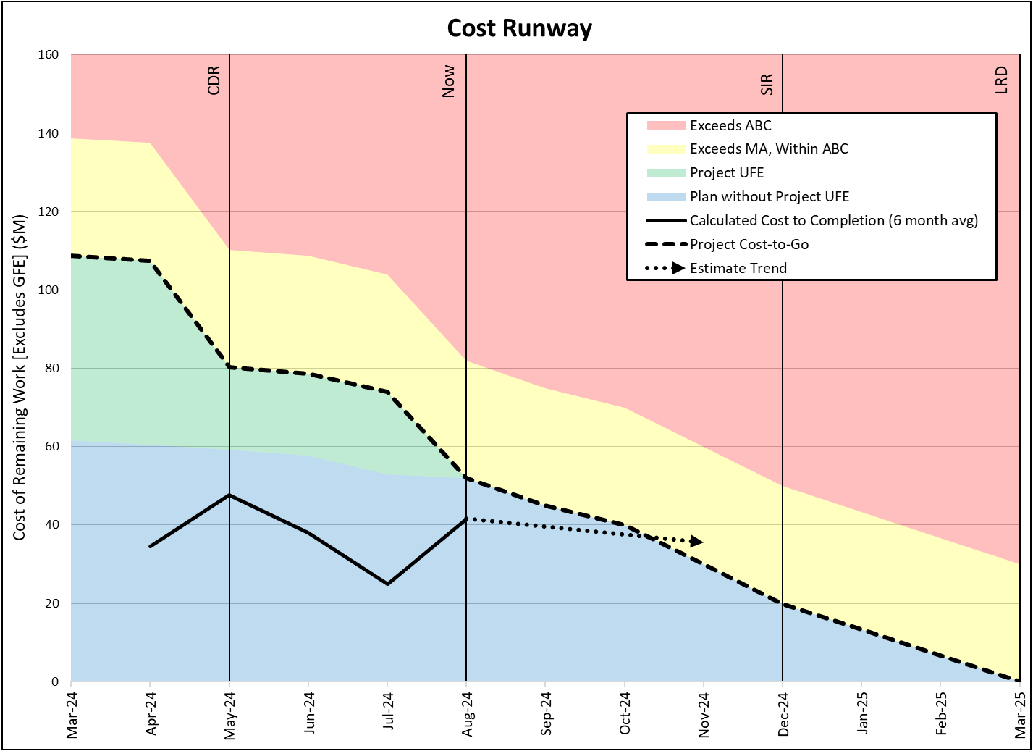
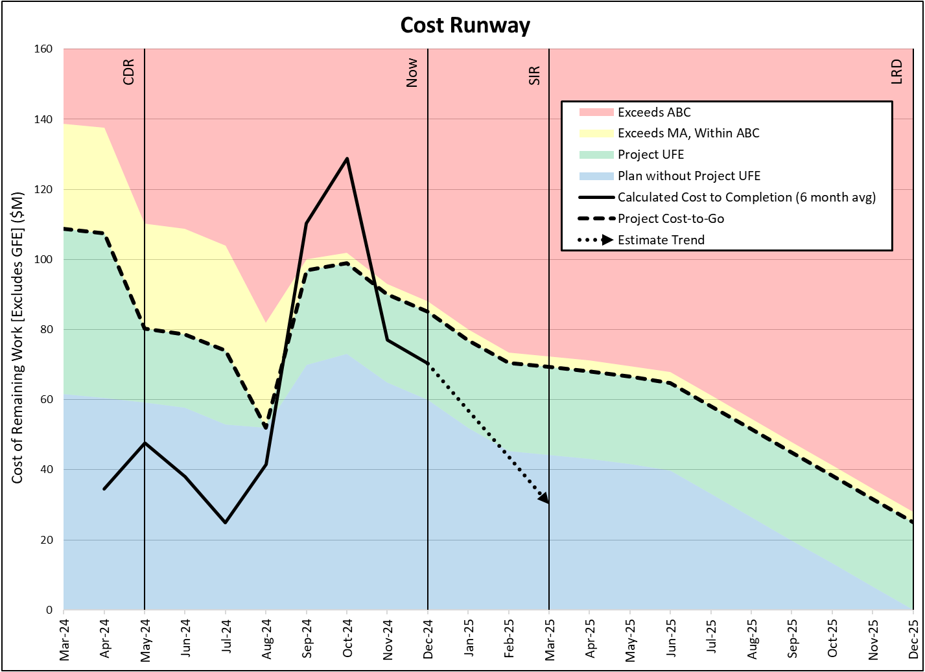
Project Programmatic Changes (cont.)
Cost Runway
Project LRD moved from March 2025 to December 2025
100 tasks added to Project plan in September 2024
  Increased Cost of Remaining Work estimate
Project SIR moved from December 2024 to March 2025
August 2024: Exhausted Project UFE
September and October 2024: Project increased cost plan
September 2024: HQ UFE released to Project
Original Project Scenario
Scope Change Scenario
HQ UFE released to Project
Project UFE exhausted
Project cost plan increased
100 Milestones Added

Slide 18
Summary
EWM enables programmatic insight through:
  Four complementary metrics provide program health visibility
    Milestones-to-Go, Milestone Backlog, Schedule Runway, Cost Runway
  Streamlined approach requires minimal monthly data vs. Earned Value Management (EVM)
  Built-in capability to track scope changes over time
  Clear visual presentation for rapid assessment
Rapid execution and comparatively low data requirements of EWM enable the potential development of a portfolio-wide product that captures the status of all SMD missions

Slide 19
Questions

