Slide 1
SRA Process Improvement Overview & Update
August 25, 2026
Developed by
Booz Allen Hamilton
Presenter Name
Organization

Slide 2
Agenda
Introduction
SRA Process Map
The Challenge
Experiment: SRA In Ten Days
Results & Observations: SRA In Ten Days
Future Efforts

Slide 3
Introduction
What is an SRA
  A Schedule Risk Analysis (SRA) generates one or more risk informed scenarios for a project. An SRA is the result of applying discrete risks and uncertainties to the base deterministic schedule
  Typically, the main inputs to an SRA are a project schedule and a risk register. Analysis scenarios are driven by expert opinion and “what if” questions
Benefits of an SRA
  Provide insight which may not be apparent when analyzing a deterministic schedule
  Help management plan ahead and develop a holistic view of their schedule and associated risks
  Tasks that may currently not be on the critical path can, after applying risks and uncertainties, move to the critical path. This insight allows management to get ahead of an issue before it impacts the schedule by addressing the risks associated with a given task

Slide 4
SRA Process Map
4
Program Schedule Data
Integrated Schedule
Clean & Validate Data
Schedule Health Checks
Draft Reports
Risk Data
Analysis
Schedule
Analysis
Review & Approvals
Final SRA Report
Preliminary Reports
“What If” Scenarios

Slide 5
The Challenge
An SRA is a resource and time intensive effort
  SRAs can be very time and manpower intensive efforts spanning multiple months to refine and perfect the model
  This can result in a lag between data collection and actionable results produced reducing the value of the SRA
  These constraints can limit the frequency of SRAs
Reducing time and cost allows for better use of resources for faster and
more frequent SRAs
  Better and more timely visibility into the project
  Greater flexibility and more nimble analysis
  Faster reaction times to new information such as a new risk
Time
Cost
Resources

Slide 6
Experiment: SRA In Ten Days
Determine how fast an SRA can be completed in an ideal world
Caveats and Assumptions:
  No issues with or slow downs due to data collection
  Reviews and approvals are not part of the core SRA (or the experiment)
The assumptions are, to a large degree, outside of our control

Slide 7
Results & Observations: SRA In Ten Days
Results:
  The experiment was completed in ten working days. But….
    This was an ideal situation
    No major issues encountered
    This was only the “core” of an SRA – the data analysis; not the data collection and review/approval processes
  In the “real world” a safety margin of at least several days should be built in
Observations:
  We assumed all data was available
    data collection normally requires significant time and effort
    Regular reporting (i.e. weekly, bi-weekly, monthly, etc.) improves the data collection process
  Review and socialization of the results is necessary but time consuming
    Several weeks are required for review and socialization for a “simple” SRA and this only increases with the complexity of the SRA and number of stakeholders

Slide 8
Future Efforts
Tools – The tools we have adopted and created have delivered great results. We plan to continue looking to automate where possible and feasible
Processes – We continue analyzing the SRA process (and reporting in general) to identify areas ripe for process improvement. We are also looking to, as much as possible, implement standardization (standardized forms and APIs) so people and tools can easily/efficiently “talk”
Communications – There will always be a human component to SRAs and reporting in general. Along with this is the need for good communications and to build trust with data providers/owners. One idea we have is to develop a communications playbook to document and standardize
these processes

Slide 9

Questions / Comments
  Questions on SRA Automation
  Up Next:
  Contact Information:
  Hemrich_Michael@bah.com, Michael.J.Hemrich@nasa.gov
Thresher

Slide 10
Thresher
Introduction
& Update
August 25, 2026
Developed by
Booz Allen Hamilton
Presenter Name
Organization

Slide 11
Agenda
What is Thresher?
How Does Thresher Help?
How Do You Use Thresher?
Thresher User Interface
Thresher

Slide 12
What is Thresher?
Thresher’s original purpose was to create small analysis schedules of the critical or
near-critical path from larger schedules
Thresher has been updated to allow for field-based filtering of a schedule to generate
an analysis schedule
This is aimed at analyzing effects of different parallel schedule options such as working with two vendors to produce an article but deciding in the future which one to use
Thresher is built using VBA and “lives” in MS Project

Slide 13
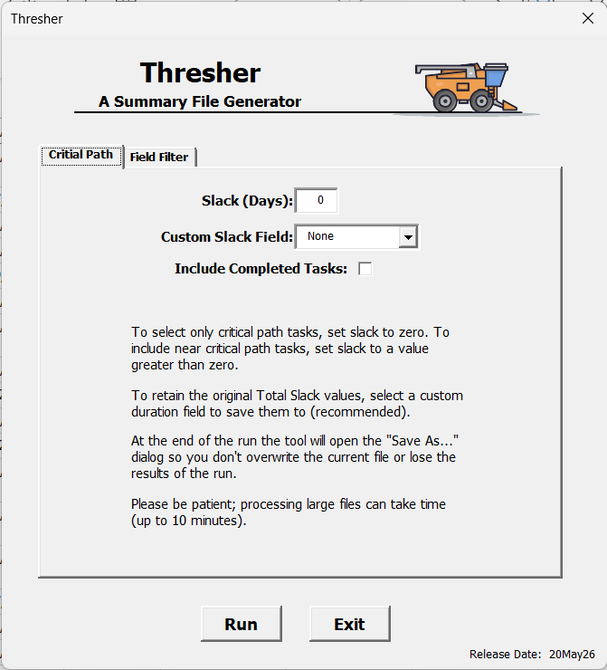
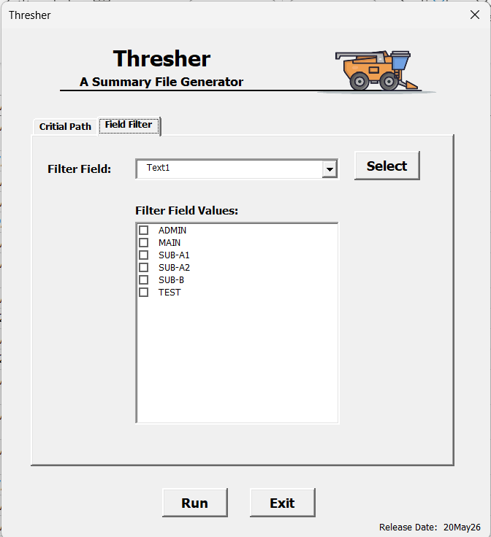
How Does Thresher Help?
Thresher has two primary uses:
Generating Critical and Near Critical Path Analysis Schedules
  Small analysis schedules are easier to analyze
  Seeing only the critical (or near critical) path helps
  to focus attention
Section/Path Filtered Analysis Schedules
  Easier schedule development; allows multiple possible paths to “co-exist” in one main schedule
  Allows for analysis of each possible path alone
  Ability to “knock out” specific task types or sections based on filter field values
Screenshot of Critical Path Tab
Screenshot of Filtered Path Tab

Slide 14
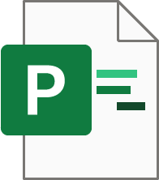
How Do You Use Thresher? (1 of 2)
Generating a critical path analysis file
Source Schedule File
Thresher greatly reduces the size of the file by removing any task in the schedule that is not on the critical (or near critical) path from the file
Being much smaller, the resulting Critical (or Near Critical) Path Analysis File is much easier to analyze

Slide 15
How Do You Use Thresher? (2 of 2)
Generating a filtered analysis file
Source Schedule File
Possible Path 1
Possible Path 2
Thresher selectively removes only those tasks which match the selected values in a custom text or flag field
The resulting Analysis File no longer contains the filtered out tasks
Possible Path 1
Possible Path 2

Slide 16
Thresher User Interface – Critical Path
Thresher removes any tasks which are not on the critical (or near-critical) path from the schedule.
Slack is used to determine proximity to critical path
  Zero slack = critical path
  Near-critical path tasks can be included by increasing Slack (i.e. 2, 3, 5, …)
Resulting cut-down file is saved as a new file for analysis
1
2
3
1
Amount of Slack to allow. Setting to zero includes only the critical path
3
Option to include completed tasks (otherwise they will be removed from the analysis file)
2
Thresher can “save” the original slack values to a custom field if desired
4
Click Run
4

Slide 17
Thresher User Interface – Field Filter
Thresher removes any tasks in the file which match the selected field values from a custom Text or Flag field
Resulting cut-down file can be saved as a new file
for analysis
1
1
Select the custom text or flag field with your filter values
2
2
Thresher will present a list of unique values for the selected filter; one or more can be selected
3
Click Run
3

Slide 18
Questions / Comments
  Questions on Thresher
  Contact Information:
  Donovan_Brady@bah.com, Donovan.D.Brady@nasa.gov

Slide 19
Splicer Introduction
August 25, 2026
Developed by
Booz Allen Hamilton
Presenter Name
Organization

Slide 20
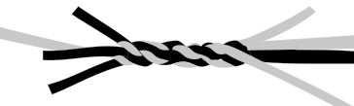
Agenda
What is Splicer?
Benefits of Splicer
Splicer Use Cases
How Does Splicer Work?
Splicer User Interface
Splicer Development Roadmap
Splicer

Slide 21
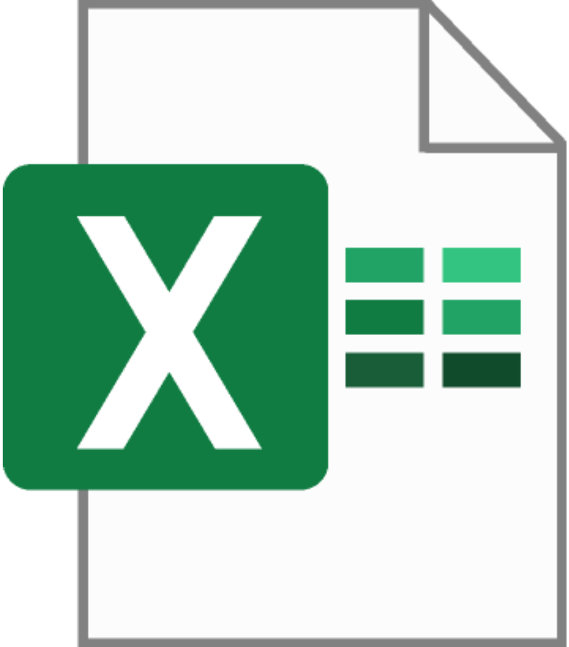
What is Splicer?
Splicer is a tool to semi-automate integration and summary schedule updates from individual or multiple source schedules and other data sources
Splicer saves time and effort, increases accuracy and eases traceability of schedule data
Without Splicer these updates are, in most cases, performed manually
Splicer
Splicer

Slide 22




Benefits of Splicer
Reduced time & effort
Through automation, Splicer reduces the time and effort to update integration/summary schedules. Time savings depends on file size and data to import/integrate but 90-95% reductions in time/effort are not unusual
Traceability & repeatability
Saved configurations and configuration files improve the ability to trace, document and repeat tasks for better process traceability and repeatability
Improved accuracy
Careful and selective automation reduces human error and improves
process accuracy
Standardization
Configurations and configuration files can be shared allowing for standardization within and across teams

Slide 23
Splicer Use Cases
Splicer has three main use cases:
Integration of
multiple schedules
Summary schedule from
a single schedule
Excel data into
a schedule

Slide 24
How Does Splicer Work?
Splicer uses a two-stage process to Import data from one or more source files to a target file then Integrate the data into the target file. Two stages allows for verification and validation of imported data prior to integration
Importing copies data from one or more source files to “temp” fields in the target file
Integration copies the data from the “temp” fields to the “real” fields using logic for sequencing
Other features include:
  Highlighting / de-highlighting differences in data between “temp” and “real” fields
  Ability to preserve original (pre-update) data
  Ability to set and track update date

Slide 25
Splicer Data Integration Example
Updates to be made:
Task A: Duration increases.
Task B: Shifts to the right (due to Task A).
Task C: Shifts to the right (due to Task D).
Task D: Duration increases.
A
A
A
B
B
C
C
D
D

Slide 26
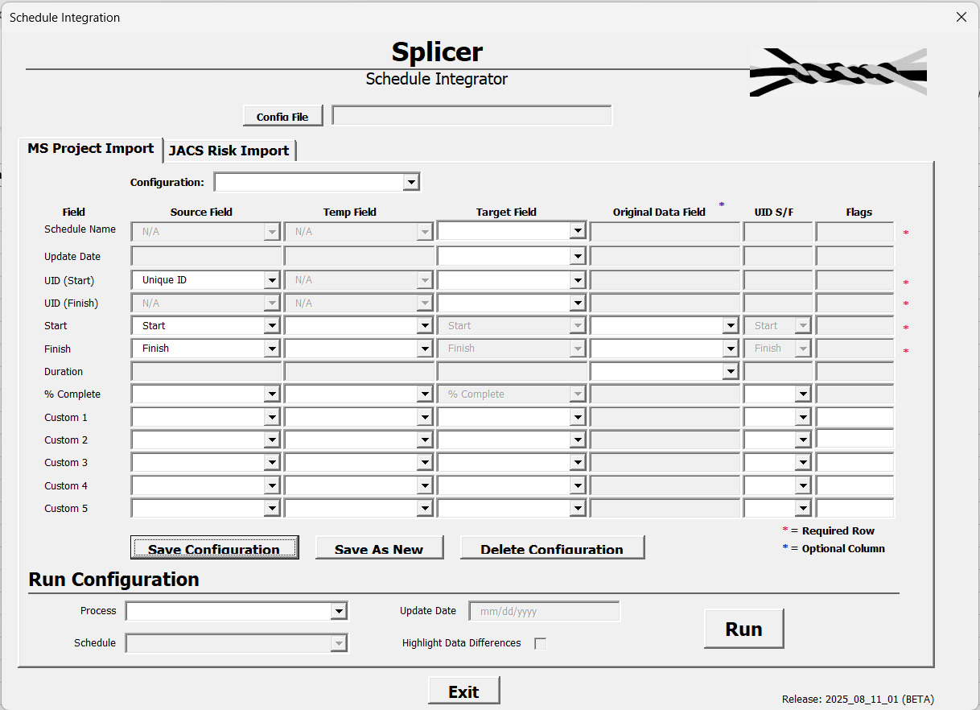
Splicer User Interface
Two Main Sections
Feature Highlights
Field Configuration
1
Multiple configurations in external files
1
The mappings of fields between source files and integration or summary files.
Mappings can be saved and
are portable
2
Multiple source schedules can have multiple mappings
2
3
3
No field mapping restrictions
4
Easy and intuitive
configuration management
Run Configuration
5
Fast and simple data import
and schedule updates
4
Using a configuration mapping, select and either import or update a source schedule to the integration or summary file
5
Automated highlighting to ease data validation and updates
6
6

Slide 27

Splicer Development Roadmap
WE
ARE
HERE
Initial Release
“Polished” Release
JACS Risk
Import
Excel Import
Mostly worked (some bugs)
Data integration was “simple”
Some function/feature limitations
Many bug fixes
Data integration process updated
Functions/features fully working
Major code update/rewrite
UI update to allow tabs
Algorithm optimizations
Import JACS risk data from an MS Excel spreadsheet
Bug fixes & code optimizations
Add tab and UI for flexible data imports from MS Excel (and, indirectly, P6)

Slide 28
Questions / Comments
  Questions on Splicer
  Contact Information:
  Zander_Eric@bah.com, Eric.S.Zander@nasa.gov

Slide 29
Credits
  Special Thanks For All Their Help:
  Maritza Alexander
  Anna Wieger
  Andrew Ochs
  Ed Walsh
  Brett Fennell
  Jessica Clark
  Contact Information:
  Hemrich_Michael@bah.com, Michael.J.Hemrich@nasa.gov
  Brady_Donovan@bah.com, Donovan.D.Brady@nasa.gov​
  Zander_Eric@bah.com, Eric.S.Zander@nasa.gov

