Slide 1
Where it All Breaks Down:
How Cost Growth Exists Within Specific WBS Elements
Zachary Matheson – Zachary.matheson@nnsa.doe.gov
Vikram Basude – Vikram.basude@nnsa.doe.gov

Slide 2


Meet your Speakers
Zachary Matheson
Vikram Basude
OPERATIONS RESEARCH ANALYST, NNSA
Senior Associate, Technomics, Inc.
Zachary is an analyst in the National Nuclear Security Administration (NNSA) Office of Programming, Analysis, and Evaluation (PA&E).
Vikram supports the NNSA at the Office of Programming, Analysis, and Evaluation (PA&E) and the Navy at PEO IWS (Program Executive Office Integrated Warfare Systems)

Slide 3
Agenda
01
Problem/Background
02
Data Collection, Normalization, and Validation & Verification
03
Cost Growth Analysis
04
New/Future Capabilities

Slide 4
Problem/Background
PROBLEM
NNSA capital projects face persistent cost growth, limited visibility into lower-level drivers due to inconsistent WBS structures, and re-baselining that can mask cumulative performance degradation in top-level EVM metrics.
OBJECTIVE
Identify which lower-level elements drive baseline deviation, quantify the associated cost, schedule, and scope impacts, and demonstrate how WBS-level insights can improve estimating, benchmarking, and mitigation strategies.
APPROACH
Leverage Normalized Earned Value Management (EVM) Work Breakdown Structures (WBS) with re-defined metrics to identify, quantify, and benchmark baseline deviation drivers across projects.

Slide 5
Data Collection, Normalization, and Validation & Verification

Slide 6
Data
Data processing and data wrangling
1
2
3
Collection
Normalization
V&V
Used a DOE system (PARS) used for tracking, assessing, and reporting on the status and performance of projects
Standardized M&O WBS & escalated project costs
Performed a Qualitative and Quantitative Validation and Verification
  Manufacturer and Operating (M&O) WBS
  Time-phased costs by WBS
  Project Documents
  Leveraged Machine Learning model to standardize at scale
  Used Python script to escalate costs
  Set thresholds to ensure projects were capturing 95% of cost growth
  Trustworthy dataset - ensure no AI hallucinations
Outcomes

Slide 7
WBS Variations Across Projects Are Inconsistent
Title | Level
TOTAL PROJECT COST | 1
Total Estimated Cost | 2
Management and Support | 3
Design and Non-Recurring Engineering | 3
Site Work | 3
Vertical Construction | 3
Standard Equipment & Utilities | 3
Process Equipment & Instrumentation | 3
Transition and Turnover to Operations | 3
Other Project Costs | 2
Pre-CD-1 Costs | 3
Post-CD-1 Costs | 3
Other Direct Costs | 2
Contractor Fee | 2
Project One | Level
project management | 2
Project Office | 3
Capital Acquisition Estimating Framework 2.0
  Uses UNIFORMATII & Masterformat
  Developed by CEAG (Cost Estimating Analysis Group)
    Cross-functional group encompassing LPSs & HQ
  Allows a way for M&Os to bucket their costs in a standardized format
Project Two | Level
project integration | 2
construction project management | 3
Project Three | Level
project management | 2
03.01.14 project management | 3
Notes:
Background on CAEF 2.0: CEWG – Cost Estimating Working Group developed a standardized WBS LPS can utilize to track/report their project costs.

Slide 8
AI/ML Solution
What is it?
Scope of data
A tool that reads text, interprets meaning, and classifies it into a predefined category
All Active and Completed NNSA projects
ENGINE
Natural Language
Processing
(NLP) Model
Output
Limitations
CAEF 2.0 standard WBS for each historic WBS
Limited sample size and lack of contextual information
For more details on the model, refer to 2023 CECOP Presentation All in the Hierarchy: Meta-Estimators for Work Breakdown Structures by Maura Lapoff & Patrick Shelton

Slide 9
Qualitative & Quantitative V&V Process Flow
Perform manual re-allocation
Perform validity checks on each lowest level WBS element
Inconsistent or incorrect outputs
Unknown acronyms
Context specific or niche WBSs
Qualitative Checks
Retain Output
Input: Qualitative checked WBS
Identify and compare ACWP to the Total Cost in closeout report
Split project cost categories from ACWP
Pass/Fail QA
Pass
Compare to Actual Closeout reports
Fail
Investigate Omission from Results
Re-Bucketing WBS elements to align with Reported Costs
Maintain quantitative project category split

Slide 10
QA Findings
V&V Process
Includes all corrections and assumptions from historical projects
Accuracy Percentage of WBS Levels
High-Level Elements
19,291
92%
Total number of WBS elements
WBS
New training dataset
Low-Level WBS Elements
Observed limitations
55%
Project Context
Legacy Acronyms
Scope Nuances
Niche WBS Elements
ML Model
All projects WBS standardized to CAEF 2.0
Key Improvements:
Ability to more accurately output standardized WBSs & close the gap on key limitations

Slide 11
Cost Growth Analysis

Slide 12
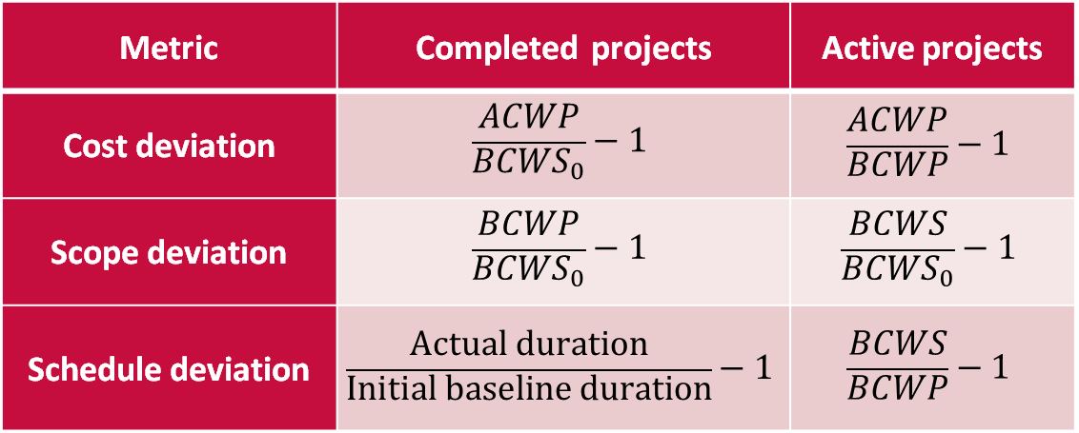
Cost Growth Metrics
Intended to show deviations from the original project baseline, not the most recent re-baseline
Metrics are evaluated for each project at WBS level 3
Metric | Completed projects | Active projects
Cost deviation | $$\frac{ACWP}{BCWS_{0}}−1$$ | $$\frac{ACWP}{BCWP}−1$$
Scope deviation | $$\frac{BCWP}{BCWS_{0}}−1$$ | $$\frac{BCWS}{BCWS_{0}}−1$$
Schedule deviation | $$\frac{Actual duration}{Initial baseline duration}−1$$ | $$\frac{BCWS}{BCWP}−1$$
Notes:
Why different metrics for active vs completed projects? If a project never rebaselines, then the two metrics would ideally be the same. But rebaselines do happen, so out metrics intend to isolate specific types of growth behaviors independently of one another
Take cost growth for instance. Makes sense for completed projects: how much you actually spent vs how much you originally expected to spend. But scope changes make it difficult to use that same metric for active projects – for example, consider a project that completed half its original scope at double the expected cost.

Slide 13
Cost Deviation Metrics
Both active and completed projects experience cost inefficiency
  Metrics suggest higher inefficiency for completed projects across most WBS elements, however…
  Discrepancy is likely related to different metrics for active vs. completed projects
Favorable cost deviation for transition to operations (TTO) for completed projects may be a sign that TTO scope is trimmed to be completed off-project
Numbers indicate # of projects
← Better than expected | Worse than expected→

Slide 14
Cost Deviation Metrics
Non-rebaselined projects experienced greater design and engineering cost inefficiency than projects which rebaselined
Otherwise, rebaselined projects show consistently greater cost inefficiency for nearly all WBS tasks than projects which have not been re-baselined
Particularly pronounced for WBS elements that take place “in the field” rather than behind a desk, including
  site work
  equipment procurement and installation
  vertical construction
  transition to operations
Numbers indicate # of projects
← Better than expected | Worse than expected→

Slide 15
Scope Deviation
Large schedule deviations for standard and process equipment are each due to a single outlier project
As suggested before, TTO for completed projects shows evidence of cut scope
Minor scope creep elsewhere, with no clear difference between completed vs incomplete projects
Numbers indicate # of projects
← Better than expected | Worse than expected→
Notes:
Emphasize that TTO scope cutting could be good or bad

Slide 16
Scope Deviation
Rebaselined projects see scope growth in every category
  Scope discovery is a common cause for project re-baselines.
Non-rebaselined categories mostly appear to have had scope cut
  Perhaps scope was shed to complete within baseline
  Minor design and engineering scope added to non-rebaselined projects
Numbers indicate # of projects
← Better than expected | Worse than expected→

Slide 17
Schedule Deviation
Completed projects show almost no schedule delays outside of TTO
  Not dependent on the choice of metric; using the active project metric of BCWP/BCWS yields a similar number
May be an artifact of the type of projects in NNSA’s portfolio
  Older projects tended to be smaller, less complex, less expensive, and therefore less prone to delays than today’s active projects
Numbers indicate # of projects
← Better than expected | Worse than expected→

Slide 18
Schedule Deviation
On average, no part of a project completes on or ahead of schedule
Later project phases (which appear toward the bottom) tend to have increasingly longer delays
Numbers indicate # of projects
← Better than expected | Worse than expected→

Slide 19
Lessons Learned
Did a sensitivity analysis with data acceptance criteria
  Any effects of the data cutoff threshold, if they exist, are overshadowed by the effects of influential points in a small dataset
Influential points
  Using the metrics we’ve defined, project activities with small baselines can have an outsized influence on aggregate score even if the actual change in dollars is small
Consider using weighted average or median rather than flat average
  See backups

Slide 20
Conclusions and Future Work

Slide 21
New/Future Capabilities
Ability to accurately, efficiently, and confidently perform…
Lower-Level EVM Project Control
Early Warning Systems
Create XERs
Cost, Schedule, & Phasing Estimating Relationships
Developing PER of when WBS occur throughout the lifecycle of a project
Utilizing Baseline Growth Factors at the WBS level to forecast and assess projects with increased granularity
Our baseline growth defined metrics can allow organizations to detect cost or schedule risks sooner and take corrective action before they escalate.
Organizations which implement these steps will be well-positioned to better quantify cost growth risks, identify mitigation strategies, and ultimately support more informed mission execution

Slide 22
Questions

Slide 23
Additional Material

Slide 24
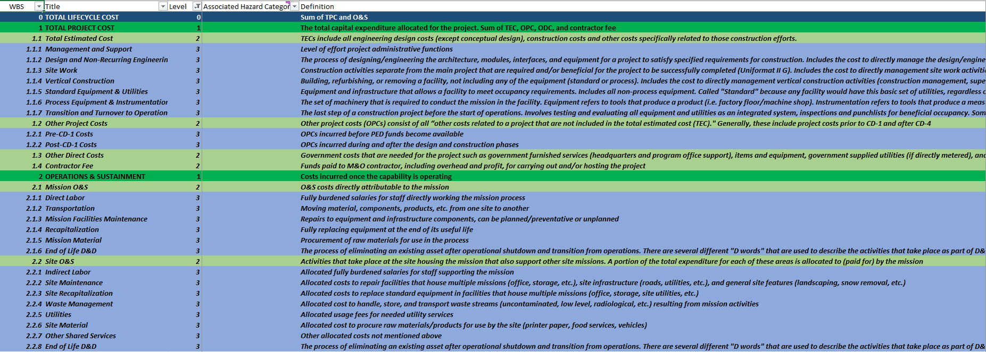
Snapshot of CAEF WBS
Full WBS - Levels 0-9

Slide 25
Back Up

Slide 26
WBS Benchmarking Capability

Slide 27
Benchmarking and Cost Growth
What are benchmarking tools?
Benchmarking tools are a way to quickly compare project cost estimates to historical actual costs for similar projects
With project EVM data mapped to a common WBS, we can benchmark projects at lower levels than before
How does benchmarking combat baseline growth?
Ensure the best estimate is put forward as the baseline and removing unrealistic estimates

Slide 28
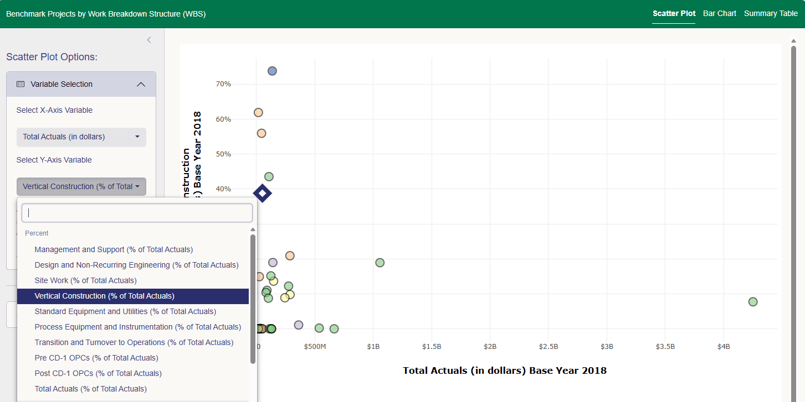
PA&E Benchmarking Tools
Capital Acquisitions Analytic Toolkit (CAAT)
Has suite of tools for benchmarking capital projects at lower WBS levels
Ability to export data and create XERs
Will develop tools for generating common visualizations, including benchmarks during Datathon Group 5
CAAT – WBS Benchmarking

Slide 29

PARS Data Selection
PARS
2
3
1
Project Assessment and Reporting System
A DOE system used for tracking, assessing, and reporting on the status and performance of projects
Includes Project Documents and WBS level data
Project Inclusion
SPAE Report
M&O WBS
Objective
Obtain Managing and Operating (M&O) WBS & associated costs
Identify Active and Completed Projects
SPAE (bcwS, bcwP, Acwp, Etc) files in Reports
EVM data provides time-phased Actual Cost of Work Performed (ACWP) through M&O WBS

Slide 30
Multi-Year SPAE WBS Normalization
The SPAE File in PARS only gives EVM metrics on the most recent baseline. To assess baseline deviation, we needed all prior baselines.
V&V WBS
Pars Request
Set Thresholds
Data Sync
Requested and received Multi-Year SPAE File from PARS
Set Thresholds
Multi-Year SPAE
Data Sync
Visualize Baseline Over-Time
Excluded projects where initial baseline differed from our earliest baseline in dataset by more than 5%
Leveraged a Python script to escalate EVM dollars and apply WBS V&V across multi-year SPAE WBSs.
Notes:
Special request to PARS
5% thresholds for analysis in the case of incomplete EV data
95% of post baseline execution
Utilized Python Script to sync the WBS reallocation mapping and aggregation to level 3 WBS

Slide 31
Cost Growth Results
Using median rather than mean

Slide 32
Cost Deviation Metrics
When using the median instead of the mean:
  Slight positive cost deviation observed for standard equipment vanishes
  Slight negative cost deviation observed for vertical construction for active projects vanishes
Both active and completed projects experience cost inefficiency
  Metrics suggest higher inefficiency for completed projects across most WBS elements, however…
  Discrepancy is likely related to different metrics for active vs. completed projects
Favorable cost deviation for transition to operations (TTO) for completed projects may be a sign that TTO scope is trimmed to be completed off-project
Numbers indicate # of projects
← Better than expected | Worse than expected→

Slide 33
Cost Deviation Metrics
Median cost inefficiency for site work for non-rebaselined projects is positive, while mean is negative. Otherwise, no major changes
Non-rebaselined projects experienced greater design and engineering cost inefficiency than projects which rebaselined
Otherwise, rebaselined projects show consistently greater cost inefficiency for nearly all WBS tasks than projects which have not been re-baselined
Particularly pronounced for WBS elements that take place “in the field” rather than behind a desk, including
  site work
  equipment procurement and installation
  vertical construction
  transition to operations
Numbers indicate # of projects
← Better than expected | Worse than expected→

Slide 34
Scope Deviation
No meaningful differences between mean and median
Large schedule deviations for standard and process equipment disappear when using median rather than mean
As suggested before, TTO for completed projects shows evidence of cut scope
Minor scope creep elsewhere, with no clear difference between completed vs incomplete projects
Numbers indicate # of projects
← Better than expected | Worse than expected→
Notes:
Emphasize that TTO scope cutting could be good or bad

Slide 35
Scope Deviation
Rebaselined projects see scope growth in every category
  Scope discovery is a common cause for project re-baselines.
Non-rebaselined categories mostly appear to have had scope cut
  Perhaps scope was shed to complete within baseline
  Minor design and engineering and site work scope added to non-rebaselined projects
Numbers indicate # of projects
← Better than expected | Worse than expected→

Slide 36
Schedule Deviation
No meaningful differences between mean and median
Completed projects show almost no schedule delays outside of TTO
  Not dependent on the choice of metric; using the active project metric of BCWP/BCWS yields a similar number
May be an artifact of the type of projects in NNSA’s portfolio
  Older projects tended to be smaller, less complex, less expensive, and therefore less prone to delays than today’s active projects
Numbers indicate # of projects
← Better than expected | Worse than expected→

Slide 37
Schedule Deviation
No meaningful differences between mean and median
On average, no part of a project completes on or ahead of schedule
Later project phases (which appear toward the bottom) tend to have increasingly longer delays
Numbers indicate # of projects
← Better than expected | Worse than expected→

