Slide 1

1-Minute Schedule Dashboards
2026 NASA COST & SCHEDULE SYMPOSIUM
Zachary Dolch
NASA Program Analysis & Control (PAAC) V Contract

Slide 2
Overview
An Automated Reporting Suite Built on Free, Open-Source Tools
The Problem
Monthly reporting burden and time lost to manual effort.
Solution Overview
Suite capabilities, outputs, and the headline result.
Architecture & Data Pipeline
Tools used, monthly process workflow, and distribution.
Live Demo
End-to-end: MS Project export → full dashboard suite in under 1 minute.
Creating Your Own Dashboard
Progressive scripting, AI-assisted development, visual options.
Lessons Learned & Broader Applicability
Key takeaways and how any MS Project program can adopt this.

Slide 3
The Monthly Reporting Burden
Creating monthly schedule reports often requires significant involvement from one or many team members.
Each manual step introduces risk:
Inconsistent formatting across reporting periods
Error-prone manual data manipulation
Hours consumed with zero analysis value - time that cannot be spent on project decisions
Redistribute updated products
Rebuild charts and visuals from scratch each cycle
Conduct stakeholder review and corrections
Export data from MS Project
Reformat and clean data manually

Slide 4
What We Lose: Time Spent Generating vs. Analyzing
The 1-minute production time is constant regardless of reporting package size. The script scales; a person does not.
Manual Efforts
~1 full day per reporting cycle
Manual Process
Automated Efforts
Under 1 minute to generate the full reporting suite
Automate Process
Report Generation
Analysis & Discussion

Slide 5
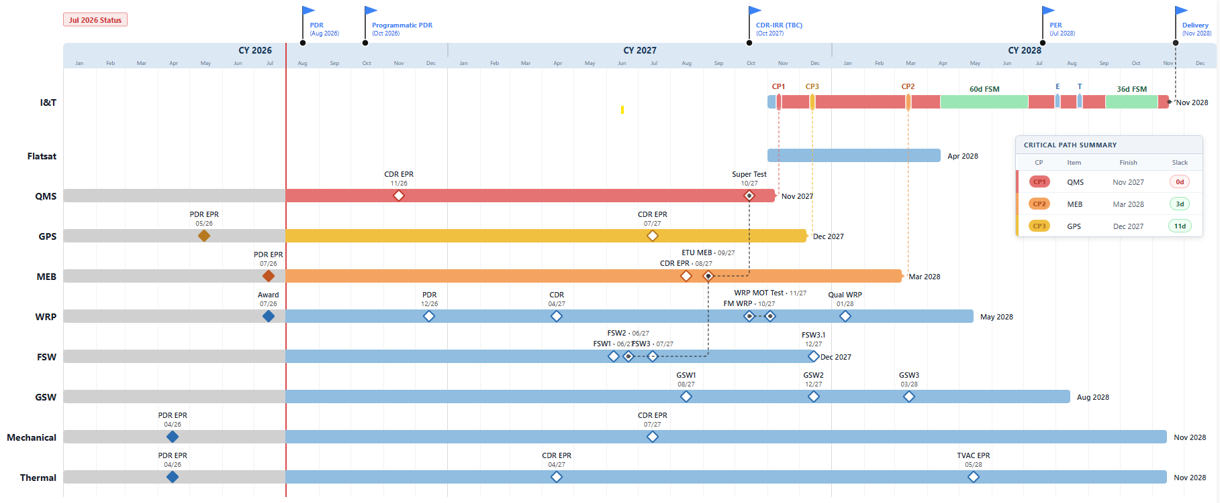
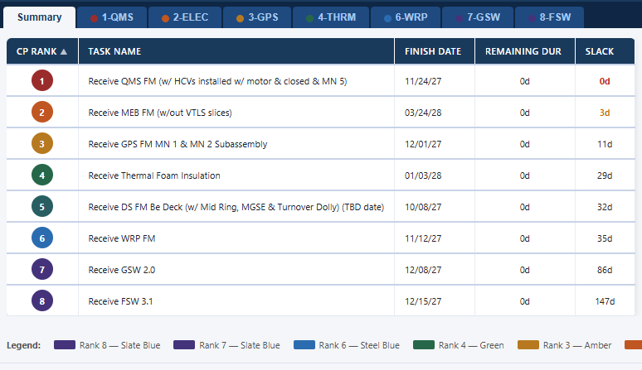
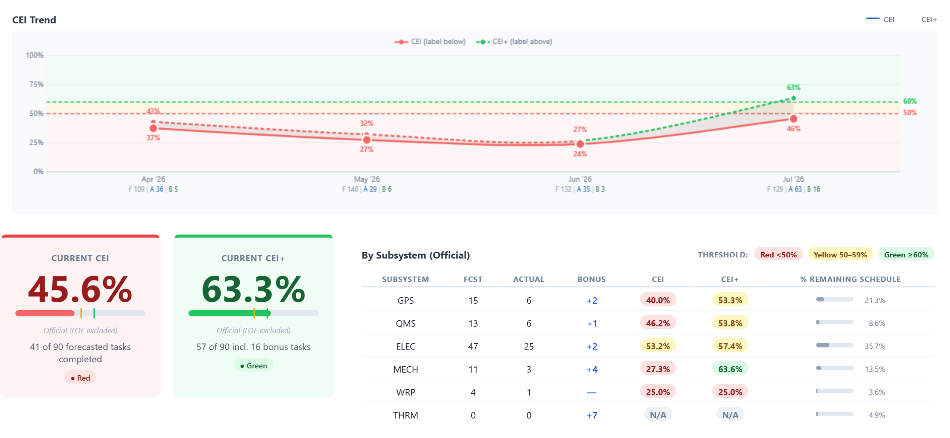
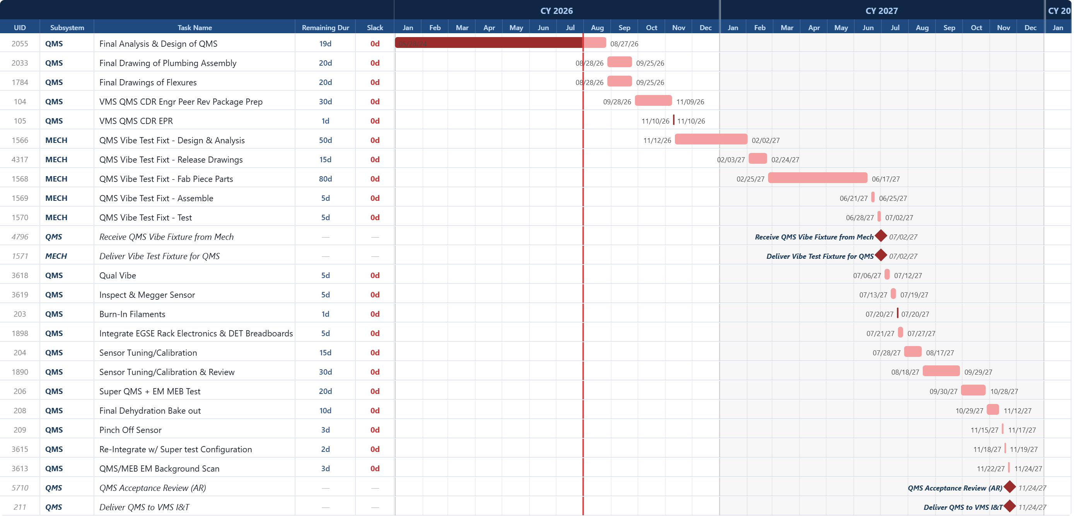
The Reporting Suite: Six Distinct Outputs
Full Schedule Viewer
Interactive filtering and logic tracing across the full schedule.
Subsystem-Level Gantt Summary
Rolled-up Gantt organized by subsystem for executive-level review.
Critical Path Trace
Organized by rank - shows exactly which tasks drive the schedule end date.
Control Events & Milestone Tracker
Month-over-month comparison of key events and milestones.
Network Dependency Diagram
Visual representation of task relationships and dependencies.
High-Fidelity IMS Summary Chart
Integrated Master Schedule summary - publication-quality output.
All reports open in any modern web browser
No installation, no server, no external software required. Outputs carry a consistent visual identity and are date-stamped automatically from the schedule status date.

Slide 6
Key Capabilities
Type Your Subtitle Here
Single Source of Truth
The schedule drives everything. No parallel spreadsheets, no manual data entry. All configuration is driven by MS Project fields that already exist in the schedule.
1
Browser-Based - Zero Installation
Opens in any modern web browser on any OS. No server, no plugins, no IT involvement required to view or share reports.
2
Automatic Date-Stamping
Reports inherit the status date directly from MS Project, ensuring consistent traceability and accurate month-over-month comparison across every reporting cycle.
3
Consistent Visual Identity
Every report produced has the same look and feel — same layout, same color conventions, same structure — regardless of who runs the script or when.
4

Slide 7
The Headline Result
Under 1 Minute to generate the complete reporting suite - every reporting period.
MS Project Export → Run Script → Full Suite Ready.
One step. Every reporting period. Any scope of reporting package.

Slide 8
Tools & Technologies
All tools are free and open-source - no licensing costs, no procurement required.
Input Layer
MS Project - standard .xls or .csv export (the same file already produced for reporting today).
Processing Layer
Python - core scripting language for data processing and report generation.
Open-source libraries for data manipulation, formatting, and HTML output generation.
Output Layer
HTML/JavaScript — self-contained files that render in any modern browser.
No server, no database, no runtime environment required to view outputs.
Folder Structure
Fully configurable - the end user can organize script outputs however their project requires

Slide 9
How Outputs Are Distributed & Viewed
Because the output is a standard HTML file, anyone with a modern browser can receive and view reports - no special software required.
Email
Attach the HTML file; recipient opens directly in their default browser.
Any Major Browser
Chrome, Edge, Firefox, or Safari.
SharePoint / Microsoft Teams Upload to a document library and share a link.
Any Operating System
Windows, Mac, or Linux.
DISTRIBUTION
METHODS
VIEWING OPTIONS
Shared Network Drive Place in a team folder; open directly from file explorer.
Desktop or laptop
No server connection required to open or view reports.

Slide 10
Data Pipeline
No manual data entry at any step in the pipeline.
Source
Extraction
Processing
Display
Archival
MS Project
All report content is driven by fields that already exist in the schedule.
No external data sources required.
Export XMLs
Standard .xls or .csv export from MS Project.
No special configuration beyond what you already do today.
Python Scripts
Field mapping and data validation.
Data formatting and schedule logic processing.
Chart generation and HTML layout rendering.
HTML Dashboards
Self-contained files written to the output folder.
Ready to distribute immediately.
Save & Archive
Copy outputs to a dated folder (e.g., YYYY-MM) after each cycle.
Builds a full historical record and enables month-over-month comparison.

Slide 11
Monthly Process Checklist
Steps 1–3 are the same work you would do today. Step 4 is where automation replaces hours of manual effort.
Status the Schedule
Complete all task updates, apply status date, verify data integrity.
Data Cleanup & Validation
Review export for anomalies, confirm field population, check critical path logic.
Export from MS Project
Standard .xls or .csv export - no special configuration required.
Run the Script
One command. Under 1 minute. Full suite generated and ready to distribute.
Review Outputs
Spot-check reports, verify status date stamp, confirm visual accuracy.
Distribute to Stakeholders
Email or SharePoint / Teams - same distribution process as before.

Slide 12


Live Demo
End-to-end: MS Project export → complete dashboard suite
Export → Run Script → Full Suite Ready
Target: under 1 minute

Slide 13
Creating Your Own Dashboard: Progressive Scripting
Don't go all in at once. Build in stages, save versions as you go, and verify at each checkpoint before moving forward.
Port the Schedule Data
Format the Data
Build Version 1 Dashboard
Refine Visuals
Prove your MS Project export is readable by the script.
Confirm field names map to expected inputs.
Clean fields, apply date formatting, validate logic (durations, links, WBS).
Save a checkpoint version.
Focus entirely on functionality.
Does the data appear correctly?
Is filtering working?
Visuals come later.
Provide AI with the visual changes you want to see.
Revise and repeat.
Iterate to final product.
01
02
03
04

Slide 14
Using AI to Accelerate Development
AI is your pair programmer - guide it, don't fight it.
What AI Does Well
Porting and reformatting schedule data from the export into the structure the script needs.
Generating boilerplate HTML structure and JavaScript chart scaffolding.
Applying visual updates quickly - colors, layout adjustments, icon swaps, spacing changes.
How to Work With AI Effectively
Let AI handle the first visual pass, then get specific with follow-up prompts
Provide the exact visual changes you want; revise and repeat until satisfied
You can be specific from the start, but letting AI choose initially is often faster
Save a version at each AI iteration - rolling back to a prior state is easy and worth the habit

Slide 15
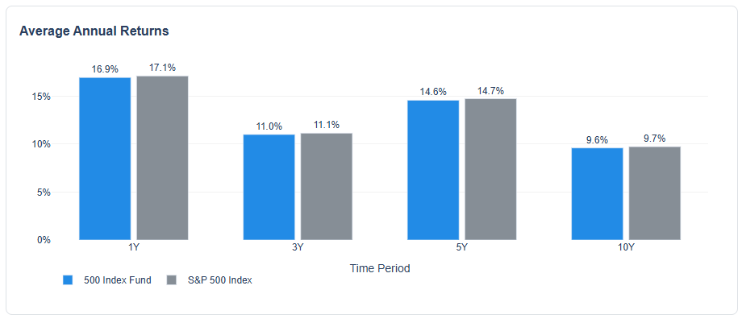
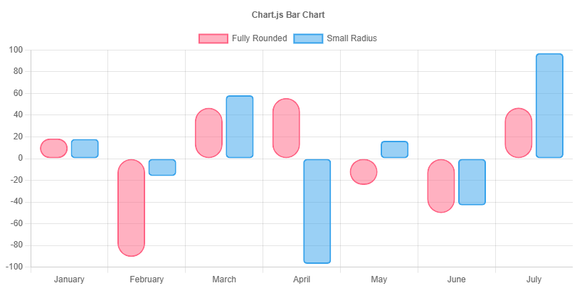
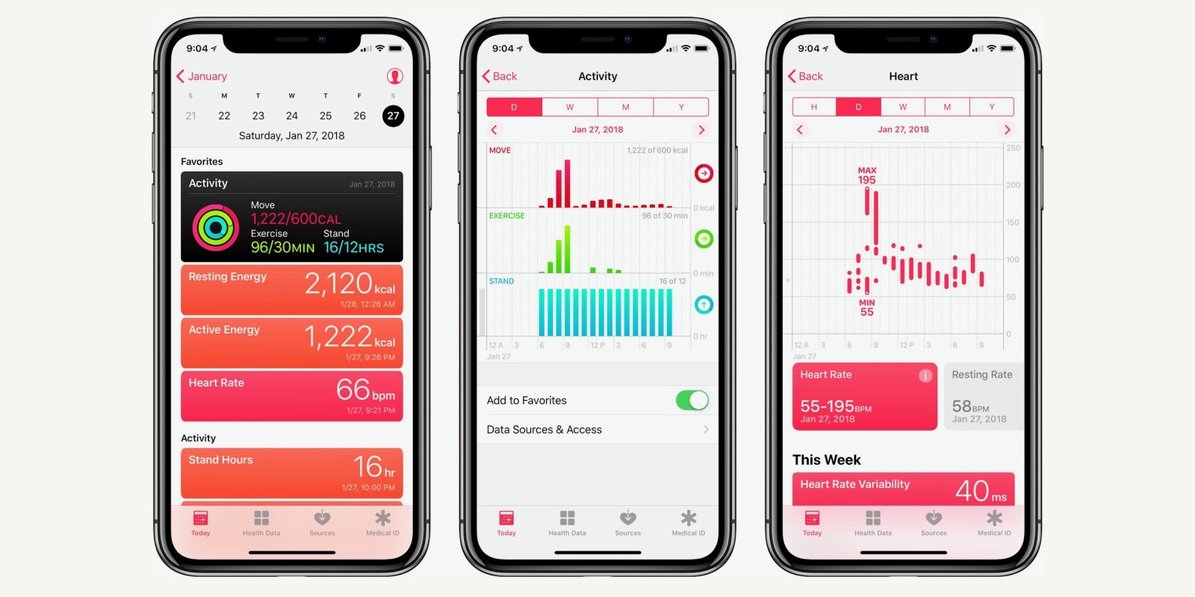
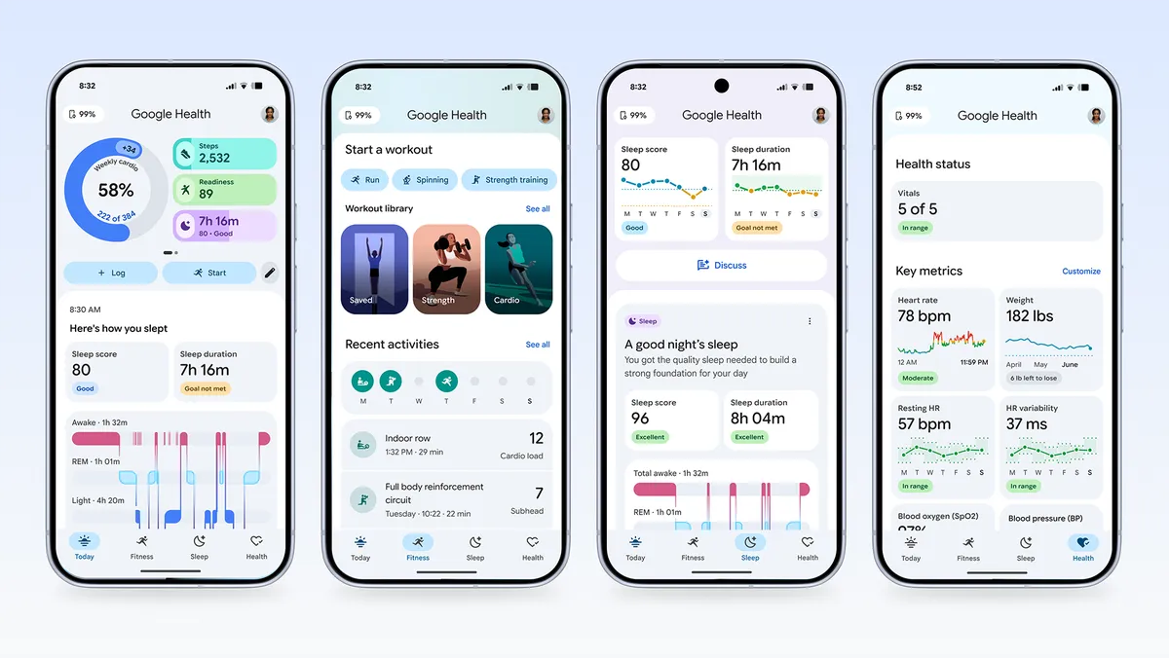
Visual Options Quick Reference
These decisions define the look and feel of your entire suite. Pick once and stay consistent across all dashboards.
Icons
Emojis - zero setup, broadly supported, informal feel; good for internal-facing tools.
Lucide Icons - clean, professional SVG icon set; recommended for stakeholder-facing reports.
🚀
🗓️
Charting Libraries
Plotly - interactive charts with zoom and filter; strong fit for schedule and time-series data.
Chart.js - lightweight, simple charts; good for high-level summary and status views.
D3.js - maximum flexibility; steeper learning curve; best for custom visuals like network dependency diagrams.
UI Style
Think of it like iOS vs. Android vs. Windows - your dashboard has a personality.
Pick a visual language that matches your organization's expectations and commit to it across every report in the suite.

Slide 16
Lessons Learned
Keep the Schedule as the Source of Truth
If it isn't in MS Project, it doesn't drive the reports.
Parallel spreadsheets reintroduce the manual effort you set out to eliminate.
Status Date Discipline Matters
Consistent, accurate status dates are what make month-over-month comparison reliable.
Sloppy status dates produce misleading trend data.
Automate the Boring Parts
Formatting is not analysis.
Free your team from monthly reformatting and direct that effort toward decisions that actually matter to the project.
Start Small, Script Progressively
Don't build everything at once.
Prove each stage works before advancing. The investment is front-loaded, but the monthly payoff is permanent.
Know Your Export Format
Different MS Project export formats give you different data.
Know what fields survive, what gets flattened, and what disappears before building your script around it.

Slide 17
Broader Applicability
This approach is not specific - any MS Project-based program can adopt the same methodology.
What Your Program Needs to Get Started
Guidance for Complex, Multi-Subsystem Schedules
Getting Started
Uses MS Project as its scheduling tool
Has a consistent monthly export process
Wants repeatable, stakeholder-ready reporting outputs without the monthly manual overhead
The suite scales - subsystem-level filtering, WBS hierarchy, and multi-level Gantt views are built-in capabilities
Programs with higher reporting complexity benefit most - more dashboards does not mean more generation time
Review schedule data structure - confirm MS Project fields are populated consistently
Configure field mappings for your project's WBS and subsystem structure
Apply the progressive scripting approach covered in this presentation

Slide 18
Questions?

