Slide 1
Utilizing AI to Find and Categorize Risks
Abby Franck
The Aerospace Corporation
2026 NASA Cost and Schedule Symposium (NCSS)
August 26, 2026

Slide 2
Introduction
Automating Risk Extraction
Challenge
  Difficult to track large amounts of programmatic data across multiple sources
  Manual analysis is time-consuming and doesn't scale
  Risk insight spread throughout various sources
AI-enabled solution
  Automate data collection and analysis at scale
  Standardize and aggregate data from multiple sources
  Mine data from:
    Open-source internet searches
    Publicly available vendor annual reports
    Project-specific materials
  Host risks found in various sources in a single interactive visualization
Purpose
  Extract meaningful insights from overwhelming data
  Demonstrate practical AI application for NASA SMD

Slide 3
Leveraging Large Language Models (LLMs)
Large Language Models (LLMs) are used in this approach to automate the extraction and analysis of risks from documents and data sources
What are LLMs?
  AI models trained to understand and generate human language
  Can process and analyze large volumes of unstructured text
  Extract insights, identify patterns, and synthesize information at scale
Models used
Application to risk mining
  Automated extraction of risk insights
  Standardized analysis across multiple document types and sources
  Scalable processing of large programmatic datasets
  Consistent identification of patterns and anomalies
Model | Training/Specialization | Strengths | Limitations
GPT-OSS-120B | Trained on internal Aerospace technical reports and program deliverables | • Domain-specific Aerospace knowledge • Programmatic terminology expertise • Document understanding | • Smaller model size limits complexity
Claude 4.5 Sonnet | General-purpose frontier model | • Advanced reasoning • Complex multi-step tasks • Structured data extraction | • Lacks domain-specific training • Requires careful prompt engineering for optimal results

Slide 4
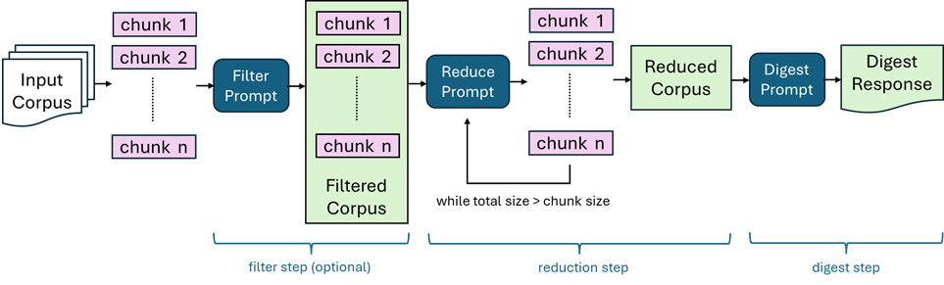
Custom LLM Tool: DocMiner Intelligent Virtual Engine (DIVE) Digest
Extracting Risks from Large Documents
DIVE Digest is a custom AI tool developed by Aerospace that handles documents larger than LLM context windows through iterative processing
Three-step approach: Filter → Reduce → Digest
  Filter: Identifies sections containing risk information
  Reduce: Condenses content while preserving key details
  Digest: Extracts and standardizes risk data
Application to risk mining
  Processes internal programmatic documents e.g., status reports, reviews
  Outputs standardized risk format for aggregation
  Enables consistent analysis across all document types

Slide 5
Web Scraping for Open-Source Risks
Automated Collection of External Risk Data
What is being mined
  Current news on vendors and press releases
  Industry publications and trade journals
  Annual reports and financial disclosures
Process
  Define search parameters - Customize google queries for each data source
  Automated collection - Web scraping tools gather content and rank by keyword relevance with TF-IDF (Term Frequency-Inverse Document Frequency) model
  LLM filtering - AI identifies risk-relevant information
  Standardization - Extract and categorize risks consistently
  Aggregation - Combine with internal data for comprehensive view of vendor performance
Example Search Query | Risk Keywords
“BAE systems recent news -site:baesystems.com”​ (excludes any links from the actual BAE website)​ | ‘risk', 'threat', 'anomaly', 'malfunction', 'delay', 'failure', 'radiation', 'debris', 'communication', 'loss’

Slide 6
Prompt Engineering for Risk Extraction
Crafting Effective LLM Prompts
Why prompt engineering matters
  Determines quality and consistency of extracted risks
  Ensures LLM focuses on relevant information
  Standardizes output format for aggregation
Key prompt design principles
Iterative refinement
  Test prompts on sample documents
  Adjust based on output quality
  Document successful prompt patterns
  Create prompt library for different use cases
Principle | Example | Purpose
Be Specific | "Extract cost and schedule risks" vs. "Find problems" | Focuses LLM on relevant risk types
Define Format | "Output as: Risk, Impact, Source" | Enables automated processing
Set Boundaries | "Do not add suggestions or commentary" | Prevents hallucination, keeps facts
Provide Context | "You are analyzing vendor risks for NASA missions in development" | Frames appropriate risk lens

Slide 7
End-to-End Process for Vendor Risk Extraction
Step 1: Automated Data Collection
Internet searches with customized queries
Web scraping of annual reports and news sources
Collection of relevant articles and documents
Step 2: LLM Processing
DIVE Digest summarizes lengthy documents
Filter prompts identify risk-related content
Extract specific risk insights with context and source information
Step 3: Risk Categorization
Sample Prompt: "Categorize the following risks into: Technical, Cost, Schedule, Programmatic, or Other. For each risk provide: category, risk title, and description."
Step 4: Aggregation & Storage
Standardized format enables database storage
Multiple sources combined for comprehensive view
Visualize risks in interactive dashboard

Slide 8
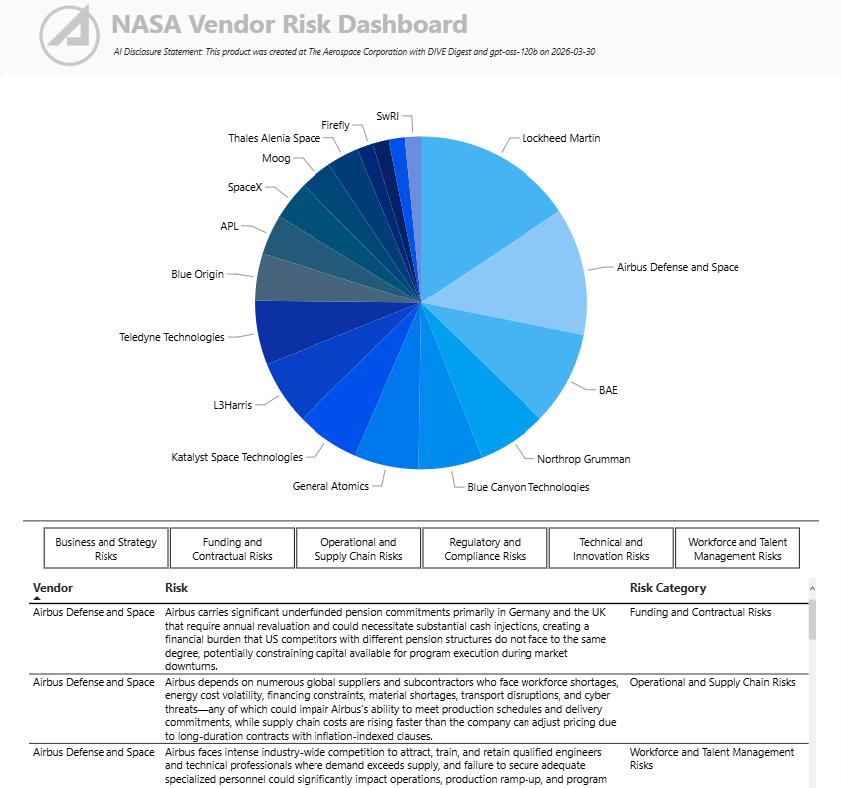
Dashboard Visualization

Slide 9
Next Steps
Scaling and Enhancing the Approach
Near-term
  Automate periodic scrapes and updates to visualization
  Expand vendor coverage and data sources
  Refine categorization taxonomy based on user feedback
Long-term
  Expand to other vendor metrics and risk focus areas like supply chain
  Create reusable framework for other programs/domains
Scalability
  Framework designed to be program-agnostic
  Customizable queries and keywords for different domains
  Applicable to any unstructured data challenge

Slide 10
Conclusion
Automated risk mining using LLMs processes internal and external sources at scale
Customization of search queries and prompts drives consistent, quality results
Standardized extraction enables aggregation and interactive visualization
Provides comprehensive risk insights for informed decision-making
Scalable framework is reusable and adaptable to other cost and schedule challenges

Slide 11
Questions

