Slide 1
Navigating the UFE Quagmire: Is Implementing UFE Undermining Forecasts?
Presenters: Michele King and Barbara Phillips
NASA Cost & Schedule Symposium | Glenn Research Center | August 2026
Notes:
First, let’s start with some humor. Let’s do a call out question, who knows what a quagmire is?
In slang and informal speech, quagmire means a messy, complicated, and hard-to-escape situation or a total mess. It comes from the literal word for a soft, muddy swamp where you sink and get stuck, metaphorically meaning you are "bogged down" in trouble.

Slide 2
Contents
What is UFE?
Polling Questions
Why are UFE and MR Confused?
How can UFE Impact Forecast?
What are the Triggers for an Over Target Baseline (OTB)?
Notes:
"Welcome everyone. Today we are untangling the UFE quagmire. We'll start by looking at policy definitions, test our collective knowledge, look at the structural framework of baselines, and finally review actual project data showing why getting this wrong is a strategic risk to the Agency."

Slide 3
What is UFE? Defined in 7120.5
UFE is a mechanism to protect NASA projects from exceeding their Agency Baseline Commitments (ABC). Per NASA policy¹, UFE “are costs that are expected to be incurred but cannot yet be allocated to a specific sub-element of a programs or project’s plan because the estimate includes probabilistic risks and specific needs that are not known until these risks are realized. Management control of some UFE may be retained above the level of the project (i.e., Agency, Mission Directorate, or program).”
The UFE allocated above the project, known as Mission Directorate UFE (MD UFE), is part of the documentation at confirmation (KDP-C). Estimated MD UFE when added to the estimated Management Agreement life cycle cost (MA LCC) equals the mission’s total LCC.
In 7120.5F, Section 3.0 Project Control Plans, 3.1 Technical, Schedule, and Cost Control Plan to include:
Cost Trends (Plan vs. actual, UFE, EVM)
Describe the project’s implementation of Earned Value Management (EVM) including:
  How the PMB will be developed and maintained for the project and how UFE will be established and controlled (page 130)
  Describe the process for utilizing the project’s technical and schedule margins and UFE to meet the Management and Commitment Baselines (page 131)
NOTE: In 7120.5F, EVM and UFE are treated separately and not intended to be comingled.
The term “funding” is not used in 7120.5.
¹ NASA Space Flight Program and Project Management Require 7120.5F
Notes:
"Let's ground ourselves in NPR 7120.5. UFE is meant for probabilistic risks that aren't known until they are realized. Note the distinct separation of EVM and UFE in the policy. But the crucial takeaway is at the bottom: The term 'funding' is not used in 7120.5. Yet, out in the real world, UFE ultimately turns into funding to pay the bills. That gap is where our trouble starts."

Slide 4
Polling Questions
Can UFE be used for fee? [yes/no]
Can UFE be used for new scope? [yes/no]
Can UFE be used for overruns before the money has been spent? [yes/no]
Has there ever been a project that didn’t exhaust its Project-level UFE? [yes/no]
Has there ever been a project that didn’t exhaust its allotted Mission Directorate-level UFE? [yes/no]
Notes:
"Before we dive in, let's test the room. I’ll read these out loud—just raise your hands or think of your answer. [Read questions]. If we have mixed answers in this room, it means we have mixed applications across NASA projects. Let's look at why that matters."

Slide 5
Surveillance Findings
Persistent Patterns Identified: Surveillance data reveals four recurring issues in NASA supplier reporting:
  Ambiguities in reserve treatment (conflating MR and UFE).
  Structural misalignment between funding mechanisms and EVM constructs.
  Governance sensitivities and suppressed escalation triggers.
  Reporting limitations that obscure analytical visibility.
The Root Cause: A breakdown in synchronization among Program Management, Procurement, and EVM surveillance organizations during contract execution and baseline maintenance.
Immediate Result: EIA-748 compliance gaps, masking of actual cost growth, and inconsistent variance attribution.
Long-Term Impact (The Strategic Risk): Failure to capture accurate root causes for cost overruns degrades NASA’s historical actuals database. The lack of clean, reliable historical data structurally weakens the Agency's ability to accurately estimate and price future missions.
Notes:
"Before we answer those poll questions, let's look at why getting them wrong is a strategic risk to NASA. This isn't just a minor administrative mix-up.
Our EVM Surveillance data shows a breakdown in synchronization between Program Management, Procurement, and EVM teams. The strategic risk here is massive: If we conflate MR and UFE, we mask the root causes of cost overruns. This degrades NASA’s historical actuals database, which structurally weakens our ability to price future missions."

Slide 6
Why are UFE and MR Confused?
Criteria | MR | UFE
Source of Policy Guidance | EVM Standard, EIA-748 D, Guideline 14, cites MR is for unplanned activity within the project scope. Unexpected work scope growth within the contract SOW, rates changes, or schedule slips are examples. | NPR 7120.5F, paragraph 2.4.1.4, cites UFE as costs that are expected to be incurred but cannot yet be allocated to a specific WBS sub-element of a program or project’s plan.
Value Determined by Risk Analysis? | YES. Based on ongoing project-specific risk analysis and PM discretion. PM sets challenges on CAMs and collects the budget in MR to distribute based exception[[ns through the change control process | YES. Based on JCL and probabilistic risks.
Budget v Funding | Budget. Used for planning and measuring performance. | Funding. Converted to money used to pay invoices. Budget. Converted to planning dollars for measuring performance.
Used for Cost Overruns | NO. EVM Standard clearly states MR is not to be used to cover overruns (can cover variances). | YES. Contract mods show clearly that UFE can be used for overruns.
Usage for EAC | Part of project management EAC | Added to project management EAC to determine EAC (or breach buffer) against the MA/ABC.
Fee Assessed? | YES | NO. “Since it is for risk reduction, and if the risk never materializes, then not costed and at the end of the project any residual is wiped off the books.” *
Controlled by Contract Mod | NO | YES. Attachment J-4 in ARDES II Task Orders
* Email message from Procurement, Jane Thomas Bush, to Kristen Kehrer, May 15, 2024
Question: Is the confusion between MR and UFE warranted?
Notes:
"Before we dive into this table, let's grade our poll from a few minutes ago. The answers are:
No, UFE is not allowed to be used for fee on contracts we’ve seen. UFE doesn’t get fee assessed right out of the box. On an exception basis, NASA can convert it to fee in a contract mod, should the agency choose to do so. It is not a restriction so much as not automatically given. It’s at NASA’s discretion. Welcome to the quagmire.
Yes, UFE can be used for new scope via a contract mod.
No, you cannot use UFE to pre-fund overruns before the money is spent.
And for questions 4 and 5... the answer is almost universally No. Projects almost never leave Project-level or MD-level UFE unspent. If the money is there, it gets used.
So, why did we have mixed answers in the room? The confusion is actually warranted because our policy guides—EIA-748 for EVM and NPR 7120.5 for Program Management—speak slightly different languages.
If you look at the 'Budget v Funding' row on this table, EVM speaks in terms of 'budget,' while 7120.5 speaks in terms of 'funding.' And regarding that first poll question, look at the 'Fee Assessed' row. We actually have an email from Procurement confirming UFE should not be assessed for fee, because it's meant for risk reduction. If the risk never materializes, the residual is wiped off the books."

Slide 7
Defining MR vs. UFE Core Functions
Management Reserve (MR): Governed by EIA-748 EVMS guidelines. It is strictly an in-scope budgeted contingency. It resides within the CBB/MA, but outside the PMB. It is only moved into the PMB when allocating budget for realized in-scope risks or newly identified authorized work.
Unallocated Future Expense (UFE): Governed by NPR 7120.5. Expected total risk budget (JCL buffer). It resides above the CBB and outside the contract baseline. It protects the Agency Baseline Commitment (ABC) and must be formally released (via Contract Mod or OTB) before it can be incorporated into the PMB.
The Rule: Both reserves sit outside the measuring stick (the PMB). The difference is that the Project Manager has the discretion to allocate MR into the PMB, whereas UFE requires formal external release to cross the contract boundary.
Notes:
"To clear up the confusion, let's distill this into 'The Rule.' Both reserves sit outside the PMB measuring stick. MR is within the Project Manager's discretion to handle in-scope risks. UFE requires formal external release to cross the contract boundary. You cannot just slide it in."

Slide 8
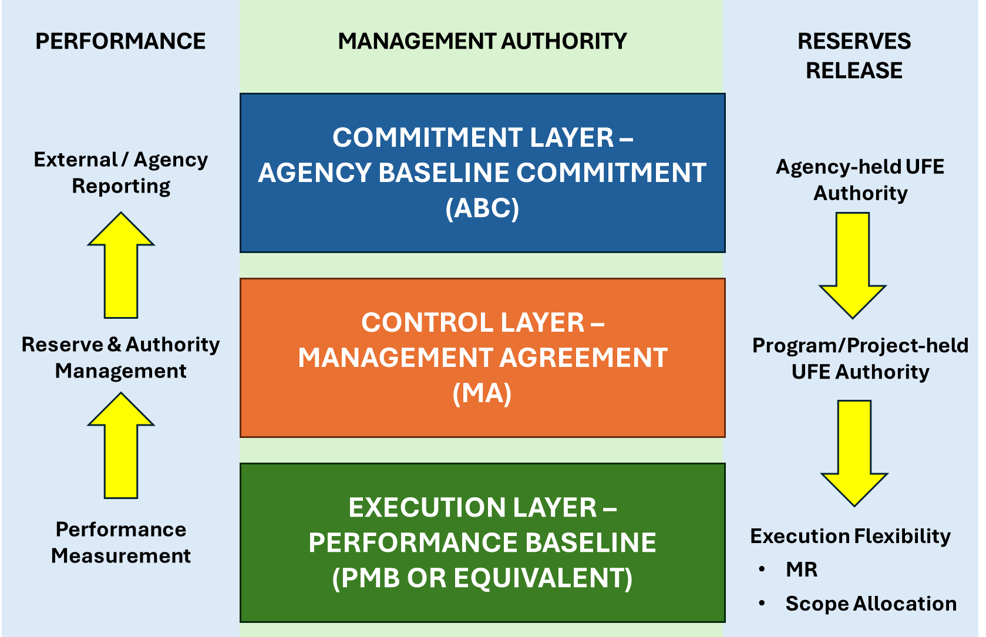
The Framework – Commitment, Control, Execution
Commitment Layer = ABC
Protected by UFE
Control Layer = MA
Where MR provides execution flexibility
Execution Layer = PMB
The measurable baseline
The PMB must remain shielded from blunt funding releases to keep performance measurement credible.
Notes:
"To understand that rule, look at how NASA structures authority. UFE protects the Commitment Layer—the ABC. MR provides flexibility in the Control Layer—the MA. The PMB is strictly your Execution Layer. As the blue box says, the PMB must remain shielded from blunt funding releases, or you destroy your ability to measure performance."

Slide 9
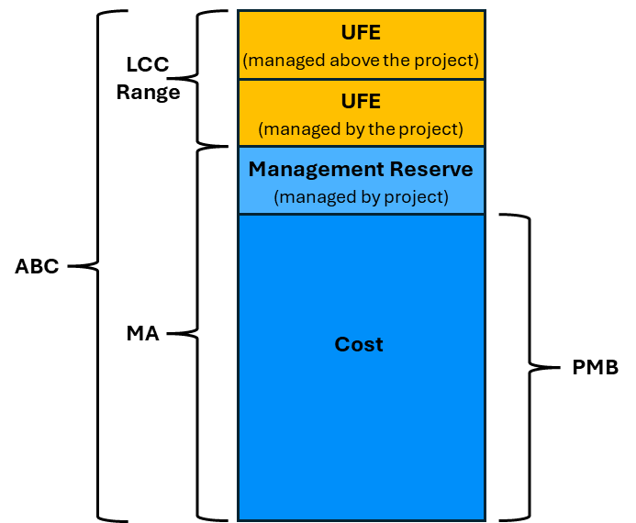
Defining the Baseline Boundaries
(Constituent Parts)
PMB (Performance Measurement Baseline): The time-phased budget plan for accomplishing authorized in-scope work. This is the core EVM measuring stick.
MA (Management Agreement): The total project cost and schedule target (PMB + MR). This is the internal project execution authority.
ABC (Agency Baseline Commitment): The highest-level external commitment to Congress and stakeholders. (MA + UFE).
LCC Range (Life Cycle Cost Range): The total estimated cost of all project phases (A–F). During Formulation, this is expressed as a High/Low range. At KDP-C, the LCC becomes a single-point estimate and is equal to the ABC.
Notes:
"Visually, here is how those layers stack up. Notice how MR is inside the Management Agreement (the blue box), but UFE sits completely above it (the yellow boxes). You cannot simply push UFE down into the PMB without crossing a formal governance boundary."

Slide 10
How Can UFE Impact Forecast?
Project BAC | $100 | UFE | $25 | BAC + UFE | $125
CPIcum | 85%
EACcpi | $118 |  |  |  | $147
Difference between Project EAC and Project w/UFE EAC |  |  |  |  | $29
 |  |  |  | Difference | 20%
EAC without UFE visibility | $118
Actual EAC with UFE (assuming same efficiency) | $147
Hidden cost overrun | $29
Percentage underestimation | 20%
In this scenario, the BAC is $100 and the cumulative to date cost performance index is .85 so the project is getting $.85 on every $1.00 spent. Then the project gets an infusion of $25 in UFE. It doesn’t get planned and no performance is measured against it. But suppose, the budget plus the UFE performs the same as the budget that is being measured. That EAC is 20% higher. But we don’t know.
This is the critical problem: Because UFE isn't tracked or forecasted with the same rigor as the baseline budget, project managers and stakeholders are blind to 20% of the actual cost overrun. The project appears to be tracking toward an EAC of $118, when it's actually heading toward $147—a significant gap that can lead to:
  Budget shortfalls
  Inadequate funding requests
  Poor decision-making based on incomplete data
  Stakeholder surprises at project completion
Notes:
"Here is the mathematical consequence of breaking that boundary. If a project is performing poorly (a CPI of .85) and gets a $25 infusion of UFE that they just dump into the budget without adding planned work, it artificially inflates their EAC by 20%. We lose true visibility into what the project will actually cost.“
You're flying blind on 20% of your project costs. Because the UFE isn't being measured, you don't know if it's performing well or poorly. If it performs as badly as the rest of the project, you're significantly underestimating your final costs.
Bottom line: Untracked money creates invisible risk in your forecast.

Slide 11
The Right Tools for the Job
(Contract Mod vs. OTB)
Contract Modifications
(Adding Authority)
  Trigger: New work is authorized.
  Action: UFE is legally awarded to the supplier to incorporate newly authorized work into the PMB or Contract Budget Base.
  Rule: It is not an EVM administrative tool to restructure or overwrite execution variances on existing work.
Over Target Baseline / OTB
(Restoring Analytical Credibility)
Trigger: The existing plan is mathematically impossible to execute (sustained unrecoverable variances on existing, authorized in-scope work).
Action: UFE is legally awarded to the supplier to formally re-budget the remaining work to restore management-by-exception capability.
Rule: Triggered by a loss of baseline validity, not just a desire for more funding.
Notes:
"So, how do we get UFE into the project legally? There are two proper tools. First, a Contract Mod—this is used to add new scope or legally award UFE. Second, an Over Target Baseline, or OTB. This is triggered when the existing plan is mathematically impossible to execute, and you need to formally re-budget the remaining work to restore credibility."

Slide 12
Guarding the Baseline
(Best Practices)
Guardrail 1: Guarding Against Variance Erasure
  Concept: A Contract Mod adds budget for new work; it does not change the budget for existing work.
  Warning: Analysts must verify that newly awarded UFE/budget from a mod is not improperly used to retroactively zero-out existing cost/schedule variances.
Guardrail 2: Archiving Before a Reset
  Concept: If an OTB is used to execute a "Total Reset" (measuring to a new baseline), you establish a clean slate.
  Warning: The historical baseline and performance data must be archived before the reset to prevent the absolute loss of visibility into prior execution inefficiencies.
Notes:
"But even with the right tools, there are traps. Guardrail 1: You cannot use a Contract Mod to retroactively erase existing cost variances. Guardrail 2: If you do execute an OTB to do a total reset, you must archive your historical data first, or we lose all the learning from our past inefficiencies."

Slide 13
Interaction Example: When Cost Growth Triggers an OTB
Step 1 (The Overrun): Contractor experiences unrecoverable overruns on existing work. MR cannot be used.
Step 2 (The UFE Release): UFE is formally requested and authorized to cover the financial reality.
Step 3 (The EVM Disconnect): Because the original PMB budget is blown, continuing to measure against it yields useless data.
Step 4 (The OTB Interaction): An Over Target Baseline is executed. Historical variances are zeroed out, the PMB is reset using the authorized UFE, and future performance is measured against the new, realistic PMB.
Example: Imagine a contractor finishes building a widget. They planned to spend $1M (PMB), but they actually spent $1.5M. They have a massive, unrecoverable cost overrun of -$500K. Because they literally need the money to pay their engineers, NASA releases $500K of UFE to "bail them out."
The Trap: The contractor will desperately want to put that $500K into their PMB. Why? Because if their PMB goes from $1M to $1.5M, their Cost Variance magically goes to zero. It hides their poor performance and makes their metrics look green.
The Rule: EVM policy strictly forbids this. You cannot retroactively increase the PMB budget for work that is already overrunning just to make the math look better. Therefore, the $500K UFE is added to the Contract Value (so they can get paid), but it is kept out of the PMB.
The Exception: The only legal way to put that overrun money into the PMB to reset the variances is to force the contractor to execute a formal Over Target Baseline (OTB).
Notes:
"Let’s put this in the real world. Imagine a contractor building a widget. They overrun by $500K. They literally need cash to pay their engineers, so NASA releases $500K of UFE. The Trap is the contractor desperately wanting to put that $500K into their PMB because it magically makes their cost variance go to zero and their metrics look green. The Rule is EVM strictly forbids this. The only legal way to reset those variances is to execute a formal Over Target Baseline (OTB).
So, if the rule says you have to do an OTB to reset your variances... it begs the question: Are there actually any known instances of projects proposing and being granted an OTB lately? Let's look at the data..."

Slide 14
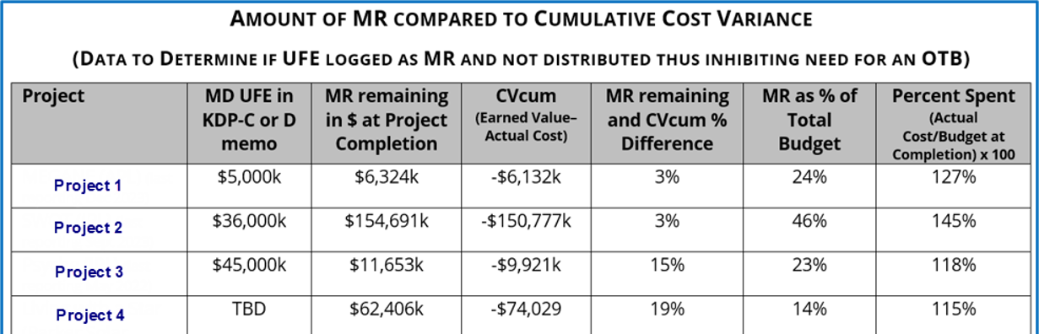
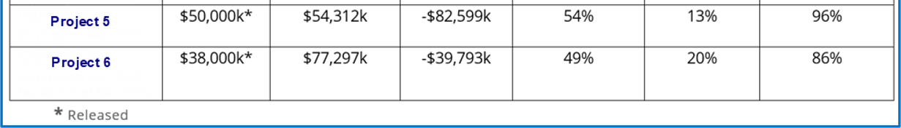
Triggers for OTB are Masked when Data supporting that UFE is logged with MR in the EVMS; thus, inhibiting OTB trigger
The "Catch-22" & Silent Cost Growth
Question: Is UFE in MR deterring OTBs?
Notes:
"The short answer is no. And this chart of actual projects shows exactly why. As you can see, UFE is being improperly logged as MR. By dropping that funding into MR without an OTB, projects are absorbing massive cost growth silently. It masks the true cumulative cost variance. EVM reporting looks mathematically 'healthy,' but it's an illusion. The trigger for an OTB is completely suppressed, and we lose all visibility into the true health of the mission.“
So now for the red box question – Is UFE in MR deterring OTBs? As we’ve just shown, the answer here is yes.

Slide 15


Slide 16
Abstract
The challenge with Unallocated Future Expense (UFE) lies not in the concept itself, but in its implementation. Suppliers frequently fail to incorporate UFE into their performance measurement baselines, resulting in up to 25% of project budgets remaining unmeasured. In many cases, UFE is improperly bookkept as Management Reserve (MR) and is never formally distributed. Consequently, performance tracking is compromised, and decision-makers lack visibility into what may constitute a quarter of their total budget. The money gets spent, but it fails to contribute to the performance trends.
Significant ambiguity exists regarding the proper use of UFE. Project teams, procurement, and program offices often operate with divergent interpretations and expectations, creating systemic misalignment across the agency. By clarifying the strict governance boundaries between MR and UFE, this presentation will address these common implementation hurdles and procurement realities.
This presentation demonstrates the real-world impacts of current practices, including silent cost growth, suppressed Over Target Baseline (OTB) triggers, and critical traceability gaps that undermine project oversight and accountability.

