Slide 1

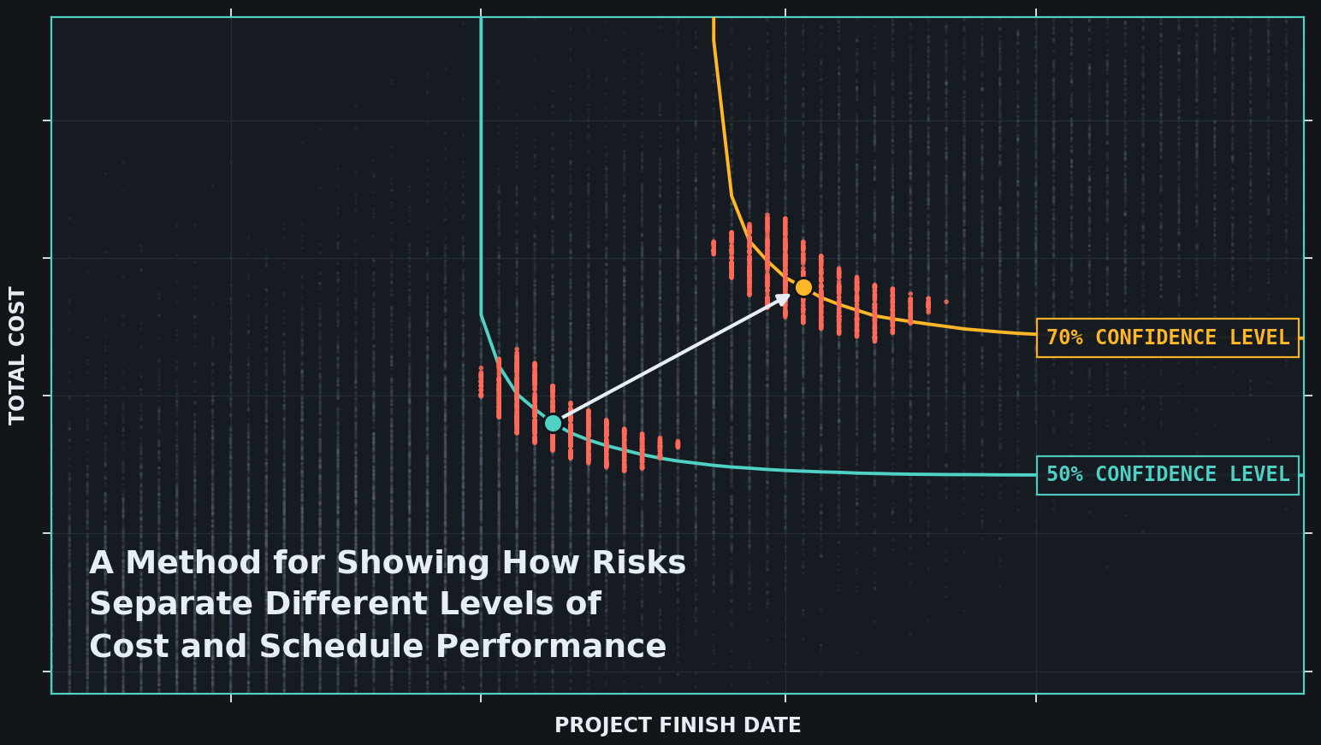
The Geometry of Confidence
aamir.consulting
The Geometry of Confidence
2026
New Mathematical Foundations for Joint Confidence Level (JCL) Analysis
By Aamir Ahmad, M.S. Applied Mathematics
Principal Consultant
at aamir.consulting
Notes:
Save questions for the end.
Worked at NASA’s Kennedy Space Center (KSC) with a background in applied mathematics.
I translate to unite:
Biologists -> Engineers
Statisticians -> Leadership
Math is a common language
I transform to create:
Earth Data -> Space Solutions
Historical Data -> Active Projects
Math is a structural common ground
Presentation today is inspired by my work on JCL analysis at KSC.

Slide 2
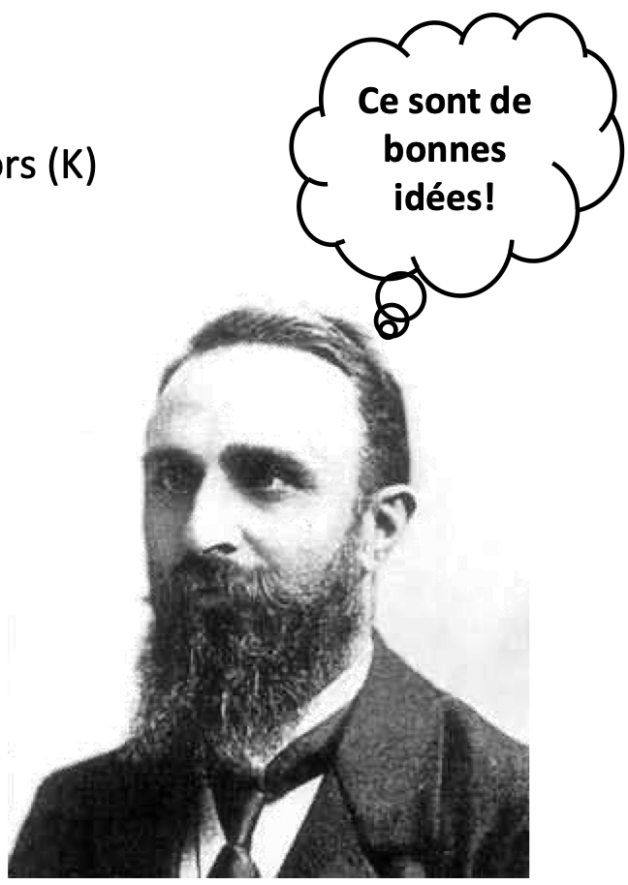
Louis Fussell
aamir.consulting
The Geometry of Confidence
2026
Louis Fussell’s 2024 presentation Standardization of JCL Value Selection
A JCL models the possible cost and schedule outcomes of a project through a Monte Carlo simulation based on initial schedule assumptions.
Louis wanted to develop a confidence interval around the perfect JCL point.
Why? To tie the JCL back to discussions about project risks
Note: This is a photo of a French mathematician, not Louis Fussell.

Slide 3
Part 1
The Basics of
Joint Confidence Level (JCL) Analysis
aamir.consulting
The Geometry of Confidence
2026

Slide 4
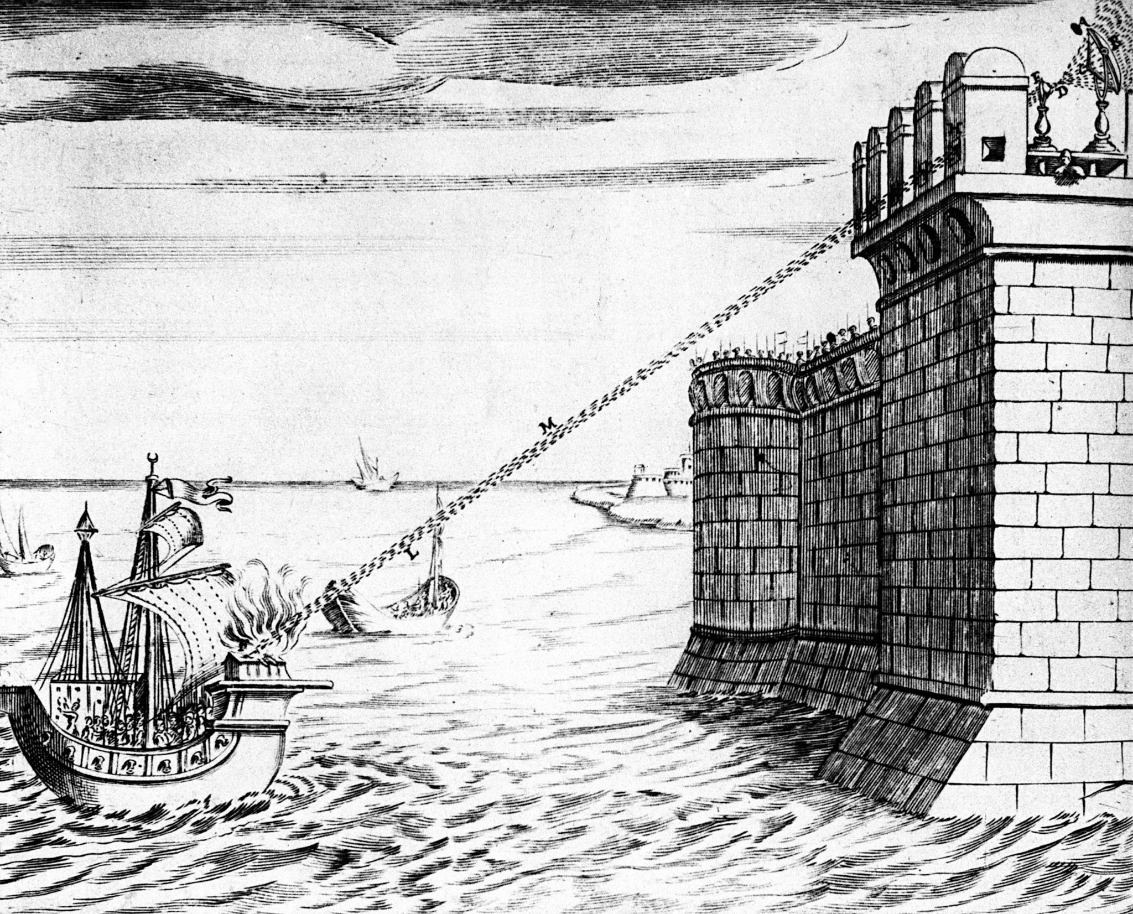
Archimedes’ Sun-Laser
aamir.consulting
The Geometry of Confidence
2026
Archimedes is a mathematician in Syracuse, Sicily
Roman ships are headed to siege the city
He will build a sun-laser to defend Syracuse.
Sun-Laser:
Subsystem 1: Mirrors to focus sun rays
Subsystem 2: A frame for mobility

Slide 5
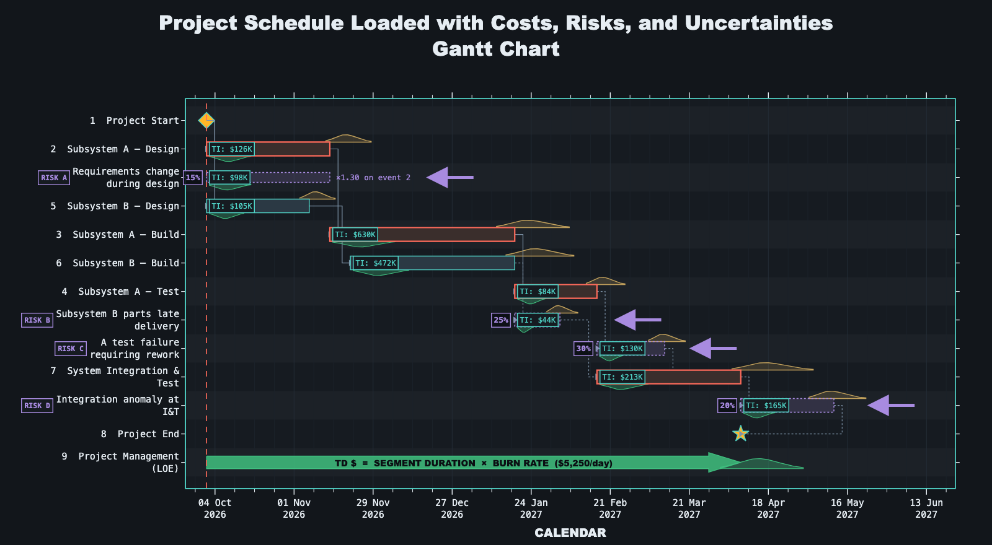
Establish Project Baselines
aamir.consulting
The Geometry of Confidence
2026
Notes:
Design, build, test, and integration of the two subsystems.
Mainly NASA CEH with key substitutions
Lognormal distribution for uncertainties instead of triangular
Build up the JCL and point back to the risks
Risks A, B, C, D

Slide 6
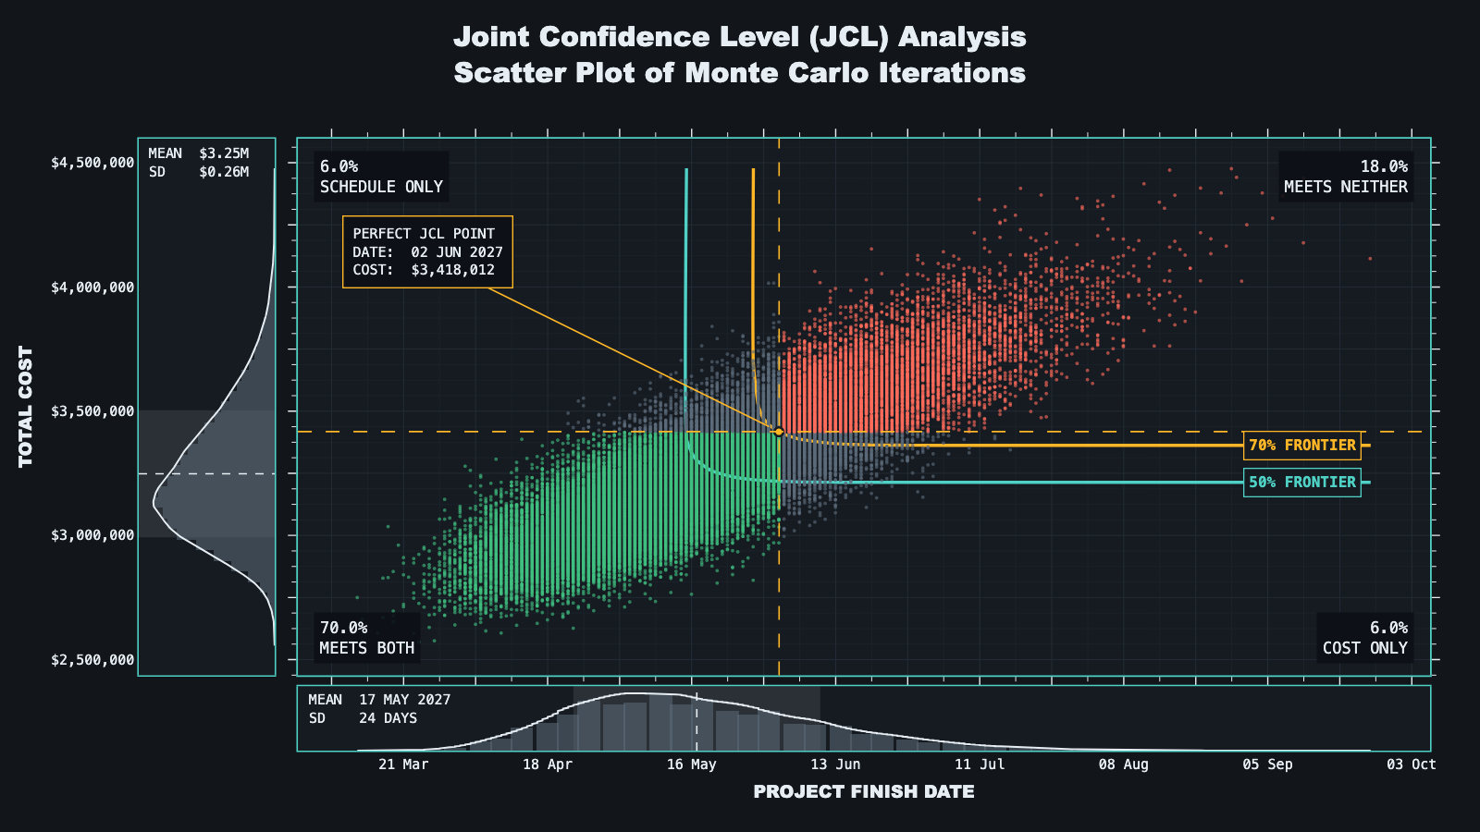
Run a Monte Carlo Simulation
aamir.consulting
The Geometry of Confidence
2026

Slide 7

Flexible Thinking
aamir.consulting
The Geometry of Confidence
2026
The Doors.
Hmm…
Confidence intervals are STATISTICAL objects
Wait!
JCL distributions are PROBABILISTIC constructs
The ?
The devil’s in the details.
Confidence intervals have no meaning in this context.
No, the band.

Slide 8

A New Data Table
aamir.consulting
The Geometry of Confidence
2026
While the Monte Carlo simulation is running, build a data table that records the
Individual risks (A, B, C, or D)
Risk combinations (e.g. A0C0)
that show up in each iteration of the scatter plot.
Then, report descriptive statistics of selected regions in the JCL.
This tells us the risk profiles that drive project performance to certain cost and schedule levels.

Slide 9
Flexible Thinking
aamir.consulting
The Geometry of Confidence
2026
Hmm…
Confidence intervals are STATISTICAL objects
Wait!
JCL distributions are PROBABILISTIC constructs
A-ha!
We can report the statistics of TARGETED regions
The devil’s in the details.
Confidence intervals have no meaning in this context.
We get the best of both worlds.

Slide 10
Part 2
Choosing Regions
of the JCL to Compare
aamir.consulting
The Geometry of Confidence
2026

Slide 11
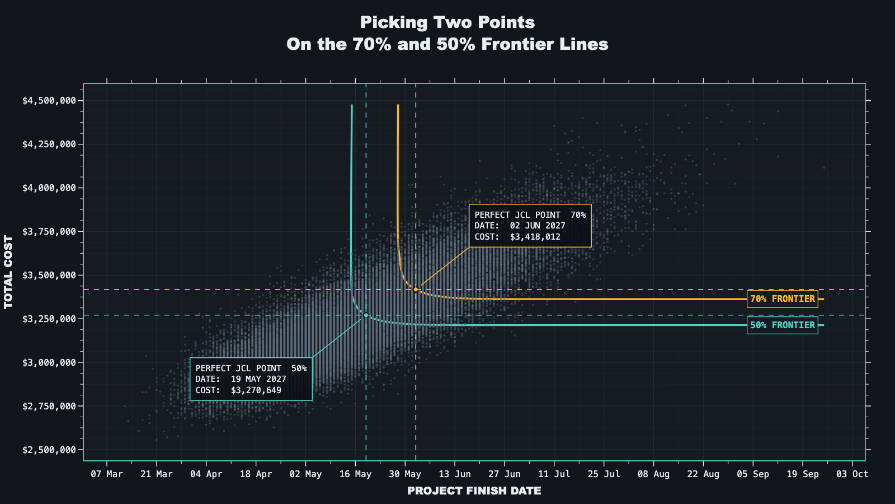
Pick Two Points
aamir.consulting
The Geometry of Confidence
2026
We start by choosing two points on the JCL scatter pilot to compare and build the regions around

Slide 12
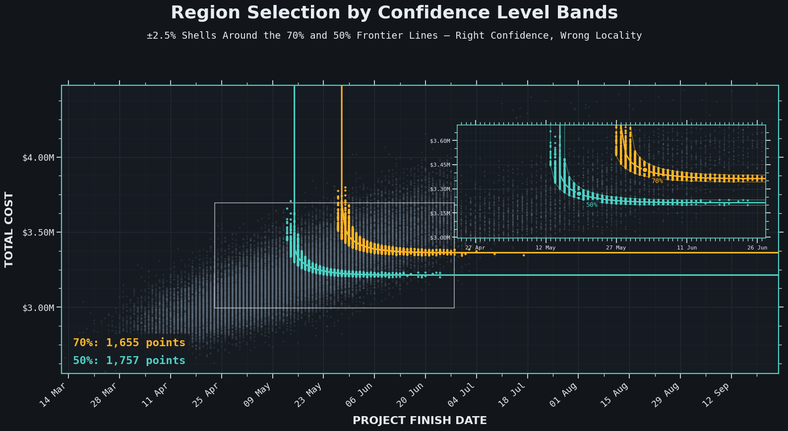
Confidence Level Bands
aamir.consulting
The Geometry of Confidence
2026
Pro: All points are at a similar confidence level
Con: Different regions of the band are not comparable

Slide 13
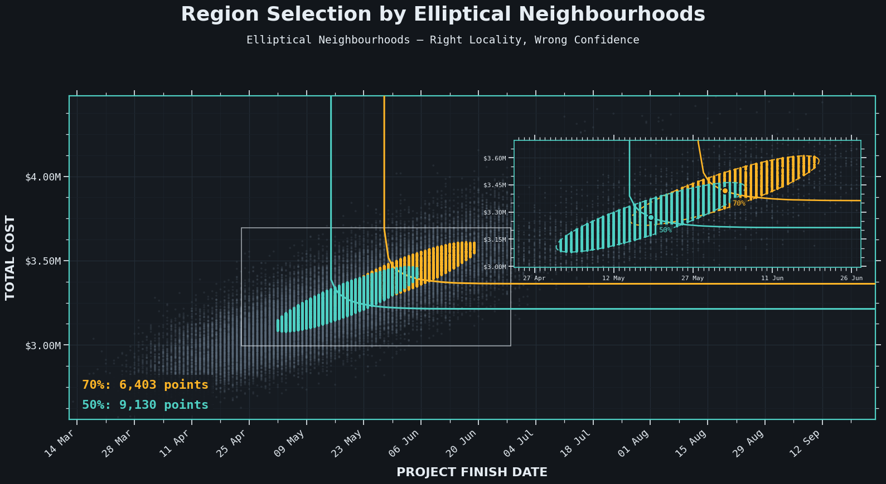
Elliptical Regions
aamir.consulting
The Geometry of Confidence
2026
Pro: Points in each region are statistically relevant to each other
Con: Points in the region are not at a similar confidence level

Slide 14
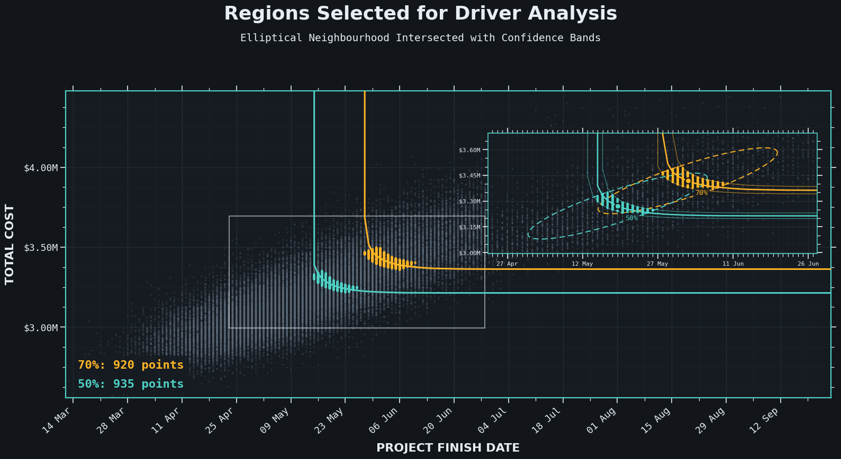
The Best of Both Worlds
aamir.consulting
The Geometry of Confidence
2026
Pro: Points in each region are statistically relevant other and at a similar confidence level
Caution: Run enough interactions on the Monte Carlo simulation to reach convergence

Slide 15
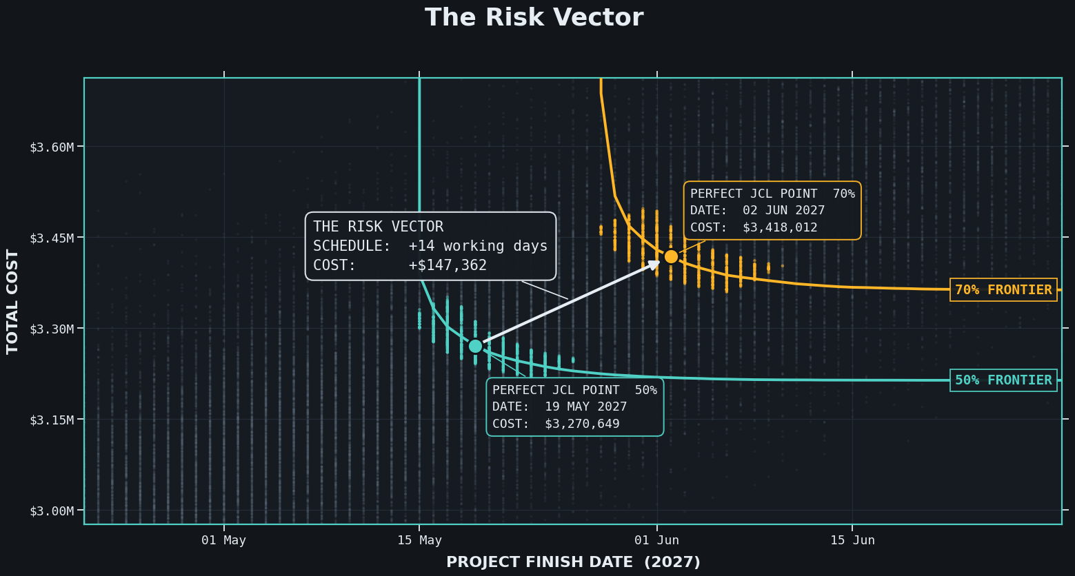
The Risk Vector
aamir.consulting
The Geometry of Confidence
2026
We have: The cost and schedule difference between the two points.
We need: To know which risks drive this difference.

Slide 16
Part 3
Visualizing the
Impacts of the Risks
aamir.consulting
The Geometry of Confidence
2026

Slide 17
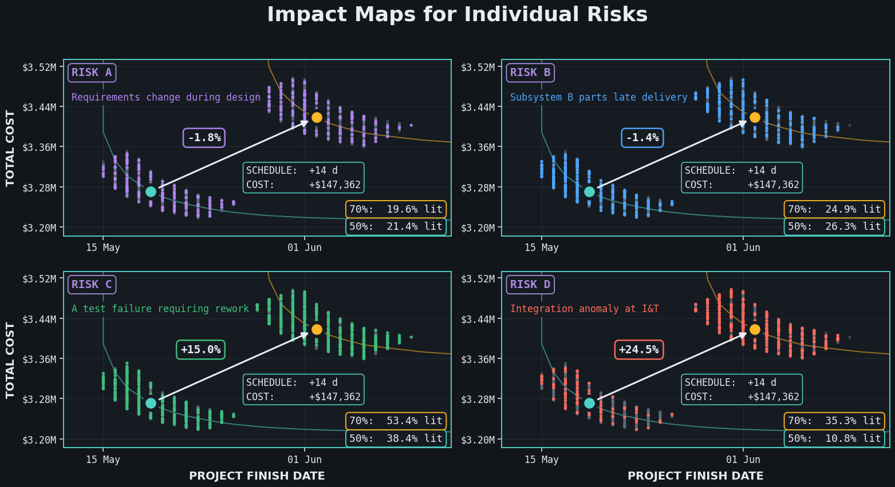
aamir.consulting
The Geometry of Confidence
2026
We can now see how each risk contributes to changes in cost and schedule and prioritize which ones need to be managed.

Slide 18
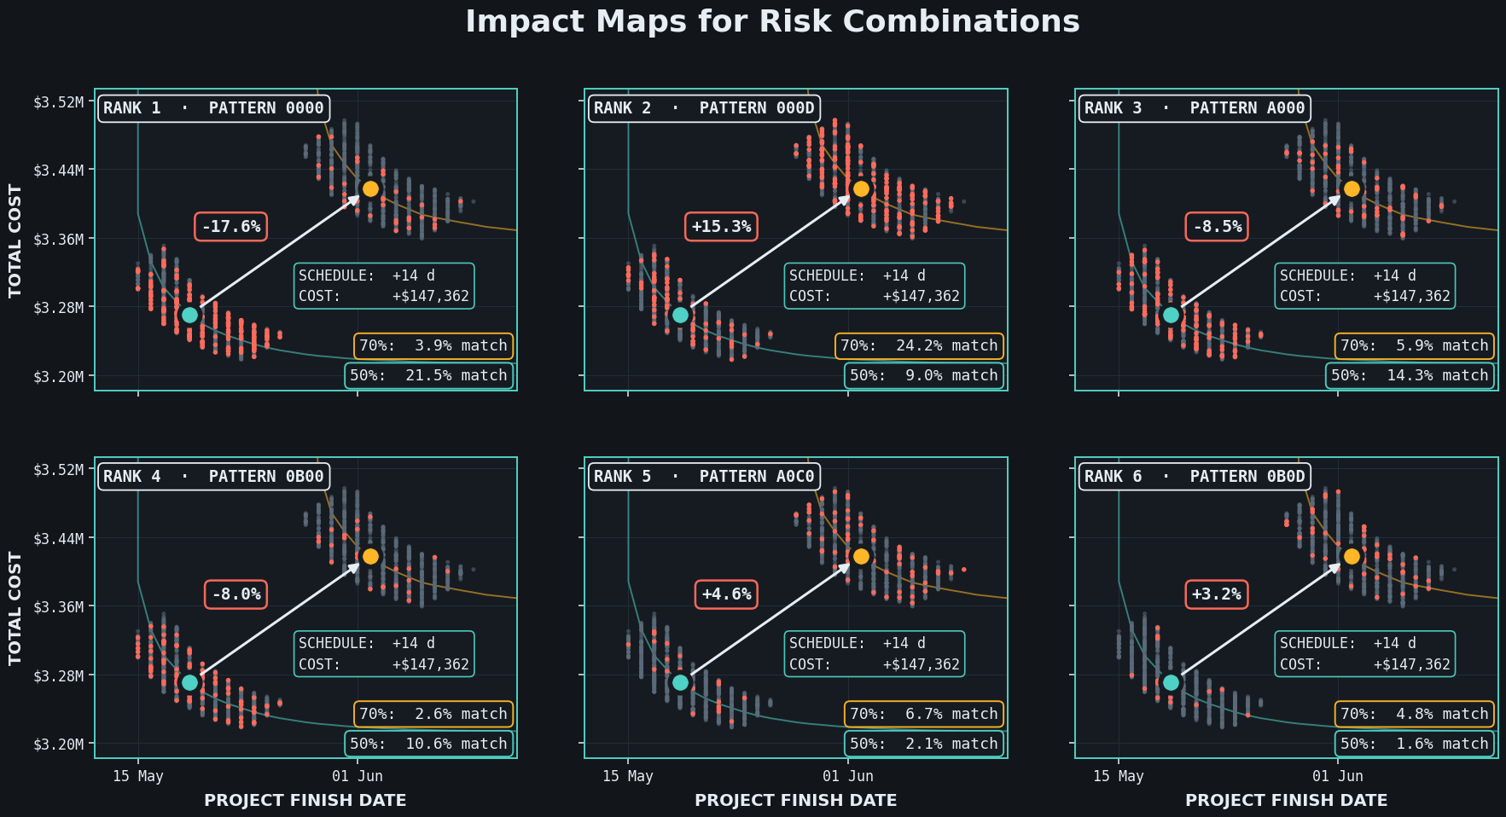
aamir.consulting
The Geometry of Confidence
2026
We can now see how each risk combination contributes to changes in cost and schedule and prioritize which chains of risk need to be managed.

Slide 19
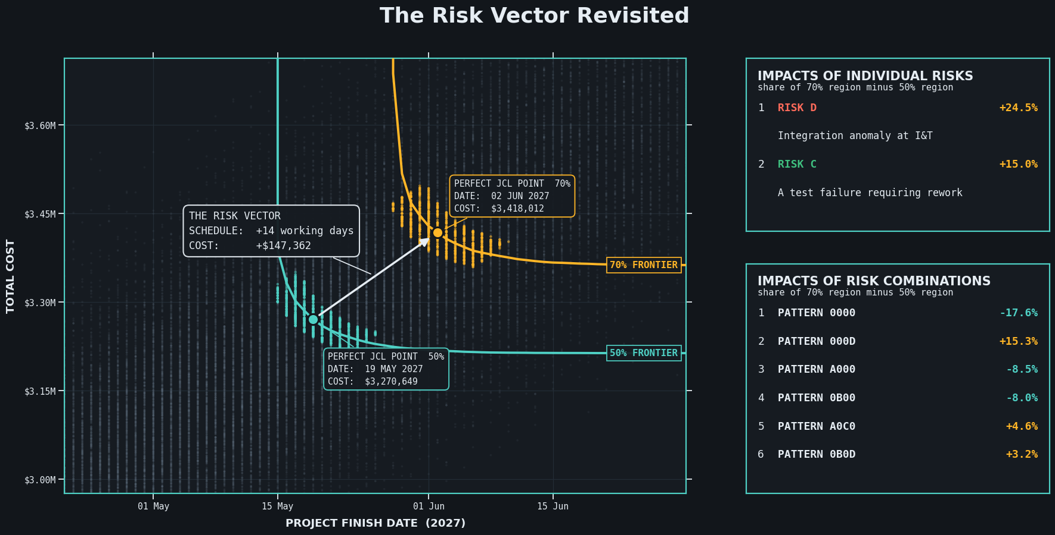
The Risk Vector Revisited
aamir.consulting
The Geometry of Confidence
2026
A simple way to summarize which risks drove the difference between the two regions.

Slide 20
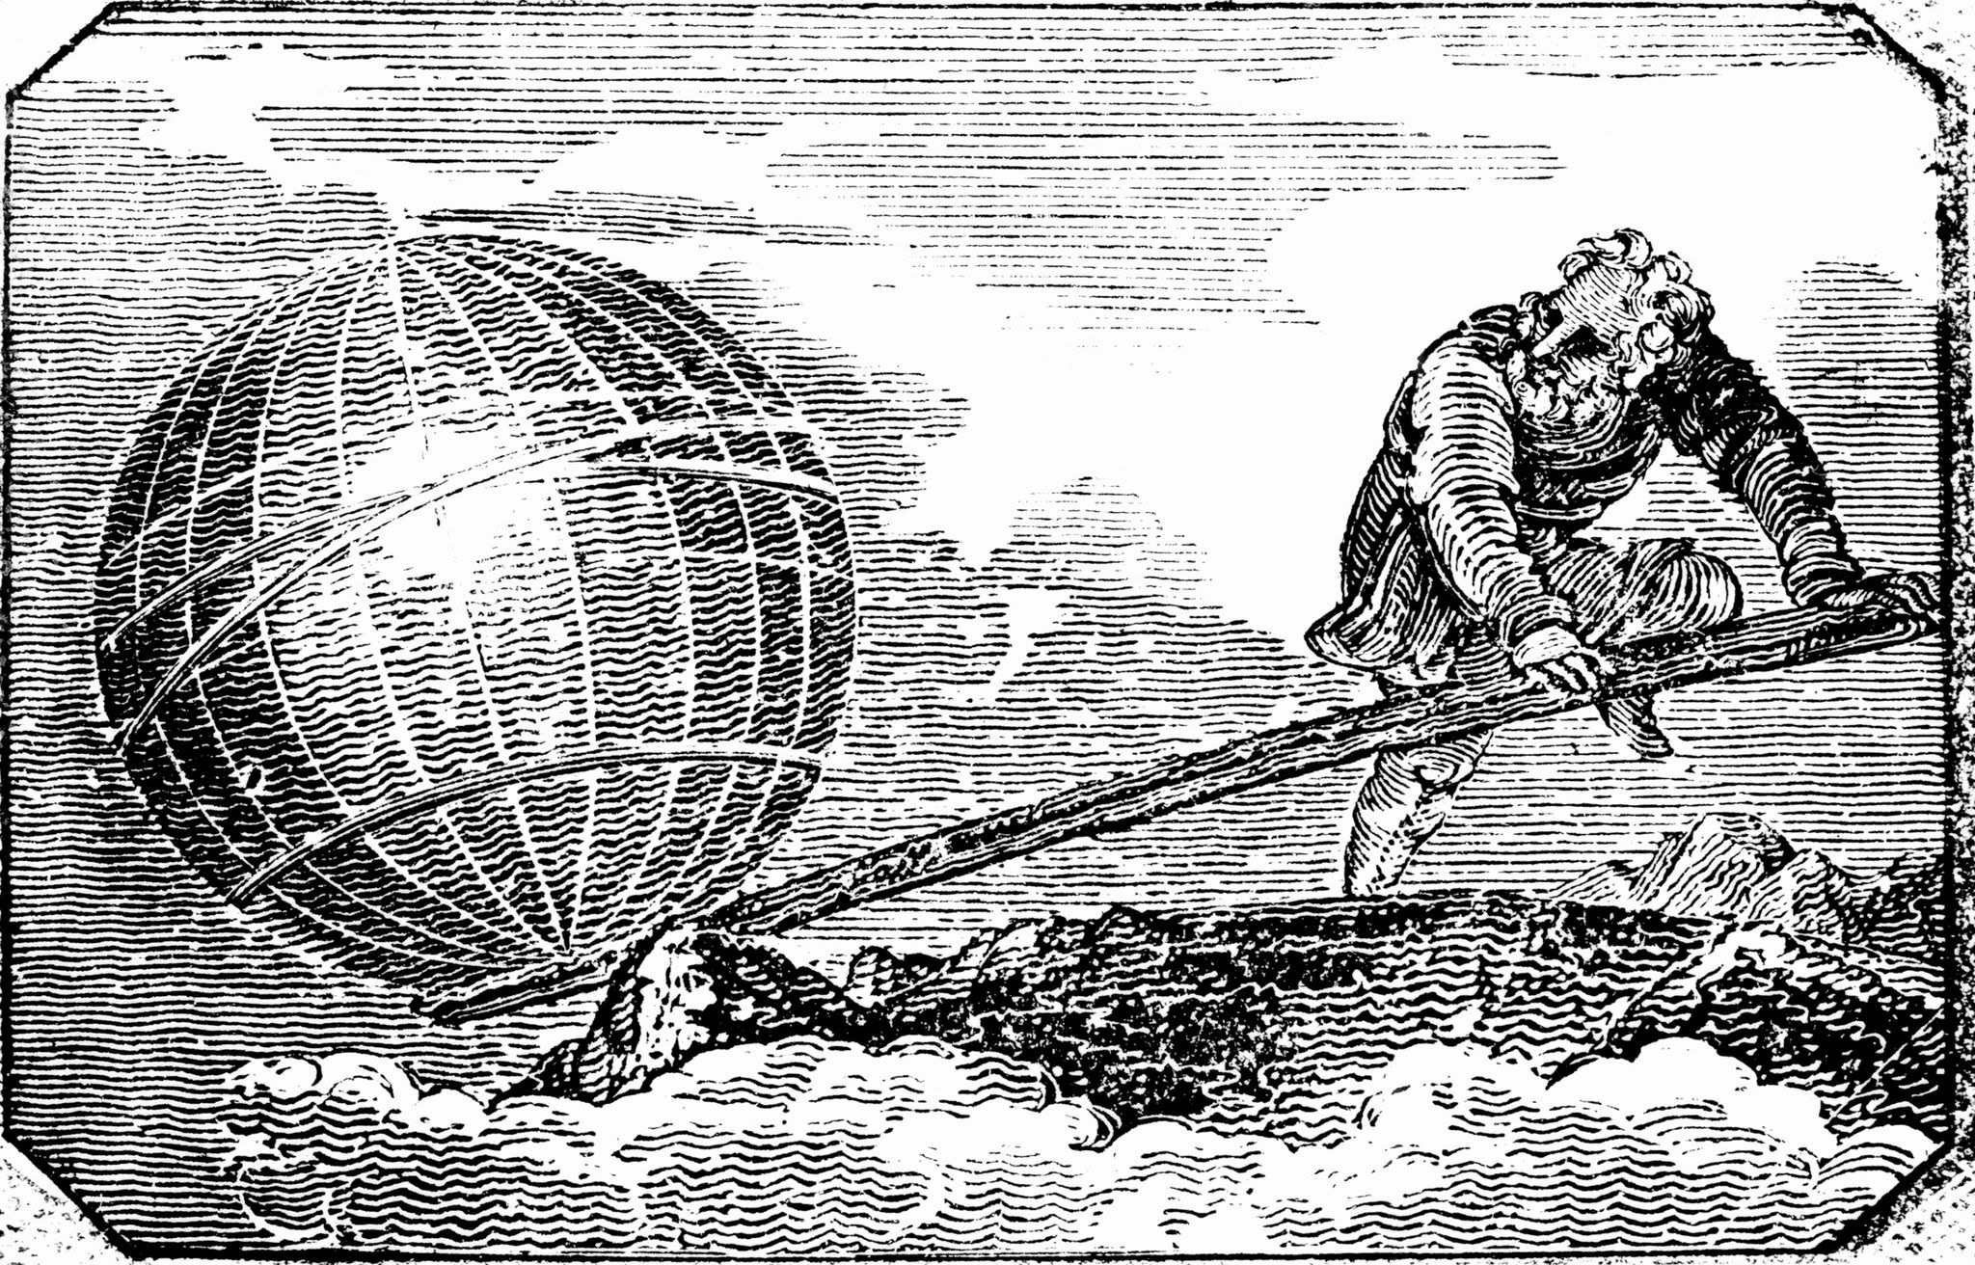
Archimedes Moves On
aamir.consulting
The Geometry of Confidence
2026
Finishes building his sun-laser ahead of schedule and under budget
Turns his attention to moving the Earth with a lever and a fulcrum

Slide 21
References
aamir.consulting
The Geometry of Confidence
2026
National Aeronautics and Space Administration. (2015). NASA Cost Estimating Handbook (Version 4.0). NASA Headquarters. https://www.nasa.gov/ocfo/ppc-corner/nasa-cost-estimating-handbook-ceh/
Fussell, Louis (2024, April 23). Standardization of JCL value selection [Conference presentation]. 2024 NASA Cost and Schedule Symposium, Hampton, VA, United States. https://www.nasa.gov/wp-content/uploads/2024/05/16-standardization-of-jcl-value-selection.pdf

Slide 22

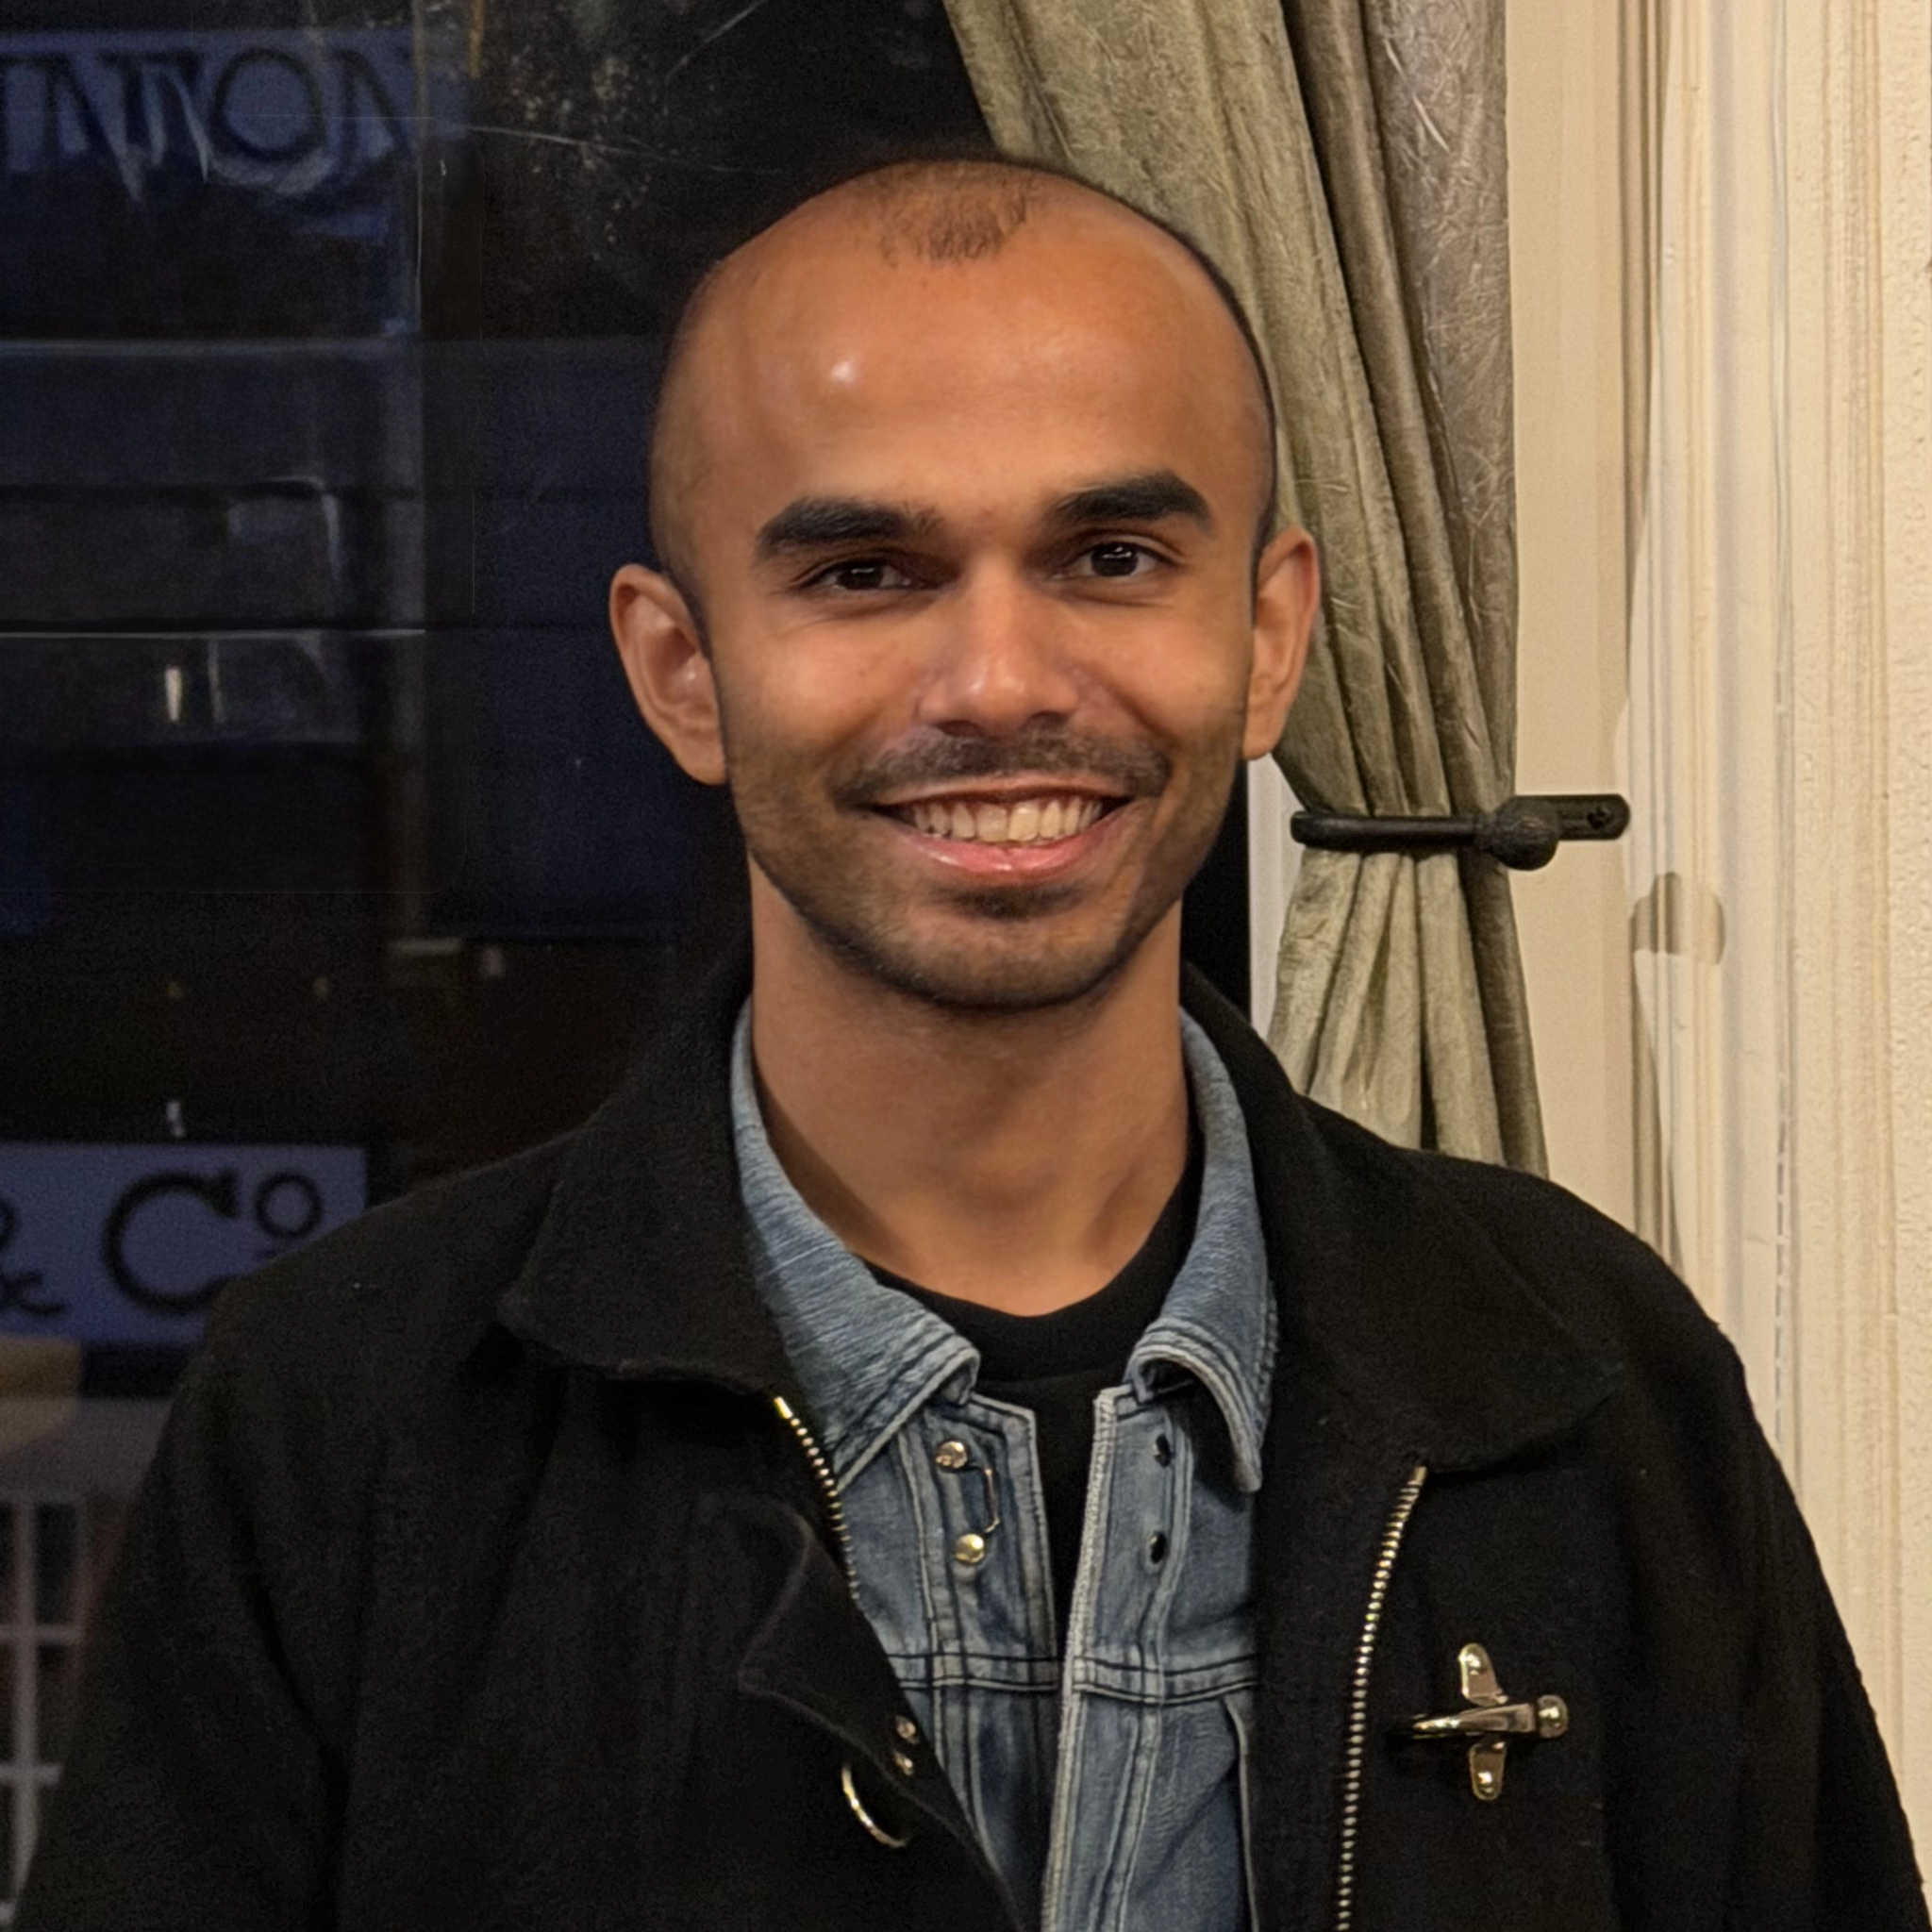

Contact
aamir.consulting
The Geometry of Confidence
2026
Email
LinkedIn
Website
aamir.consulting@proton.me
https://www.linkedin.com/in/
aamir-consulting/
https://aamir.consulting/

