Slide 1


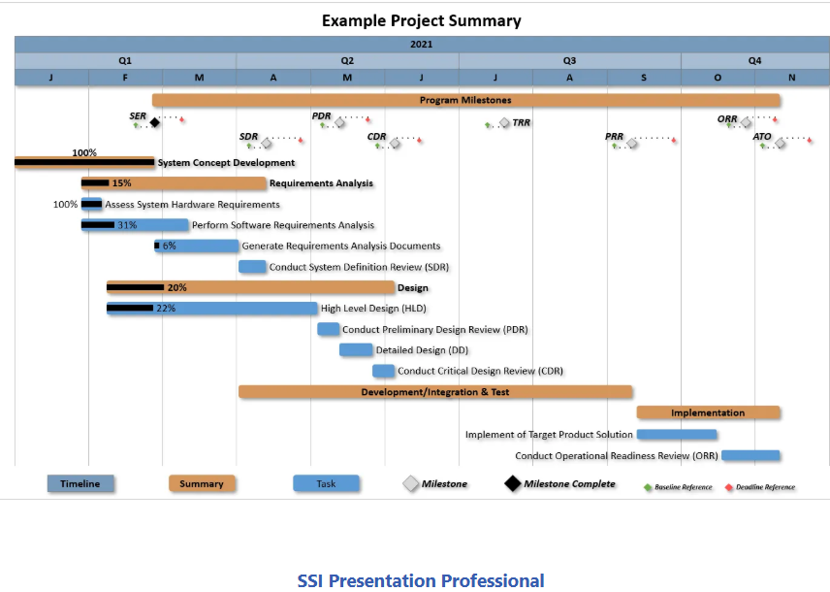

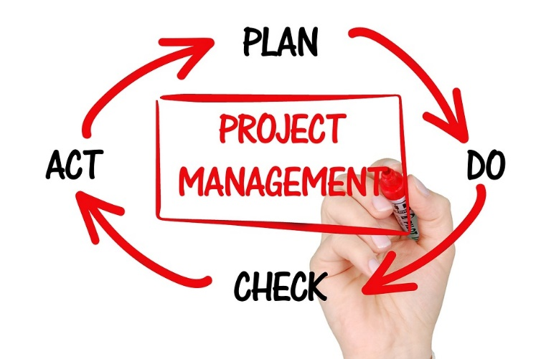




The MS Project
Master Schedule
Prepared and Presented by:
William (Bill) Paradis

Slide 2
Agenda
The Master Schedule; what is it and why we use them
Why use MS Project for Master Schedule; and why we don’t
Step by Step Process of Setting up Master (and Summary) Schedules
Tailoring Discussions
Other Summary Schedule Examples
Questions/Comments

Slide 3
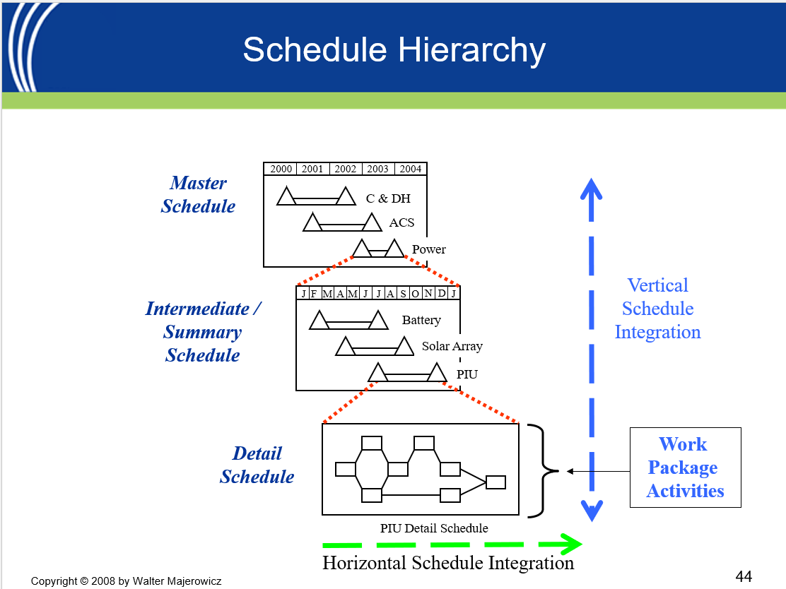
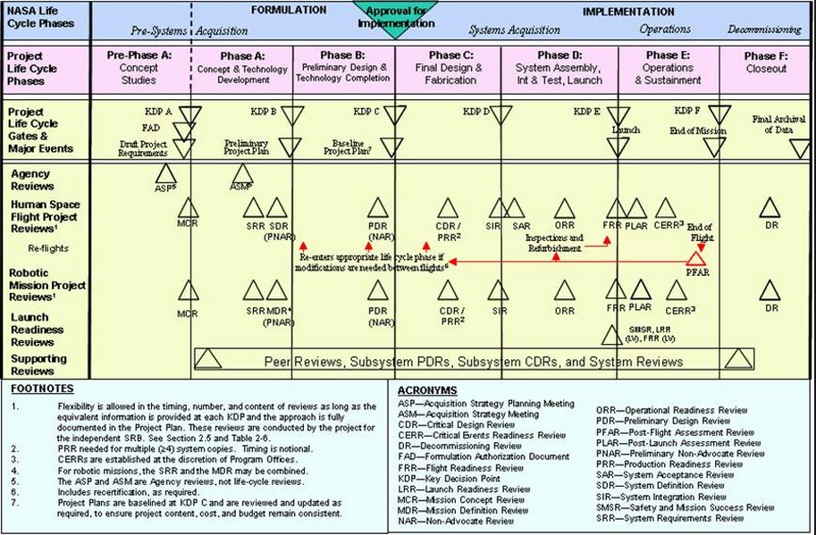
The Master Schedule; what is it and why we use them
A master schedule is a high‑level, integrated timeline covering spacecraft, instruments, ground systems, and mission operations.
Serves as the single authoritative source for milestone dates aligned with NPR 7120.5 and life‑cycle reviews.
Synchronizes work across NASA directorates (Engineering, SMA, Mission Ops, Procurement) to maintain phase alignment.
Identifies critical path drivers and major risks ahead of KDPs, integration events, and gate reviews.
Supports coordination across civil service teams, support contractors, and external vendors to preserve mission timelines.
Provides leadership with concise roll‑ups for CMCs and mission status reviews to enable informed decision‑making.
Credit: Walt Majerowicz

Slide 4
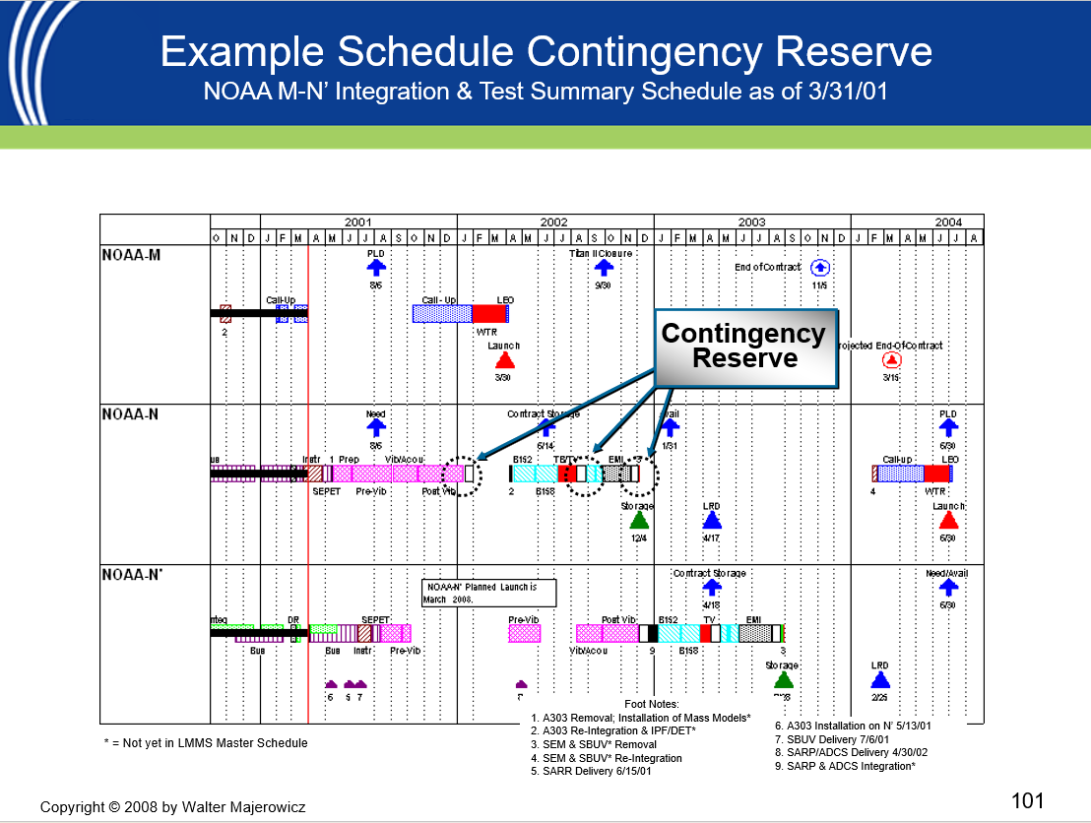
Why to use MS Project for Master Schedules
MS Project Summary Schedule
“Baby Picture 1998”
Keeps scheduling products to one software tool. No need to spend extra money to purchase additional tools.
Summary schedule lines can be used for multiple schedules. (ie Mission Milestones comes from the same schedule line in MS Project as in the Master Schedule, Element Schedules, Sub System Schedules and so on).
Schedules are easily customized and changed.
Once process is understood, schedules can be summarized very quickly
It’s a seamless..
Credit: Walt Majerowicz

Slide 5
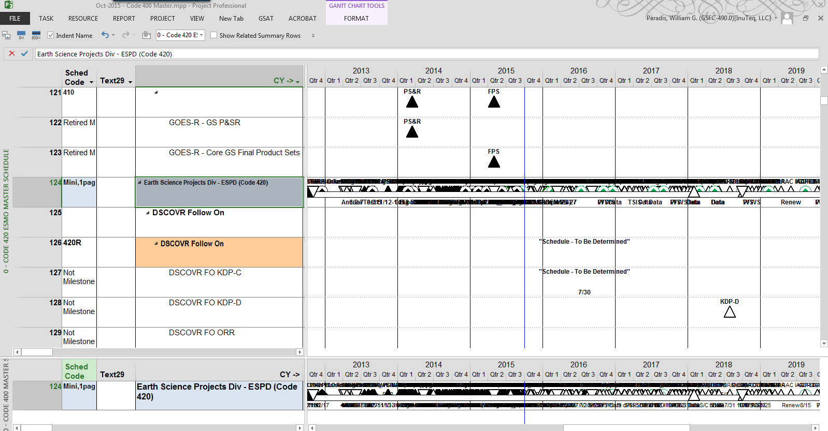
Why we Don’t Use MS Project for Master Schedules
When we try to do roll ups, we get this and turned off right away
There is a steeper learning curve using MS Project
Using 3rd party software seems to be more flexible and simpler to use
People using Agile PM tools such as JIRA
Hard to figure out at first causing people to give up
Not a lot of cool Bells, Whistles, dashboards that some 3rd Party Software includes

Slide 6
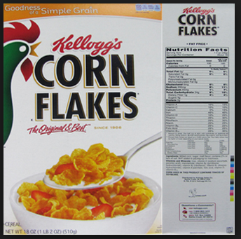

The MS Project Step by Step Process
So, this presentation is like this old commercial
Let's Try MS Project Master Schedules again
for the 1st time

Slide 7
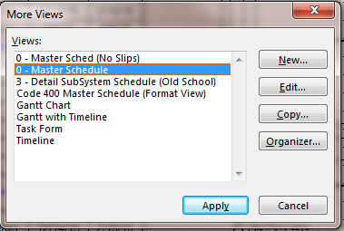
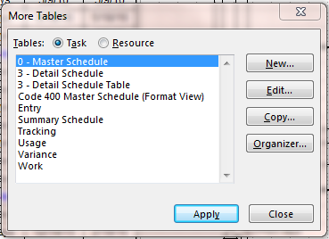
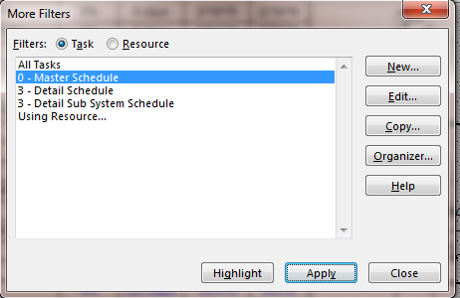
The MS Project Step by Step Process
Let's Create a Master Schedule
Using MS Project
Set up a View, Table, and Filter

Slide 8
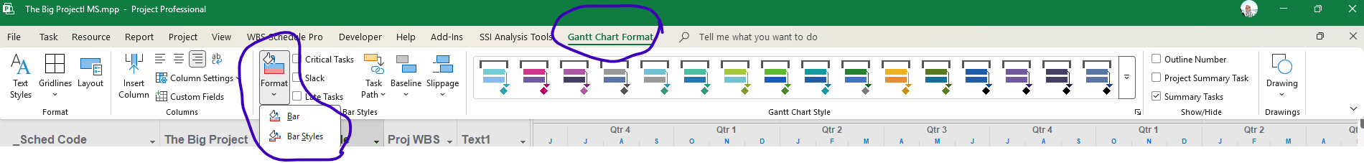
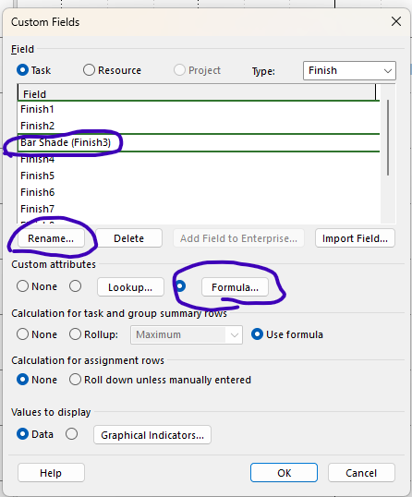
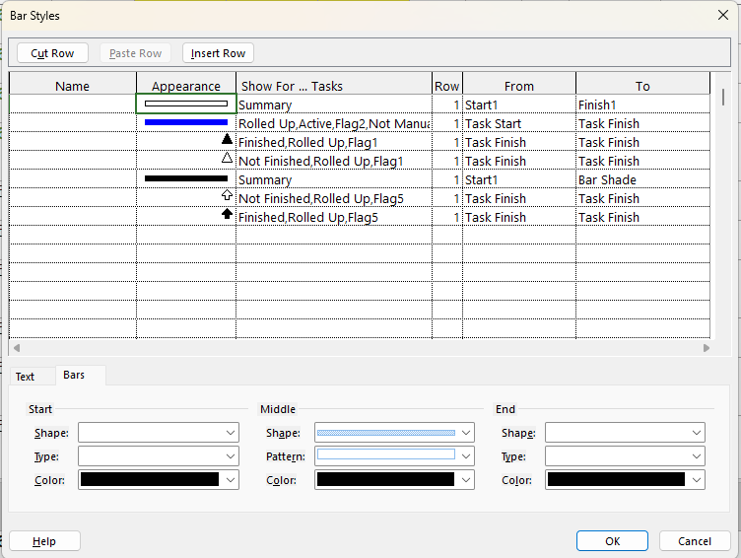
Set-up Bar Styles
Gantt Chart Format – Format – Bar Styles then the “Bars” Tab
Bar Styles Set-up
For Symbols
“Bars”
Bar shading:
Set up an unused Finish Field (I use “Finish3”) and customize it, Rename it (optional) and use the above equation

Slide 9
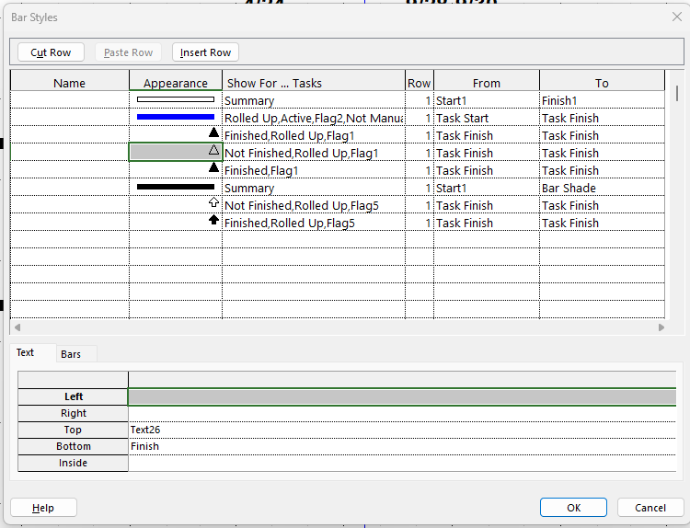
Set-up Bar Styles
Gantt Chart Format – Format – Bar Styles then the “Text” Tab
Bar Styles Set-up
For Symbols
“Text”

Slide 10
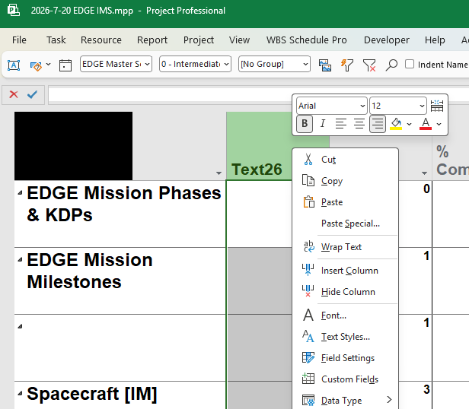
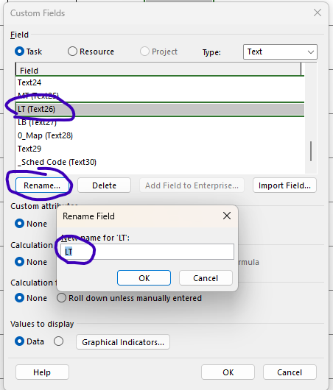

Set-up Bar Styles Con’t
Symbol Labels:
I use Text 26 for LT or Label Top &
Text 27 for LB or Label Bottom
Name does not matter it's just the default and can be changed and customized when needed
Right Click
LT or Label Top
LB or Label Bottom

Slide 11
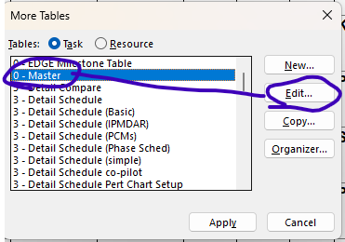
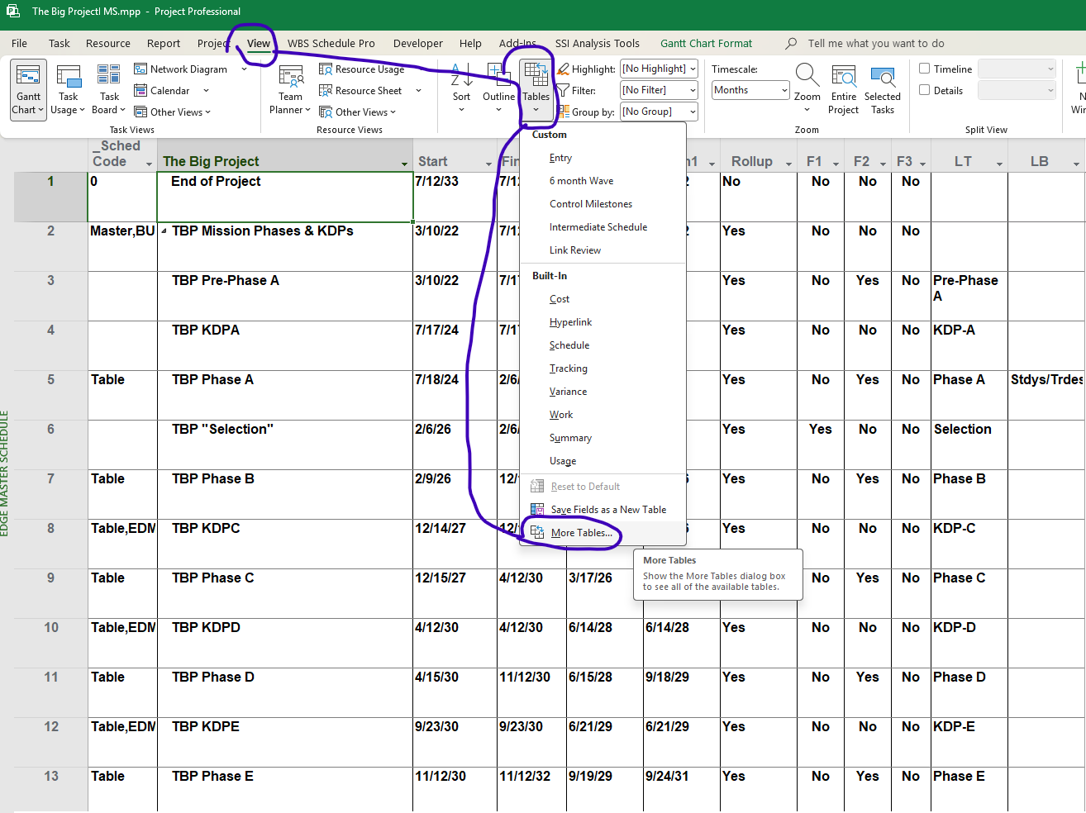
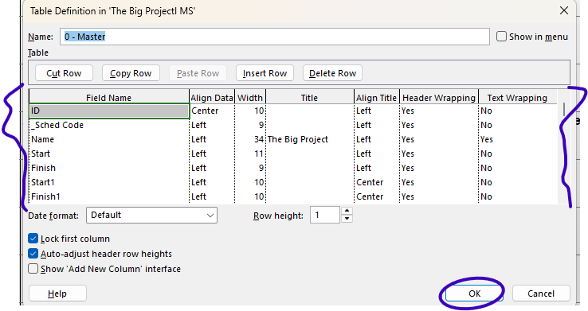
Set-up Master Schedule Table
Table Definition Panel Set-up

Slide 12
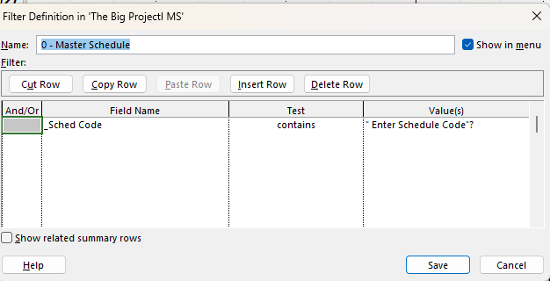
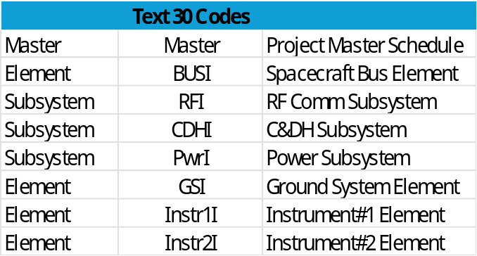
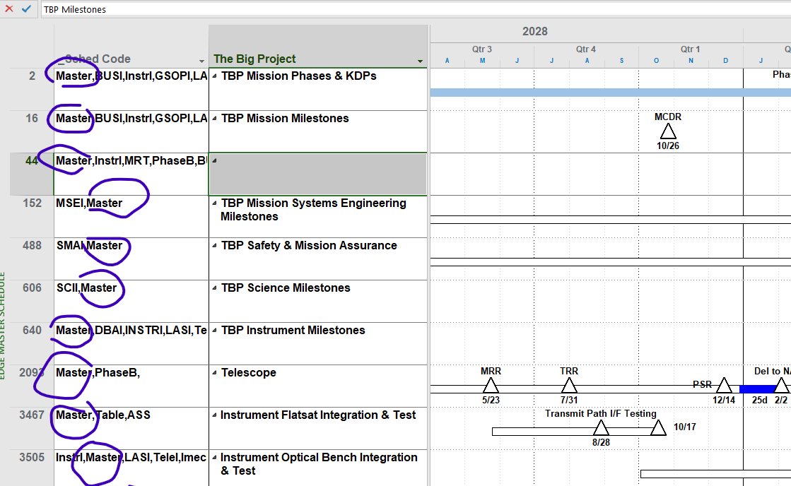
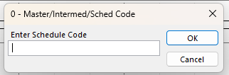
Set-up the Filter & Set-up Code Structure
I use Text30 to hold codes and usually Rename the Field to “_Sched Code”
“Enter Schedule Code”?
Master

Slide 13
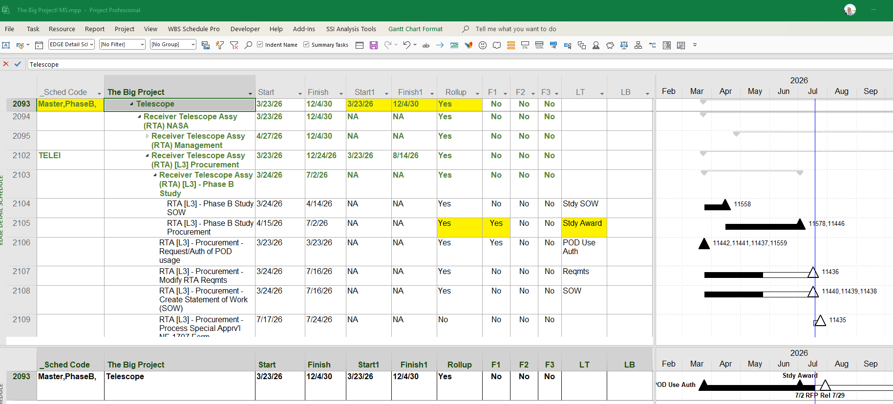
Build the Master Schedule
This is the work part of the Process

Slide 14
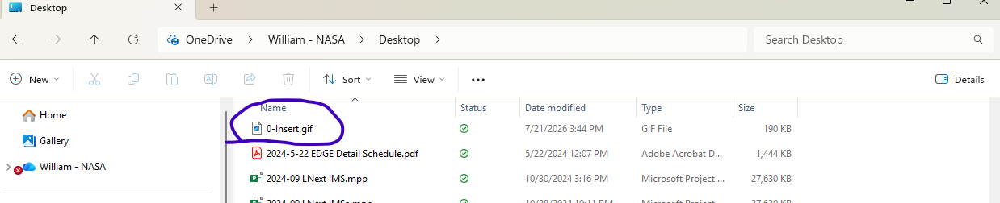
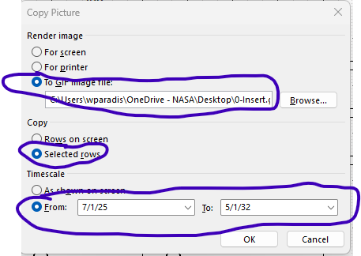
Copy Picture & Make .Gif file
Use the same file name each time and store it nearby Desktop
0-Insert.gif
(Saves space on your computer)

Slide 15
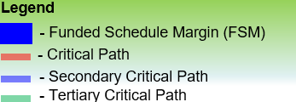

Insert Picture into PowerPoint (or another Office Tool)
The Big Project
Have a Pre-Formatted place Ready for your Schedule Chart

Slide 16
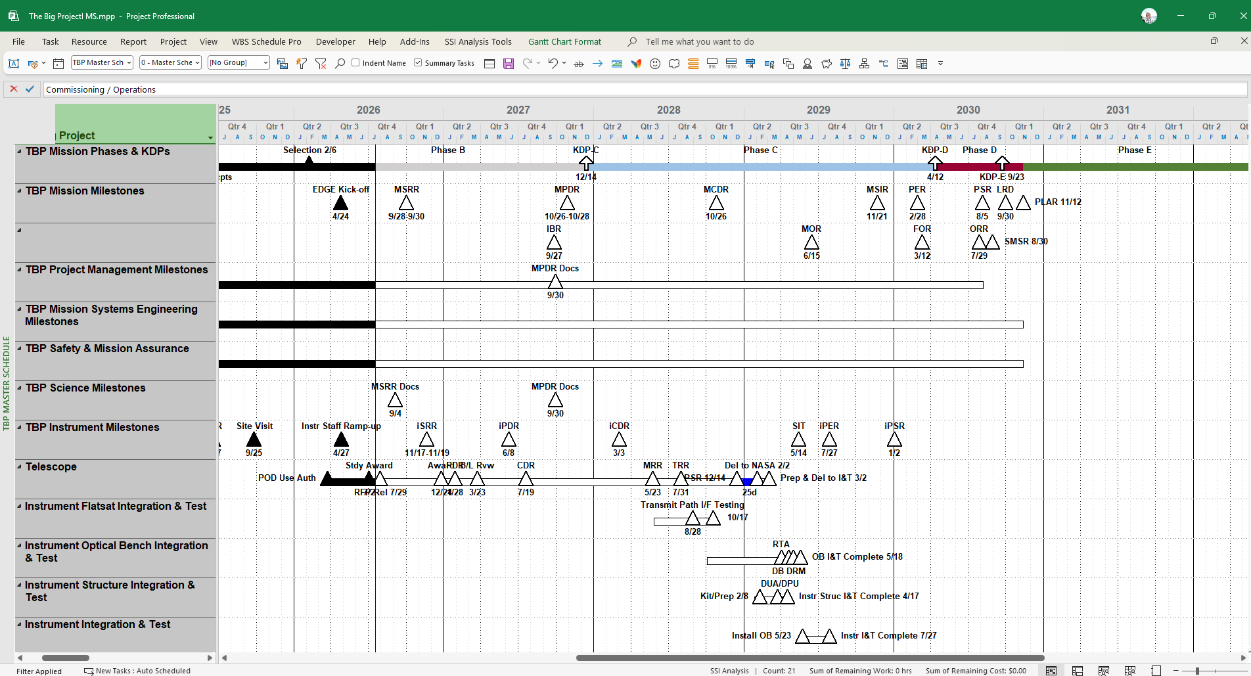
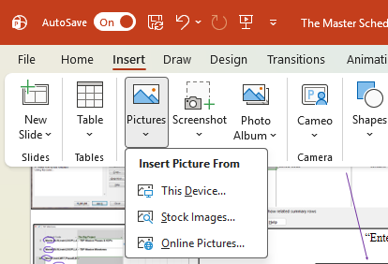
Master Schedule
The Big Project
Once Happy with Schedule; Highlight the lines you want, Copy Image using the Copy Picture tool and Insert Picture into your desired location: Power Point, Word, Outlook, or Excel etc.. ( I only use MS Office Products)

Slide 17
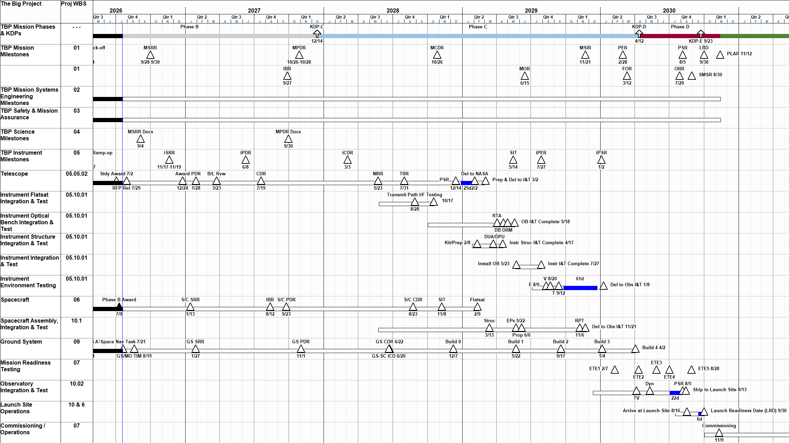
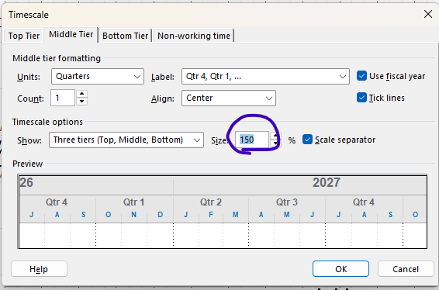
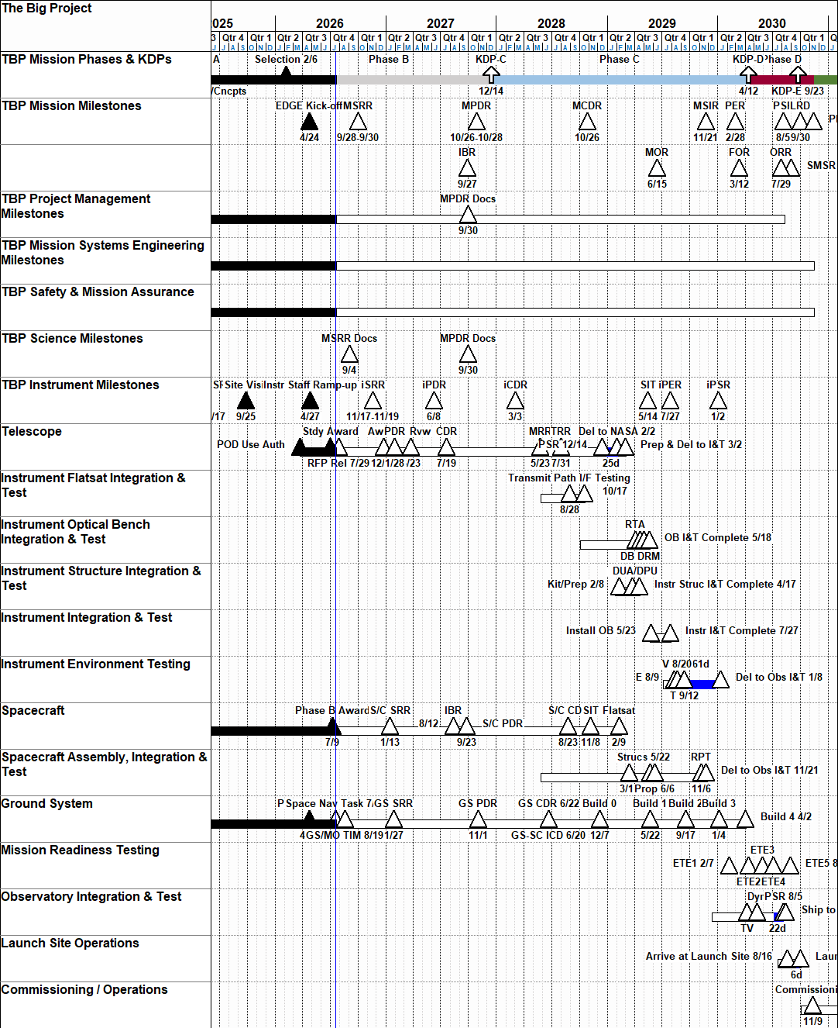
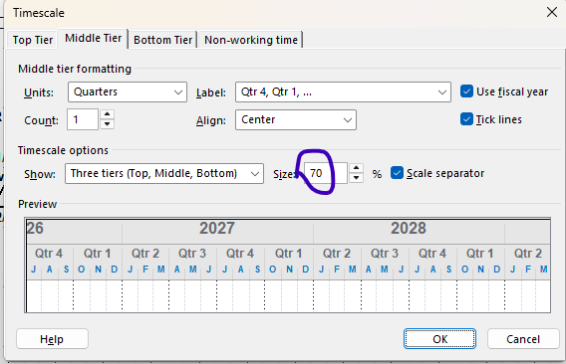
Adjust Timescale As Desired
Adjust Time Scale to get the Aspect that matches the Slide and keeps the labels from overlapping.
Timescale 70 will yield a very narrow Schedule
Timescale 150 will elongate the schedule

Slide 18
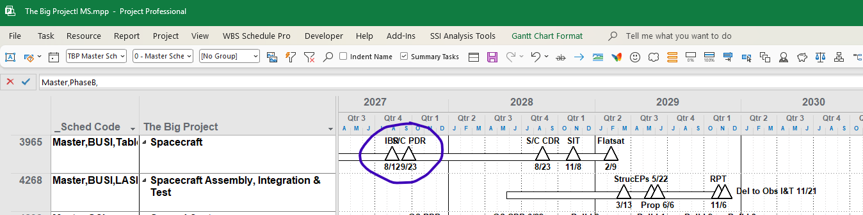
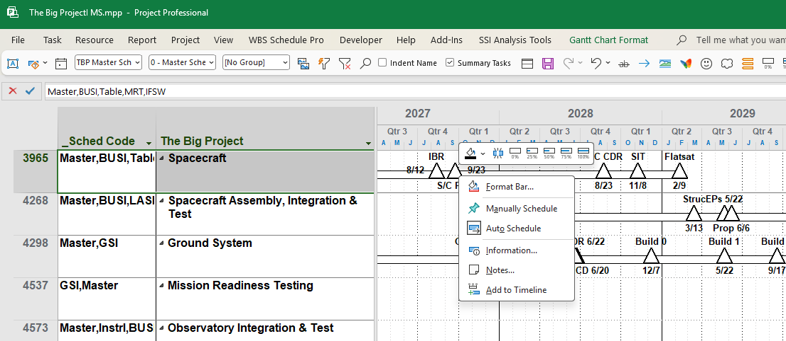
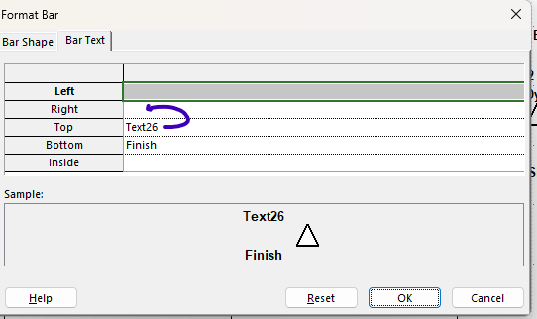
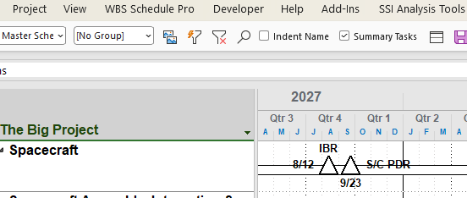
Clean up & Adjust Schedule
You can modify individual labels & symbols as you see fit
The modifications stay with the View until you reset them or change them
Right Click

Slide 19
Master Schedule
The Big Project
Once Happy with Schedule; Highlight the lines you want, Copy Image using the Copy Picture tool and Insert Picture into your desired location: Power Point, Word, Outlook, or Excel etc.. ( I only use MS Office Products)

Slide 20
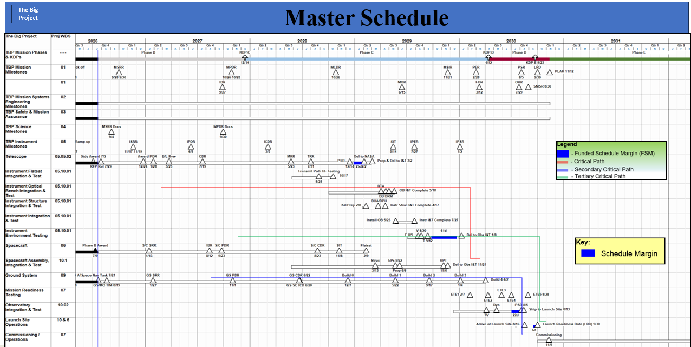
Clean up Final Product
Once Inserted; Critical Path Lines, legends can be pasted in

Slide 21
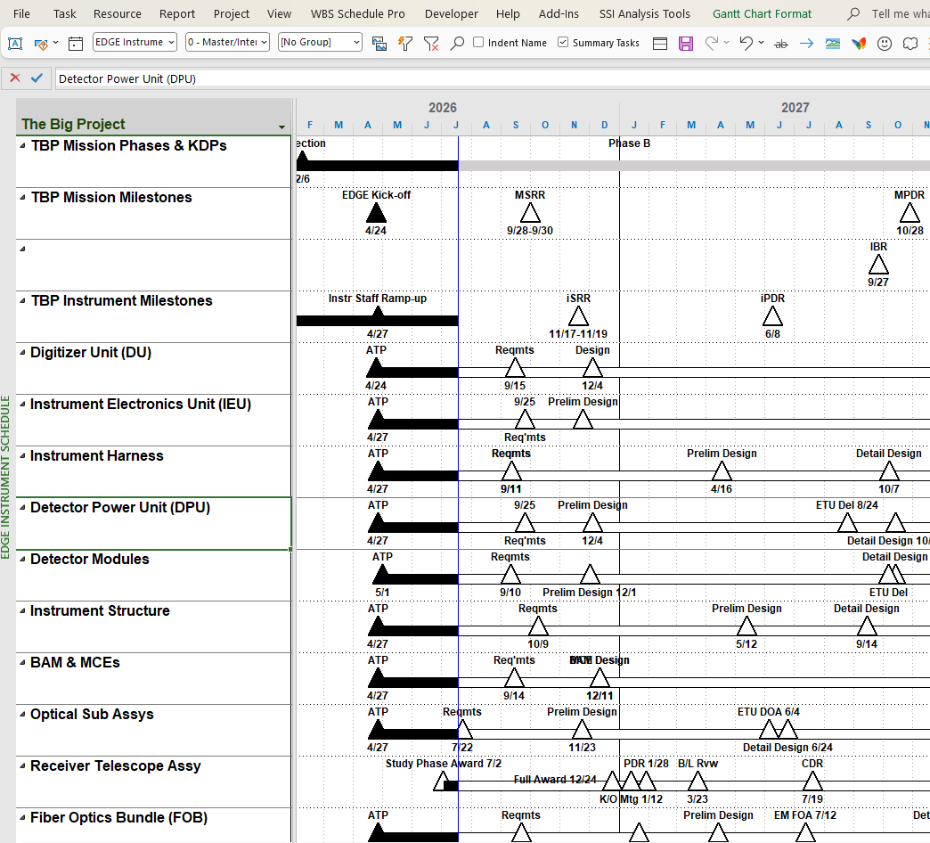
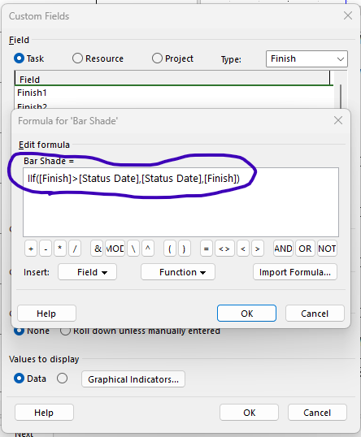
Tailoring Features

Slide 22
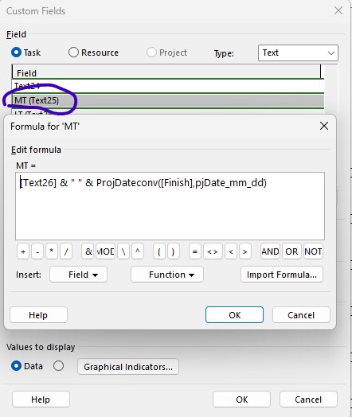
Tailoring Features Con’t
Creates Label + Date

Slide 23
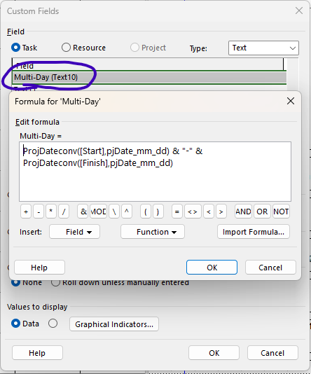
Tailoring Features Con’t

Slide 24
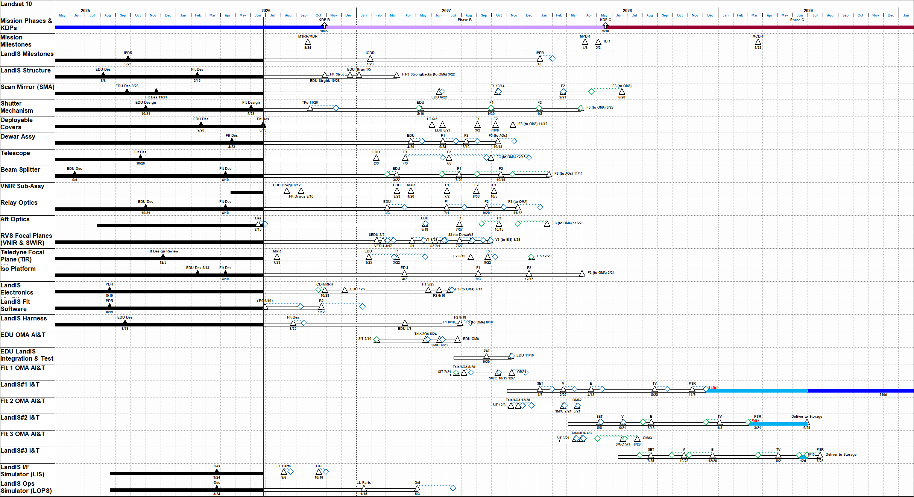
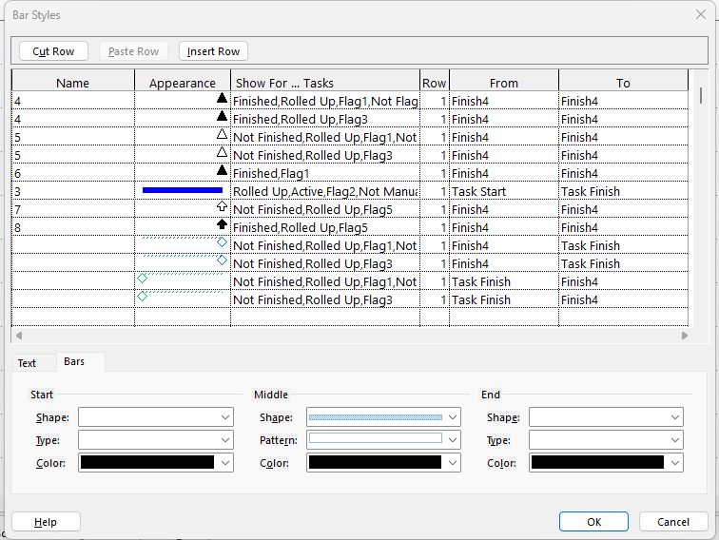
Examples - Showing Changes from a Baseline

Slide 25
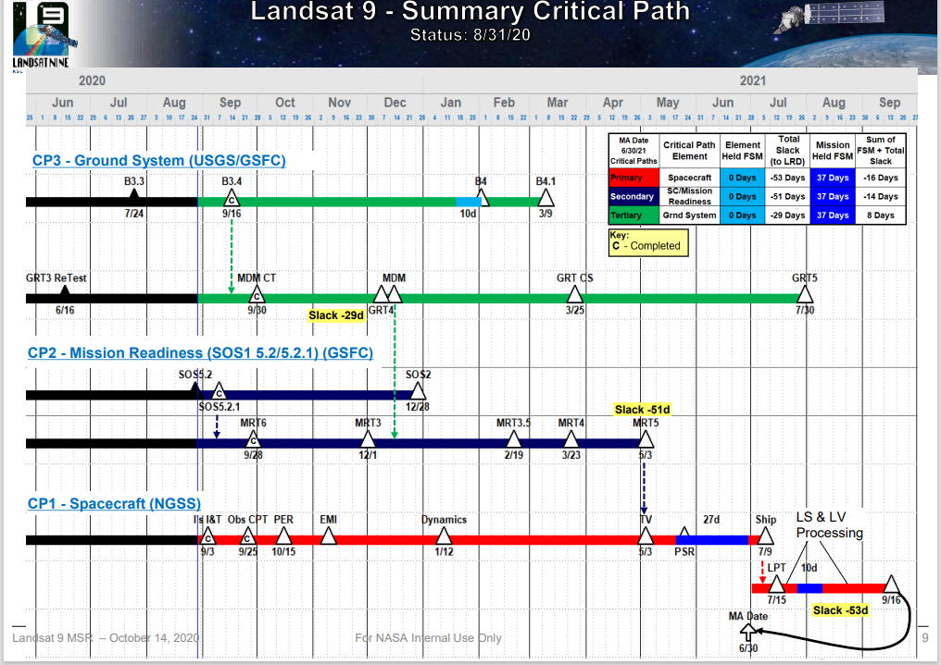
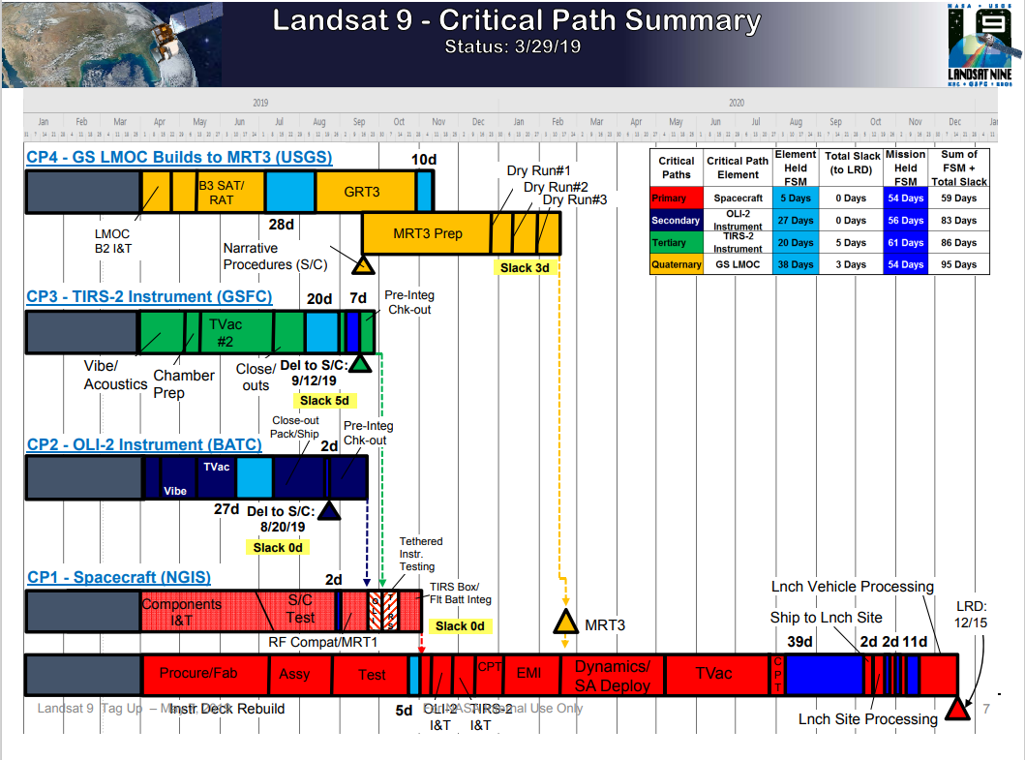
Examples - Summary Critical Path Chart

Slide 26
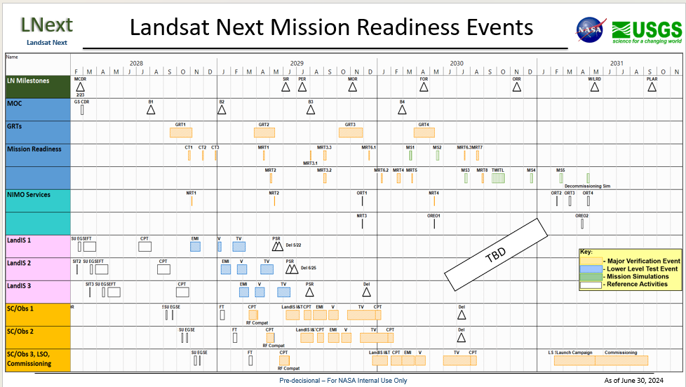
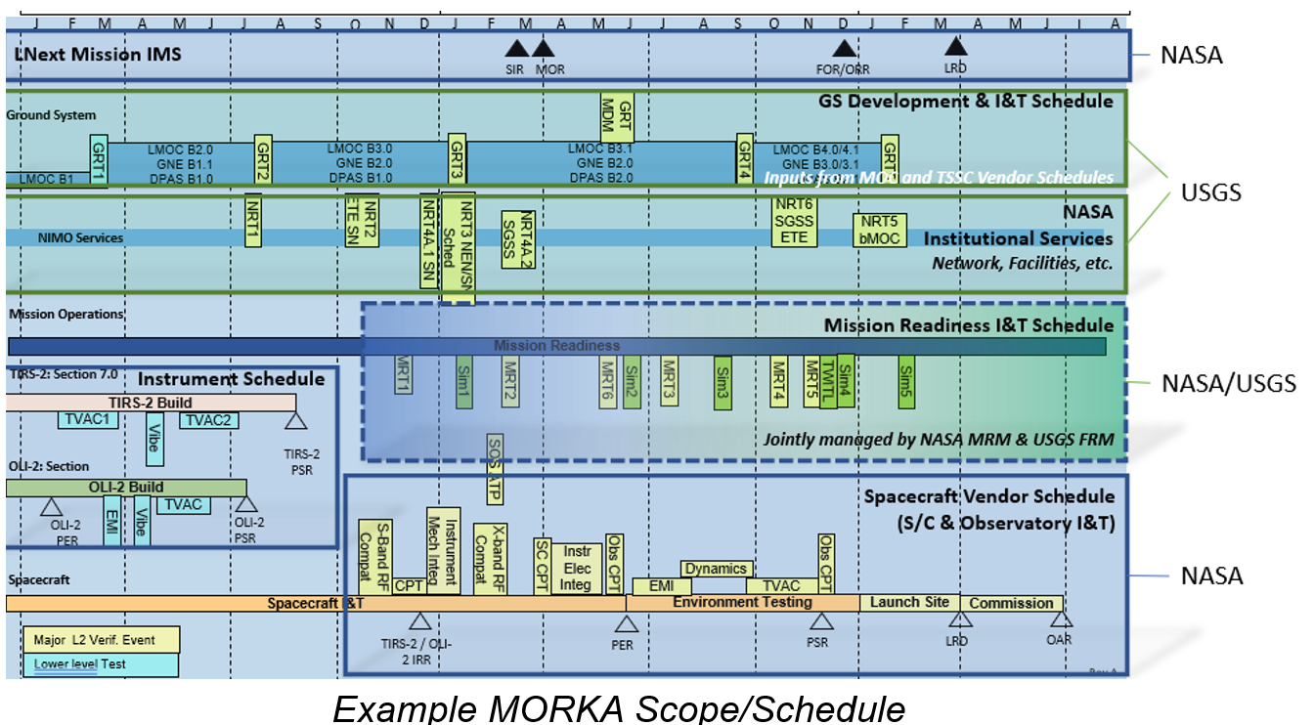
Examples - Summary Critical Path Chart

Slide 27
Fields to Remember
Basic Fields to Remember
Text30 - Schedule Codes (master, BUSI, GSI, etc)
Text26 - Default Labels Top of Schedule Bar
Text27 - Default Bottom of Schedule Bar
Start1/Finish1 - Rolls up a Summary Line for the Schedule bar
Bar styles: Roll Up, Flag1 - For Master Schedule Triangle Roll ups
Bar styles: Roll Up, Flag2 - For rolling up individual activities (Colorize as needed using Format Bar)
Bar styles: Roll Up, Flag3 - For Intermediate level Schedule Triangle Roll ups
Bar styles: Roll Up, Flag5 - For Master Schedule Up Arrow Roll ups
Customizations
Finish3 - for shading Bars up to Status Date
Text10 - Custom Field to show the Start and Finish Dates
Text25 - Custom Field to show Label Top + Finish Date

Slide 28

Questions & Comments

Slide 29

The MS Project
Master Schedule

