Slide 1
Empowering Project Leads:
Enhancing EVM Data Integrity and Analysis
Across NASA Programs
Office of the Chief Financial Officer | August 2026

Slide 2
Contents/Agenda
Purpose
Empower Features & Dashboard Overview
Trend and Variance Analysis
Data Quality Metrics
EAC Realism

Slide 3


Purpose
As Project Leads, you carry the responsibility of keeping complex work moving forward with clarity, confidence and purpose. Empower is a tool designed to support that mission. It gives you immediate access to the information that matters most, so you can anticipate challenges, steer your teams effectively, and make informed decisions backed by real data.
Think of Empower not as another system to learn, but as a force multiplier. It brings together earned value, schedule, cost and performance data into one clear, intuitive workspace, allowing you to see the full picture of your project’s health at a glance. With Empower, you’re better equipped to navigate uncertainty and maintain control of the plan.
This tool is available to you, to strengthen your leadership and give you the insight to make proactive, confident programmatic decisions. Empower is built to help you lead well – and lead with impact.

Slide 4
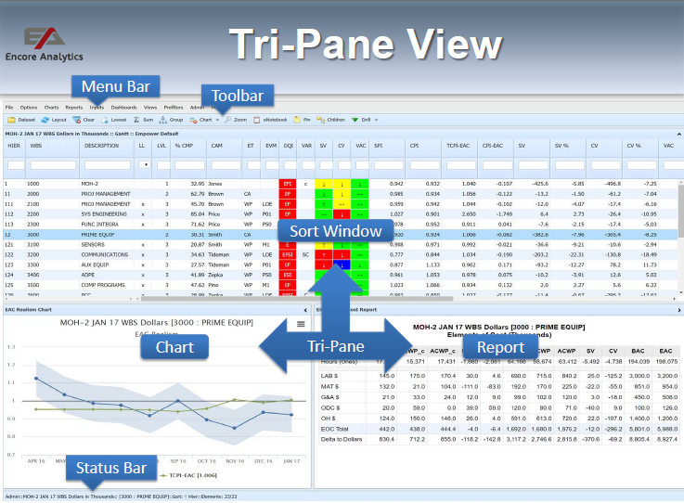
Empower Dashboard Overview
A Dashboard stores and recalls the state of
your Empower tri-pane view
Retains the location and size of charts and reports
Export as “User Items” to share with other users
Saves the stored settings for the following:.
Sort Window
- Selected View and size/location on the screen
- Sort order
- Interactive Filters and Prefilters
Charts
- Selected Chart and settings
- Prefilters selected on Gantt chart
Reports
- Selected Report and settings

Slide 5

Trend Analysis
WHAT CAN A TREND TELL YOU?
Trends can identify reoccurrence of the same variance
Trends can identify if corrective actions have been effective
Trend can identify emerging problems by observing:
- Improving trends or trending up
- No change or “flat” trends
- Trend deteriorating or trending down
AS YOU ANALYZE THE DATA,
ASK YOURSELF:
What do the trends indicate over time?
Is this trending going to continue and why?
What future performance is expected?

Slide 6
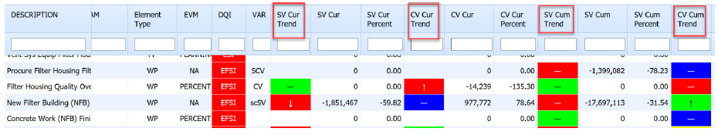
Trend Analysis
Sort Window
Color Coded Field – identifies how favorable or unfavorable the variance is:
- R – Red – Unsatisfactory
- Y – Yellow – Marginal
- G – Green – Satisfactory
- B – Blue – Exceptional
- No Color – No data
Trend Arrows – identifies if the trend from the previous month is:
- Down Arrow – Worse than last month
- Horizontal Line – No change
- Up Arrow – Better than last month
- No Arrow – Need two periods

Slide 7
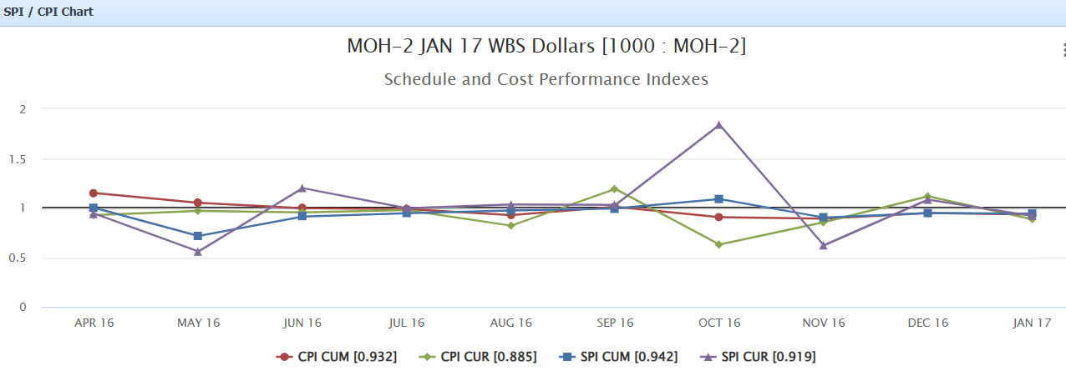
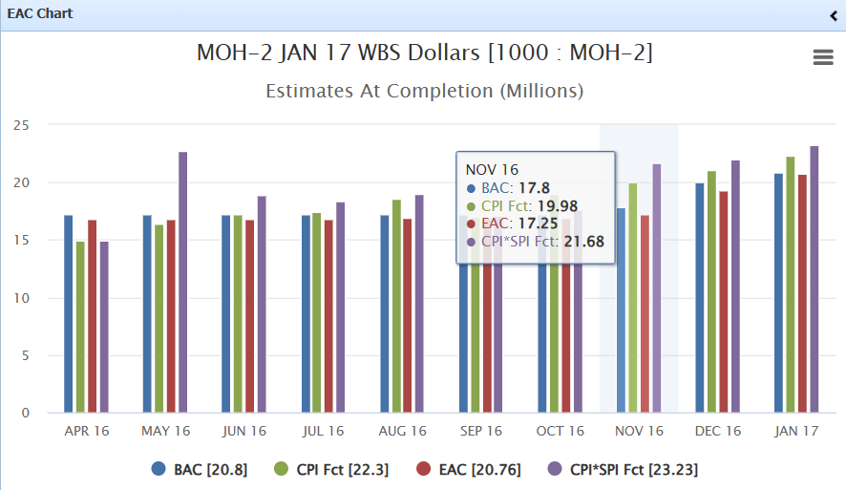
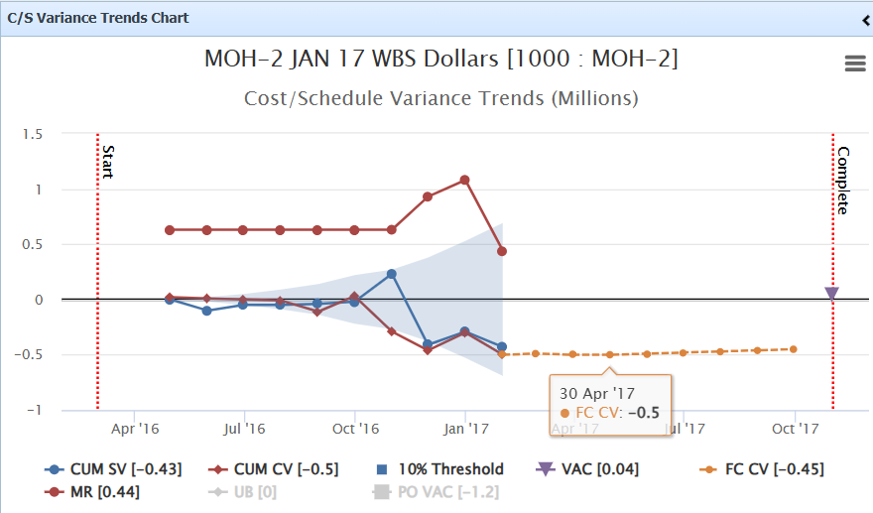
Trend Analysis
Chart Window
Charts are a great way to identify trending conditions over time
- Look for downward, upward or flat performance over time
- Look for peaks (high and lows) that is also a trend – instability, volatility
- Look for color conditions (Performance)
Flat trending can also be an indicator that the current under performing data is not improving, or Corrective Action plan is not working

Slide 8
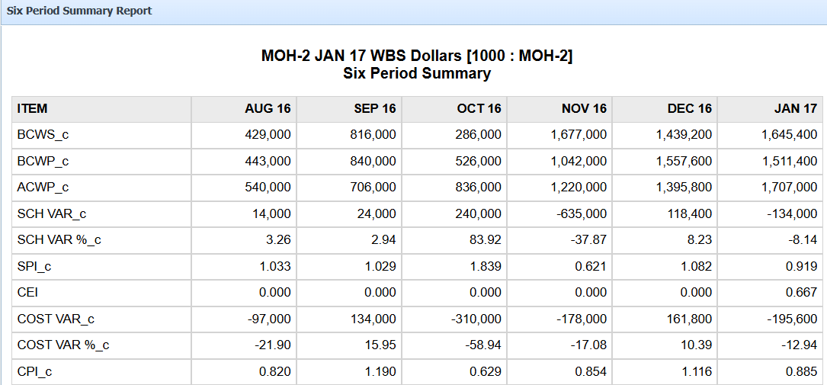
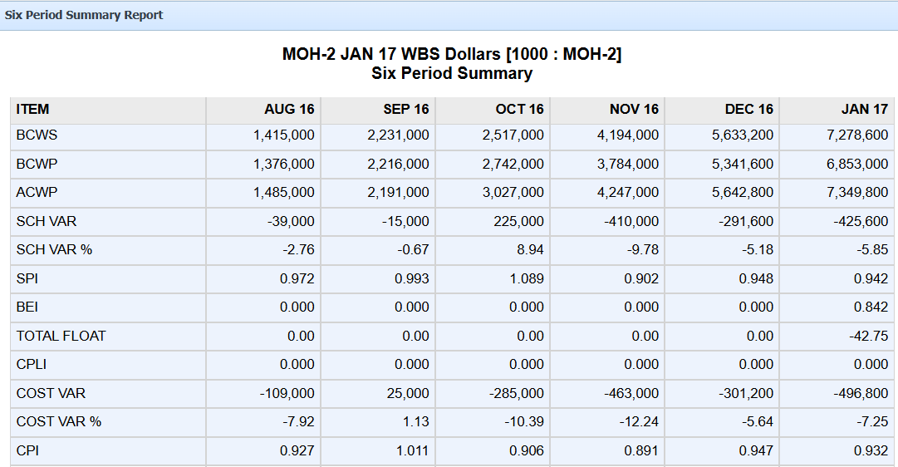
Trend Analysis
Report Window
Reports can identify trends of performance over time:
Six Period Summary Report
Up to six periods of prior data represented by period (column)
Each calculation (SPI, CPI, etc.) is shown for each period
Shows both current (lighter) and cumulative (darker) data by period

Slide 9
Trend Analysis
Empower Demo

Slide 10
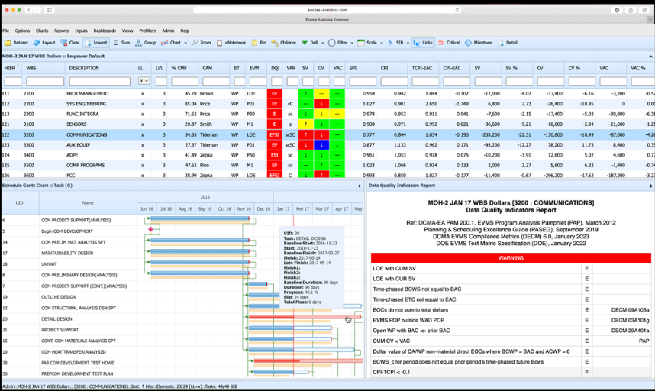

Data Quality Indicators
WHY IS DATA QUALITY IMPORTANT?
“Bad data in, bad decisions out.”

Slide 11
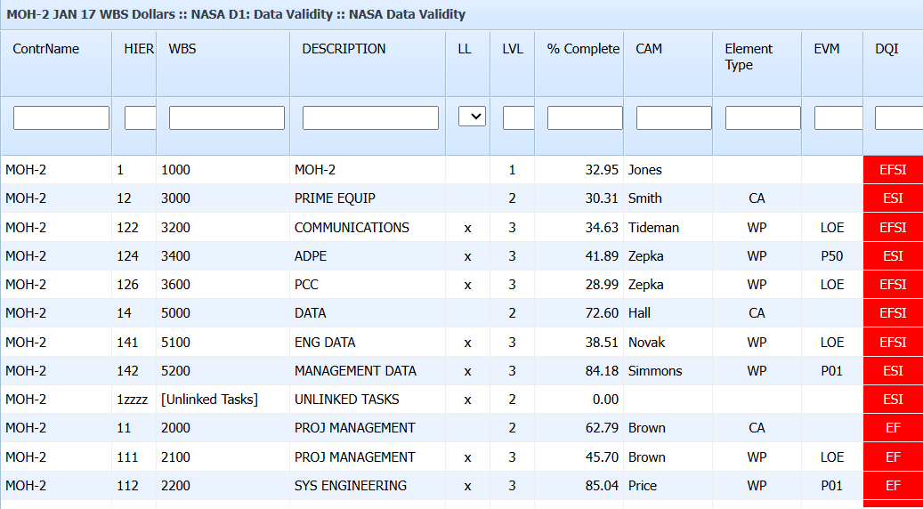
Data Quality Indicators
The quality checks are grouped into four categories, along with the letter codes Empower uses to identify them:
- E – Earned value anomalies
- S – Schedule anomalies
- F – Forecast/EAC reasonableness anomalies
- I – Cost/Schedule integration anomalies
The DQI column will contain a
combination of these code letters that
indicate which categories of data quality
checks have been violated.
To filter on the DQI field, enter one
or more of the four code letters, in any
order. Any element whose DQI field
contains any of the letters entered will be
shown.

Slide 12

EAC Realism
WHY IS AN ACCURATE EAC IMPORTANT?
Provides a forward-looking cost forecast
Strengthens proactive decision-making
Highlights emerging risks early
Improves communication with stakeholders
Supports planning for remaining work
Enhances accountability

Slide 13
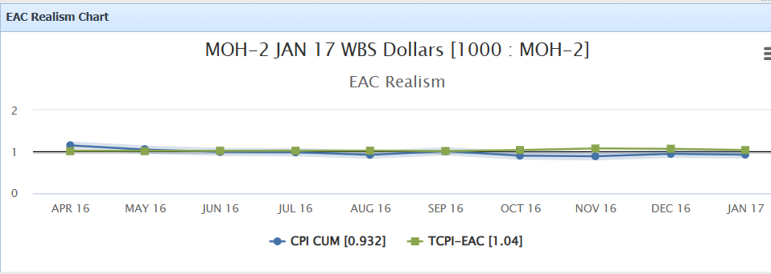
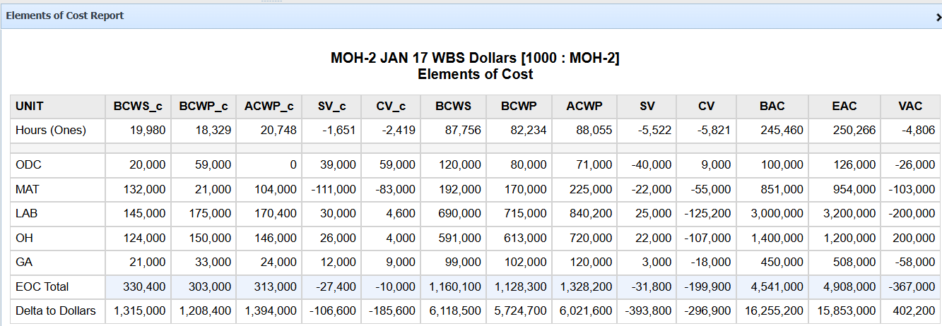
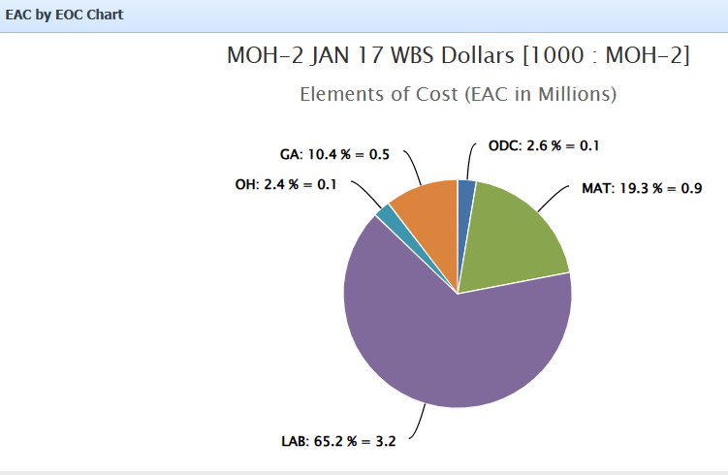
EAC Realism
Evaluating EAC Realism in Empower
CPI vs. TCPI Comparisons
Independent Statistical EACs (IEAC)
CV vs. VAC Trends
Element of Cost (EOC) Breakdowns

Slide 14

EVM Tools Team
Patrick Jordan
EVM System Administrator
patrick.jordan@nasa.gov
Crysta Bouldin
Deputy EVM System Administrator
Crysta.m.bouldin@nasa.gov
Briannah Smith
EVM Tools Team
briannah.n.smith@nasa.gov
hq-dl-evm-tools-admin@mail.nasa.gov

