Slide 1

Michael Trumper
Lev VIRINE
Managing Very Large Integrated Program Schedules

Slide 2
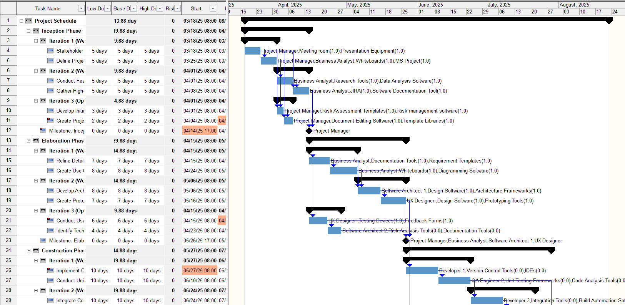
Large Integrated Project Schedules
Very Large Number of Activities:
Tenth of thousands
Very large number of milestones
Could be resource loaded
Master Projects with Subprojects:
Sometimes nested projects/subprojects
Complex set of links between subprojects
Projects Managed by Multiple Different Owners:
Different project managers
Different organizations
Different security settings and access levels
Complex Project Control and Risk Management
Multiple project managers and risk analysts
Complex process of monitoring and updating project schedules

Slide 3
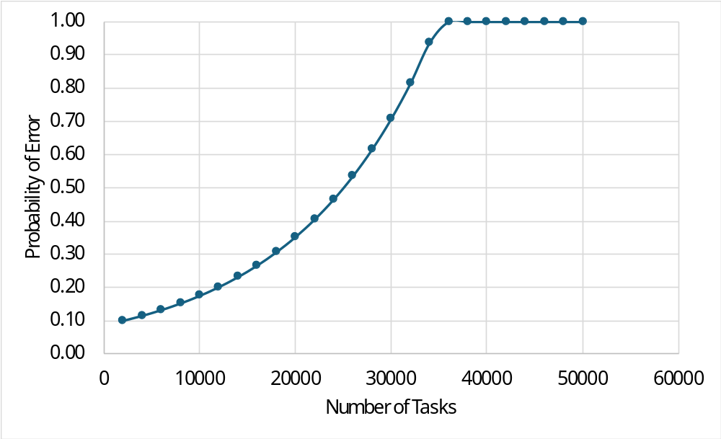
Example of Large Integrated Project Schedule
Assumptions
Maximum Number of Outline Levels | 6
Number of Subtasks per SummaryTask | 10
Number of Successors Per Predecessor | 1.15
Serious error occurs at the middle of the schedule
Every new activity adds:
new paths
convergence points
divergence points
near-critical paths
indirect dependencies
Network complexity grows faster than activity count

Slide 4
Problem with Large Integrated Project Schedule
Project schedules become increasingly detailed and interconnected
Probability of modeling, logic, estimation, and status errors increases
Additional schedule decomposition may reduce rather than improve the accuracy
Number of alternative and near-critical paths can grow rapidly
Less Details
More Details
Schedule Errors
Number of Tasks

Slide 5
Challenges with Large Integrated Schedules
Large Integrated Schedules:
Designed to Manage Individual Activities
Potentially Accurate Timeline
Detailed Cost and Response Management
Accurately Reflect the Scope
Challenges with Large Integrated Schedules:
Schedule and Cost Risk Analysis
of Large Integrated Program Schedules
Schedule Quality Analysis
of Integrated Programs
Joint Confidence Level Analysis
of Large Integrated Schedules
Project Control of Integrated Programs
with Large Number of Activities

Slide 6
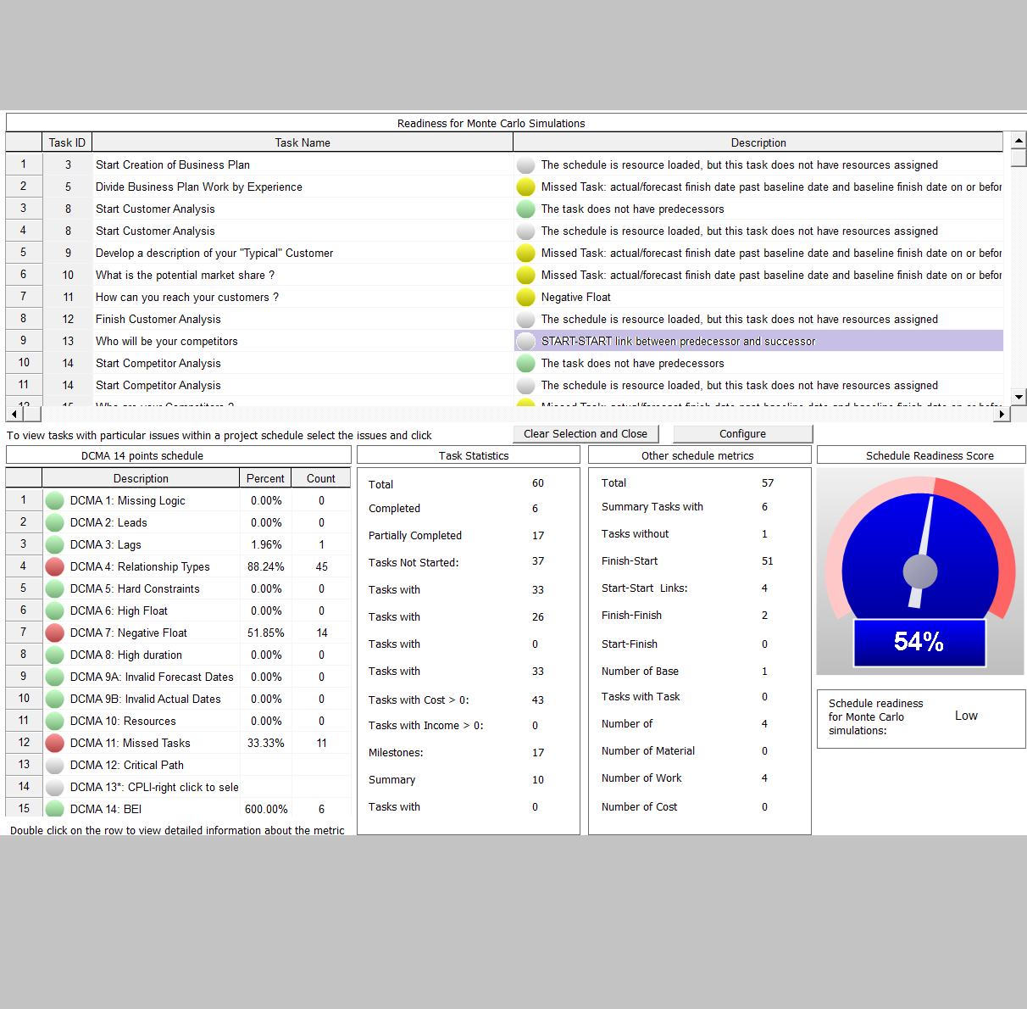
Schedule Quality Control

Slide 7
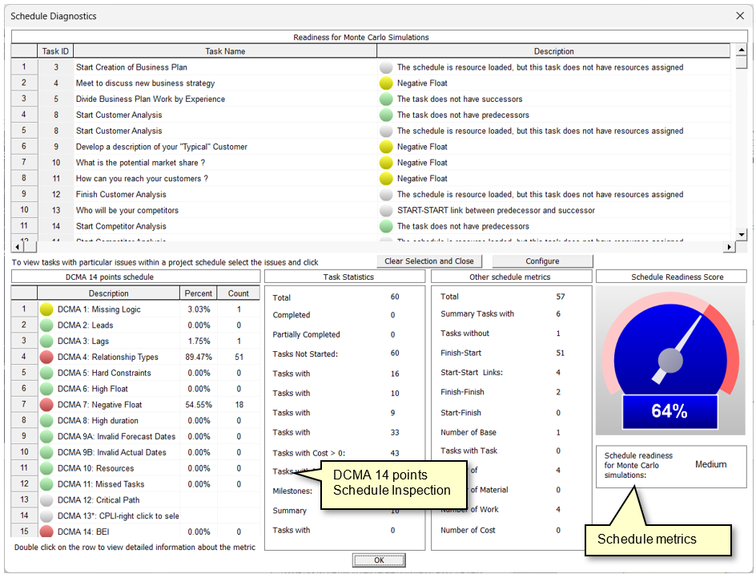
Schedule Diagnostics
identify issues with the project schedule which may lead to incorrect or misleading results of analysis.
DCMA 14-point inspection schedule diagnostics
Tests tailored to different types of analysis.
Logical scheduling problems (unnecessary constraints, dangling activities, etc.)
Issues which may affect results of Monte Carlo simulations.
Diagnostics of resource pool, resource assignment
….

Slide 8
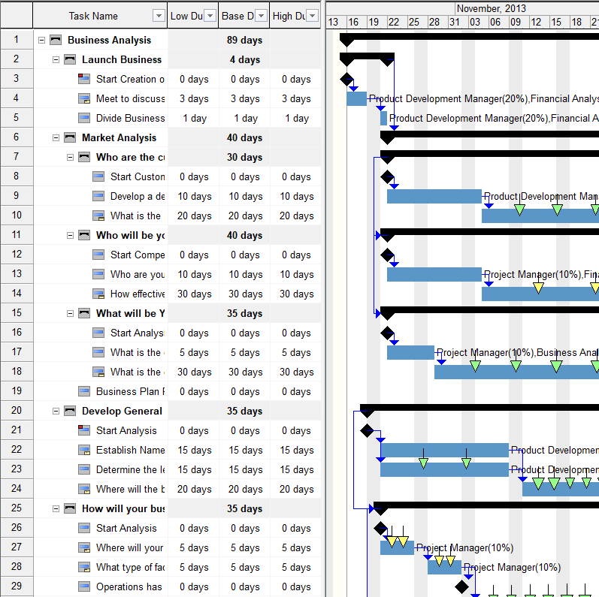
Schedule Consolidation

Slide 9
Identification of Repeated Activities
The schedule may consist of a number repeatable group of activities.
These groups may have different start and finish times but have the same set of activities with the same durations, costs, and assigned resources.
These groups can be automatically identified and replaced with single summary activities.

Slide 10
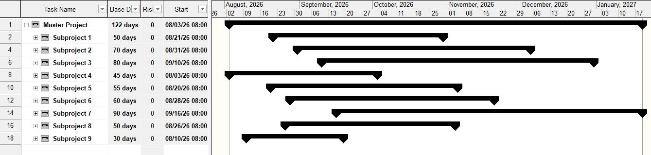
Identification of Subprojects
Integrated schedules often consist of a few linked and nested subprojects.
These subprojects can be analyzed separately, and results of analysis can be used in analysis of master schedules.
In some cases, subprojects need to be identified automatically and extracted from the master schedule.

Slide 11
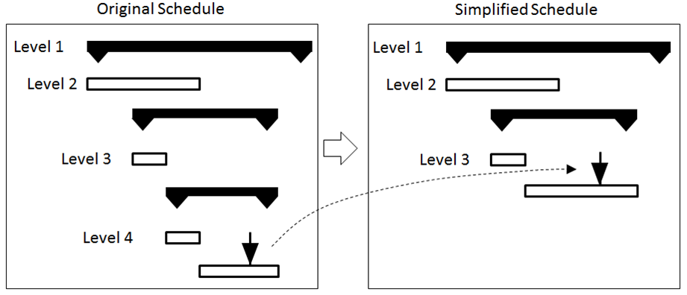
Schedule Consolidation
This is a process of jointing sequential activities and subprojects, and generating equivalent schedules based on cost, duration, start and finish times, and resource allocation.

Slide 12
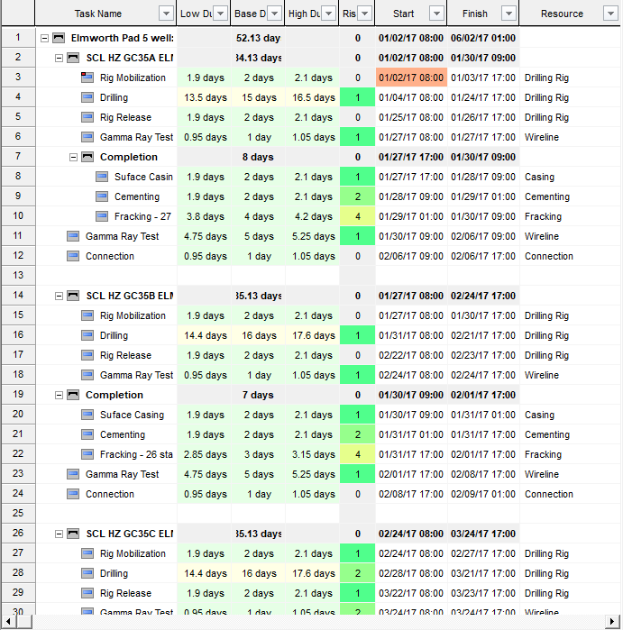
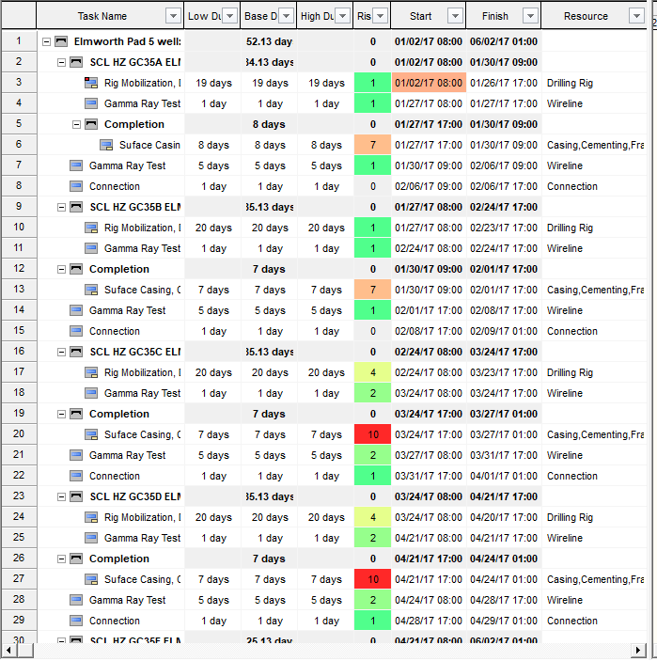
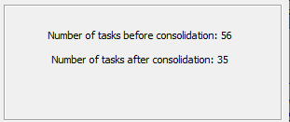
Example of Schedule Consolidation
Original Schedule
Equivalent Consolidated Schedule

Slide 13
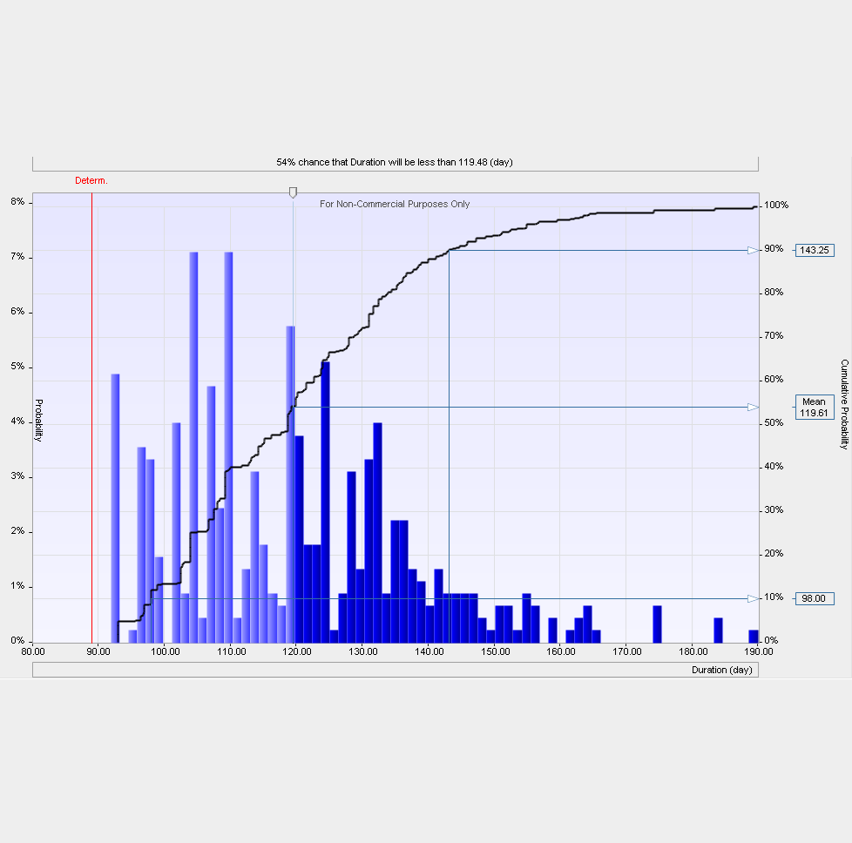
PORTFOLIO Risk ANALYSIS

Slide 14
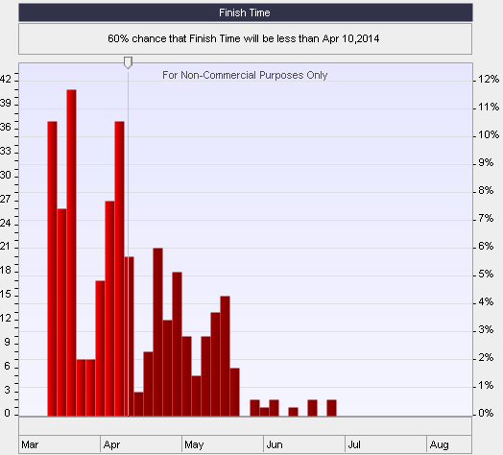
Schedule and Cost Risk Analysis of Large Integrated Program Schedules
Monte Carlo analysis of subprojects can be performed individually.
These schedules will be inserted into a master schedule as single activities together with their risk profiles.
Monte Carlo simulations are performed on a much smaller number of activities and significantly faster
The process also improves managing mitigation and response plans, because it is possible to calculate impact of multiple risk mitigation scenarios to select the most efficient and cost-effective scenario.

Slide 15
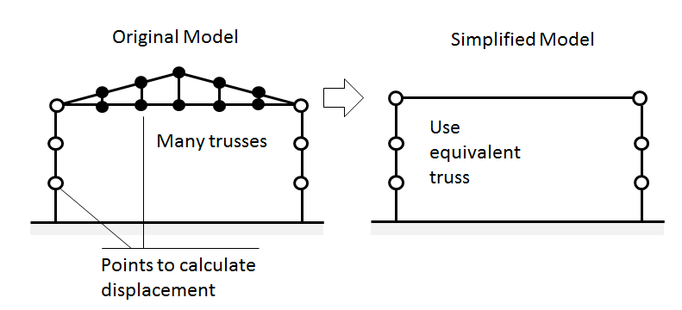
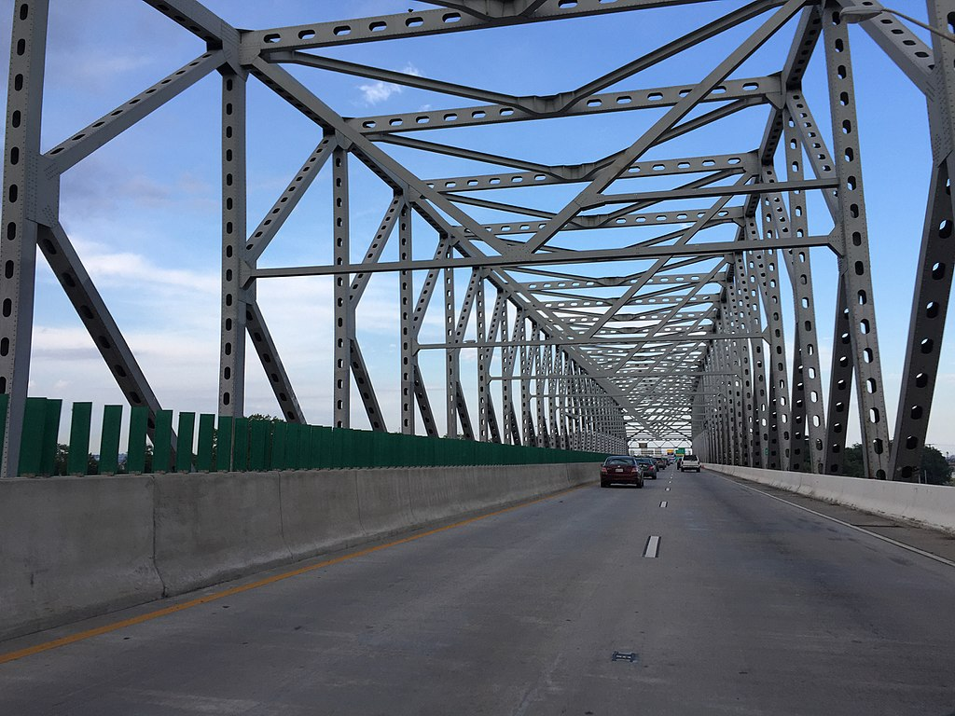
Subprojects with Risks and Uncertainties

Slide 16
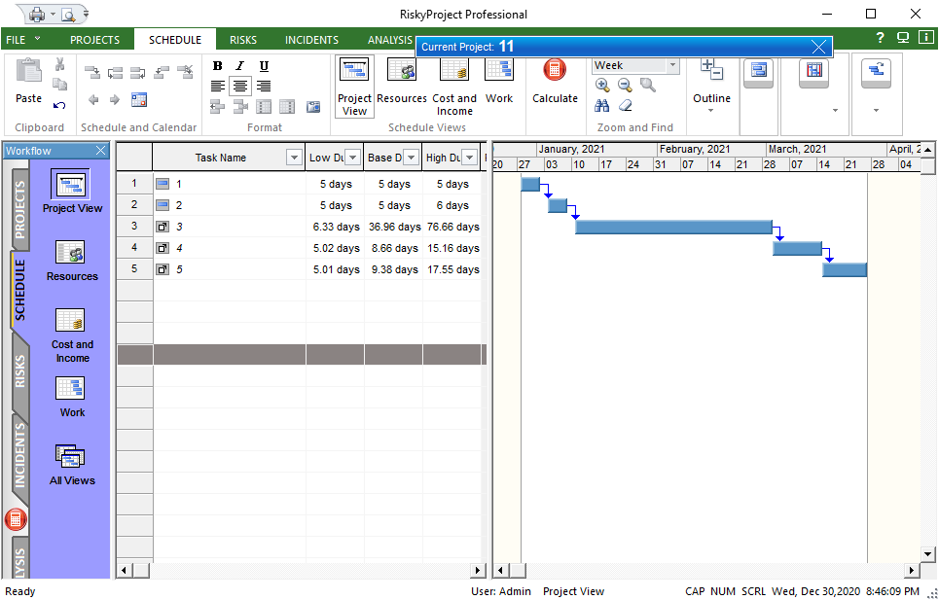
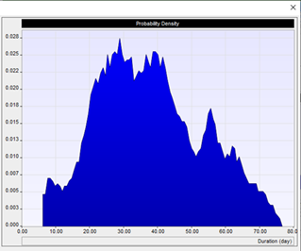
Example of project with subproject
Monte Carlo for each subproject is performed separately. The project is inserted to the portfolio and can be refreshed when subproject is calculated again.
These are subproject, which are represented as individual tasks
Risk Profile for duration of individual project

Slide 17
Subprojects For Mitigation/Response
Mitigation 1. Schedule
Risk 1. Change of Requirements
Task 1
Task 2
Mitigation 1. Additional Meeting with client
Task 3
…..
Mitigation 2. Detailed documentation of requirements
Mitigation 2. Schedule
Task 1
Risk 2. Delay with supplier
Task 2
Task 3
…..
Mitigation 2. Additional Meeting with client
Mitigation 3. Schedule
Mitigation 3. Supplier qualification review
Task 1
Task 2
Task 3
…..

Slide 18
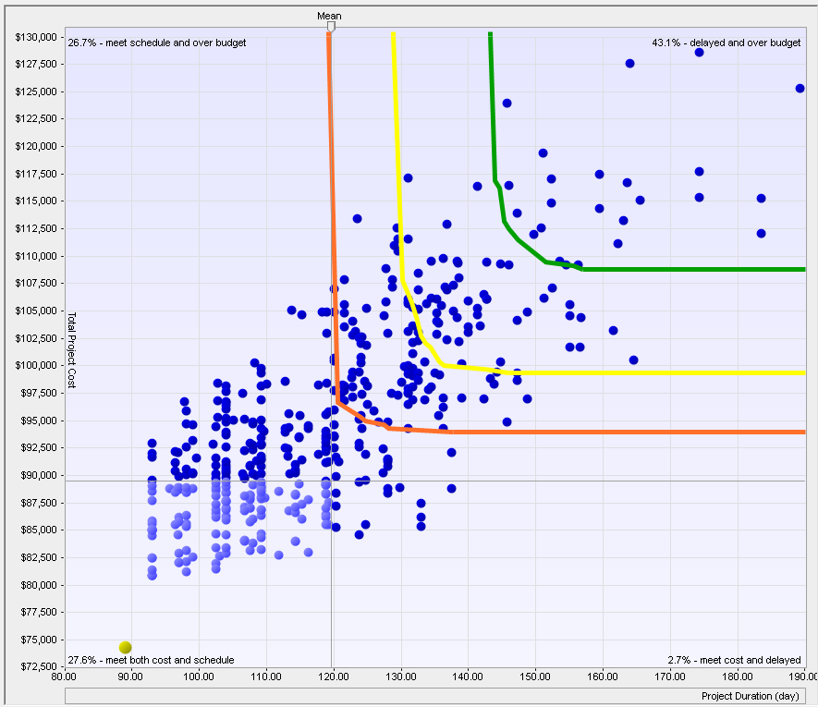
JOINT CONFIDENCE LEVEL ANALYSIS:
Consolidated Schedules and Multiple Objectives

Slide 19
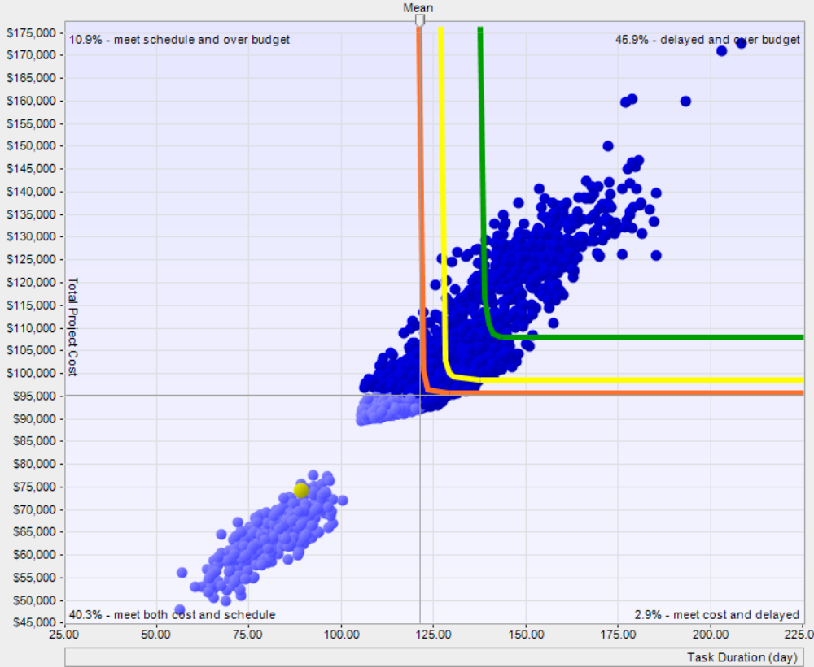
Traditional Joint Confidence Level Analysis of Consolidated Schedules
The result of a Joint Confidence Analysis shows the probability that a project’s cost will be less than the targeted cost and the finish time or duration will be less than the targeted finish time or duration.
Each dot is a result of one Monte Carlo simulation (cost and schedule)
Deterministic project cost and schedule

Slide 20
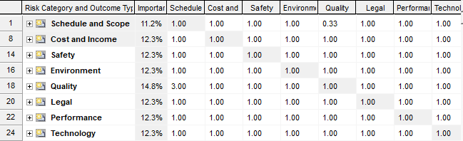
JCL Analysis with Multiple Objectives
All objectives
Quality is 3 times more important than schedule
All objectives
Calculated priorities for each objective

Slide 21

Monte Carlo Simulation
Risk and Uncertainties in Duration
Risk and Uncertainties in Cost
Technical Performance Risk
Quality Risk
Safety Risk
Security Risk
…………

Slide 22
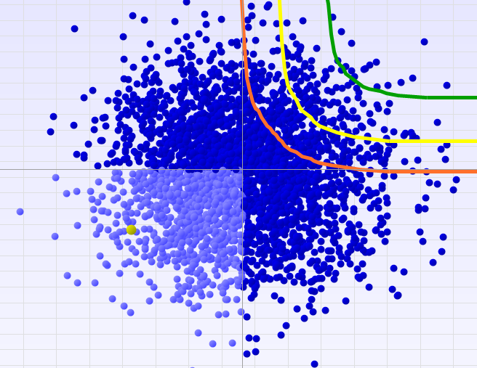
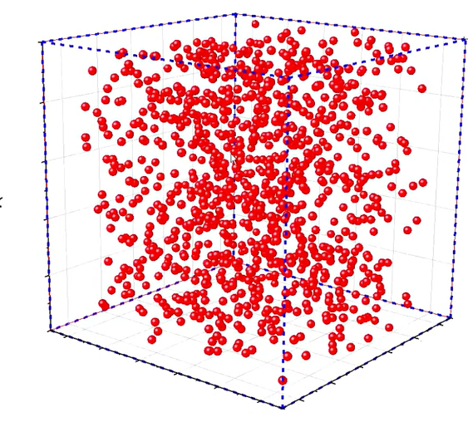
Analysis using Joint Confidence Level Scatter Plot
On budget, but did not meet safety targets
Over budget and did not meet safety targets
Example of 3D Plot
Frontier lines show the combination of cost and safety that meets certain predefined targets: e.g. 70%,80% and 90% chance that project will be on time and meet safety targets.
Safety Issues
Security Issues
Duration
Technical Performance
Meet safety and cost targets
Meet safety target but over budget
Cost

Slide 23
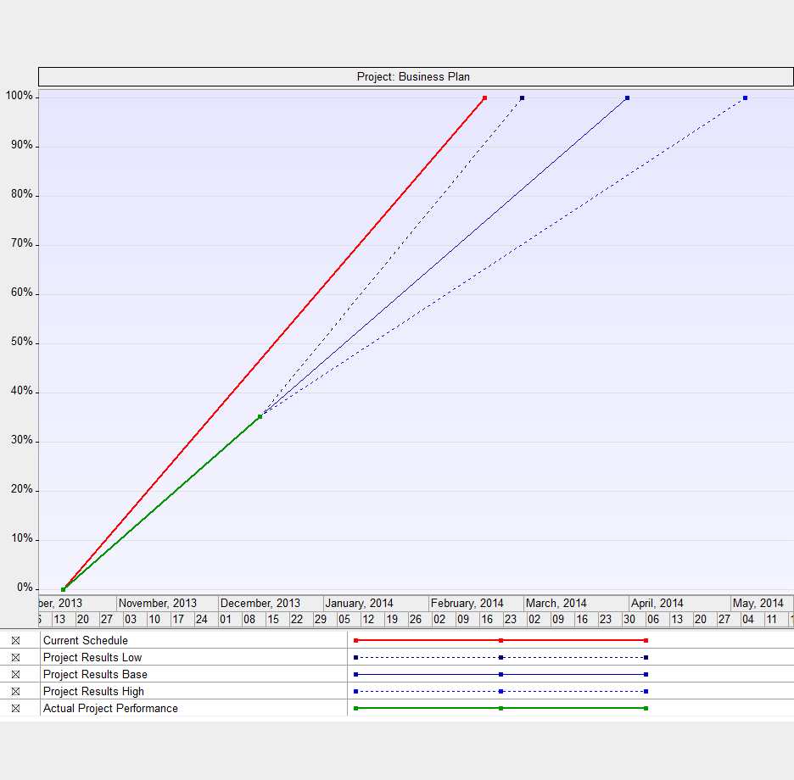
Project Control OF Program with Large Number of Activities

Slide 24
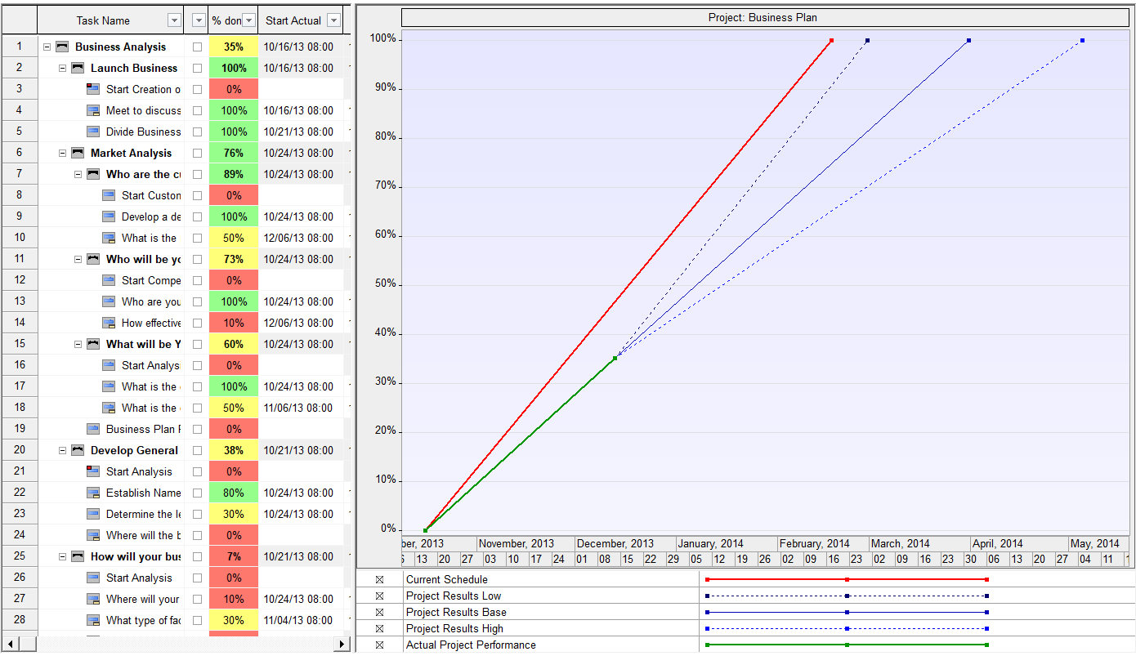
Project Control of Integrated Programs with Large Number of Activities
Project Control information can be entered in original and consolidated project schedule.
Project Control is performed under uncertainties: consolidated project schedule may be required.
Original Project Duration
Low, base, and high forecasted duration
Actual Project Duration

Slide 25

Conclusions
Accuracy of project schedules can degrade exponentially when the number of activities exceeds a certain threshold.
Large integrated project schedules require detailed quality control, including schedule diagnostics and schedule health checks.
Large schedules can be consolidated: equivalent schedules can be generated for the purpose of analysis.
Schedule and Cost Risk Analysis and JCL analysis can be performed on consolidated schedules.
Project control can be performed under uncertainty using consolidated project schedules.

