Slide 1


COMPACT and ASCoT 2026: Recent Enhancements to the ONSET Cost Estimation Tool Suite
NASA Cost and Schedule Symposium | August 26, 2026
Presented by Michael DiNicola (COMPACT Task Manager) and Joe Mrozinski (ASCoT Task Manager)
Jet Propulsion Laboratory, California Institute of Technology

Slide 2

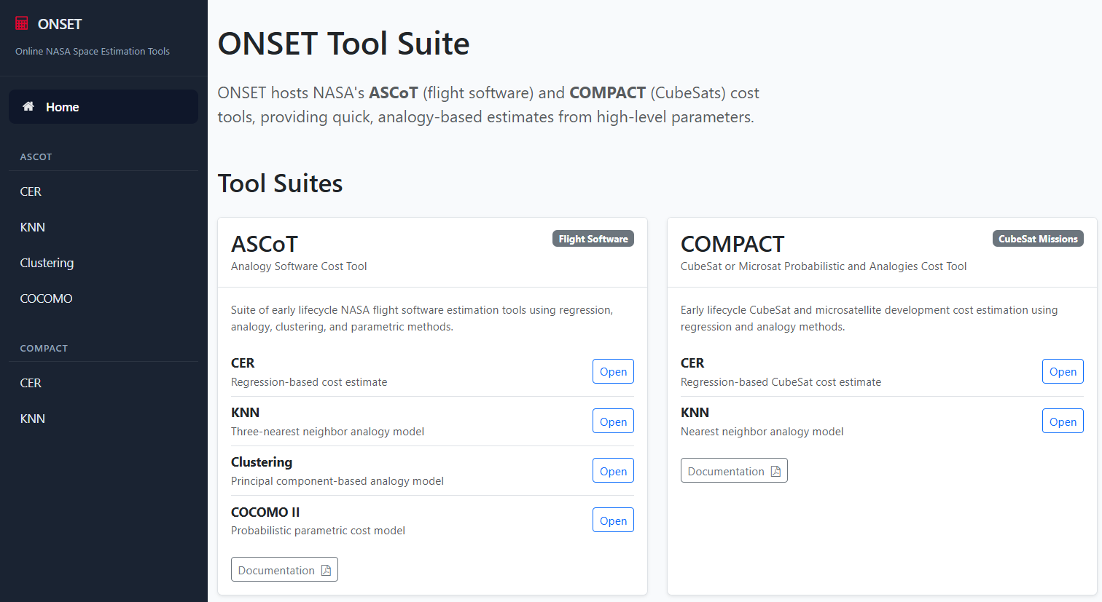

ONSET
Architecture
Two tools currently hosted on ONSET:
ASCoT
(Analogy Software Cost Tool)
COMPACT
(CubeSat Or Microsat Probabilistic and Analogies Cost Tool)
ASCoT and COMPACT share algorithms, team members, and philosophies.
Both tools are hosted online in ONSET at https://onset.jpl.nasa.gov/

Slide 3
What’s in COMPACT?
Mathematical modeling and statistics at work in cost estimation
  COMPACT is found on the ONSET tool suite and includes two tools
  Cost Estimating Relationship (CER)
    Good for: multiple builds; capturing trends in your cost estimate in an S-curve
  K-Nearest Neighbor (KNN)
    Good for: Early ballpark analog-based point estimates
  Each tool comes with a database of normalized CubeSat data
Show tool
https://oncedata.hq.nasa.gov/frmMainSplit.aspx
Which tool is better for you depends on your needs and access privileges.

Slide 4
Why Did We Build COMPACT?
Mathematical modeling and statistics at work in cost estimation
  Cost models for typical spacecraft are not applicable
    CubeSats are extremely small compared to typical spacecraft – other models have to extrapolate and do so poorly
    CubeSats are implemented very differently – high risk tolerance, many times students involved, modular, quick turnaround, many built at once
Cost model estimate extrapolated from traditional S/C
Cost
GAP
Actual CubeSat costs
Mass
COMPACT fills a gap in NASA cost estimation for small, inexpensive satellites

Slide 5
Updates & Enhancements
Mathematical modeling and statistics at work in cost estimation
ONSET and COMPACT have an updated look and improved UI/UX
Newest version of COMPACT released this past July
7 normalized datapoints added since last release
  CUPID, CuSP, CUTE, Dellingr, HARP, SeaHawk-1, TROPICS
  Total normalized datapoints: 48
Model recalibrated with these new datapoints
  Bayesian CER: Higher RE% than previous version

Slide 6
COMPACT Tool DEmo
Mathematical modeling and statistics at work in cost estimation
Notes:
Thursday: 9:40-10:40 COMPACT and ASCOT workshop

Slide 7
Thank you!
Mathematical modeling and statistics at work in cost estimation
  Questions & Feedback
  Contact us at COMPACT@jpl.nasa.gov
  or at Michael.DiNicola@jpl.nasa.gov
We want your feedback to continue to improve the tool!

Slide 8
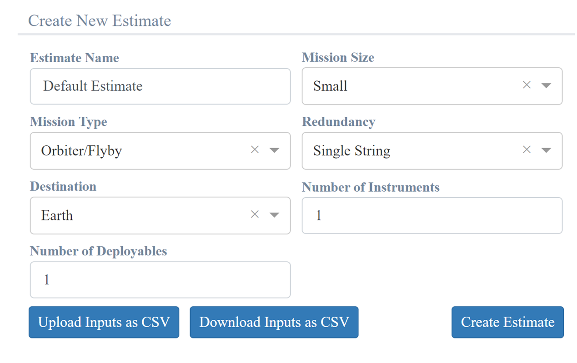
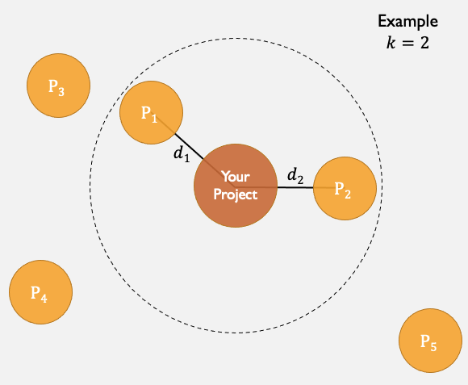
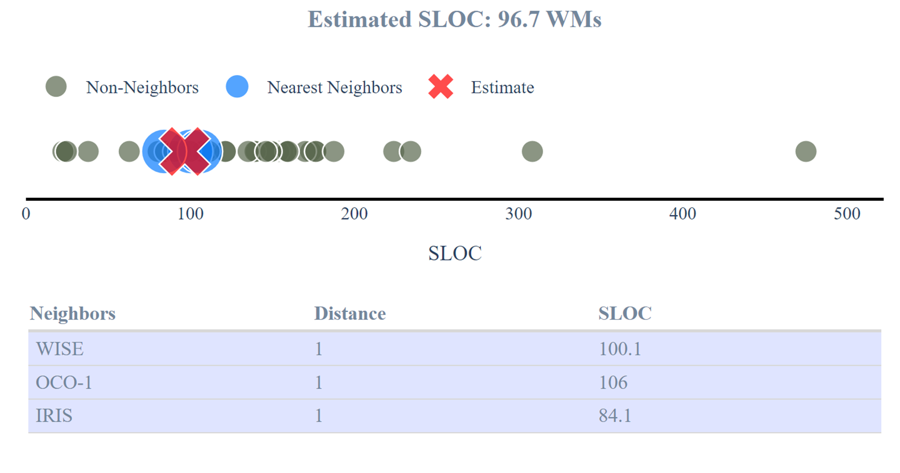

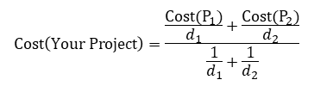
What is ASCoT?
(Analogy Software Cost Tool)
Inputs
How does $k$-Nearest Neighbors ($k$NN) work?
ASCoT is a suite of tools to estimate the software development effort, software size and cost for flight software using a variety of techniques
  Analogic cost estimation via k-Nearest Neighbors (kNN) and clustering
  Simple Bayesian CERs
  Probabilistic version of USC's Constructive Cost Model (COCOMO II)
ASCoT is built off of a Dataset of 46 Missions
Outputs
$$Cost\left(Your Project\right)=\frac{\frac{Cost(P_{1})}{d_{1}}+\frac{Cost(P_{2})}{d_{2}}}{\frac{1}{d_{1}}+\frac{1}{d_{2}}}$$

Slide 9
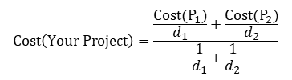

Analogy Estimation: Find Missions Like Yours
How does $k$-Nearest Neighbors ($k$NN) work?
KNN and Clustering use high-level mission characteristics to estimate software development effort or size (kSLOC) from historical NASA missions.
K-Nearest Neighbors (KNN)
Finds the historical missions most similar to your project
Estimates from the nearest analogs, giving more weight to the closest matches
Clustering
Places your project into a group of similar historical missions
Estimates from analogous missions within that group
These use only a few early-life-cycle inputs: Mission Size, Redundancy, Inheritance, Mission Type, Destination, # of Instruments, and # of Deployables
Outputs include the estimate, uncertainty, and the historical missions supporting the analogy estimate
$$Cost\left(Your Project\right)=\frac{\frac{Cost(P_{1})}{d_{1}}+\frac{Cost(P_{2})}{d_{2}}}{\frac{1}{d_{1}}+\frac{1}{d_{2}}}$$

Slide 10
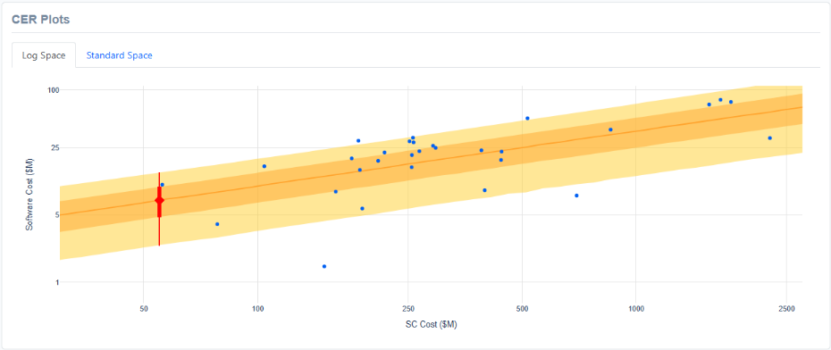
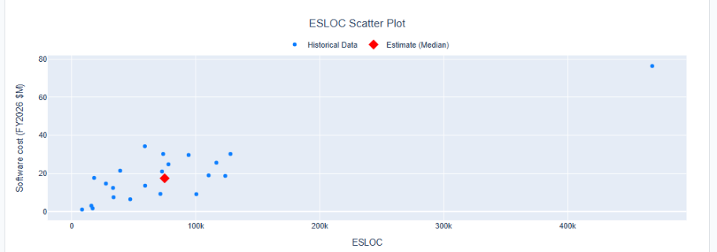
ASCOT BAyesian CERs
ASCoT provides two simple software cost estimating relationships, depending on the information available:
Using Spacecraft Cost
Inputs: Spacecraft Development Cost + Destination
Estimates flight software development cost
Separate relationships for Earth-orbiting and non-Earth-orbiting missions
Using ESLOC
Input: Equivalent Source Lines of Code (ESLOC)
Estimates flight software development cost from software size
Accounts for the effective size of new, reused, and modified software
Both provide probabilistic cost estimates, including 30th, 50th, and 70th percentile results and an S-curve

Slide 11
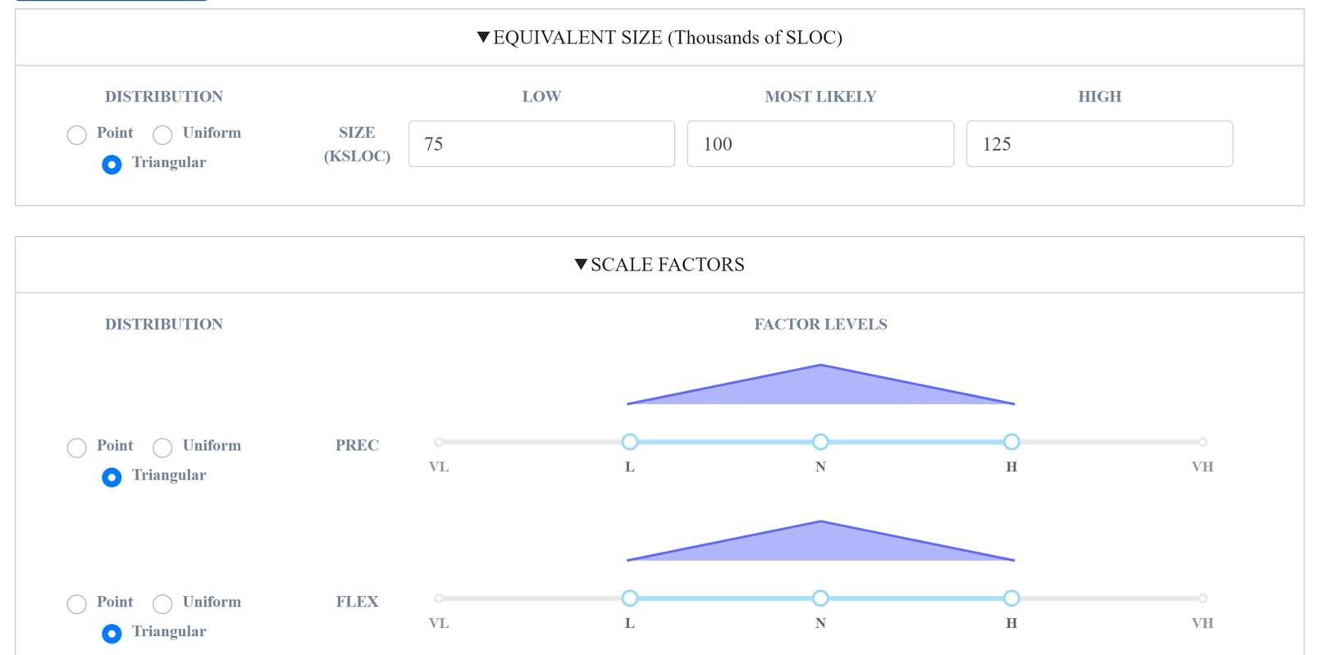
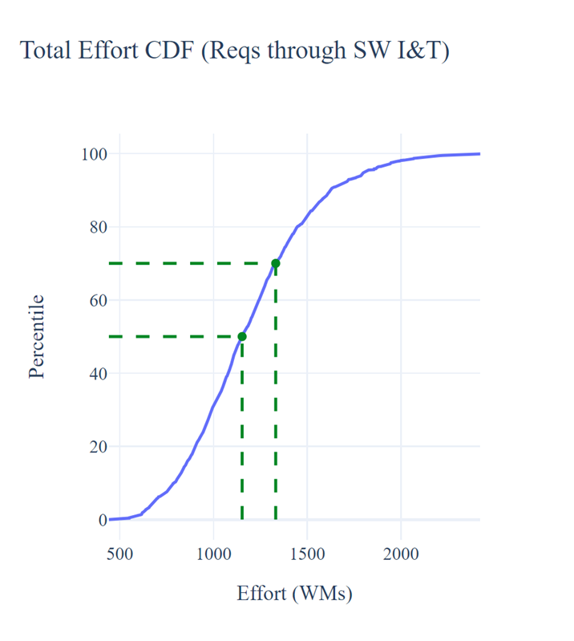
COCOMO II: A More Detailed Software Estimate
For projects where more detailed software information is available, ASCoT provides a probabilistic implementation of COCOMO II
Uses 23 software cost drivers and scale factors
Inputs can be entered as point estimates or ranges
Low / most likely / high inputs can capture uncertainty in what is known
ASCoT runs a Monte Carlo simulation to produce a distribution of possible outcomes
Outputs include software development effort and, when cost per work-month is provided, total software cost
Use COCOMO II when you know more about the software itself and want a more detailed parametric estimate

Slide 12
Ascot Tool DEmo
Mathematical modeling and statistics at work in cost estimation
Notes:
Thursday: 9:40-10:40 COMPACT and ASCOT workshop

Slide 13
Thank you!
Mathematical modeling and statistics at work in cost estimation
  Questions & Feedback
  Contact us at ASCoT@jpl.nasa.gov
  or at Joseph.J.Mrozinski@jpl.nasa.gov
We want your feedback to continue to improve the tool!

Slide 14
COMPACT Backup
Mathematical modeling and statistics at work in cost estimation

Slide 15

Using the COMPACT Tool
Mathematical modeling and statistics at work in cost estimation
Inputs | CER | KNN
Developer Type, NASA or Other
Number of Flight Units
Launch Mass, kg (per flight unit)
Form Factor (a.k.a. number of Us, per flight unit)
Average Power, W (per flight unit)
Fiscal Year of $
Outputs | CER | KNN
Total Mission Cost
Cost by Flight Unit
Probability Distributions of Cost
Point Estimate of Cost
Analog Capability
Captures Trends
CER can estimate multiple builds and quantify uncertainty…
…KNN provides analog-based point estimates.

Slide 16
What Is COMPACT Trying to Do?
Mathematical modeling and statistics at work in cost estimation
  Give you a rapid data-informed total mission cost estimate that is in-family with your mission concept
  Give you a sense of the uncertainty on the estimate
  Provide something to compare to another estimate (validation)
  Help you size your mission and perform top-level trades with CubeSat cost drivers
Scope
Trades
Evaluation
Risk
Cost
Uncertainty
Schedule
COMPACT can help you size your CubeSat mission early in formulation

Slide 17
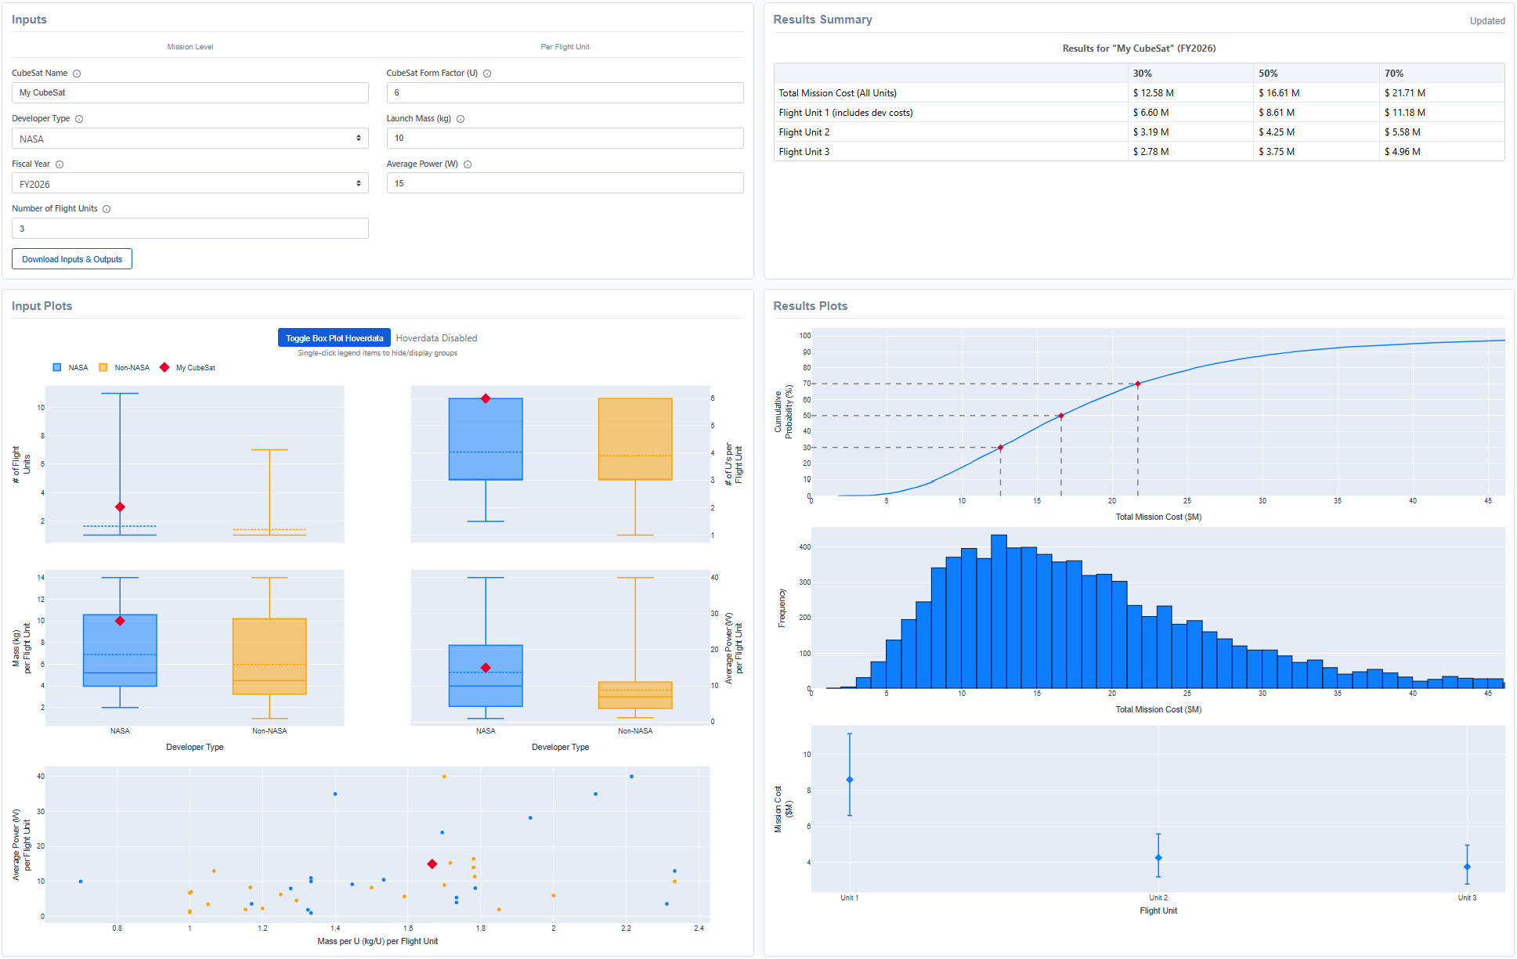
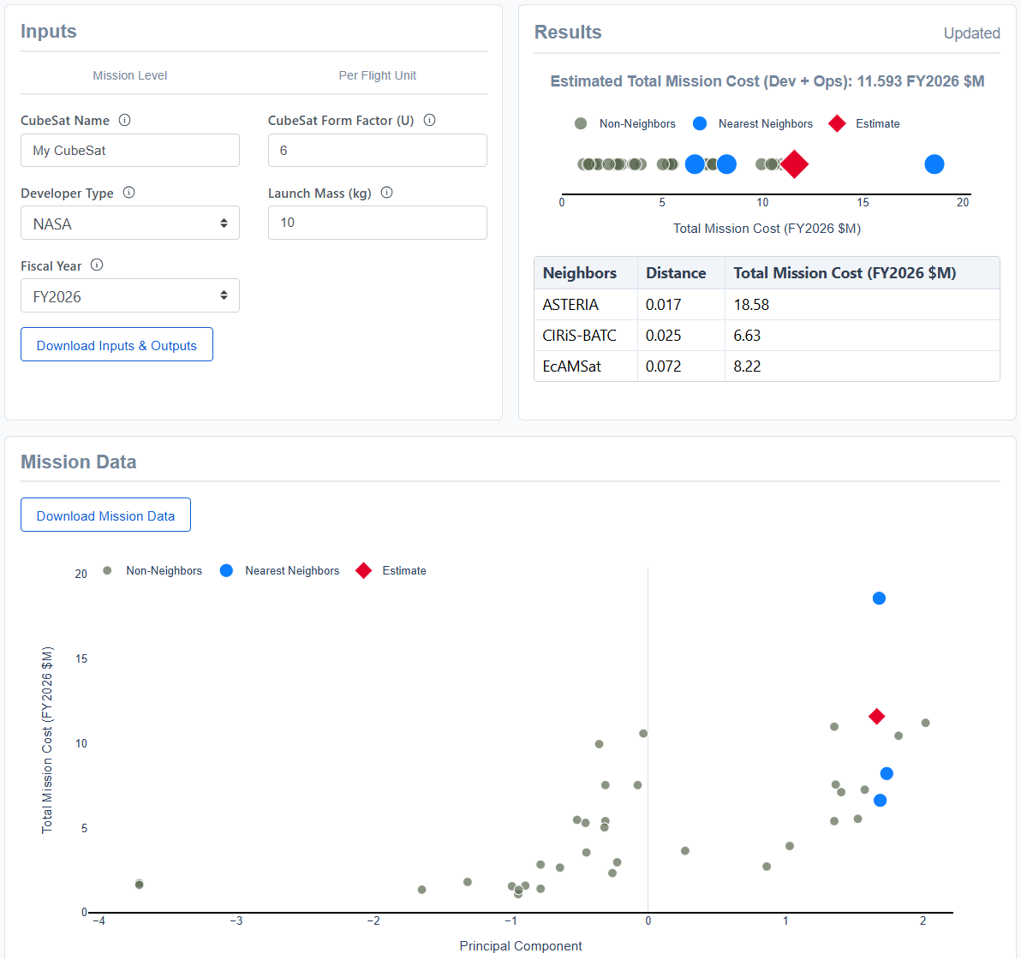
Two Tools, Two very different kinds of Estimates
Mathematical modeling and statistics at work in cost estimation
Cost estimate output summary table
Similar inputs as CER but fewer
CER
KNN
Inputs
Cost estimate is a weighted average of your mission’s three nearest neighbors
Cost estimates are probability distributions of total mission and per flight unit costs
Comparisons of inputs with actuals

Slide 18
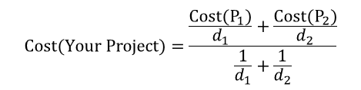
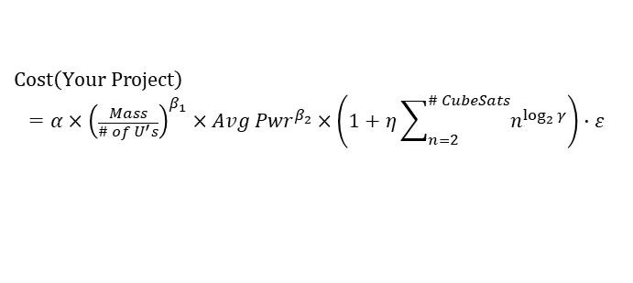
How these tools Work
Mathematical modeling and statistics at work in cost estimation
CER
KNN
NASA
$
Other
~2x Other
$
$
Lead Developer
Mass per U
Avg Pwr
Learning (γ)
Multiple build scaler
RE % (η)
# of units
$$Cost\left(Your Project\right)$$
$$=α×{\left(\frac{Mass}{\# of U^{′}s}\right)}^{β_{1}}×{Avg Pwr}^{β_{2}}×\left(1+η\sum_{n=2}^{\# CubeSats}{n^{\log_{2}{γ}}}\right)∙ε$$
Error term (+/-50%)
$$Cost(Your Project)=\frac{\frac{Cost(P_{1})}{d_{1}}+\frac{Cost(P_{2})}{d_{2}}}{\frac{1}{d_{1}}+\frac{1}{d_{2}}}$$
First Unit Cost
Multiple build scaler

Slide 19
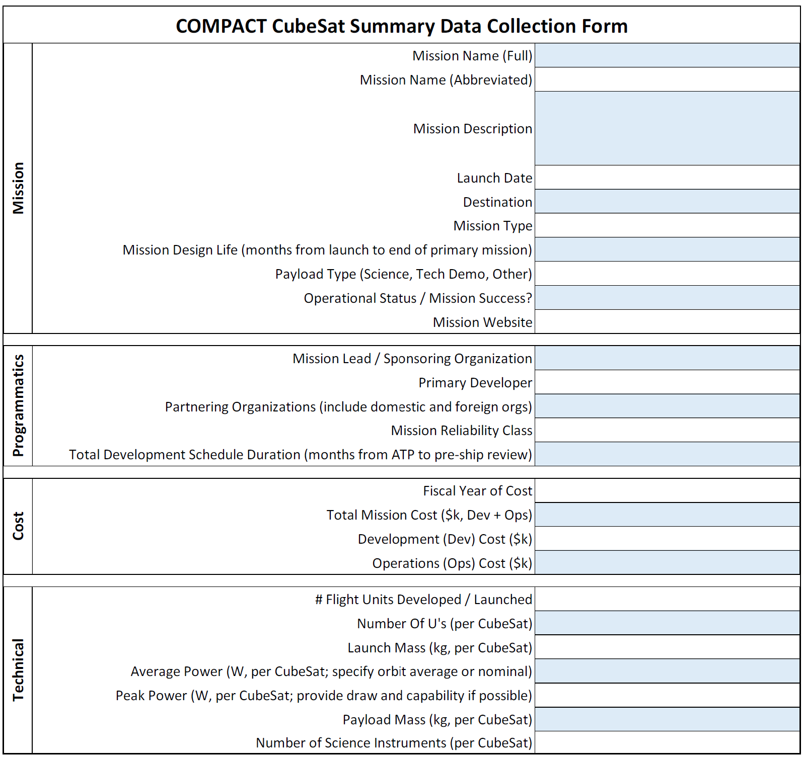
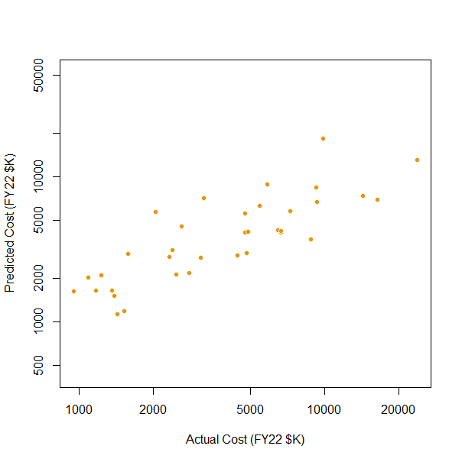
How COMPACT is Maintained
Mathematical modeling and statistics at work in cost estimation
Initial Data Collection
Data Review and Normalization
Model/Tool Development and Validation
Full Mission Cost to NASA (Formulation-Ops, incl. reserve)
Includes storage costs
Includes contractor burdens, fees, etc.
Includes value of foreign contributions, bypass costs and civil servants*
Inflated to a common year
Process documented in the database
Model calibration
Testing
Selection
Tool Development
*Student labor can be difficult to dollarize and is a source of noise in the data.
The COMPACT Team collects, reviews and normalizes the data before bringing into the model, with full traceability documented in its database.

Slide 20
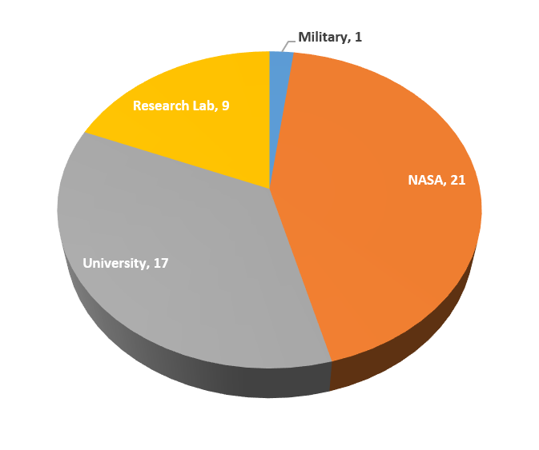
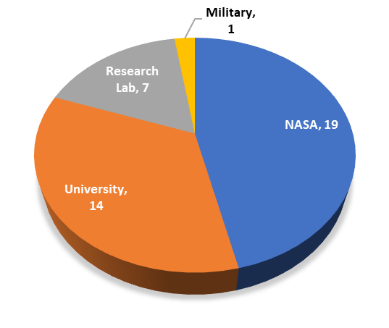
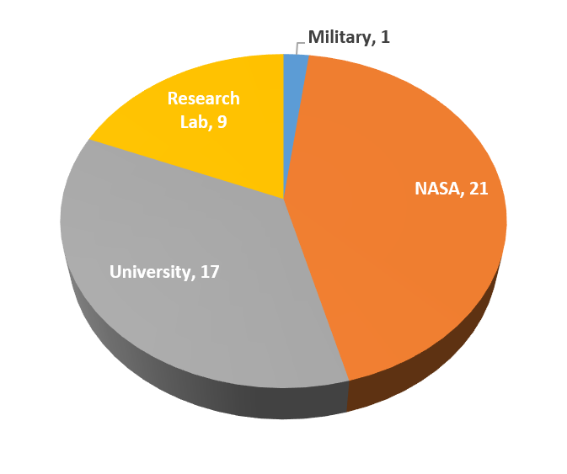
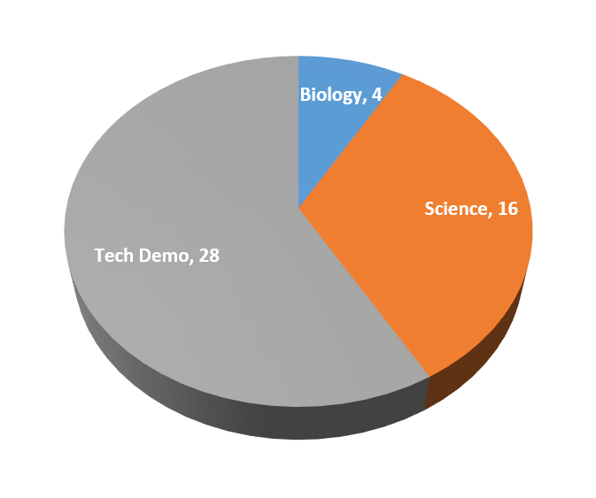
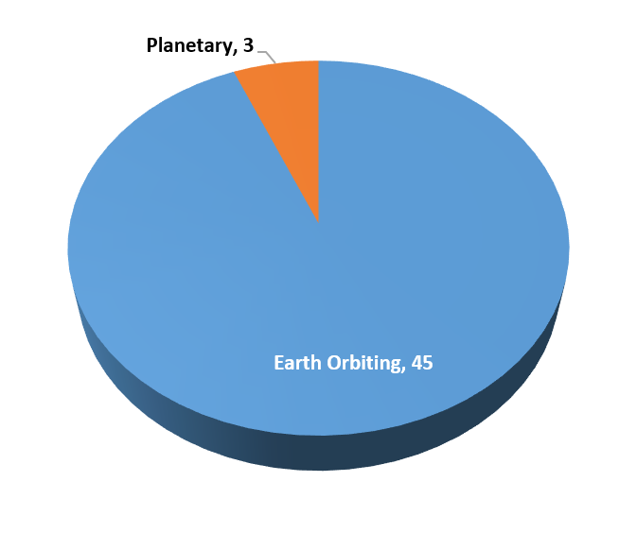
What’s in the Database?
Mathematical modeling and statistics at work in cost estimation
  Total CubeSats Tracked: 361
  Total CubeSats Normalized: 48
    Mix of NASA and non-NASA CubeSats, Tech Demo and Science missions
    Excludes educational missions
    CER uses 42 of these data points
    KNN uses 36 of these data points
We are looking to add CubeSat data from missions either waiting for launch or launched up to 2-3 years ago.
Email Mike DiNicola if you want to collaborate! michael.dinicola@jpl.nasa.gov

Slide 21
Using the Cost Output From COMPACT
Mathematical modeling and statistics at work in cost estimation
  Total Mission Cost output includes all CubeSat development and operations, including reserves
    Model results are based on actual costs of flown CubeSat missions – any reserves spent are included in the costs used to calibrate the model
    There can be a lot of uncertainty (+/- 50%) in the costs output from COMPACT, which should be considered when using the tool to compare with your project’s estimate
    Your inputs should provide your best estimate of your CubeSat projects mass, power, etc.
      The closer your inputs reflect your project at launch, the better estimate you will likely receive.
COMPACT provides a jumping off point for a more refined project cost estimate as well as a way to validate project costs.

Slide 22
Normalized Data (1/3)
Mathematical modeling and statistics at work in cost estimation
Mission Name | Launch Date | Mission Type | Developer Type | Mass (kg) | # of Us | # of Flight Units
TROPICS | 5/26/2023 | Science | Other | 5.3 | 3 | 7
Lunar Flashlight | 12/11/2022 | Tech Demo | NASA | 13.3 | 6 | 1
CuSP | 11/16/2022 | Science | Other | 10.2 | 6 | 1
CTIM-FD | 7/2/2022 | Tech Demo | Other | 10.7 | 6 | 1
CuPID | 9/27/2021 | Science | Other | 7.5 | 6 | 1
CUTE | 9/27/2021 | Science | Other | 10.7 | 6 | 1
CIRiS-BATC | 12/5/2019 | Tech Demo | Other | 14.0 | 6 | 1
MiniCarb | 12/5/2019 | Science | Other | 6.4 | 6 | 1
HARP | 11/2/2019 | Tech Demo | Other | 4.8 | 3 | 1
E-TBEx | 6/25/2019 | Science | Other | 3.9 | 3 | 2
Kenobi | 4/17/2019 | Tech Demo | NASA | 2.1 | 3 | 1
Seeker | 4/17/2019 | Tech Demo | NASA | 4.2 | 3 | 1
AlBus | 12/16/2018 | Tech Demo | NASA | 4.0 | 3 | 1
CeReS | 12/16/2018 | Science | NASA | 4.3 | 3 | 1
CubeSail | 12/16/2018 | Tech Demo | Other | 1.7 | 1.5 | 2

Slide 23
Normalized Data (2/3)
Mathematical modeling and statistics at work in cost estimation
Mission Name | Launch Date | Mission Type | Developer Type | Mass (kg) | # of Us | # of Flight Units
Shields-1 | 12/16/2018 | Tech Demo | NASA | 6.9 | 3 | 1
STF-1 | 12/16/2018 | Tech Demo | Other | 3.0 | 3 | 1
CSIM-FD | 12/3/2018 | Tech Demo | Other | 10.2 | 6 | 1
MinXSS-2 | 12/3/2018 | Science | Other | 3.5 | 3 | 1
SeaHawk-1 | 12/3/2018 | Science | Other | 4.7 | 3 | 2
ELFIN | 9/15/2018 | Science | Other | 3.6 | 3 | 2
CUBERRT | 5/21/2018 | Tech Demo | Other | 10.3 | 6 | 1
HaloSat | 5/21/2018 | Science | Other | 12.0 | 6 | 1
RainCube | 5/21/2018 | Tech Demo | NASA | 11.6 | 6 | 1
Tempest-D | 5/21/2018 | Tech Demo | NASA | 14.0 | 6 | 1
MarCO | 5/5/2018 | Tech Demo | NASA | 12.7 | 6 | 2
MiRaTA | 11/18/2017 | Tech Demo | Other | 4.5 | 3 | 1
EcAMSat | 11/12/2017 | Biology | NASA | 10.7 | 6 | 1
ISARA | 11/12/2017 | Tech Demo | NASA | 5.0 | 3 | 1
ASTERIA | 8/14/2017 | Tech Demo | NASA | 10.2 | 6 | 1
23

Slide 24
Normalized Data (3/3)
Mathematical modeling and statistics at work in cost estimation
Mission Name | Launch Date | Mission Type | Developer Type | Mass (kg) | # of Us | # of Flight Units
Dellingr | 8/14/2017 | Tech Demo | NASA | 9.2 | 6 | 1
CSUNSat-1 | 4/18/2017 | Tech Demo | Other | 2.7 | 2 | 1
IceCube | 4/18/2017 | Tech Demo | NASA | 4.0 | 3 | 1
RAVAN | 11/11/2016 | Tech Demo | NASA | 4.0 | 3 | 1
MinXSS-1 | 12/6/2015 | Science | Other | 3.5 | 3 | 1
EDSN | 11/4/2015 | Tech Demo | NASA | 2.0 | 1.5 | 11
GRIFEX | 1/31/2015 | Tech Demo | Other | 4.0 | 3 | 1
RACE | 10/28/2014 | Tech Demo | NASA | 3.8 | 3 | 1
SporeSat-1 | 4/18/2014 | Biology | NASA | 5.2 | 3 | 2
CP8 | 12/6/2013 | Tech Demo | Other | 1.0 | 1 | 1
Firefly | 11/20/2013 | Science | NASA | 3.5 | 3 | 1
CINEMA-1 | 9/13/2012 | Science | Other | 3.2 | 3 | 1
CSSWE | 9/13/2012 | Science | Other | 3.0 | 3 | 1
M-Cubed/COVE | 10/28/2011 | Tech Demo | Other | 1.0 | 1 | 1
PSSC-2 | 7/8/2011 | Tech Demo | Other | 3.7 | 2 | 1
O/OREOS | 11/20/2010 | Biology | NASA | 5.2 | 3 | 1
RAX-1 | 11/20/2010 | Science | Other | 3.0 | 3 | 2
PharmaSat-1 | 5/19/2009 | Biology | NASA | 5.0 | 3 | 2
24

Slide 25
the Future of COMPACT
Mathematical modeling and statistics at work in cost estimation
We want to talk to you!
  Collect data on recent CubeSat missions
  Continued emphasis on data transparency
  Continue development of parametric cost models that are accessible to the community
  Expand accessibility to more readily help contractors and universities
  Web tool update coming this calendar year
Launched a CubeSat in the last 2-3 years?
Delivered your CubeSats and waiting to launch?
We need your feedback to continue to improve the tool!

Slide 26
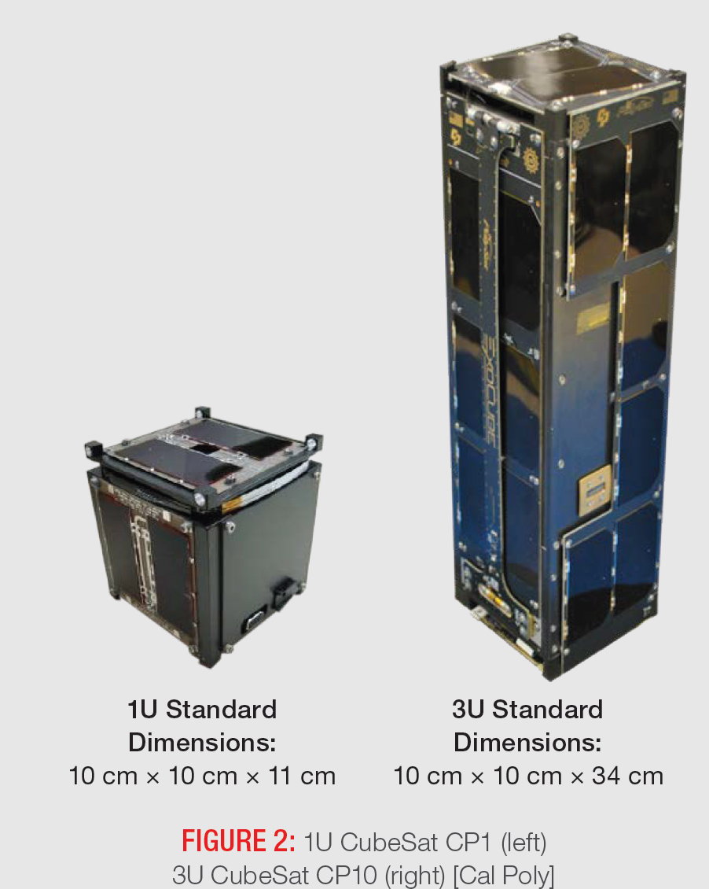
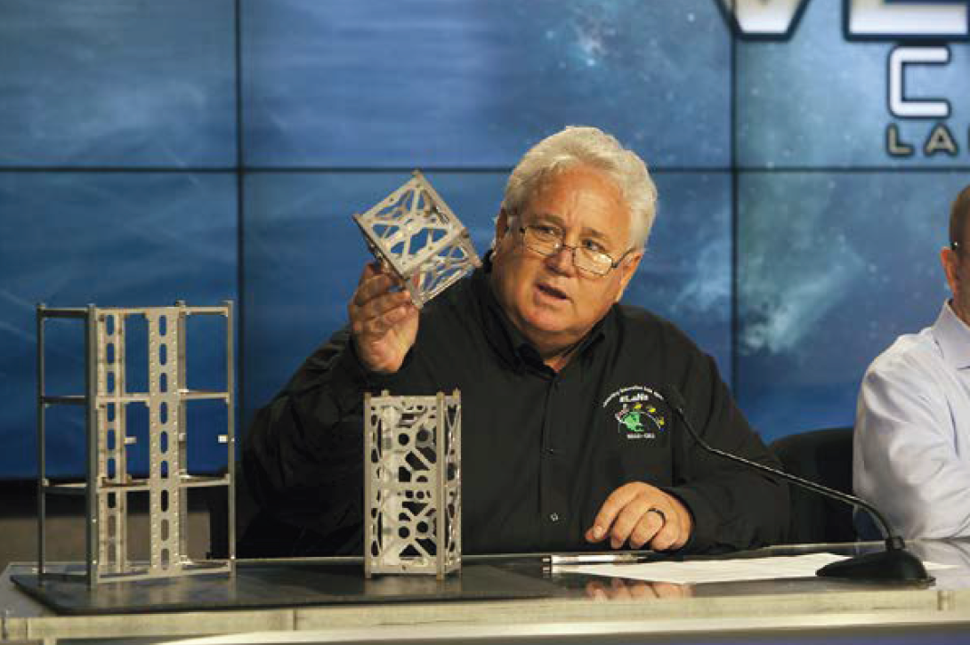
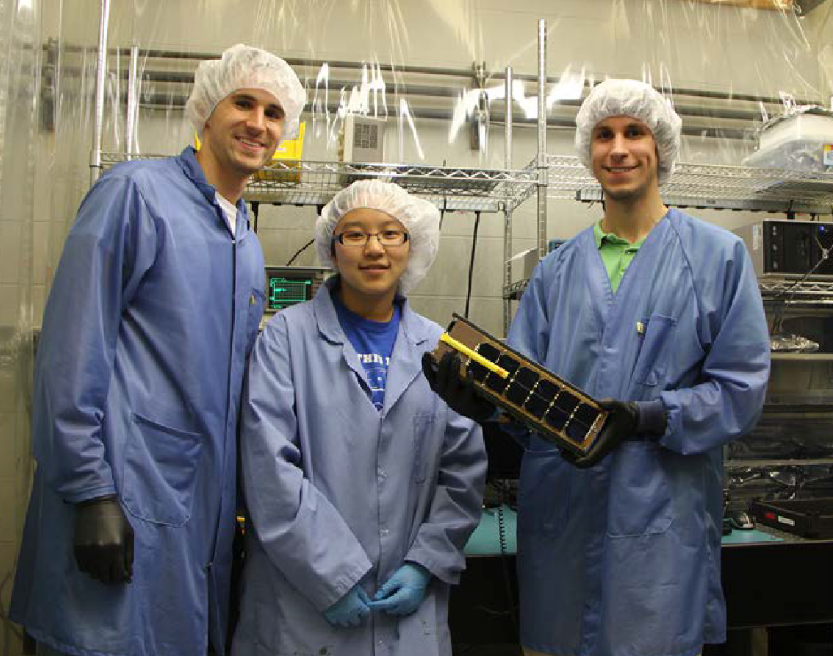
What do CUBESATS Look Like?
Mathematical modeling and statistics at work in cost estimation
Source:CubeSat 101
https://www.nasa.gov/wp-content/uploads/2017/03/nasa_csli_cubesat_101_508.pdf

Slide 27
ASCOT Backup
Mathematical modeling and statistics at work in cost estimation

Slide 28
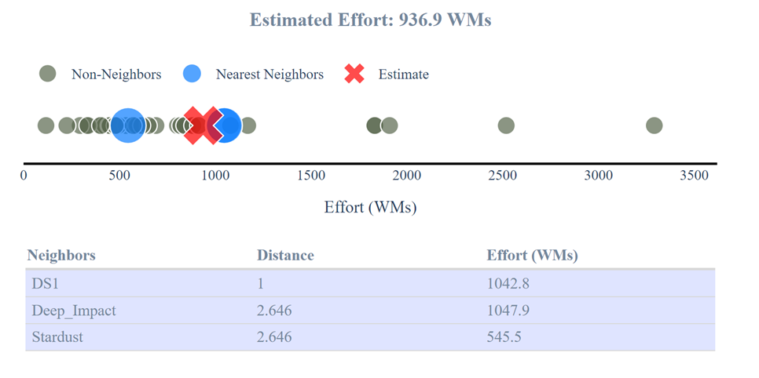
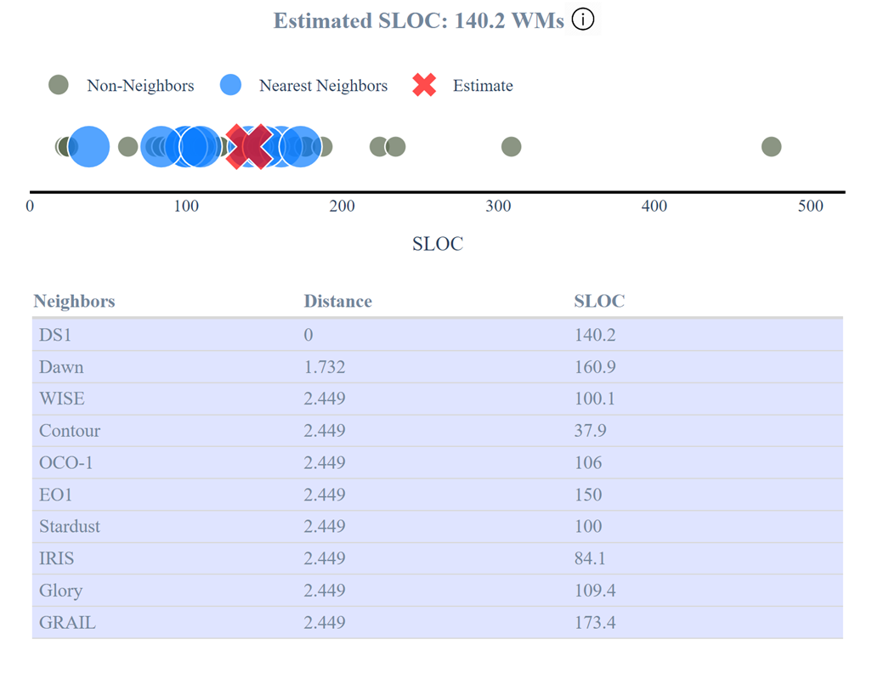
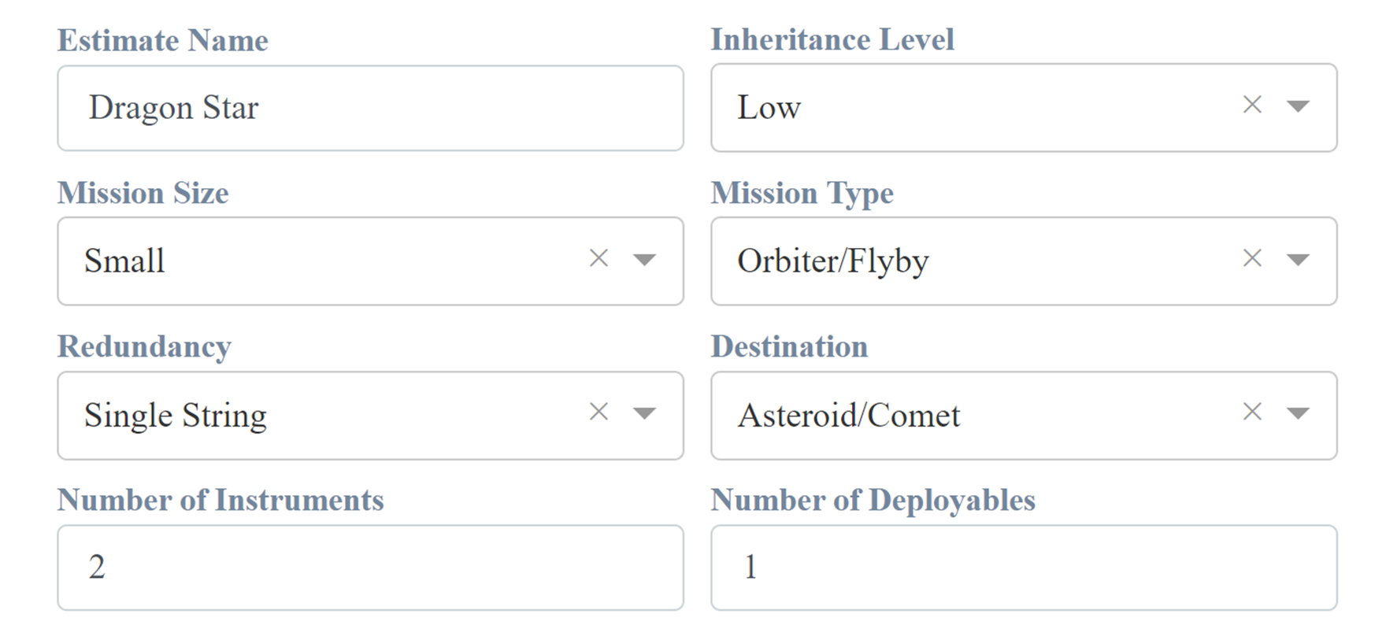
KNN Analogy Example
Develop an estimate for the software development effort using kNN for the proposed DragonStar project
Inputs:

Slide 29
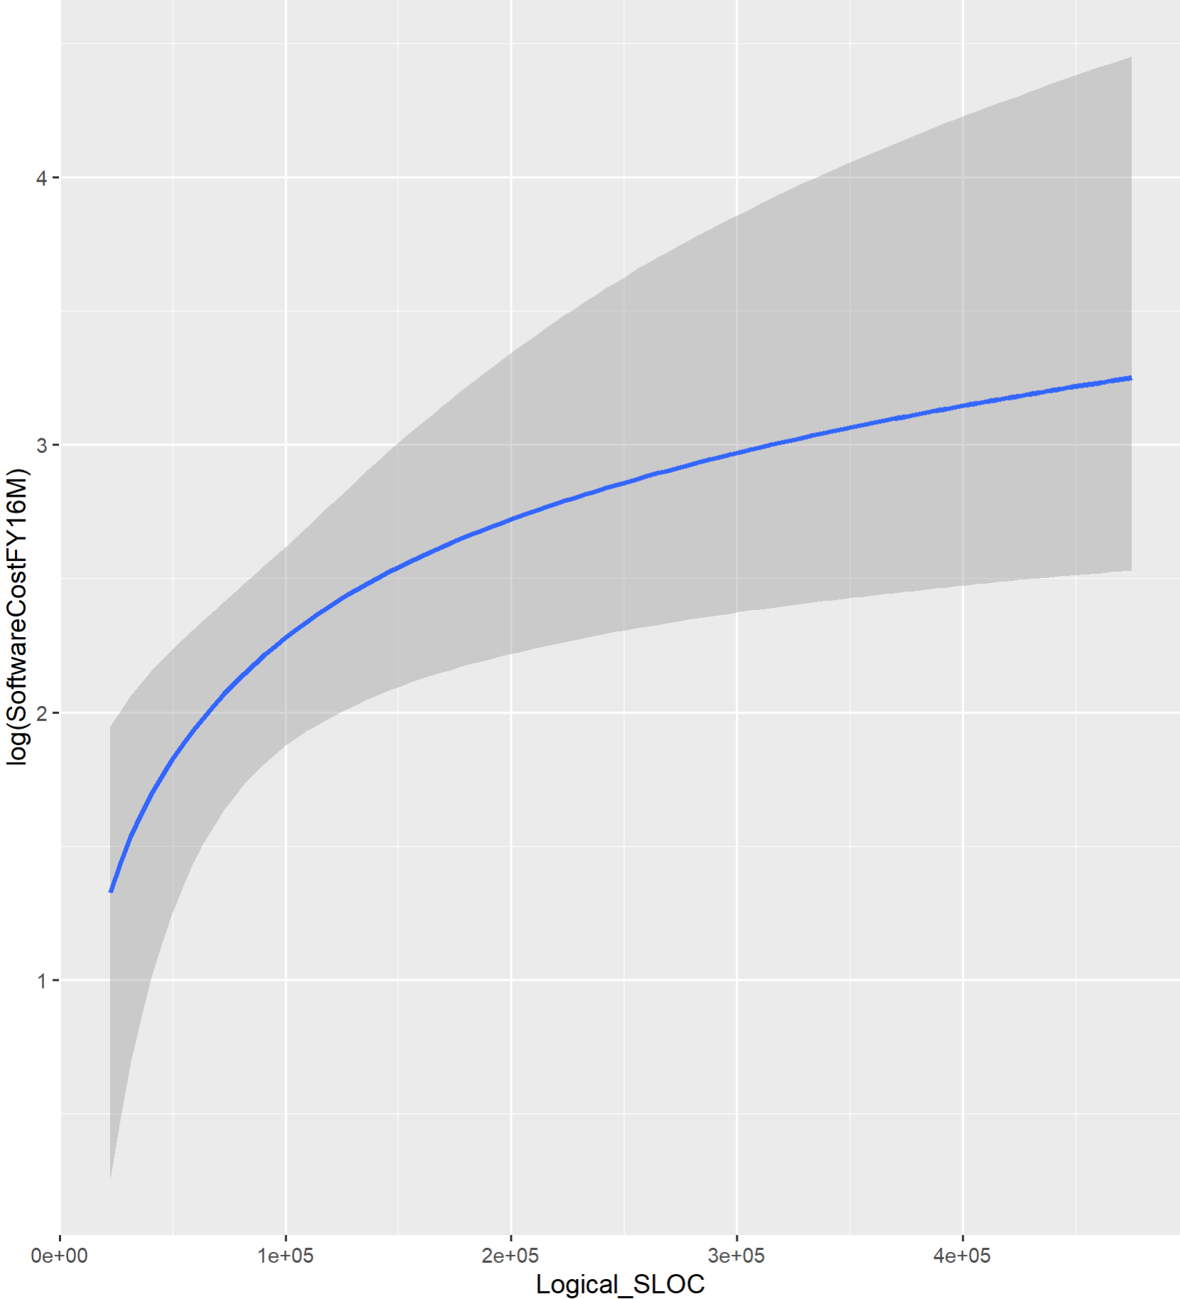
Early LOC CER: Motivation for ESLOC
Lines of Code is a More Common Driver than Hardware Cost
Input: Logical Lines of Code
Physical Lines of Code includes all lines of code
Logical Lines of Codes excludes blanks and comments
22 Historical Data Points
Bayesian CER: Prior on b coefficient is centered at 1.1 (from COCOMO)
Bus SW Cost (FY16$M) = 0.004*Logical LOC^{0.68}
Bayes R² = 24%

Slide 30
What is ESLOC?
Equivalent Source Lines of Code (ESLOC)
  The effective size of reused and adapted code adjusted to its equivalent in new code + the size of the new code
  The adjustment is based on the additional effort it takes to modify the code for inclusion in the product
Equation from COCOMO:
Parametric models that use lines of code as an input typically use equivalent sources lines of code
This accounts for reused code and modified code
Typical assumption is that 40% of the effort required for a new line of code is design, 30% is for coding, and the other 30% is testing
This plus the amount of effort required for redesign, recoding, and retesting of modified code can be used to calculate equivalent source lines of (new) code (ESLOC)
ESLOC = SLOC * [ (40% * % Design Modified ) + (30% *% Code Modified ) + (30% * % Integration & Test ) ]

Slide 31
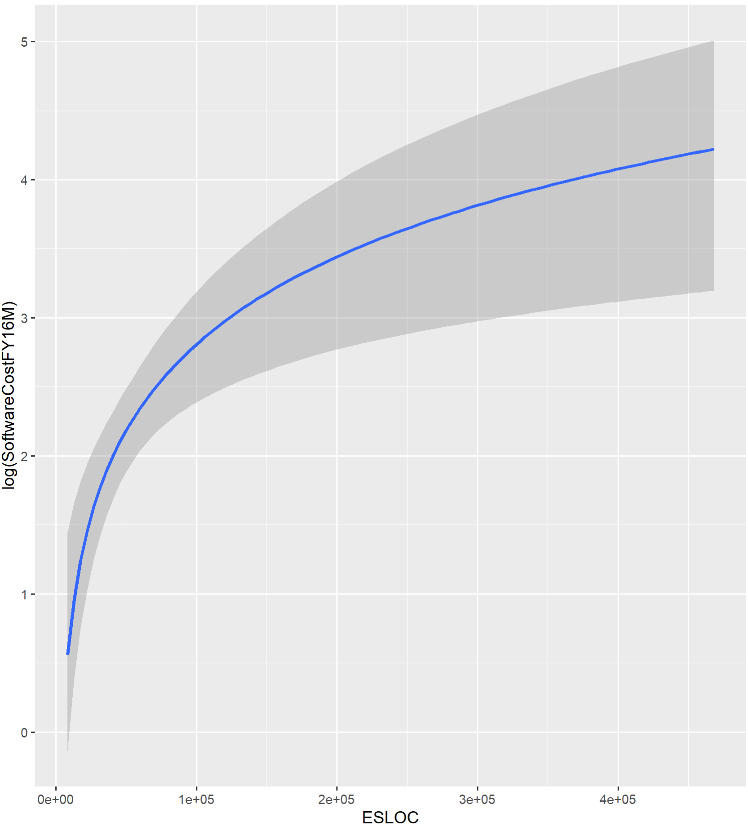
ASCoT’s esloc cer
Input: Equivalent Source Lines of Code
Bayesian CER: Prior on b coefficient is centered at 1.1 (from COCOMO)
22 Historical Data Points
Bus SW Cost (FY16$M) = 0.00044*Logical LOC^{0.92}
Bayes R² = 61%
Log-Gaussian rather than Skew Normal error
Destination (Planetary Vs. Earth Orbiting) not a factor (adding did not improve fit)

