Slide 1



Leveraging AI for PP&C:
Infusing Missions with Practical Programmatic Applications at Goddard Space Flight Center
Eric Mansbach, PMP
GSFC EVM Surveillance Lead/PP&C Best Practices Assessment Lead
GSFC CAIO AI Training Lead
EVM Lead, Dragonfly Payloads/Ocellus

Slide 2
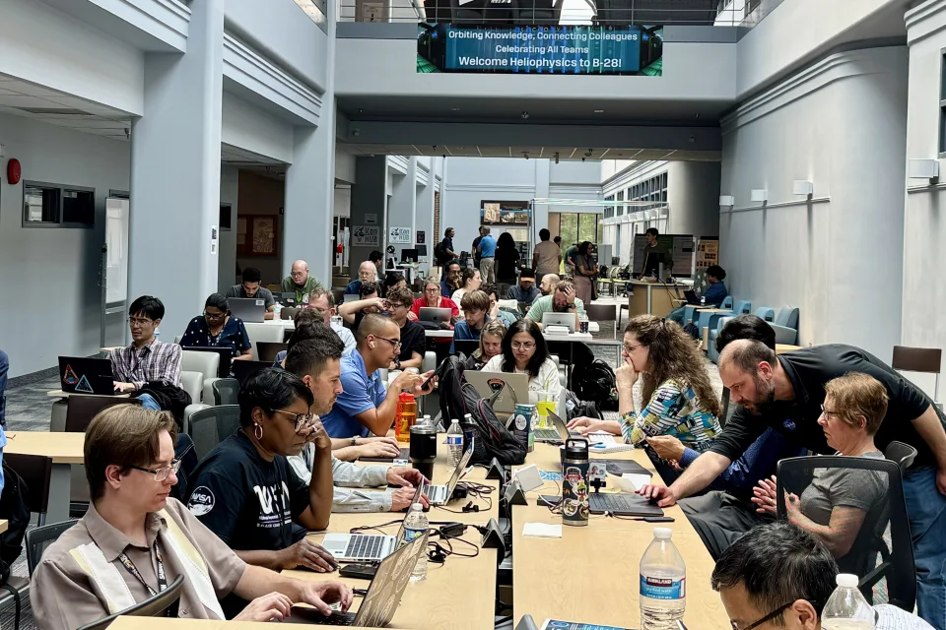
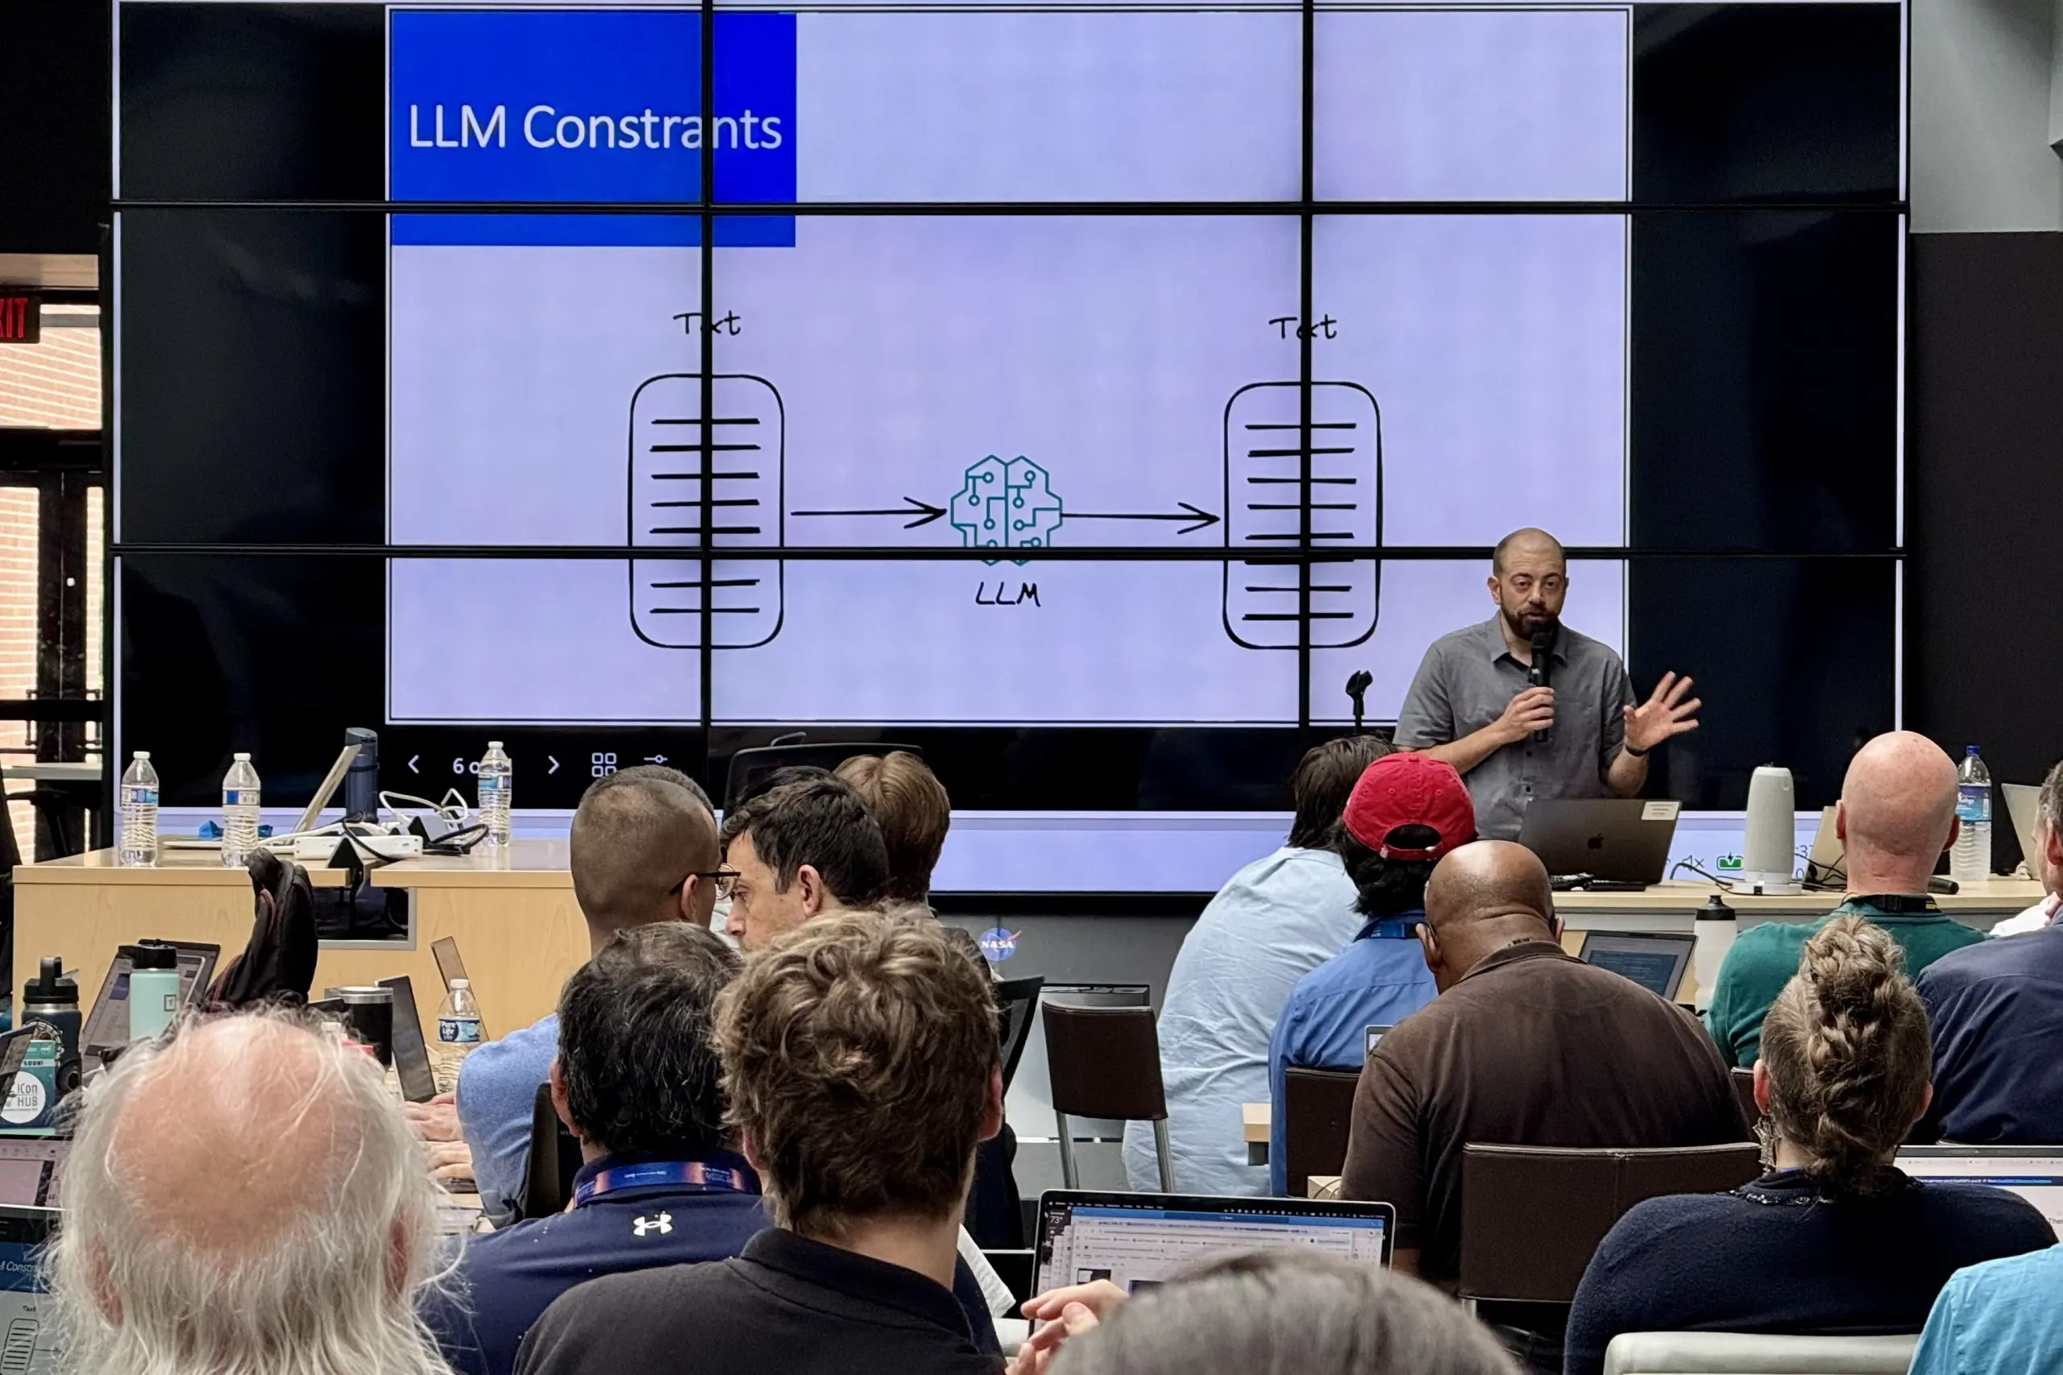
Center-Level AI Forums and Training
GSFC AI PP&C Working Groups- through August 2026 conducted 40+ monthly PP&C-focused working groups.
  PP&C AI WGs span full range of programmatic disciplines (e.g., risk, schedule, resource/cost management, EVM, and config/document management).
PP&C discipline-specific, hands-on ChatGSFC Agent Builder Workshops for Center practitioners looking to leverage AI in their workflows.
Lunch & Learns (e.g., Intro to AI and ChatGSFC, Schedule Dashboard Development with AI)
Directorate-level monthly AI briefings, Goddard AI Community Leads Monthly, Goddard Data Management Board
AI Immersion Week- Multi-disciplinary challenges, hackathons, lectures, lightning talks, hands-on demonstrations, and poster session.
Notes:
- Goddard has been leading the way on AI development, empowering the community with trainings and forums to learn about AI and how to apply it to workflows
- Goddard AI Community Leads Monthly- cross-directorate forum to coordinate GSFC AI strategy, roadmap, use cases, etc.
- Goddard Data Management Board- forum for overall digital transformation, metadata and data standards, data policy & governance strategy, etc.

Slide 3
GSFC Mission Infusion of AI
May 2026- GSFC Acting Center Director Cynthia Simmons directed Chief AI Officer (CAIO) to accelerate “mission infusion” of AI at GSFC.
  Initial targeted missions/programs include:
    DAVINCI (PP&C AI applications, trajectory design)
    Habitable Worlds Observatory/HTMPO (Text-to-Spaceship AI-based design/engineering agent development, Model Context Protocol (MCP) development)
    Swift/BAT (AI data pipeline management, ChatGSFC-designed on-orbit SOPs)
    Magnetosphere Multiscale (MMS) Fast Plasma Investigation (FPI) (mission agent and MCP development)
    Space Weather Office (SWO) (Program Agent development).
CAIO team also supporting mission infusion of AI at other Centers:
  Artemis II SMA (Holy Grail Risk Aggregation Tool)
  Flight Opportunities/Small Spacecraft & Distributed Systems (SSDS) (MCP development & ChatGSFC Mission AI Agent).
  IPM Working Group demonstrations of PP&C use cases in ChatGSFC and Agent Builder workshop
Notes:
May 2026- asked to accelerate mission infusion, began discussion with multiple missions on how to incorporate AI resources and tech into missions.
We’ll talk about applications being prototyped on DAVINCI today
Also supporting HWO- text to spaceship- agentic AI-driven engineering design that rapidly accelerates development of flight parts
- SWIFT/BAT- project used ChatGSFC to develop on orbit standard operating procedures for turning on and off instruments for SWIFT Boost mission
- Magnetospheric Multiscale (MMS) spacecraft Fast Plasma Investigation (FPI) assistant is chatbot with access to FPI engineering, science, design data, git repo, meeting minutes/reports etc. built around a custom MCP server

Slide 4
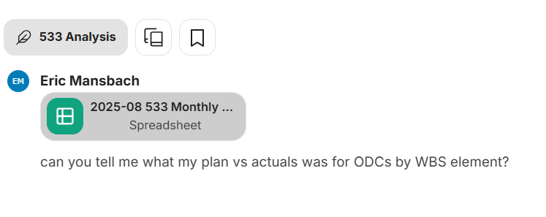
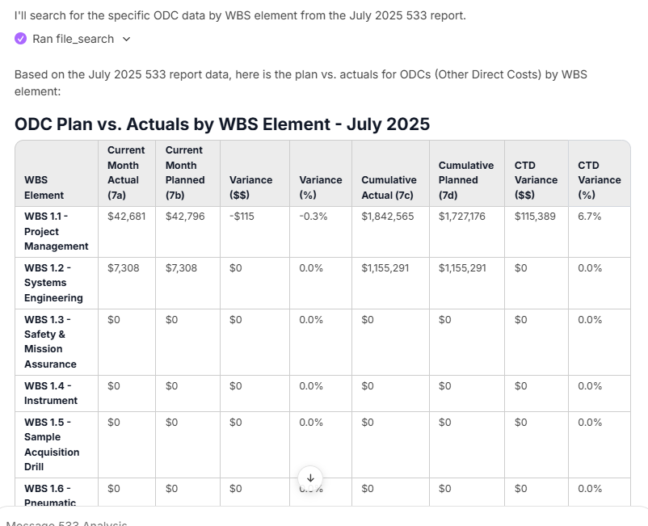
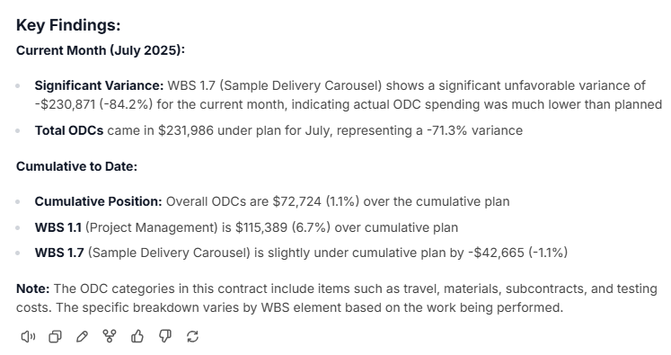
PP&C AI Tools for ChatGSFC: AI Agents
  533 Analysis Agent- Analyzes NASA contractor 533 cost reports, extracting data from documents, calculating variances between actual vs. planned performance, identifying cost drivers, assessing funding status, and summarizing contractor performance and contract health.
  AI Risk Manager- Agent used to identify, assess, and mitigate risks while providing guidance directly from NASA standards, directives, and lessons learned.
  AI Schedule Analyzer- Schedule management, critical path analysis, and predictive schedule metrics. Assists users in analyzing project schedules, identifying risks, conducting rough SRAs, and providing data-driven insights for schedule performance and forecasting.
  EVM Analyzer- Integrated cost, schedule, and EVM performance analysis to assess project health, identify root causes of performance issues, conduct variance analysis, and produce IPMR Format 5 reporting
  EVM Surveillance Agent- Analyzes EVM data, runs DECM tests, interprets EIA-748 compliance, and helps with NASA/DCMA surveillance policies and procedures
Notes:
- These are prototypes being developed for ChatGSFC independently within the PP&C community, not official GSFC sanctioned tools.
These agents provide good analysis and worthwhile data points, but all outputs need a human review and should still be compared against validated tools of record. If you run an SRA with the AI Schedule Analyzer, our expectation is that you can use that result as a data point, but it cannot be the
Initial tools started with incorporation of AI agents for analysis
Highly customizable- can be given specific “persistent knowledge” that acts like training data that underpins agent responses.
Can connect agents to one another to amplify quality and thoroughness of responses.
Tools are effective, but limited by currently limited by platform features particularly lack of skills, code execution, and need for additional deterministic tools to be called via MCP.
Can be shared between individuals, teams, organizations
First example I want to highlight is one we are very excited about at Goddard, the 533 Analysis Agent built by Emily Montoya.
For those who may not be familiar, 533s are a contractor financial report that is submitted monthly/quarterly and the report feeds into multiple other reports including variance analysis.
This is a great example of a purpose built tool solving a need because depending on the size of your project, you may receive dozens of these a month from all of your subcontractors, and each one has WBS tabs, so it can become a lot to wade through.
The 533 Agent assists the Goddard OCFO with monthly 533 financial reporting analysis by automating core processes like data extraction, analysis, and validation.
That includes all kinds of month-to-month checks, labor, ODCs, plan vs. actuals, etc.
Lots of other examples of PP&C-focused AI Agents being built and utilized in ChatGSFC here, including the AI Risk Manager, which leverages MCP connections directly to NASA Standards and Directives and the EVM Surveillance Agent, which can handle automated DECM testing and provide interpretation and guidance on compliance metrics.

Slide 5
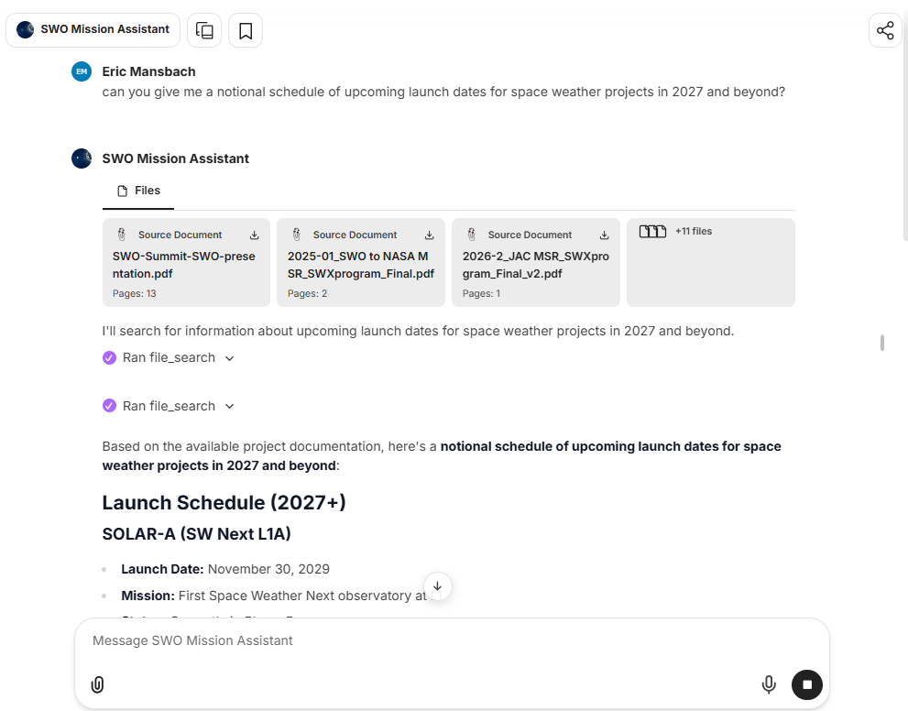
PP&C AI Tools for ChatGSFC: AI Agents
  AI Mission Assistants- (DAVINCI, SWO, PACE, etc.)- Dedicated mission assistants that provide centralized access to project documentation, status information, technical data, schedules, budgets, risks, and requirements.
  Amplify analysis by integrating information across different sources (e.g., linking schedule impacts to budget, EVM, or risk data).
  Leverage historical data to provide context for decisions and reporting and understand the evolution of a project through the lifecycle.
Notes:
- We also started building bespoke mission assistants for projects that act as centralized repository for project data
- What does that look like? We integrate programmatic data sets and reason over them, amplifying their power
- So we load all project MSR data, project planning docs, requirements, rosters, BOEs, risks, EVM data from empower exports, etc.
Leverage cost, schedule, risk data with Tables MCP that allows us to structure excel data to maximize effectiveness of LLM retrieval.
As some folks may be aware, the agency has selected AskSage now known as NASA Chat as the chat tool for the agency. It is a good tool and has lots of models for folks to choose from. I won’t be covering AskSage now NASA Chat in much detail today, the capabilities and features within NASA Chat are still being built out and token allotment is still fairly limiting.
But the Agency is hosting a series of trainings for NASA Chat over the next few weeks, which will be a good opportunity to familiarize yourself with the tool

Slide 6
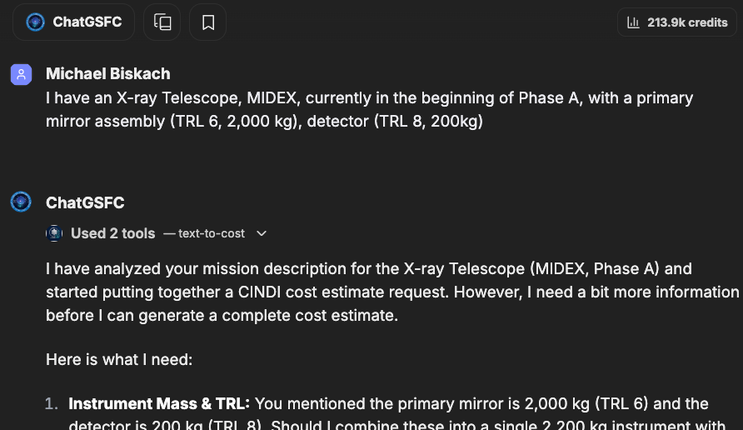
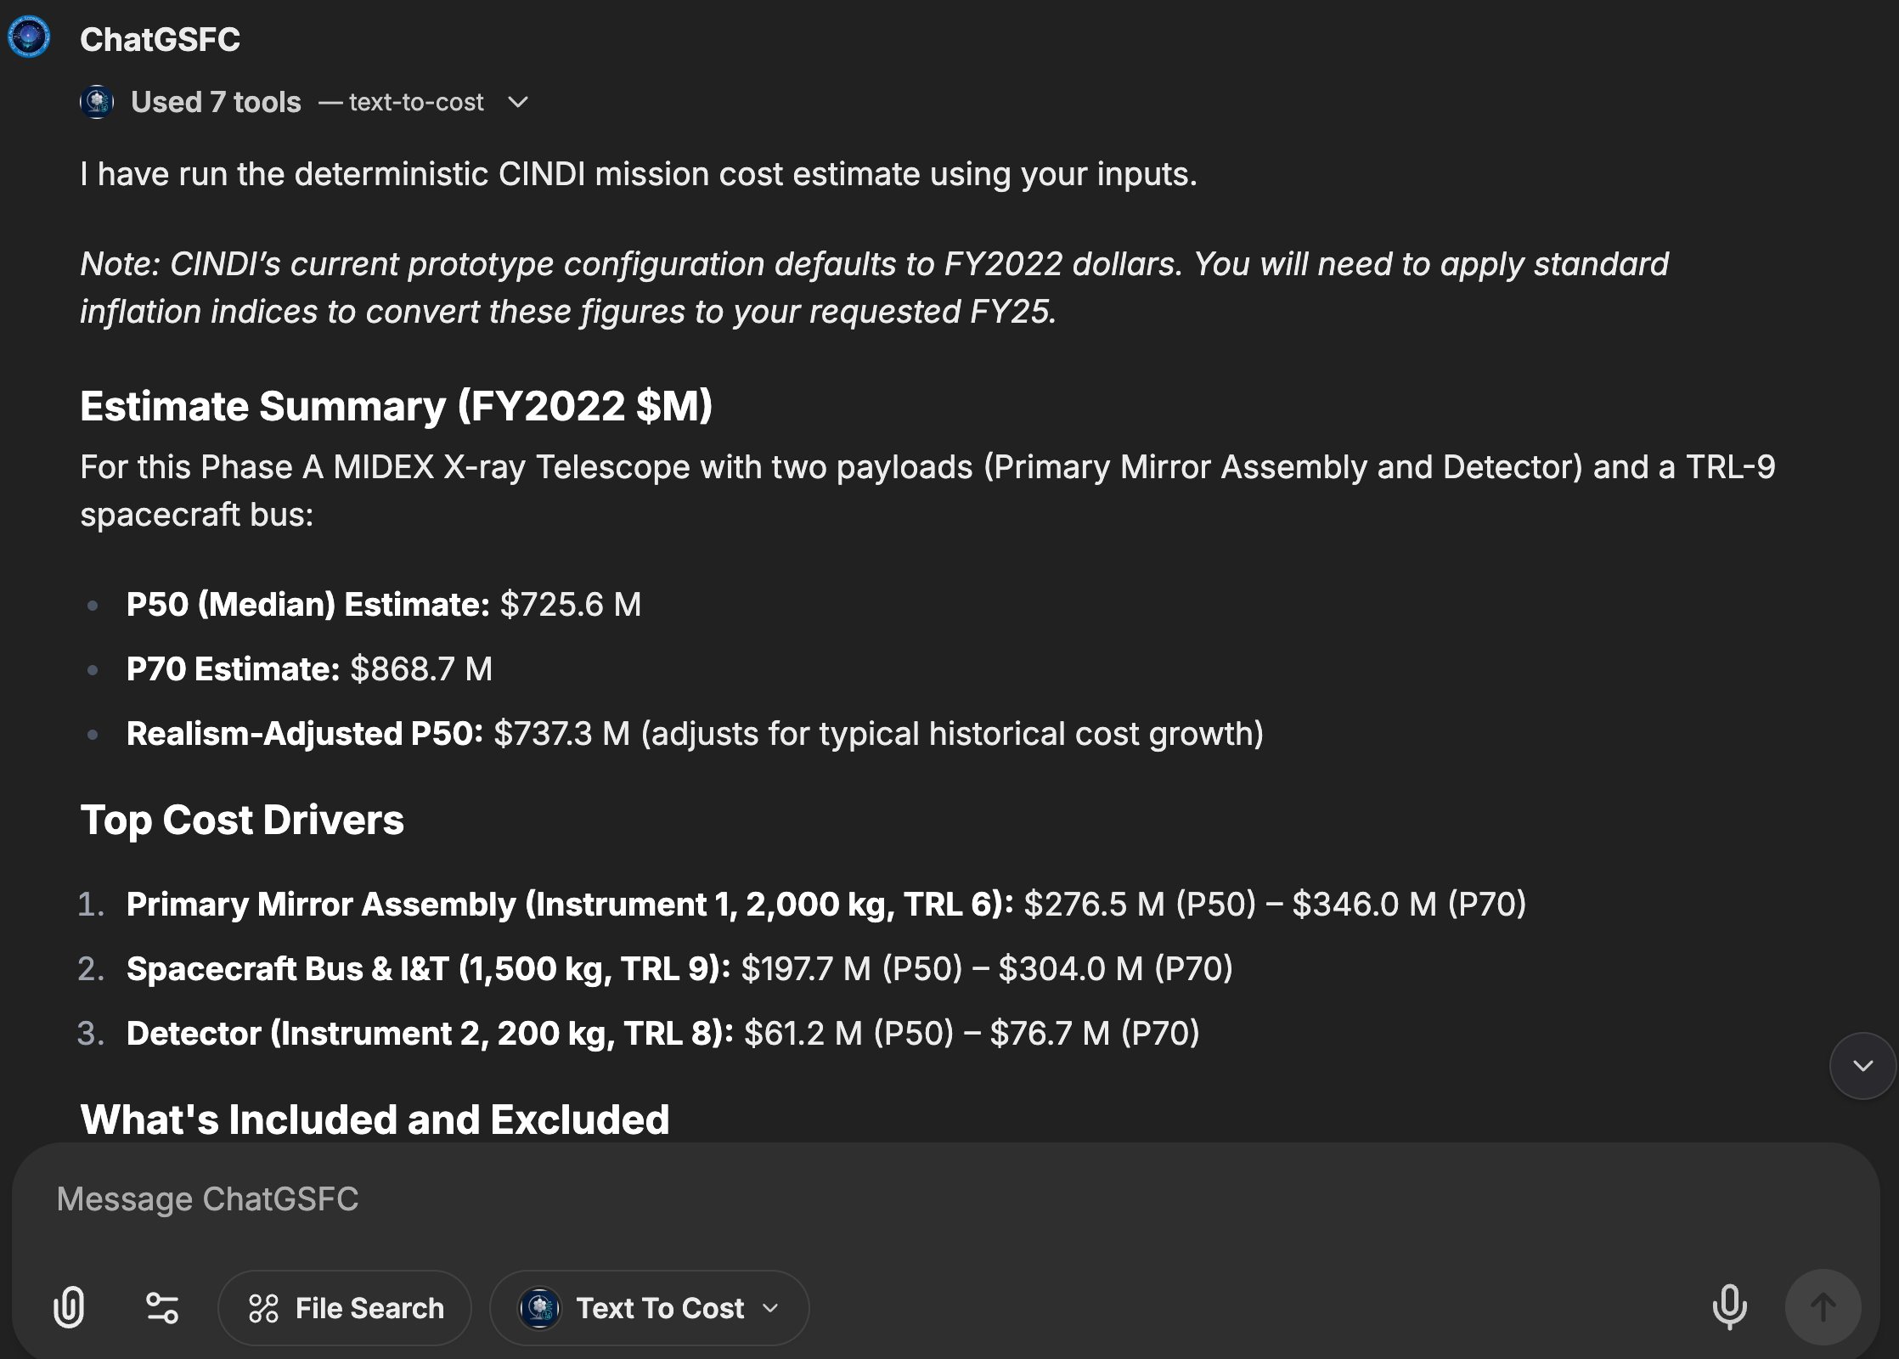
PP&C AI Tools for ChatGSFC: Cost Estimation
  Text-to-Cost prototype; this is a human-in-the-loop, chat-first, transparent mission-ROM costing system developed as a partnership between CAIO, FPD, and GSFC OCFO.
  Users provide the physical/mission parameters and through ChatGSFC MCP, Text-to-Cost provides deterministic outputs based on underlying rules, algorithms, and CERs (Cost Estimating Relationships).
Notes:
Mostly the AI Agents we just discussed are not very deterministic, especially for complex computation.
How do we take our LLM conversations and build determinism into them? We start with giving the LLM tools to call through Model Context Protocol or MCP.
Text-to-Cost (formerly known as CINDI) Cost Inference using Natural-language for Decision-support & Insights. is a prototype for early cost estimation built as a partnership between CAIO, FPD, and OCFO
Early tool users envisioned to be PIs, project formulation managers, SEs, instrument managers, proposal managers, etc.
No subsystem/component level decomposition. Text-to-Cost is currently an instrument level mass-and-maturity-driven parametric estimate.
-Same parameters for input generate same outputs every time.
Parsing and Reviewing: It can take a raw description of a mission or a proposal budget and extract a minimal request structure (parse), then review that request for missing inputs or required assumptions (review).
Cost Estimation: It runs CINDI mission cost estimates based on the parameters it extracts (estimate).
Proposal Budget Assessment: It can assess research proposal budgets (even if labor/indirect costs are unavailable) without applying flight-hardware Cost Estimating Relationships (CERs) (proposal_review).
Comparables and Sweeps: It can pull historical comparable instruments, buses, or cost elements (comparables), and run one-way sensitivity sweeps (sweep) to see how changing a specific variable affects the overall cost.
Comparison and Export: It allows you to compare two different saved model runs (compare), apply vendor or analyst quotes (quote), and export the results (export).
Summary
The MVP helps users answer three questions within the New Frontiers reference class:
Are we plausibly in the box? — including explicit treatment of the New Frontiers cost cap, cap-included vs. cap-excluded elements, and delta to the cap.
What is driving the cost? — via Transparency Report, main-driver explanation, and Baseline vs. Realism-Adjusted comparison.
What can we change to improve affordability? — via follow-up questioning, variant comparison, and sensitivity exploration.
It does so using a mixed-basis, human-in-the-loop, auditable methodology that combines curated CERs, explicit wraps, aggregate phase paths, and pass-throughs, with mandatory Transparency Report and Estimate Record artifacts for every run, and with both Baseline and Realism-Adjusted estimates presented together.
If it does those three things well for New Frontiers-class concepts, and hands users off appropriately when formal costing is needed, it will create immediate value while laying the groundwork for expansion to additional mission classes and deeper capability in later phases.

Slide 7
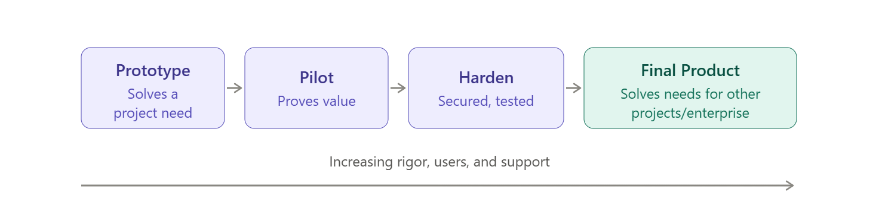
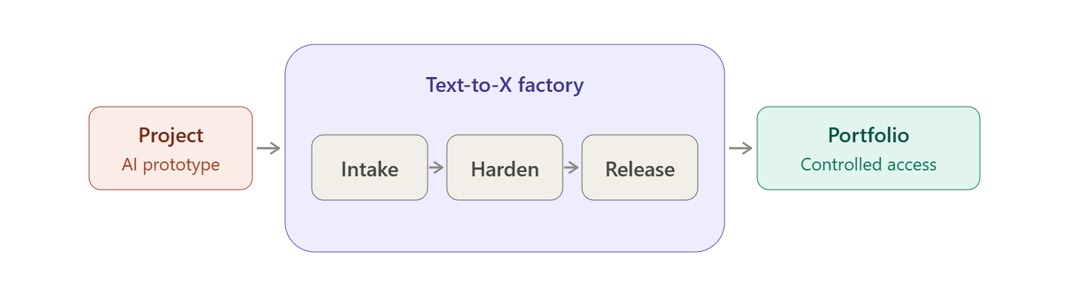
Mission Infusion: Project to Portfolio Pipeline
Missions at GSFC are beginning to investigate dedicated AI support/tools programs. DAVINCI is an example of a mission that is beginning to use prototypes.
DAVINCI and others at GSFC are a proving ground for a “project to portfolio pipeline” where projects experiment with building tools (and process improvements around the tools) and surface up and out to the portfolio the tools that are impactful.
Text-to-X Factory is the software dev support that elevates these tools from mission MVPs and prototypes to legit applications.
Notes:
Now in a phase where we are moving towards tool development outside of ChatGSFC/NASA Chat
- DAVINCI is one of the first missions infusing AI into their programmatics.
- This is new ground and the project is just starting to use tools built around project needs.
As tools are built on the project, they are integrated into project processes, involving the leads and personnel for those processes who help define pain points, etc.
Tools that prove successful or that save time or enhance analysis can be scaled to other projects or the portfolio and Text to X is the pipeline to make that a reality

Slide 8
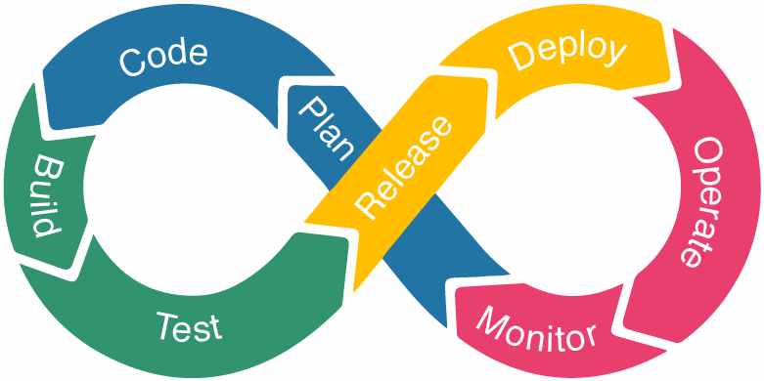
Scaling PP&C AI Tools with Text-to-X Factory
Text-to-X Factory is a rigorous pipeline for AI-powered and AI-accessible application development across a variety of disciplines, including potential PP&C integrations (e.g., Text-to-Cost for cost estimation).
Establishes a controlled process for “graduation” of prototypes and minimum viable products (MVPs) built by non-software developers into polished, distributable software applications/tools with appropriate access controls (NAMS, etc.).
Next step: Define processes around benchmarking/evaluation to confirm quality of AI applications and a governance structure for selecting applications for graduation.
Notes:
May 2026- GSFC CAIO’s flagship “Text-to-Spaceship” program expanded to encompass “Text-to-X Factory.”
Text to X formalizes the development of these apps and tools into “real” software, going from vibe coding to hardened controlled applications
Idea is interoperable applications- building blocks that can be stacked or connected with different tools and extendable across missions, programs, or portfolio
Team of developers and AI engineers will meet with builder(s) and/or projects, get a repo set up, discuss security and access requirements, and then start to build towards deployment

Slide 9
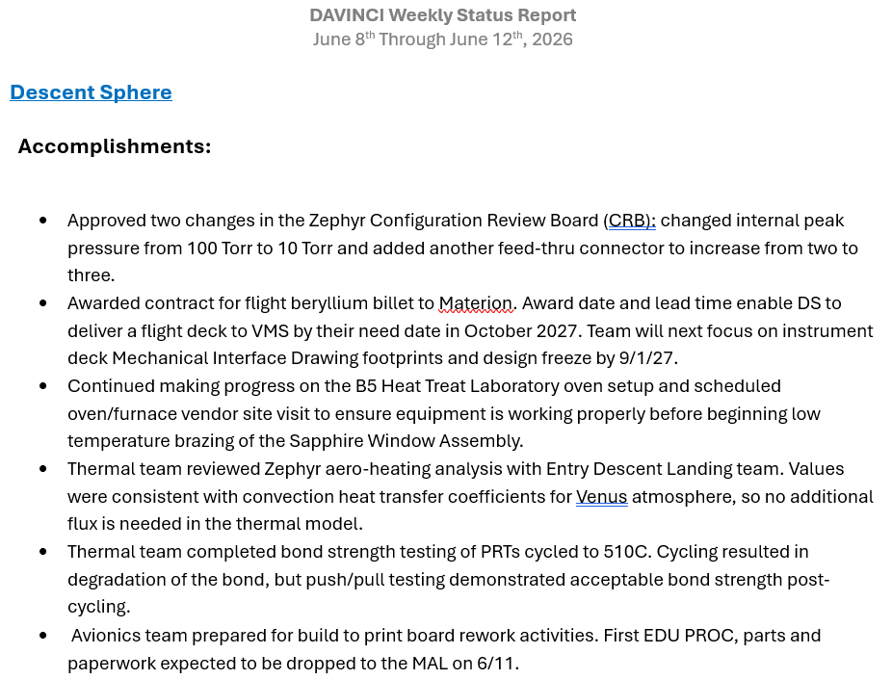
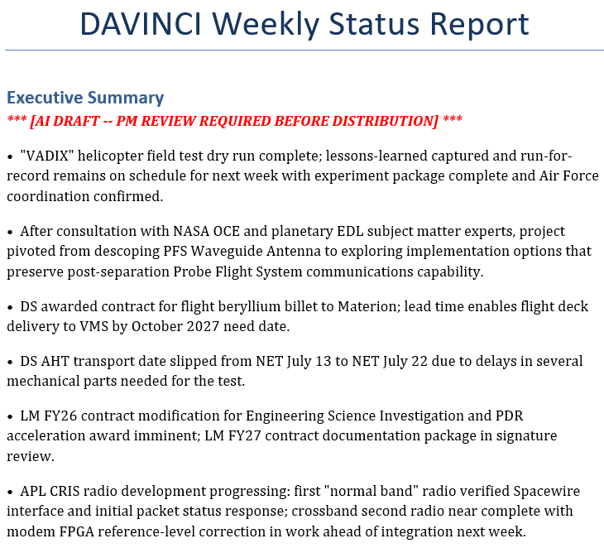
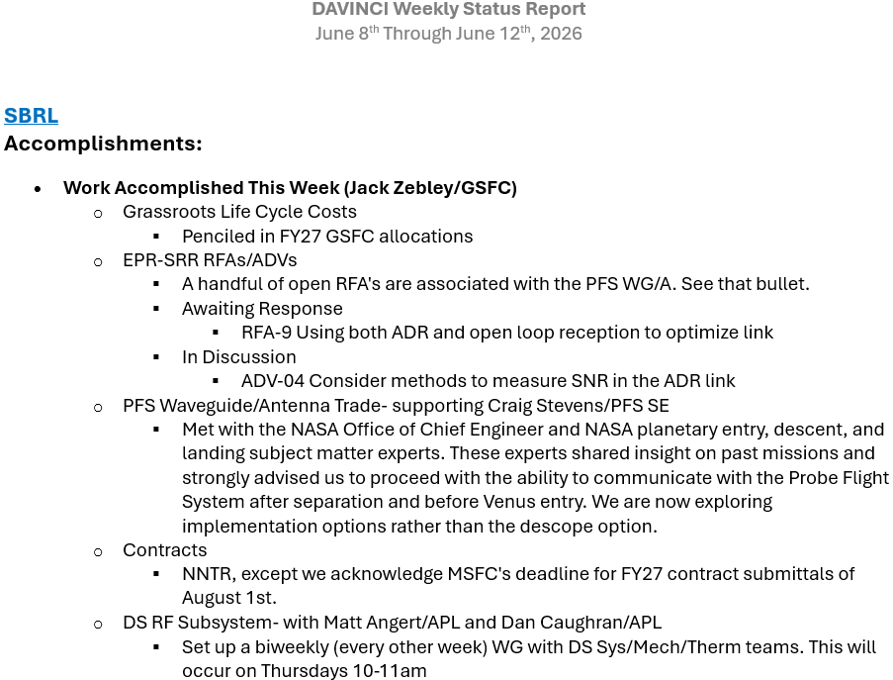
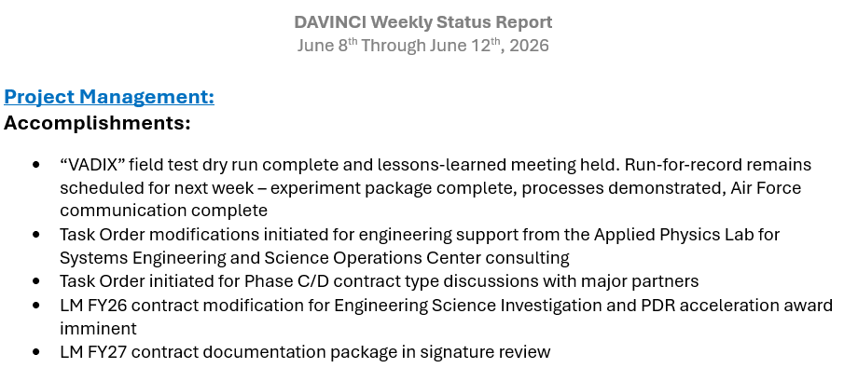
Mission Infusion: Targeted PP&C AI Prototypes for Projects
Streamline/automate repetitive or administrative tasks:
  Project Weekly Tool prototype automates the aggregation of weekly summaries from a large quantity of project subsystems and instruments.
    Leverages AI (Claude) and “Skill” trained on project MSR data and plans to provide a rolled-up PM summary and briefing of weekly accomplishments, setbacks, upcoming milestones and work, etc.
    Saves time in collation/distribution of data and allows PM to focus on key details
Notes:
When we talk about the reasons why projects and NASA want to leverage AI, the reasons fall into a couple of buckets: First is a need to streamline/automate repetitive or administrative tasks
Built a skill to read MSR data, designed to use that skill to tailor summary outputs to project “voice.”
Vibe coded a macro that runs an executable- the executable calls Claude, leverages skill and specific parameters to elevate relevant details from subsystem weekly reports to a PM executive summary.
Also collates all of the subsystem reports together into that report at the same time, so PM gets AI summary + the full details to review
Saves PM time, keeps human in the loop, elevates critical information
Process previously involved repeated emails, different file formats, moving files around and copy/pasting data, etc.
New process all files in same format, files go in an input folder on sharepoint that most have access to, tool is pointed at input folder, draft AI summary file generates in output folder. Admin notifies PM that draft is ready for him in output folder. PM finalizes, Admin puts in final folder. Everything mostly stays on sharepoint and saves PM time in summary and review.

Slide 10
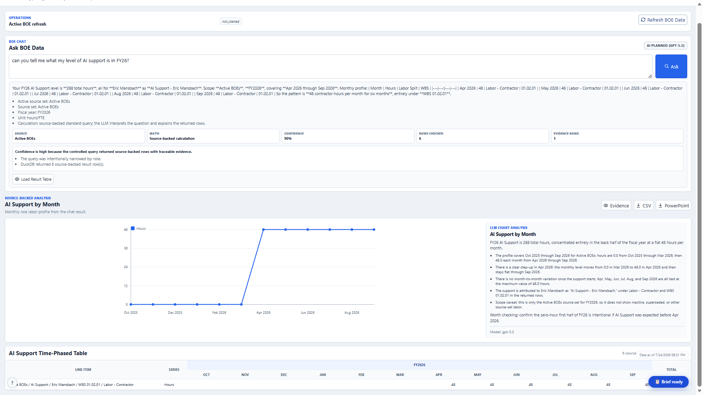
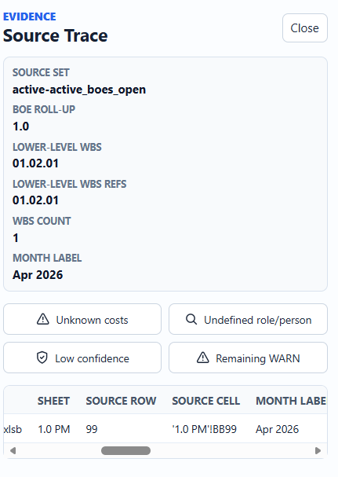
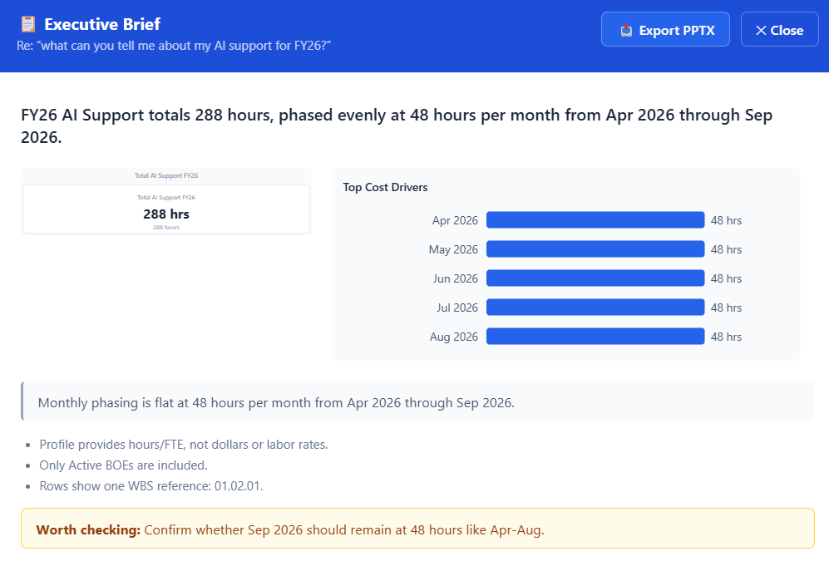
Mission Infusion: Targeted PP&C AI Prototypes for Projects
Enhance or accelerate analytical capabilities:
  BOEChat prototype allows a project to leverage an embedded LLM model (GPT-5.5) to chat with project BOEs.
  Get AI-generated insight into project cost and resource profiles, compare BOE sets, and chart project resource data.
  Uses an AI-assisted routing pipeline to convert user questions into structured query plans and provides analysis of results.
Notes:
2) Enhance or accelerate analytical capabilities
- Many tabs in a BOE for each lower level WBS element, many BOEs in a single active set, many sets in a full project LCC. There is a LOT of resource cost/budget data for a project!
- How can someone realistically understand trends and changes from set to set, easily move between BOEs and get answers to questions. Take a lot of analysis and time spent.
BOEChat allows DPMRs, RAs, FMs, etc. to leverage a chat capability with GPT 5-5 to interact with the full range of four years worth of BOEs.
- Built a skill to read BOEs, used it to create a database of the project BOEs to the person/item level
(intent gate → LLM planner → deterministic role → local rule-based)
- AI takes user question and structures the query, query is routed to a database of all of the BOE data, data is returned, AI performs the analysis.
- Ask questions about labor, roles, hours/dollars/FTEs, BOE set comparisons, time-phasing, etc.
Tool will give you a confidence score in the answer where the AI planner emits a raw score based on strength of semantic match,
adjusted_confidence enforces query-type-specific floors before the query is routed to the database, and post_query_confidence
applies evidence-driven floors and caps after execution.
-Can see source trace data down to the exact Excel sheet, row, cell

Slide 11
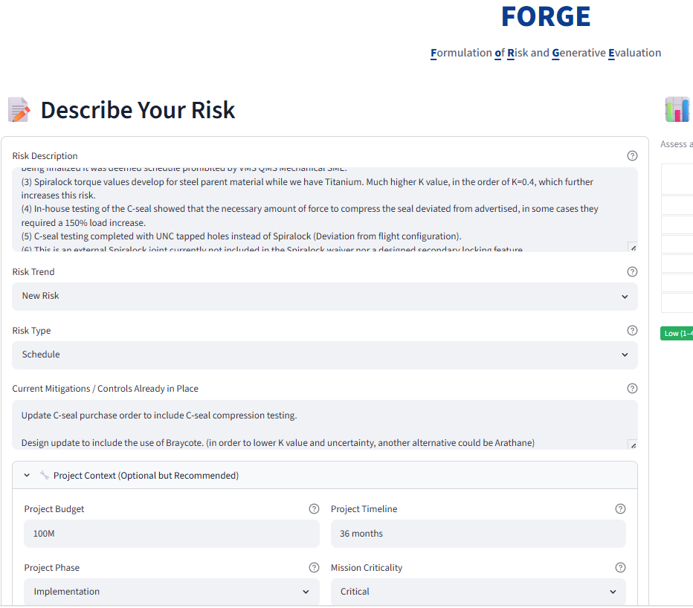
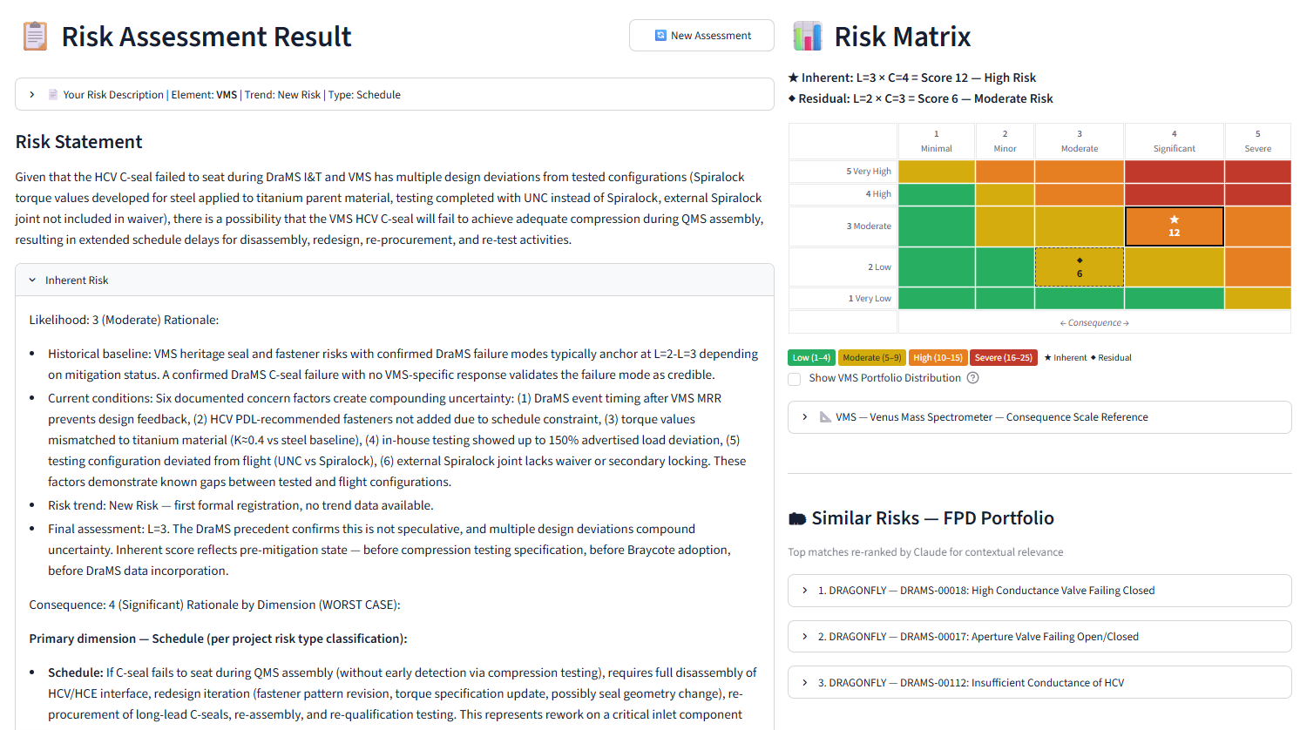
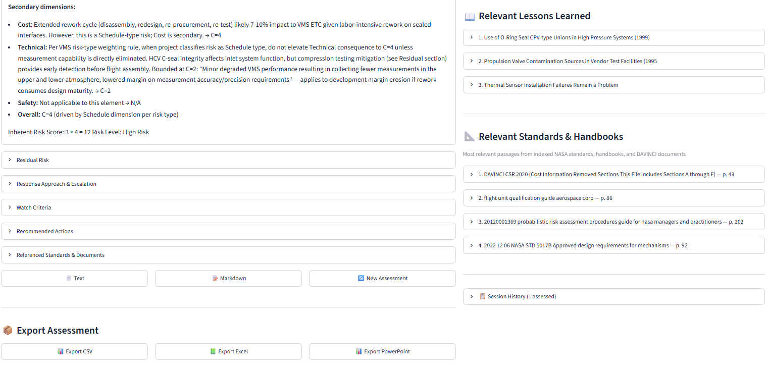
Mission Infusion: Targeted PP&C AI Prototypes for Projects
Fill gaps where existing tools may not exist or may be inefficient
  Formulation Of Risk and Generative Evaluation (FORGE) prototype is intended to bridge knowledge gaps around cross-project risks.
  Accelerate risk development with AI (Claude ITAR) and provide an independent AI-generated assessment of risk scoring that leverages GSFC risk portfolio and lessons learned.
    Note: Future state will incorporate project risk dashboard that leverages MCP to interact with risk data in Technical Data Management System (TDMS). Perhaps NODIS, NTRS, and Agency Lessons Learned MCPs as well.
Notes:
One of the key takeaways from our many PP&C AI working groups was the sheer volume of critical programmatic data we have but how walled off that data is from one project to the next. In our risk group in particular, we have discussed quite a bit that we need better mechanisms for communicating common risks across projects and creating risk awareness between projects with mutual heritage, requirements, contractors, etc.
FORGE fills that gap by providing an avenue for projects to both develop their own risks, as well as understand if there are similar risks on other projects, and if there are relevant lessons learned to be applied to their risks.
User enters a description of their risk, as much info as they have. User selects risk trend, whether new, increasing, decreasing etc.
User enters a description of any planned or ongoing mitigations
User enters project budget, timeline, phase (formulation, implementation, etc.) and the criticality of the potential risk)
Now this is bespoke to DAVINCI, and they have their own definitions around risk scoring and risk consequence that are both instrument specific and project specific. We have incorporated those definitions into the application.
Call A (allowed to vary): full narrative reasoning with all RAG context injected. Produces the assessment text
the user reads, plus a small structured JSON block of the key facts that drove the reasoning. Claude is told to emit a JSON block with per-dimension consequence integers, inherent_likelihood, residual post mitigation likelihood
- Call B (deterministic): pure Python — max() takes only those extracted facts from the JSON (no variable context), uses a forced tool-call schema,
and produces authoritative integer L/C scores. This is where the score actually lands. The matrix, the export fields, and the history entry all use Call B's output. fields, and risk_response_approach.
Will give you a risk statement in the proper NASA format, will give you LxC with reasoning/justification and of course plot it on the 5x5, will recommend a mitigation strategy (or to watch or accept), and recommended actions
Will give you a residual risk score for post mitigation implementation
Will give you similar risks from the portfolio and relevant lessons learned and relevant handbooks and standards
- Future state is a bolted-on dashboard developed in combination with project risk manager and others from project that leverages MCP connection to TDMS that is in development, as well as potentially other data sources like NTRS and Lessons Learned. Interact with and perform analysis on project risk data.

Slide 12
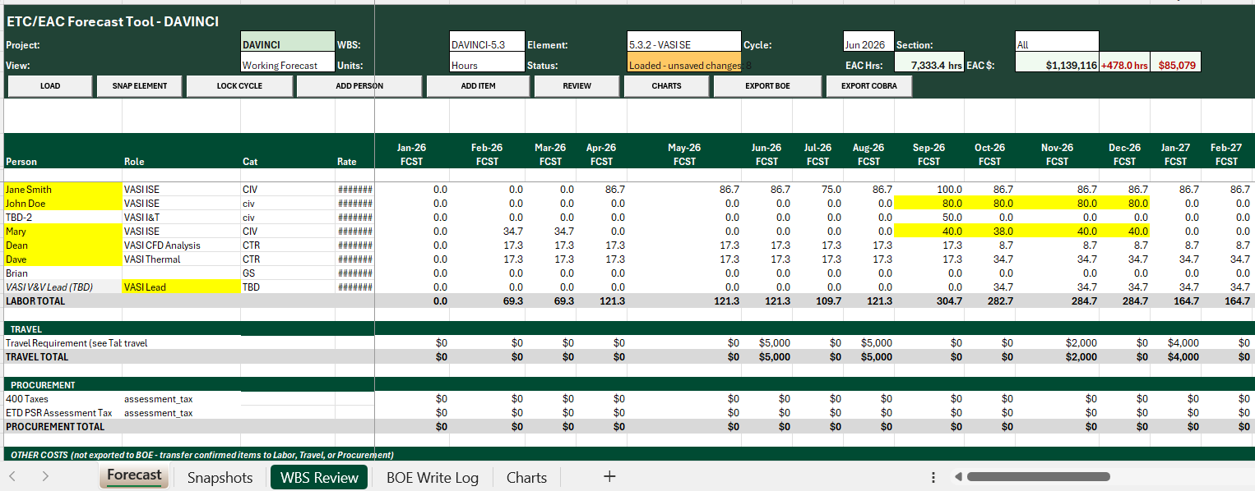
Mission Infusion: Targeted PP&C AI Prototypes for Projects
Leverage EVM surveillance results to enhance GSFC PP&C best practices:
  Project Updates and Resource Status Estimator (PURSE) prototype addresses frequent GL27 EAC realism and EAC process test failures by making monthly grassroots forecasting more feasible.
  Accelerates cadence of “by-name” bottoms-up forecast updates with improved flexibility relative to direct BOE updates; can view impacts of dollar/hour/FTE changes in real-time, add resources, take snapshots, and export hour/dollar/FTE updates to both project BOE template and Cobra load file.
  Note: Future state could layer IMS on top of PURSE to be used as validation cross-check of cost/schedule integration.
Notes:
PURSE is a tool that was built with AI, but does not actually contain or run any AI itself.
Does anyone know what the most failed GLs at NASA are? Two of the top three most failed tests at an agency level are GL 27 Maintain EACs
Do EACs consider performance to date
Are ETCs aligned to the remaining tasks in the IMS
- Why do we struggle with EACs? One aspect is frequency of EAC updates. Many projects (most?) do EAC updates 1-2x a year for PPBE, phasing plan.
- When we do EAC updates that infrequently, we lose the marching army cost in between. People work OT, they take PTO, they take on work with a new project and split their time, they move between WBS elements, etc.
When work drifts, we should capture that drift in our EAC and not just in project liens that are tied to specific risks
PURSE provides a flexible, painless tool for updating EACs. 1 hour a month RA sits with CAM, gets that CAM’s updates for their people (OT, PTO, changes to resources, etc.).
Add resources, change hours/dollars/FTEs, see updates and dollar/hour impacts of changes live.
Export to COBRA in correct forecast upload format with WBS and element of cost populated
Export back out to project BOEs directly into project BOE template format.

Slide 13
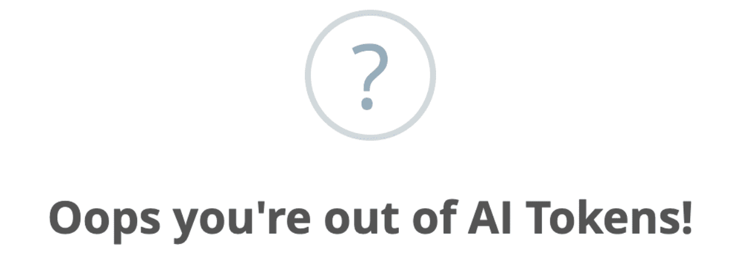
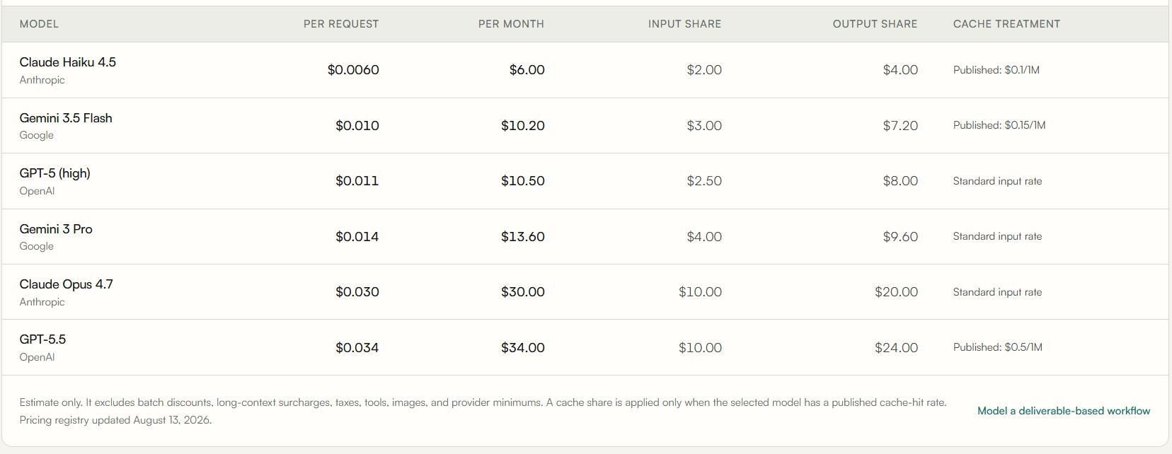
Mission Infusion: Logistics for AI Planning
Increasingly, projects are planning for AI support/token spend in BOEs and PPBE.
  Understand that token costs are real and growing.
  Pick a lead to manage AI development, requirements, strategy, templates, team git repository, cost management, etc.
  Set up a token cost pool with a cap on individual and/or team token usage to manage cost effectively.
  Set realistic goals for tools development (cost/schedule). Bigger/better tools cost more money and take more time to develop.
  Small teams with a robust AI budget can outperform their FTE count!
Notes:
-Projects are planning for AI support/token spend in BOEs and PPBE in elements other than Flight/Ground Software and Systems Engineering.
- AI capacity is now a budgeted resource, no longer a free productivity multiplier. ChatGSFC and AskSage will continue to be free to use for most simple tasks, but anything heavy duty or ongoing development is going to require some amount of investment.
- How Do AI Agents Spend Your Money? Analyzing and Predicting Token Consumption in Agentic Coding Tasks- Stanford April 2026- (1) agentic tasks are uniquely expensive, consuming 1000x more tokens than code reasoning and code chat, with input tokens rather than output tokens driving the overall cost; (2) token usage is highly variable and inherently stochastic: runs on the same task can differ by up to 30x in total tokens, and 3) models vary substantially in token efficiency: on the same tasks, Kimi-K2 and Claude-Sonnet-4.5, on average, consume over 1.5 million more tokens than GPT-5; (4)

Slide 14
Defining a Top-Down Agency Use Case Strategy for PP&C and AI
Many of the project-based prototypes under development are transposable to program, directorate, and Center-level use cases.
Sustained Agency, Center, and Directorate-level direction/prioritization (and funding) of AI development work is critical to focusing/maximizing limited resources and reducing duplicative development effort.
NASA Annual AI Use Case Registry data call opens soon! NASA needs a centralized AI integration & use case strategy for PP&C specifically. What areas does the agency need to target? Follow the surveillance data!
Data transparency/accessibility is key!
The power of AI is in the quality and availability of data!
Notes:
Projects are the testing grounds for many of these kinds of tools, where they have individual needs and parameters, but projects can’t shoulder the developmental burden alone.
There is a need for the agency to define from the top down the priorities for targeted use cases and to weigh in on which PP&C projects to graduate and invest in.
Early august the agency sent out the preliminary notice that they are opening the annual AI Use Case Registry- as a PP&C community, we should define the set of use cases that we want to push forward
What is an AI Use Case? For this registry, an AI use case refers to any specific scenario where AI is designed, developed, procured, or used to advance NASA's missions. This includes both USAGE (using an existing AI system, tool, or model) and DEVELOPMENT (developing or updating AI systems, tools, or models, or research in preparation for development).
Focus on Custom and Open-Source: We are primarily tracking custom-built or open-source AI solutions that have been customized for NASA's use.
- This is ultimately all dependent on the quality of our data and its availability. We have an incredible wealth of programmatic data, whether it is ONCE and CADREs, which I was thrilled to see is releasing an API or REDSTAR or others, we need to free our data from the silos that it currently lives in if we’re going to take advantage of it in a meaningful way.

Slide 15
Acknowledgements
These cutting-edge PP&C AI tools and prototypes and many more have been developed by practitioners across a multitude of programmatic disciplines. Contributors to GSFC’s AI excellence in PP&C include:
GSFC OCFO/FPD:
Ricardo Martinez-Serrano
Vince Elliott
Cabin Samuels
Holly Bryant
Jen Poston
Robert Montgomery
Pietro Campanella
Christine Steeley
Mellani Edwards
Leigh Forbes
Maria Nowak
GSFC CAIO:
Matt Dosberg
Ryan Mcclelland
Michael Biskach
Jason Gilman
Marshall Doyle
Matt Vaerewyck
Amber Bartlett
Henock Legesse
Caleb VanGerpen
Jamie Dulaney
John Schmidt
Brennan Hay
Sarah D’Angelo
Mark Carroll
Alex Reustle
Risk/SMA:
Dann Brown
Ying Shi
Michael Zeydelis
Austin Ryan
Kasey Phillips
Luke Martin
Carla Cunningham
Jennifer Rabulan
Kimberly Lane
Schedule:
Jeff Slade
Jason Houston
Zach Dolch
Bill Paradis
Joe Krygiel
Joanie Nelson
Marissa Flood
Zach Walters
Russell Washington
Andre Davis
Kadie Esi
Richard Wiley
Will Ostumi Lima
Jonathan Dornblaser
Config./Doc. Mgmt:
Rick Berry
Rebecca Prats
Toni Hegarty
Terri Pindell
Lisa Link
Rae Ann Roe
Alica August-Fuhrman
Heidi Connolly
Alicia Chipman
Robert Swartz
Tracee Rice
Cost Estimation:
Tracy Borden
Jeff Brown
Jason Schwartz
EVM:
Patrick Jordan
Crysta Bouldin
John Dotson
Daniel Goldsmith
Sarah Kirby Smith
Scott Reynolds
Kim Huffman
Bob Hesenperger
Business Mgmt/Resource Analysis:
Emily Montoya
Bradley Thomas
Grant Pappas
Patricia Butler
Matt Moran
Vanessa Soto Mejias
Petal Anderson
Michele Thompson
Stacy Loiacono
Christopher Webb
Theresa Thomas
Seth Stewart
Kimberly Bruno
Ryan Royal
Carlos Natera
Claire Higgins

