Slide 1
Grounding Future Decision Support for NASA Cost & Schedule Management
A practice-informed co-design discussion
Yunping Liang, Ph.D., Justin Knot
Virtual
8/17/2026

Slide 2
How we will use these 30 minutes
1 Establish context
2 Test review-derived gaps
3 Reflect back
Briefly report the project and the homework conducted (0-5 min).
Understand research needs and expectations with three homework-derived prompts (5-20 min)
Synthesize short-term needs and long-term visions (20-30 min)
The purpose is to validate researcher-observed, literature-derived opportunities with practitioners by identifying short-term actionable tasks and long-term visions.
We also hope to make connections for future collaboration.
It is not a product pitch, a replacement proposal, or a formal assessment

Slide 3
The project
Innovating NASA's Project Cost and Schedule Management to Align with Modern Stewardship Standards, NASA Nebraska EPSCoR 2026 Mini-Grant
  Systematically examine NASA's current practices and challenges in enhancing project cost and schedule control, particularly under funding uncertainty;
  Establish a sustainable framework for future NASA collaboration focused on targeted challenges pertinent to project control, project delivery, as well as financial management and dispute resolution

Slide 4
The presenter
Faculty at University of Nebraska-Lincoln
Experience in leading the development of data-driven cost and schedule management tools for transportation agencies
  A Guide for Weather-Resilient Airport Infrastructure Investments in Airports, Transportation Research Board, 2026
  Nebraska Risk-Informed Construction Scheduling and Impact Analysis, Nebraska Department of Transportation, 2026
  Developing a New Cash Flow Expenditures Model Considering the Flexibilities Offered by the Design–Build–Finance (DBF) and Public–Private Partnership (P3)Project Delivery Methods, Georgia Department of Transportation, 2020
Lecturer for International Civic Aviation Organization
Editor of the American Society of Civil Engineer’s flagship journal – Journal of Construction Engineering and Management

Slide 5
What we completed before this session
We have thoroughly reviewed:
NASA policy and management guidance
NPD/NPR 7120 materials; phased life cycles; Key Decision Points; Work Breakdown Structure; Integrated Master Schedule; Performance Measurement Baseline; Earned Value Management; Integrated Baseline Review; schedule margin; Schedule Risk Analysis; integrated cost and schedule risk analysis; Estimate at Completion; change control.
APPEL and knowledge infrastructure
Learning and development; knowledge management; knowledge-sharing forums; Lessons Learned Information System; collaboration with the Project Management Institute.

Slide 6
What we completed before this session (cont’d)
NASA-centered literature (previous Project and Program Management Research Center )
Cost estimate; expert systems and project portfolio reviews; scheduling; culture change and Faster-Better-Cheaper; financial management; risk management; NASA-specific project management frameworks; productivity.
PP&C tools and data capabilities identified
PATT • PMT • ASCoT 3 • PCEC • NICM • MOCET • COMPACT • SMART • NNSI • CADRe • ONCE portal • Empower • Cobra • Aurora

Slide 7
Identified Opportunity #1
Explainable, Lifecycle-Aware AI Integrated with Digital Twins for Cost and Schedule Management
Existing foundation
Lifecycle need identified
Decision requirement
CADRe, ONCE, SMART, PCEC, and ASCoT support historical cost and schedule modeling and discrete estimating applications.
The proposed opportunity is a continuously learning lifecycle environment that updates as design maturity, requirements, testing, supply conditions, and realized performance evolve.
The proposed AI must show which technical, programmatic, and execution factors drive forecasts, preserving transparency for independent estimates, management reviews, and stakeholder trust.

Slide 8

Discussion #1: explainable, lifecycle-aware AI + digital twins
Where could an explainable, lifecycle-aware AI capability integrated with digital twins improve cost and schedule decisions across project phases?
USE CASE
LIFECYCLE
EXPLAINABILITY
INTEGRATION
Which cost or schedule decision should it support?
When should information begin updating, and across which phases?
What forecast drivers, assumptions, or evidence must remain visible?
Which existing tools or data sources should connect first?
The AI includes both “traditional” data-driven methods and generative AI, large language models
Join at menti.com | use code 4820 9444

Slide 9
Identified Opportunity #2
Identification of Extreme Cost and Schedule Events and Their Early Warning Indicators
Problem patterns in the review
Candidate early signals
Decision use
The proposed opportunity highlights optimism bias, unstable requirements, aggressive commitments, and unusually high downside risk as recurring concerns.
Outlying proposals, compressed schedules, atypical funding profiles, rapid requirement volatility, and patterns in early performance data are proposed as signals to examine.
Earlier detection is proposed to support independent review, reserve planning, and corrective action before consequences become irreversible.

Slide 10
Discussion #2: extreme events + early warning indicators
Which extreme cost or schedule events should NASA detect earlier, what indicators could precede them, and what decision should an alert enable?
EVENT
INDICATOR
TIMING
ACTION
Which rare, high-impact event matters most?
What could be observed before the event?
How early must the signal appear to be useful?
What review, reserve, or corrective decision should follow?
Join at menti.com | use code 4820 9444

Slide 11
Discussion #3: what are we missing?
Looking across planning, control, cost, schedule, EVM, and digital-twin practice, what important research need is not captured by the first two opportunities?
DECISION NEED
CURRENT LIMIT
PRACTICAL VALUE
CO-DESIGN
What recurring decision remains difficult to support?
What is missing from current data, methods, tools, or workflow?
What would improve if the need were addressed?
Who should help define and test the research task?
Join at menti.com | use code 4820 9444

Slide 12
Synthesis: what we heard
Action item 1
Action item 2
Action item 3
Long-term vision
________________
________________
________________
________________
________________
________________
________________
________________
________________
________________
________________
________________
________________
________________
________________
________________

Slide 13
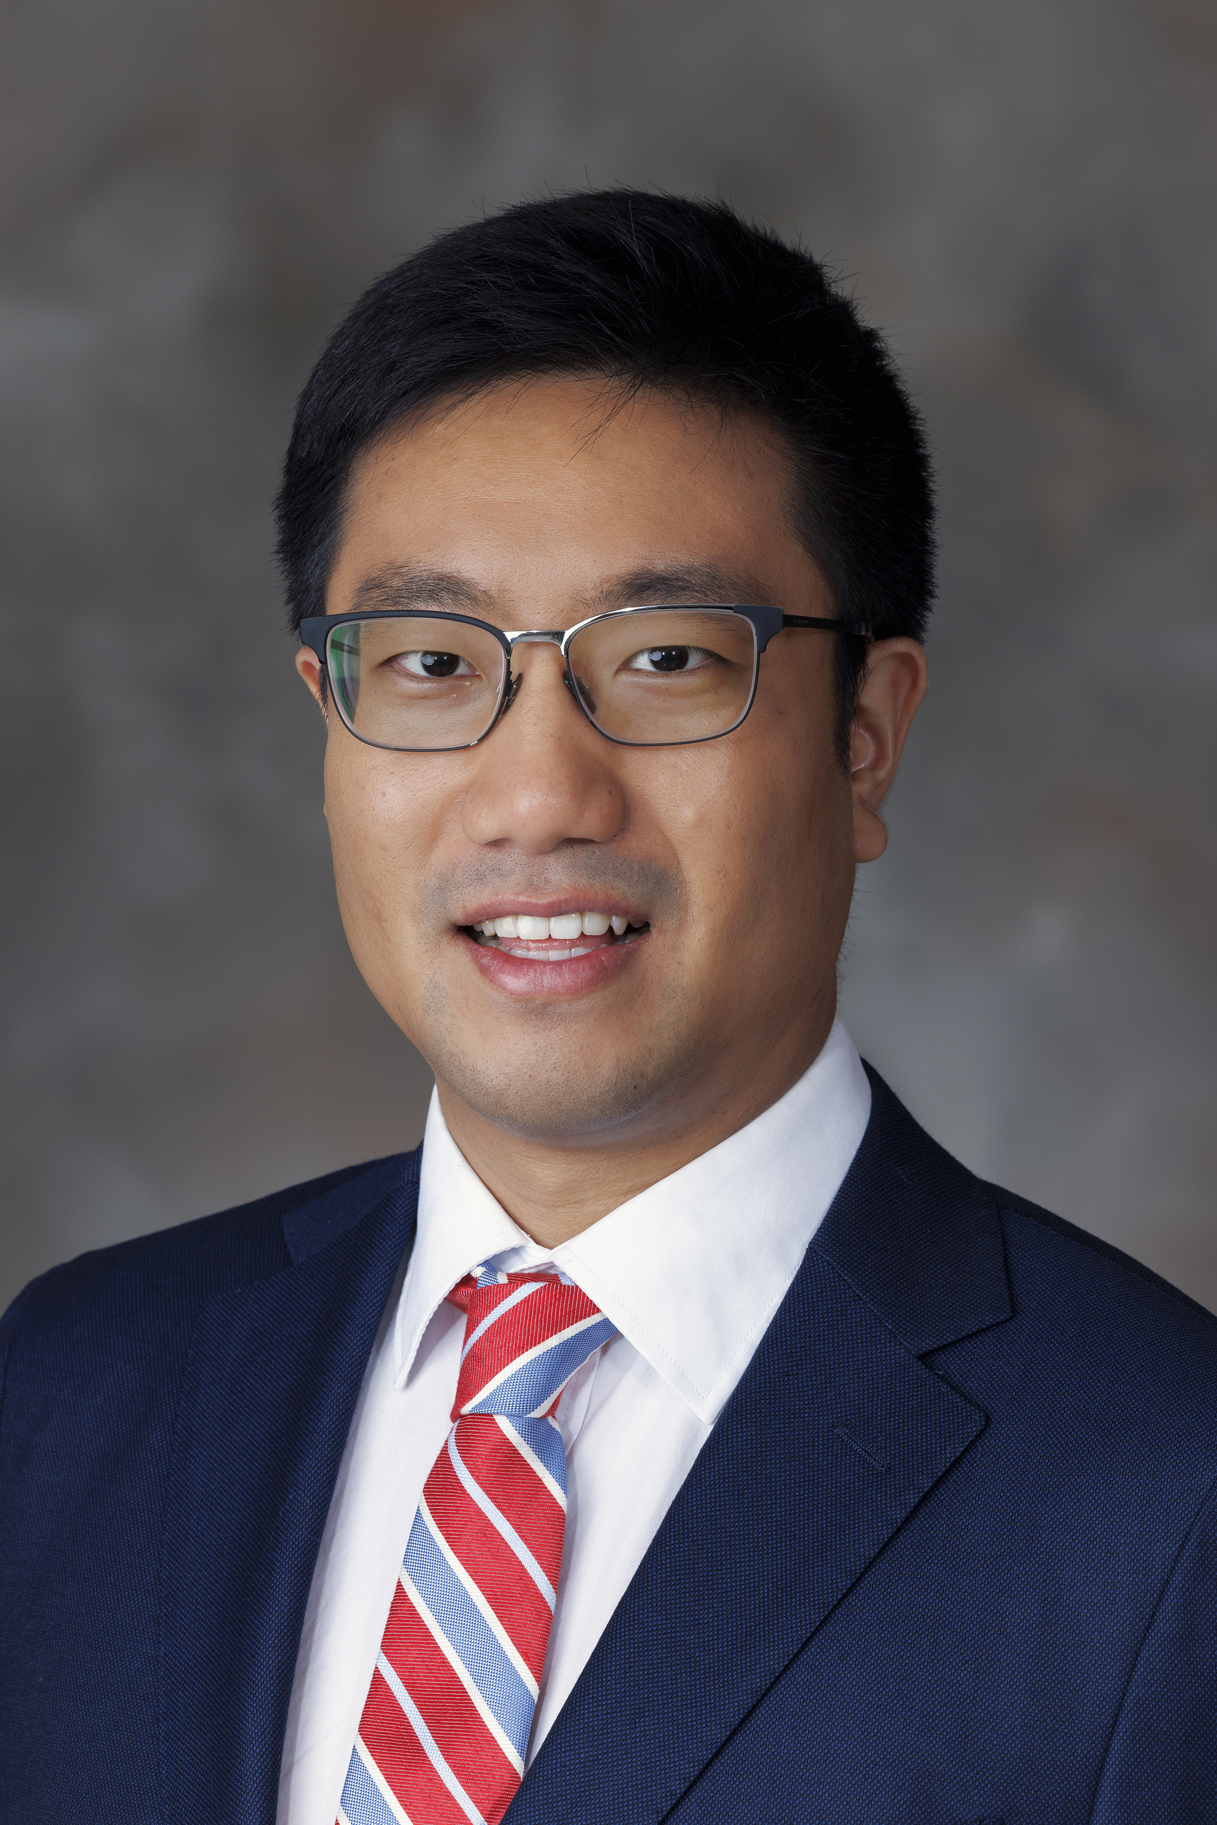
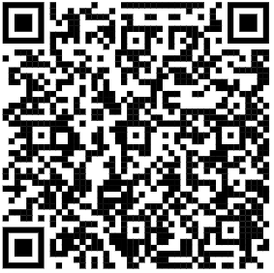
Thank you!
Yunping (Yvan) Liang, Ph.D., M.ASCE
Assistant Professor
University of Nebraska–Lincoln | College of Engineering | Durham School Arch Engr & Const
Fellow, Nebraska Transportation Center
Assist. Specialty Editor, ASCE Journal of Construction Engineering and Management
Affiliate Faculty, Build America Center
The Kiewit Hall, 1700 Vine St., Lincoln, NE, 68588-0684.
Email: yliang17@unl.edu | Tel: 402-472-3742 | Office: A405E
The presenter thanks Mr. Justin Knot, an undergraduate student in the Durham School, for his work on the literature synthesis. Justin can be reached at jknott3@huskers.unl.edu
Dr. Liang’s faculty page at UNL:

