Slide 1
Beyond the Baseline: Developing the Next Generation of PP&C Talent
Marshall Space Flight Center
Melissa Lee, Kenneth McPherson, Kimberly Bennett
Notes:
(1:30)
Hello everyone and welcome.
My name is Melissa Lee and I'm a program analyst at MSFC in the PACE Integration and Analysis office.... I'm joined here today by my colleagues Kimberly Bennett who is also a Program Analyst in the same office and with Kenneth McPherson who is now the HLS Requirements and Verifications Lead also at MSFC.
Today, we are presenting 'Beyond the Baseline: Developing the Next Generation of PP&C Talent' on behalf of the Marshall Space Flight Center.
The quote “No Bucks, No Buck Rogers” from the book & film, The Right Stuff, is a phrase that we believe holds significant importance and relevance within the agency today.
Most individuals associate NASA primarily with astronauts, rocket scientists, engineers, etc.
However, without the critical contributions of PP&C analysts – who oversee schedules, cost estimates, and Earned Value - programs would face significant challenges in launching those critical projects.
As a PP&C analyst, you must go “beyond the baseline” and be able to tell the whole story behind the data.
To become good storytellers, PP&C analysts need to have a well-rounded understanding of the various disciplines.
The MSFC PACE PP&C Integration and Analysis Office have introduced several programs, initiatives and training designed to foster interest in PP&C and to cultivate a pipeline of future practitioners.

Slide 2
Presentation Overview
Our Mission
Strengthen PP&C capability at MSFC and across the Agency by developing interest and building a pipeline of future practitioners
TODAY’S JOURNEY
THE NEED
LEADERSHIP DEVELOPMENT
CAREER ROADMAP
TRAINING REVAMP
COURSE DEMONSTRATION
Why PP&C talent development is critical for MSFC and the Agency.
Develop leaders through the PP&C Leadership Development Series (LDS) Program
Provide a clear path for growth and development for PP&C Practitioners
Modernize and enhance PP&C training to build skills and confidence.
See our new Intro to PP&C course in action
Notes:
1:15)
We will walk you through our overall strategy, and To do that, we’ve mapped out 'Today’s Journey' for you, which covers our key areas.
First, we’ll start with The Need—discussing exactly why PP&C talent development is so critical right now for MSFC and NASA as a whole, especially given recent capability erosion.
Next, we’ll highlight how we are addressing the need of developing PP&C Leadership by shaping future leaders through the PP&C Leadership Development Series (LDS) program.
Third, we will transition into our NEW initiative the PP&C Career Roadmap, showcasing how we are providing a clear, structured path for growth and development for our PP&C practitioners.
Then, we'll discuss how we are modernizing and enhancing PP&C training to sharpen capabilities, align with operational needs and build practitioner confidence.
Finally, we'll wrap up with a quick peak at our “Introduction to PP&C" course and explain how the course is structured including an overview into our practical hands on class exercises.
Our objective is to share the strategies that have been effective for our Cost & Schedule community here at MSFC, with the aim of inspiring other centers within the agency to adopt similar practices and for other centers to share some of their ideas as well!

Slide 3
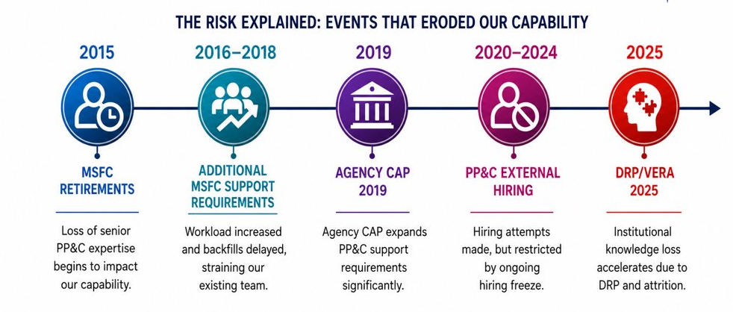
PP&C Capability Erosion Timeline
Key events over the past 10+ years have eroded our PP&C capability
Notes:
(1:40)
Before we talk about our strategy, we need to talk about the challenge / need. Why is this initiative so critical right now? Why has the PACE PP&C Integration and Analysis Office launched these new talent development initiatives?
Beginning back in 2015, the PACE office (then known as the Office of Strategic Analysis and Communication or OSAC) recognized that the PP&C Community was facing a number of retirements at MSFC. So beginning, over 10 years ago, we began to look closely at the trajectory of our workforce.
Under normal circumstances, we would backfill these positions to ensure continuity. However, the increase in the need for MSFC P/p support, the 2019 Agency Corrective Action Plan, plus the ongoing hiring freeze, we were severely limited in our ability to bring in new personnel to replace those seasoned experts.
And with the loss of deep institutional knowledge due to the Deferred Resignation Program, or DRP, as well as standard attrition, this risk was updated to show how all these issues brought everything to a head.
Even though this risk has evolved over the past 10+ years, the problem hasn't changed. The bottom line is that the success of our programs and projects relies on robust PP&C capabilities.
We recognized we couldn't simply hire our way out of this deficit; our strategy had to shift inward. We had to be proactive about developing interest in PP&C, training our current workforce, and begin creating an internal pipeline of future practitioners—which leads directly into the mitigation strategies we will discuss next.

Slide 4

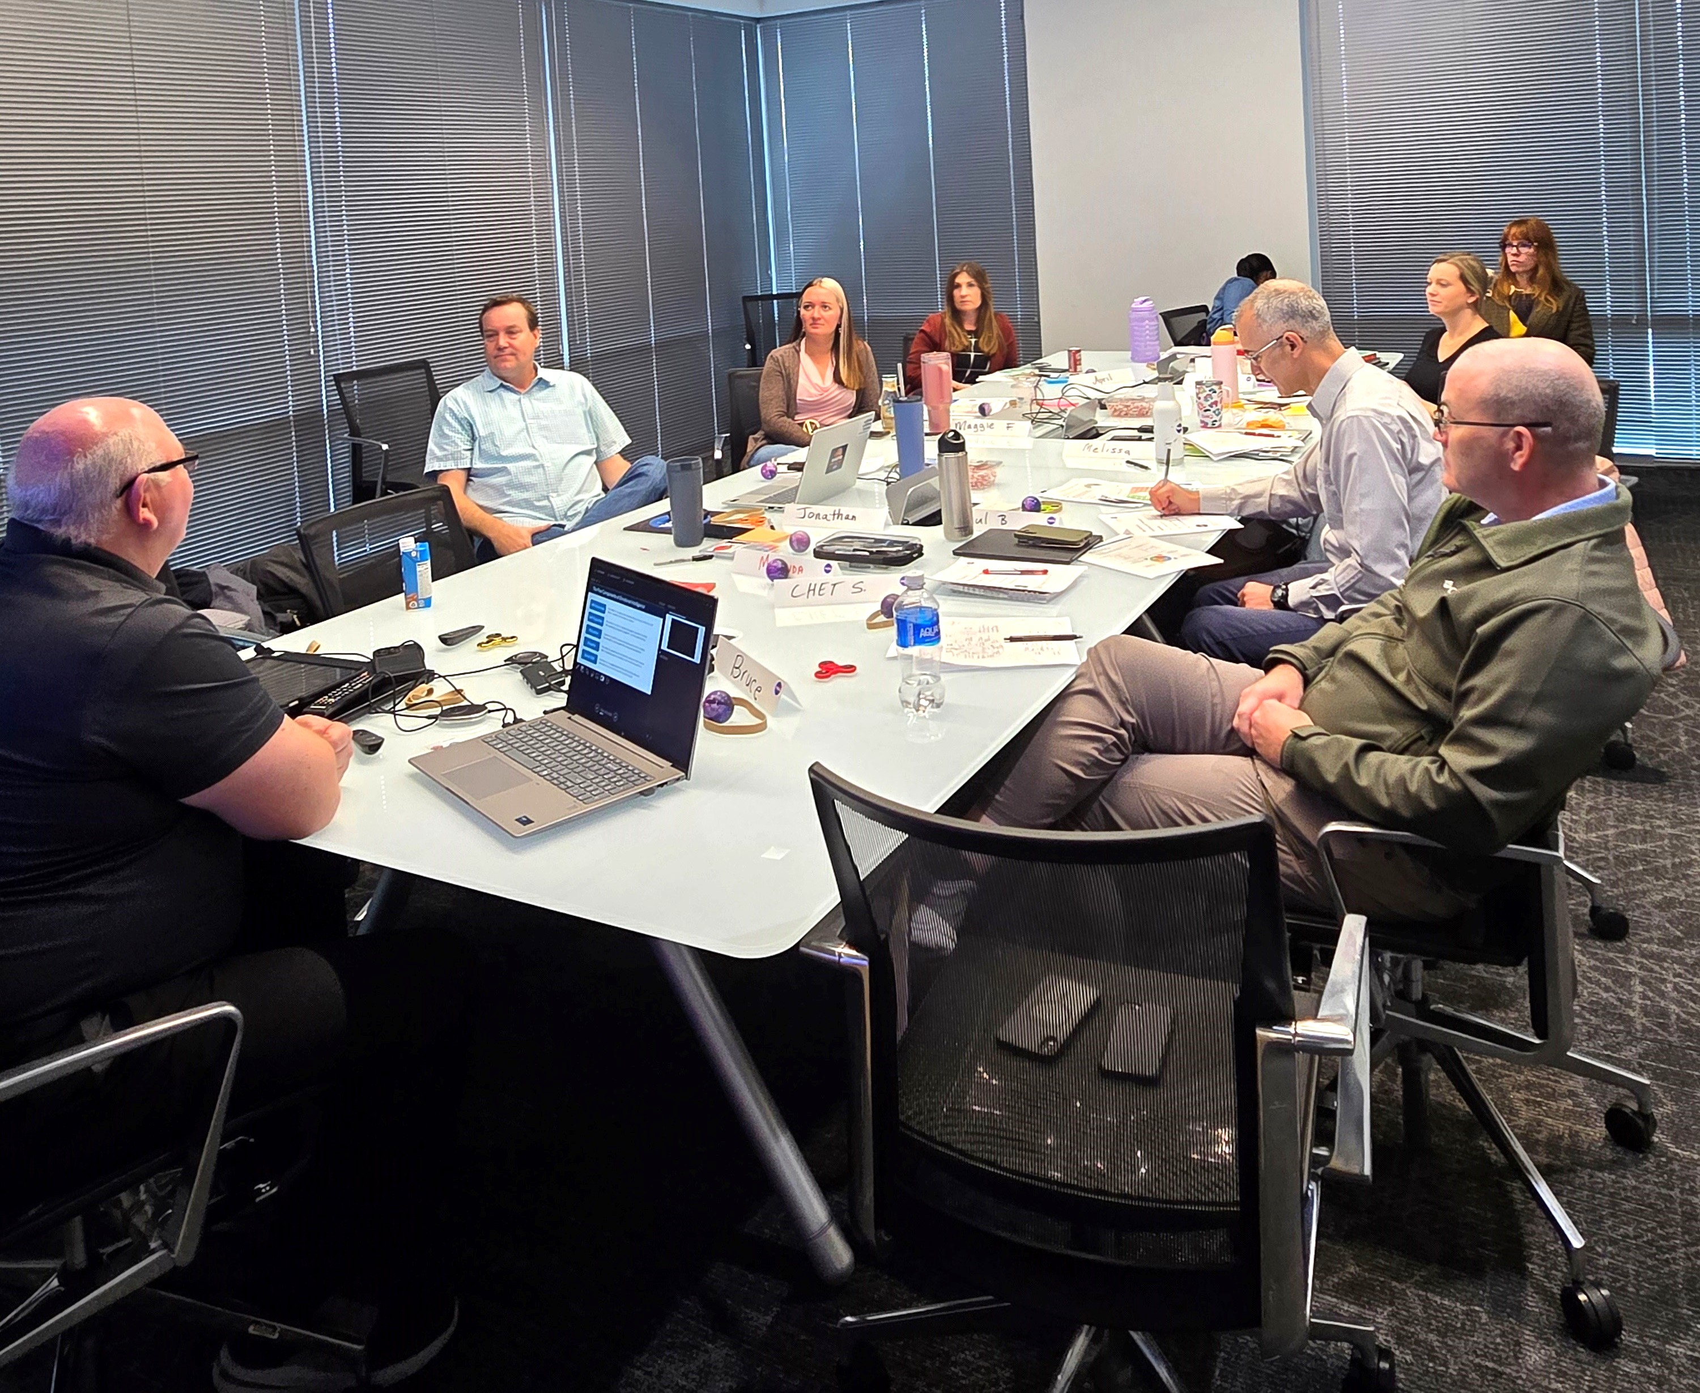
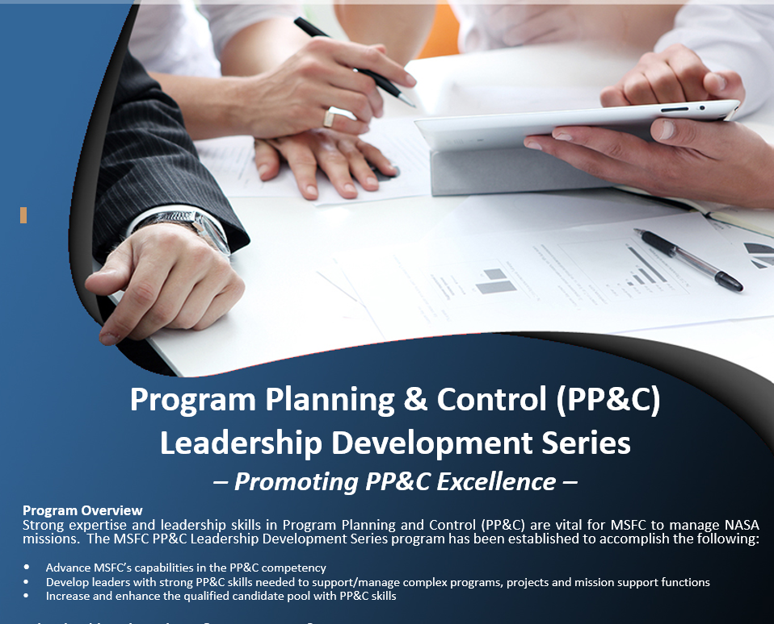
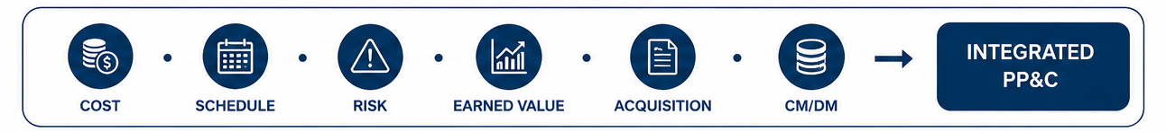
PP&C Leadership Development Series (LDS)
Real Learning. Real Impact.
1
BUILD CAPABILITY
Advance PP&C capability
across Marshall
DEVELOP LEADERS
Develop technically proficient
PP&C leaders
2
3
STRENGTHEN WORKFORCE
Build the future
PP&C workforce
Building the Next Generation of PP&C Leaders
Notes:
(1:25)
One of our first major initiatives was the PP&C Leadership Development Series, or LDS program., which was created several years ago.
Our organization developed this series as a key part of our comprehensive initiative to improve overall PP&C capabilities across the Center.
We recognized that to build the next generation of talent, we need to actively enhance not just technical skills, but also the leadership abilities within our PP&C community.
So our primary goal with the LDS is to strengthen both PP&C discipline knowledge AND leadership competencies within our community.
LDS Program is a competitive, multilevel 24-month training program. It consists of ten participants / cohorts which are selected based on supervisor recommendation.
Each cohort is paired with a knowledgeable PP&C mentor to guide them over the 24-month program.
They are required to take training in each of the PP&C disciplines as well as leadership training and they wrap up the LDS experience by participating in a 6 month PP&C -related detail.
By equipping our practitioners with these dual skill sets, we can directly improve overall Program and Project management, which ultimately ensures we are providing the best possible support for the NASA Mission."

Slide 5
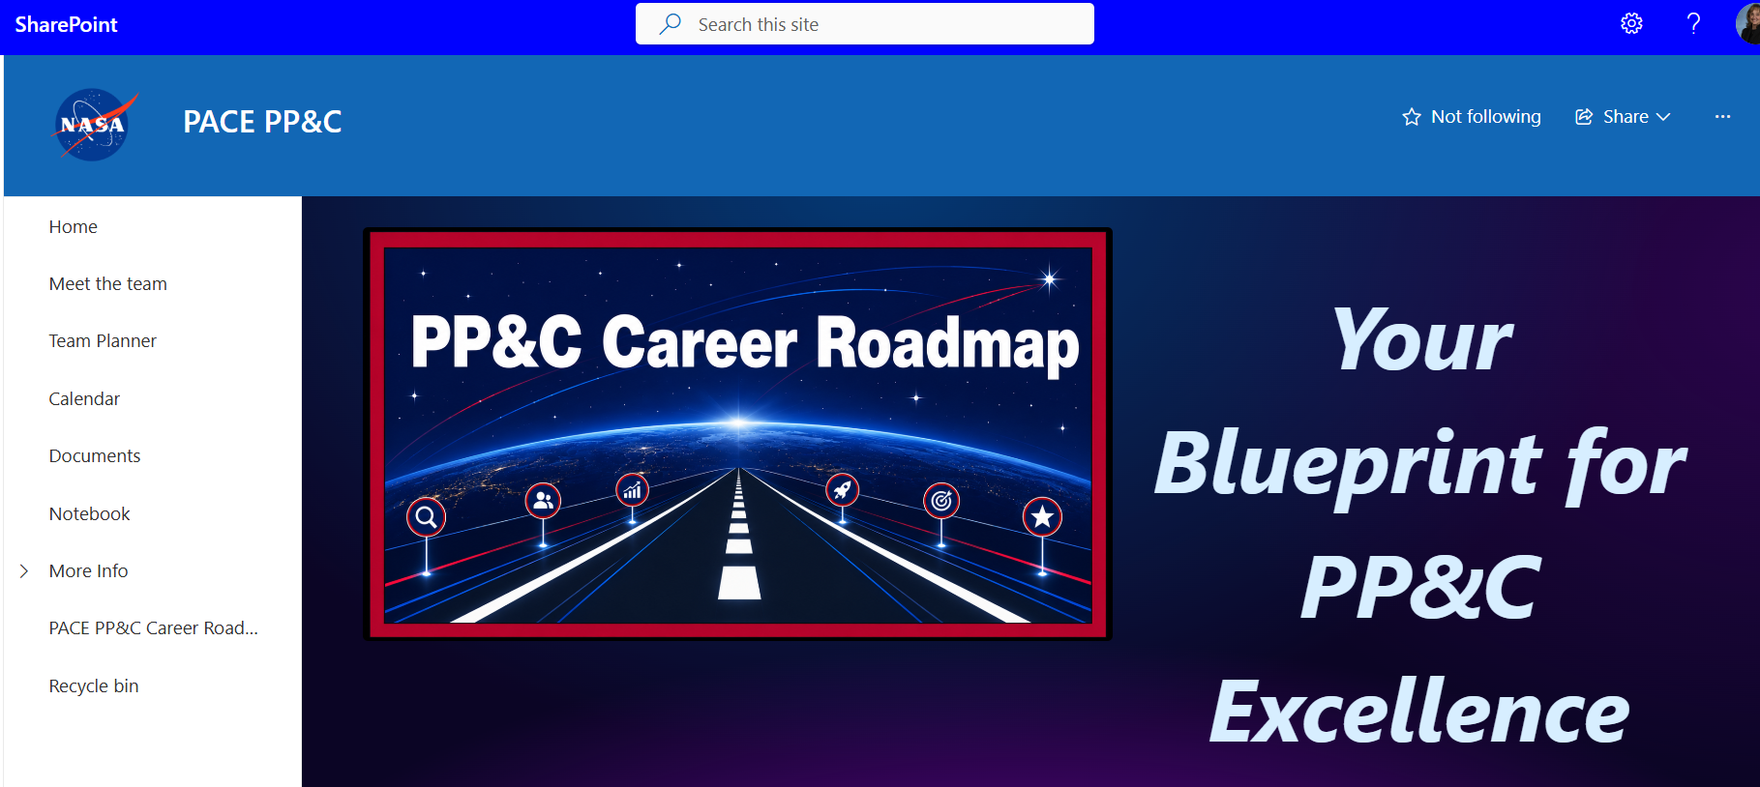
PP&C Career Roadmap
FOR PRACTITIONERS
Empowering professional growth
        Assess PP&C proficiency
        Grow skills
        Plan career progression
        Achieve goals
FOR THE CENTER
Building a stronger workforce
        Develop future talent
        Strengthen PP&C Pipeline
        Ensure talent
        Support NASA missions
PP&C CAREER ROADMAP
Your path to grow. Our future to strengthen.
Guiding professional growth while building NASA's future PP&C workforce.
Notes:
(:50)
Now, let's transition to the PP&C Career Roadmap. We built this roadmap with a dual purpose in mind: empowering the individual while simultaneously strengthening the Center.“
"First, looking at what this means For Practitioners, it’s all about empowering your professional growth. The roadmap provides a structured way for employees to assess their current PP&C proficiency, actively grow their skills, intentionally plan their career progression, and ultimately achieve their goals.“
"Second, looking at what this means For the Center, the focus is on building a stronger, more resilient workforce. By providing this clear path, we are proactively developing future talent and strengthening our PP&C pipeline.“
"Ultimately, this ensures we retain the highly skilled talent necessary to support NASA’s critical missions for years to come.

Slide 6
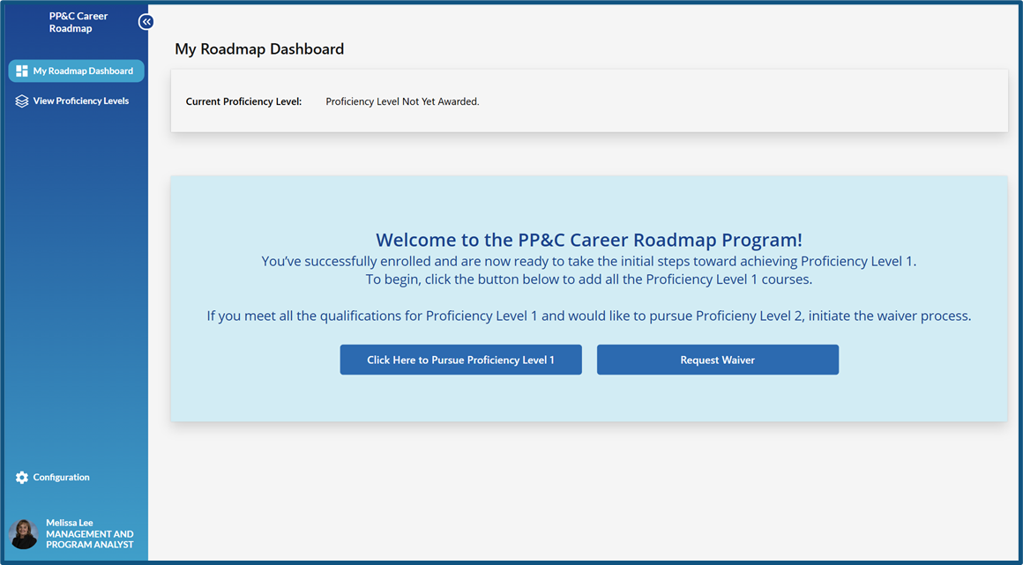
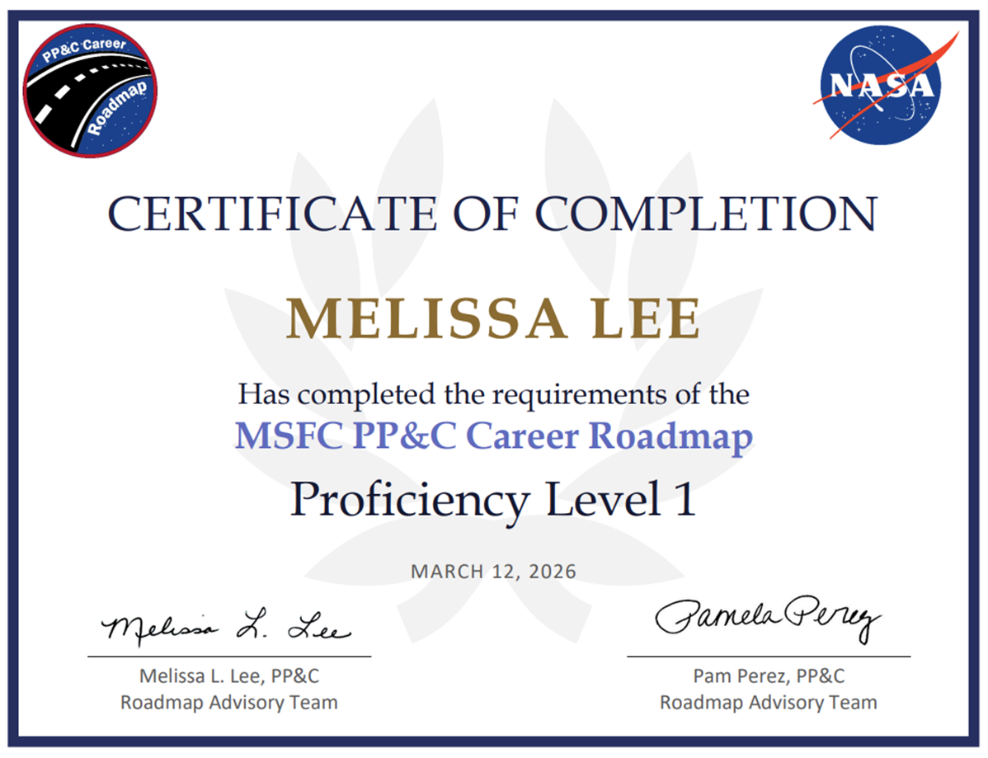
5 Step Roadmap To Grow. Advance. Succeed.
1
2
3
4
5
REQUIRED TRAINING
ON-THE JOB EXPERIENCE
APPROVALS
PROGRESS TRACKING
RECOGNITION & FLEXIBILITY
Leverage existing SATERN, APPEL & CFOU courses for each proficiency level
Minimum 3 years of on-the-job experience for each proficiency level
Supervisor approval required at each level
Documentation of classes will be tracked and maintained on SATERN
Certificates awarded for each proficiency level. Waiver process available for Levels I - III
CAREER ROADMAP PORTAL
CERTIFICATE EXAMPLE
PROGRAM PHILOSPOHY
Self-paced development
Employee-driven growth
Supports-not guarantees-career advancement
Analytics, communications, and participant tracking
Completion certificates awarded after successful achievement of each level
Notes:
(1:45)
So, how do we actually turn this vision of empowering practitioners and strengthening the Center into reality? Let’s break down the mechanics of the program by looking at our 5-Step Roadmap.
Our philosophy here is that development should be self-paced and employee-driven. It supports—and helps plan for—career advancement, rather than just guaranteeing it.
The roadmap is broken down into 5 proficiency levels, and progressing through each level requires a combination of real-world application and formal training.
First, we require a minimum of 3 years of On-the-Job Experience for each proficiency level. You can't just take classes; you have to apply what you learn.
Second, Required Training leverages our existing PACE PP&C Training, SATERN, APPEL, and CFOU courses, ensuring a standardized baseline of knowledge across the workforce.
To move forward, Approvals from a supervisor are required at each level, ensuring management is engaged in the employee's growth.
We also have robust Progress Tracking. All class documentation is tracked and maintained in SATERN, and we've built a Career Roadmap Portal to handle analytics and participant tracking.
Finally, we emphasize Recognition and Flexibility. Employees are awarded completion certificates after successfully achieving each level, and there is a waiver process available for Levels I through III to accommodate those who come in with prior experience.
Ultimately, this 5-step process provides a clear, structured, and rewarding path for our PP&C practitioners to grow their skills and succeed in their careers
As you can see, required training is a foundational piece of the LDS Program & the PP&C Career Roadmap.
To make sure our practitioners are getting the absolute best experience possible, we had to take a hard look at how we deliver that content. I’m going to turn it over to my colleagues Kimberly Bennett and Kenneth McPherson now, who will show you exactly how we’ve transformed our training program.

Slide 7
Transforming PP&C Training
▲ 17%
ATTENDANCE GROWTH
2024 - 2025
BETTER ADVERTISING
Launched MSFC PP&C Training SharePoint
IMPROVED FEEDBACK
New forms with open-text capability
COURSE REVAMPS
Introduced "Introduction to PP&C" and Mock Scenario Exercises
EXPANDED ACCESS
Expanded course availability to all NASA Centers
RESULT: Increased participation, improved engagement, and expanded access across NASA centers
Notes:
(2:27)
Thank you Melissa! As you can see, we’ve made some major updates to how we develop and deliver our training, and it is continuing to show great results.
First off, I'm thrilled to report that between 2024 and 2025, our overall attendance increased by 17%.
A big driver for that growth was taking a fresh approach to advertising. We launched the new MSFC PP&C Training SharePoint site to make finding information easier. We also got a bit creative—at the MSFC Spring Showcase, we engaged people by playing 'PP&C Tetris’, handing out PP&C discipline Monopoly cards, and giving them a handout for upcoming courses. This effort was a huge hit and really helped get the word out.
To make sure our training stays relevant, we overhauled our feedback process. Originally we relied just on SATERN course surveys, but we wanted to get some additional information from our students that could help us with tailoring our courses. To do that we switched to Microsoft Forms, which allows us to keep surveys completely anonymous while still giving us the open-text capability to gather critical, actionable information.
Using that feedback and building on the tremendous success of our Introduction to PP&C course, the PACE office updated our other PP&C related training packages.
One of the biggest additions was building in more 'real-world' mock scenario exercises so attendees get hands-on, practical experience rather than just suffering death by PowerPoint lectures. Utilizing Mintemeter / Kahoot competition quizzes since “pop quizzes” tend to have a negative light to them. These quizzes not only reinforce key concepts but they provide our students a small brain break, especially in our Intro to PP&C course.
Finally, a major shift for us was opening up our courses to all Centers. We are currently working on balancing how we advertise these openly across the agency while ensuring we actually have the capacity to meet the demand.
Just to give you a quick snapshot of our reach across the agency for 2025, on top of the 229 attendees from MSFC we had 7 attendees from JSC, 5 from Stennis, 4 from NSSC, 3 from Glenn, 2 from Michoud, and 1 from Goddard.
Overall, these changes have made our training more accessible, more practical, and much more engaging. Don’t just take our word for it though…..

Slide 8
What Participants Are Saying..
Representative feedback from participants across PP&C training courses in 2025
Intro to Planning &
Schedule Management
Planning & Scheduling
Applications Using Microsoft Project
IBR Overview
“
“
“
Overall, a great class! [...] I really enjoyed this course! Wish I had taken it years ago.
Great class, exactly what I needed. [...] Going from start to finish near the end of class was perfect.
I was referred to take this and was not sure what to expect, but it was so much better than I expected.
Intro to PP&C
Intro to Cost Estimating/WBS
“
“
Good overview of all topics. Instructors allowed participants to talk about their areas of expertise while making sure folks new to certain areas got what they needed.
You could tell it was prepared, and the instructors were knowledgeable. The house building example was fun. The slides were not overwhelming and easy to understand.
Notes:
(1:15)
As we've continued to modernize our PP&C training, one of our priorities has been collecting meaningful participant feedback. Rather than waiting until the end of the year, we use course evaluations after every class to identify what's working well and where we can continue to improve.
Across multiple PP&C courses, several themes have consistently emerged. Participants tell us they find the material immediately applicable to their work, appreciate that the courses are well organized and easy to follow, and value the interactive learning environment.
One piece of feedback we're especially proud of is that students frequently mention the discussions. We intentionally designed these courses to be collaborative rather than lecture-based, encouraging participants to share experiences, ask questions, and learn from one another. That exchange of ideas has become one of the greatest strengths of the program.
Perhaps the most encouraging feedback is that participants leave feeling more confident and better prepared to apply these concepts to their work. That tells us we're not just delivering information—we're building capability across the PP&C community.
With that, I'd like to turn it over to Kenneth, who will provide an overview of one of our newest courses, Introduction to PP&C ,and show you how we've put many of these concepts into practice.

Slide 9
The PP&C Foundation
Seven disciplines. One philosophy. One mission.
Scheduling
WHY THIS COURSE?
Cost Estimation & Assessment
Introduces the seven core disciplines
Explains how they work together
Builds a common PP&C foundation
PP&C Integration
MANAGE
•
ASSESS
• IMPROVE
Acquisition & Contract Management
MISSION IMPACT
Credible plans
Informed decisions
Future outcomes
Resources Management
Configuration Management/Data Management
Risk Management
Notes:
(0:45)
On Day 1 of the course, we ground our students in the fundamentals. We introduce the seven core functions of PP&C based on the Agency PP&C Handbook and show how they are all interconnected. We emphasize that PP&C isn't just about tracking numbers; it's about integrating stakeholder expectations and building credible, executable plans.
We also reinforce that no single PP&C discipline operates independently. Cost influences schedule, schedule influences risk, acquisition affects resources, and every discipline contributes to the overall health of a program. By establishing this integrated mindset first, students develop a common foundation that they carry throughout the remainder of the course.
Our goal isn't for students to memorize seven separate PP&C disciplines. It's for them to understand how those disciplines work together to support better decisions and ultimately enable mission success.

Slide 10
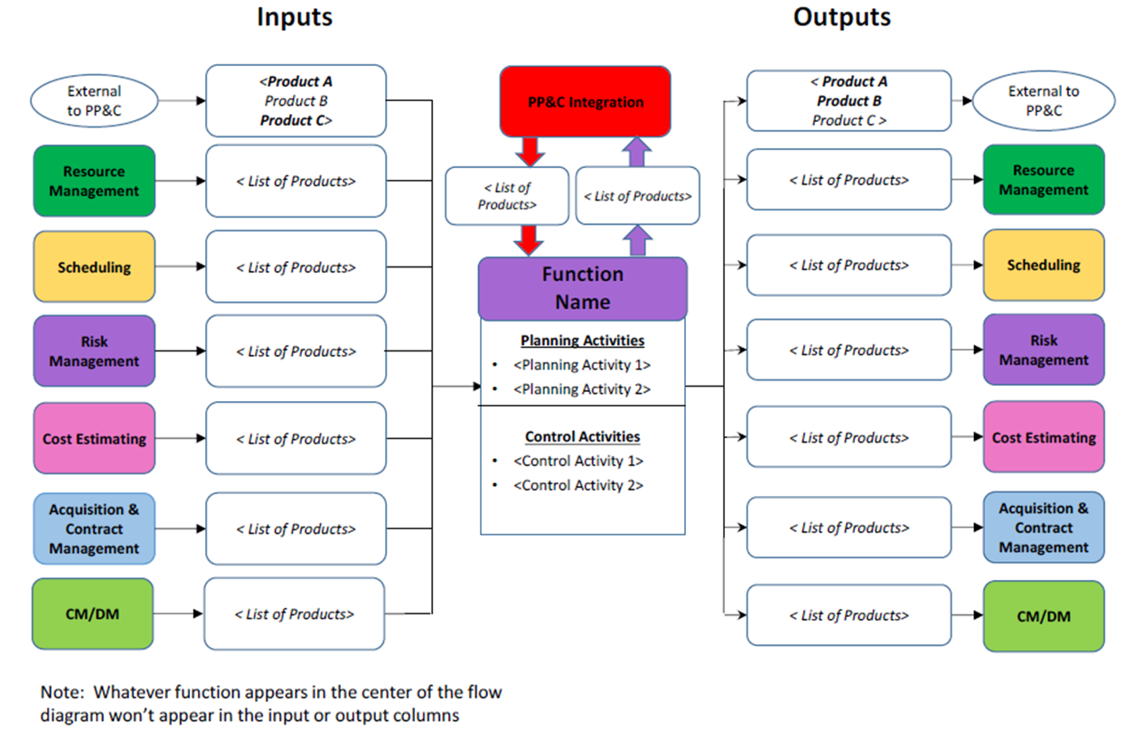
Day 1: Understanding the PP&C Functional Flow
Day 1 Learning Objectives
Understand the PP&C Functional Flow
Recognize how each discipline contributes to the process
Connect each discipline to the other
Course Design
Each module focuses on a single PP&C discipline while demonstrating how it connects to the overall functional flow.
Students examine
  Required Inputs
  Planning Activities
  Control Activities
  Expected Outputs
Day 1 Learning Objectives
Notes:
(1:15)
On Day 1, we spend a significant amount of time working through this functional flow. Rather than teaching each PP&C discipline in isolation, we use this diagram to show students how information moves through a program—from planning activities like defining scope, developing schedules, and estimating costs, to control activities like measuring performance, managing changes, and analyzing variances.
Each lesson focuses on a single PP&C discipline, but always within the context of this overall functional flow. Students examine the required inputs, the planning and control activities performed within that function, and the outputs that become inputs for the next discipline. This helps them understand not only what each discipline does, but why it matters to the overall project.
However, understanding a process on paper is very different from applying it on a real project. In practice, PP&C disciplines don't operate independently— as I mentioned before - cost influences schedule, schedule drives risk, acquisition impacts resources, and every decision has downstream effects across the program.
That's why Day 2 shifts from instruction to application. We take this exact functional flow and place students into a simulated NASA project where they must apply these concepts as an Integrated Product Team. Instead of simply learning the process, they experience how the disciplines work together to build and manage an executable program plan.

Slide 11

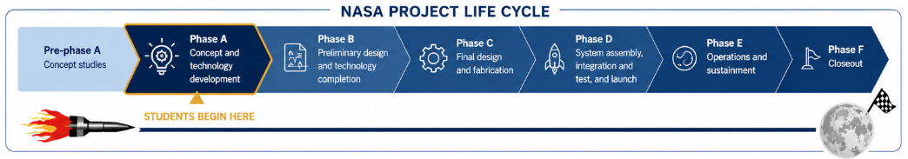
Day 2 – Integrated Project Simulation
Students are introduced to a fictional NASA project – Neil Armstrong Paper Company (NAPC) – to practice PP&C Integration in a realistic but engaging environment.
SCENARIO
LEARNING EXPERIENCE
Students work as Integrated Product Teams (IPTs) on a fictional NASA project, identifying risks, building schedules and reviewing cost data while applying every discipline in an integrated environment
Notes:
(1:30)
With the foundation established on Day 1, Day 2 shifts from learning concepts to applying them. Rather than giving students another lecture, we immerse them in a simulated NASA project where they must use every PP&C discipline as members of an Integrated Product Team.
To make the experience engaging and memorable, we introduce them to the fictional Neil Armstrong Paper Company, or NAPC. The scenario imagines NASA preparing for long-duration lunar habitation and needing a reliable supplier of office equipment for the lunar surface.
Students are divided into Integrated Product Teams and assigned payloads such as the Space Saver Binders, Astro Stapler, and Lunar Printer. Each team is responsible for planning and managing its portion of the project, just as they would on an actual NASA program. The scenario isn't about paper supplies—it's about giving students a memorable, low-risk environment to practice the same integrated planning and decision-making skills they use on real NASA programs.
The project begins during Phase A Concept and Technology Development, and throughout the simulation students build and refine the planning products that support the project as it progresses toward launch. Over the course of the day, they develop schedules, identify and assess risks, review cost information, and build the planning products needed to establish an executable PP&C baseline. As new information is introduced, they experience firsthand how decisions in one discipline influence every other discipline across the project.
By the end of the simulation, students haven't simply learned about PP&C integration—they've practiced it in a collaborative, mission-focused environment.

Slide 12
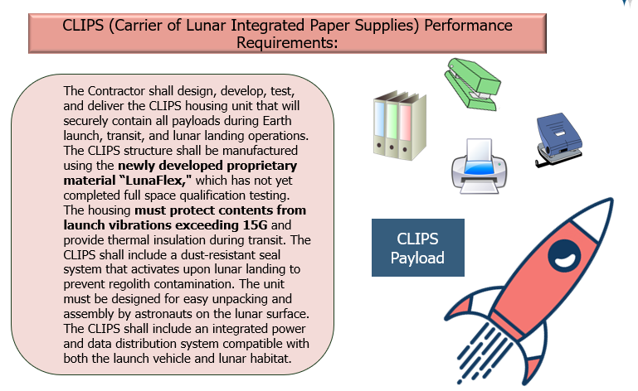
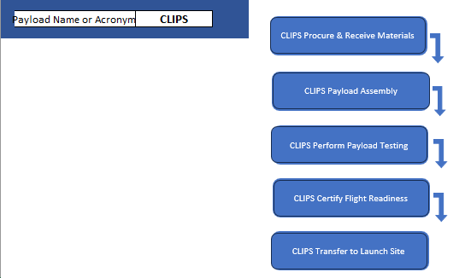
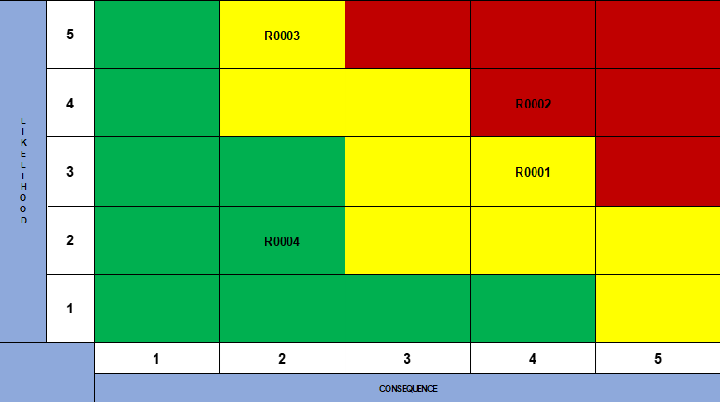
Students Build the Project
Hands-on activities develop the PP&C baseline through integration.
REQUIREMENTS
Define what we must deliver
INTEGRATED MASTER SCHEDULE
Plan how we will deliver
RISK REVIEW
Understand impacts
Teams analyze the SOW and performance requirements to understand scope, constraints, and success criteria
Teams develop the IMS to sequence work
Teams identify, assess, and prioritize risks to proactively plan mitigation steps and protect mission success
Notes:
(1:34)
With the project introduced, students immediately begin building the PP&C baseline through a series of connected exercises. Each activity builds on the previous one, just as it would on a real NASA project.
First, students will be answering the question of “What are we building” by analyzing the Statement of Work and performance requirements to determine exactly what must be delivered. They identify assumptions, constraints, and initial risks, giving them a clear understanding of the project's scope before any planning begins.
Next, they use those requirements to answer “How are we going to build it” by developing an Integrated Master Schedule. Rather than simply creating a list of activities, they sequence the work, establish logical dependencies, and integrate multiple payload schedules into a single executable mission timeline.
Finally, students will answer “What could prevent us from succeeding?” To do that they evaluate the risks they've identified using a standard 5×5 Risk Scorecard. This helps them prioritize what matters most and reinforces how schedule, cost, technical, and mission considerations all influence one another.
By the end of these exercises, students haven't completed three unrelated assignments—they've built a connected set of PP&C products that support the same project from planning through execution.
Each exercise answers the next question the project team would naturally ask, allowing students to experience PP&C as an integrated process rather than a collection of individual disciplines.
Although we've highlighted just three exercises today, this same integrated approach continues throughout the course as students build additional PP&C products and experience how every discipline contributes to successful mission planning and execution

Slide 13


Exercise 1 – Requirements Analysis
OBJECTIVE
CLIPS
Carrier of Lunar Integrated Paper Supplies
Interpret the Statement of Work and identify requirements, assumptions and ultimately any risks.
What Students Discover
Performance Requirements
New Technology
(Qualification Risk)
The Contractor shall design, develop, test, and deliver the CLIPS housing unit that will securely contain all payloads during Earth launch, transit, and lunar landing operations.
  The CLIPS structure shall be manufactured using the newly developed proprietary material “LunaFlex," which has not yet completed full space qualification testing.
  The housing must protect contents from launch vibrations exceeding 15G and provide thermal insulation during transit.
  The CLIPS shall include a dust-resistant seal system that activates upon lunar landing to prevent regolith contamination.
  The unit must be designed for easy unpacking and assembly by astronauts on the lunar surface.
  The CLIPS shall include an integrated power and data distribution system compatible with both the launch vehicle and lunar habitat.
STUDENT DELIVERABLE
High Vibration Environment
(Design & Test Risk)
Initial Risk List (by IPT)
SKILLS REINFORCED
Lunar Dust Exposure
(Operational Risk)
Scope definition
Requirements analysis
Risk identification
System Interfaces
(Integration Risk)
Notes:
(1.15)
The first exercise begins with something every PP&C professional is familiar with—a Statement of Work.
Each Integrated Product Team receives the requirements for its assigned payload. For this example, the CLIPS payload must be manufactured using a newly developed composite material called LunaFlex, while also surviving extreme launch vibration loads and operating in the harsh lunar environment.
We give the teams about 20 minutes to read through the requirements and identify potential project risks. At first, many students start reading the document exactly the way you would expect—line by line.
Then someone notices one word... 'newly developed.’
Suddenly the conversation changes.
'Wait...if it's newly developed, has it been qualified?’
‘What if the material doesn't survive vibration testing?‘
‘If it fails, how much of the design would we have to change?’
Within just a few minutes, the room transforms. Students stop reading requirements as a checklist and begin questioning assumptions, identifying uncertainties, and thinking through technical, schedule, and mission impacts.
By the end of the exercise, they haven't simply identified risks—they've discovered that every requirement represents both an opportunity and a source of uncertainty. That's exactly the mindset we want them to develop. Those risks don't disappear when the exercise ends. The list they create here becomes the starting point for the Risk Review exercise later in the day, where they'll assess likelihood, consequence, and mitigation strategies.

Slide 14
Exercise 2 – Build the Integrated Schedule
OBJECTIVE
STEP 1: BUILD THE SEQUENCE
What Students Discover
Create activity sequences for each payload IPT and integrate all payloads into one master waterfall schedule from payload development through launch
Carrier of Lunar Integrated Supplies (CLIPS) IPT
Design
How individual payload schedules must be sequenced and logically connected.
Build
Key Focus
Test
Students develop the logical sequence and dependencies for all CLIPS activities
Integrate
Dependencies across payloads impact the overall mission timeline.
STUDENT DELIVERABLE
Ready
Integrated Master Schedule (IMS) Framework
STEP 2: INTEGRATE ALL IPT SCHEDULES INTO IMS
Integration and handoffs are critical path drivers.
CLIPS Development
SKILLS REINFORCED
A single delay in one payload can affect the entire launch.
Activity sequencing
Logical relationships
Schedule integration
Critical Path awareness
End-to-end alignment
Other Payload IPTs
(Additional IPT schedules combined here)
Payload Integration
The value of an executable master schedule from development to launch.
Launch Readiness
Launch
Notes:
(1:00)
Once the teams understand their requirements and have identified their initial risks, the next question becomes, "How are we actually going to execute this work?“
That's where we introduce the Integrated Master Schedule. We explain that a schedule is much more than a list of tasks—it's a logical model of how the project will be executed.
Each Integrated Product Team begins by building the activity sequence for its assigned payload. Students identify the major activities, determine the correct order, and establish the dependencies needed to move from design through launch readiness.
Once every IPT has developed its own sequence, we bring the teams together to integrate their work into a single Integrated Master Schedule. Students quickly realize that their payload doesn't exist in isolation. Decisions made by one IPT directly affect the timelines and dependencies of every other team.
This is often the moment when the importance of PP&C integration really clicks. Students see that a delay in one area can ripple throughout the entire project, reinforcing why planning, communication, and coordination are so critical to mission success.

Slide 15
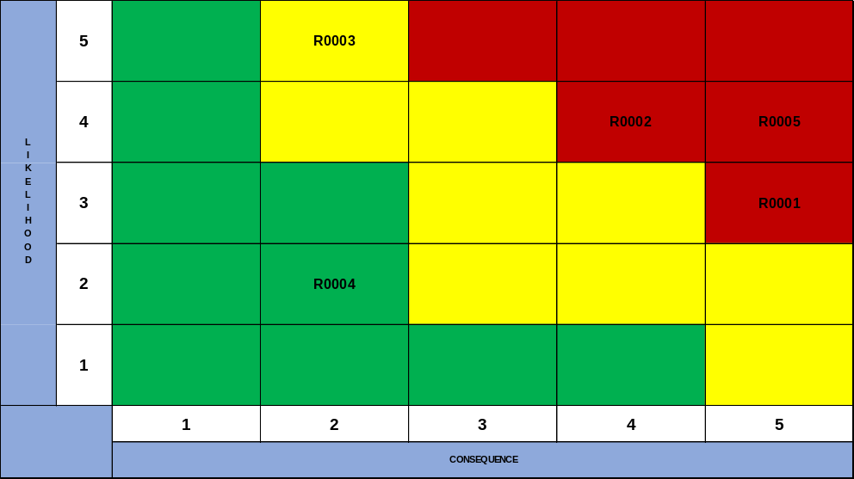
Exercise 3 – Integrate Risks into a 5X5 Scorecard
OBJECTIVE
STEP 1: ASSESS AND SCORE EACH RISK
What Students Discover
Evaluate mission risks by assigning likelihood and consequence scores and plotting them on a 5x5 risk scorecard to identify and prioritize the highest risks
Assess Each Risk
Score Each Risk
Key Focus
Review the risk statements and determine the Likelihood (1-5) and Consequence (1-5) scores based on the criteria provided.
Assign a Likelihood score and a Consequence score to each risk.
Visualizing risks helps focus attention on what matters most.
Consistent scoring is critical to accurate risk prioritization.
High likelihood and high consequence risks demand immediate attention.
STUDENT DELIVERABLE
STEP 2: PLOT RISKS INTO 5X5
Completed 5x5 Risk Scorecard
Risk prioritization supports informed decision-making.
SKILLS REINFORCED
A living risk scorecard support proactive risk management.
Risk assessment
Likelihood & consequence scoring
Risk prioritization
Risk communication
Decision support
Risk scoring takes multiple inputs not just the risk manager.
Notes:
(1:45)
Now that they've built the schedule, we circle back to those risks they identified earlier in the day. But this time, we're asking them to do more than just identify what could go wrong—we want them to determine which risks really deserve the project's attention. That's where we introduce the 5×5 Risk Scorecard.
We take the risks they identified during that first exercise and then give each team some additional risk variables to consider. From there, we ask them to look at the criteria we've provided and determine both the likelihood of that risk occurring and what the consequence would be if it did.
And this is where it gets interesting, because there isn't always an obvious answer. We start hearing the teams debate with each other about how the risk is worded, how likely they really think it is, and which consequence category it should fall under. They also start asking questions like, "Does this just impact our payload, or could this affect the schedule or the overall mission?"
And that's really what we want them to do. We don't want them just looking for the "right" number. We want them talking through the information they have, understanding the uncertainty, and being able to support why they scored the risk the way they did.
Once each IPT has completed its assessment, we bring all of those risks together onto one common scorecard. Now they can step back and look at the project as a whole and start to see which risks may need more immediate attention and where the project team may need to focus.
So by the end of this exercise, they've gone from simply identifying a risk to actually using risk information to help make project decisions.
And just like the scheduling exercise, this continues to build on what they've already done
This is where they really start to see how all of these individual PP&C products connect to one another.

Slide 16
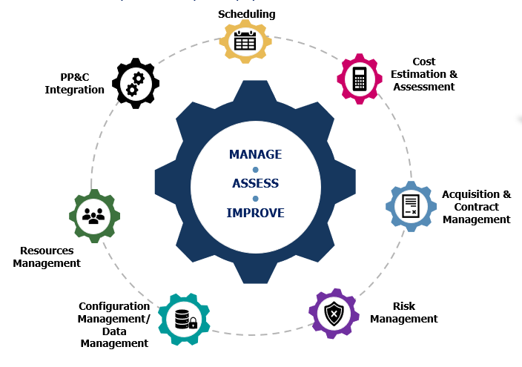

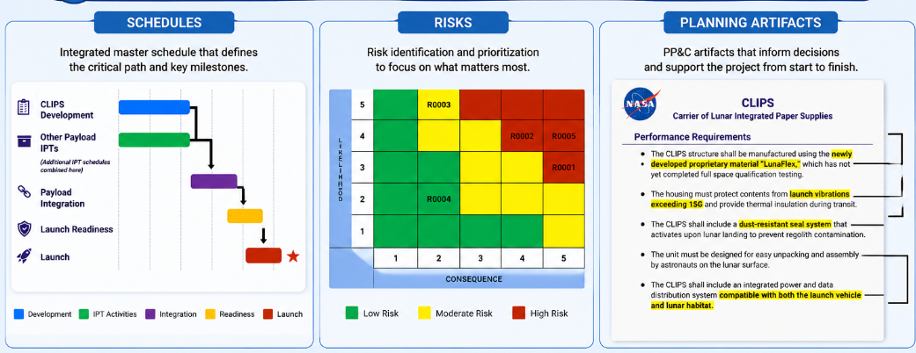
What Makes This Experience Memorable
Learn Together
Collaborate
Apply In Context
Produce real PP&C Products
Students experience how the PP&C disciplines work together.
Exercises are completed in Integrated Product Teams.
Every activity is grounded in a simulated NASA project from concept to launch.
Students create schedule outlines, risks and planning artifacts used throughout the project lifecycle.
REAL IMPACT. REAL RESULTS.
MISSION SUCCESS
Students don’t just learn PP&C Disciplines – they experience how integrated planning supports mission success.
Notes:
(0:57)
As we wrap up, I'd like to leave you with what we believe makes this experience different.
First, students don't learn the PP&C disciplines in isolation—they experience how those disciplines work together to support a common objective.
Second, they learn the same way real NASA teams work: as Integrated Product Teams. Every discussion, every decision, and every deliverable requires collaboration.
Third, everything is grounded in a realistic project scenario. Rather than solving disconnected classroom problems, students experience the lifecycle of a project from planning through execution.
Finally, students leave with more than knowledge—they've created real PP&C products. Schedules, risks, planning artifacts, and analyses that build upon one another just as they would on an actual program.
Our goal has never been simply to teach seven PP&C disciplines. Our goal is to develop practitioners who understand how those disciplines integrate to support informed decisions and ultimately contribute to NASA's mission success.

Slide 17
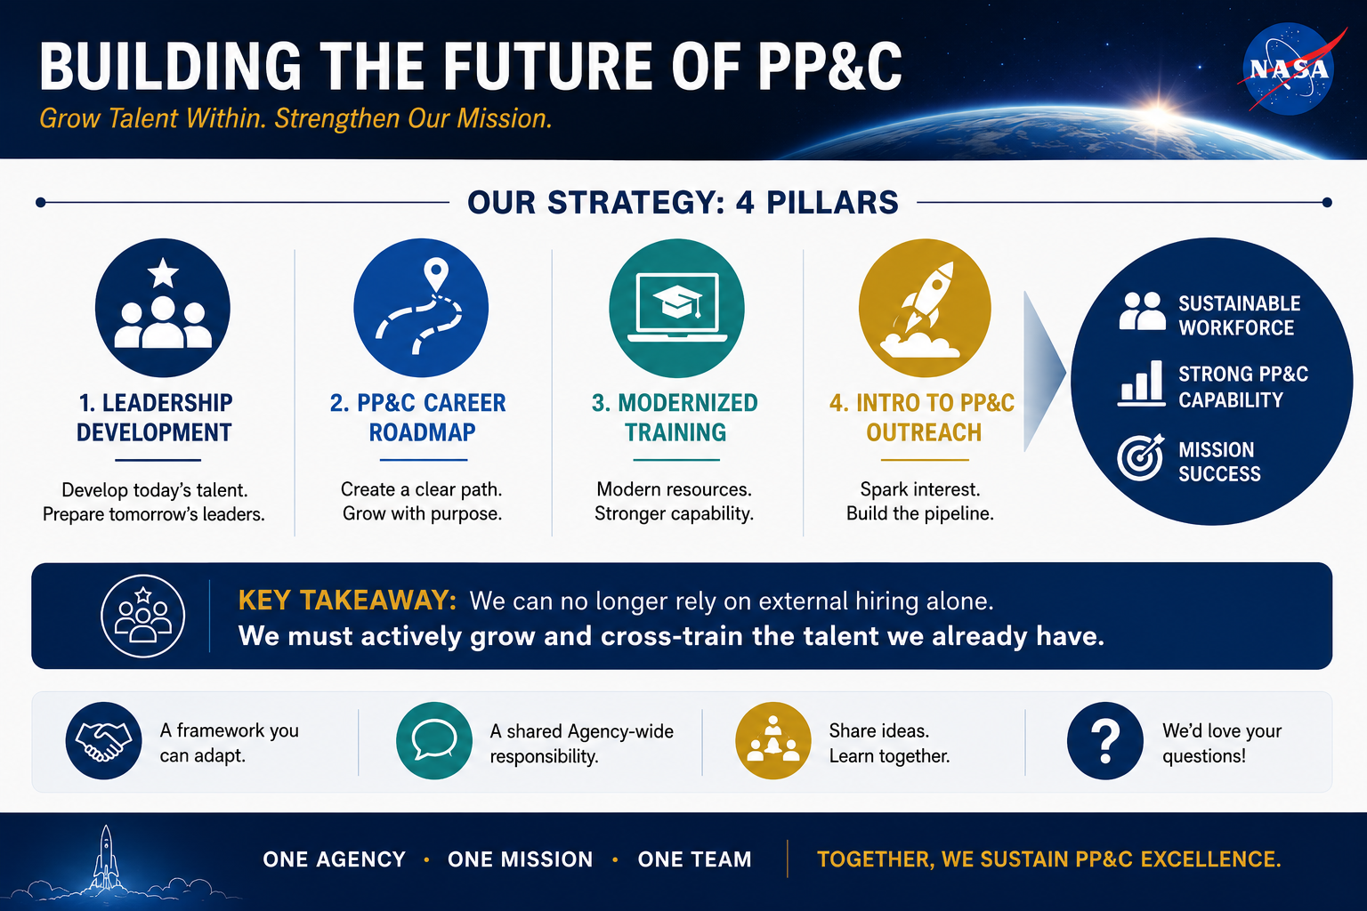
Sustaining Our Workforce: The Path Forward
Notes:
(1:22)
In summary, we want to leave this community with a few final thoughts.
At MSFC, the combination of attrition and ongoing hiring freezes has forced us to look closely at how we sustain our PP&C capabilities. But we know we aren't the only ones facing these issues—many of you across the Agency are likely dealing with similar workforce challenges.
Our strategy at Marshall—focusing inward to build the next generation of talent—relies on four main pillars:
implementing our Leadership Development Series,
defining a clear PP&C Career Roadmap,
Ensuring our PP&C training evolves with the needs of MSFC to ensure our resources are modern and effective
and spark interest in this critical career path with tools like the 'Intro to PP&C' course.
The key takeaway is that we can no longer rely on external hiring alone to maintain our critical cost and schedule capabilities.
We have to actively grow and cross-train the talent we already have.
We hope that sharing our roadmap today provides a framework that you might be able to adapt for your own centers and teams.
Because protecting the PP&C discipline is a shared Agency-wide responsibility, we’d love to hear your feedback or learn about similar initiatives you are trying.
Thank you for your time, and we'd now be happy to take your questions."

