Slide 1

Spaceport Infrastructure Maintenance and Operations (SIMO) Pre-Solicitation Conference
SIMO Source Evaluation Board (SEB)

Slide 2
Welcome
NASA KSC appreciates your interest in the SIMO acquisition
The purpose of today’s briefing is to:
  Provide an opportunity for the Government to highlight various aspects of the procurement
  Promote competition by providing industry a better understanding of the upcoming procurement
  Provide industry an informal networking opportunity

Slide 3
Agenda
Introduction
Ground Rules
Contract Structure (Core and IDIQ)
Description of Effort
PWS Sections 1 through 7
Contract Sections B through M
Tour Logistics
Closing Remarks

Slide 4
Introduction
The information provided in this briefing is based on the best information available at the time of publication and is subject to revision, based on a variety of circumstances including industry input
  Interested parties should refer to the Draft Request for Proposal (RFP) at https://sam.gov
  This briefing is not intended to cover every aspect of the Draft RFP
  Potential Offerors should monitor https://sam.gov and https://www.nasa.gov/kennedy/seb/simo/ for updates
  The RFP, when released, is the only document that should be relied upon in determining whether or how to satisfy SIMO requirements

Slide 5
Ground Rules
This briefing is for information and planning purposes and remarks made by Government officials at any point during this briefing are subject to change and shall not be:
  Construed as a comprehensive description of any future requirement
  Considered a guarantee of the Government’s course of action for obtaining SIMO services
  Construed as a commitment or obligation by the Government to procure SIMO requirements
The Government cannot:
  Directly or indirectly disclose information tied to an incumbent Contractor’s performance, processes, techniques, or other confidential business information
  Disclose financial information related to the incumbent Contractor to include cost breakdowns, profit, indirect cost rates, and similar information
  Discuss contract administration matters involving the Base Operations and Spaceport Services contract or any other NASA contract

Slide 6
Ground Rules
The Government cannot (continued):
  Provide advice on proposed technical approaches or solutions
  Respond to hypothetical or “what if” questions (e.g., if we propose this, how would you rate it?)
  Allude to, speculate, or provide insight into a “preferred” Government solution
  Discuss controlled, unclassified information

Slide 7
Contract Structure (Core and IDIQ)
SIMO Contract
Core Requirements
IDIQ Requirements
Center
Operations
Center Logistics
Services
Non-proposed
Other Direct Cost
Maintenance
Support Requests
KSC Discrete Task Order Work
WFF Discrete Task Order Work
Power
Central plants
Water and wastewater
Ctrl/monitoring sys.
Protective systems
Stormwater
Structures/towers
Horizontal infrastructure
Landfill operations
24/7 support
Property mgmt.
Transportation mgmt.
Heavy equipment
Fueling
Materials
Fuel
Services
Travel
Other direct costs
Trouble calls
Repairs
Service requests
Preventive maintenance
Predictive testing and inspection
Flight sheet support
On-demand technician support
Core and non-core customer support
M&O of FSEU
Engineering services
Logistics services

Slide 8
Description of Effort
The purpose of the SIMO acquisition is to acquire:
  Maintenance and operations (M&O) of KSC facilities, systems, equipment, and utilities (FSEU)
  Logistics services at KSC
  Future M&O, logistics services, and engineering services at WFF
What’s not included in SIMO:
  Counts or tokens (BRRs, SOs, count exchanges, total dollar formula)
  Systems engineering, engineering services, design engineering, SIES at KSC
  Local authority projects
  Spaceport integration
  Pressure vessels/systems certification
  KSCVC repairs and preventive maintenance (PM)
  Core requirements for U.S. Space Force

Slide 9
Description of Effort (continued)
New requirements under SIMO:
  Maintenance support requests
    Consolidates the BOSS contract’s pricing schedule (BRRs A-K and SOs 1-8)
    Reduces complexity by grouping PMs with trouble calls, repairs, service requests and PTI
    Billings for PMs will be based on actual work performed versus 1/12 allocation under BOSS
  More stringent certification and qualification requirements for electrical and HVAC technicians
  New priority and urgent work classifications
  Expanded pre-priced catalog of services for spaceport users
  Deduction schedule
  AbilityOne subcontracting goal

Slide 10
PWS Section 1. Contract Management
Disposition of the BOSS requirements
NASA Insourced Requirements (examples):
  Maintenance and operations engineering authority stays with NASA, including anomaly disposition and TAL investigations. SIMO still executes the trouble call and the repair.
  Engineering authority stays with NASA, including RCM, spare-parts approval, and configured-drawing approval. SIMO still tracks RCM in Maximo and executes MSRs when CAD is needed for drawing or OMD updates.
  Continuous spaceport integration stays with NASA, including monitoring, deconfliction, and customer communication. SIMO still coordinates the specific outages for its own work.
  Spaceport planning authority stays with NASA. SIMO still performs utility locates, survey support, and dig-permit response.
  Construction support authority stays with NASA, including design review and project administration. SIMO supports the work NASA administers.
Assigned to SIMO 70%
NASA Insourced 20%
Eliminated 10%
Planning split of BOSS requirements. Not a labor or dollar split.
Data is for informational purposes only, not intended for use by offerors as a bid approach and should not be construed as directing, restricting, or locking any bidding methodology.

Slide 11
PWS Section 1. Contract Management
General Overview
  The SIMO contract plays a pivotal role in providing facility management, maintenance, and operations of NASA facilities, infrastructure, and utilities, primarily at KSC, Wallops Flight Facility (WFF), and Cape Canaveral Space Force Station (CCSFS), as well as providing enterprise logistics services
  The spaceports support multiple users for both crewed and uncrewed launches for NASA, other government agencies, and commercial customers

Slide 12
PWS Section 1. Contract Management
The primary objectives for the Contractor are to:
  Provide safe and reliable facility, systems, and utility services to support the multi-user spaceports
  Provide effective operations integration across the multi-user spaceports
  Provide efficient and effective responses to the concurrent needs of multiple customers
  Provide comprehensive enterprise logistics services
  Maintain effective safety and occupational health management programs and plans that prioritize safety (i.e., ensure that safety is EVERYONE’S responsibility)

Slide 13
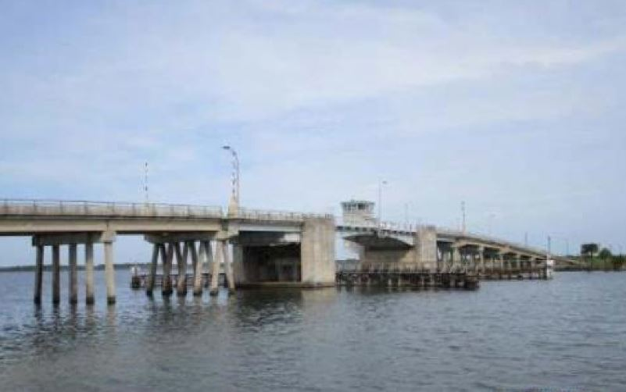
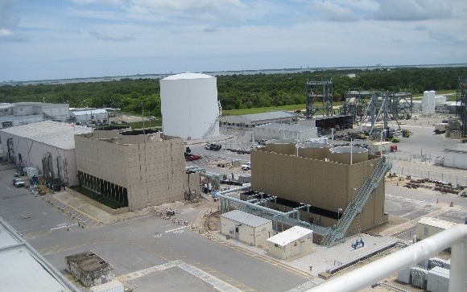
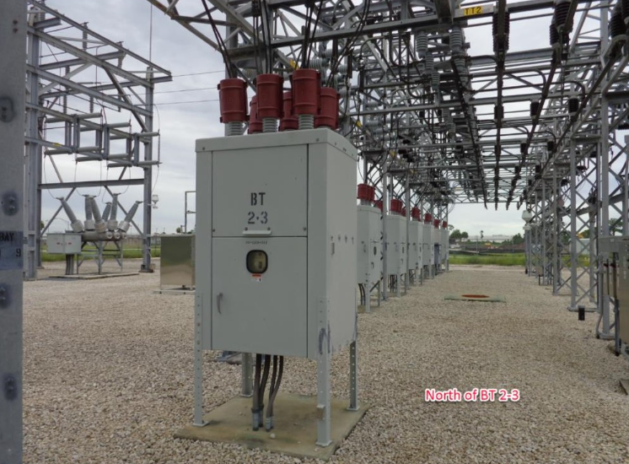
PWS Section 1. Contract Management
Magnitude of Requirements for KSC
  Footprint: approx. 220 square miles and 1,000 facilities and structures (see KSC-11452, Basic Info. Guide Facility Utilization Maps and Tech Exhibit 3.1-1, OMEU)
  Customers supported: 46 (see Tech Exhibit 1.2.1-1 Customer Identifiers)
  Center operations: 24/7 operations and recuring support in addition to support to approximately 120 launches per year
  Program operations: Facility and utility readiness in support of integrated testing, launch operations, and post launch activities (spans multiple shifts)
  Annual work requests/work tasks: approx. 34,500
  Assets: approximately 35,500 (see Tech Exhibit 3.1-2, FSEU Asset Reference List)
  Spaceport facility operations: Integration of mission requirements in support of a multitude of customers to ensure highest priority activities occur in concert with core and IDIQ work requirements
  IDIQ support: The maximum amount of IDIQ work which may be required under this contract is $1.2 billion (base and all option periods) (KSC and WFF)

Slide 14
PWS Section 1. Contract Management
Documentation Requirements
  The SIMO contractor will inherit approximately 2300+ existing BOSS processes and job plans
  See PWS Sections 1.2.1 No. 11 and 3.1.3 No. 1.a. for review and update requirements
Training and Certification Requirements
  Each PWS section includes qualification requirements to include training and certification requirements (see also DRD 1.2-04, Personnel Certification, Licenses, and Training Plan and Report)
Reporting Requirements
  See PWS Section 1.2.1 for key contract reporting requirements, which include, but are not limited to:
    Manage, track, and report all core and IDIQ work
    Provide near real-time reporting via the Government contract management portal
    Manage and prioritize electronic work requests (EWRs) within customer budgets

Slide 15
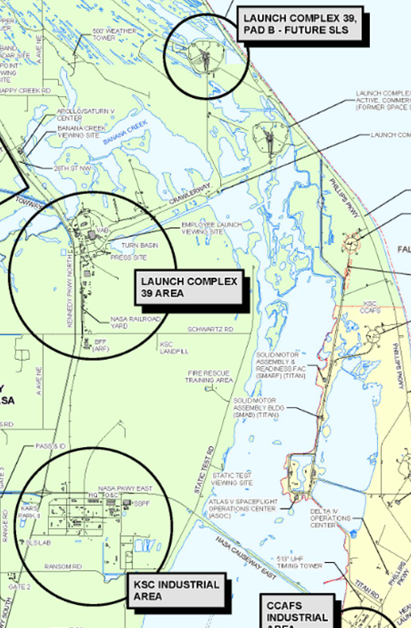
PWS Section 1. Contract Management
KSC Facility Management
  SIMO-managed facilities are grouped into the following geographical facility complex classes:
    CCSFS Industrial Area
    KSC Industrial Area
    Launch Complex 39 Area
    Launch Complex 39, Pad B - SLS
    Other (excludes the above classes)
  See Tech Exhibit 1.10-1, Facility Management Information

Slide 16
PWS Section 1. Contract Management
Facility Management (continued)
  Each SIMO-managed facility is provided with a Facility Management Level to assist in gauging the extent of facility management support required
  See PWS Section 1.10 for Facility Manager responsibilities
Facility Management Level
High | Typically daily support; higher occupancy or processing operations; higher work order level; typically critical infrastructure.
Medium | Typically lower occupancy level; lower support needed; may include critical infrastructure.
Low | Typically no occupants; often part of a larger complex with the main building tagged as high; minimal work orders throughout the year (e.g., signs, camera pads, culverts).

Slide 17
PWS Section 2. Work Management
Includes the major technical areas of work control, Maintenance Support Request (MSR) processing, and outage coordination and processing
Covers receipt, tracking, and processing of work requests
  Preventative maintenance, reactive maintenance, and operations
  MSR categories (e.g., MSR001 through MSR1000) on Table 2.2-1
  Response and completion requirements of various work types and priorities on Table 2.2-2
  Work prioritization, classification, and types, including approval requirements
  Outage coordination and processing requirements

Slide 18
PWS Section 2. Work Management
Engineering Service Request (ESR) Applicability
ESR Applicability by Work Type
Preventative Work:
PM
51%
PM-RI
6%
82%
PTI
2.0%
No ESR path
Reactive Work:
TC
22%
SR
8.0%
REP
5%
REP-PM
5%
SR-OPS
1%
Not ESR applicable 82%
ESR applicable 18%
PWS Table 2.2-2 note 5: an ESR is not a billable work type but to be used to track and manage workflows for NASA engineering’s support to parent work orders.
Applicable means the parent work order may need NASA engineering support.
Data based on work order Historicals released on August 18, 2026. Data is for informational purposes only, not intended for use by offerors as a bid approach and should not be construed as directing, restricting, or locking any bidding methodology.

Slide 19
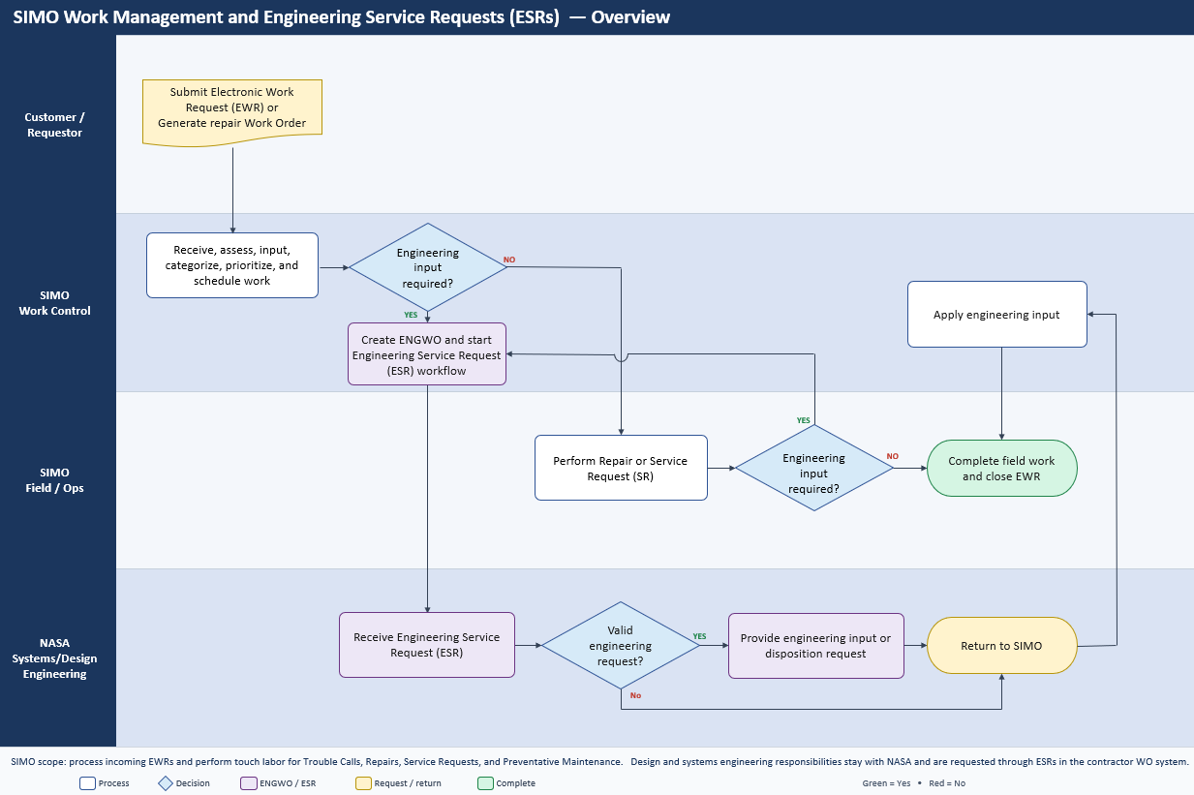
PWS Section 2. Work Management
ESR opened only when work needs NASA evaluation, analysis, or design, or a form/fit/function change to configured FSEU.
NASA provides ENG input.
SIMO applies it and completes field work.
82%
No ESR path
Not ESR applicable 82%
ESR applicable 18%
Data based on work order Historicals released on August 18, 2026. Data is for informational purposes only, not intended for use by offerors as a bid approach and should not be construed as directing, restricting, or locking any bidding methodology.

Slide 20
PWS Section 3. FSEU Maintenance and Operations (M&O)
PWS Section 3.0 contains global requirements in Section 3.1 and system specific requirements in Section 3.2
  Requirements in PWS Section 3.1 (and its subsections) apply to all specific systems in PWS Section 3.2
PWS Section 3.0
Operations
(24/7 and Recurring Support)
Preventative Work
(Maintenance)
• 24/7 support and other recurring support; examples include (not exhaustive):
• 24/7 support: Kennedy Complex Control System Console operations for control & monitoring, Utility Annex chilled water generation plant operations, Haulover Canal Bridge operations
• Recurring support: landfill, water distribution system, and wastewater collection system operations
• Associated with Core Work CLIN
• Required steps or actions to take when performing trouble calls, repairs, and service requests
• Work is executed via maintenance service requests and invoiced after completion
• Associated with MSRs CLIN
• Includes Preventive Maintenance (PM), Regulatory Inspections (RIs) and Predictive Testing and Inspections (PTIs)
• Work is executed via maintenance service requests and invoiced after completion
• Associated with MSRs CLIN
Reactive Work
(Trouble Calls, Repairs, Service Requests)

Slide 21
PWS Section 3. FSEU Maintenance and Operations (M&O)
Systems under SIMO (see Appendix J-01-01 for system descriptions):
Control and Monitoring
Fire and Protective
Power and Lightning Protection
HVAC and Compressed Air
  Industrial Operating Zone Building Automation System
  Payload Processing Facilities Building Automation System
  Kennedy Complex Control System
  System-Specific Control Systems
  Central Radio Monitoring Systems
  Enterprise Physical Access Control Systems
  Fire Alarm Systems
  Tornado Area Warning Systems
  Traffic Signaling System
  Emergency Power Plant
  High Voltage Sub Transmission
  Lightning Protection and Grounding Systems
  Low Voltage Distribution
  Medium Voltage Distribution
  UPS Systems
  Building HVAC Systems
  Industrial Area Chiller Plant
  Utility Annex Chilled Water Generation Plant
Transportation Infrastructure
Structures and Towers
Water Distribution
Elevators and Chairlifts
  Crawlerway
  Railroads and Bridges
  Waterways
Landfill, Borrow Pit,
and Disposal Services
Wastewater Collections
and Pre-Treatment
Facility Interiors and Exteriors
Heavy Equipment
Stormwater Infrastructure
Plumbing

Slide 22
PWS Section 4. Technical Support Services
Support Services: Configuration management; pressure vessel/systems management; activation and turnover; GIS, site planning, excavation, and survey support services; and information technology (IT)
  Support services also includes activation and turnover as well as site planning and surveying requirements
Information technology (IT) requirements are defined in part under PWS Section 4.6, and include, but are not limited to the following:
  Compliance with NASA IT requirements
  Operation and maintenance of software applications (see Tech Exhibit 4.6-1, SIMO Managed Applications)
  Develop and maintain contract deliverables within the Government portal
  Configuration, utilization, and maintenance of KSC’s Electronic Work Receipt System (EWRS)
  (see also PWS 2.1.1.3)
  Configuration, utilization, and maintenance of Maximo (Version 7.6) (see also PWS Section 2.1.1.2 and Tech Exhibit 4.6-1, SIMO Managed Applications)
    eCMMS deployment to Maximo Application Suite 9 planned September 2027
  Migration of BOSS legacy products to the SIMO responsible applications

Slide 23
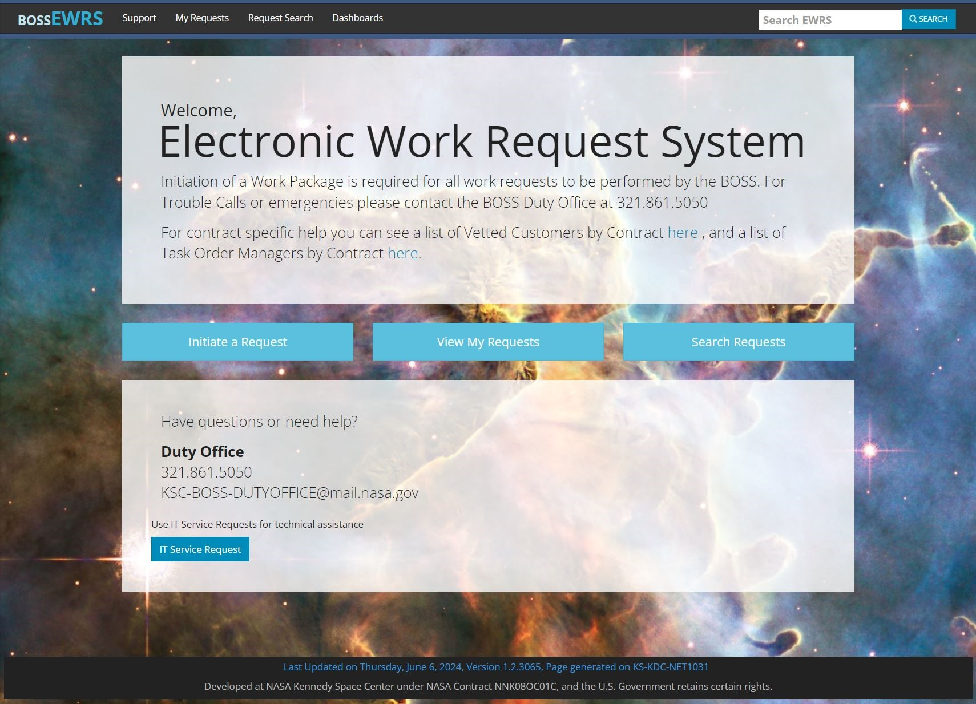
PWS Section 4. Technical Support Services
EWRS is KSC’s locally developed work electronic work receipt and approval system
  EWRS is web-based and accessible to the KSC workforce (including contractor employees working on NASA contracts)
  EWRS supplements the Duty Office
The SIMO Contractor and NASA will use EWRS to receive, assess, and approve work requests
Once approved, work is automatically sent to Maximo for tracking and recording work performed

Slide 24
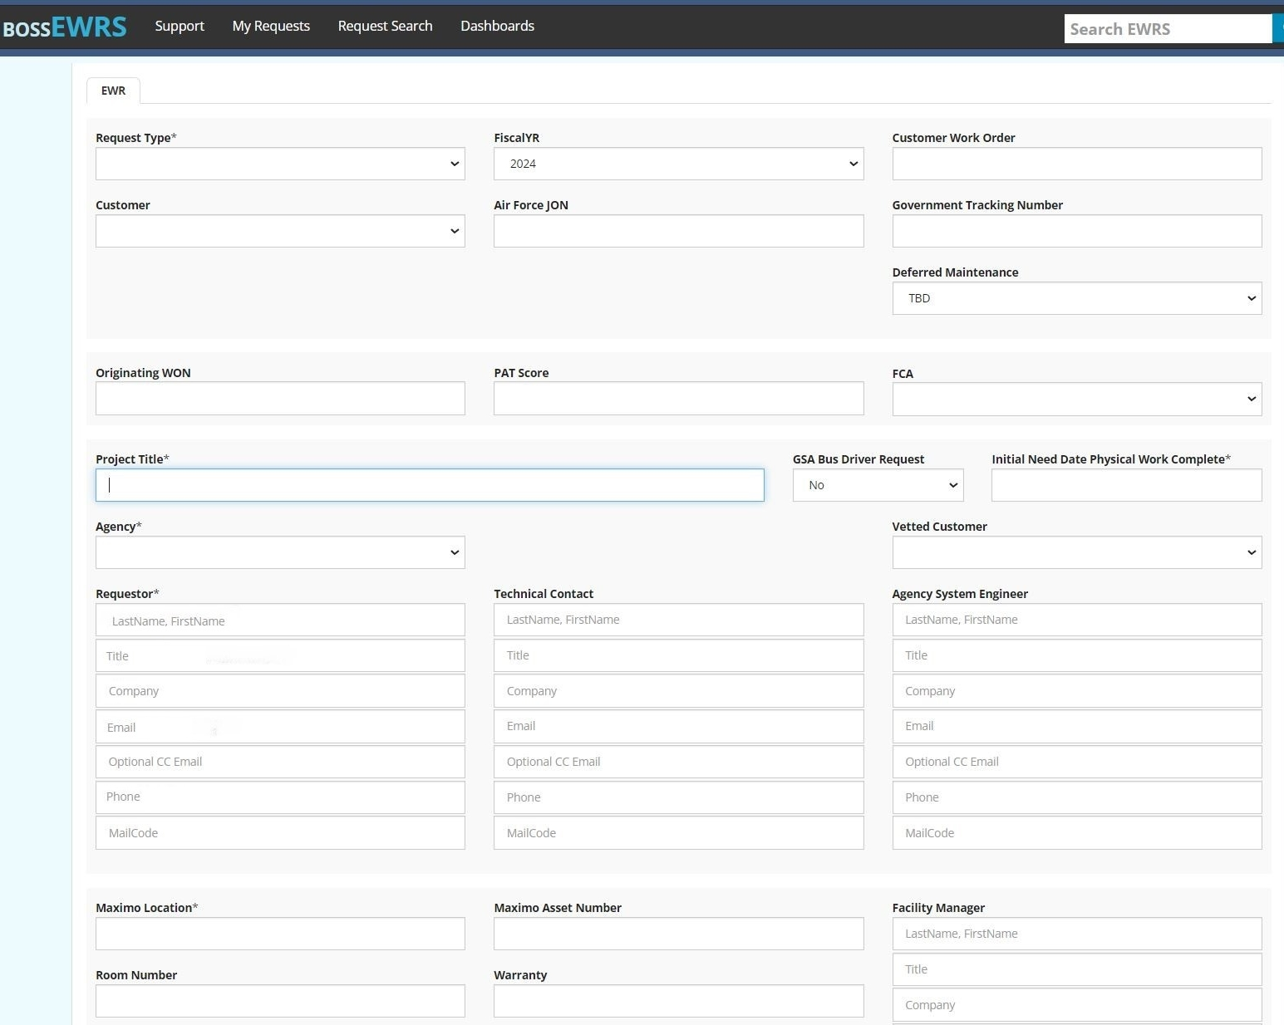
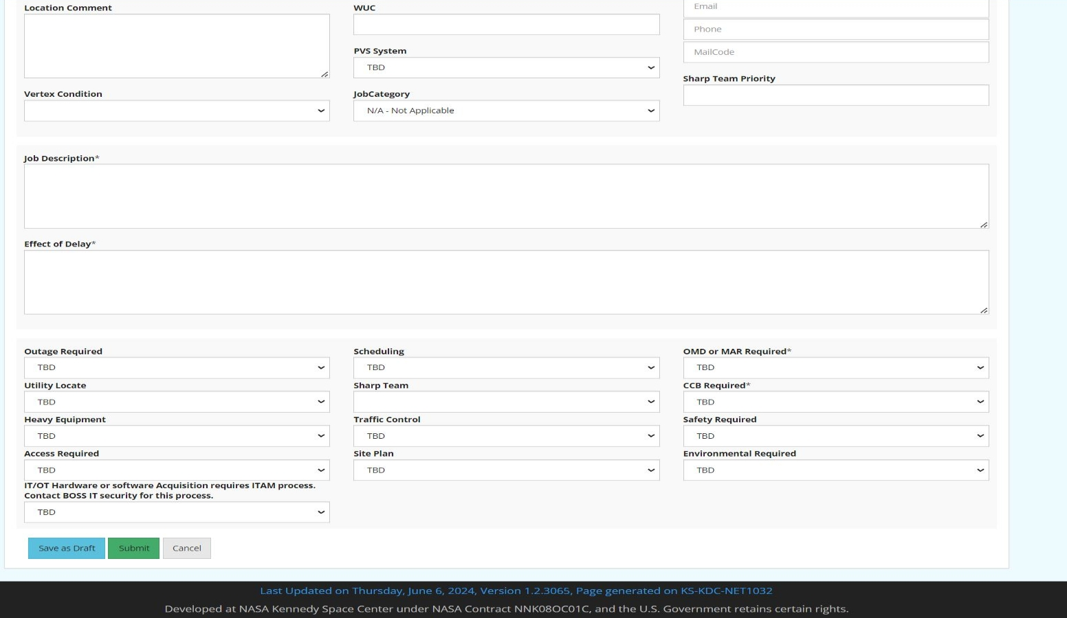
PWS Section 4. Technical Support Services

Slide 25
PWS Section 5. Enterprise Logistics Services
Enterprise Logistics Services Supporting Spaceport Customers
  General Logistics Services: Administrative functions to include establishment of procedures to ensure proper control, utilization and maintenance of Government property provided to support SIMO operations, and appointment of Property Custodians
  Property Management (Supply and Equipment): Receiving, cataloging, equipment control and classification, tagging, supply and material inventory level management, warehousing, property transfers, physical equipment inventory, and physical supply and materials inventory
  Property Disposal: Pick-up, removal, transportation, storage, sale preparation activities, reutilization activities, and demilitarization activities of excess Government property
  Transportation Management: Fleet vehicle management, fleet preventive maintenance, fuel distribution, bus services, packaging and crating, freight processing, shipping, intra-center deliveries, and hazmat transports
Note: Enterprise logistics excludes logistics support to enable completion of Maintenance Support Requests (e.g., material and equipment purchasing, equipment control, receiving, delivery, and associated labor (to include heavy equipment support))

Slide 26
PWS Section 6. Exploration Ground Systems (EGS) Program M&O
Operational Support (Core Work CLINs)
  Provide an EGS Primary and Alternate Operations Interface Contacts. Responsibilities are in PWS Section 6.1.1 which includes the requirement to integrate all SIMO operational support activities with NASA and other Associate Contractors to ensure Program operations milestones and launch support requirements are met
Maintenance Service Request Support (MSRs CLIN)
  Provide support for all phases of EGS Operational Activities that includes planning, integration, processes, procedures, facility readiness, and training
  Provide planners to track requested support for all SIMO support in processing in EGS facilities and attend the daily facility scheduling meetings and work with NASA Flow management to generate work orders in support of EGS operations
  Support multi-shift operations as needed
  Note: During Artemis launch operations, the SIMO Contractor will also be required to provide contingency M&O support (i.e., standby) through launch countdown via IDIQ (see PWS Section 7 and Attachment J-05, Pre-priced IDIQ Work Catalog for more information)

Slide 27
PWS Section 6. Exploration Ground Systems (EGS) Program Tech Support
Technical Support (Core Work CLINs)
  Perform technical support of contingency M&O and other necessary technical support on systems used to support Contingency Crew, Red Crew and Pad Re-entry team operations.
    Obtain training and required certifications to enter the pad during a launch count to resolve any out of configuration facility systems before and after vehicle fueling.
  Provide technical support to aid in quick response to work stoppages, non-conformances, emergency or unscheduled outages and anomalies during EGS Operational Activities
Provide a reentry team to immediately assess and safe systems at the Pad post launch. Support to be coordinated with NASA Test Management/Launch Director.

Slide 28
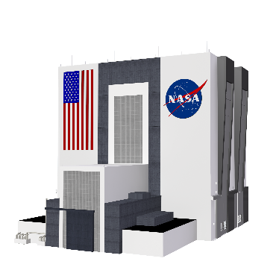


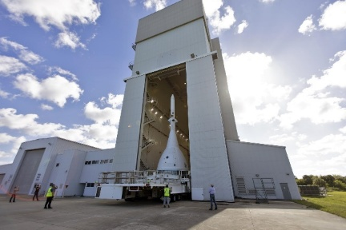
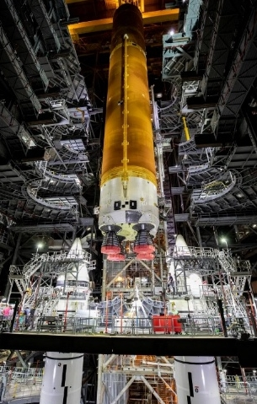
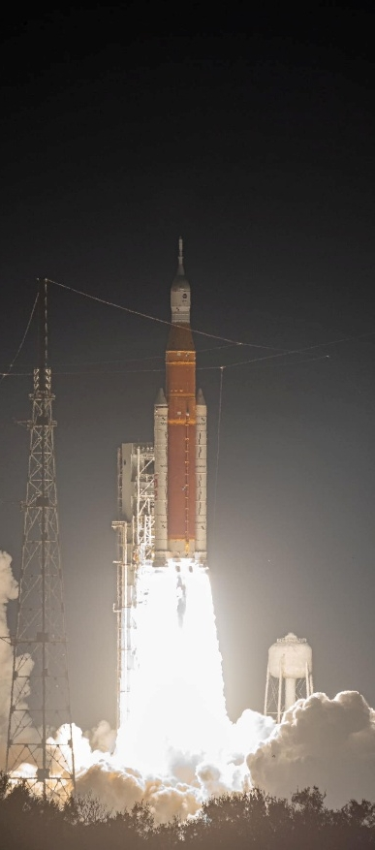


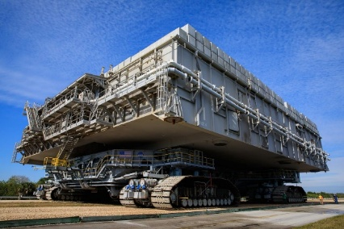
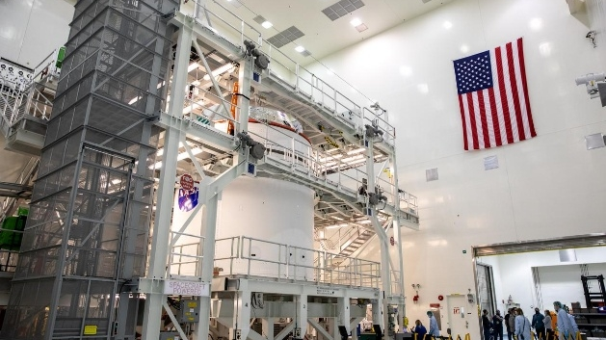
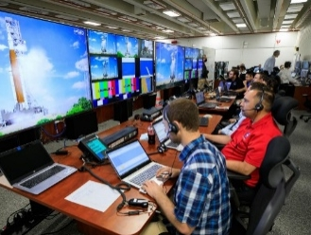


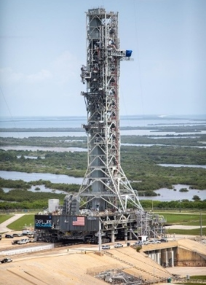
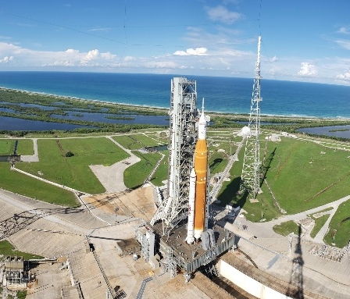

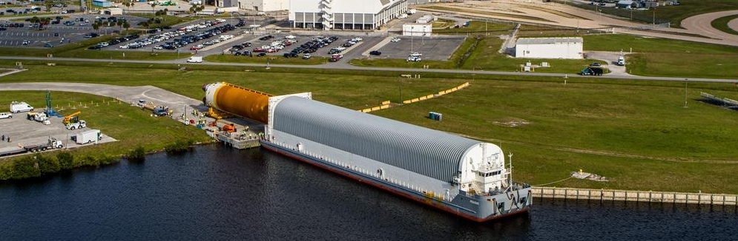



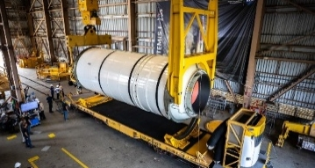



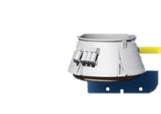
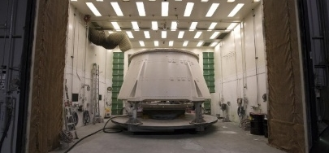
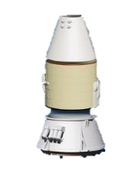
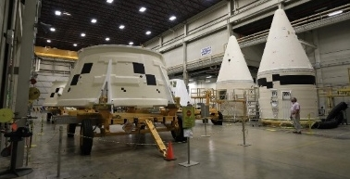
SIMO Facility M&O in Support of the Artemis Program
Vehicle Integration and Launch
LAUNCH ABORT SYSTEM (LAS)
Liftoff
Transfer Elements to
Vehicle Assembly Building
LAS OGIVE
FAIRING
CREW
MODULE
Launch Abort System Facility
Offline Spacecraft Processing
Command & Control
SERVICE MODULE
ORION STAGE ADAPTER
Crawler Transporter 2
Transport to Pad
Vehicle Assembly Building High Bay 3 and High Bay 4
INTERIN
CRYGENIC
PROPULSION
STAGE (ICPS)
Multi-Payload Processing Facility
Communication Range & Firing Room
LAUNCH
VEHICLE
STAGE
ADAPTER (LVSA)
CORE STAGE
Turn Basin
Mobile Launcher
Launch Pad 39B
Solid Rocket Booster Processing
Landing and Recovery (No direct SIMO support)
SOLID
ROCKET
BOOSTERS
Jay Jay Bridge
Railcar to Rotation Surge & Processing Facility
Space Launch System Manufacturing
RS-25 Engines
Booster Fabrication Facility
Crew Module Landing
Crew Module & Crew Recovery
Hangar AF
Booster Fabrication Facility

Slide 29
PWS Section 7. IDIQ
General Overview
  Supports all customers identified in Tech Exhibit 1.2.1-1, Customer Identifiers
  Work includes supplies or services within the scope of the contract
    See PWS Sections 1 through 6
    See other work tasks defined in PWS Section 7
      Including engineering support services, as required, to support operations at WFF
  Compliance documents, qualifications, and performance standards apply to IDIQ work

Slide 30
Section B. Supplies or Services and Prices/Cost
Section B Clause, Supplies and/or Services to be Provided
  Contract Line Item Numbers (CLINs)
    Core Work
    Non-Proposed Other Direct Costs (ODCs)
    Maintenance Support Requests (MSRs)
    IDIQ Work
  MSRs will be discussed in subsequent charts

Slide 31
CLIN Structure by Contract Type
Section B Clause, Supplies and/or Services to be Provided (continued)
SIMO Contract
Core Requirements
IDIQ Requirements
Core Work CLINs
Firm Fixed Price
Non-proposed ODCs CLINs Reimbursement
MSRs CLIN
Firm Fixed Price
IDIQ Work CLIN
Firm Fixed Price
Center
Operations
Center Logistics
Services
Non-proposed
Other Direct Cost¹
Maintenance
Support Requests²
KSC/WFF Discrete Task Order Work^{3,4}
¹Non‑proposed other direct cost (ODCs) are non-fee bearing cost that are not subject to G&A expenses, overhead, profit or any other direct or indirect cost. Non-proposed ODCs include materials; services (e.g., maintenance agreements); Government-directed travel; and fuel.
²Standing or single task order (all customers)
³Standing or single task order by customer
⁴Specific task order requirements to be defined

Slide 32
Section B. Supplies or Services and Prices/Cost
Section B Clause, Non-proposed Other Direct Costs (ODCs)
  Includes:
    Materials: consumed or incorporated in Core and MSRs (spares, parts, assemblies, supplies). Not equipment, special tooling, special test equipment, real property, or hand/power tools.
    Services: maintenance agreements and software licenses in Appendix J-01-02, Tech Exhibit 4.6-1; emergency ride-out support and special pay during Center closures (Government approval); Government-directed subcontracting.
    Fuels: for generators, vehicles, and mobile equipment used on Core and MSRs. Excludes fuel for commercial buses.
    Government-directed travel and subcontract work
    Office supplies (NASA only)
    Bottled water (NASA only)
  Excludes:
    ODCs necessary to implement the Offeror’s technical or management approach
    Materials (e.g., spares, parts, assemblies, and supplies) to repair GFP assigned to SIMO and corporate-owned property

Slide 33
Section B. Supplies or Services and Prices/Cost
Section B Clause, Maintenance Support Requests (MSRs)
  MSRs are used to perform:
    Preventative work (e.g., Preventive Maintenance (PMs), Regulatory Inspections (RIs), and Predictive Testing and Inspection (PTIs))
    Reactive work (e.g., Trouble Calls, Repairs, Service Requests, Service Request for Operations)
  MSRs use craft hour ranges to categorize work, and categories selected are based on historical “Craft Labor” hours
    Craft labor refers to maintenance and operations personnel responsible for day-to-day operations and hands-on performance of preventative or reactive work (excludes professional, executive, and administrative classes of employees)
    The Contractor is responsible for accurately estimating work requests (i.e., identifying the appropriate MSR category) and associated materials
    See Attachment J-01, Performance Standard No. 24

Slide 34
Maintenance Support Request (MSR) Overview
Section B Clause, MSRs (continued)
MSRs are discrete, fixed‑price work efforts categorized by the estimated craft labor hours needed to perform the work
  MSR categories are based on historical craft labor hours incurred (RDT has released historicals to industry (approx. 230K work orders))
  MSR pricing includes craft labor plus the Contractor’s supporting resources (e.g., work control, management)
  SIMO Contractor will be responsible for accurately identifying the appropriate MSR category
Average work orders (approx.) per year: 32K
  Approx. 90% required fewer than 20 hours to complete
  Approx. 50% split evenly across MSR004 and MSR008
Work Category | Direct Craft Labor Hours |  | Valid Work Types
 | > | <=
MSR001 | 0 | 1 | Trouble Calls Repairs Service Requests Service Requests for Operations Preventive Maintenance Regulatory Inspection Predictive Testing and Inspection
MSR002 | 1 | 2
MSR004 | 2 | 4
MSR008 | 4 | 8
MSR020 | 8 | 20
MSR050 | 20 | 50
MSR100 | 50 | 100
MSR200 | 100 | 200
MSR300 | 200 | 300
MSR400 | 300 | 400
MSR500 | 400 | 500
MSR600 | 500 | 600
MSR700 | 600 | 700
MSR800 | 700 | 800
MSR900 | 800 | 900
MSR1000 | 900 | 1000

Slide 35
Maintenance Support Request (MSR) Overview
Section B Clause, MSRs (continued)
Offerors shall propose a MSR price for each work category
MSR pricing includes:
  Craft labor cost for hours proposed within each work category
  Program Management Office (PMO) cost allocation
  Support Labor cost allocation
  Other Cost Elements allocation
MSR pricing excludes requirements and pricing covered by or under other CLINs
Work Category | Direct Craft Labor Hours |  | Valid Work Types
 | > | <=
MSR001 | 0 | 1 | Trouble Calls Repairs Service Requests Service Requests for Operations Preventive Maintenance Regulatory Inspection Predictive Testing and Inspection
MSR002 | 1 | 2
MSR004 | 2 | 4
MSR008 | 4 | 8
MSR020 | 8 | 20
MSR050 | 20 | 50
MSR100 | 50 | 100
MSR200 | 100 | 200
MSR300 | 200 | 300
MSR400 | 300 | 400
MSR500 | 400 | 500
MSR600 | 500 | 600
MSR700 | 600 | 700
MSR800 | 700 | 800
MSR900 | 800 | 900
MSR1000 | 900 | 1000

Slide 36
Section B. Supplies or Services and Prices/Cost
Section B Clause, IDIQ Discrete Task Orders
  Clause enables the Government to support all Customers under the contract
  There are three methods for pricing task orders to facilitate rapid placement of work
    Attachment J-05, Pre-Priced IDIQ Work Catalog — primary method of ordering Discrete IDIQ work. Each catalog price is fully burdened (labor, G&A, overhead, profit/fee, tools, equipment, vehicles, fuel, training, internal processes). No add-on G&A, overhead, or profit on the order.
    Attachment J-06, Fully Burdened IDIQ Rates — one fully burdened rate per Government Standard Labor Category. No add-on G&A, overhead, or profit on the order. Non-proposed ODCs remain on its respective CLIN.
    Negotiation and issuance of task orders. Section H clause Task Ordering Procedure also allows fully negotiated pricing when the CO determines J-05 will not produce a fair and reasonable price.
  Contract type for all IDIQ work is fixed price
  IDIQ minimums and maximums apply to MSRs and Discrete IDIQ Work combined and are period-specific. The Total Maximum under this contract is $1.2B.

Slide 37
Section C. Description/Specifications/Statement of Work
Data Requirements List/Data Requirements Description (DRD)
  See Appendix J-01-04, Data Requirements List: 60 DRDs
  Contractor to upload DRDs to the Government Contract Management Portal (except as noted)
  See provision Contract Phase-in for DRDs required during contract phase-in

Slide 38
Section F. Deliveries or Performance
Performance
  The performance for SIMO is 8 years as follows:
    Base period: April 1, 2027, to September 30, 2028
    Option 1: October 1, 2028, to September 30, 2030
    Option 2: October 1, 2030, to September 30, 2032
    Option 3: October 1, 2032, to September 30, 2034
    Option 4: October 1, 2034, to March 31, 2035
  Note: A phase-in approximately 45 days will precede the base period

Slide 39
Section G. Contract Administration Data
Payment and Submission of Invoices
  Invoice Content and Format: Include price per customer/category and CLIN details; submit all invoices per NFS 1852.232‑8, Submission of Vouchers/Invoices for Payment, and the following:
The price per Customer (current and cumulative) and reporting category shall be included with all invoices.
  Monthly Invoicing by CLIN Type: Core Work billed monthly on a 1/12th basis; ODCs billed at actual cost (See also Section G., Payments Under Non-Proposed ODCs CLINs); MSRs and IDIQ task orders billed monthly based on completed pre‑priced items, completed MSRs, or accepted negotiated work.
  Required Excel Support File: Submit a native‑format Excel file showing all data and calculations that reconcile with vouchers sent to the NASA billing office.

Slide 40
Section G. Contract Administration Data
NFS 1852.245-77 List of Government Property Furnished Pursuant to FAR 52.245-2
  See Attachment J-10, Government Furnished Property (GFP)
  GFP will be provided for initial provisioning only
  The Government is not responsible for repair or replacement
  Offerors shall assume that GFP is in working order at the time of contract start (see section G clause)
Property
  Includes a “Right to Purchase” requirement that directs the Contractor to make corporate-owned contract property available to the Government or successor contractor for purchase at the existing net book value
  The “Right to Purchase” requirement is available to the SIMO awardee during phase-in (see Attachment L-03, Corporate-owned Contract Property)
  Refer to Property clause within section G

Slide 41
Section H. Special Contract Requirements
Task Order Procedure
  Authority and Costs: Only the Contracting Officer (CO) may issue task orders, and contractor costs must align with authorized task orders. Task order requirements always prevail over the task plan.
  Initiation and Scoping: Either party may initiate a request in EWRS; contractor provides a scoping agreement and conducts a joint site walk‑down within 5 days. Scoping outlines purpose, objectives, scope, constraints, schedule, and risks.
  Task Plan and Competition: Contractor submits a task plan with technical approach, performance, pricing, and subcontract competition documentation. Includes a Gantt schedule, labor breakdown, and walk‑down with subcontractor when applicable.
  Pricing and Issuance: Pricing follows Attachment J‑05, Pre-Priced IDIQ Work Catalog, unless fully negotiated; CO issues a task order with scope, standards, funding, resources, and schedule. Contractor acknowledges in 1 business day, and CO may amend or issue ceiling-price/pre‑priced orders as needed.

Slide 42
Section I. Contract Clauses
NFS 1852.204-75 Security Classification Requirements
  Performance under SIMO will involve access to and/or generation of classified information, work in a security area, or both, up to the level of Secret
  Application for security clearance shall be submitted during contract phase-in
  See FAR 52.204-2 Security Requirements and Attachment J-15, DD Form 254, Contract Security Classification Specification

Slide 43
Section I. Contract Clauses
AbilityOne Subcontracting
  The Contractor shall utilize services provided by AbilityOne nonprofit agencies that employ people who are blind or have significant disabilities to the maximum extent practicable
  At least one percent (minimum requirement) of the total dollars obligated against this contract shall be utilized for services provided by AbilityOne nonprofit agencies
  To assist contractors in finding qualified AbilityOne nonprofits, contact primecontractor@abilityone.org

Slide 44
Section J. List of Attachments
The following attachments will be populated by the Government from the Offeror’s proposal:
  Attachment J-03, Contract Schedule Tables
  Attachment J-05, Pre-Priced IDIQ Work Catalog
  Attachment J-06, Fully-Burdened IDIQ Rates
  Attachment J-07, Position Descriptions and Qualifications
  Attachment J-17, Small Business Subcontracting Plan
The following attachments will be populated by the Government during phase-in using DRDs and other information submitted by the Contractor:
  Attachment J-16, Safety and Health Plan
  Attachment J-18, Organizational Conflicts of Interest Avoidance Plan

Slide 45
Section J. List of Attachments
Attachment J-10 Government Furnished Property
  Except as provided in Attachment J-10, GFP, it is the Offeror’s responsibility to provide heavy equipment, equipment, vehicles, and other ODCs necessary to implement its approach
  Tech Exhibit 3.1-2 FSEU Asset Reference List, lists heavy equipment and vehicles that the SIMO Contractor will maintain for customers; however, these assets are not available for Contractor-use as GFP

Slide 46
Section L. Instructions, Conditions, and Notices to Offerors or Respondents
Refer to Draft RFP Section L for proposal preparation and submission instructions
Contract Phase-in
  Contract phase-in shall not exceed 45 days
  Contract phase-in activities shall be performed at KSC
    Approximately 1,200 square feet of office space will be provided
    Facility M7-0351, Auditorium and Training Building may be used for road-shows, town-halls, and briefings, based upon availability
  See section L provision "CONTRACT PHASE-IN" paragraph (e) for list of DRDs required during contract phase-in

Slide 47
Section L. Instructions, Conditions, and Notices to Offerors or Respondents
Electronic Submission of Proposals–Proposal Marking and Delivery through NASA’s EFSS Box
  Proposals must be submitted via NASA’s Enterprise File Sharing and Sync Box (EFSS Box)
  Subcontractors may submit their required proposal information separately to EFSS Box
  Offerors are encouraged (but not required) to:
    Provide notice of intent to submit a proposal at least 48 hours prior to the intended submission date
    Coordinate the submission of a test file with the Contracting Officer no less than 5 days in advance of the proposal due date specified in the solicitation to allow time to work through any submission issues

Slide 48
Section L. Instructions, Conditions, and Notices to Offerors or Respondents
List of Section L Attachments
  Attachment L-04, Past Performance Questionnaire
    Questionnaires are not required for the Offeror's or its major subcontractor's prime contracts that are listed in CPARS.
  Attachments L-05, Fixed Price Template and L-06, SubK-Hourly FBLR Details Template
    Attachment L-05, Fixed Price Template summarizes the Offeror’s proposed cost/price by contract line item number (CLIN) and contract year and pulls data from various worksheets. It also shall represent the Offerors fully integrated pricing strategy, to include all subcontractor(s). This workbook shall encompass the total proposed price for all CLINs including IDIQ work task pricing and fully burdened IDIQ labor rates
    Attachment L-06, SubK-Hourly FBLR Details Template, The Offeror’s subcontractor is required to complete and submit this proposal template
    Offerors shall comply with all General Instructions listed within the instructions tab for these templates

Slide 49
Past Performance
Past Performance Overview
Submit up to 4 efforts for the Offeror and 2 each for major subcontractors (max 10 total).
Must be recent (after Oct 1, 2021).
Must be similar in size, content, and complexity to SIMO.
Identify PWS sections (X.X) each entity will perform.
Joint Ventures
JV may submit up to 4 total efforts (combined).
Newly formed JVs may use partner past performance (still max 4).

Slide 50
Past Performance
Affiliate / Parent Company Past Performance
  Government may consider affiliate past performance only if the affiliate will participate meaningfully in contract performance (excludes phase‑in).
  Must provide:
  • Resources the affiliate will provide, mapped to PWS third‑level (X.X.X) requirements.
  • Narrative showing meaningful involvement, describing how affiliate resources directly affect contract execution.
  • Signed letter of commitment for any workforce or resource support.
  General statements such as “resources will be available” are not sufficient.

Slide 51
Section M. Evaluation Factors for Award
Refer to Draft RFP Section M for evaluation factors and evaluation criteria
Acquisition Schedule:
  RFP release: On or about October 28, 2026
  Proposal due date: On or about December 7, 2026
  Targeted award date: On or about February 11, 2027
  Phase In Period: 45 days from award
  Contract start: April 1, 2027

Slide 52
Tour Logistics
Tour consists of stops in the Industrial Area and the Launch Complex 39 Area, including a lunch break
  Tour includes a subset of facilities that will be maintained under the SIMO contract and is not all-inclusive
All participants will be bussed to the tour locations; attendees are not permitted to drive their own vehicles
  KSC is a controlled area, and tour participants must be escorted at all times
  Attendees are required to remain with the tour from start to finish
  Photo identification will be required to board the bus
  Participants must leave personal items on the bus upon exiting for facility tours
Notecards will be available for participants to fill out and submit to the SEB Representative on the bus. The submitted questions and Government responses will be posted on https://sam.gov.

Slide 53
Tour Logistics
Dress code requirements
  Shoes must cover the entire foot (socks and sneakers are recommended)
  No high heels, ballet shoes, or sandals/slippers
  Full-length trousers, slacks, or jeans are required
  Shorts, capris, dresses, or skirts are prohibited
  No skin should be showing below the waist
  Short-sleeved shirts are permitted
  Sleeveless shirts and mesh shirts are prohibited

Slide 54
Tour Logistics
Attendees may be required to climb up and down stairs, walk distances, and be aware of surroundings to avoid hazards (e.g., tripping hazards of work areas) since the tour will include active work locations
  Personal Protective Equipment will be provided if needed
Photography is prohibited and will result in removal from the tour if not followed
Be aware of all announcements and directions as tour stops may include facilities in areas of high hazards
In the event of an emergency evacuation from the facility, follow tour POCs to the marshalling areas
Inclement weather may affect tour stops

Slide 55
Closing Remarks
Industry Day Reminders
  Potential Offerors should monitor https://sam.gov and https://www.nasa.gov/kennedy/seb/simo/ for updates
  RFP release: On or about October 28, 2026
  The RFP, when released, is the only document that should be relied upon in determining whether or how to satisfy SIMO requirements
Potential Offerors and interested vendors are encouraged to register on the interested vendors list (see Notice ID 80KSC027R0001 under https://sam.gov)
Please proceed toward the bus for departure around 10:00 a.m.

Slide 56
Thank you for attending!

Slide 57
Importance of Safety and Health at KSC
Safety is essential to NASA and is a material part of this contract
  KSC Contractors must protect the public, astronauts, pilots, NASA and the contractor workforce, tenants, partners, hardware, equipment, property, and the environment from potential harm resultant of Contractor activities and operations
  All KSC organizations are expected to develop and implement activities that strengthen and support their safety culture
  The SIMO Contractor will consistently undertake hazardous activities, including working with high voltage systems, working at heights, using heavy equipment, and maintaining high pressure systems
    Successful management of these risks is a challenging and integral part of KSC’s safety efforts
  The SIMO Contractor is responsible for the safety and health of their entire workforce, including its sub-contractors

Slide 58
Importance of Safety and Health at KSC
Mishaps/close calls
  All mishaps and close calls (“near misses”) are expected to be reported and investigated
  Root cause(s) will be identified and corrective and preventative actions implemented before closing out investigations
  The SIMO Contractor is responsible for their sub-contractors’ investigation and close out of close calls and mishaps

Slide 59
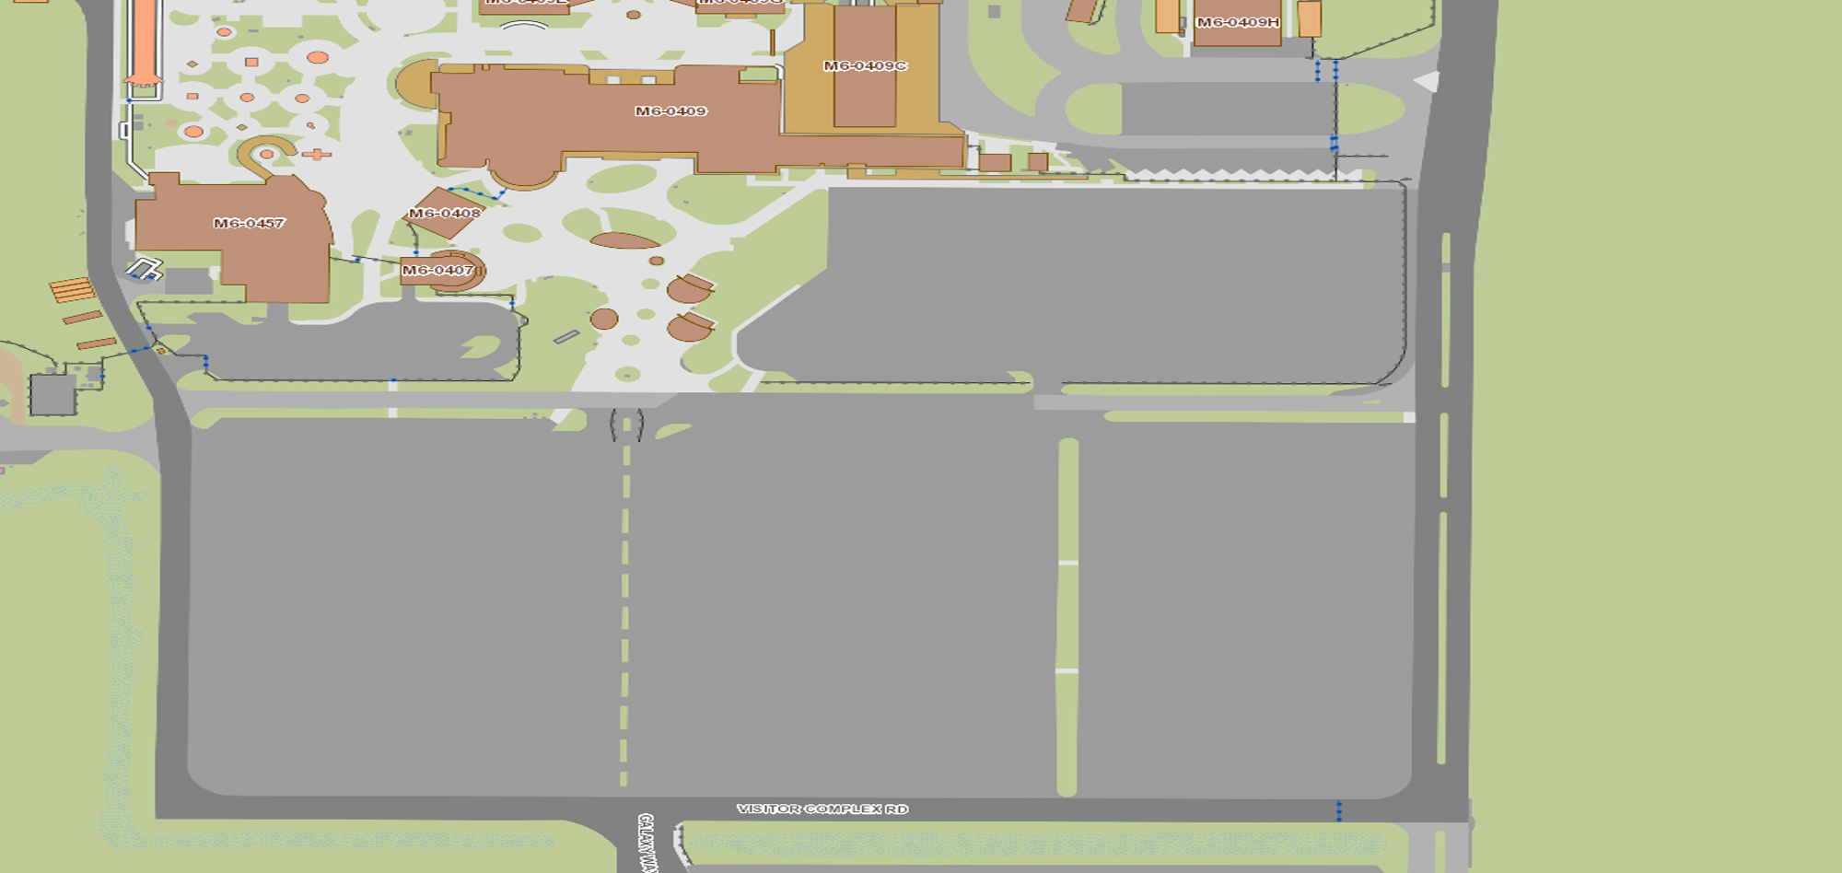
KSC Visitor Complex – Parking and Check-In
Enter KSC Visitor Complex through the employee entrance off SR 405. Show parking placard at the guard gate
Park in Lot #4
Check in at picnic tables just north of Lot #4.
You must show government issued ID to check in.
After check-in, please board the bus.
Employee Entrance
Main Gate
Picnic tables
Bus
Bus
PARKING LOT 4
VC Main Entrance
Path

Slide 60
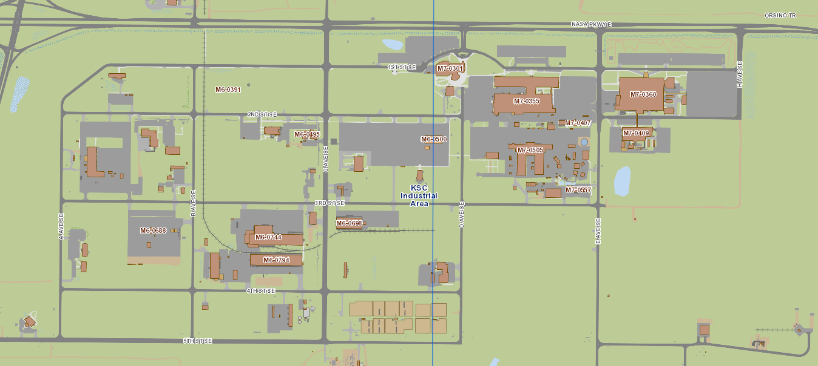
Industrial Area
Central Campus
Training Auditorium
O&C
SSPF
Base Support Facility
Central Supply
Orsino
Bus Path
Tour Stop

Slide 61
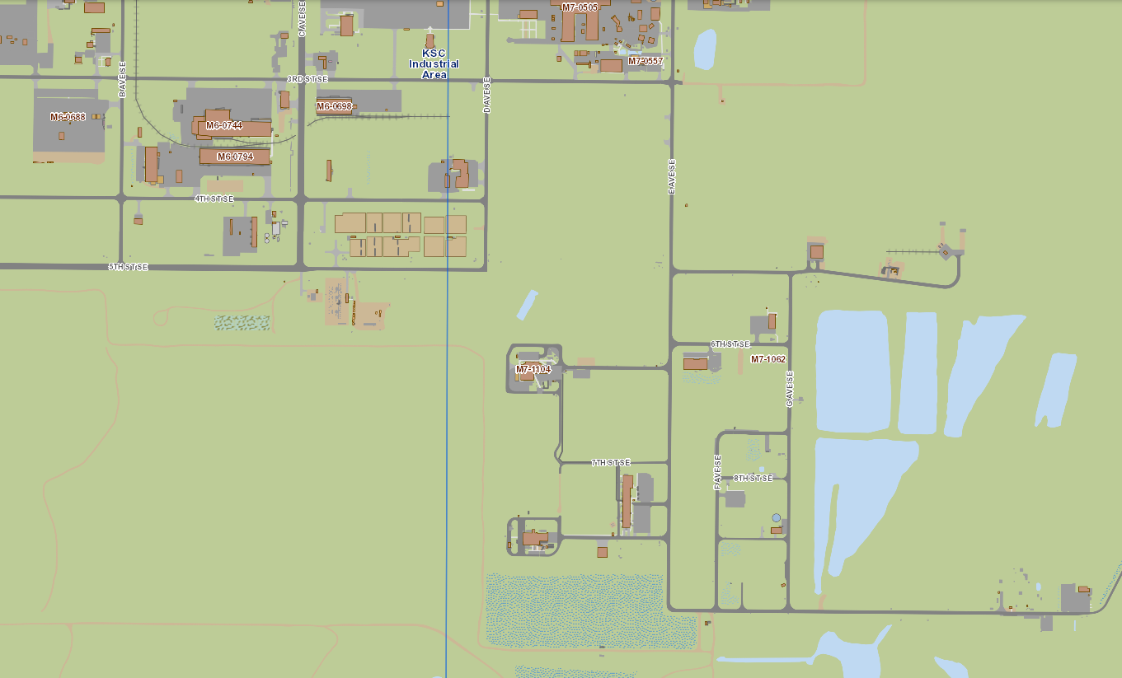
Industrial Area – MPPF, MOSB, and PHSF
Central Supply
Orsino
MPPF
MOSB
PHSF
Bus Path
Tour Stop

Slide 62
Industrial Area Chiller Plant
O&C
IACP
Bus Path
Tour Stop

Slide 63
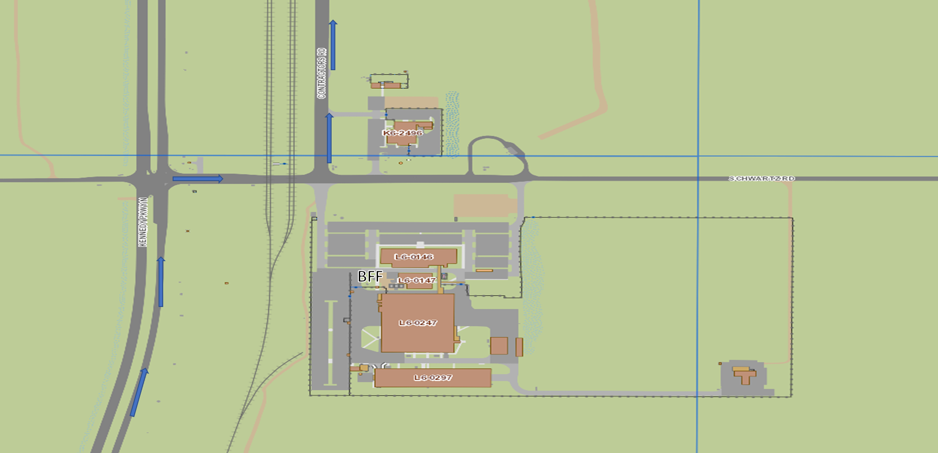
Launch Complex 39 Area - Booster Fabrication Facility (BFF) Complex
Bus Path
Tour Stop

Slide 64
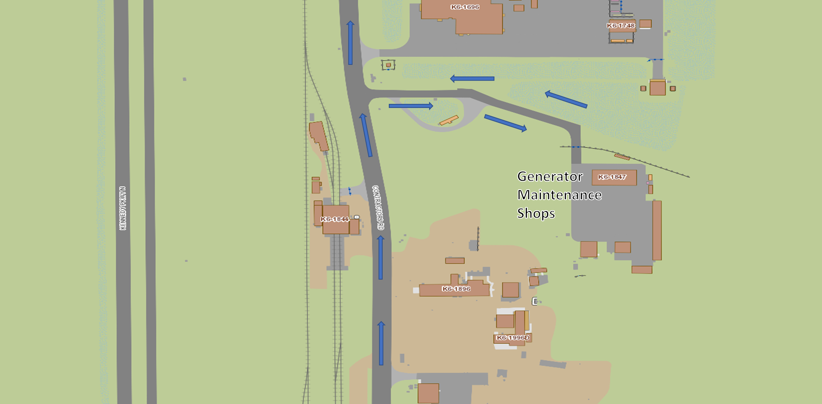
Launch Complex 39 Area - Generator Maintenance Facility
Bus Path
Tour Stop

Slide 65
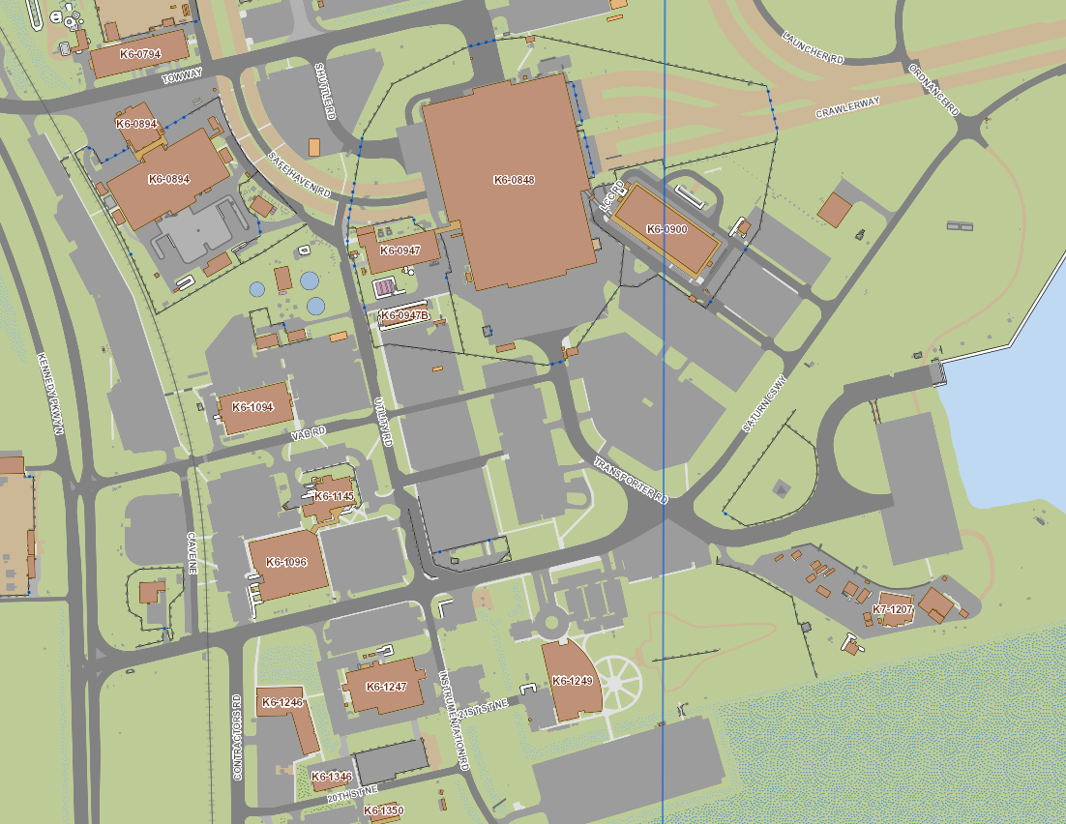
Launch Complex 39 Area
ML1
Utility Annex
VAB
LCC
Utility Shops Facility
Bus Path
Tour Stop

Slide 66
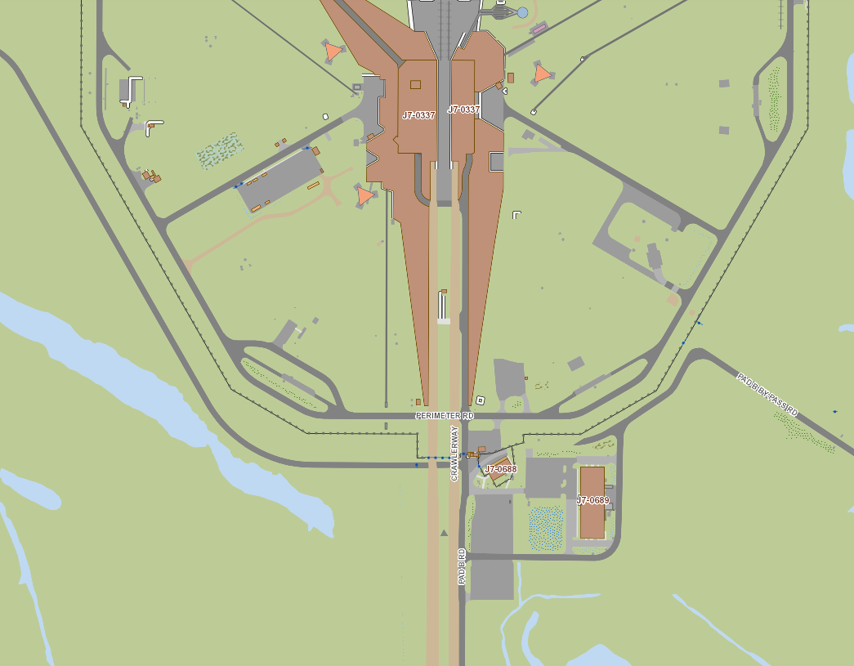
Launch Complex 39, Pad B
Launch Complex 39B
Bus Path
Tour Stop

Slide 67
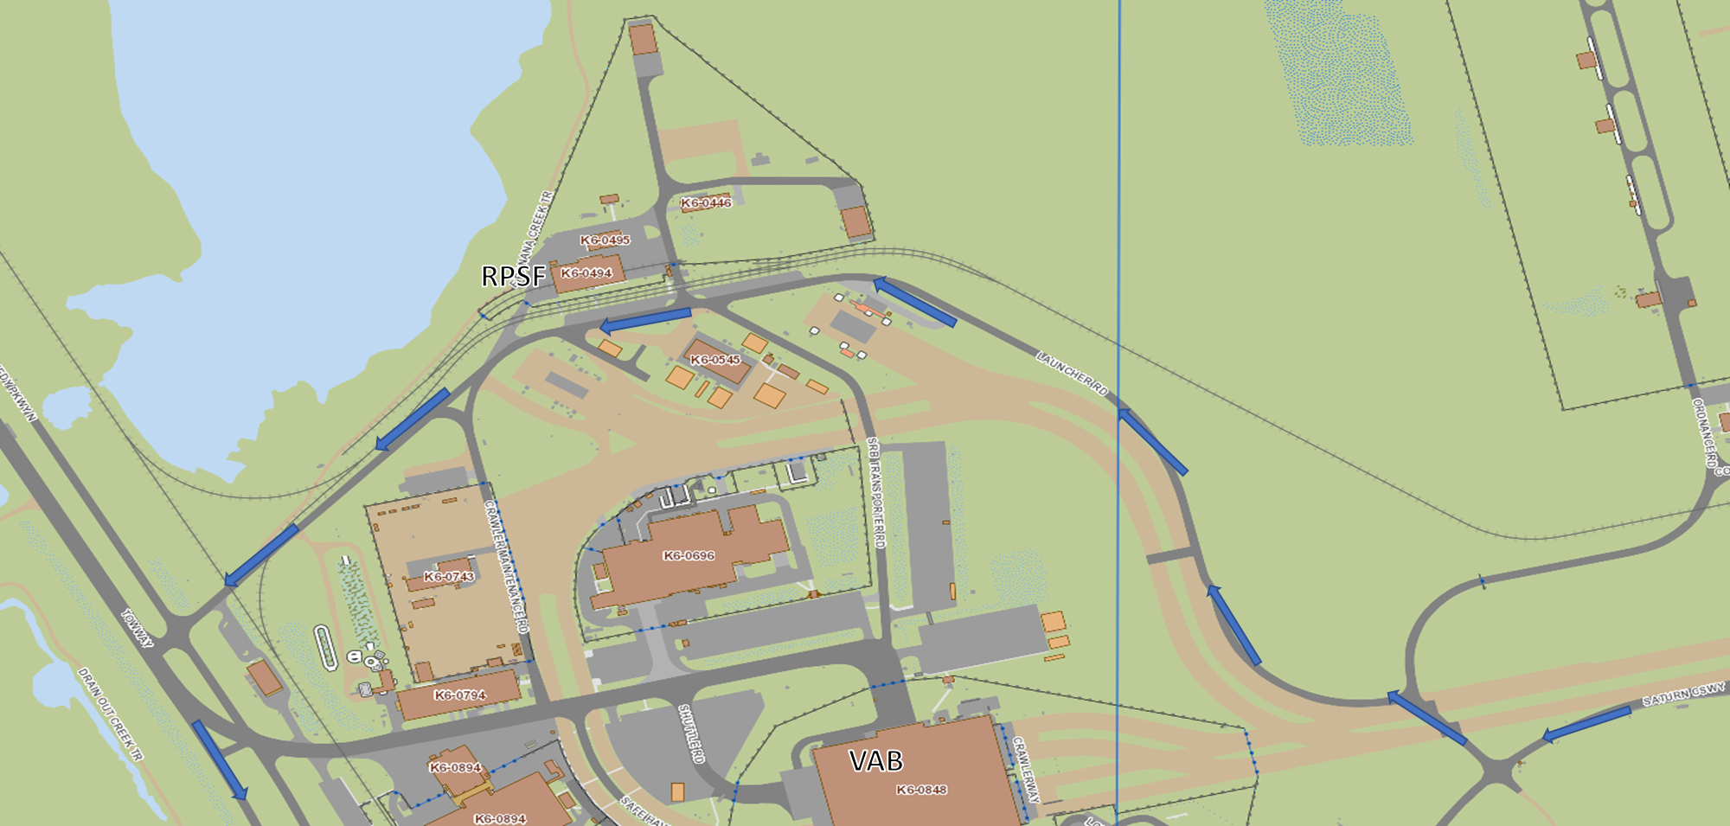
Launch Complex 39 Area - Rotation, Processing, and Surge Facility (RPSF)
Bus Path
Tour Stop

Slide 68
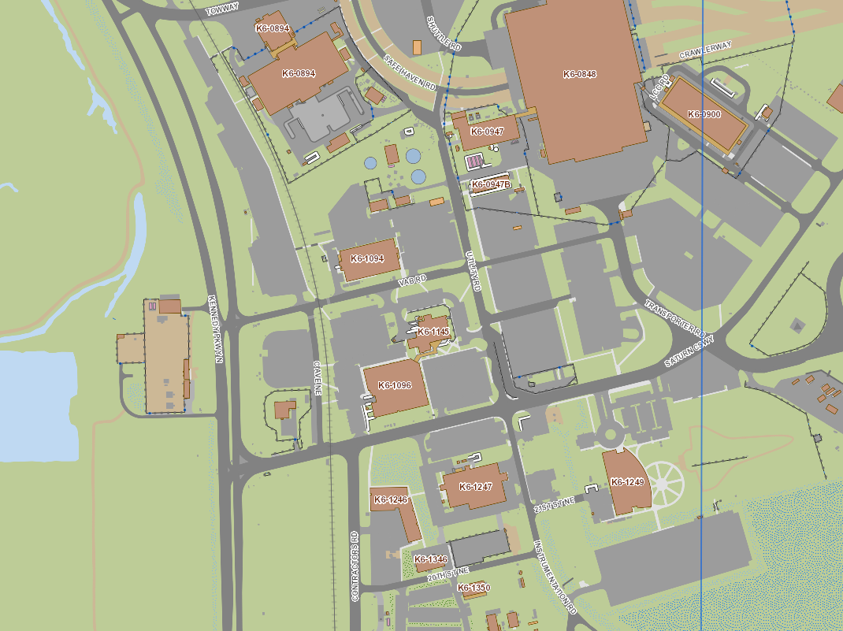
Launch Complex 39 Area - C5 Substation/Emergency Power Plant (EPP)
VAB
C5 Substation
Back to Training Auditorium
Bus Path
Tour Stop

