Slide 1
Flight Log Cover

Slide 2
Beach Scene Coloring Page

Slide 3
Flight Log Entry Page

Slide 4
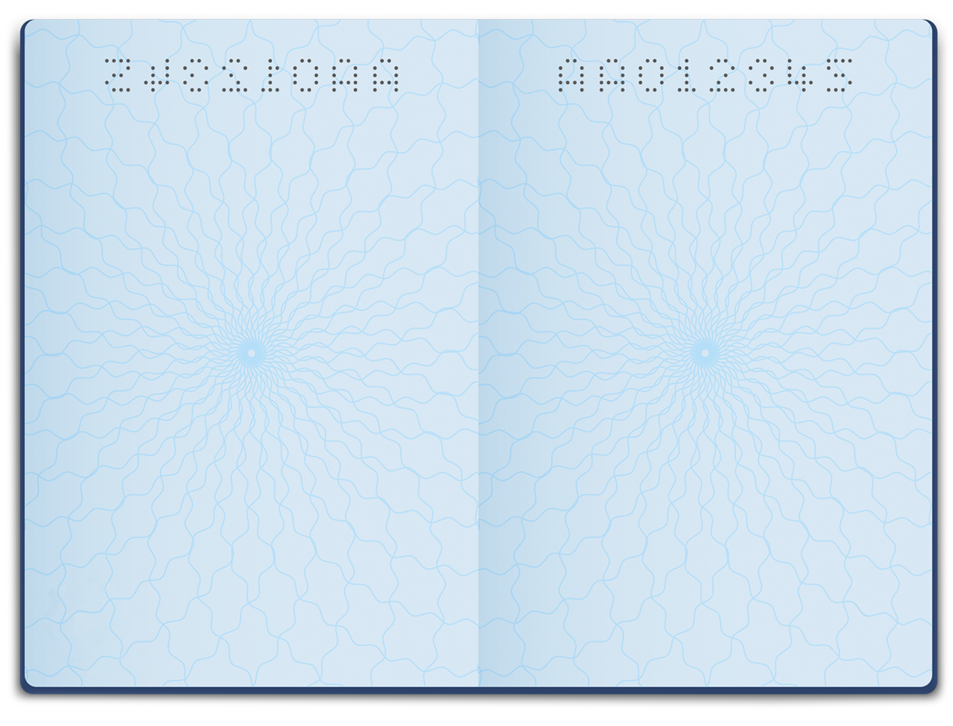

















Passport Example
Check out how fun your endorsement stamps can look in your Flight Log! Complete activities, join events, and then head over to the Flight Log Digital Stamps page to grab your next stamp!
Ready to make it your own? Go ahead and delete this slide when you’re ready to start your Flight Log!

Slide 5

Digital Stamps Entry Page

Slide 6
Camping Scene Coloring Page

Slide 7
Travel Journal Page

Slide 8
Travel Coloring Page

Slide 9
World Map

Slide 10
US Map

Slide 11
Back Page

