Slide 2
Ames High Rate Composite Manufacturing Facility
Aeronautics Directorate
NASA Ames Research Center

Slide 3
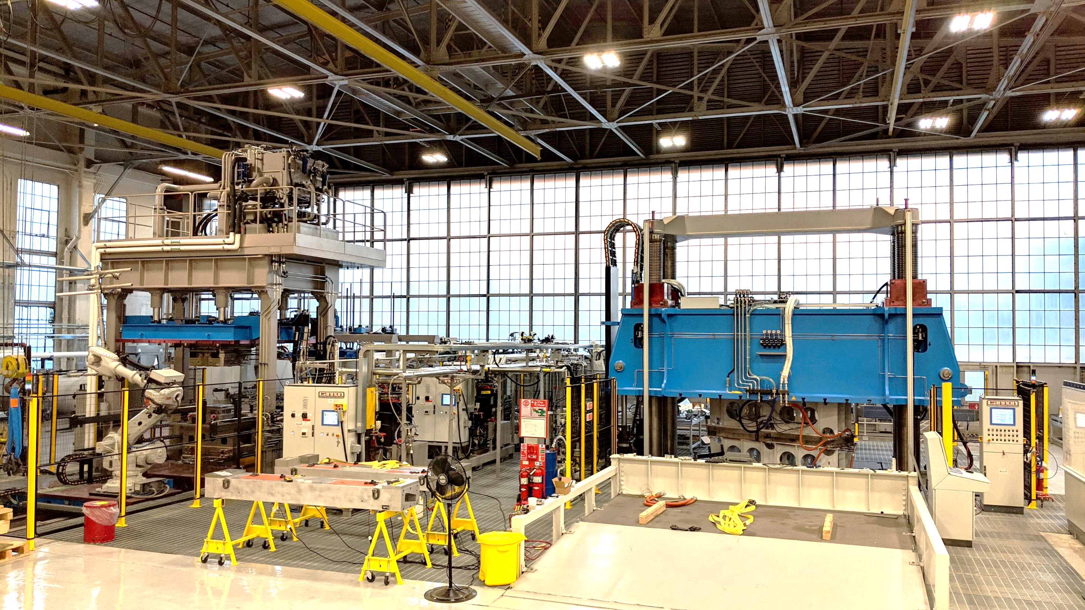
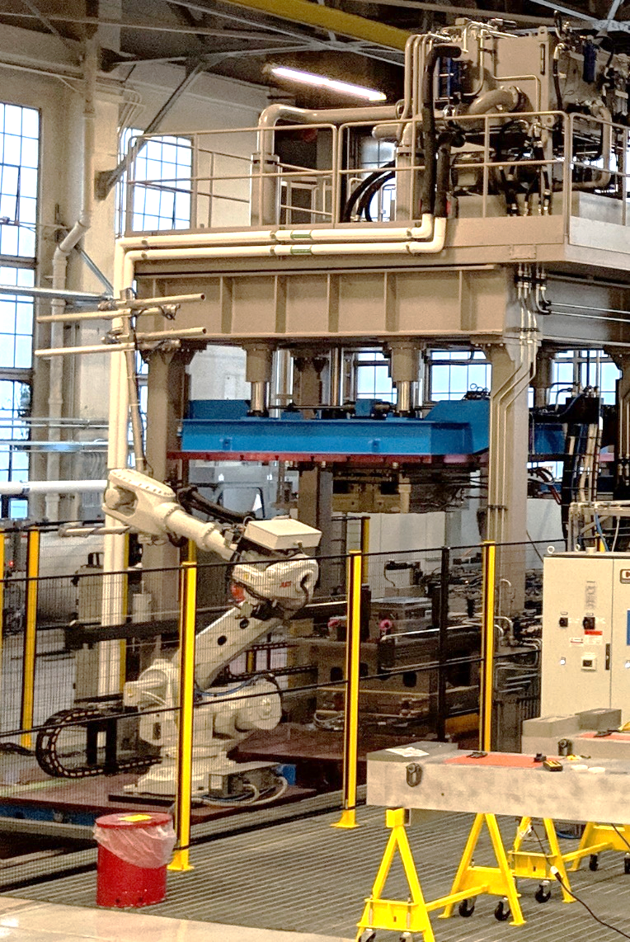
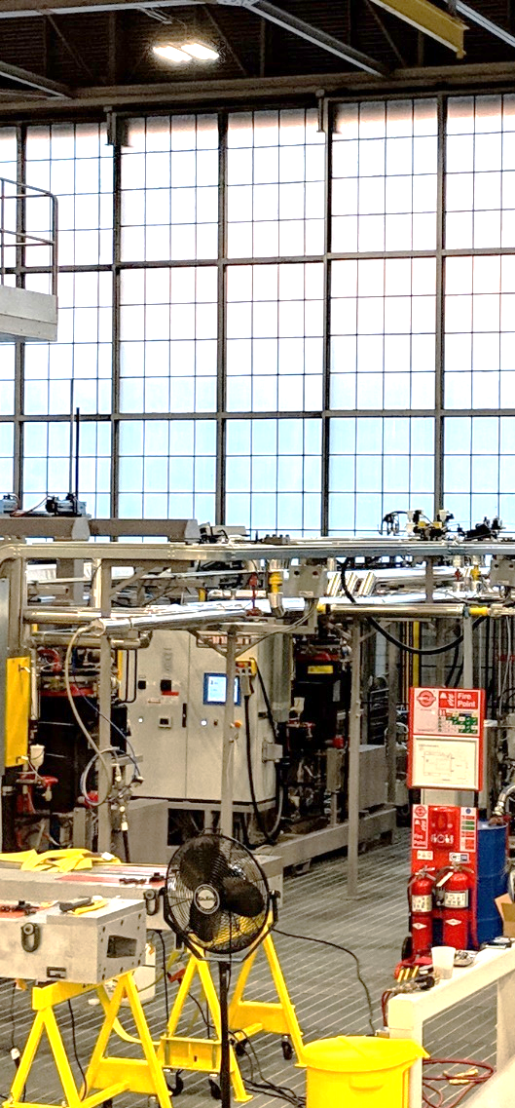
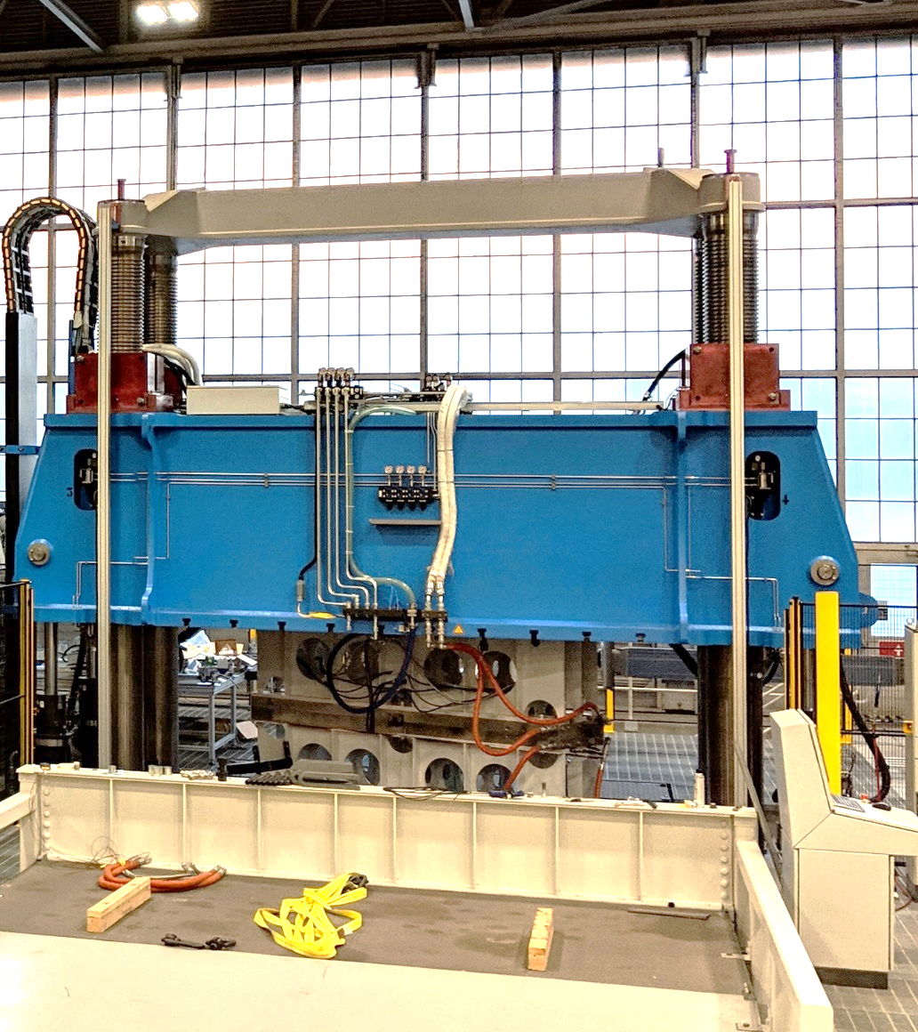
Ames High Rate Composite Manufacturing Facility

Slide 4
Ames High Rate Composite Manufacturing Facility
PREFORMER LINE
(aka Small Press)
Max Force 330T
RESIN INJECTION
BIG PRESS
Max Force 3600T

Slide 5
Ames High Rate Composite Manufacturing Facility
PREFORMER LINE
(aka Small Press)
Max Force 330T

Slide 6
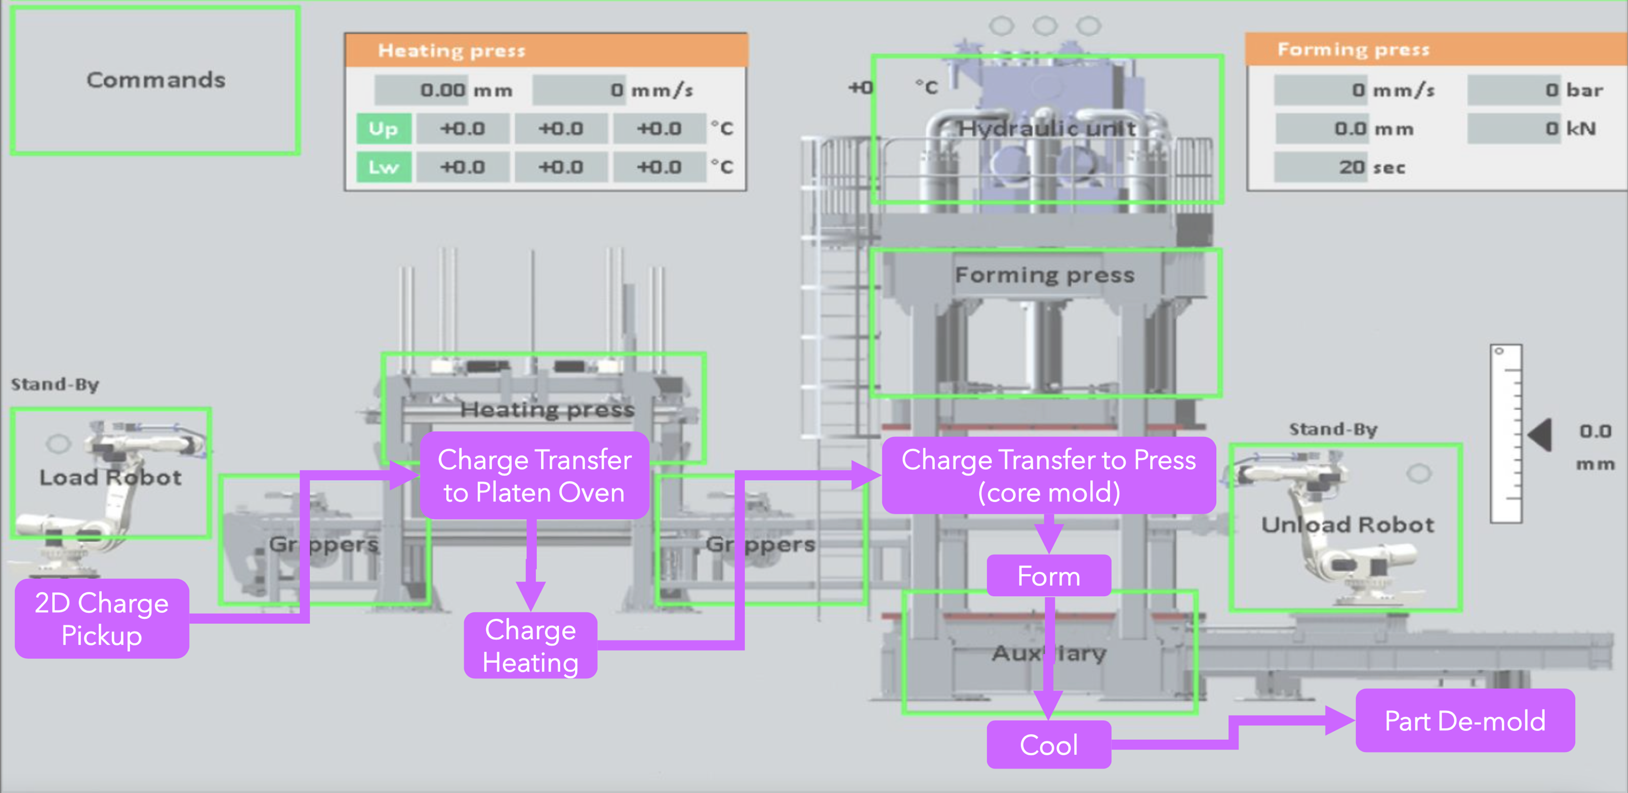
PreFormer Line Processes

Slide 7
PreFormer Line Features
Automated material handling
Two five-axis ABB robots
Pneumatic gripper system
Horizontal press sliding lower plane
Laser safety curtain and fall arrest system for safety
Large charge heating and press planform areas
Large press vertical stroke
Fluidic thermoregulator system for tool heating and cooling
Closed-loop pressure and temperature control
Throughput driven by charge heating and cooling requirements

Slide 8
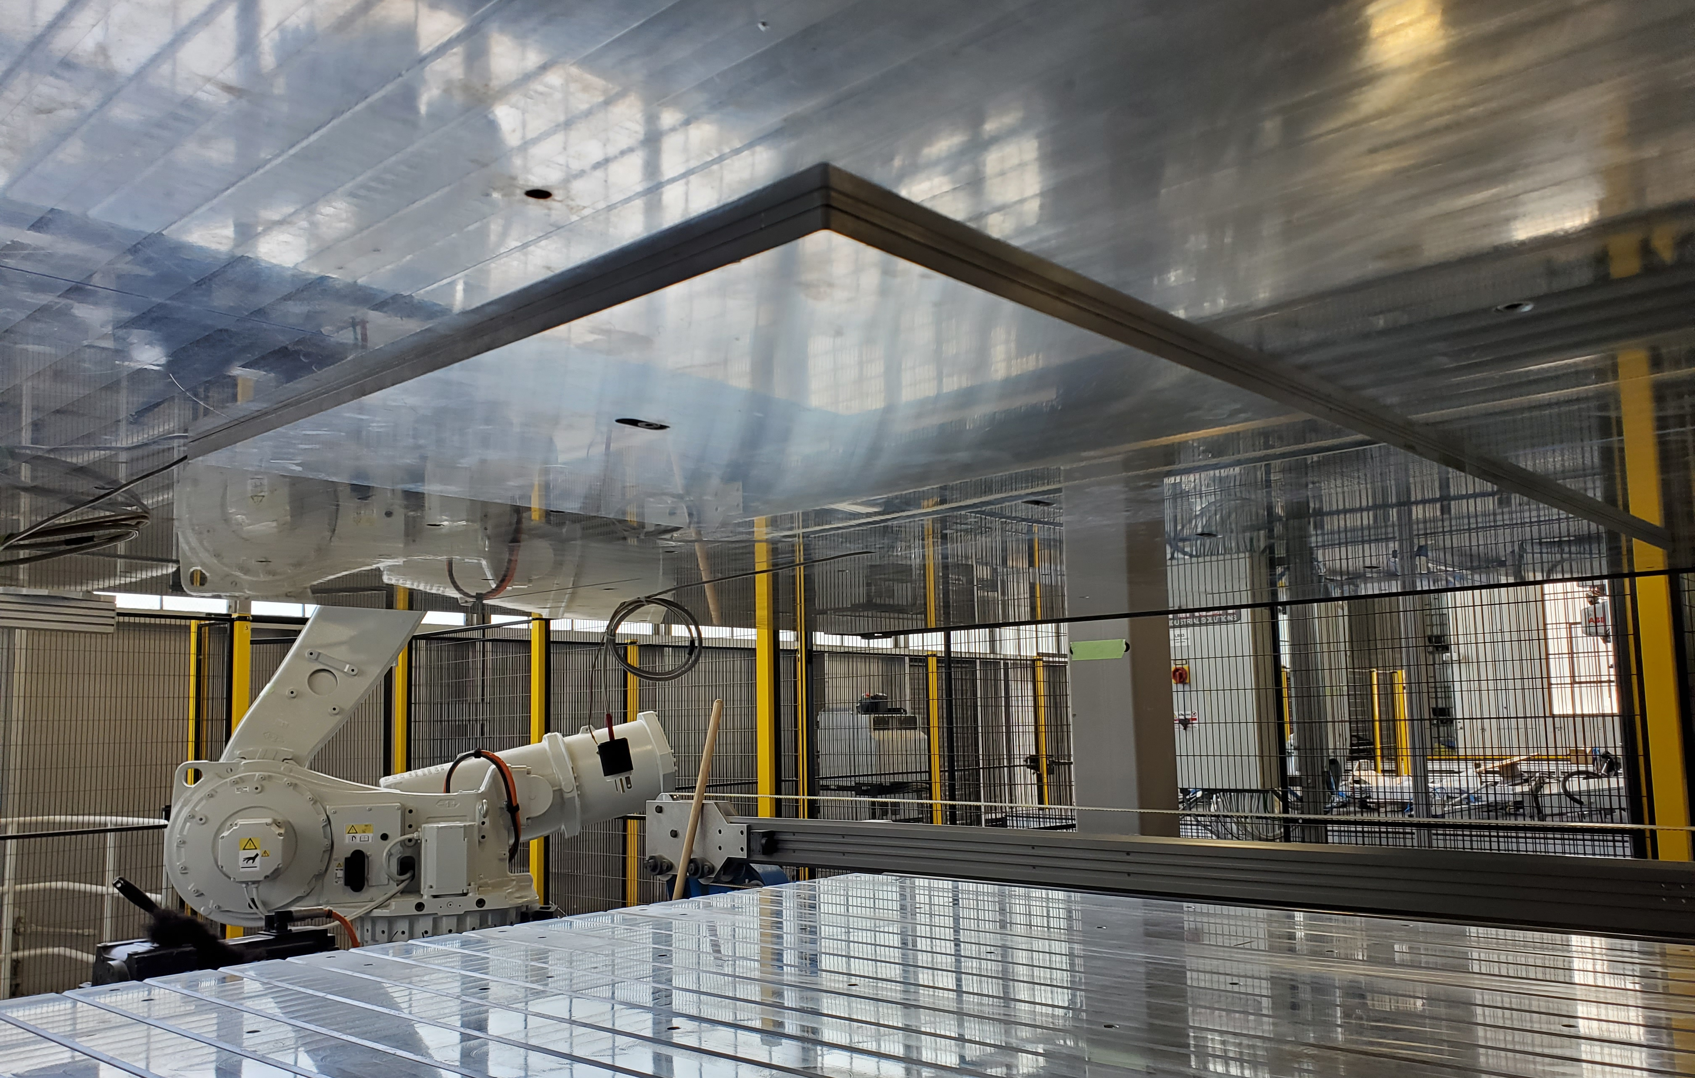
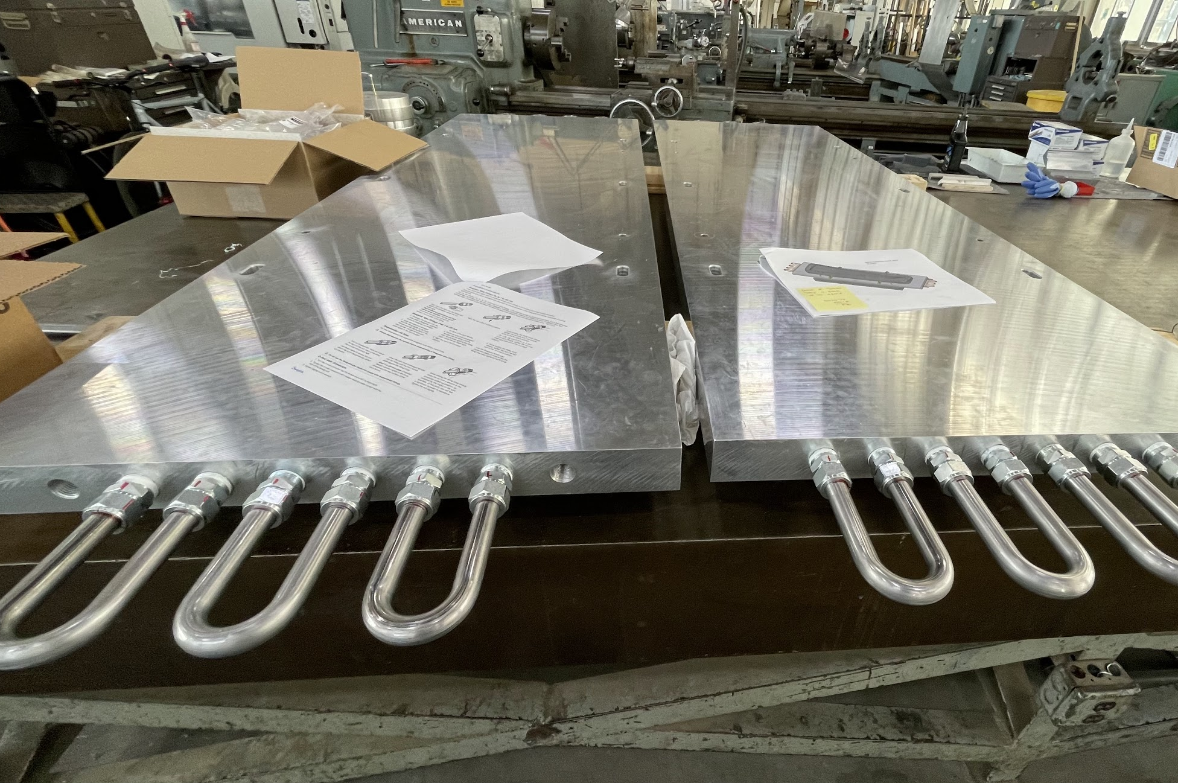
Thermal Upgrades to PreFormer Line
Auxiliary Electric Heating Plates
Tooling Heating/Cooling Plates

Slide 9
Ames High Rate Composite Manufacturing Facility
BIG PRESS
Max Force 3600T

Slide 10
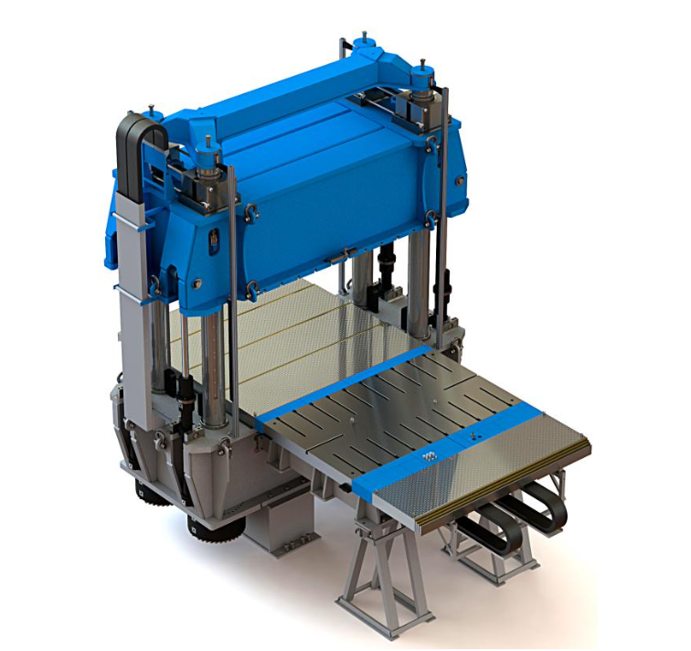
3600 Ton Press Features
Fixed lower plane with wings
Moving upper plane
Automated material handling
Five-axis ABB robot (not shown)
Sliding table
Parallelism control system for active mold alignment
Four hydraulic columns with locks

Slide 11
Facility Applications
Component Manufacturing Process Development
Heating and cooling requirements
Pressing requirements
Resin injection requirements
Material handling requirements
Process optimization
Component Manufacturing Process Certification
Quality assessment
Consistency/repeatability assessment
Composite Material Development/Assessment
Composite Component Manufacture

Slide 12
PreFormer Line Demonstration

Slide 13
Contacts
Technical Lead: Alex Mazhari – a.mazhari@nasa.gov
Facility Operations Manager: Dean Giovannetti – dean.p.giovannetti@nasa.gov
Programmatics: Ed Austin – edward.m.austin@nasa.gov

Slide 14
Heating Oven Specifications
Heating plane dimensions – 2800 x 2200mm
Vertical stroke upper plane – 2000mm
Heating power – 172kW
Maximum temperature
500F with standard cartridge heaters
700F with auxiliary heating plates

Slide 15
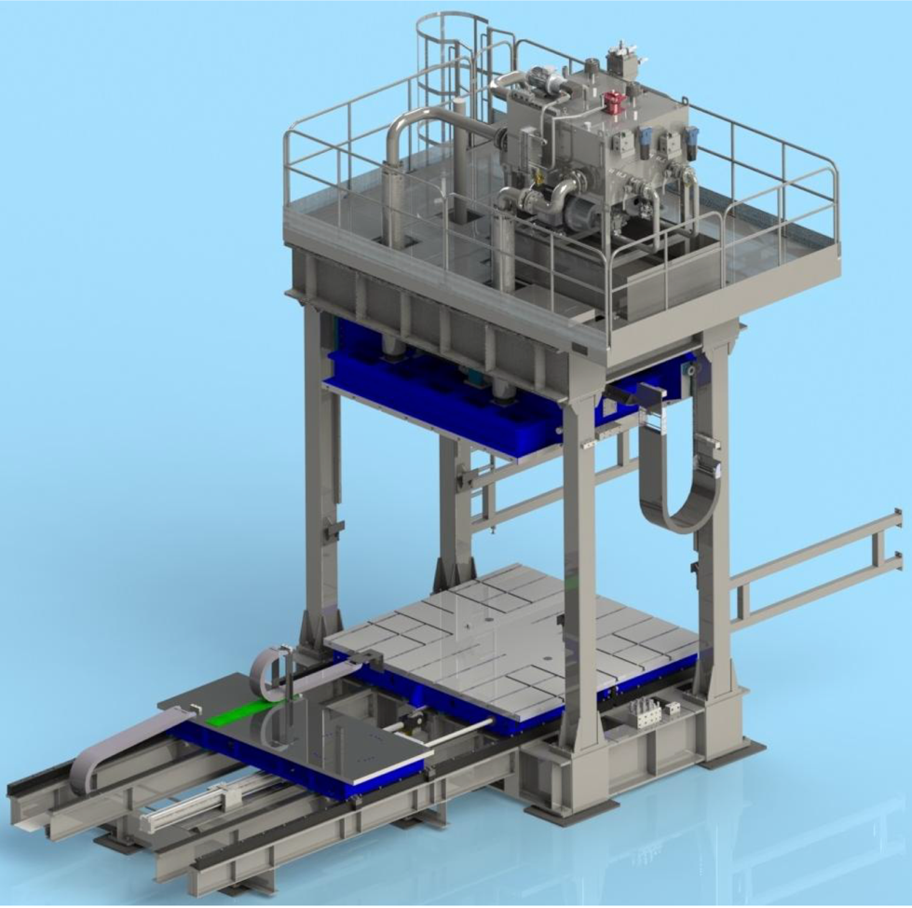
Preformer Press Specifications
Preformer plane dimensions – 3000 x 2900mm
Minimum/Maximum span – 1170mm/2900mm
Vertical stroke upper plane – 1730mm
Maximum closing force – 3000kN
Total installed electric power – 1170kW
Maximum hydraulic pressure – 250bar
Maximum pneumatic pressure – 6bar

Slide 16
3600 Ton Press Specifications
Technical Specifications
Closing Force | 36000 | kN | Sliding Table Stroke | 3000 | mm
Slow Opening Force | 6000 | kN | Speed (Upper Mold = 25000 kg)
Fast Opening Force | 2000 | kN | Fast Closing Speed | 400 | mm/sec
Sizes of Planes |  |  | Closing Working Speed | 1-20 | mm/sec
Front Upper Plane | 4400 | mm | Opening Working Speed | 1-10 | mm/sec
Depth Upper Plane | 2900 | mm | Fast Opening Speed | 200 | mm/sec
Front Lower Plane | 4400 | mm | Sliding Table Speed | 200 | mm/sec
Depth Lower Plane | 2500 | mm | Weights
Distance Between Columns | 4600 | mm | Maximum Mold Weight | 50000 | kg
Maximum Distance Between Planes | 2500 | mm | Maximum Mold Upper Section Weight | 25000 | kg
Minimum Distance Between Planes | 700 | mm | Plant
Strokes |  |  | Maximum Hydraulic Pressure | 250 | bar
Mobile Plane Stroke (total) | 1800 | mm | Power Installed | 240 | kW
Mobile Plane Working Stroke (short stroke) | 140 | mm

