Slide 1
NASA Johnson Space Center Astromaterials Research Exploration Science Image Science and Analysis Group (ISAG) ISAG Support to the ISS Program Dwight Osborne dwight.d.osborne@nasa.gov

Slide 2
ISAG Support to the ISS Program
Primary focus is on maintaining the safety of the crew and vehicle.
ISAG personnel request and screen imagery to:
Monitor changes in the ISS external condition
Anomalous indications
Hardware out of configuration
Detect Micro-Meteoroid or Orbital Debris (MMOD) impacts leading to:
Hardware failure
EVA sharp edges
ISAG personnel derive engineering data from imagery for:
Anomaly investigations
Structural dynamics measurements
Clearance assessments
Verifying ISS configuration against models and requirements
Jettison trajectory calculation
Provide Real-Time Support to the ISS and Anomalies

Slide 3
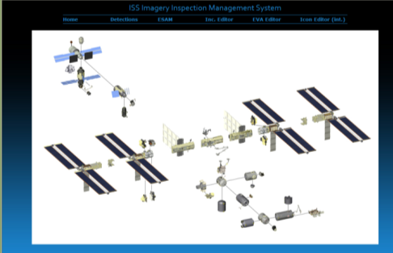
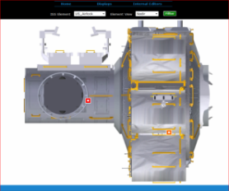
ISAG Web Tools
Findings and Analyses are posted to the ISAG homepage
http://isag.jsc.nasa.gov/
Potential sharp edge sites on the ISS truss and elements are noted for EVA planning.
ISS Inspection Imagery Management System (IIIMS) is used to catalog external inspection findings.
http://isag.jsc.nasa.gov/IIIMS-public/

Slide 4
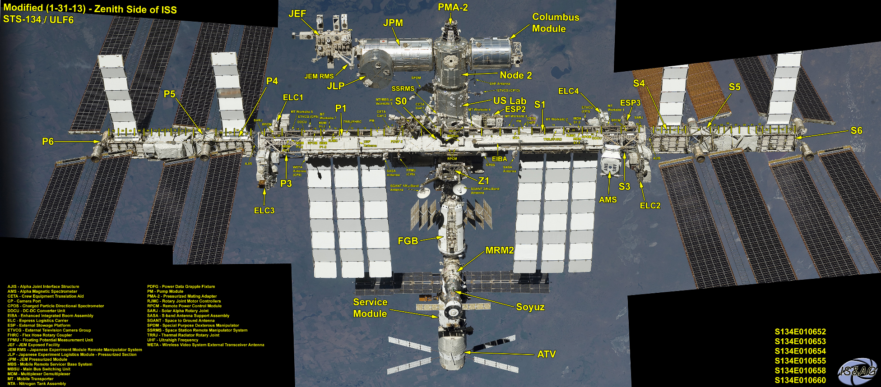
Mosaic, ISS Zenith, ULF-6 Mosaics provide high-resolution overviews of ISS

Slide 5
External Survey Imagery Sources
Crew discretionary imagery which includes ISS structure (EVA, Earth Observation, off-duty)
Wireless EVA Camera video
ERCA
HECA
Planned Surveys
Type Frequency
External Survey of ISS – External Cameras External Video 6 months
EHDC (High-Definition EMU Camera Assembly) 2064x1544 (3.1MP) at 122fps
ETVCG (External Television Camera Group)
External Survey of ISS – Internal Crew Internal Crew Photo Yearly
S1-3 HRS Radiator Damage Inspection External Video Quarterly
Port HRS Radiator Inspection External Video Yearly
STBD HRS Radiator Inspection Internal Crew Photo Yearly
Port Solar Array Wing Mast Internal Crew Photo Yearly
STBD Solar Array Wing Mast Internal Crew Photo Yearly

Slide 6
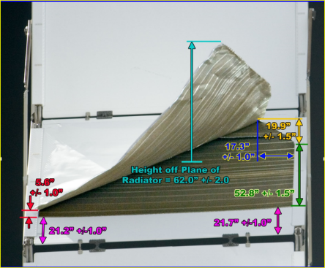
Quarterly Video Inspection of S1 HRS Radiator Panel (S1-3 Panel 7)

Slide 7
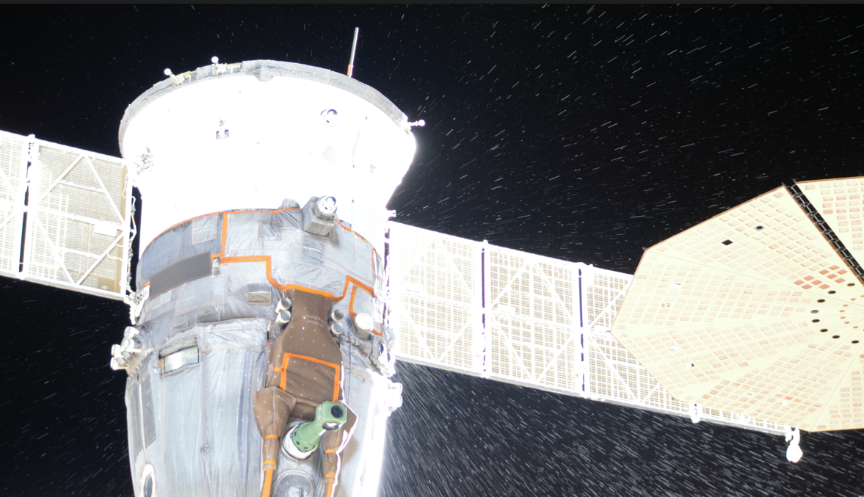
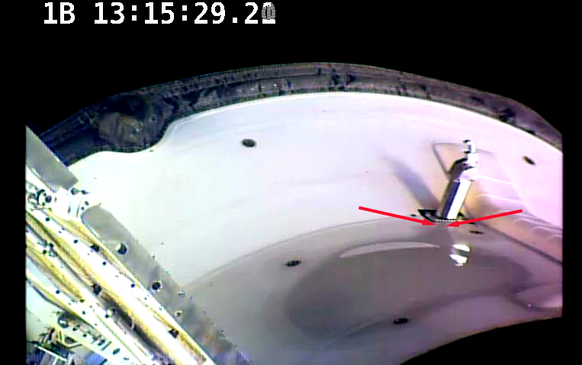
Dynamic Vehicle Anomalies
ISAG provides both Real-Time support to Mission Control and support to anomaly investigations via imagery operations and detailed photogrammetric analysis
Examples of support in 2023 include analysis of Soyuz 68S, Progress 82P, and MLM coolant leaks

Slide 8
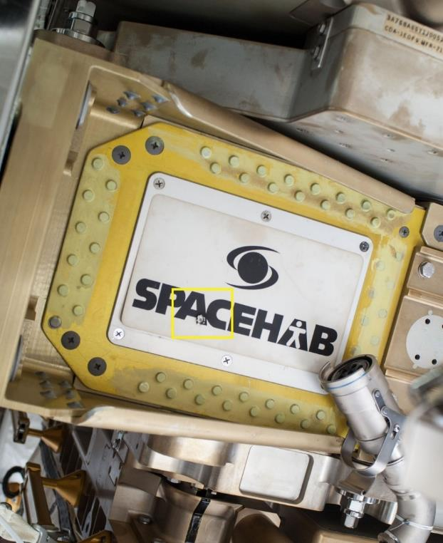
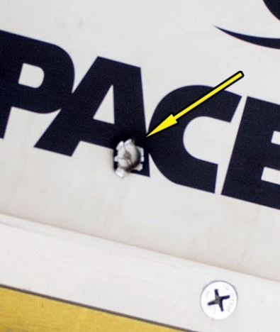
US EVA 25 MMOD Strike on External Stowage Platform 3

Slide 9
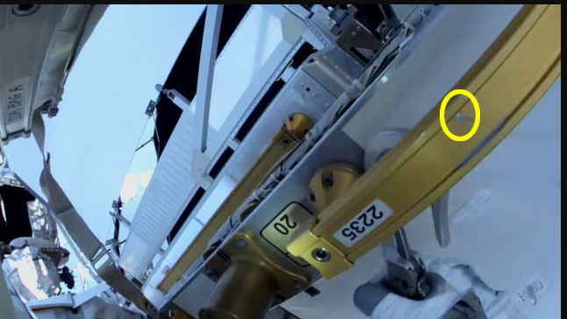
US EVA 85 iROSA Prep 1A This EVA Completed the 1A Mod Kit from the previous EVA. A screenshot of an MMOD Strike on a Handrail 2235 was captured from the High-Definition EVA Mobility Unit (EMU) Camera Assembly (HECA) Camera video using Downlink 4 live views.

Slide 10
US EVA 84 Support Near the end of the EVA, FOD was detected moving from aft to forward of the ISS. The FOD was observed on the SSRMS Camera; no other ISS Cameras captured the FOD.

Slide 11
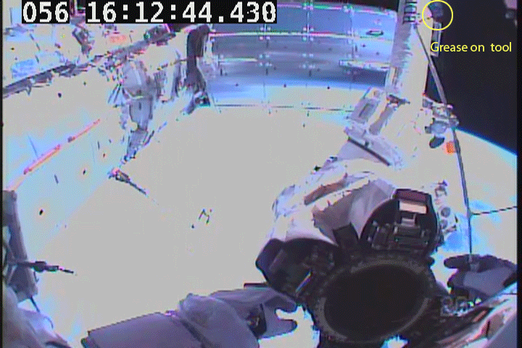
US EVA 30 – Grease Separation The purpose of this EVA, was to lubricate the Space Station Remote Manipulator System (SSRMS) Latching End Effector (LEE). Some of the grease liberated from the special lubricating tool and became FOD. The EMU RF Camera Assembly (ERCA) Camera on the Crew Member’s Helmet captured the AOI.

Slide 12
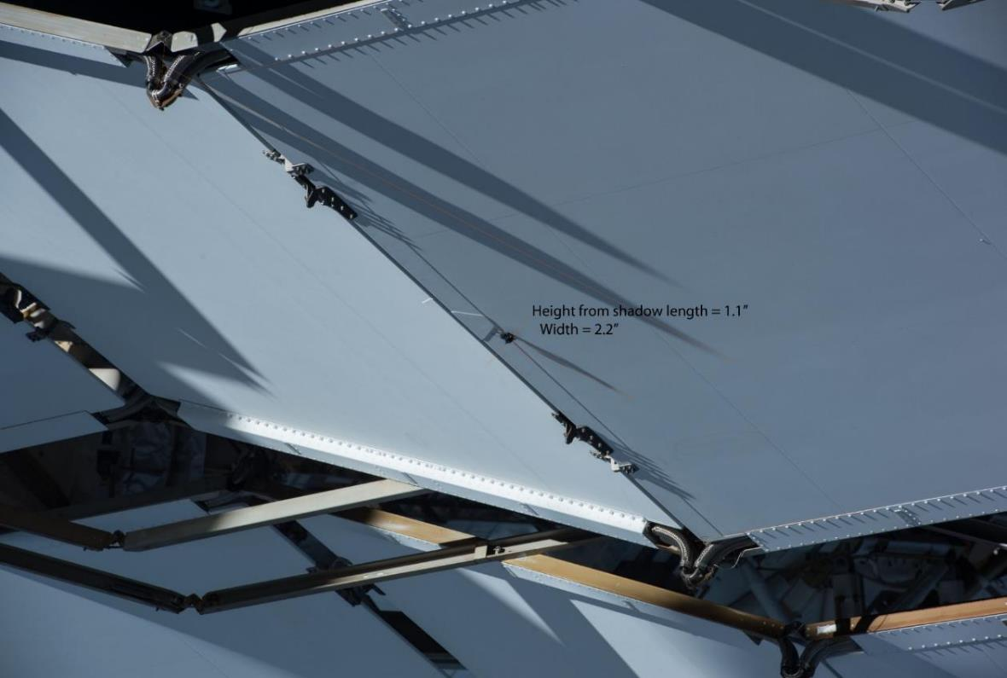
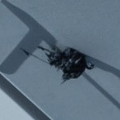
External Monitoring and Inspection Discovered Liberated Grease from Previous EVA on the Port HRS Radiator

Slide 13
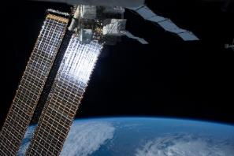
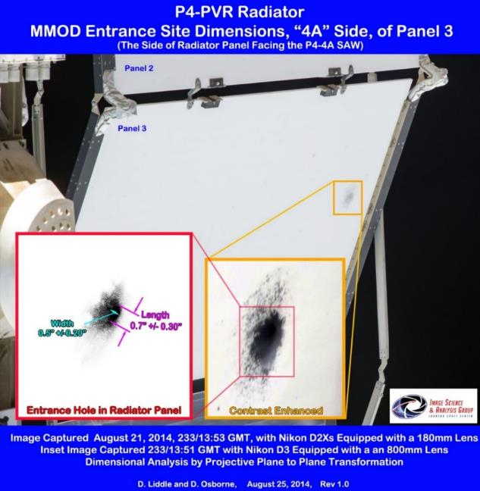
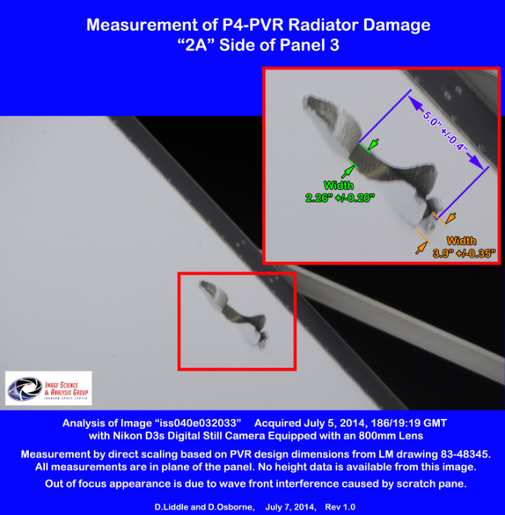
MMOD Strike on P4 Truss, Panel 3 Photo-Voltaic Radiator (PVR)
Probable Entrance Hole of MMOD Strike.
Probable Exit Hole of MMOD Strike

Slide 14
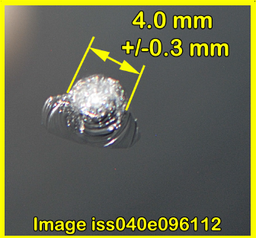
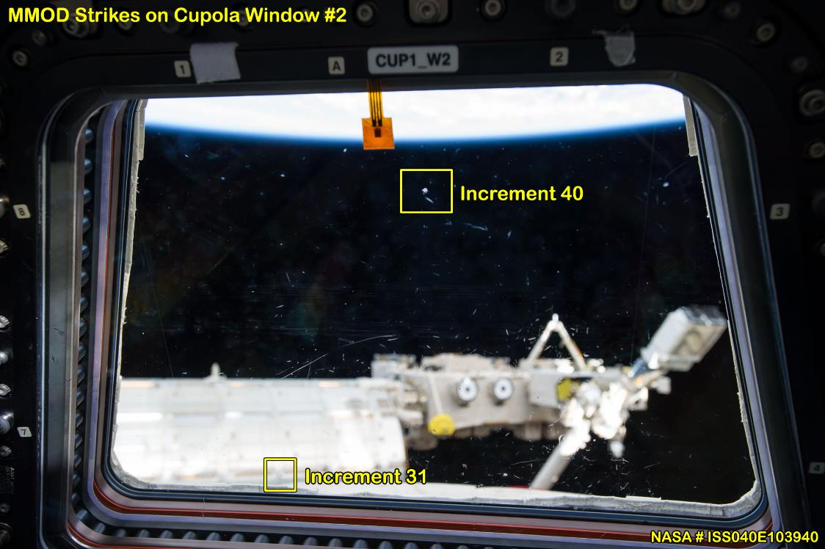
MMOD Strike on Cupola Window 2

Slide 15
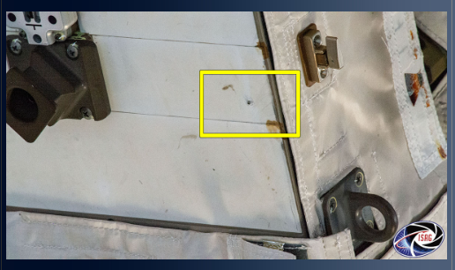
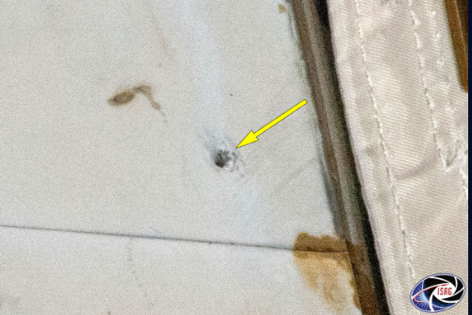
MMOD Strike Observed on ACU/MCU on MBS

Slide 16
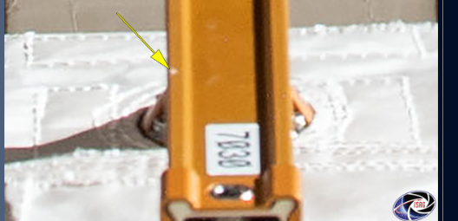
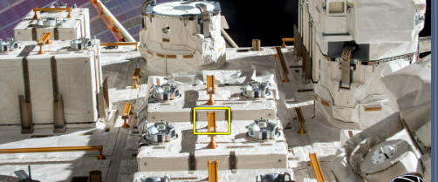
External Monitoring and Inspection:
Possible MMOD Strike Detected JLM on Handrail 7030

Slide 17
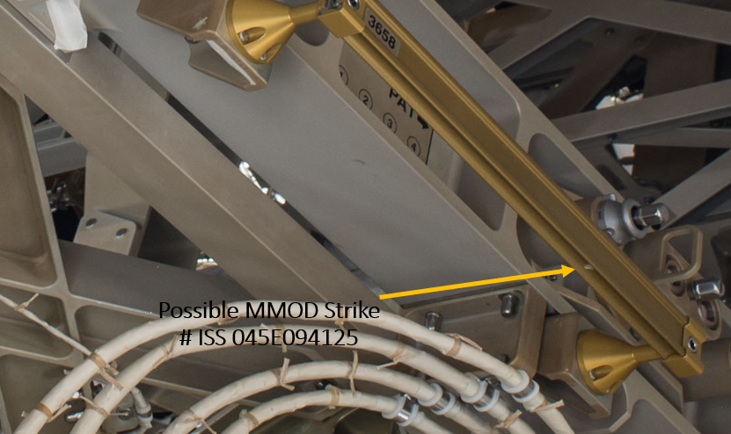
External Inspection Image Acquired from EVA Camera

Slide 18
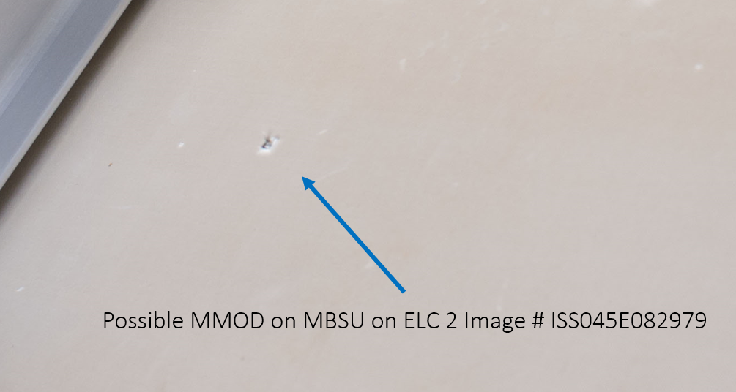
External Inspection Image Acquired from EVA Camera

Slide 19
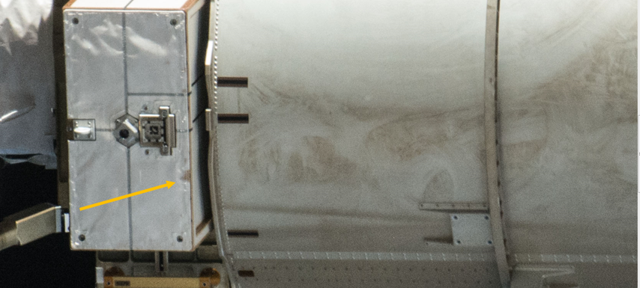
MLI Damage and Discoloration on S6 Mast Canister

Slide 20
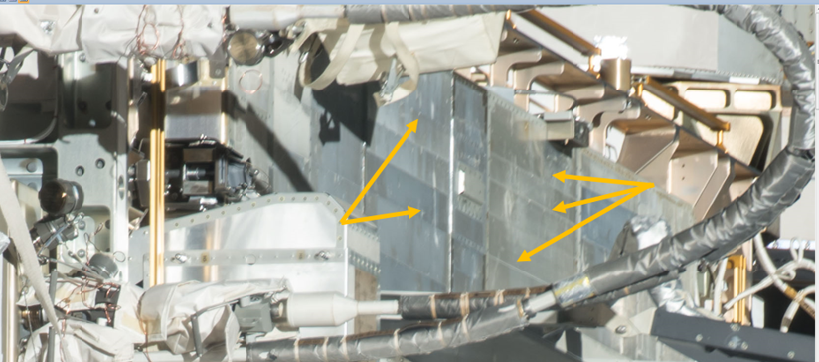
MMOD and Marks on S6 PVR

Slide 21
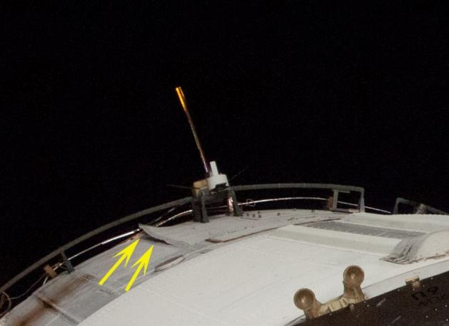
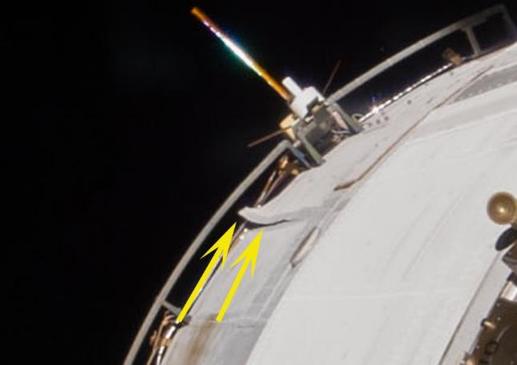
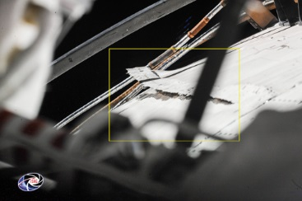
Increment Monitoring Lifted Panel on ISS Module
Increment 37
Increment 38
Increment 40

Slide 22
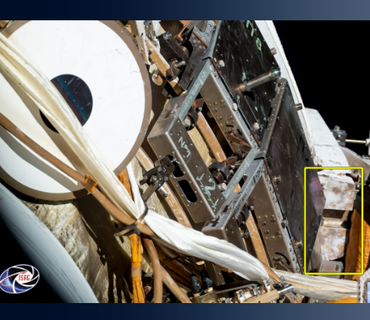
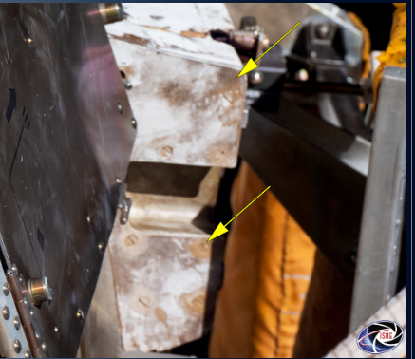
ISS Periodic Inspection Analysis Discoloration Detected on ISS Module Secondary Structure

Slide 23
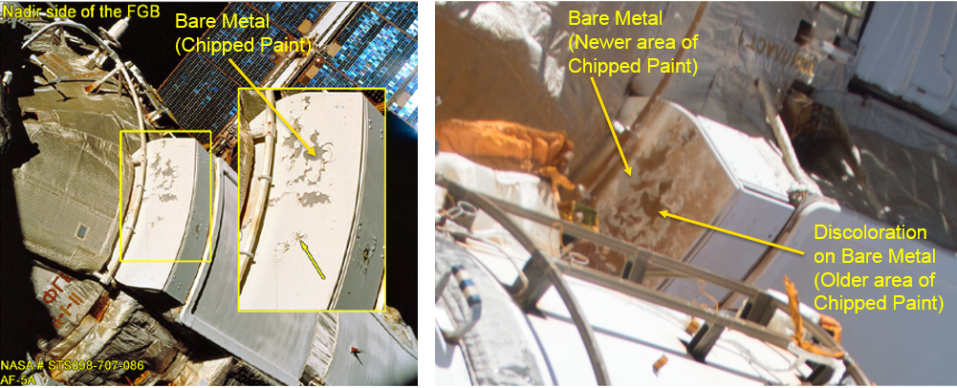
External Monitoring and Inspection
STS-098/AF-5A Chipped Paint on ISS MMOD Module Shielding Panel
Increment 47 Chipped Paint and Discoloration on same ISS Module MMOD Shielding Panel

Slide 24
ISS Status Monitoring; Discoloration Observed on ISS Module

Slide 25
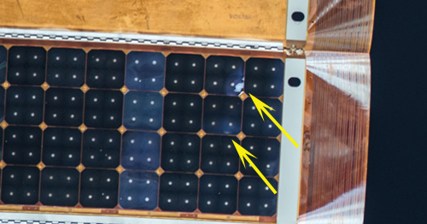
External Monitoring and Inspection
AOI’s from Increment 45/46 External Survey
Over 4000 images were screened.
27 new areas of interest were added to the ISS Imagery Inspection database. http://isal-web1.jsc.nasa.gov/content/folder1607/INC45&46_Report.htm.

Slide 26
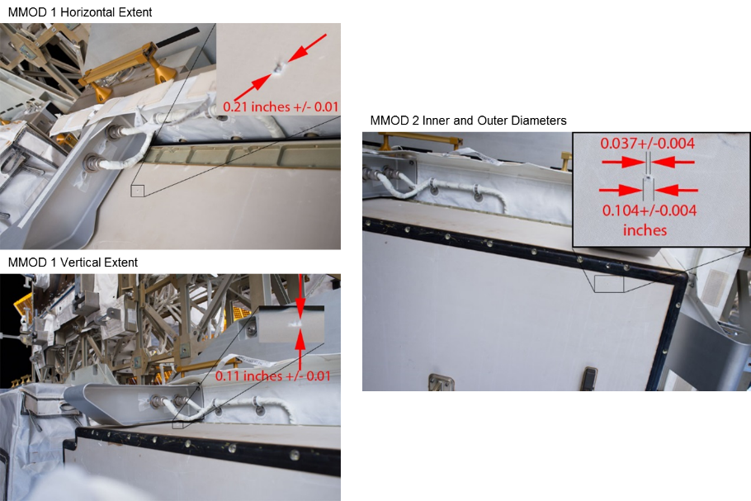
External Monitoring and Inspection
AOI’s from Increment 47/48 External Survey
MMOD Strikes on the Spare MBSU currently stowed on an External Logistics Carrier (ELC). Long term plan is to bring it inside Station so that the crew can change out the firmware card. At that time, it will be determined if this probable MMOD strike could have a relation to the failed firmware card.
ISAG provided a photogrammetric estimated analysis of 5mm diameter for IFI 2283.

Slide 27
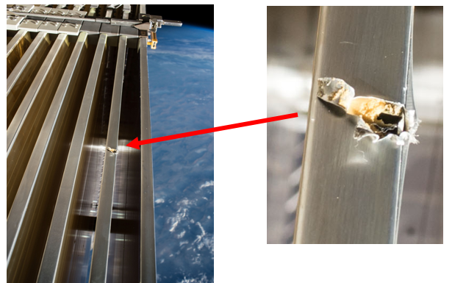
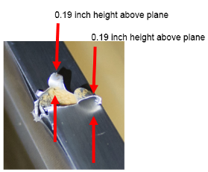
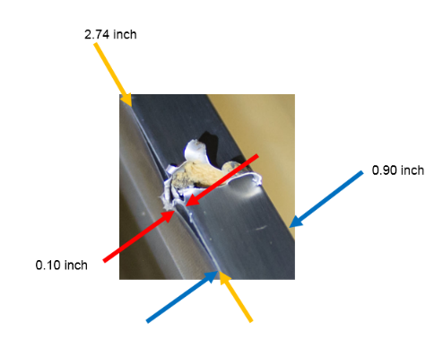
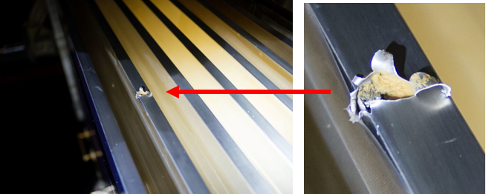
External Monitoring and Inspection
MMOD Strike on P6 Trailing Thermal Control Radiator (TTCR)
Crew photo from TTCR EVA #37

Slide 28
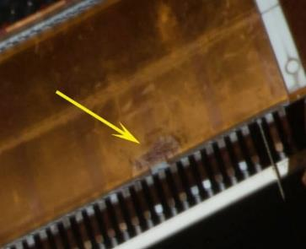
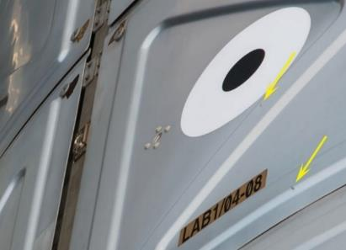
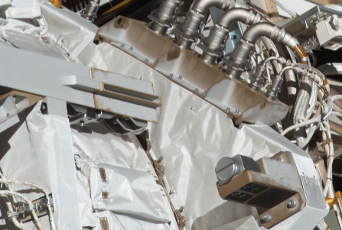
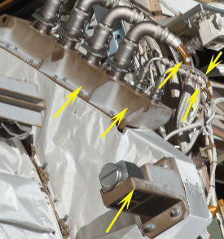
External Monitoring and Inspection
Completed Port SAW Masts and Port/Stbd HRS crew photo surveys
AOI’s from Increment 47/48 External Survey Report
Over 3500 images were screened for damage and degradation.
Approximately 40 Areas of Interest (MMOD strikes, discolorations and lifted MLI) were added to the ISS Inspection Imagery Management System database.
http://isal-web1.jsc.nasa.gov/content/folder1618/INC47&48_Report.htm.

Slide 29
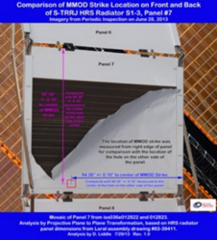
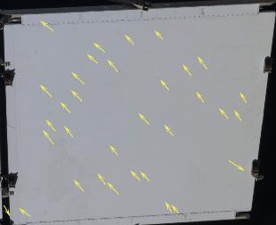
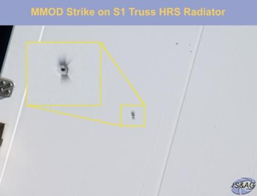
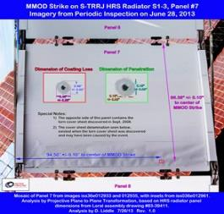
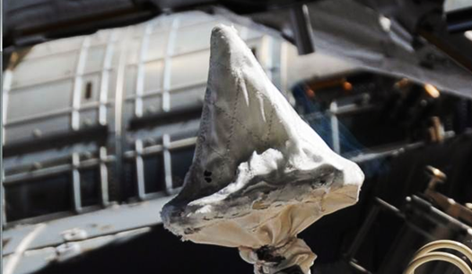
External Monitoring and Inspection
AOI’s from Increment 37 External Survey
Items of interest were discolorations on US ORUs, MLI, Primary and Secondary Structures, lifted MLI cover near CMG3, MRM 2 wire that has its MLI partially removed revealing a possible exposed wire, possible MLI degradation exposing substrate on a Japanese Exposed Facility payload, MLI degradation on a FGB antenna thermal insulation blanket, and numerous MMOD strikes. Of note was an MMOD strike on a thermal radiator with damage area of approximately a square cm. Observations were forwarded to the hardware owners and External Contamination and Space Environments Team.
Quarterly (Aug) video survey of the damaged S1-3 Radiator Panel.
Animated historical comparisons are available:
http://isal-web1.jsc.nasa.gov/content/folder341/Inboard_radiator_damage.htm

Slide 30
Discoloration and AOIs Observed on S4 Truss 3A Array Wire Harnesses http://isal-web1.jsc.nasa.gov/content/folder1376/SSU_Areas_of_Interest5.htm

Slide 31
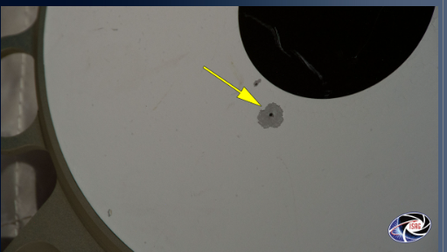
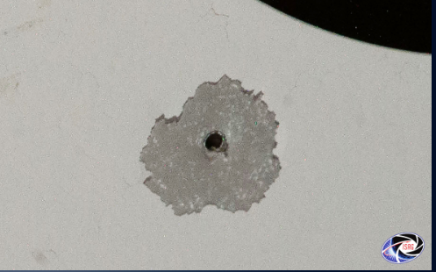
ISS Status Monitoring; MMOD Strike Observed on S1 Truss SVS Target

Slide 32
Image Science & Analysis Homepage https://isag.jsc.nasa.gov/

