Slide 1
JSC Industry Forum: Informational Session on Organizational Conflicts of Interest (OCI)
JSC Gilruth Conference Center
August 30, 2023

Slide 2
Agenda
9:00 – 9:10 a.m. Welcome Introduction – Jose Garcia, JSC Director of Procurement
9:10 – 9:45 a.m. Briefing on NASA’s OCI Policy Framework – Rogelio Curiel, Team Lead, White Sands Test Facility Office of Procurement
9:45 – 12:00 p.m. Facilitated Interactive Innovation Session – Kelly Castano & Ulcka Patel, JSC Business Development & Technology Integration Office

Slide 3
Welcome Introduction – Jose Garcia

Slide 4
Welcome Introduction
Law signed into effect in December 2022 requiring FAR Council to update FAR 9.5 OCI by June 2024
JSC OP will be providing HQ recommendations for this policy update
JSC wants industry input and recommendations on OCIs to assist with recommendation

Slide 5
Law language - Preventing OCI in Federal Acquisition
IN GENERAL.—Not later than 18 months after the date of the enactment of this Act, the Federal Acquisition Regulatory Council shall revise the Federal Acquisition Regulation—
(1) to provide and update—
(A) definitions related to specific types of organizational conflicts of interest, including unequal access to information, impaired objectivity, and biased ground rules;
(B) definitions, guidance, and illustrative examples related to relationships of contractors with public, private, domestic, and foreign entities that may cause contract support to be subject to potential organizational conflicts of interest, including undue influence; and
(C) illustrative examples of situations related to the potential organizational conflicts of interest identified under this paragraph, including an example of the awarding by a Federal regulatory agency of a contract for consulting services to a contractor if employees of the contractor performing work under such contract are permitted by the contractor to simultaneously perform work under a contract for a private sector client under the regulatory purview of such agency;

Slide 6
Law language (cont)
(2) to provide executive agencies with solicitation provisions and contract clauses to avoid or mitigate organizational conflicts of interest, for agency use as needed, that require contractors to disclose information relevant to potential organizational conflicts of interest and limit future contracting with respect to potential conflicts of interest with the work to be performed under awarded contracts;
(3) to allow executive agencies to tailor such solicitation provisions and contract clauses as necessary to address risks associated with conflicts of interest and other considerations that may be unique to the executive agency;
(4) to require executive agencies
(A) to establish or update as needed agency conflict of interest procedures to implement the revisions to the Federal Acquisition Regulation made under this section; and
(B) to periodically assess and update such procedures as needed to address agency-specific conflict of interest issues; and
(5) to update the procedures set forth in section 9.506 of the Federal Acquisition Regulation to permit contracting officers to take into consideration professional standards and procedures to prevent organizational conflicts of interest to which an offeror or contractor is subject.

Slide 7
Briefing on OCI Framework – Rogelio Curiel

Slide 8
Contracting Officer’s (CO) Duties
IAW FAR 9.504, COs’ have 2 primary responsibilities:
Identify and evaluate potential organizational conflicts of interest as early in the acquisition process as possible
Unfair Access to Data
Biased Ground Rules
Impaired Objectivity
Avoid, neutralize, or mitigate significant potential conflict before contract award
CO’s review should avoid creating unnecessary delays, burdensome information requirements, and excessive documentation

Slide 9
Contracting Officer’s (CO) Duties – Cont.
OCIs may surface across various stages in the acquisition:
Pre-award (Source Selection Process)
Development of Acquisition Strategy
OCI ground rules and special clauses in RFP/Solicitation
Communications with Offerors
Contractor’s OCI plan – considered as part of CO Responsibility Determination, not part of evaluation for selection purposes
Post-Award (Contract Administration)
Monitoring changes in requirements to ensure appropriate resolution in contract modifications
Continuous review when issuing Task Orders under an IDIQ contract
Novations require determination if successor contractor creates OCIs to impair performance
Mergers, acquisitions, business investments and subcontracting relationships require assessments

Slide 10
OCI Process – FAR 9.506
Step 1: CO Considers Internal Information
SOW/PWS
Predecessor/related contracts feeding into the current acquisition
Govt oversight / insight approach
Other COs
CORS
Auditors
Step 2: CO Considers Information from Contractor(s)
Market Research RFI
OCI RFI
Industry Day Feedback
Contractor OCI DRD
Step 3: CO Written Analysis (i.e., OCI Determination Memo)
IDs actual or potential OCIs
Recommends actions to avoid, neutralize or mitigate
Defines any clauses needed
CO may seek a waiver

Slide 11
OCI Analysis
COs seek to answer the following questions/conditions:
Will the contractor’s performance involve development of requirements (i.e., solicitation) for a future contract in any manner? (Biased ground rules)
Will the contractor’s performance involve access to contractor proprietary or sensitive/confidential government information that could create a competitive advantage in connection with a future contract. (Unfair access to data)
Can the same contractor perform the anticipated NASA contract alongside any other NASA contract without being placed in a position of evaluating its own work products or services? (Impaired Objectivity)

Slide 12
OCI Potential Resolutions
Biased ground rules
Government removes requirements that use subjective judgment.
Having more than one contractor preparing the requirement, so it is not biased to favor a particular offeror.
If the anticipated contract requires the contractor to generate requirements, it will contain the Limitation on Future Contracting clause.
Impaired objectivity
Government removes requirements that use subjective judgment.
Government does not issue work creating a conflict (e.g., not issuing a task order and either having the work performed under another contract or by Government personnel).
Contractor agrees not to perform the conflicting work (i.e., through the OCI Plan or through the Limitation on Future Contracting clause).
Contractor use of a non-conflicted subcontractor to perform the OCI-related and if the CO determines the subcontractor does not have any additional issue.

Slide 13
OCI Potential Resolutions Continued
Unequal access to information
Government proactively releases information in a technical library and provides access to all offerors.
Contractor implements a “firewall” which involves corporate non-disclosure agreements (NDAs) (between the contractor and its employees) to prevent disclosure of information.
Contractor implements policies isolating and prohibiting the movement of personnel with access to the information from performing proposal writing duties.
If the instant contract requires access to sensitive non-public information, the solicitation will contain NFS 1852.237-72, Access to Sensitive Information.

Slide 14
Contractor Responsibilities
Address OCI’s as early as possible.
Actively engage and communicate with COs.
Identify areas in PWS/SOW that could create an OCI.
Analyze and submit facts to determine if conflicts exist or not.
Take action to avoid, neutralize, or mitigate any potential conflict.
Propose measures to resolve conflict.
Contractor is in the best position to identify conflicting interests and propose initial techniques to address conflicts.

Slide 15
Facilitated Interactive Innovation Session – Kelly Castano & Ulcka Patel, JSC Business Development & Tech Integration

Slide 16
Back Up

Slide 17
NASA OCI Policy & Guidance
Federal Acquisition Regulation (FAR) 9.5, NASA FAR Supplement (NFS) 1809.5
NFS 1852.209-71 Limitation of Future Contracting (Dec 1988)
NFS 1852.237-72 Access to Sensitive Information (Jun 2005)
NFS 1852.237-73 Release of Sensitive Information (Jun 2005)
NASA’s Guide on Organizational Conflict of Interest
CO OCI Determination & Checklist Template
CO OCI Limitation of Future Contracting Memo Template

Slide 18
Backup – OCI Definitions
Unfair access to data – When a contractor has access to nonpublic information which may provide the firm an unfair competitive advantage in a later competition for a government contract.
Impaired objectivity – When a contractor’s judgment and objectivity in performing the contract requirements may be impaired due to the fact that the substance of the contractor’s performance has the potential to affect other interests of the contractor.
Biased ground rules – When a firm, as part of its performance of a government contract, has in some sense set the ground rules for another government contract by, for example, writing the statement of work or the specifications.

Slide 19
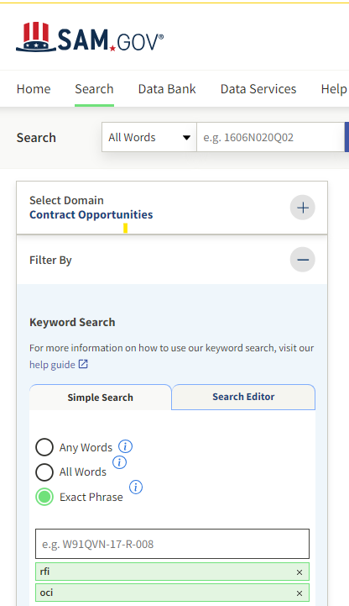
OCI Request for Information
A CO’s tool for competitive procurements to gather information to define OCI issues and mitigations.
All OCIs RFIs are posted in www.sam.gov and in the acquisition’s specific Source Selection Website https://www.nasa.gov/jsc/procurement.

Slide 20
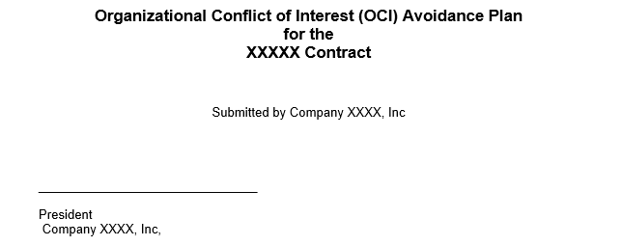
Contractor’s OCI Plan
The Plan will communicate the contractor’s approach to identify and resolve OCIs.
The contractor is responsible for identifying, dispositioning, and reporting OCIs during contract performance.
20

Slide 21
Backup – Typical DRD contents for a contractor’s OCI plan
Point of contact for OCI issues and reports.
Demonstrate an understanding of (1) OCI principles and (2) the full breadth of OCI issues and the types of harm that can result.
Define company roles, responsibilities, and procedures for (1) screening (i.e., identifying/recognizing), and (2) monitoring and reporting.
Describe employee’s notification of Plan’s requirements and training approach.
Describe how the contractor will report breaches of the protective measures in the Plan.
Identify any affiliated companies/entities and procedures for coordinating OCI.
Address the process for reporting all potential/actual OCIs that arise during performance of the contract.
Explain how the contractor will flow down the provisions of the Plan to any subcontractor.

Slide 22
Backup – Typical DRD contents for a contractor’s OCI plan – Cont.
Define organizational and employee sanctions for violations of OCIs.
Include the contractor’s assertion that to the best of their knowledge no OCIs exist, if applicable. List all the primes and subcontractors working with NASA.
Include a requirement to update this plan as necessary to address specific OCIs.
Require periodic self-audits to ensure compliance with OCI procedures.
Define records related to the OCI plan (e.g., training and audit records) that will be made available to the Government upon request.
In an appendix to the OCI Plan identify the strategy (e.g., mitigation, limitation on future contracting, etc.) for resolving each OCI that is identified.
Maintenance: The contractor reviews the OCI Plan annually or as directed by the CO to revise the OCI Plan if necessary.

