Slide 1
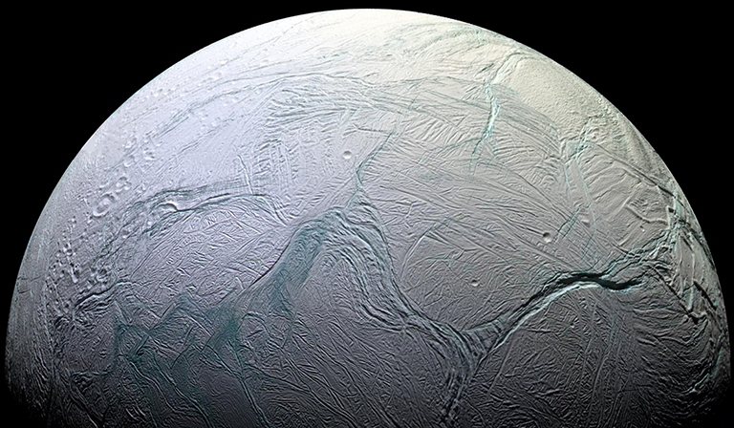
Interpreting Hydrogen and Carbon Dioxide Disequilibrium on Enceladus
Science question. The combination of hydrogen (H₂) and carbon dioxide (CO₂) in the ocean of Saturn’s moon Enceladus represents chemical energy that could support life. But the question was raised at the Planetary Science and Astrobiology (PS) Decadal: Should we expect to see any energy “left on the table” if anything alive is actually there to use it?
Findings. The extent of H₂/CO₂ disequilibrium (a measure of seemingly ‘unconsumed’ energy) was shown to vary in Earth environments that host ‘methanogens’ -- organisms that actively consume H₂ and CO₂ in a metabolism that produces methane. That extent was shown to depend on rates of turnover in the methanogen population, along with the physiological properties of the organisms themselves. Because these parameters are not currently knowable for Enceladus, the sizeable H₂/CO₂ disequilibrium observed there cannot be seen as incompatible with an inhabited ocean.
Why does this matter. It is valid and important to have asked, in the context of the PS Decadal, whether the H₂/CO₂ disequilibrium observed on Enceladus might be incompatible with an inhabited world. This study showed that it is not. In this light, Enceladus remains a no less compelling target in the search for evidence of life beyond Earth.
T. Hoehler, “Implications of H₂/CO₂ disequilibrium for life on Enceladus,” Nature Astronomy, in press (2022).
Ames researcher Tori Hoehler collects a core of marine sediment at Cape Lookout Bight, NC, one of several ‘methanogenic’ ecosystems considered in this study.

