Slide 1
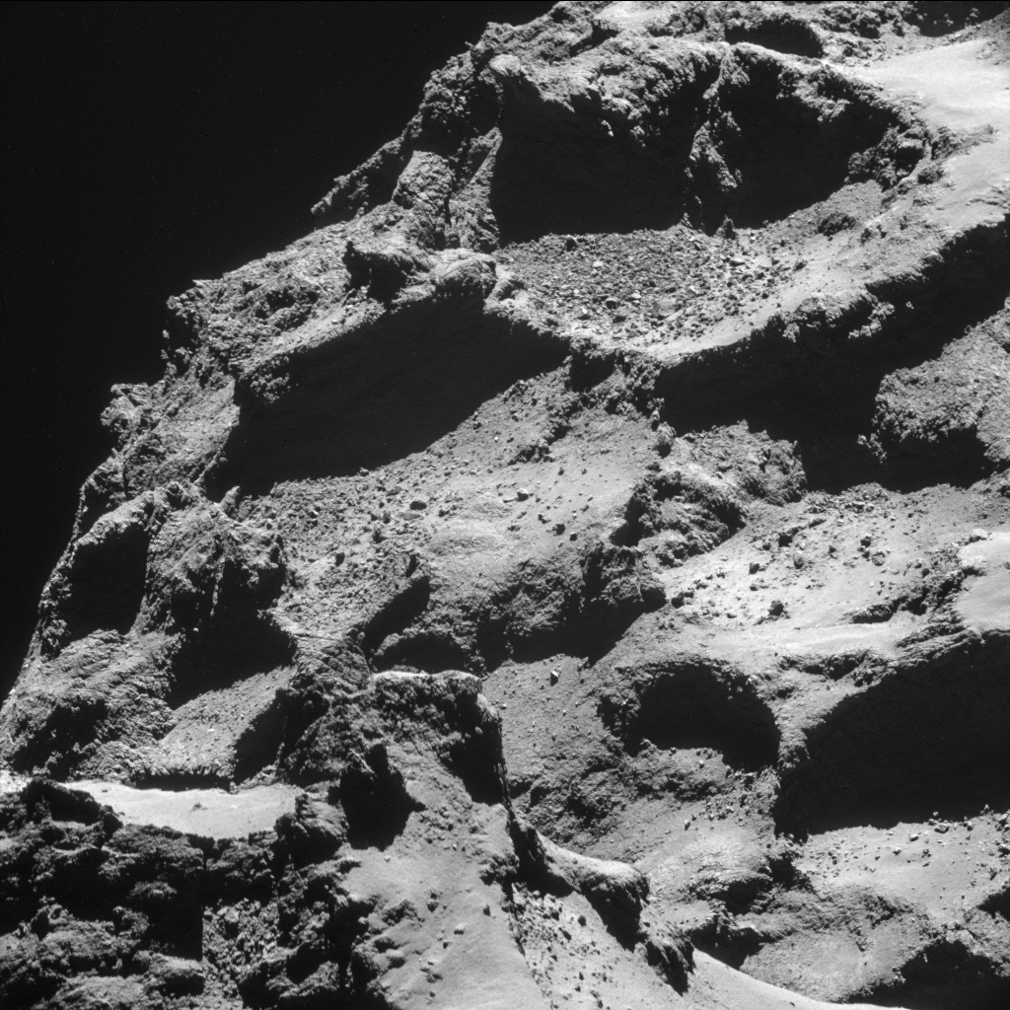
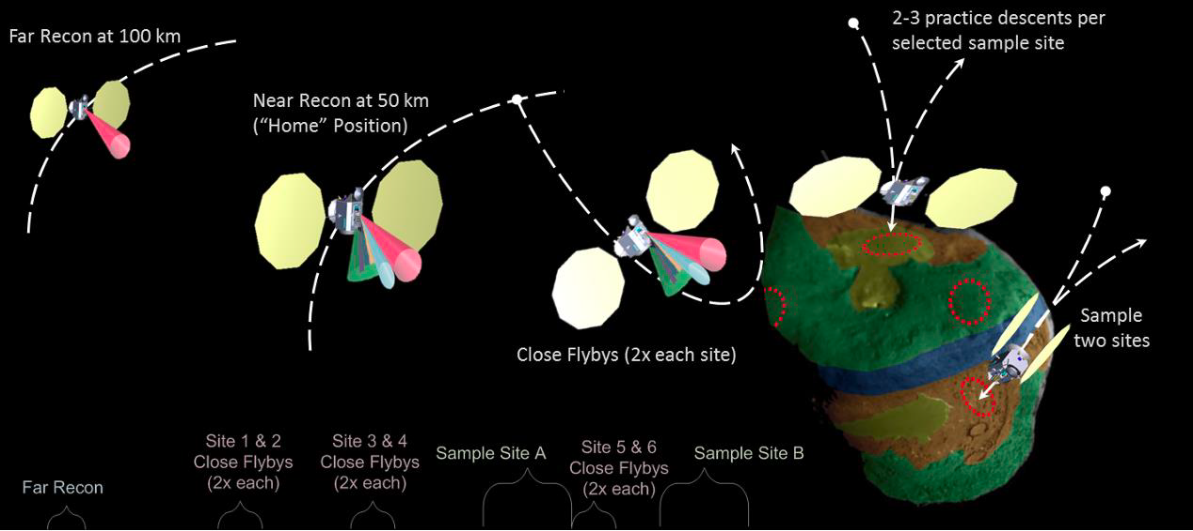
Operating Spacecraft in a Near Nucleus Environment Around Comets
What is the science question? The team outlined the current state of knowledge pre/post-Rosetta for future spacecraft operations and outlined potential hazards when conducting science near a comet nucleus. What began as scribbles on the back of an envelope, developed into sophisticated engineering models of spacecraft behavior. Our article provides recommendations on lessons learned for future long-term operations missions orbiting around a comet.
What were your findings? Spacecraft operations near the nuclei of comets requires the mitigation of risks associated with emitted comet particles, surface topography, and outflowing gas emission, but the potential hazards can be anticipated and prepared for with safe and robust navigation procedures developed and implemented in flight systems. We provide a summary checklist of recommendations for operating cometary mission spacecraft in the near nucleus zone of active comets.
Why does this matter? Sample return from the surface of a comet is listed as a priority for the New Frontiers Mission line in the Decadal Survey. Knowing how to safely operated spacecraft in the near comet environment will be critical to successful sample acquisition and return.
Image: Typical stations in the near-nucleus environment anticipated for a state-of-the-art comet rendezvous & touch-and-go (TAG) sampling mission spacecraft. Image; APL/Scott Sandford
Background: Surface of the nucleus of Comet 67P from 10 km away as seen by Rosetta spacecraft Image credit: ESA/Rosetta/NAVCAM/Wikipedia
Publication citation
C.M. Lisse, M.R. Combi, T.L. Farnham, N. Dello Russo, S. Sandford, A.F. Cheng, U. Fink, W.M. Harris, J. McMahon, D.J. Scheeres, H.A. Weaver, J. Leary, “Operating spacecraft around comets: Evaluation of the near-nucleus environment”,
Acta Astronautica, 2021, https://doi.org/10.1016/j.actaastro.2021.11.030.

