Slide 1
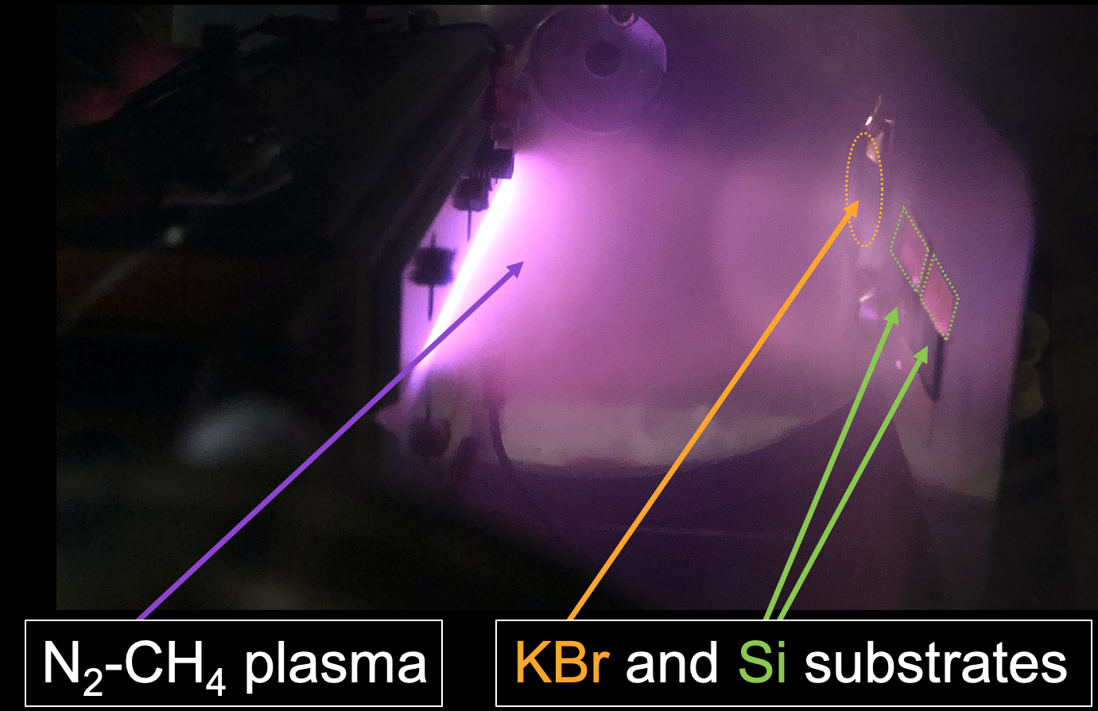
Simulating the Formation of Organics in Titan’s Atmosphere
What is the science question? Titan is often compared to early Earth because of its molecular nitrogen-based dense atmosphere and its methane cycle resembling Earth’s hydrological cycle. The complex organic chemistry in Titan’s atmosphere results in the formation of solid particles that form the haze layers hiding Titan’s surface. These aerosols play an important role in Titan’s atmospheric dynamics, climate, as well as surface composition and processes. The chemical processes leading to the formation of these aerosols, and their composition are still not well understood.
What were your findings? The NASA Ames COSmIC Titan Haze Simulation (COSmIC/THS) experiment allows to simulate Titan’s atmospheric chemistry at low temperature using plasma chemistry. New experimental results from COSmIC/THS have demonstrated the impact the initial molecular precursors have on the nitrogen chemistry during the formation of Titan aerosol analogs, or tholins.
Why does this matter? The differences in chemical and elemental compositions of tholins produced from different precursors illustrate how a change in composition at the location where aerosols are formed in Titan’s atmosphere may lead to variations in the chemical composition and nitrogen content of Titan’s aerosols. These new results may have implications for the development of models and the interpretation of Titan observational data, especially during seasonal changes in Titan’s atmospheric composition.
Publication citation
Nuevo, M., Sciamma-O’Brien, E., Sandford, S.A., Salama, F., Materese, C.K., Kilcoyne, A.L.D. (2021). The Titan Haze Simulation (THS) experiment on COSmIC - Part III. XANES study of laboratory analogs of Titan tholins. Icarus (Accepted 12/04/21)
Main image: Photograph of the plasma expansion generated in
the COSmIC/THS chamber during production of solid particles, analogs of Titan aerosols (‘tholins’), and their deposition onto different substrates.
Background: Image of Titan
credit: NASA/JPL/SSI/composite by Val Klavans

