Slide 1
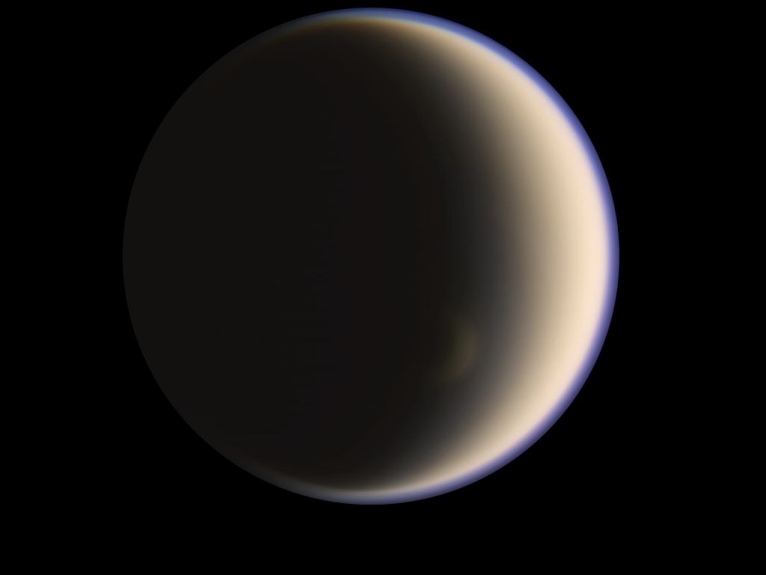
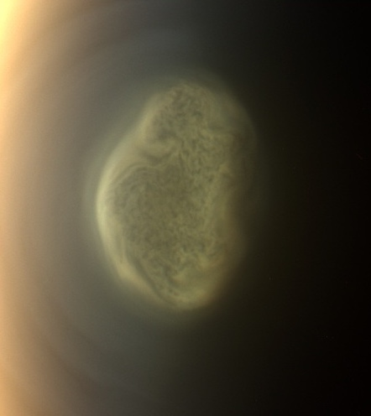
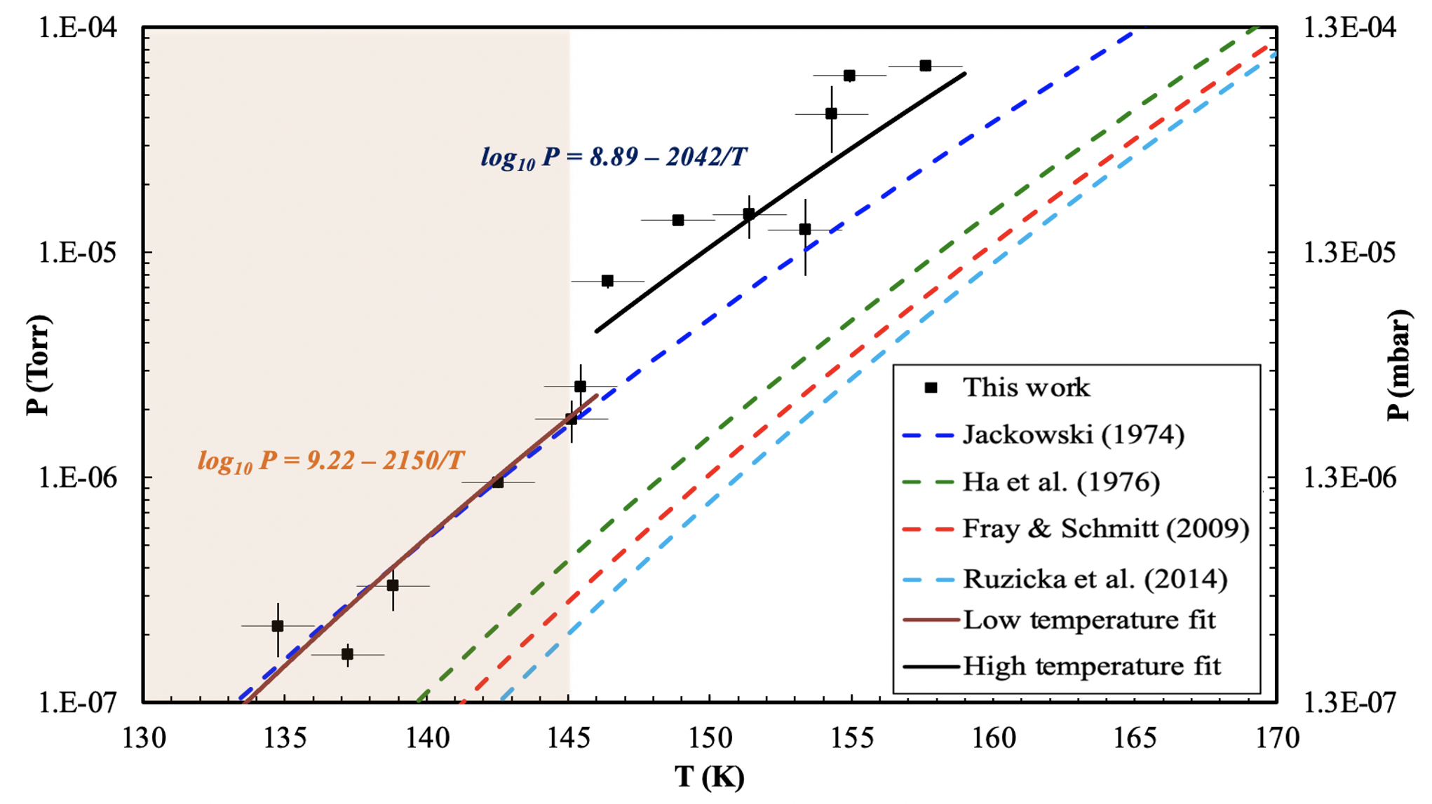
Investigating Benzene (C₆H₆) Cloud Formation in Titan’s South Polar Vortex
A Cross-Divisional Effort Leveraging Earth and Space Science Expertise at NASA Ames
Science Question: High-altitude clouds containing C₆H₆ ice signatures were observed by Cassini in Titan’s south pole. Microphysical models used to simulate the formation of clouds and predict their
vertical distribution need vapor pressures of the species condensing as input. Until now, no measured vapor pressure of C₆H₆ at Titan low temperature (< 180K) were available, and published extrapolations from higher temperature were insufficient to explain the formation of C₆H₆ cloud in Titan’s high altitude south polar vortex.
For the first time, we have measured the vapor pressure of
C₆H₆ at Titan-relevant temperatures. We used the NASA Ames
Atmospheric Chemistry Laboratory (an Earth Science experimental facility)
to characterize the condensation and growth of C₆H₆ ices from 134-158 K. These experimental results were used in the CARMA microphysics model and to reanalyze
Cassini observations. We found C₆H₆ condensed deeper in the stratosphere than
previously estimated using extrapolations, and abundances of up to 1000x higher.
Impact: Synergistic studies combining laboratory, modeling and observation efforts across different disciplines are essential to better understand the complex physico-chemical processes in planetary atmospheres. The results of this CDAP project provided new experimental data that will enable the scientific community to conduct further analysis for multiple applications, and our synergistic approach enabled us to better characterize and predict C₆H₆ cloud formation in Titan’s atmosphere, hence enhancing the science return of the NASA Cassini mission.
Experimental vapor pressure measurements of benzene ice (black) compared with extrapolations from higher temperature data in the literature (Dubois et al. 2021). Note the large difference (red arrow) between current measurements and the red dashed line, which is the most-commonly used parameterization.
D. Dubois, L. Iraci, E. Barth, F. Salama, S. Vinatier, E. Sciamma-O’Brien, “Investigating the Condensation of Benzene (C₆H₆) in Titan’s South Polar Cloud System with a Combination of Laboratory, Observational, and Modeling Tools”, 2:121, The Planetary Science Journal, (2021)

