Slide 1
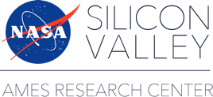
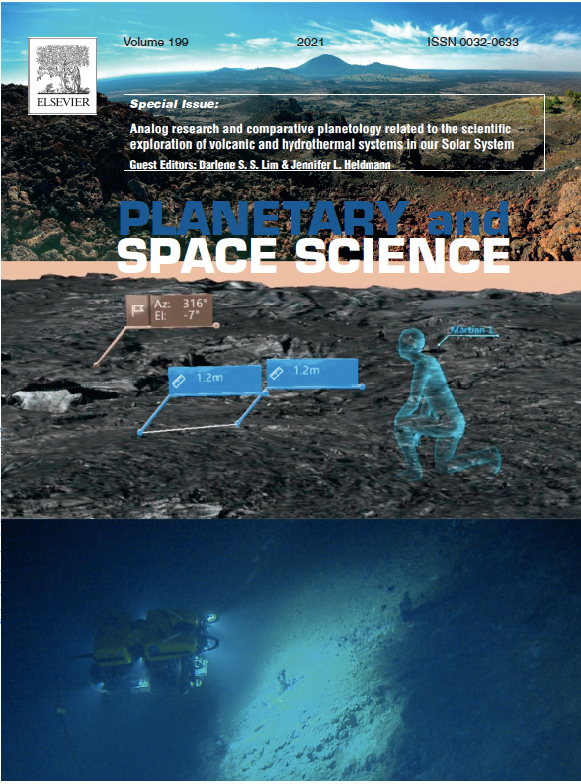
Ames Scientists Publish Special Issue in Planetary & Space Science
Background: As humans and robots explore beyond Earth, it is critical to optimize our scientific understanding and concepts of operations to enable exploration of key terrains including volcanism and hydrothermal systems as prioritized science targets throughout the Solar System.
Findings: A coordinated package of scientific papers was published in a special issue of the journal Planetary & Space Science (PSS), entitled: “Analog research and comparative planetology related to the scientific exploration of volcanic and hydrothermal systems in our Solar System”. This issue was edited by Darlene S. Lim and Jennifer L. Heldmann.
Impact: This collection of papers focuses on recent results from studies associated with three ARC-led terrestrial analog research programs: FINESSE (Field Investigations to Enable Solar System Science and Exploration), BASALT (Biologic Analog Science Associated with Lava Terrains), and SUBSEA (Systematic Underwater Biogeochemical Science and Exploration Analog). These research programs required coordination between agency, academic, industry and not-for-profit partners, and ranged in size from 35 to 100+ research, logistics and operations stakeholders. These analog programs integrated across various research domains (e.g., natural sciences, social sciences, operations, engineering, design) to address research goals aimed at advancing the human and robotic exploration of volcanic and hydrothermal systems in our Solar System.
A complete list of all papers in the PSS Special Issue can be found at: https://www.sciencedirect.com/journal/planetary-and-space-science/special-issue/104MT6CZR26

