Slide 1
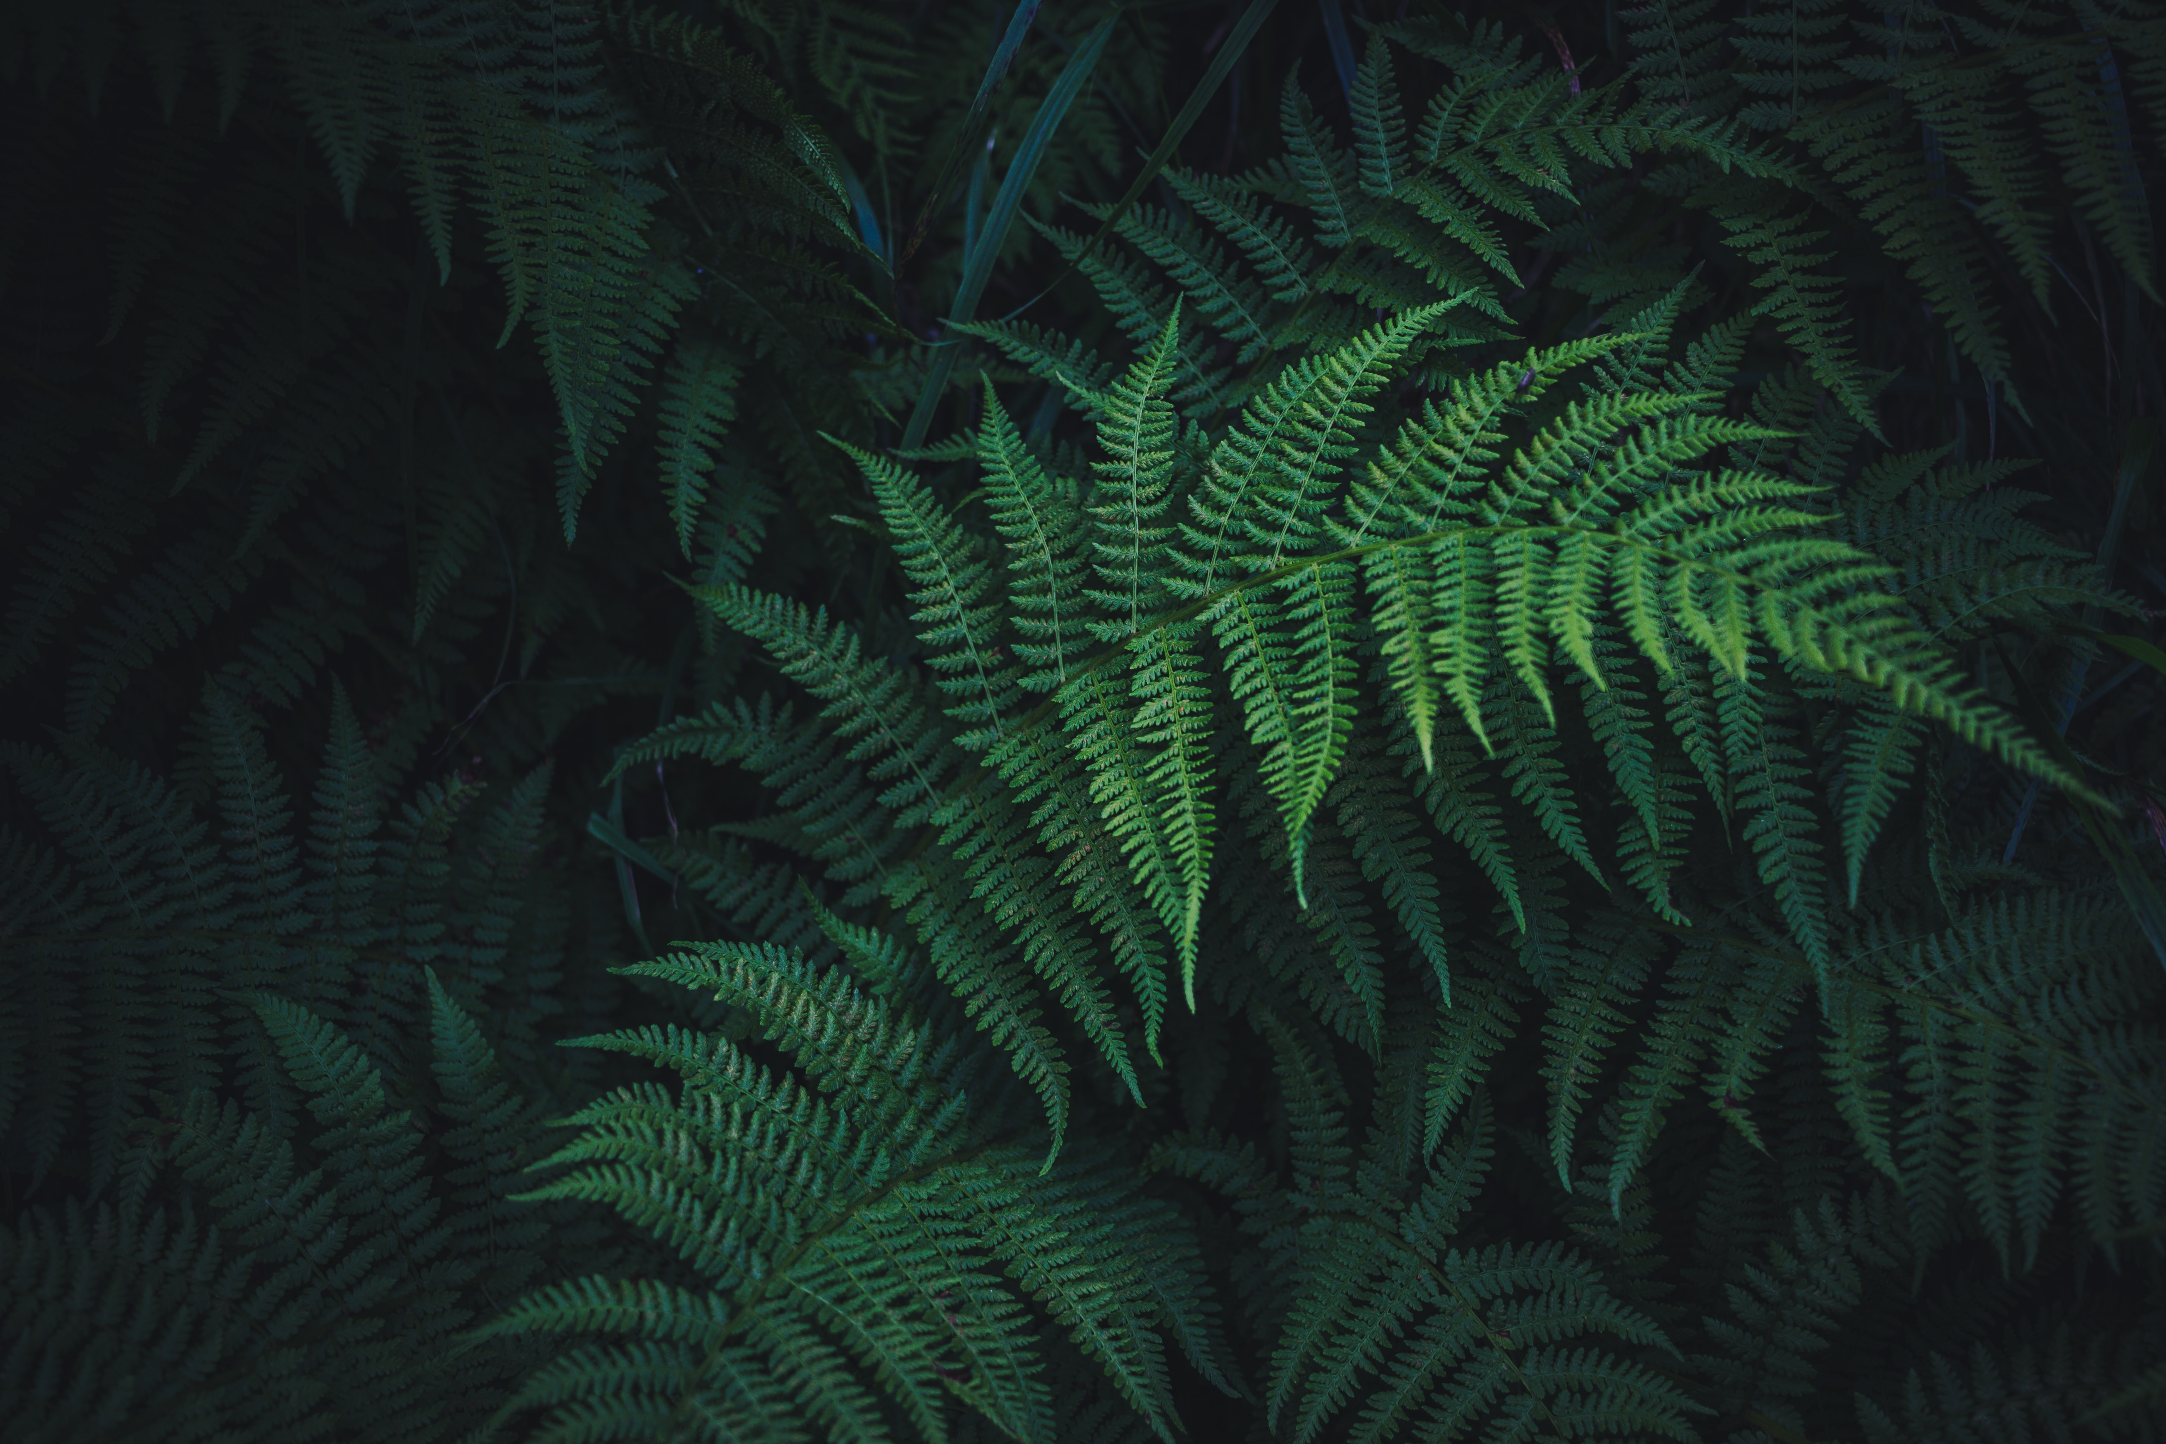
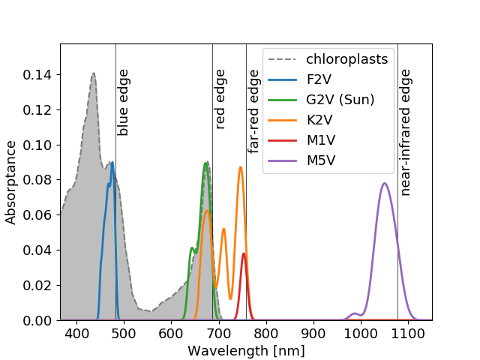
The Color of Plants Around Other Stars
Science question. Plants on the modern Earth preferentially reflect green light in the visible wavelengths and strongly reflect light just beyond the visible in the near-infrared. If alien plants exist on other planets, it remains unknown if they might reflect similar colors of light or if they will perhaps reflect different colors than plants on the modern Earth.
Findings. Using a computer simulation that predicts the colors of light reflected from extant Earth organisms, we calculated how plant colors might change around other stars. Around stars hotter than the Sun, we might expect alien plants to preferentially reflect blue light, while around stars much cooler than the Sun, plants might preferentially reflect infrared light.
Why does this matter? Future NASA missions will directly observe Earth-like exoplanets orbiting nearby stars to search for signs of surface life. If alien vegetation exists on such worlds, perhaps similar to trees on the modern Earth, it could be detected by the colors of light it reflects, which we predict with our simulation.
The colors of light preferentially absorbed by alien plants around different stars from our computer simulation. The gray shaded region represents the absorption of spinach chloroplasts. The colored lines show the predictions of our simulation. The vertical black lines labelled “edge” are the wavelengths of light we might expect alien plants to preferentially reflect, which we can search for with future NASA telescopes.
Lehmer, O.R., Catling, D.C., Parenteau, M.N., Kiang, N.Y., Hoehler, T.M., 2021. The peak absorbance wavelength of photosynthetic pigments around other stars from spectral optimization. Front. Astron. Space Sci. 8. https://doi.org/10.3389/fspas.2021.689441

