Slide 1
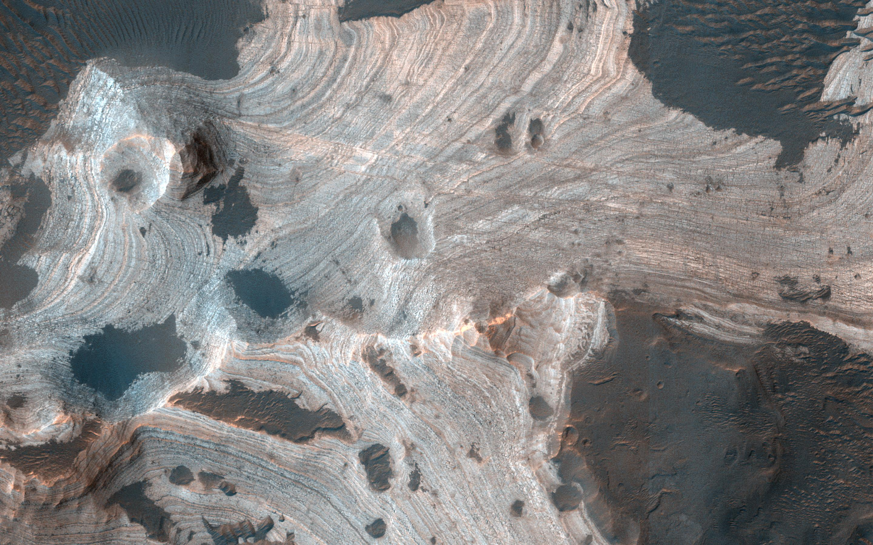
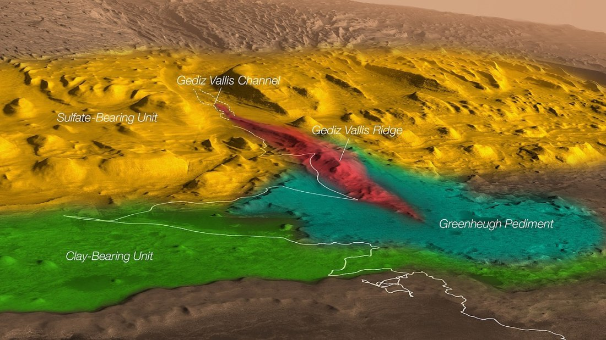
Climate Driven Destruction of Clay Minerals on Mars
Science Question. On Mars, billion-year-old sedimentary rocks containing clay minerals are key indicators of ancient habitable environments and may preserve organic compounds. On Earth, where plate tectonics drives the burial and heating of rocks, clay minerals are transformed into new minerals, influencing organic preservation, and impacting global geochemical cycling of carbon, oxygen, and water. Mars lacked plate tectonics for much of its history, but data from Mars Science Laboratory Rover, Curiosity, point to another process influencing clay minerals in ancient rocks.
Findings. Curiosity examined a lateral transect of 3.5-billion-year-old rocks that formed in a lake that once occupied the floor of Gale crater. This investigation revealed that clay minerals were destroyed and converted into iron oxide minerals by salty solutions (brines) in some areas. These brines were generated and sunk into the subsurface when the martian climate changed and the planet started drying out.
Why does this matter? The global distribution of sulfate minerals detected by Mars orbital spacecraft indicate the production of brines and thus the potential influence on clay mineral-bearing rocks was widespread. The conversion of clay minerals to iron oxides released water and would have helped counter planetary desiccation, perhaps prolonging habitability. Destruction of clay minerals will have also influenced the preservation of organic compounds in the martian rock record. The mineral signatures of brines discovered at Gale will help current and future Mars missions select well-preserved samples and targets.
T. F. Bristow, J. P. Grotzinger, E. B. Rampe, et al. Brine-driven destruction of clay minerals in Gale crater, Mars. Science. Vol 373, Issue 655. doi.org/10.1126/science.abg5449
Vera Rubin ridge
A view of rock strata exposed at the base of Aeolis Mons (Mt. Sharp) in Gale Crater. Various rock units (based on orbital mineral detections) and geomorphic features are highlighted in color. The white line shows the path of the Curiosity rover. Mineralogical comparisons of ancient lake strata analyzed from the ‘Clay-bearing unit’ and ’Vera Rubin ridge’ were the focus of this study.

