Slide 1
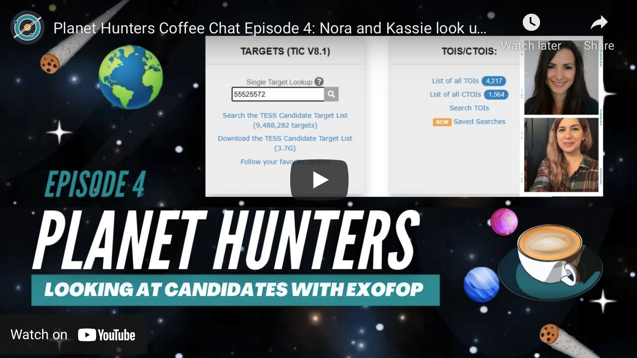
Do Live Science: Join the Search for Undiscovered Worlds
Science Background. Scientists and the public have teamed up on NASA citizen science projects and have made thousands of important discoveries. Planet Hunters Coffee Chat is a new, community-driven, online citizen science project that provides opportunities to collaborate with scientists and hunt for exoplanets - planets outside Earth’s Solar System. The project works in collaboration with NASA Ames Code S, Zooniverse, University of Oxford, and is complementary to the Planet Hunters TESS project.
Impact. Planet Hunters Coffee Chat can be done by anyone, anywhere, anytime with just a laptop and cellphone. Citizen science volunteers participate in the scientific process by formulating research questions, collecting and analyzing data, interpreting results, making new discoveries, and contributing to scientific papers. Volunteers use the same tools and resources astronomers use to make credible discoveries. All the necessary tools to assist astronomers in locating planets outside our Solar System are readily available in the Planet Hunters Coffee Chat - videos, documents, and coding scripts.
Planet Hunters Coffee Chat relies on public involvement and interactivity between volunteers and astronomers. Coming soon are regular face-to-face online interactions that will occur during “office hours” and live discussions where volunteers meet with astronomers to ask questions.
In Planet Hunters Coffee Chat Episode 4, ExoFOP – the Exoplanet Follow-up Observing Program – is explained by Code S’s Kassie Perlongo and Oxford University’s Nora Eiser, who co-manage the citizen science project Planet Hunters Coffee Chat.

