Slide 1
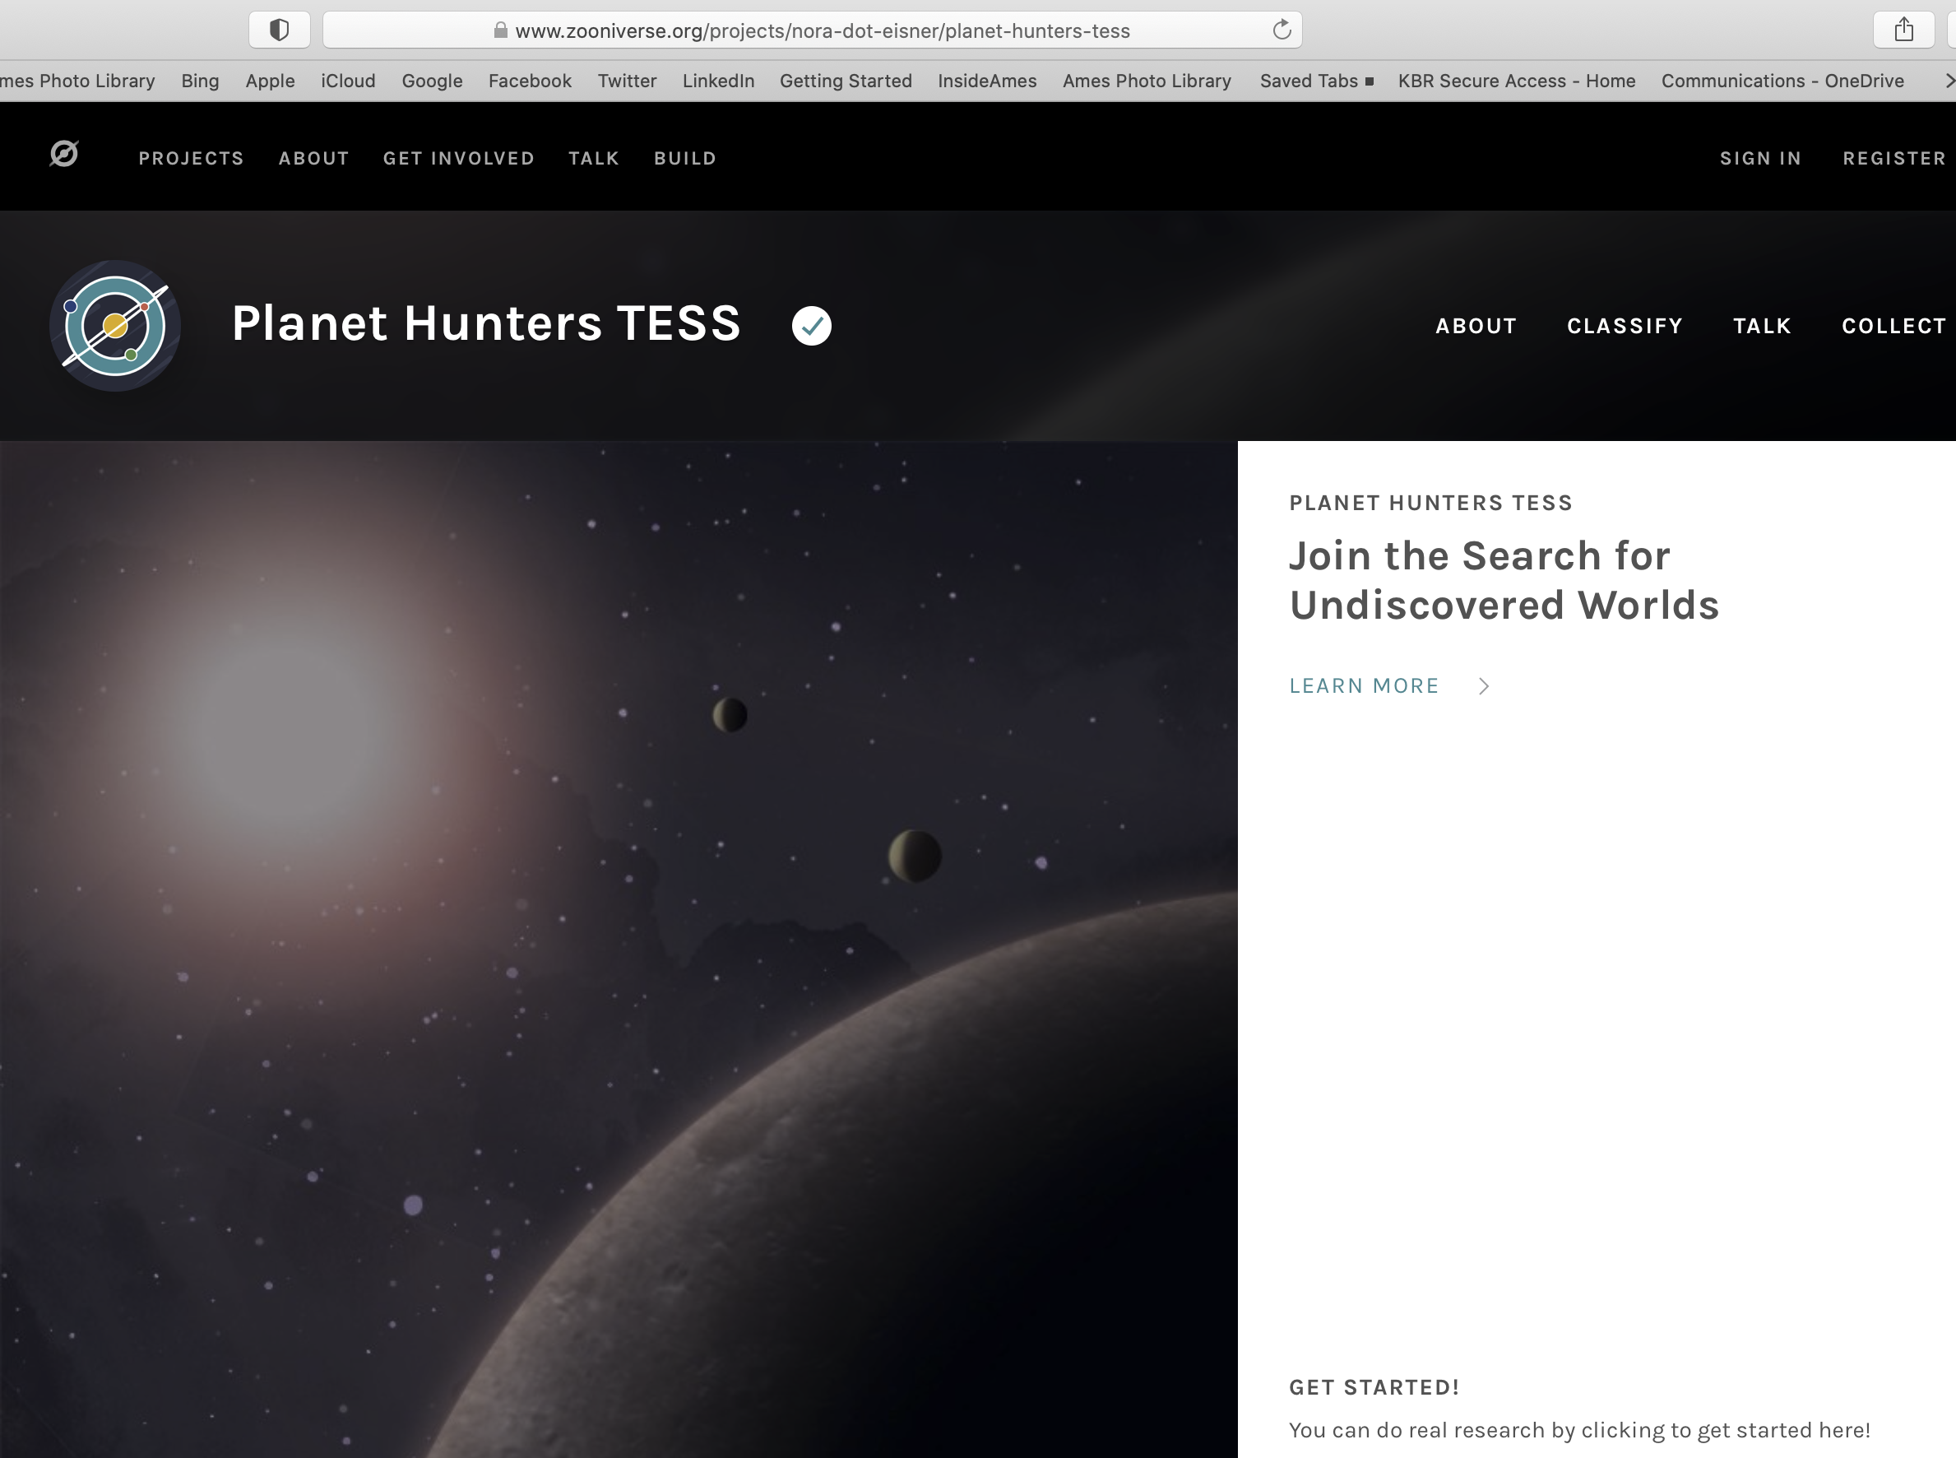
Maintaining Critical Open Source Community Software for NASA’s Kepler, K2, and TESS Data Archives
Science Background. Geert Barentsen’s (SSA/BAER) proposal, “Maintaining Critical Open Source Community Software for NASA’s Kepler, K2, and TESS Data Archives to the Astrophysics Data Analysis Program” has been selected for funding.
Findings. This newly funded project is focused on maintaining and expanding a popular open-source Python package, Lightkurve, which was developed at NASA Ames to facilitate the use of data from NASA’s Kepler, K2, and TESS missions.
Impact. This open-source software package garners ~150 citations annually and has been widely adopted among citizen scientists participating in the Planet Hunter TESS project. It is also being used to support several courses at top-ranked national observatories. The awarded proposal will fund continued development, user support, and the development of additional tutorials.
.
Lightkurve, open-source community software developed at Ames is used in the citizen science project Planet Hunters TESS to help find exoplanets using your own eyes. It does this by having users analyze data from the NASA Kepler space telescope and the NASA Transiting Exoplanet Survey Satellite.

Slide 2
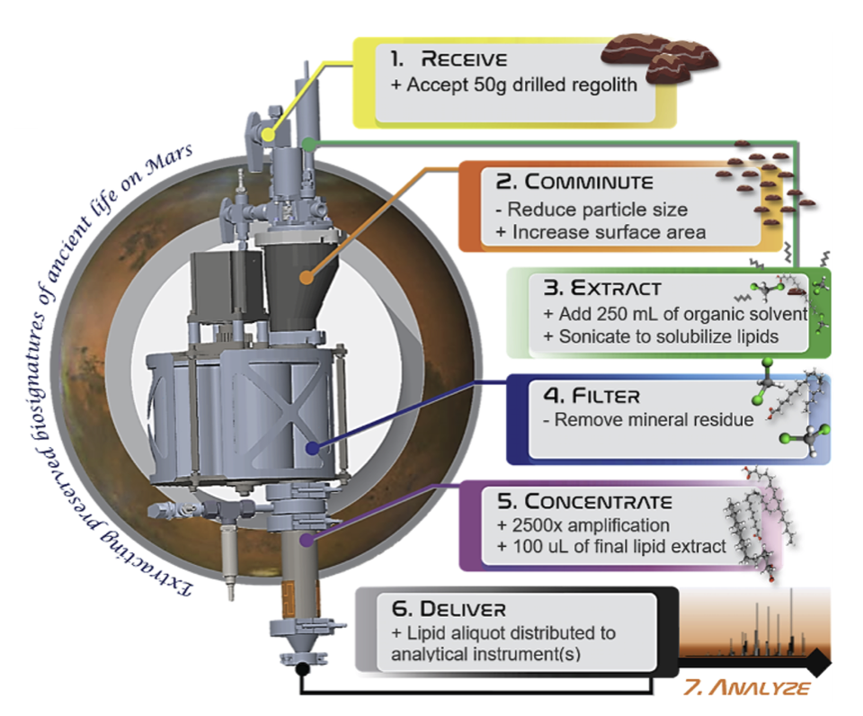
New Proposal Funded to Improve Technology to Search for Life on Mars and Icy Moons
Science Background. Mary Beth Willhelm (SST) and her team's "KAMELOT" (Kerogen and Macromolecule Extractor Liberating Organics Thermolytically) proposal has been selected for funding through NASA’s Science Mission Directorate’s Planetary Science Division’s "PICASSO" (Planetary Instrument Concepts for the Advancement of Solar System Observations, NNH20ZDA001N-PICASSO) research element.
The PICASSO Program supports the development of spacecraft-based instrument systems that show promise for use in future planetary missions. The goal of the program is to conduct planetary and astrobiology science instrument feasibility studies, concept formation, proof of concept instruments, and advanced component technology development.
Impact. The KAMELOT proposal is one of only 10 selected out of 94 proposal submissions this year. It will help improve technology to search for life on Mars and Icy Moons and will significantly augment the capabilities of the team’s existing "ExCALiBR" (Extractor for Chemical Analysis of Lipid Biomarkers in Regolith) sample processing system.
The ExCALiBR fluidic system will enable six key steps required to extract potential biomarkers from rock powders on Mars and deliver extracts to instruments for analysis.

Slide 3
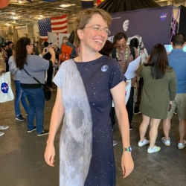
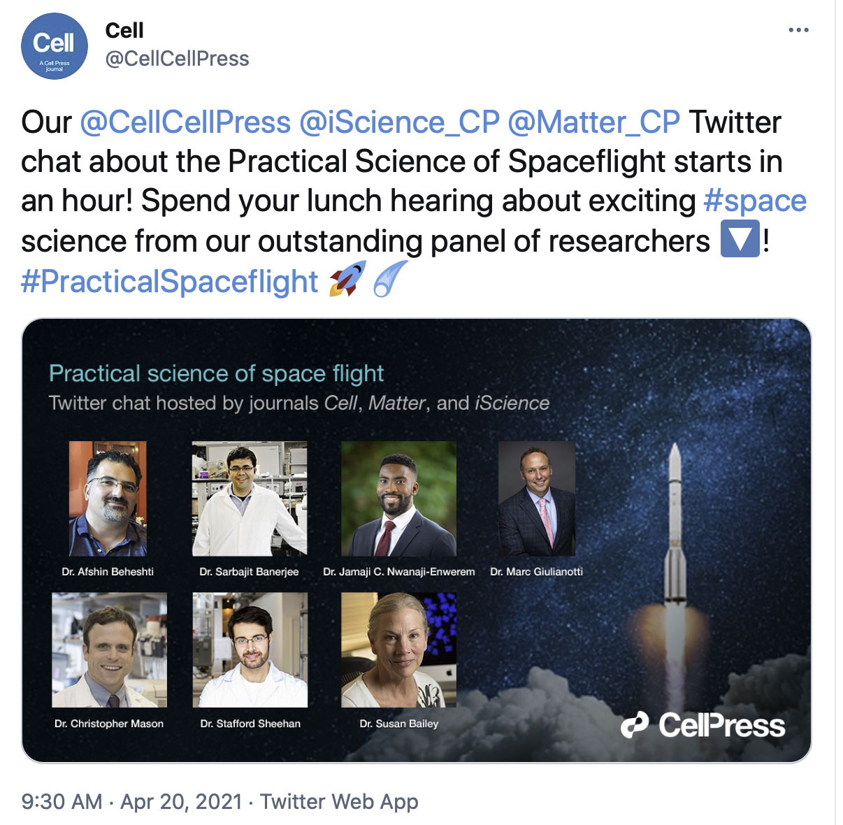
Science Education Outreach: Virtual Colloquium to Live Twitter Event
Science question. Why is science education outreach important?
Findings and impact. Kimberly Ennico-Smith (SSA) gave an invited, virtual colloquium to San Francisco State University’s Dept. of Physics and Astronomy on April 28 as part of the SFSU’s Women in Science and Engineering (WISE) Distinguished Speaker Series. Ennico-Smith also met with WISE faculty and students from the Women in Physics and Astronomy group. In her talk, “VIPER - A Next Great Leap in Mapping Water on the Moon,” she provided an overview of the current understanding of lunar water and how the NASA Ames-led VIPER mission will provide important ground truth to unanswered questions about lunar water origins and utilization.
https://cose.sfsu.edu/wise-events
Afshin Beheshti (SCR) was invited to participate in a live Twitter event with Cell Press on the Practical Science of Spaceflight. The one-hour event was hosted by Cell, Cell Matter, and iScience on April 20. Beheshti and five additional scientists were asked questions about spaceflight from the Cell Press editors and audience members. The tweets were viewed 500,000 times! The Cell editors conveyed to Beheshti the great success this event.
https://twitter.com/CellCellPress/status/1384545061954899971

