Slide 1
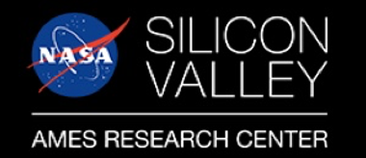
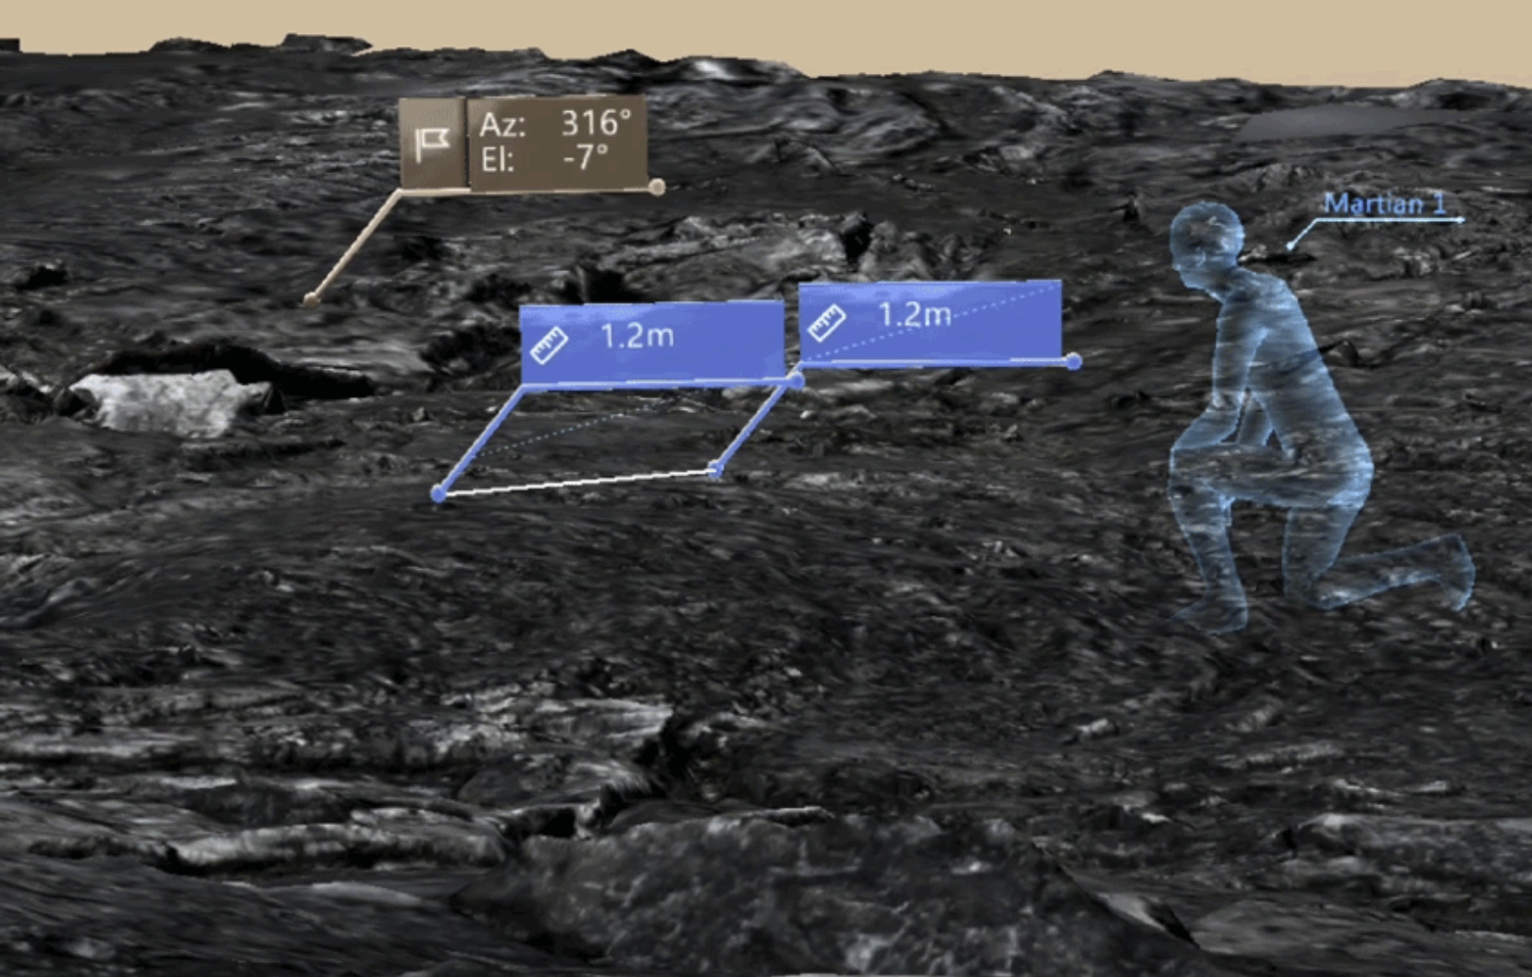
Science Education Outreach: Public TV and Radio, Science Societies and Live NASA Broadcasts
Science question. Why is continued science outreach important?
Findings and impact. Public television’s KQED-TV San Francisco featured a newsroom program on the James Webb Space Telescope and The Search for Exoplanets with Natasha Batalha (SST) and Natalie Batalha (University of Santa Cruz and formerly SST). The mother-daughter interview on April 1 can be viewed at: https://ww.youtube.com/watch?v=HD_02wsYlyU
National Public Radio’s Share Your Science StoryCorps program (Science Directorate) interviewed Diana Gentry (SGE) about her work studying survival and dispersal of microbes in Earth’s atmosphere and the possibility of life in the clouds of Venus. For this and 16 more interviews of Code S personnel, go to: https://archive.storycorps.org/interviews/i-believe-the-future-of-humanity-lies-beyond-the-surface-of-the-earth-iwant-to-help-make-this-possible-an-interview-with-diana-gentry
Jeff Moore (SST) spoke at the Mount Diablo Astronomical Society meeting on The Ocean World Europa and NASA’s Europa Clipper Mission: Exploring a Potentially Habitable World as an overview of the geology of Europa and its ice-covered ocean ,and why it’s possible that it could be an abode for life. Over 70 people attended on Zoom.
Mixed reality technologies, like virtual reality headsets or augmented reality apps, aren’t just for entertainment – they can also help make discoveries on other worlds like the Moon and Mars. In a recent NASA Science Live Broadcast, Darlene Lim (SST) starred in Episode 30- Modern-day Explorers Search for Life Beyond Earth and spoke about how NASA scientists are testing technologies and tools to gain insight into how they can be used to make valuable contributions to science. Check out: https://www.nasa.gov/feature/ames/analog-missions-mixed-reality
Researchers on the Biologic Analog Science Associated with Lava Terrains team found mixed reality technology, like the augmented reality in use here assisting in taking measurements, allowed explorers in the field to send data visualizations back to a science team, which in turn could conduct complex analyses to inform where the field team would go next. Here, we can see a distance measured between two points and information on the elevation and orientation of the field site. (Image credit: JPL)

