Slide 1
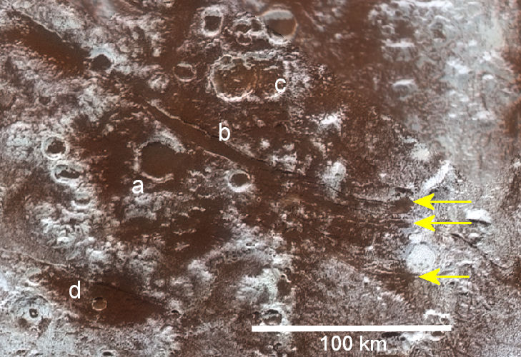
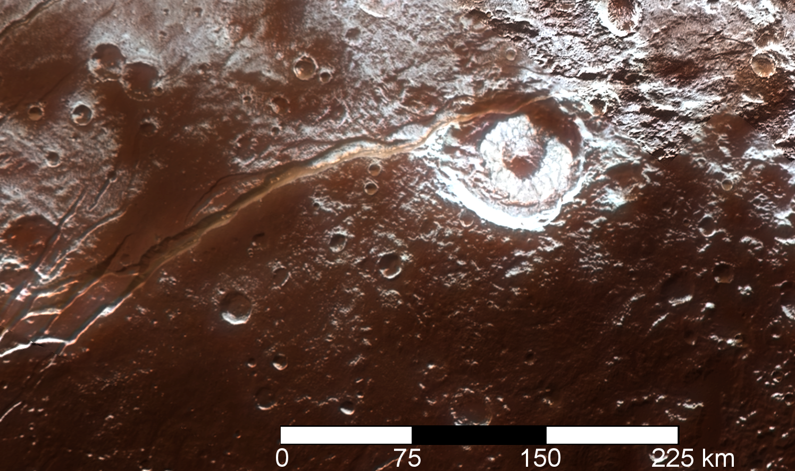
Ice Volcanoes Emerge from Flooding in Viking Terra on Pluto
Science Background. A cryolava erupted from a fluid reservoir or global ocean in Pluto’s interior. We wanted to investigate this discovery and its chemical clues regarding its origin and evolution of the dwarf planet.
Findings. The flood crater has (a) a tectonic trough (b) fractured crust of Viking Terra, west of Sputnik Planitia. The material consists of water ice that carries a red-brown pigment and an ammonia compound, discovered in New Horizons data. A nearby fissure (d) may be the site of a fountaining volcanic eruption.
Impact. The flooding in Viking Terra is a manifestation of past episodes of cryovolcanic activity that is also seen in other nearby structures, such as Virgil Fossa and Elliot crater, shown in the second picture to the right. The morphology and composition in this region are indicative of cryovolcanism.
Publication citation:
Cruikshank et al. Cryovolcanic flooding in Viking Terra on Pluto,. Icarus. Volume 356, 2021, 113786.
c
b
a
d
Virgil Fossae
Elliot crater

