Slide 1
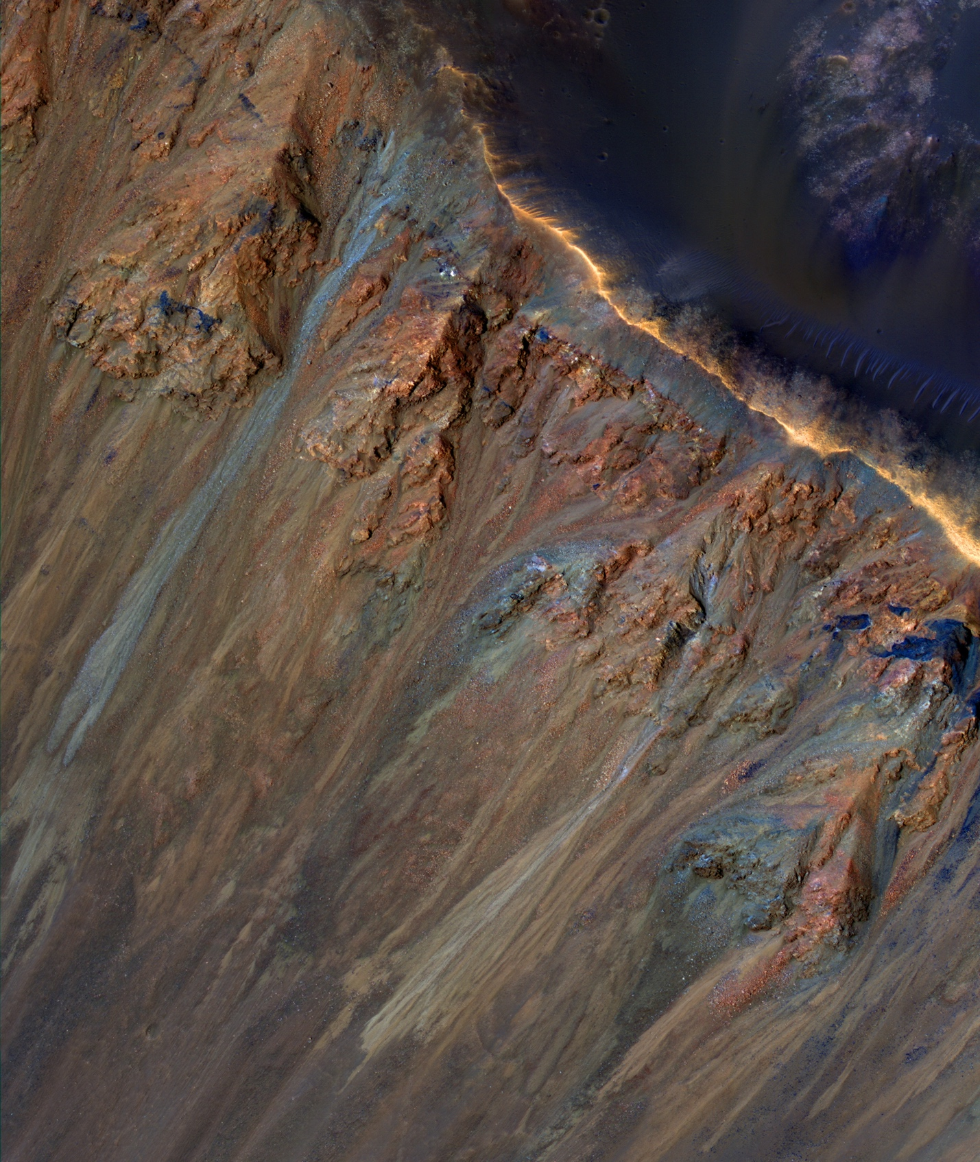
Are Martian Landslides Caused by Microscale Melting Ice and Underground Salts?
What is the science question? Different theories have been proposed for landslides and seasonal flows of material on the Martian surface, but none completely explain these intriguing features. Chloride (Cl) salts and melting ice have been considered previously, but those scenarios were not fully consistent with Martian environments.
What were your findings? Bishop et al. recently proposed a new theory based on field studies, geochemical models and lab experiments, demonstrating that melting of near-surface ice imbedded in permafrost occurs at cold temperatures through interactions with salts. This creates a liquid-like slush that further facilitates migration of salts in the regolith and produces unstable surfaces that can be shifted by dust storms and wind. This hypothesis arose from observations of gypsum voids in the Salar de Pajonales, sink holes near the Dead Sea in Israel, cave collapse in sulfate karst systems, and migration of salts below the surface in Antarctic sediments. Lab experiments with Cl salts and gypsum imbedded in Mars analog volcanic soil further clarified migration of these salts and the power of interactions of Cl salts with sulfates in this matrix.
Why does this matter? This new theory suggests that Mars’ subsurface continues to evolve and may contain thin films of water, with opportunities for the field of astrobiology and human exploration.
Publication citation:
Bishop, J.L. et al. (2021) Martian Subsurface Cryosalt Expansion and Collapse as Trigger for Landslides. Science Advances, Feb. 3rd.
View of gullies along the rim and relative sea level lower on the wall of Krupac crater on Mars. Credit: NASA/JPL/UArizona.

