Slide 1
The Challenges of Managing Small Space Flight Projects
Butler Hine
Flight Project Manager
NASA Ames Research Center
butler.p.hine@nasa.gov

Slide 2
Summary
NASA Flight Projects range from enormous flagship missions that cost multi-$B down to CubeSat technology demonstration missions that cost less than $100K. All of these projects have aspects in common and aspects that are very different. NASA has steadily been moving from a one-size-fits-all approach to flight projects towards allowing a significant range of risk postures, processes, and mission assurance. This talk will go over the common aspects of all flight missions, and the particular challenges of managing small, low-cost missions with limited resources. We will try to answer the question of which type is harder to manage.
Notes:
Theme: Why MDC and NOC
The Center has made an decision to pursue Space flight missions
To achieve this the Center needs to design mission concepts, and turn those missions concepts into mature mission proposals to win Agency announcements of opportunity as well as other proposal opportunities.

Slide 3
My Background
Trained as an Astronomer
So a weird hybrid between a Scientist and an Engineer
Started with Instrument Development
Instruments are mini-projects and have all aspects
Moved into Planetary Robotics
Learned Systems Architecture, Systems Engineering and Integration
Moved into Spacecraft Design
Carries the instruments and enables the science
Involved in a Range of Projects:
Skunkworks (Rovers, Landers)
Commercial (LM A2100)
Medium (Pathfinder, LRO, LADEE, Arcus, HS)
Larger Missions are more rewarding, but Skunkworks are more fun

Slide 4
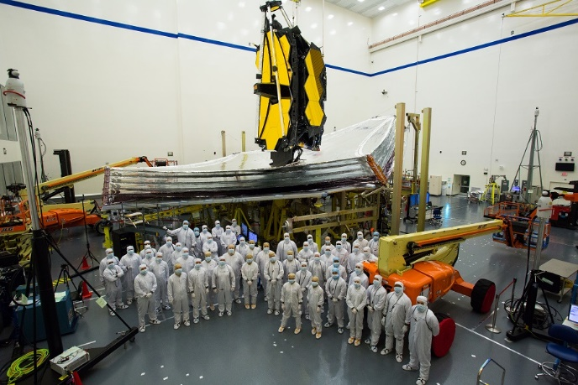
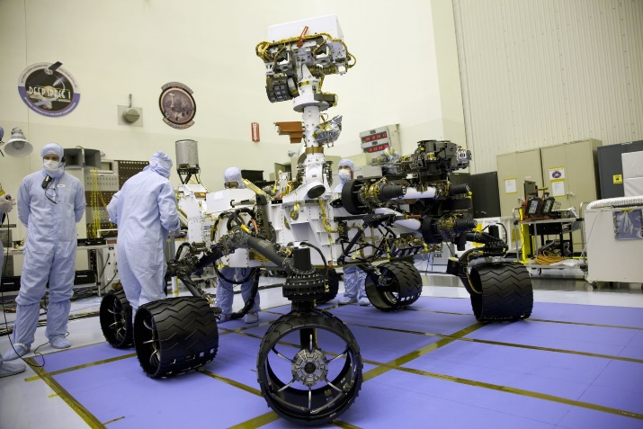
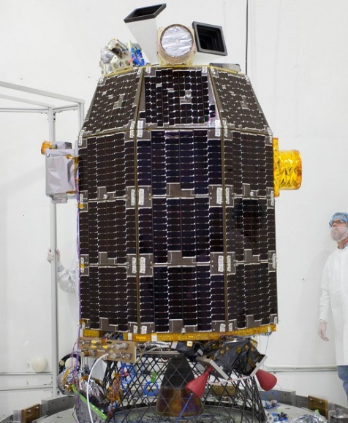
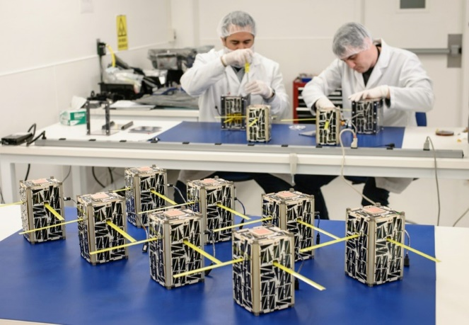
Project Sizes
Sizes range orders of magnitude from very large (Flag Ship) to very small (CubeSat)
Larger missions have low risk posture
Class B
MIDEX missions are the middle
Class C
Smaller missions have higher risk posture
Class D or even lower

Slide 5
Project Management Models
NPR 7120.5 provides the NASA Space Flight Program and Project Management Requirements
One size fits all has been a recurring problem
Attempts at adjusting the model over time
NPR 7120.5 Rev F is the latest coming out
One of the changes is Enhanced Tailoring Guidance
NPR 7120.8 provides the NASA Research and Technology Program and Project Management Requirements
Is becoming more acceptable for some space flight missions
Mostly technology missions in the past, but some are large (e.g. VIPER)

Slide 6
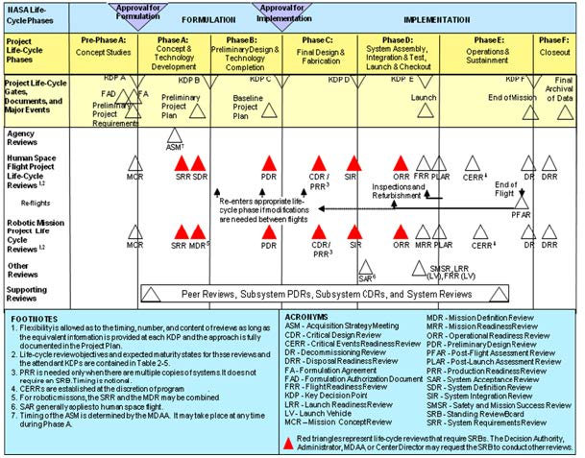
Project Management Models
NPR 7120.5:
One-size-fits-all…except
Covers a range from Human Spaceflight (Class A) through Small Robotic Missions (Class D)
Past efforts at streamlining have occurred around Class D missions

Slide 7
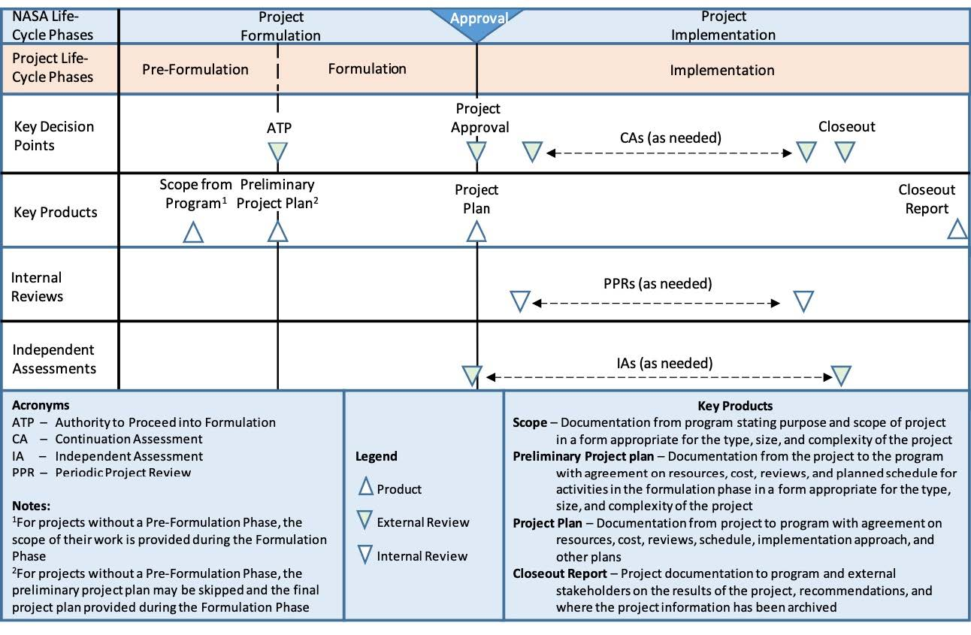
Project Management Models
NPR 7120.8 is simpler in structure and easier to tailor
Becoming more acceptable for some space flight missions
Mostly lower cost technology missions in the past, but some are getting larger

Slide 8
Similarities
Complexity of Interfaces
SmallSats often have the same number and complexity of interfaces
Systems Engineering
Even for smaller teams, the SE principles are still important
Operations
To MOS, all missions are points in space
Note: LEO is the exception, because of the support infrastructure
The main variability is the operational risk posture
Systems Block Diagram
components are smaller but the diagram is often the same

Slide 9
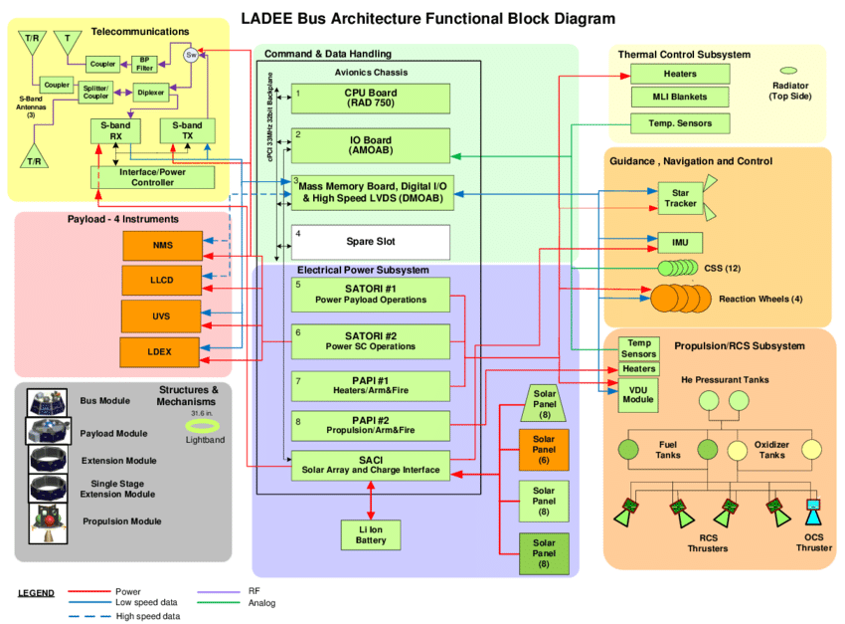
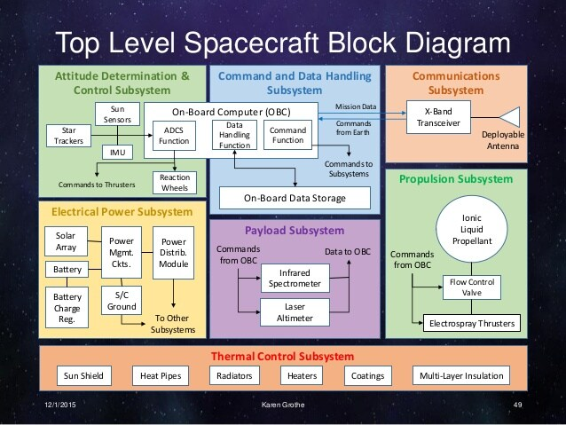
Similarities
Systems Block Diagram
MIDEX
CubeSat
Credit: Biswas, Gautam & Khorasgani, et al. (2016). An Approach To Mode and Anomaly Detection With Spacecraft Telemetry Data. International Journal of Prognostics and Health Management.
Credit: Karen Grothe Capstone Project: Conceptual Mercury CubeSat Mission, Loyola Marymount University

Slide 10
Differences
Small Missions have Fewer Cost Reserves (if any)
Smaller 0-10% vs Larger 25-30%
Schedule
Larger Missions: Funded Schedule Reserve along Critical Path at Risk Points
Smaller Missions: Unfunded Margin at end after delivery
Limited Technical Depth
More dependent on organizational back-fill support
Launch Arrangement
Larger Missions usually have dedicated rides
Smaller Missions are often Secondary Payloads or Ride Share
GSE Approach (Lifts, Transport, etc.)

Slide 11
Differences
Schedule Margins
MIDEX: Distributed on CP at Risk Points
Small Missions: Held at I&T or Storage
Cost Reserves
MIDEX: 25%-30% CTG
Small Missions: 0%-10% ATP

Slide 12
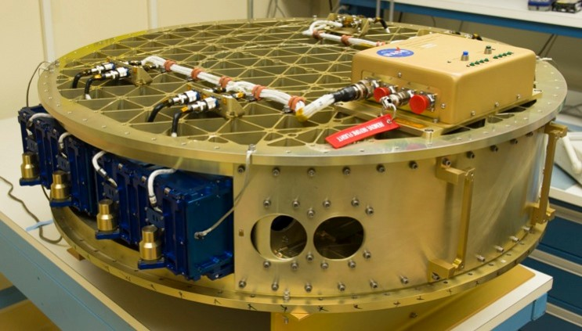
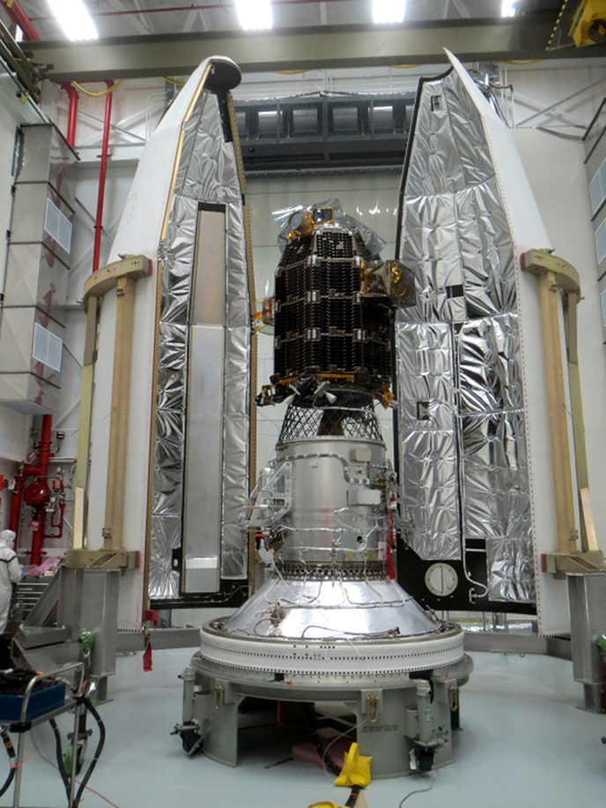
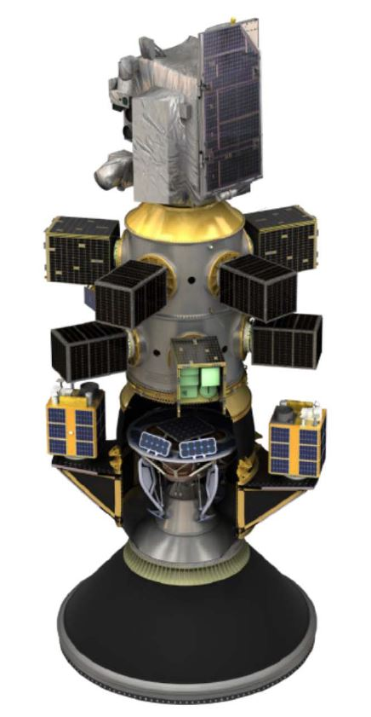
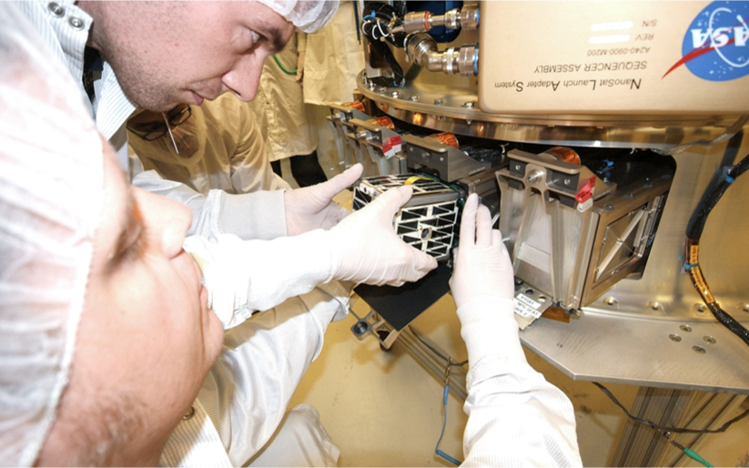
Differences
Launch Access
CubeSat
RideShare
Primary
Credit: Caffrey - Rideshare/Multi‐Manifest Payload Overview 2019

Slide 13
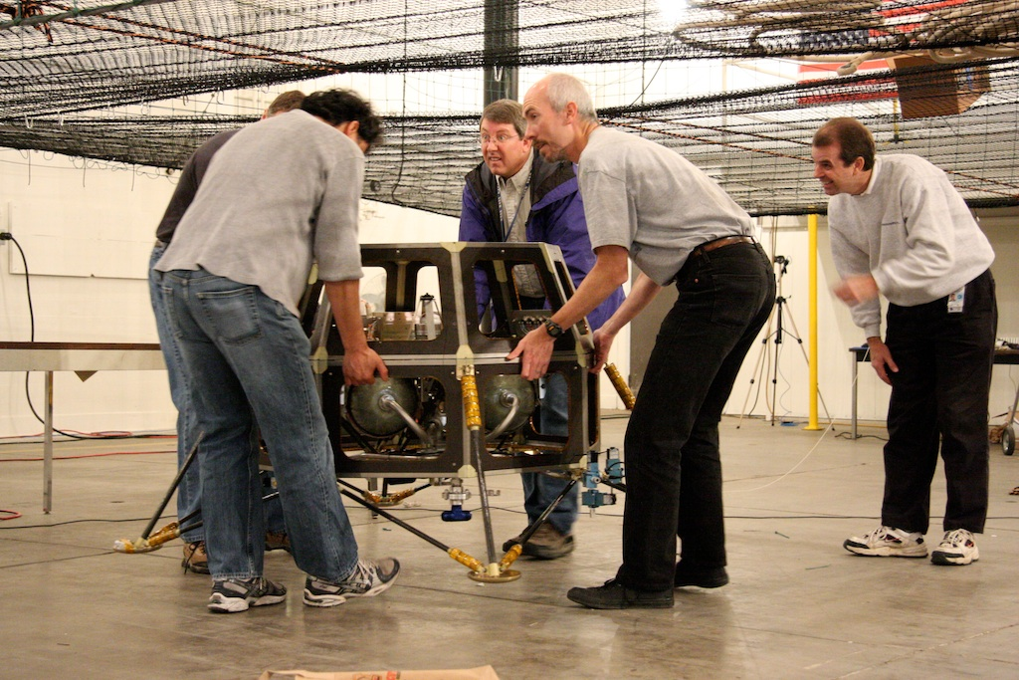
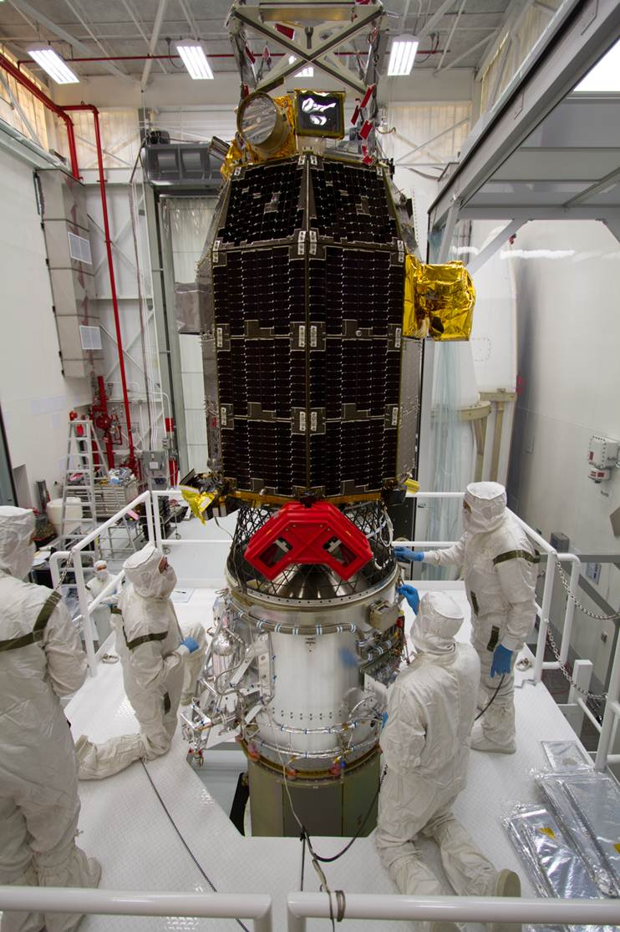
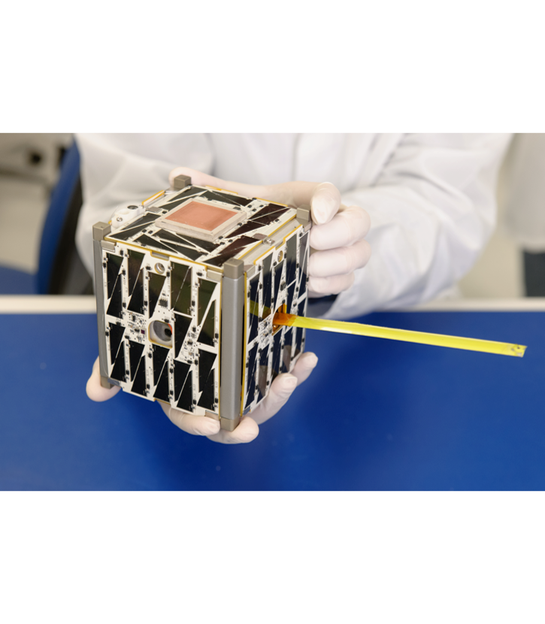
Differences
Critical Lifts
Skunkworks
CubeSat
MIDEX

Slide 14
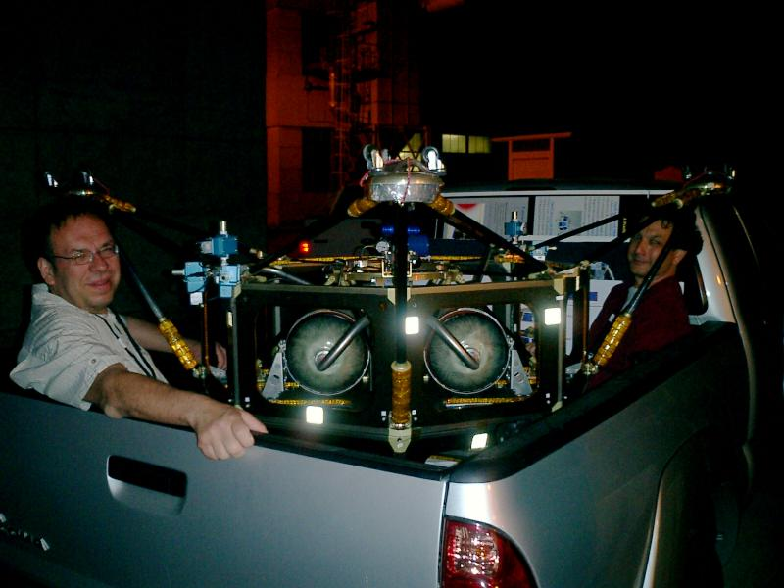
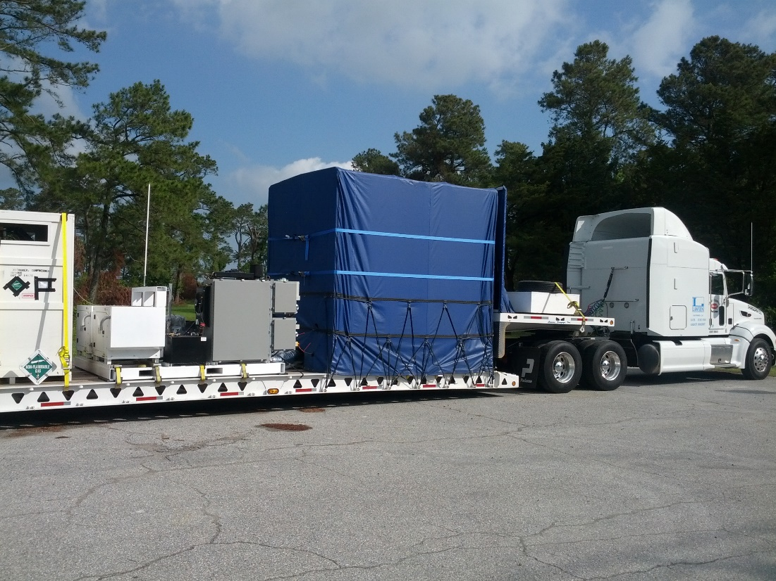
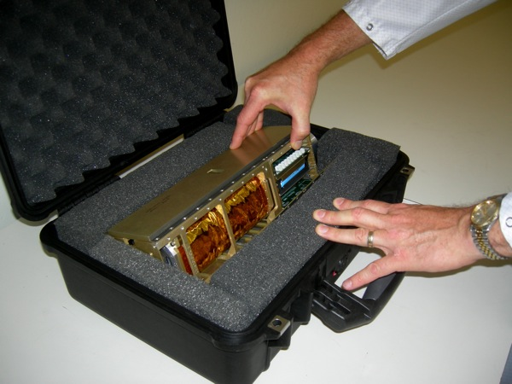
Differences
Transport
Skunkworks
CubeSat
MIDEX

Slide 15
Management Challenges for Small Projects
Organizational Priority
Small Projects are usually lower priority for senior management
Lack of key tools to solve problems:
Minimal cost and schedule reserves
Fractional Staff:
Competing priorities with their other work
Type of Staff:
Breadth vs Depth
Attracting Heavy Lifters

Slide 16
So Which Size Project is Harder to Manage?
Project Manager
Smaller projects are more difficult to staff
Smaller projects are more brittle to problems
Smaller projects have fewer tools available to solve problems
But
Larger projects have much more complicated organizational issues
Larger projects have tremendous execution inertia, so often less nimble
Larger projects have a lot more politics
Larger projects fail more spectacularly
Conclusion: I think smaller projects are more difficult to manage,
but provide excellent opportunities to gain experience.
Project Manager

Slide 17
Questions?

