Slide 1
Small Spacecraft Reliability
John W. Evans, NASA OSMA
Tony DiVenti, NASA, GSFC, SMA
March 28, 2016

Slide 2
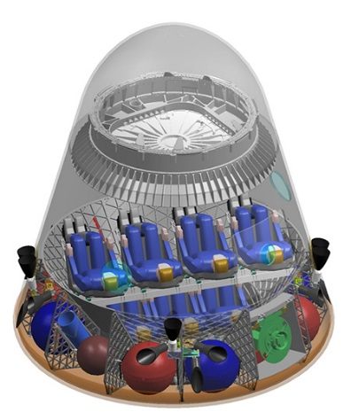
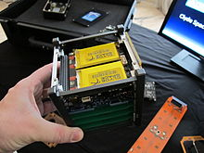
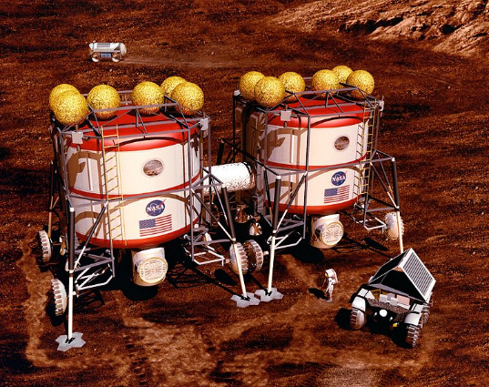
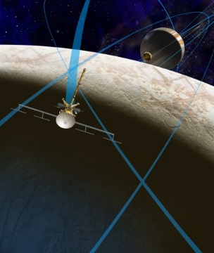
NASA Diverse Challenges
Commercial Crew
Small Sats
Mars
Europa and Beyond

Slide 3
NASA OSMA Small Spacecraft Reliability Efforts
Data Tracking and Analysis
Trends
Probability of Mission Success
Root Cause Analysis
COTS Systems and Parts Assessments
Radiation Effects
Test and Evaluation
Reliability of Designs
Model Based Mission Assurance
Assurance Case and Applications of Goal Structuring Notation (GSN)
Physics of Failure Simulations
New Tailorable Standard for R & M

Slide 4
Today’s Agenda
Data Collection: Mission Success in CubeSats: Improving the Data Collection, Professor Michael Swartwout, St Louis University
Data Analysis: CubeSat Reliability Data Analysis, Dr. Mark Kaminskiy, ARES, GSFC
Physics of Failure Implementation: Future Directions in Reliability Analysis of CubeSAT Electronics, Mr. Bhanu Sood, NASA GSFC

