Slide 1
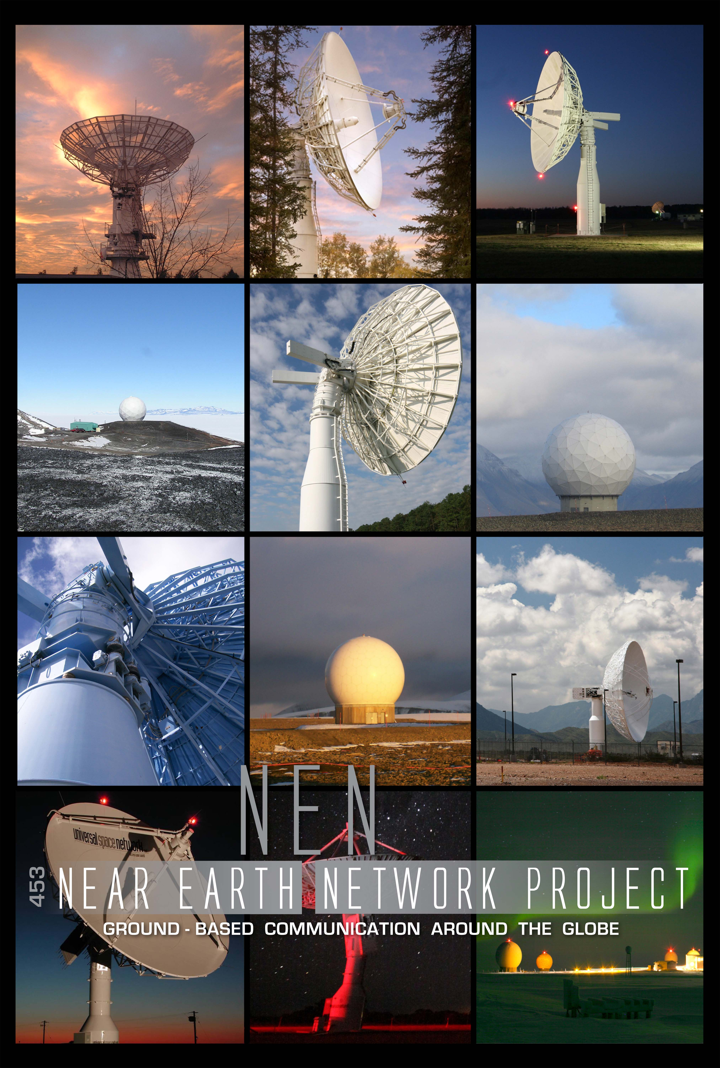
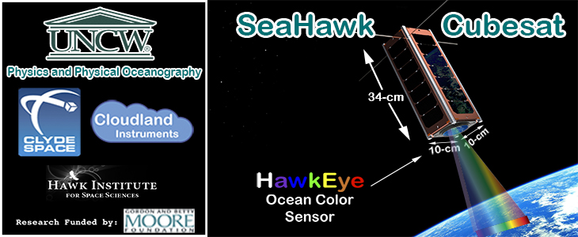
Near Earth Network (NEN)
CubeSat Communications
Scott Schaire
January 2017
The SeaHawk CubeSat is scheduled to launch in 2017. It is a "proof of concept to demonstrate capability to construct low-cost autonomous nanosatellites to provide sustained, high spatial resolution and temporal resolution information about the surface ocean processes.“ The project is also known as SOCON: Sustained Ocean Color Observations using Nanosatellites. A second SOCON CubeSat may launch in 2018.

Slide 2
Agenda
Overview
NEN CubeSat Analysis LEO
Upcoming CubeSat Support
CubeSat Flight Radio Capabilities
CubeSat Flight Antenna Capabilities
NEN Lunar/L1/L2 CubeSat Support
NEN Evolution
Conclusion

Slide 3
Near Earth Network Overview
As shown on the following slide, the NASA Near Earth Network (NEN) is composed of stations distributed throughout the world
NEN services are provided through
  NASA-owned and operated ground stations
  Partner agencies (e.g., National Oceanic and Atmospheric Administration (NOAA) Command and Data Acquisition (CDA))
  Commercial ground station providers (e.g., Kongsberg Satellite Services (KSAT), Swedish Space Corporation (SSC) and its subsidiaries, Deutsches Zentrum für Luft- und Raumfahrt (DLR))
The NEN supports orbits in the Near Earth region from Earth to 2 million kilometers
  Communication services are provided for various low-Earth orbits (LEO), geosynchronous orbits (GEO), highly elliptical orbits (HEO), LaGrange orbits, lunar and suborbital, and launch trajectories

Slide 4
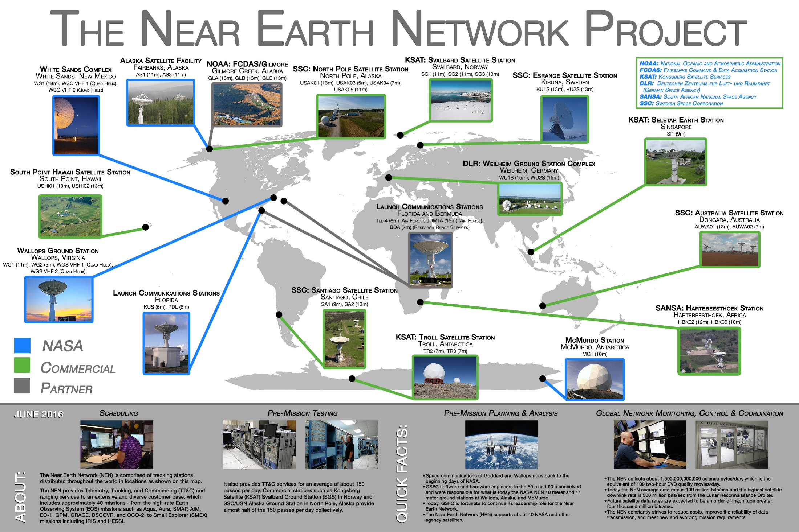
THE NEAR EARTH NETWORK PROJECT

Slide 5


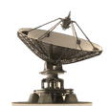



NEN Ka-Band Baseline Architecture Adds Stations for Increased CubeSat Capacity
Single Ka-band antenna
Trade Study considering four options:
Upgrade AS3
Replace AS1
Install new Antenna AS4
Install new Antenna UAF3
NEN Ka-band Drivers
Svalbard
(KSAT)
NI-SAR (Launch NET 2021)
33 Tbits/day; Data rate of 3.5 Gbps
Four stations needed to meet the mission requirement
  ASF
  Svalbard
  Punta Arenas
  Trollsat
Fairbanks
(ASF)
Single Ka-band antenna
Upgraded 7.3m Ka-band antenna already operational
White Sands
(WSC)
Single or arrayed Ka-band antennas
Current trade study for support of WFIRST is single versus arrayed 18 meter antenna. Transition planning of the SDOGS to NEN has already started
Single or arrayed Ka-band antennas
Current trade is considering a location either in Chile or South Africa. Either one or two 18 meter antennas
PACE (Launch NET 2022)
5 Tbits/day, Data rate of 600 – 1200 Mbps
Three NEN stations will meet the requirement
  Leverage sites used for NISAR
  2nd Punta Arenas antenna required
Single Ka-band antenna
Critical for NISAR support
CH
SA
WFIRST (Launch NET 2024)
L2 orbit requires a site in both the northern and southern hemispheres
  WSC
Single Ka-band antenna
Upgraded 7.3m Ka-band antenna already operational
Punta Arenas
Second Ka-band antenna
Additional antenna Critical for PACE Support
TrollSat
(KSAT)

Slide 6
NEN CubeSat Support Analysis – LEO
CubeSat/SmallSat mission communication requirements including frequencies and data rates can be met by utilizing NEN S and X-band support based on 745 km low earth orbit
Coverage analysis indicates adequate ground coverage and support time utilizing NEN ground stations for CubeSats at an altitude of 745 km
Links | Data Rate | Mod & Coding | CubeSat EIRP | Link Margin
S-band Downlink | 2 kbps | BPSK, ½ conv. + RS | -1 dBw | 40.1 dB
S-band Downlink | 4 kbps | BPSK, ½ conv. | -1 dBW | 36.5 dB
S-band Downlink | 256 kbps | BPSK, ½ conv. | -1 dBW | 18.45 dB
S-band Downlink | 513.7 kbps | BPSK, RS | -1 dBW | 14.4 dB
X-band Downlink | 13.1 Mbps | QPSK, 7/8 LDPC | 4 dBW | 10.3 dB
X-band Downlink | 130 Mbps | QPSK, ½ conv + RS | 4 dBW | 3.2 dB
11.3 m at AS1, CubeSat PA = 1 W, 0 dBi Antenna Gain (S-band), Antenna Gain = 5 dBi (X-band)

Slide 7
Near Earth Network (NEN) Upcoming CubeSat Support
Mission | Launch Date (No Earlier Than)
SOCON 1 | 2017
iSAT | 2017
MicroMAS | 2017
Jefferson High | 2017
CryoCube | 2018
Lunar IceCube | 2018
BioSentinel | 2018
CaNOP | 2018
SOCON 2 | 2018
CuPiD | 2019
Burst Cube | 2019
RadSat | 2019
TROPICS (12 CubeSats) | 2020
Propulsion Pathfinder (RASCAL) | TBD
CSIM | TBD
Kit Cube | TBD
PIC/USIP | TBD

Slide 8
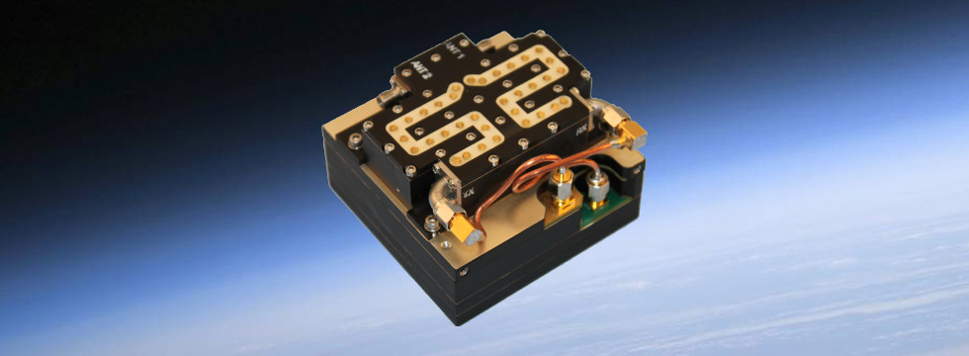
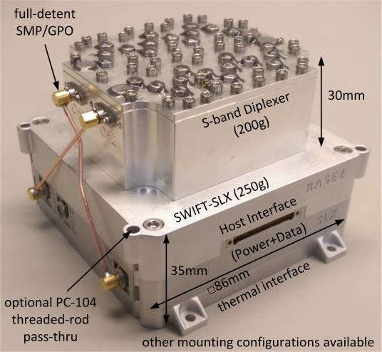
Current Selected CubeSat Flight Radio Capabilities
Freq. | Transceiver Name/Vendor | Size (cm) | Mass (g) | Flight Heritage | Max. Data Rate | Modulation/FEC | NASA Network Compatibility*
S-band | Innoflight SCR-100 | 8.2 x 8.2 x 3.2 | 300 | Sense NanoSat | 4.5 Mbps | BPSK,QPSK,OQPSK GMSK,FM/PCM FEC: Conv. and R/S | NEN, SN, DSN
 | Tethers Unlimited SWIFT-SLX | 10 x10 x 3.5 | 380 | None | 15 Mbps | BPSK | NEN,SN,DSN
 | Clyde Space S-Band TX (STX) | 9.6 x 9.0 x 1.6 | < 80 | UKube-1
 | MHX-2420 | 8.9X5.3X1.8 | 75 | RAX | 230 Kbps Downlink/115 Kbps Uplink | FSK | Partially NEN
 | Quasonix nano TX | 3.3x3.3x3.3 | ? | CPOD | 46 Mbps | PCM/FM, SOQPSK-TG, Multi-h CPM, BPSK, QPSK, OQPSK, UQPSK | NEN
X-band | LASP/GSFC X-band Radio | 9.8 x 9 x 2 | 500 | None | 12.5 Mbps Downlink/50 Kbps Uplink | BPSK/OQPSK R/S and Conv. | NEN
 | Syrlinks/X-band Transmitter | 9 x 9.6 x 2.4 | 225 | None | 5 Mbps | BPSK/OQPSK R/S and Conv. | NEN
 | Marshall X-band Tx | 10.8 X 10.8 X 7.6 | <1000 | FASTSat2 | 150 Mbps Downlink/50 Kbps Uplink | BPSK/OQPSK LDPC 7/8 | NEN
 | Tethers Unlimited SWIFT-XTS | 8.6 x 4.5 (0.375U) | 500 | None | 300 Mbps | {8,16A,32A}PSK | NEN,SN,DSN
 | JPL /Iris Transponder | 0.4U | 400 | INSPIRE | 62.5 Kbps Donwlink/1 Kbps Uplink | BPSK bit sync, CCSDS frame size | DSN, Partially NEN
Ka-band | Canopus Systems/ | 18 x 10 x 8.5 | 820 | None | 125 Mbps | {Q,8,16A,32A}PSK, DVB-S2, CSSDS, LDPC Concatenated with BCH | NEN,SN,DSN
 | Ames Ka-band Tx
 | Tethers Unlimited | 8.6 x 4.5 (0.375U) | 500 | None | 300 Mbps | {Q,8,16A,32A}PSK, DVB-S2, CSSDS | NEN,SN,DSN
 | SWIFT-KTX
Innoflight SCR-100
Quasonix S- Band Transmitter
Tethers Unlimited SWIFT-SLX
* Compatibility shown as advertised by vendor

Slide 9
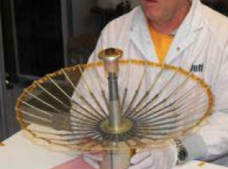
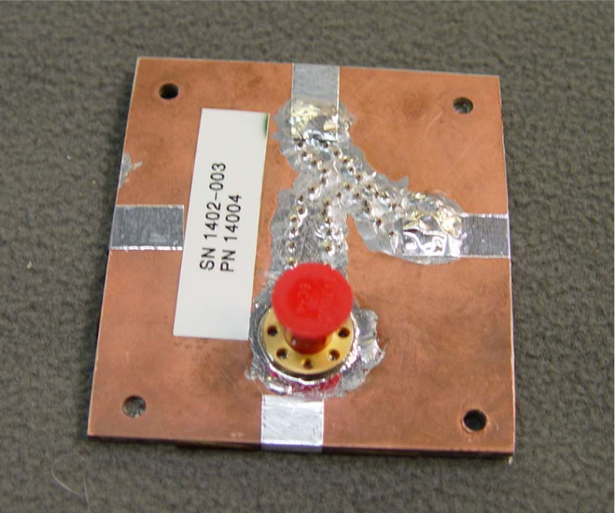
Current Selected CubeSat Flight Antenna Capabilities
Antenna Vendor Name | Band | Antenna Gain (dBi) | Dimensions | Mass (g)
Antenna Development Corporation S-Band Low-Gain Patch Antenna (LGA) | S | 2 | (4 x 4x0.25)" | 115
Haigh Farr S-band Patch | S | 2 | (94x76x4) cm | 62
University of Southern California’s Information Sciences Institute Space Engineering Research Center (SERC) | S and X | TBD | 50 cm | 760
BDS Phantom Works Deployable High Gain S-band Antenna | S | 18 | 50 cm | 1000
Antenna Development Corporation X-Band Patch Array | X | 9 | (1.85x1.85x0.55)" | 300
BDS Phantom Works Deployable High Gain X-band Antenna | X | 25 | 50 cm | 1000
Canopus System Horn | Ka | 25 | 18 cm | 820
University of Southern California’s Information Sciences Institute Space Engineering Research Center (SERC)
Ant Dev. Corp: Medium Gain X-band Patch Array Antenna

Slide 10
NEN Potential Benefits for EM CubeSats
While the NEN is not anticipated to provide primary support to any of the thirteen EM-1 CubeSat missions, the NEN offers “as-is” and upgradable ground system solutions for lunar, L1/L2, and future exploration CubeSat missions, that could benefit the EM-1 CubeSat missions
The NEN may benefit EM-1 CubeSat missions utilizing the IRIS radio in the form of coverage and larger beamwidth
  NASA-owned NEN and NEN commercial ground systems are positioned around the globe and are able to provide significant to full coverage, depending on sites utilized, for CubeSats in Lunar orbit or beyond (e.g., L1/L2 missions)
  NEN coverage could be utilized to provide higher data rate support to EM-1 CubeSat missions immediately following dispersal from Orion (~35,000 km through 100,000km)
  Smaller NEN apertures (e.g., 11m), compared to other apertures, provide a larger beamwidth, which can benefit CubeSat missions in the event of navigation/ephemeris uncertainty
In order for the EM-1 CubeSats to realize the NEN coverage and beamwidth benefits, NEN ground stations would need varying levels of modifications, depending on services required; Options the NEN is currently investigating
  NEN modification (e.g., receiver Turbo decoding licenses, converters, switches) of either NASA-owned or commercial provider X-band downlink capable assets would allow support for the reception of EM-1 CubeSats using the IRIS radio (e.g. Turbo 1/6 decoding)
  NEN could utilize the X-band uplink capability of certain commercial provider assets or could upgrade other NASA or commercial provider assets (NEN evaluating options) to support X-band uplink requirements, Doppler, and tone ranging for IRIS equipped EM-1 CubeSats

Slide 11
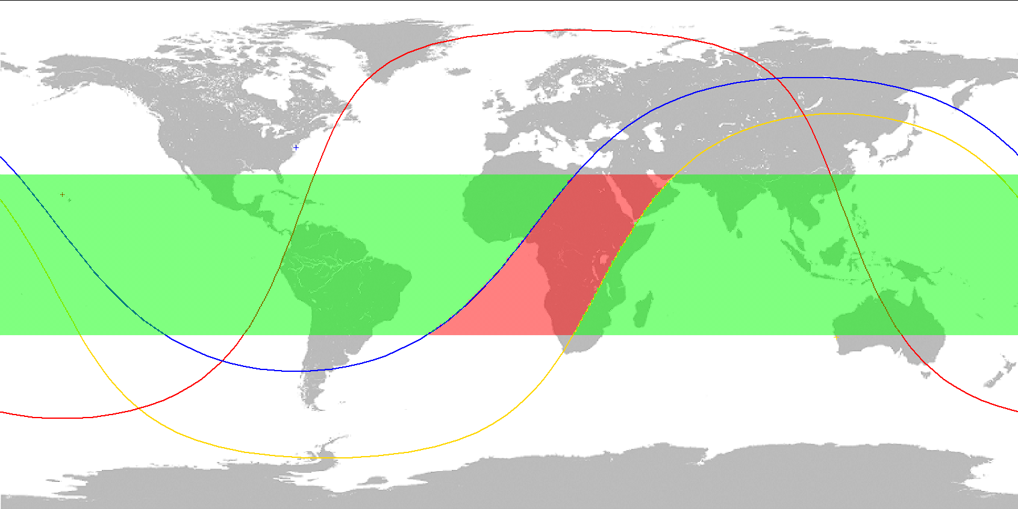
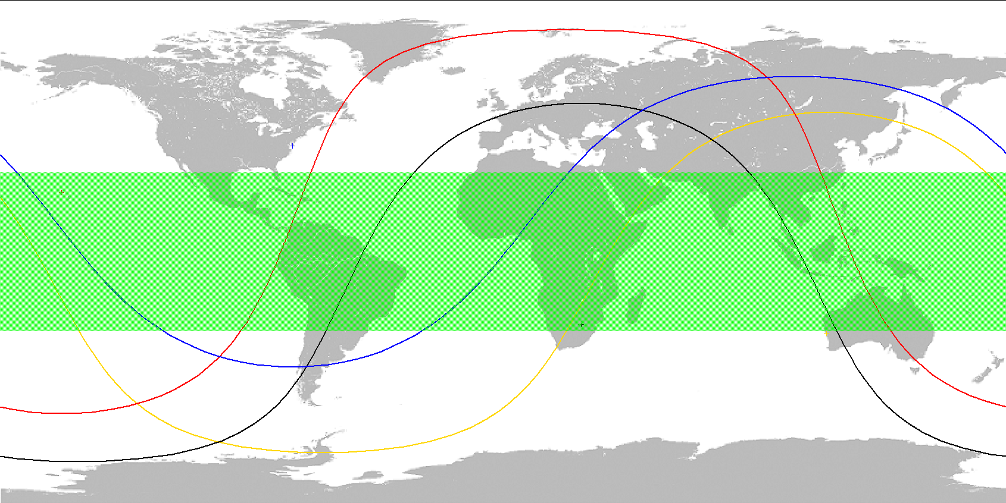
NEN Coverage to EM CubeSats at Lunar Distances
The NEN can provide ~89% coverage to a Lunar EM-1 CubeSat utilizing three NEN ground stations
  Coverage assumes the following stations/antennas:
  NASA NEN Wallops (1 x 11m)
  CSP SSC Hawaii (2 x 13m)
  CSP SSC Australia (1 x 13m)
  All sites currently support X-band downlink frequency range of 8.0 GHz to 8.5 GHz
Including the NEN CSP site in Hartebeesthoek would allow the NEN to provide 100% coverage
  NEN utilizes Hartebeesthoek through the SANSA Space Operations Services
  The 10m Hartebeesthoek antenna, designated HBK-5, supports the full X-band receive frequency (8.0 – 8.5 GHz)
NEN Three Station Architecture Providing 89% Lunar Coverage
Wallops
Hawaii
Australia
NEN Four Station Architecture Providing 100% Lunar Coverage
Wallops
Hawaii
Hartebeesthoek
Australia
Note: Coverage percentages assumes mission is not behind moon (i.e., lunar occultation)

Slide 12
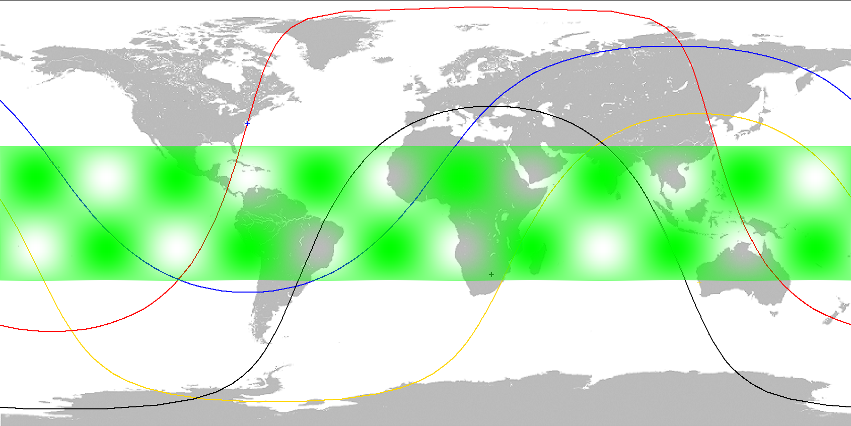
NEN Coverage to EM CubeSats During Trans-Lunar Orbit
The EM-1 CubeSats will be deployed from dispensers on Orion once at a safe distance (~35,000 km)
  Once released there is an anticipated range from 35,000 km to 100,000 km known as the “12 hours of terror”
  The NEN could provide complementary coverage during this period utilizing the four NEN stations in Wallops, Hawaii, Australia, and Hartebeesthoek
  The four ground stations together can provide 100% coverage at 35,000 km
Wallops
Range 35,000 km
Coverage 100%
Hawaii
Hartebeesthoek
Australia
Notes:
10,000 = 92.07%
20,000 = 99.20%
22,000 = 99.53%
22,500 = 99.59%
25,000 = 99.80%
27,000 = 99.90%
29,000 = 99.96%
30,000 = 99.96%
32,000 = 99.99%
33,000 = 99.99%
34,000 = 100%
35,000 = 100%

Slide 13
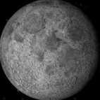
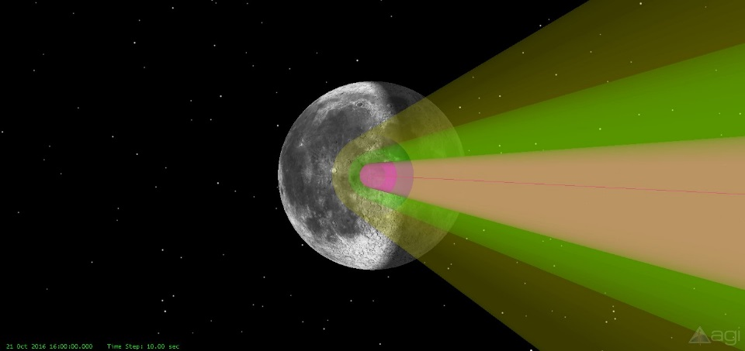
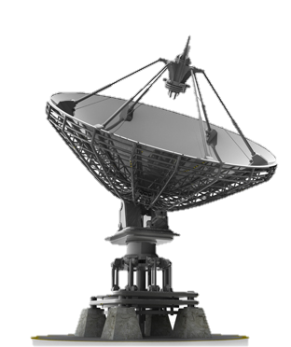
NEN Beamwidth Advantage for Lunar EM-1 CubeSats
The NEN’s use of small apertures provides a larger beamwidth, compared to the larger DSN apertures, which can benefit Lunar CubeSats with uncertain ephemeris data
  WG1 11m would cover 3.10x the area of a DSN 34m
  APL 18m would cover 1.86x the area of a DSN 34m (NEN looking at obtaining services from APL)
Assumptions:
  Frequency: 8450 MHz
  The Moon’s angular diameter is 0.5 degrees
3 dB Beamwidth for Varying Antenna Diameter*
  10m = 0.250 degrees (half of Moon angular diameter)
  11m = 0.226 degrees
  13m = 0.191 degrees
  18m = 0.136 degrees
  34m = 0.073 degrees
3D View
* Not all antenna diameters depicted in graphic
DSN 34m
APL 18m
WG1 11m
Notes:
Scale: 0.5 degrees = 1.5

Slide 14
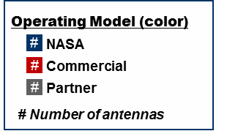
NEN Modification to Support IRIS X-band Downlink
The NEN currently includes multiple ground stations with X-band downlink capabilities that could be upgraded to support the IRIS radio
  Upgrades could be targeted to assets that currently use a Cortex modem, which has a clear upgrade path to support the necessary coding (i.e., Turbo 1/6)
  Targeted sites include: Wallops, Hawaii, and Australia which utilize the Cortex as well as Hartebeesthoek (Receiver TBV)
Modification of NEN modems to add IRIS radio receive compatibility will vary by site, but would likely include:
  Addition of Cortex DS menu to existing Cortex to add Turbo Codes (this has added advantage of adding support for very low data rates)
  Addition of switching system to switch Cortex input between S-band and X-band
If directed, the NEN would carry out the systems engineering process to upgrade a NASA site or oversee the modification of a commercial site to add IRIS X-band downlink compatibility
NEN X-band Return Stations and Antennas
North Pole
(SSC)
Svalbard
(KSAT)
3
4
2
2
Kiruna
(SSC)
Fairbanks
(ASF)
1
Wallops
2
Hawaii
(SSC)
1
Hartebeesthoek
(SANSA)
1
Australia
(SSC)
1
McMurdo
1
TrollSat
(KSAT)
Targeted Station for Upgrade to Add IRIS Downlink Compatibility

Slide 15
NEN Achievable Data Rates with Representative EM CubeSat Missions (Based on Analysis)
NEN would be in a position to support a majority of the discrete IRIS radio downlink rates assuming the NEN implements the upgrade to ensure IRIS downlink compatibility
  The IRIS radio does not support a continuous range of data rates, but rather discrete rates (not all possible rates have been tested/verified)
Notes/Considerations:
  Morehead without cryogenic LNAs was not shown since Morehead is planning to upgrade the asset
CubeSat Radio/Antenna Assumptions:
  Frequency: 8.45 GHz
  Modulation = BPSK
  COTS CubeSat radio: PA output power of 4W
  COTS antenna with 11 dBi gain @X-band ¹
  Passive loss of 1 dB
General Assumptions:
  Acheivable rates assume a 2 dB margin
  Slant range of 405,221 km (Max Lunar Distance)
  10 degrees elevation
  Lunar Noise Temperature of 185 K (loss of 2.27 dB/K)
  Link availability for propagation effects : 99%
Asset Size | Reference Antenna | Cryogenic LNAs | G/T ² (dB/K) | Conv. ½ ³ Rates kbps | Turbo 1/6 Rates kbps | NEN Asset Capable of Supporting IRIS Discrete Data Rates (kbps)
 |  |  |  |  |  | 1 | 4 | 8 | 16 | 32 | 64 | 128 ³ | 256
11m | WG1 | No | 32.23 | 19.68 | 52.60 |  |  |  |  |  |  |  | 
 |  | Yes | 33.13 | 24.21 | 64.71 |  |  |  |  |  |  |  | 
13m | SSC Hawaii/ Australia | No | 35.43 | 41.11 | 108.89 |  |  |  |  |  |  |  | 
 |  | Yes | 36.33 | 50.38 | 133.97 |  |  |  |  |  |  |  | 
18m | APL | No | 36.38 | 51.17 | 136.8 |  |  |  |  |  |  |  | 
 |  | Yes | 37.28 | 62.95 | 168.27 |  |  |  |  |  |  |  | 
21m | Morehead | No | NA | - | - | - | - | - | - | - | - |  | -
 |  | Yes | 40.34 | 37.41 | 99.08 |  |  |  |  |  |  |  | 
¹ The rates for the Morehead 21m assume an antenna gain of 6 dBi to reflect the known EM-1 CubeSat mission using that asset (i.e., Lunar IceCube).
² Includes a Lunar noise temperature losses.
³ Capabilities are currently untested with the IRIS radio.

Slide 16
NEN Modification to Support IRIS X-band Uplink
The NEN currently utilizes two commercial provider sites that are equipped with asset capable of supporting X-band uplink in the frequency range of 7025 – 7200 MHz
  SSC Hawaii has one 13m antenna capable of supporting X-band uplink with a published EIRP of 86 dBW
  SSC Australia has one 7m antenna¹ with a published EIRP of 85 dBW
Modification to add X-band uplink would vary by site
  Upgrades required assuming existing X-band uplink support:
  Addition of Tunable upconverter (convert from 70 MHz to X-band frequency)
  Addition of IF distribution system to send IF from Cortex to upconverter
  Updates to HWCTRL to control and monitor the new capabilities
Candidate NEN X-band Uplink Stations and Antennas
1
Wallops
1
Hawaii
(SSC)
1
Hartebeesthoek
(SANSA)
1
Australia
(SSC)
Targeted Station Currently Supporting X-band Uplink
¹ The Australia asset is uplink only, but can be slaved to a collocated 13m asset capable of X-band downlink

Slide 17
CubeSat Radio Support Requirements to Achieve NEN Compatibility Without Station Modifications
RF Frequencies
  Earth to Space
    2025 – 2120 MHz
  Space to Earth
    2200 – 2300 MHz
    8025 – 8500 MHz
    25.5 – 27.0 GHz
Modulation
  Earth to Space
    PCM/PSK/PM, PCM/PSK/PM, BPSK, SS-UQPSK
  Space to Earth
    PCM/PSK/PM, PCM/PSK/PM, OQPSK (SQPSK), QPSK, BPSK, Reed-Solomon, Convolutional, Viterbi
Tracking
  Coherent Doppler, Tone Ranging

Slide 18
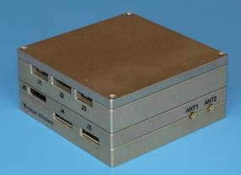
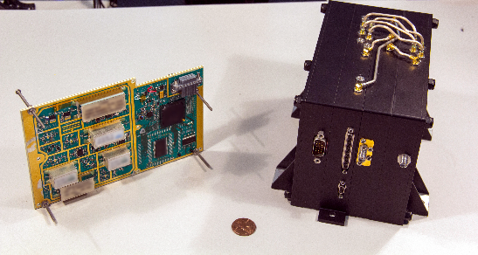
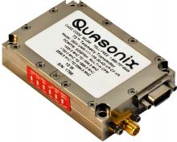
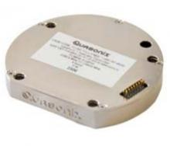
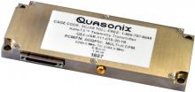
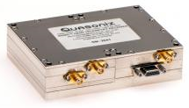
Potential Radios for Lunar and L1/L2 CubeSats
Vulcan®
Innoflight® CubeSat S-Band Transceiver (SCR-100)
Tethers SWIFT® Software Defined Radios
TIMTER Transmitter
nanoPuck Transmitter
nanoTX Transmitter
Compact RDMS Receiver
APL CORESAT® Frontier Radio Lite
Quasonix®

Slide 19
Lunar and L1/L2 CubeSat Radios High Level Comparison (1/2)
Radio | IRIS | Innoflight (SCR-100) | Tethers Swift Software Defined | Vulcan | APL Frontier | Quasonix
Cost | $700k | TBD | $200K | TBD | $200k-$500k+ | Varies, <$50k
Network Compatibility | DSN, NEN*, SN* | DSN, NEN, SN | NEN, SN | DSN, NEN | DSN, NEN, SN | NEN, SN
Input Power** | 0.5W – 38W | 0.8W – 10 W | 2.5W – 47.5W | 12.8W – 21W | 400mW – 4.2W | Varies
Output Power | X-band: 3.8W | S-band: 20mW – 2.0W X-band: N/A | S-band: 2.5W X-band: 1 – 7 W (adj.) | S-band: 4W | 650mW – 1W (external PA optional) | Varies, 10mW – 25W
Size | 568 cm³ (0.5U) | 238 cm³ | 333cm³ | 568 cm³ (0.5U) | 324 – 649 cm³ (0.33-0.66U) | Varies up to 197 cm³
Mass | 1100 g | 290 g (w/o Diplexer+Splitter | 350 g | 370 g | 1700 g (S-band), 2100 g (X-/Ka band ) 400g g (UHF-C band) | TBD
Frequency Bands (TX) | X-band: 7.145 – 7.190 GHz (7.190 – 7.235 GHz)* | S-band: 2.2k – 2.3k MHz | S-band: 1.7k – 2.7k MHz X-band: 7.0k – 9.0k MHz | S-band: 2200 - 2305 MHz | UHF, S, L, or C-band, X and Ka-band | Varies, Lower L-, Upper L- S-, C-, and P-
Frequency Bands (RX) | X-band: 8.4 – 8.45 GHz (8.45 – 8.50 GHz) * | S-band: 2025 - 2110 MHz | S-band: 1k – 3k MHz X-band: 6k – 12k MHz | S-band: 2025-2115 MHz | UHF, S, L, or C-band, X and Ka-band | Varies, Lower L-, Upper L- S-, C-, and P-
* Capability being investigated or planned
** Input power dependent on services supported
NEN/SN Compatibility is based on vendor claims

Slide 20
Lunar and L1/L2 CubeSat Radios High Level Comparison (2/2)
Radio | IRIS | Innoflight (SCR-100) | Tethers Swift Software Defined | Vulcan | APL Frontier | Quasonix
Modulations | RX: TBD TX: PM/PSK/NRZ | RX: GMSK, FSK, PCM/FM TX: BPSK, QPSK, OQPSK | RX: BPSK,QPSK,BPSK; TX: 8PSK, 16APSK, 32APSK, OQPSK, GMSK, PM, CPM, SGLS-Ternary, Spread Spectrum | BPSK, QPSK, FSK, STDN USB PM/PCM, SGLS AM/FSK, Commercial FM/PCM, TDRS-MA | Arbitrary waveforms (PM/PSK, M-PSK, M-QAM, GMSK) | PCM/FM, SOQPSK, Multi-h CPM, BPSK, QPSK, SQPSK, USQPSK
Coding | 1/6 Turbo Code, Convolutional 7-1/2, Manchester, Bi-Phase, and bypass (NRZ), Reed Solomon (255,223) | Convolutional, Reed Solomon (TX) | Reed-Solomon, Convolutional, Viterbi, BCH, Turbo/LDPC, CRC | Rate ½ Viterbi K=7, RS(255,223). Turbo and others available | CCSDS ½ convolutional, LDPC, Turbo Coding | TBD
Ranging | Diff 1-way Ranging (coherent w/DL carrier) - X-Band 2F1: 19.2 MHz[1] programmable modulation index 17.5° typical | TBD | Coherent tone ranging, <1 Hz carrier tracking and Doppler estimation, Regenerative PN Ranging | Coherent Turn Around and Ranging | Two-way coherent architecture for Doppler navigation, PN, Tone-Ranging | Varies: 1-Way Doppler only, or None
Radiation | TBD | TID (3 mm Al): LEO - 10 krads; GEO - 100 krads; | ≈1200 km polar orbit, 6.5 year lifetime: High energy (GCR) shielding being added under Langley SBIR contract | SEU Recovery, AI shield for TID | 50 to 125k rad | TBD
Data Rates | 62.5, 125, 250, 500, 1k, 2k, 4k, 8k, 16k, 32k, 64k, 128k, 256k, 512k*, 1.024M*, 2.048M*, 4.046M*, 8.192M*(bps) | TX: Up to 4.5 Mbps RX: 1 – 100 kbps | S-band, up to 15 Mbps, X-band, up to 300 Mbps. | TX: 100 bps to 3 Mbps RX: 100 bps - 64 kbps | 0.2-2/2-50 (S-band) 0.2-2 / 2-150 (X/Ka-band) 2 / 10 (UHF to C-band) | Varies up to 46 Mbps
TRL | 6 (Present) 9 (2018, MarCO launch) | 9 | 7 | 6 | 9 (S-band), 6 + (S/Ka, X/Ka) | 9
* Capability under investigation or planned

Slide 21
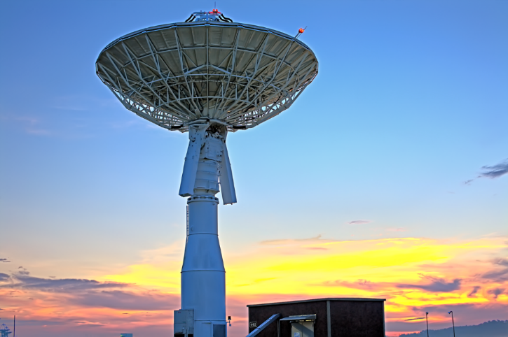
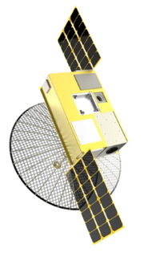
NEN Evolution
NEN is ready today to support CubeSats
Planned NEN expansions provide increased CubeSat support
Enhance CubeSat radios and NEN receivers to achieve high data rates for CubeSat missions
Assist missions moving to X, S and Ka-band
Capitalize on Commercial Service Providers (CSP)/Academic Partnerships including small apertures, large apertures and X-Band uplink
Streamline mission planning and integration and test and scheduling activities
Continue to engage with the CubeSat community
NEN Wallops 11 Meter class antenna
NASA GSFC/Wallops LunarCube with deployable X-band antenna based on University of Colorado/Goddard X/S band CubeSat Radio and NEN

Slide 22
Conclusion
After selection, no charge for pass supports for NASA missions using NASA-owned stations
  Use of Commercial Service Providers/Partners of NEN is subject to budget appropriations
Mission Planning (e.g. RFICD, Coverage, Link Analysis, Loading Analysis), no charge prior to mission commitment
  Mission Planning, Integration and Test (MPI&T) services after mission commitment are negotiable, function of risk versus cost
Questions – contact Scott Schaire, scott.h.schaire@nasa.gov, 757-824-1120, NASA Goddard Space Flight Center, Near Earth Network Wallops Manager

