Slide 1
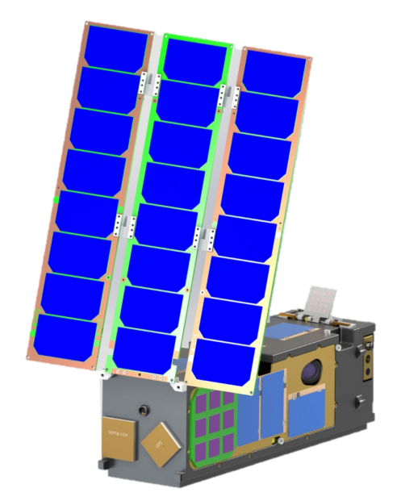
© 2018 California Institute of Technology
Government sponsorship acknowledged
ISARA Lessons Learned
May 3, 2018
Presenter:
Dorothy Lewis (ISARA PM)
Contributions from:
Richard Hodges (ISARA PI)
Jet Propulsion Laboratory,
California Institute of Technology

Slide 2
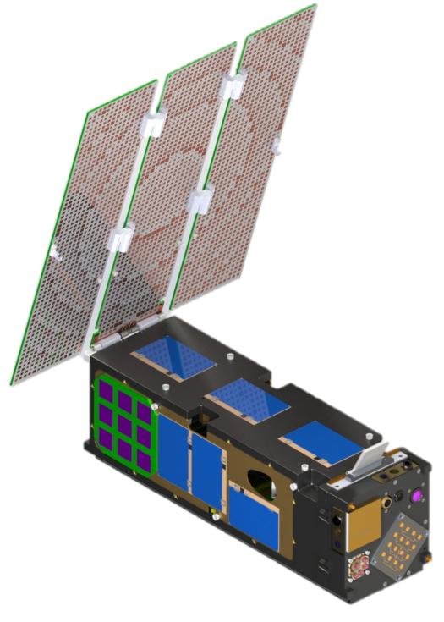
Project Overview
Objectives:
Demonstrate a practical, low cost Ka-band High Gain Antenna (KBA) on a 3U CubeSat to enable increasing downlink data rates from 9.6 kbps to over 100 Mbps with minimal impact on spacecraft mass, volume, cost and power requirements.
Enabling Technology:
Integrated Solar Array Reflectarray Antenna (ISARA)
ISARA Reflectarray/Solar Array mounted on a 3U CubeSat
Subsystem Flight Validation Plan
Measure KBA Gain from Low Earth Orbit and validate against antenna model
Measure Carrier SNR to demonstrate application of KBA to high data rate links
Flight System – CubeSat w/ ISARA antenna in LEO orbit
Ground System – Ka Terminal for experiment, UHF for S/C communications and control
Role | Name | Org
PI | Richard Hodges | JPL
Proj Mgr | Dorothy Lewis / Richard Welle | JPL / TAC
Payload Manager | Dan Hoppe | JPL
Payload Partner | Andrew Kalman | Pumpkin
S/C Bus and ops | Darren Rowen | TAC

Slide 3
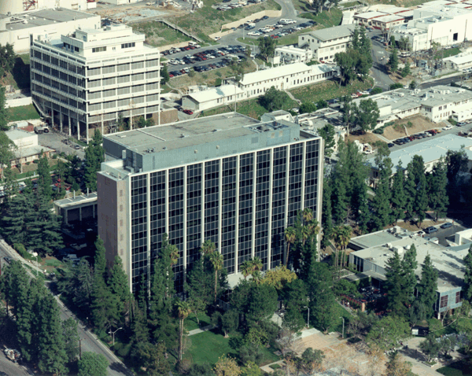
ISARA On-Orbit Gain Measurement
Ka-Band Payload
>32 dB Reflectarray High Gain Antenna (HGA)
19 dB Standard Gain Antenna (SGA)
Ka-band CW transmitter switches rapidly between SGA and HGA
Gain Measurement
Record received power P_{HGA}, P_{SGA}
Calculate HGA gain:
Gain = P_{HGA} – P_{SGA} + known SGA Gain
Key Advantages
Eliminates key uncertainty factors:
Transmit / receive line power losses
Space loss
Atmospheric loss
Ground station antenna pointing error
Minimize polarization mismatch loss
Residual error can be estimated
Receiver noise, SGA knowledge, etc.
Receiver noise is the main source
S/C antenna pointing (cause gain underestimate)
Directly calculate mean and variance
Ka-Band Tx
Switch
SGA
HGA
UHF comm link
ADCS attitude, GPS, Time data
Ka-Band downlink
SGA/HGA
Ka-Band Receiver is JPL experimental ground station

Slide 4
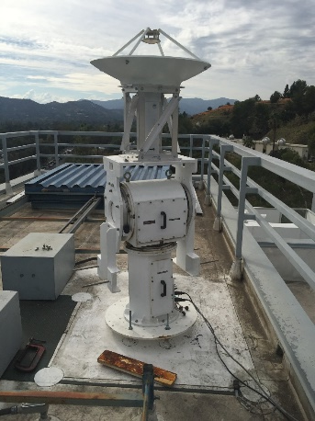
Lessons Learned (1 of 3)
NTIA (or FCC) License
Start early!
FCC changed the rules & we got rejected for a FCC license at UHF.
ISARA specific requirement for UHF signal to be present when operating Ka-band.
Check available stations & verify same “footprint” for both, to ensure adequate coverage
Got lucky here. Our partner put a station at Vandenberg, which is close enough to JPL to have very similar coverage.
Ground Station Development
List all of the constraints of station (Location (FOV), placement of electronics, mission type considerations, noise at frequency of operation, etc)
Write requirements to satisfy constraints
Plan (far) Ahead!
Length of time (Involving facilities, safety office, ordering material, etc)
Station Calibration
Do you have something to test this station against?
Reevaluate Plans as Necessary to Keep Things Simple
Initial proposal was to have JPL build & operate the entire satellite.
Switched to Aerospace Corp for “Off-the-Shelf” bus & for UHF command and control.
Antenna panels were initially proposed for 5-7 panels.
Went with 3 panels in the end.

Slide 5
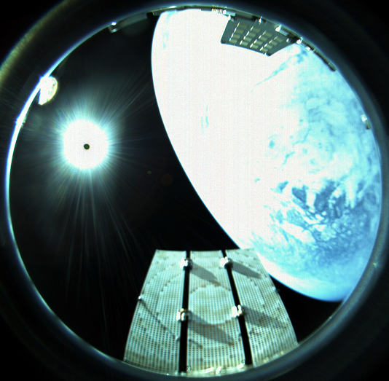
Lessons Learned (2 of 3)
Holes drilled in the antenna PCB fab for solar cell installation
Contractor assembling the antenna had concerns with trapping air bubbles under the cells
Contractor had us drill ~1000 holes in each PCB (between patches of the array) to mitigate “risk”
During satellite vibe, the conductive, PCB material blanketed the satellite body with a dot-pattern, matching the hole pattern of the array!
Resulted in consultation of material experts & rework to painstakingly fill all 6000 holes by hand! (3000 on EM unit and 3000 on FM unit)
Trust your gut! Don’t give into un validated concerns
Identify, then Mitigate for Project Identified Potential Risks
Held a project level risk of panel bowing over temp.
Should have added a temp sensor on the antenna wing
Add more telemetry!
Cameras are great.
If you can add it with minimal effort- do it.
Success rates are improving on CubeSats…
but plan for the unexpected.

Slide 6
Lessons Learned (3 of 3)
Do your Homework up Front, Apply Resources Proportionally to Perceived Risk
Not running enough/sufficient analysis up front resulted in technical problems down the road (Costing more $ to fix).
Mechanical stresses (Failing Vibe- multiple times)
Release mechanism failure
EPS-H Board Failure
New Ground Station Development
Beware of heritage arguments
Ensure you have an adequate APPROVED plan in place PRIOR to operations.
This ensures everyone knows how to proceed as events occur.
Who gets informed of what and when?
How to deal with different classes of s/w changes in-flight.
Level of review required. Internal only, or outside review?
Other Bits of Wisdom
Test As You Fly (TAYF)
Take quality photos along the way
Don’t skimp on reviews or round tables (Get others’ inputs)
Don’t be complacent or treat the hardware as second-class, because it’s a Cubesat.

