Slide 1


The Lunar Polar Hydrogen Mapper (LunaH-Map)
Mission and Systems-Level Status
Craig Hardgrove

Slide 2

LunaH-Map Mission Overview
NASA SMD SIMPLEx 2015 mission led by ASU
6U+ CubeSat form factor to launch on SLS EM-1
Science Objective: Map hydrogen enrichments within PSRs at the lunar south pole
Tech Objectives: Demonstrate neutron spectroscopy, deep space operations & propulsion from a small sat

Slide 3
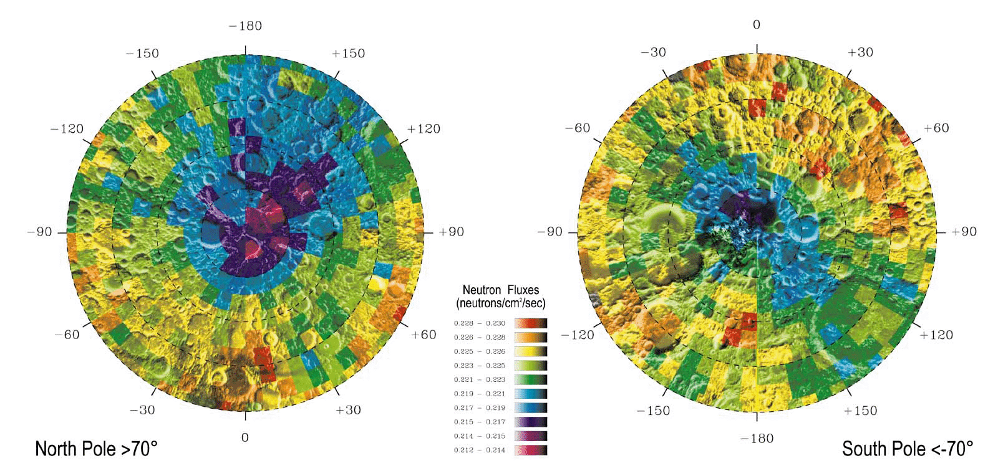
Polar Volatile Distributions from Neutron Spectroscopy
150 km² pixels
Neutron measurements are sensitive to bulk hydrogen distributions at 1 meter depth
Uncollimated neutron detector ‘footprints’ are approximately 1½ times orbital altitude
Lunar hydrogen abundances within PSRs broadly ranging from 200 ppm up to almost 40 wt% could be consistent with LPNS data depending on spatial distribution, extent of coverage, and burial depth [Lawrence et al 2006].
*Feldman et al., Science, 281, 1496, 1998
Notes:
LP – launch 1998, 30/100 km, 19 mos (12 @ 100, 7 @ 30)
LRO – launch 2009, 50/100km as low as 30

Slide 4
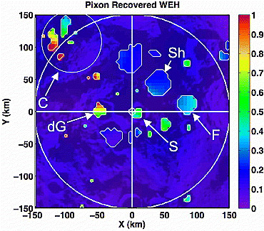
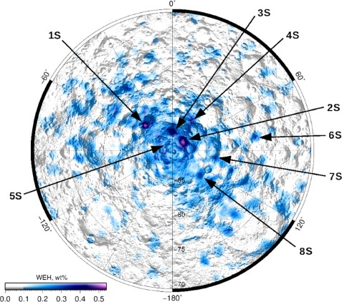
Lunar Neutron Spectroscopy
35 km² pixels
15 km² pixels
Pixon-based reconstruction of LPNS data (Elphic et al 2007) reveals high WEH abundances in Cabeus (near 1 wt%) and lower abundances in Shoemaker, Haworth, and Faustini (~0.3 wt%)
Analysis of LEND data (Sanin et al 2017) reveals higher WEH abundances (~0.5 wt%) in south polar craters Shoemaker, Haworth, and Faustini
Notes:
LP – launch 1998, 30/100 km, 19 mos (12 @ 100, 7 @ 30)
LRO – launch 2009, 50/100km as low as 30

Slide 5
Lunar Neutron Spectroscopy
35 km² pixels
15 km² pixels
LunaH-Map will acquire similar neutron data from lower altitudes to constrain abundances at small spatial scales (~10km x 10km)
Notes:
LP – launch 1998, 30/100 km, 19 mos (12 @ 100, 7 @ 30)
LRO – launch 2009, 50/100km as low as 30

Slide 6
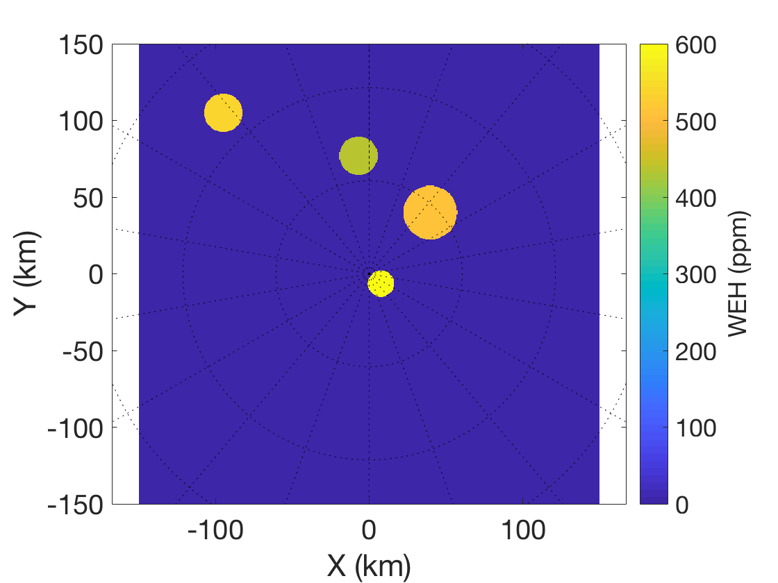
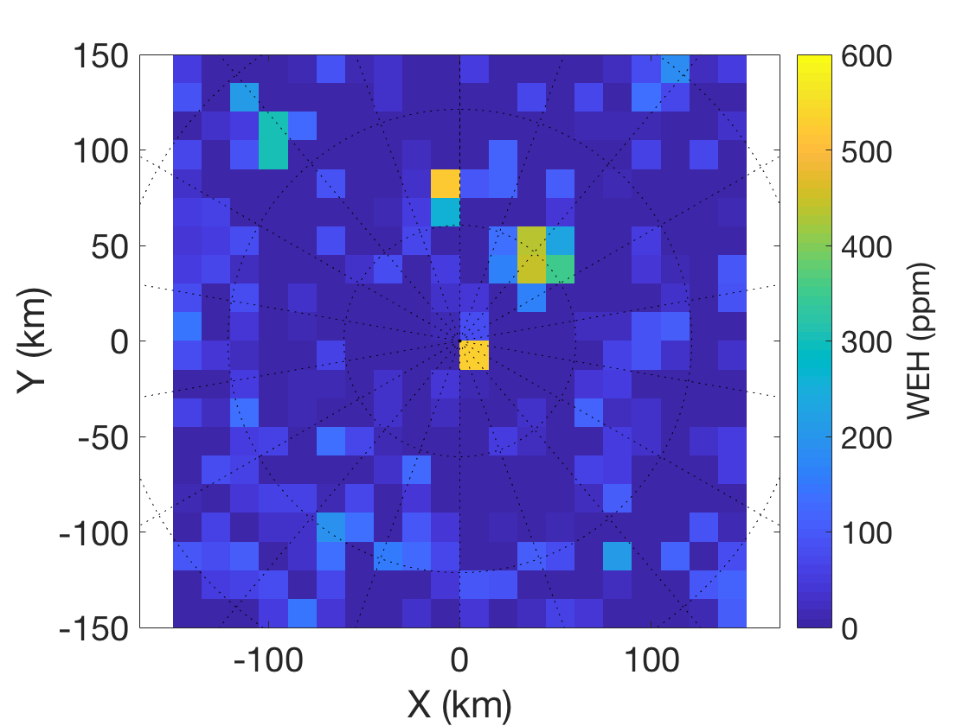
LunaH-Map Predicted South Polar Volatile Mapping
C
H
Sh
S
Simulations of maps made from 15x3150km science orbit. Basemap combines LEND high H regions (Sanin et al., 2017) and the Shackleton enrichment from pixon-reconstructed LPNS data (Elphic et al, 2007) to illustrate the type of map LunaH-Map will be able to create.

Slide 7
LunaH-Map Science and Technology Mission Objectives
Evaluate uniformity of hydrogen across the lunar south pole
  Map hydrogen abundance of no less than 0.6% WEH (600 ppm) +/- 120 ppm
  Map hydrogen abundances at spatial scale of less than or equal to 15 km²
Demonstrate neutron spectroscopy from a 6U CubeSat
  Acquire in-flight data from Mini-NS instrument
Demonstrate emerging capabilities of small spacecraft relevant to planetary science missions
  Maneuver using a low-thrust ion propulsion system into polar lunar orbit
  Demonstrate deep space communications and operations with an interplanetary CubeSat
  Demonstrate eHawk+ solar array design in flight
  Demonstrate autonomous performance of CubeSat command and data handling subsystem (fault recovery, scheduled propulsive maneuvers, fine pointing, etc.)

Slide 8
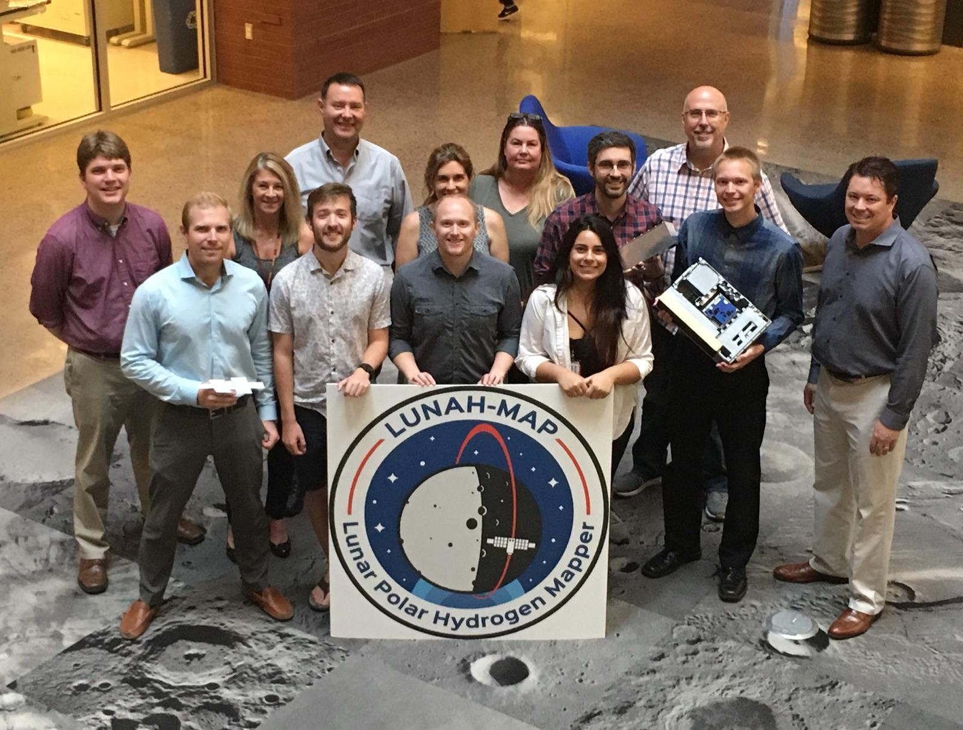
The ASU LunaH-Map Team

Slide 9







LunaH-Map Partners
C&DH, EPS, and ADCS
Mission Design & Navigation
Ames Research Center
Mission Design, Integration & Test
Marshall Spaceflight Center
SLS Secondary Payload Office
Kennedy Space Center
Launch Vehicle Integration
Mini-NS Instrument
Propulsion
Solar Arrays
Communications, DSN

Slide 10
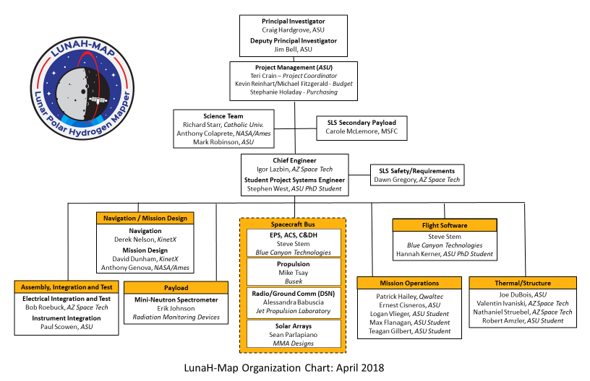

Slide 11




Who We Are / How We Are Managed
  This project is at the crossroads of cubesat and traditional gated engineering development
  NASA Science Mission Directorate
  ASU is the prime, student work is integrated into a professional structure
  Many subcontractors:
JPL, BCT, Busek, RMD, MMA, KinetX, NASA Ames, Marshall and Kennedy
Earth and Moon by OSIRIS-REx 10-2-2017

Slide 12
LunaH-Map Mission Summary
  In development since late 2015
  S/C delivery in April 2019
  Launch on SLS EM-1 in late 2019
  Deploy – Cruise – Transition to lunar orbit in mid-2020
  60 day science phase
Earth and Moon by OSIRIS-REx 10-2-2017

Slide 13
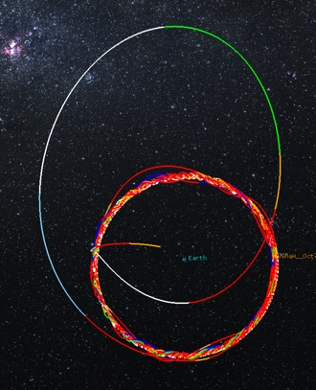
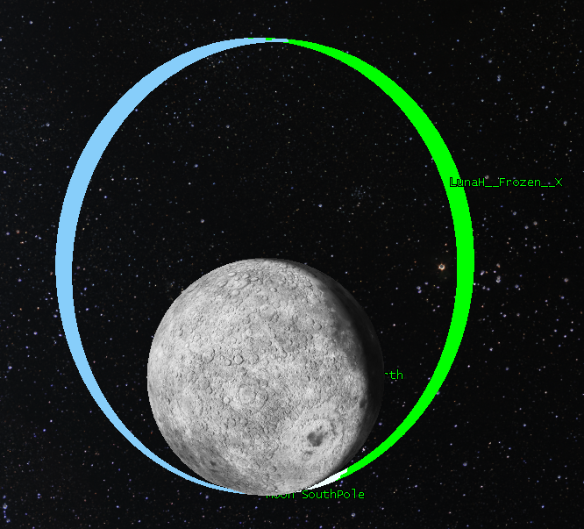
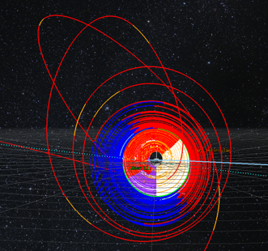
Trajectory Design
1
3
Period | 4.76 hour
Aposelene Altitude | 3150 km
Periselene Altitude | RAAN dependent 15-25 km
Inclination | 90°
Argument of Periselene | 273.5°
2
Genova, A. L. and Dunham, D. W. (2017) 27th AAS/AIAA Space Flight Mechanics Meeting 17-456.

Slide 14
Road to Launch
Critical Design Review – Completed June 29, 2017
Phase 2 Safety Review – August 8, 2017
Enter Assembly, Integration, and Test – Q4 2017
  AI&T Review/Workshop with review board
Launch – SLS EM-1, NET Dec 2019
LunaH-Map Program Milestones to Date
IAA | 11 December 2015 | Δ-IAA REQUIRED
Δ-IAA | 24 February 2016 | PASSED with RFAs
SRR | 8 April 2016 | PASSED with RFAs
I-PDR | 9 June 2016 | PASSED with RFAs
P1SR | 21 June 2016 | PASSED
M-PDR | 25 July 2016 | PASSED with RFAs
CDR | 29 June 2017 | COMPLETED
Notes:
Fix solar panels
Add more reviews
- past (IAA, SRR, PDR, I-PDR)
- future (AITRR, FRR, etc.)

Slide 15
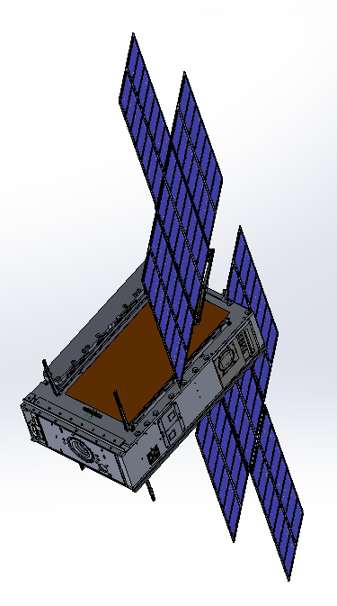
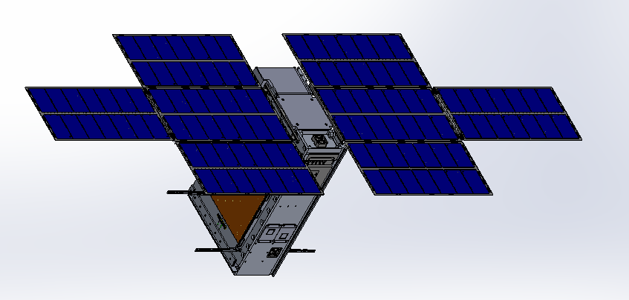
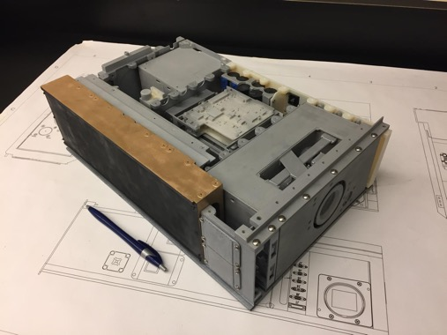
LunaH-Map Flight System
Single Axis
Solar Array Drive
Mini-NS
Instrument
1:1 3D Printed Model of LunaH-Map Flight System
LGA
XB1-50 /
Star Tracker
Solar Array
Hold Down
Arms
Primary Coarse
Sun Sensor
LGA
Separation
Connector
BIT-3 Thruster
Coarse Sun Sensor

Slide 16
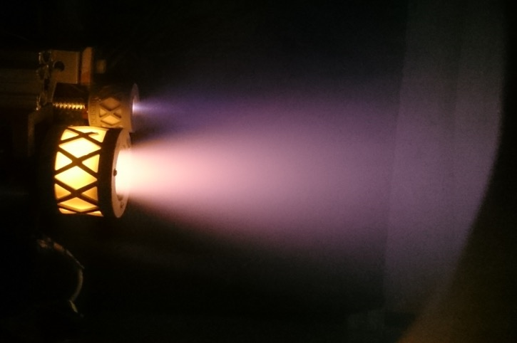
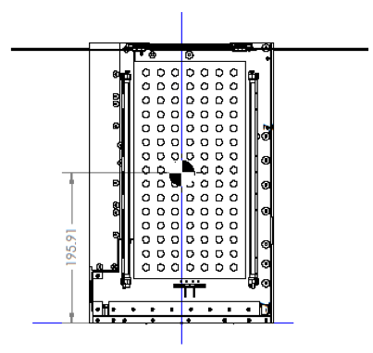
Propulsion (BIT-3)
Busek BIT-3 ion thruster
Iodine propellant
10° gimbal for momentum management

Slide 17
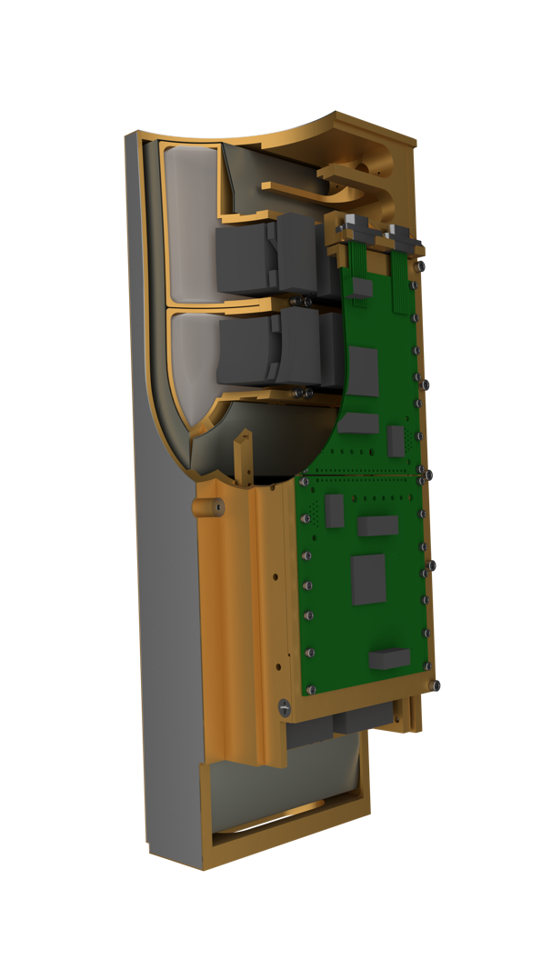
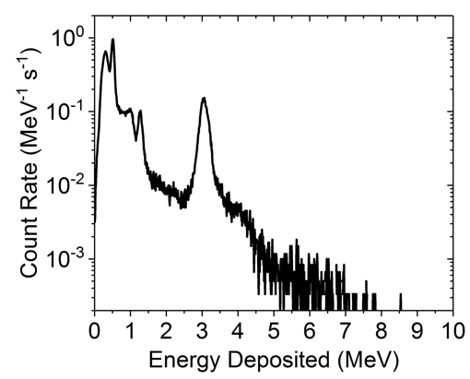
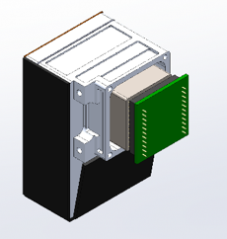
Miniature Neutron Spectrometer
Detector | 2x4 array of CLYC (elpasolite scintillator, Cs₂LiYCl₆:Ce) crystals, each crystal 4 cm x 6.3 cm x 2 cm
Dimensions | 25 cm x 10 cm x 8 cm
Mass | 3.3 kg
Power | 10W (min), 22W (max)
Data Acquisition | Counts binned every 1 sec
CLYC Module
Instrument Housing and Electronics

Slide 18
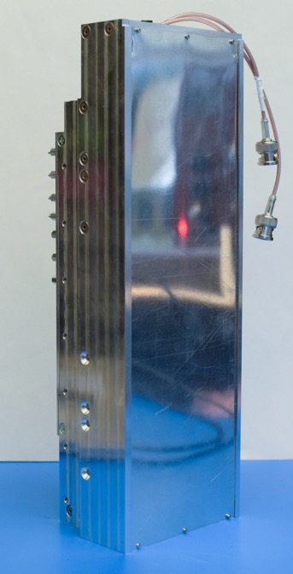
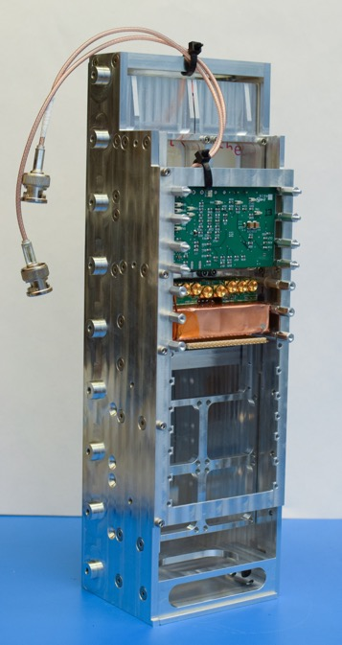
Mini-NS EDU
Test results from single EDU module exposed to Na-22 and AmBe
Notes:
Yes add graphic

Slide 19
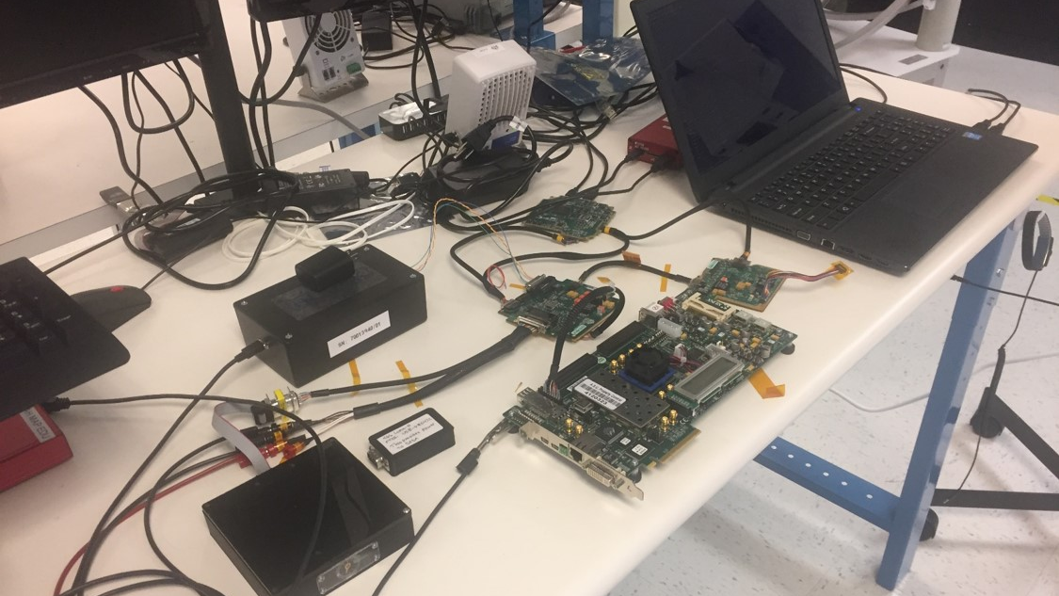
Flatsat

Slide 20
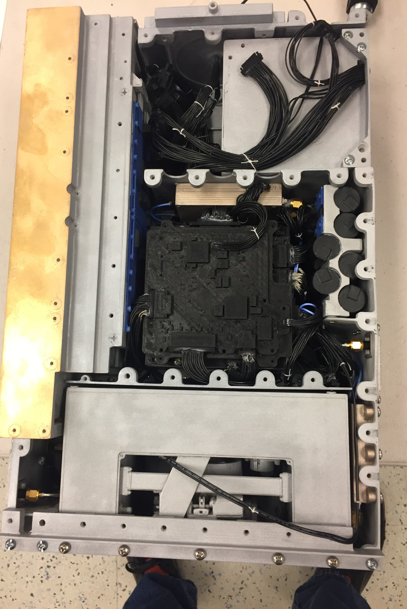
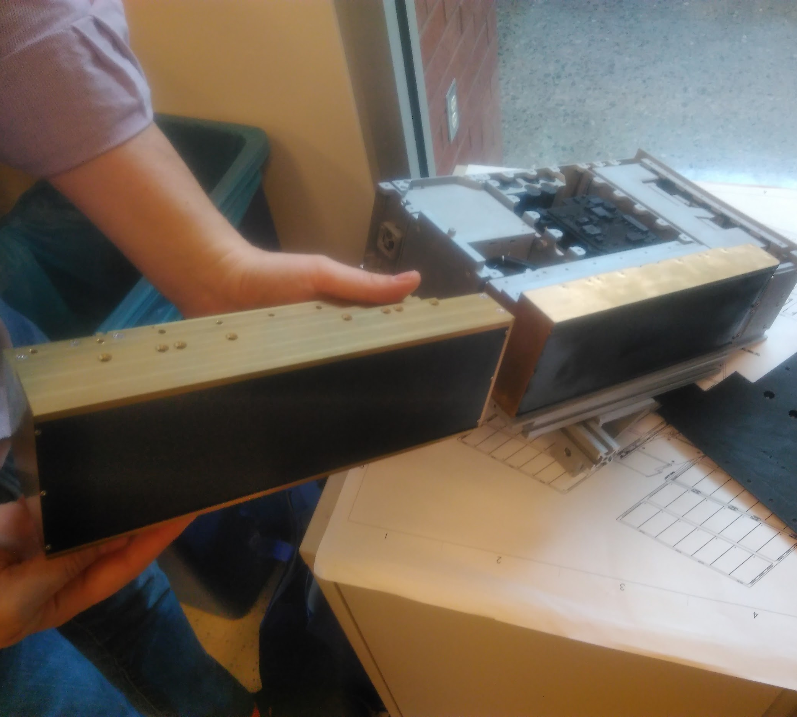
Prototype Components
3D printed full S/C

Slide 21
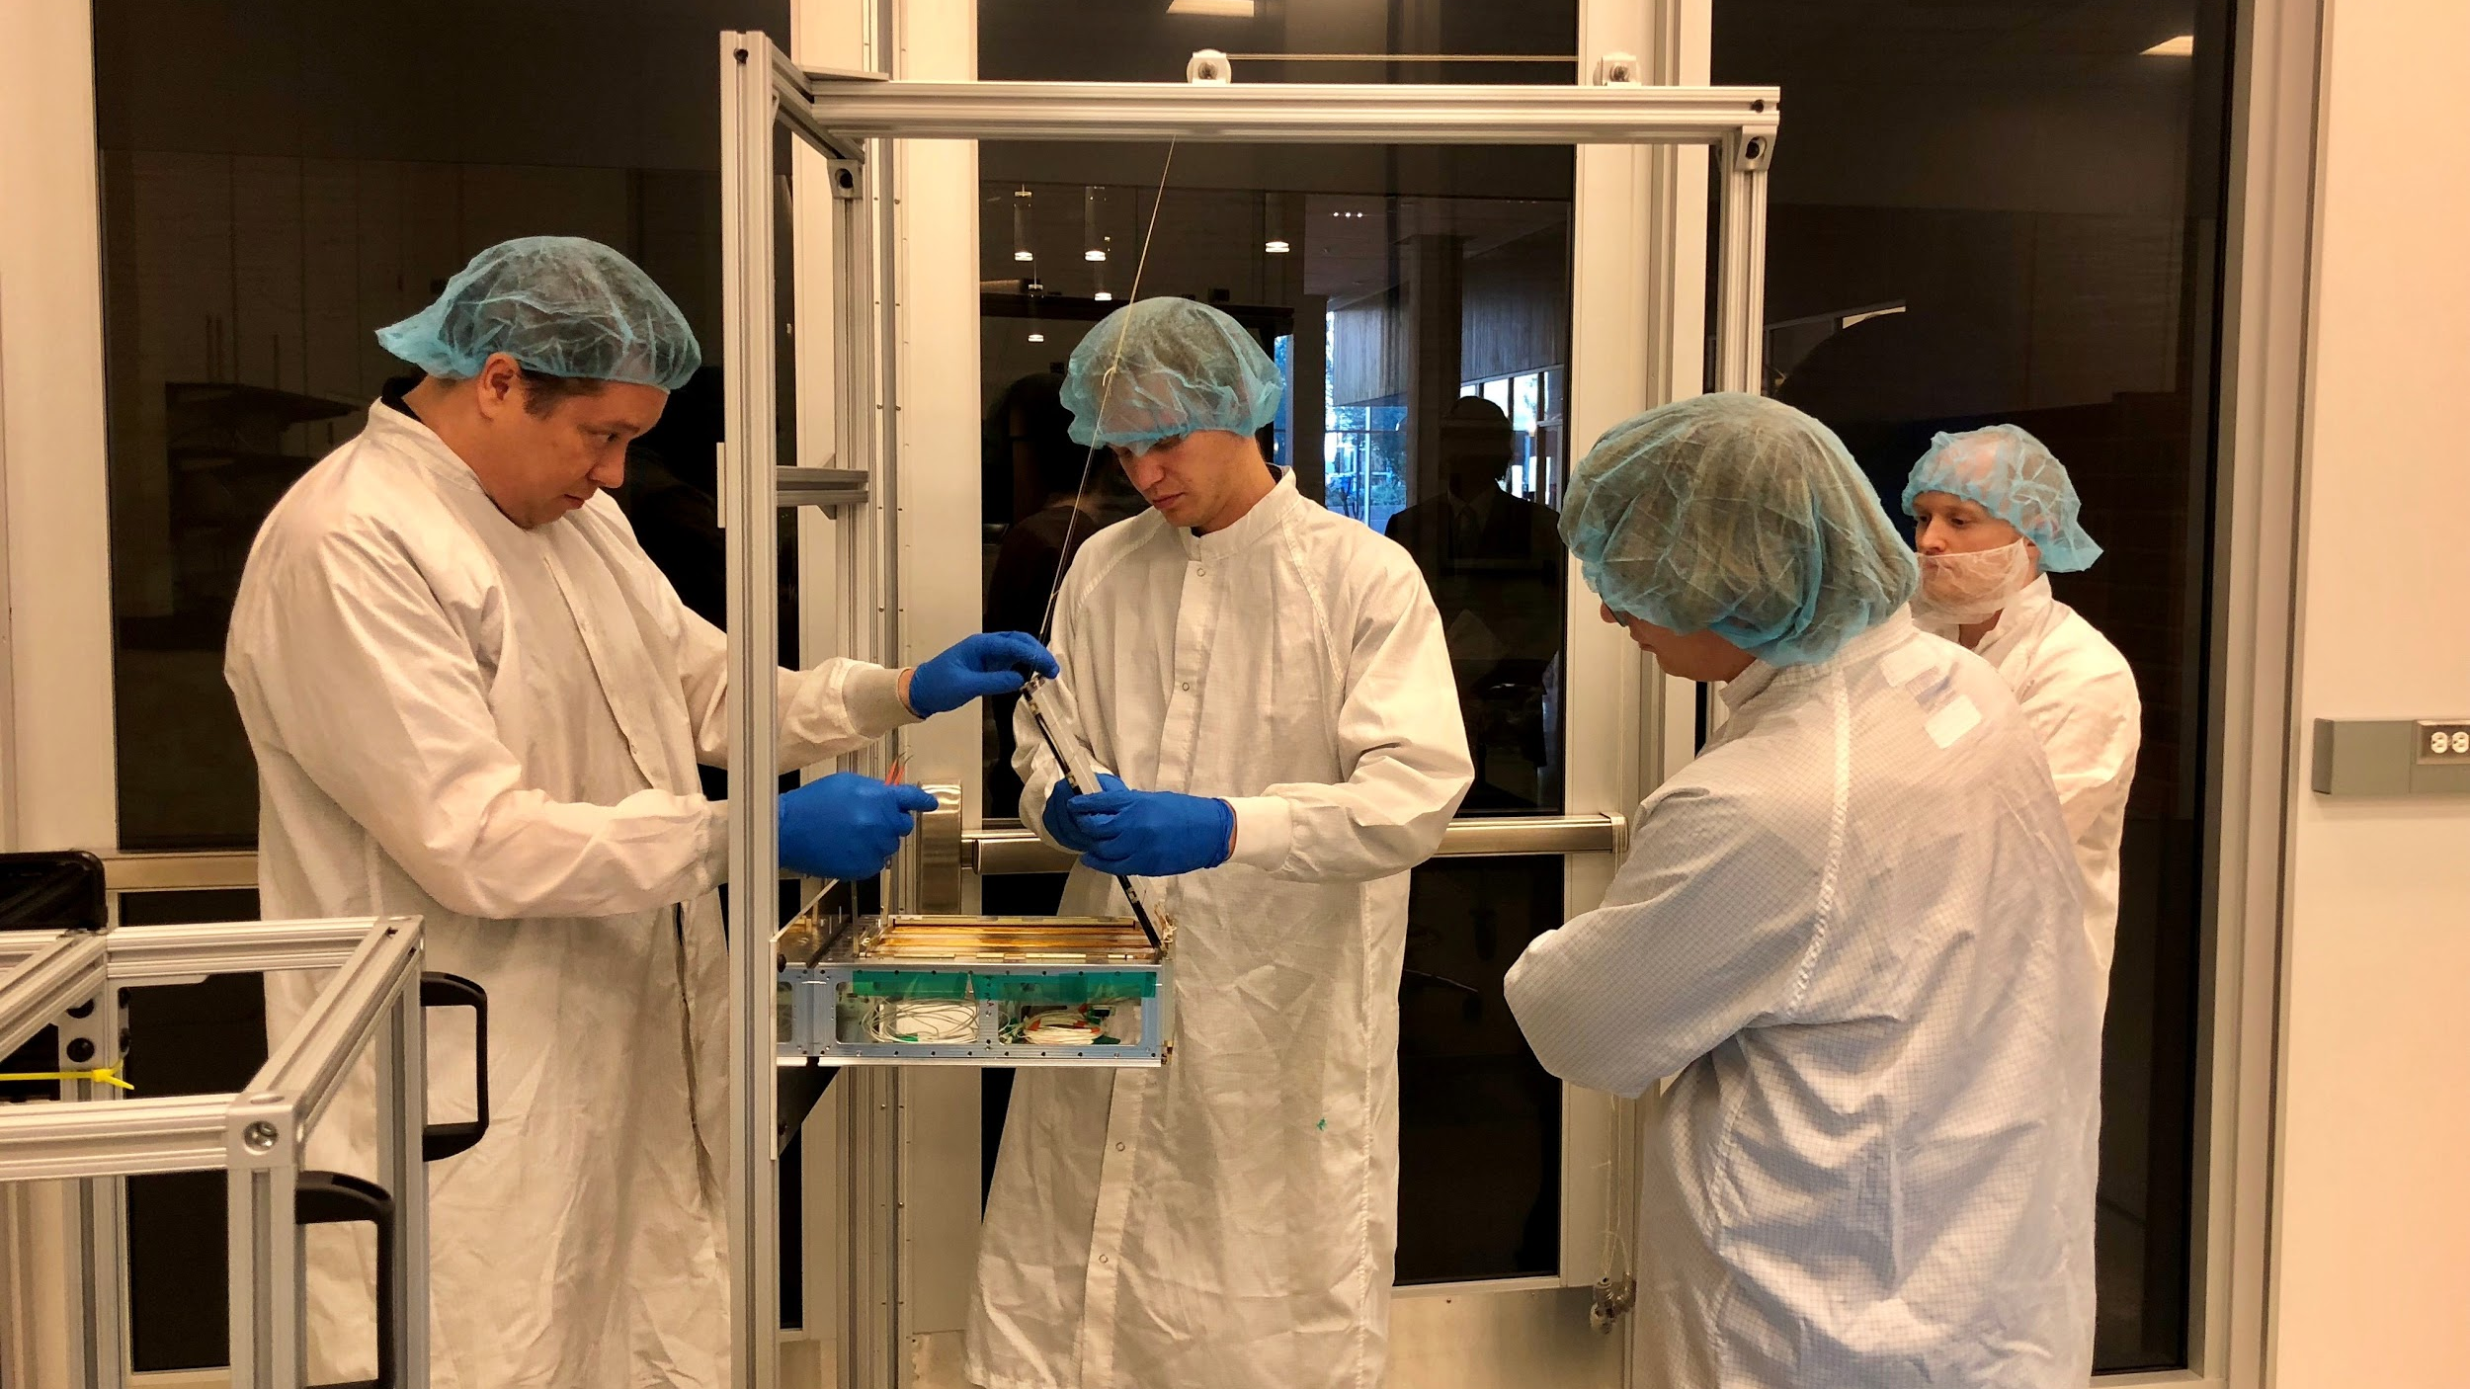
Engineering Models

Slide 22
Qualification
FM components are tested to GEVS prior to delivery
S/C at proto-qual vibe and TVAC levels
Mini-NS calibration at Los Alamos Neutron Free In-Air Facility (LPNS and Dawn GRaND instrument calibration)
Test
Component functional testing integrated in S/C
S/C level functional testing – operational modes, day-in-the-life
GDS testing with Flat sat and flight components, S/C
Flat sat development: EM (C&DH, EPS, Expansion Board, Solar Arrays, Iris radio), Emulators (BIT-3 propulsion, Iris radio, Mini-NS, SATA), EDU (Mini-NS)
Notes:
Fix solar panels
Add more reviews
- past (IAA, SRR, PDR, I-PDR)
- future (AITRR, FRR, etc.)

Slide 23
Lessons Learned So Far …
FLUID DESIGN PROCESS REQUIRED
Examples of fluid design so far:
  As a result of the safety review with launch vehicle (SLS), a late change was identified that required extra level of fault tolerance in separation switches. A third switch violated the allowable switch force pushing on the pusher plate. We identified a new switch lever that imparts a much lower force, and re-designed the bracket to permit the installation of three switches. All of this re-design was done within the same volume as the old design and without changing any other component on the spacecraft at a net zero mass change.
  EM solar array sticking in deployment tests. Resolved with a change in procedure and inspection.
  Dispenser Interference. Hole interference with the dispenser ICD. Resolved through a slight design change.
  The Mini-NS design was coming in over weight. We formed a tiger team to assess the mass of all components and reduced the overall mass to within an acceptable level for the spacecraft
  BCT identified noise on sun sensor readout lines. Resolved by not polling the magnetometer.
  The EPS and XEPS board brackets have an interference with traces on the EPS and XEPS boards. The resolution is to re-work the brackets to avoid the traces.
  We have an unavoidable interference between the screws that mount the Solar Array and the BIT-3 volume. We have gotten approval from Busek to violate the volume envelope in the area of the screws.
Perform GDS trade study early on in coordination with the C&DH vendor and FSW team
Notes:
Fix solar panels
Add more reviews
- past (IAA, SRR, PDR, I-PDR)
- future (AITRR, FRR, etc.)

Slide 24
Lessons Learned So Far …
Documentation - inconsistencies in documentation. Perhaps this is partly due to more NRE from the subs on lunar missions vs. LEO missions? How do the actual class-D cubesats handle this (e.g. TROPICS, MinXSS?).
Technical Project Management is Required by CE, PSE, ME/TE/EE team, PI
Approach to Flight Hardware - We are aiming for a middle road between traditional academic CubeSats that may only have FMs for key subsystems which they use for development, testing, and flight and larger projects that have complete EMs and only use FMs for final integration, test, and flight. We are taking steps to check EMs against software emulators and development units in parallel with development using the FMs (at BCT).
No Flight Spares Approach
Calibration with Integrated System - Unlike larger spacecraft/instruments, we have the option to perform our instrument calibration with many of the spacecraft systems in place. This reduces the risk that the spacecraft EPS/CDH have unknown interferences with the instrument that we only discover in flight.
Unique Risk Reduction and Science Opportunities
Notes:
Fix solar panels
Add more reviews
- past (IAA, SRR, PDR, I-PDR)
- future (AITRR, FRR, etc.)

Slide 25
What Worked / Is Working
  Gated reviews work - SRR, IAA, PDR, CDR, SLS safety review process
    Design maturation at slower rate, punt on certain tasks at reviews, punt on some (not all) subsystem reviews, close RFAs later at next review or memo/presentation to review board
  Partnerships with NASA centers and other institutions
    Rely on expertise in reviews
    Shared facilities and equipment
  Relying on subs in design and implementation
  Modifying LEO hardware for deep space, tolerant to resets, i.e. radiation (somewhat TBD)
  Early emulator/EM and 3D model development
  Early thermal design and analysis
  Early wire harness routing on physical model
  Collaborative engineering using cloud based resources
    Necessary to collaborate often with remote team members and subs
Small Satellite Reliability Technical Interchange Meeting 2018

Slide 26
What Was / Is Harder
  Low TRL components ECRs
    Process changed to lower risk
    Tiger team to deal with a mass reduction due to parallel instrument and spacecraft development
    Attempt to extend performance beyond design and destroyed hardware
    Schedule slips on almost all of our vendors
  ICD
    Resolved with early 3D modelling and actual 3D printing of flight design
    eICDs tend to lag hardware, requires constant communication
    True and complete documentation from vendors and internally
  SLS
    Schedule slips, requirements definition, interface waivers (just don’t)
  Failure modes and recovery
  DSN time - Early on-orbit checkout - Early burn needed because we are a secondary
  “Design – Build – Test/Fly time X” is necessary but hard (budgets, EMs)
Small Satellite Reliability Technical Interchange Meeting 2018

Slide 27
What Is Next
  Flight integration
  Calibration at the system level
  Environmental - full system - test as we fly
  Storage?
  Launch
  Operations
Small Satellite Reliability Technical Interchange Meeting 2018

Slide 28
Backup
Notes:
Graphic from LPSC microsymposium - LP SNR compared to ours
Maybe show count/s over mission duration

Slide 29
LunaH-Map CubeSat
Mission Manager’s Assessment
PI: Craig Hardgrove, ASU
PM: Teri Crain, ASU
Mission Manager: Rick Turner
PS: Bobby Fogel
PE: Gordon Johnston
Technical
Cost
Schedule
Programmatic
Overall
JUL | AUG |  | JUL | AUG |  | JUL | AUG |  | JUL | AUG |  | JUL | AUG
G | G |  | G | G |  | Y-G | G |  | G | G |  | Y-G | G
  Technical:
  No significant issues
  Cost:
  No significant issues
  Schedule:
  No significant issues
  Programmatic:
  No significant issues
G
On plan, adequate margin
Y
Problems, working to resolve within planned margin
R
Problems, not enough margin to recover
Notes:
29
6
1

