Slide 1
HESTIA Model Based System Engineering with SysML
Lui Wang/ ER6
lui.wang-1@nasa.gov
Spacecraft Software Engineering Branch
JSC
May 6, 2016

Slide 2
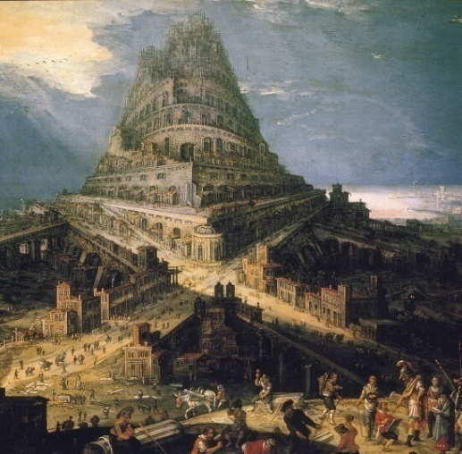
Why Model Based Systems Engineering?
Spacecraft designers and operation stakeholders create models and artifacts of the same system with different processes, tools, and representations.
These uncoordinated modeling approaches create
locally successful products but also create a
communication barrier among the various
stakeholders (the “Tower of Babel” Effect).
The same information is captured multiple
times, in multiple places, with multiple representations, creating a maintenance challenge.

Slide 3
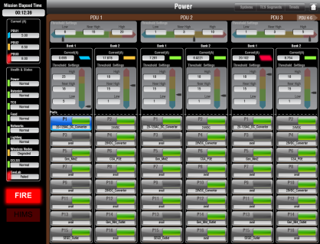
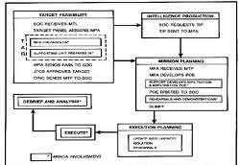
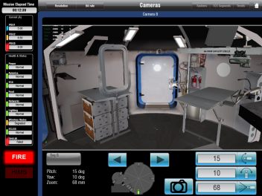
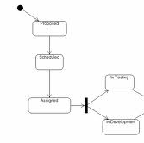
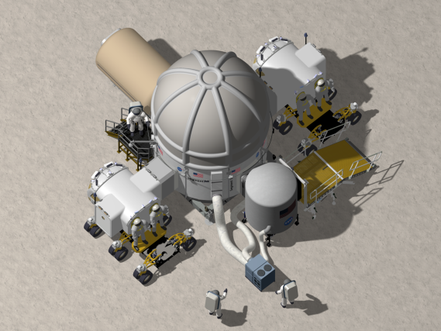
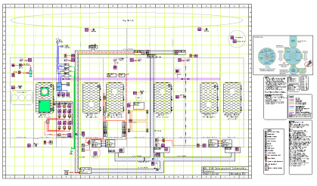
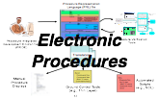
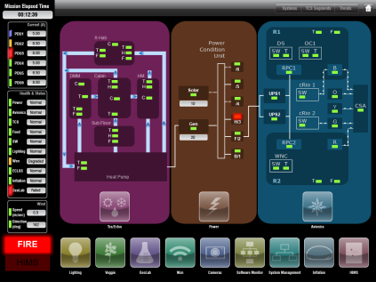
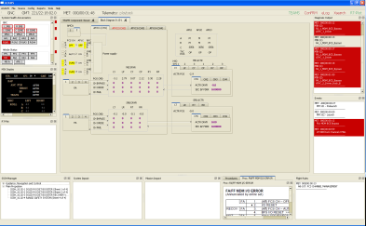
HDU Artifacts by Multiple Stakeholders
Telemetry and Command
Mission Operation Planning
Simulation
CAD Drawings
System Displays
ISHM and C/W
Notes:
My work with MBSE started in 2009 with the Habitat Demonstration Unit (HDU)
When we started this project the HDU was in the detailed design phase and we were running tests on the habitat in the Arizona Dessert
As we started to collect data to build the software; we quickly ran into the classic system engineering and integration problem
multiple stakeholders,
multiple artifacts
varying versions,
conflicting data within the various artifacts)
We generated a SysML model representation of the Habitat,
Consolidated all the data from the various stakeholders;
Began to process and producing artifacts from the model
Supplied back to the stakeholders with the updates system artifacts from everyone’s input
Pretty soon, the SysML model became the official source of information

Slide 4
Uses of System Models
Model Once and Use Many Times
Resource
Management
Mission Operation
Planning
Capability/Impact
Assessment
Schedule
MEL
Cost
Simulation
SCXML
XTCE
FMEA
RBD
Activity Diagrams
Modelica
SCXML
Safety Analysis
SysML Models
Exchange
Mechanism
software
Fault Trees
RBD
FMEA
Electronic
Procedure
XTCE
ATML
System
Design
FMEA
Connectivity
MEL
SCXML
FMEA
Connectivity
ISHM and
C/W
FMEA
Requirement
Traceability
RBD
XTCE
Connectivity
System Design
Validation
System
Displays
Training
Notes:
The idea here is that you have a SysML representation of the system
Have an efficient method for collecting system engineering data from all stakeholders
Produce up to date artifacts required by the stakeholders
So you can use the data from the model to perform their analysis
For example power subsystem domain expert provide data to the model, the SMA analyst extract the data from the model to use in their FMEA analysis
Model Once and Use Many Times

Slide 5
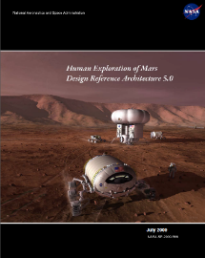
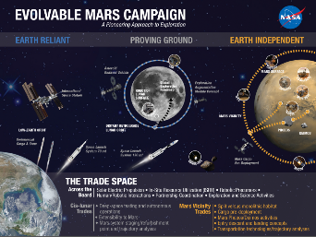
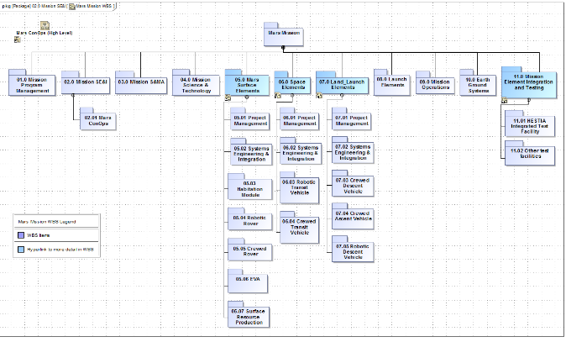
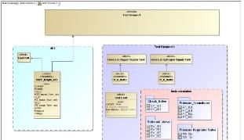
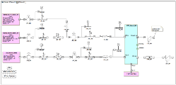
HESTIA SysML Models
Mars Planning
Reference Input
DRA 5.0
Mission ConOps
Mars ConOps used for HESTIA scenario development
WBS used to organize the project
WBS
ConOps
Mars Mission WBS
Interface Definition
Physical Models
Functional Models
Functional Decomposition
HESTIA
Physical Model/ Interface Definitions
HESTIA Requirements
HESTIA FY15 Demonstrations
Interface Definition
Physical Models

Slide 6
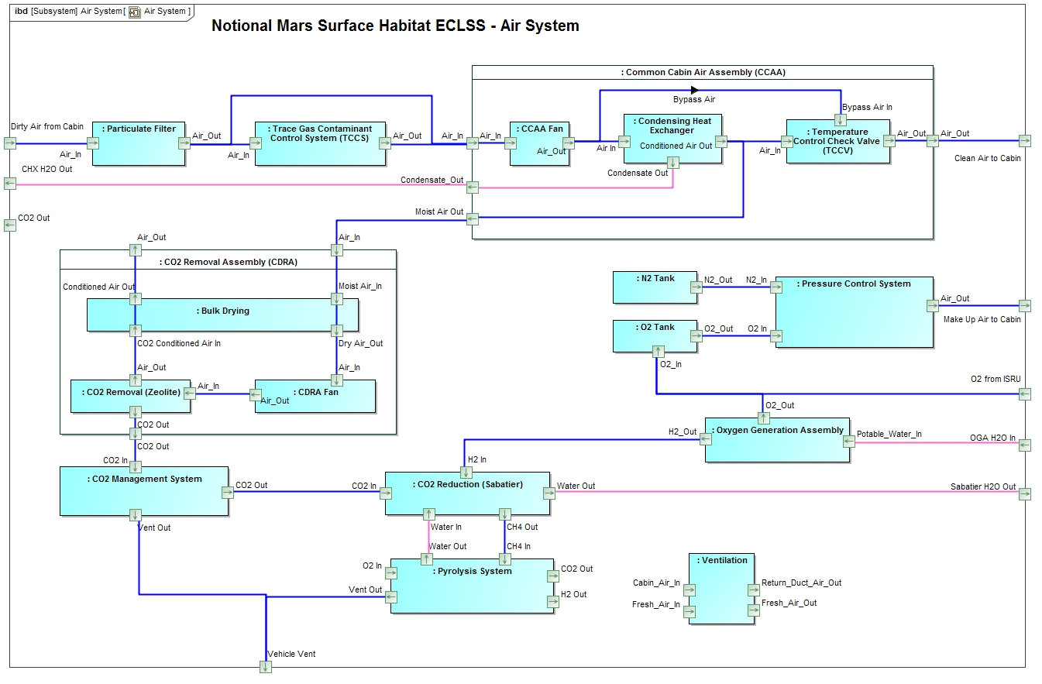
Modeling for Mars Life Support Notional Architecture
Model Mars Life Support Notional Architecture to support design trades.
Capture Requirements, Functional Breakdown, and Architecture
Architecture and Key Design Parameters
Interface Specifications

Slide 7
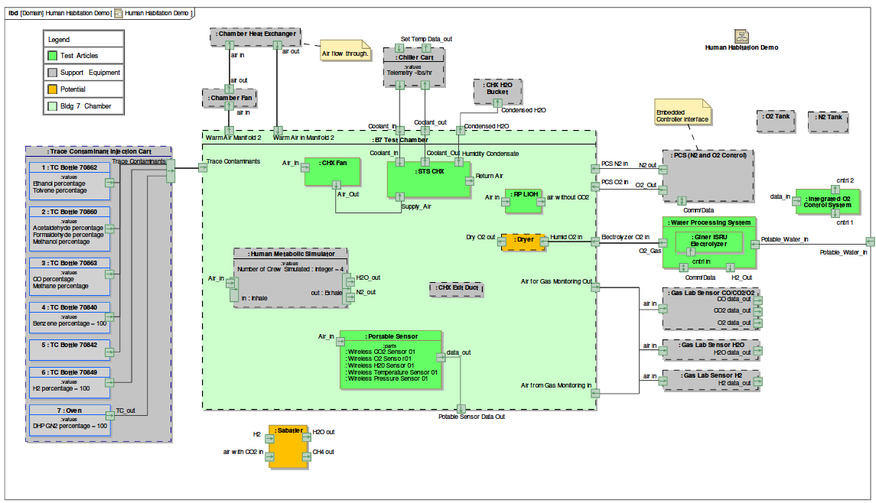
Modeling for Test Support (Capturing facility, existing and new technology)
Model the Life Support Test Setup Architecture
20 foot Chamber for Life Support System Testing
Notes:
Life Support Domain Modeling
Captured ECLSS HESTIA Demo Objectives in SysML model (imported objectives from spreadsheet/ demonstrated export to spreadsheet, PDF image, and report document)
Created SysML model of B7 Test Chamber interfaces (facility, support equipment, and test articles)

Slide 8
Maintaining Traceability between Notional Architecture and Testing
Notional Mars Architecture Model
Test Architecture Model
Using SysML Model to Maintain Traceability

Slide 9
Model Usage Examples
Use the model to support design trades on key design parameters
Mass, Power, Thermal etc…
ConOps Simulations
CDS example
Integrate the model with immersive 3D environment
HDU example

Slide 10
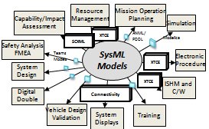
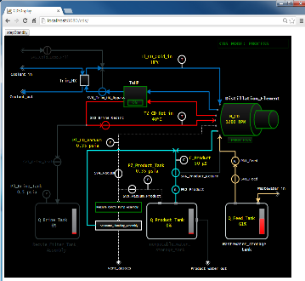
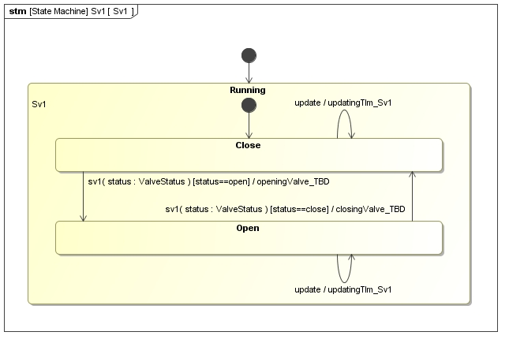
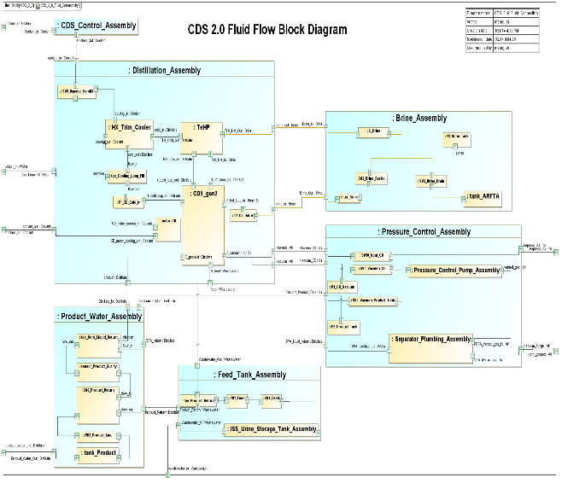
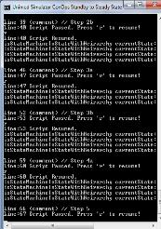
Use SysML to Support Design Trades on Key Design Parameters
Extracted ConOps Simulation

Slide 11
Demonstrated Technology on CDS 2.0

Slide 12
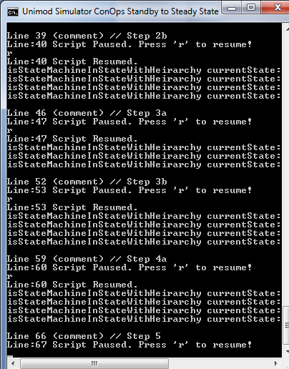
Concept of Operations/ Simulation

Slide 13
HDU SysML Model Usages
Telemetry and Command
Mission Operation Planning
Simulation
CAD Drawings
System Displays
ISHM and C/W
Notes:
My work with MBSE started in 2009 with the Habitat Demonstration Unit (HDU)
When we started this project it was in the detailed design phase and we were running tests on the habitat in the Arizona Dessert
As we started to collect data to build a model; we quickly came across the problem previously noted (multiple stakeholders, multiple artifacts, varying versions, and conflicting data within the various artifacts)
We generated a SysML model representation of the Habitat, consolidating all the data from the various stakeholders; and began the process of producing artifacts from one data and supplying multiple stakeholders with their system artifacts (in turn the stakeholders would notify the SysML modeler of vehicle updates knowing that we would quickly produce turnaround artifacts reflecting the latest changes for the multiple stakeholders).

Slide 14
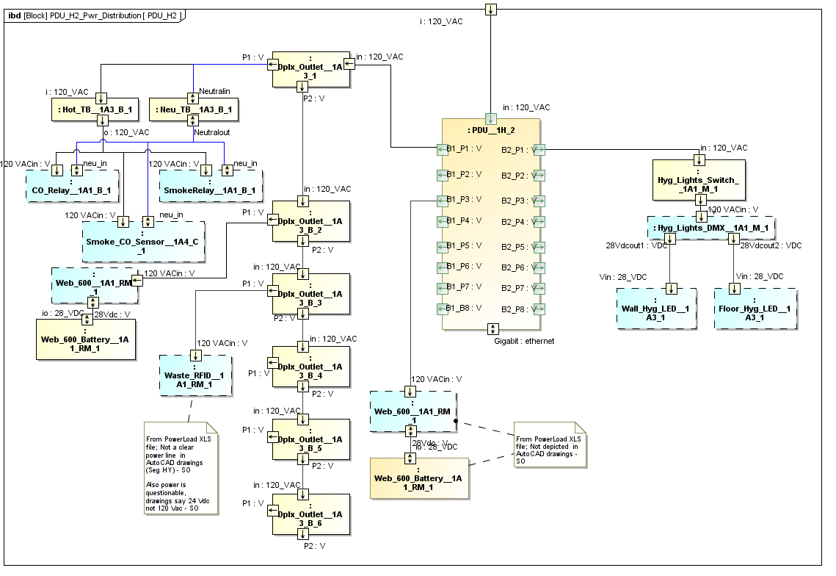
Integrate the Model with Immersive 3D Environment
HDU 3D Simulation – Immersive Environment
HDU SysML Models
Integrate
Notes:
Problem
Current Status (Current Condition)
Target Condition
Suggested Improvements (Goals)
Current Work
Future Plans (Implementation Plan)

Slide 15
Backup

