Slide 1
Steam Methane Reformation For Air-Independent Solid Oxide Fuel Cells
Presenter: Kamwana Mwara

Slide 2
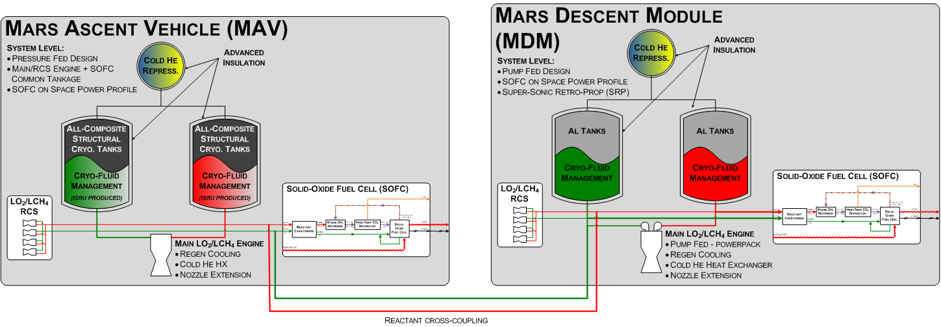
HESTIA Architecture

Slide 3
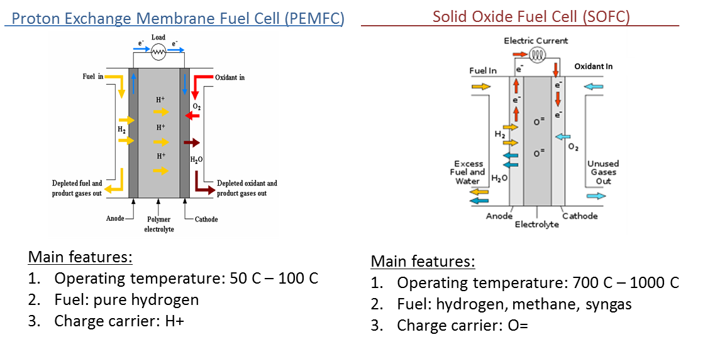
Why Steam Methane Reformation?
Background
The availability of LOx/CH4 in the HESTIA-ISRU architecture, introduces Solid Oxide Fuel Cells (SOFCs) as an option, due to their ability to efficiently utilize those reactants.
Notes:
4 cylinder design:
Based on SMR Matlab model which took into consideration:
System & architecture constraints
Desired methane reaction rates & equilibrium molar fractions
Catalyst contact with steam & methane mixture
Heat transfer rate to catalyst
Length & area of SMR tubes
Pros of 4 cylinder design:
More catalyst contact with gas mixture
Smaller diameter of tubes gives even more heating

Slide 4
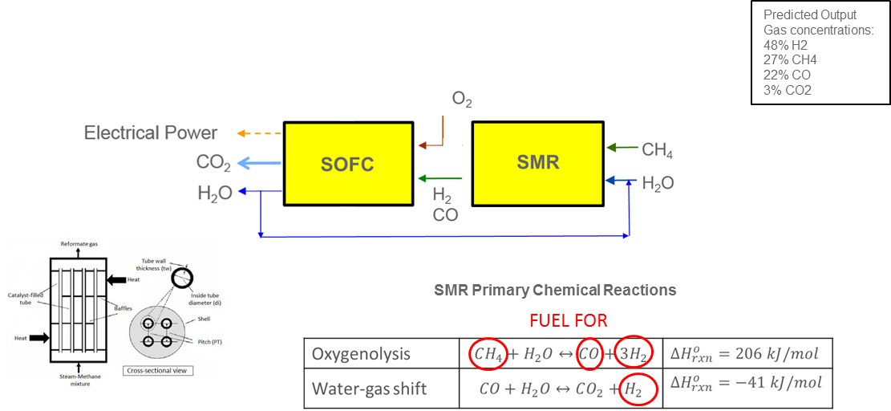
Why Steam Methane Reformation?
Introduction
SOFCs can do internal reforming to convert CH4 into H2 to be used for fuel
But would be optimal to reform methane externally first
Utilizing an external steam methane reformer (SMR) would be the first step to creating a more efficient SOFC system
Notes:
4 cylinder design:
Based on SMR Matlab model which took into consideration:
System & architecture constraints
Desired methane reaction rates & equilibrium molar fractions
Catalyst contact with steam & methane mixture
Heat transfer rate to catalyst
Length & area of SMR tubes
Pros of 4 cylinder design:
More catalyst contact with gas mixture
Smaller diameter of tubes gives even more heating

Slide 5
HESTIA SMR Testing
Need:
Obtain data on SMR CH4 conversion efficiencies and operating conditions, in support of HESTIA
Objective:
To design, develop, & in-house SMR system
Determine optimal operating conditions, reactor design, fluid delivery, & heating
Utilize lessons learned from in-house testing, to generate requirements for vendor-provided SMR integration with SOFC
Phases of JSC In-House Testing:
Phase 1: Test reactor design based off of theoretical Matlab model
Phase 2: Test refined reactor and system design
Phase 3: Test optimized system design and new metal foam catalyst
Notes:
4 cylinder design:
Based on SMR Matlab model which took into consideration:
System & architecture constraints
Desired methane reaction rates & equilibrium molar fractions
Catalyst contact with steam & methane mixture
Heat transfer rate to catalyst
Length & area of SMR tubes
Pros of 4 cylinder design:
More catalyst contact with gas mixture
Smaller diameter of tubes gives even more heating

Slide 6
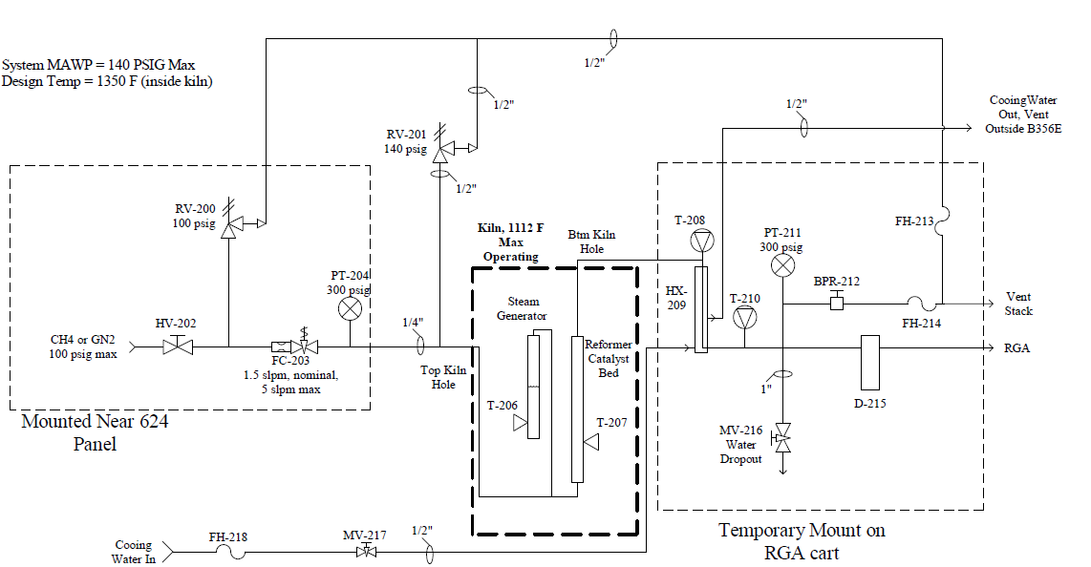
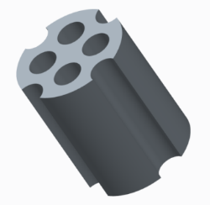
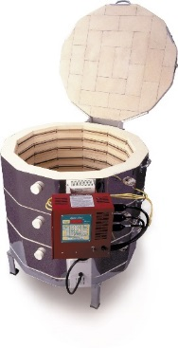
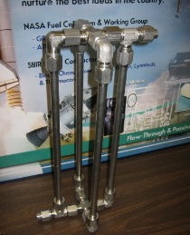
SMR Testing: Phase 1
System Layout
Catalyst
Nickel Oxide Catalyst
Reasons for selection:
Low cost
Reasonably good efficiency
Hot Flow Test (With Preheating of Gases)
Test # | CH₄ Mass Flow Rate [g/min] | H₂O Mass Flow Rate [g/min] | Steam to Methane Ratio [mol/mol] | SMR Temperature [˚F] | System Pressure [psia]
1 | 0.982 | 1.2 | 1 | 1020 | 14.7
2 | 0.982 | 2.3 | 2 | 1020 | 14.7
3 | 0.982 | 3.3 | 3 | 1020 | 14.7
Notes:
4 cylinder design:
Based on SMR Matlab model which took into consideration:
System & architecture constraints
Desired methane reaction rates & equilibrium molar fractions
Catalyst contact with steam & methane mixture
Heat transfer rate to catalyst
Length & area of SMR tubes
Pros of 4 cylinder design:
More catalyst contact with gas mixture
Smaller diameter of tubes gives even more heating

Slide 7
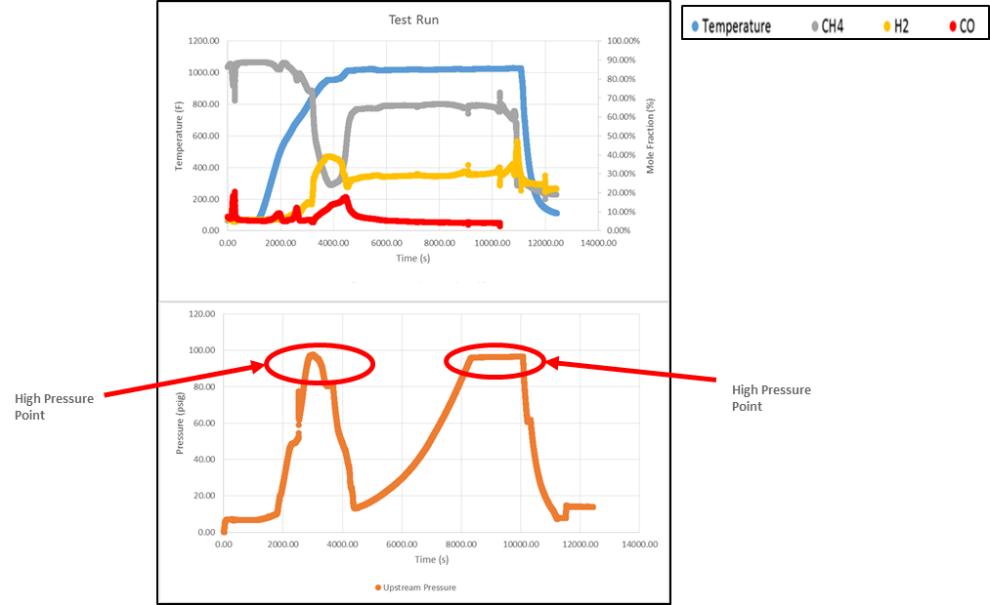
SMR Testing: Phase 1
Generated H2 production, and also high build-up of upstream pressure

Slide 8
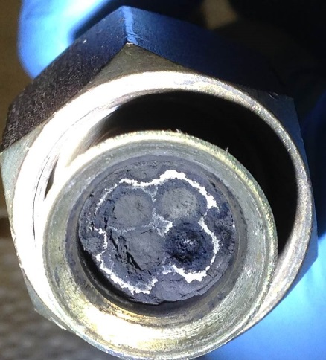
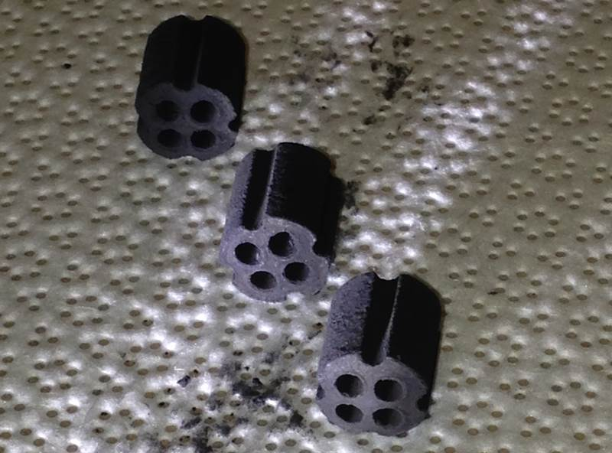
SMR Testing: Phase 1
Test results:
Initial production of Hydrogen
Carbon deposition blockage in the catalyst bed
Conclusions:
Use of a kiln to produce steam
No steam flow regulation (steam-to-methane ratio)
Catalyst was not reduced:
𝑁𝑖𝑂+𝐻₂↔𝑁𝑖+𝐻₂𝑂
Phase 2 recommendations:
Use syringe pumps to regulate water flow
Use a separate heater to generate steam
Reduce catalyst

Slide 9
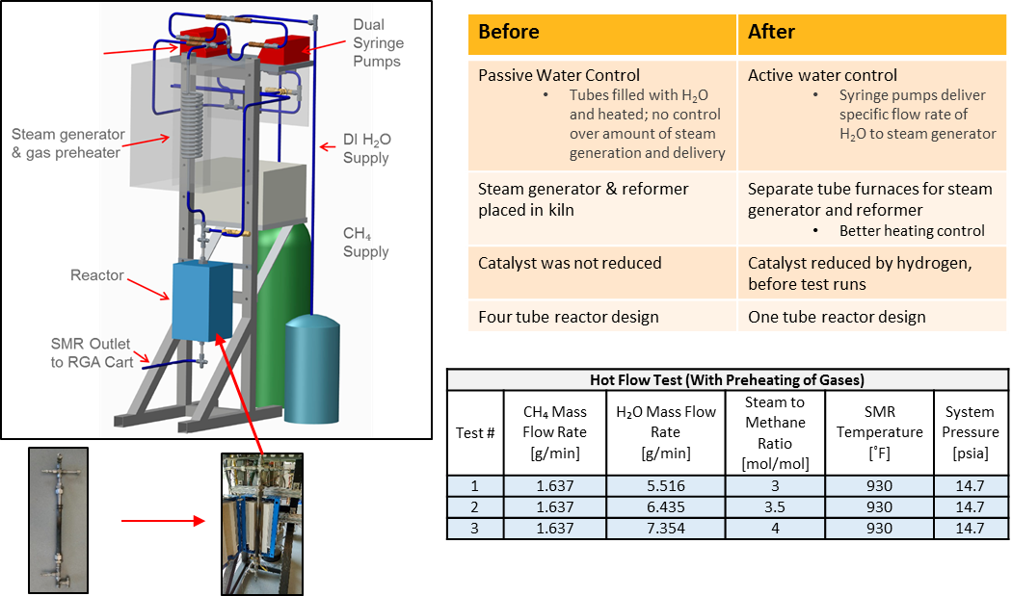
SMR Testing: Phase 2
System Layout
Improvements

Slide 10
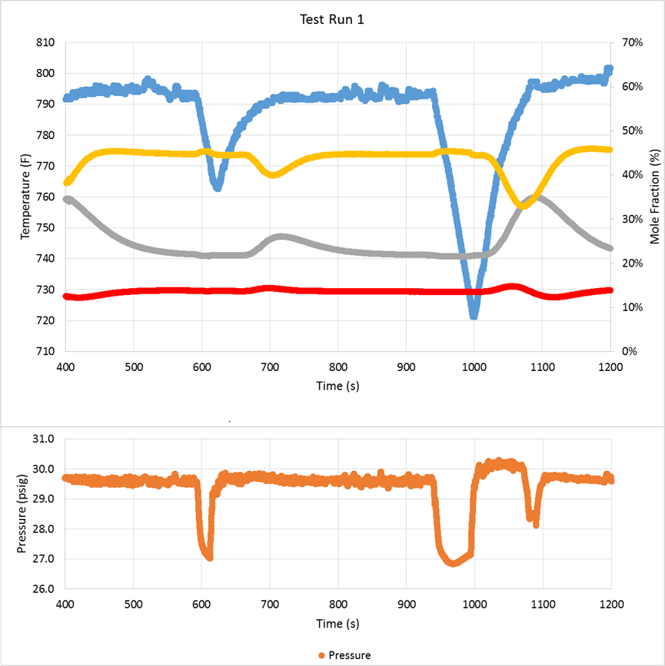
SMR Testing: Phase 2
Observed temperature and pressure transients – Affected H2 production at certain points

Slide 11
SMR Testing: Phase 2
Test Results:
Higher overall amount of hydrogen being produced
Carbon deposition still being generated, though at lower rate
Conclusions:
Catalyst was not sufficiently reduced
Need to increase thermal mass to heat up fluids to design temperatures
Need to minimize hotspots that promote carbon deposition
Essential to maintain consistent heating profile for input stream going into the reactor
Recommendations:
Obtain more robust catalyst
Conduct one more round of testing, with system modifications
Carbon deposition in test system

Slide 12
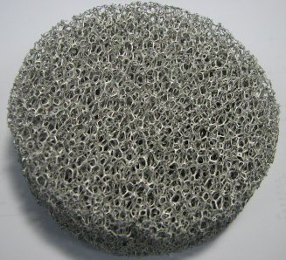
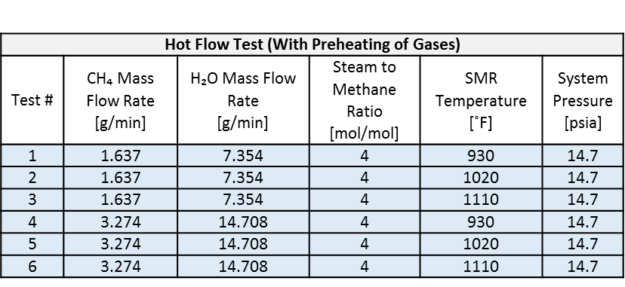
SMR Testing: Phase 3
System modifications:
Switched to new metal foam catalyst – for increased chemical stability and potential conversion efficiency
Heat Transfer | Mass Transfer
Higher thermal conductivity minimizes temperature gradients & hot spots | Porous structure provides more tortuous path for gas molecules
Helps favor the reactions we want and prevent those we don’t | Better dispersion of the active metals coated on the metal foam structure
Ordered Pd/Rh coated SIC metal foam catalyst, machined to SMR physical dimensions with through-hole for high temp temperature probe

Slide 13
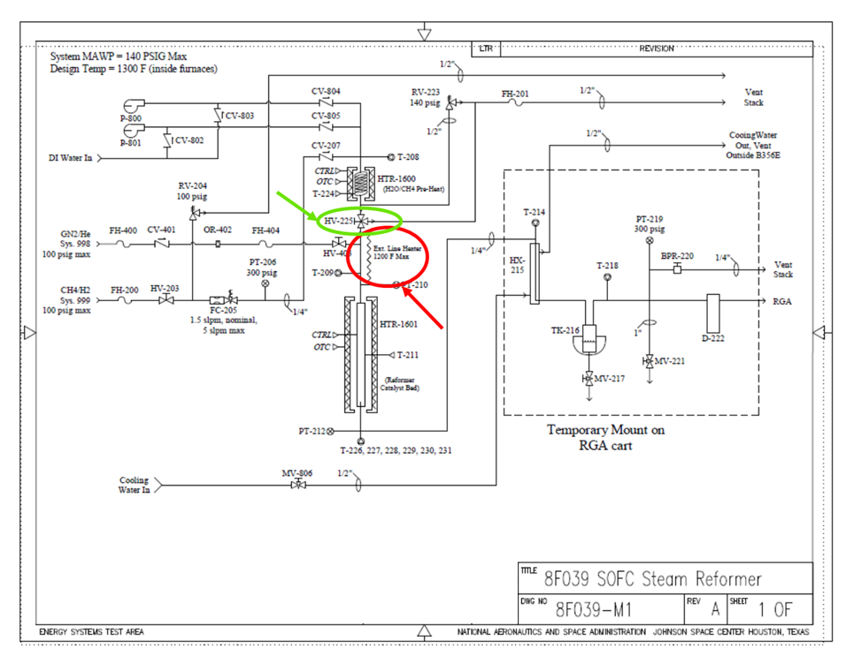
SMR Testing: Phase 3
System modifications:
Installed 3-way valve downstream of steam generator, to help avoid T and P transients (circled in green)
Installed heating tape between steam generator and reactor, to maintain consistent heating profile (circled in red)

Slide 14
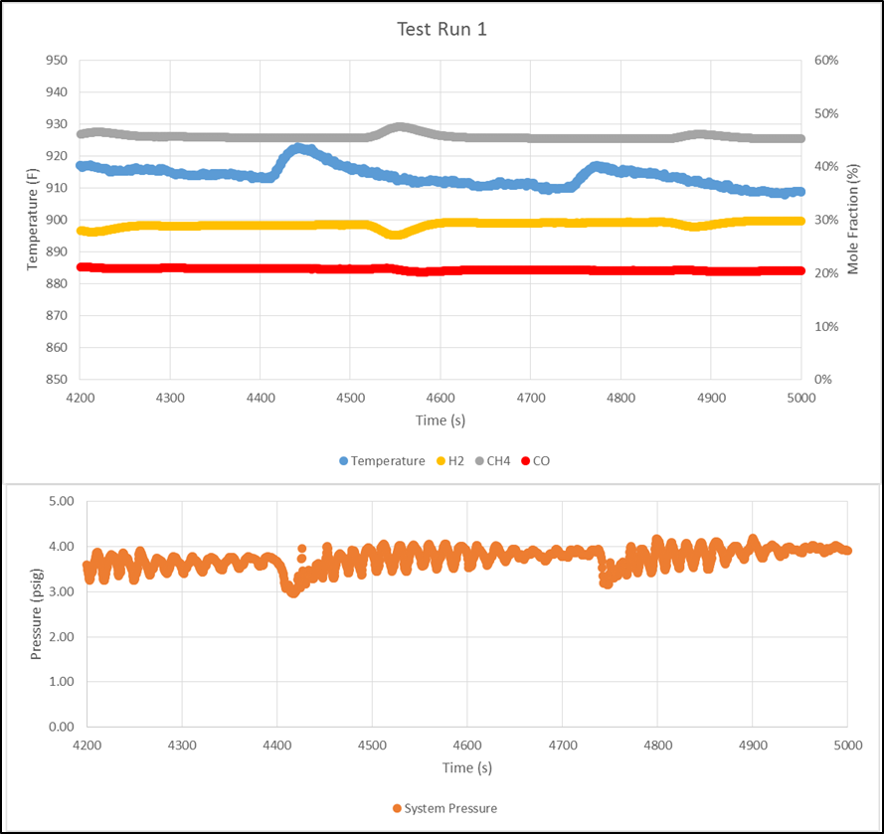
SMR Testing: Phase 3
Initial test run – steadier temperature and pressure rates

Slide 15
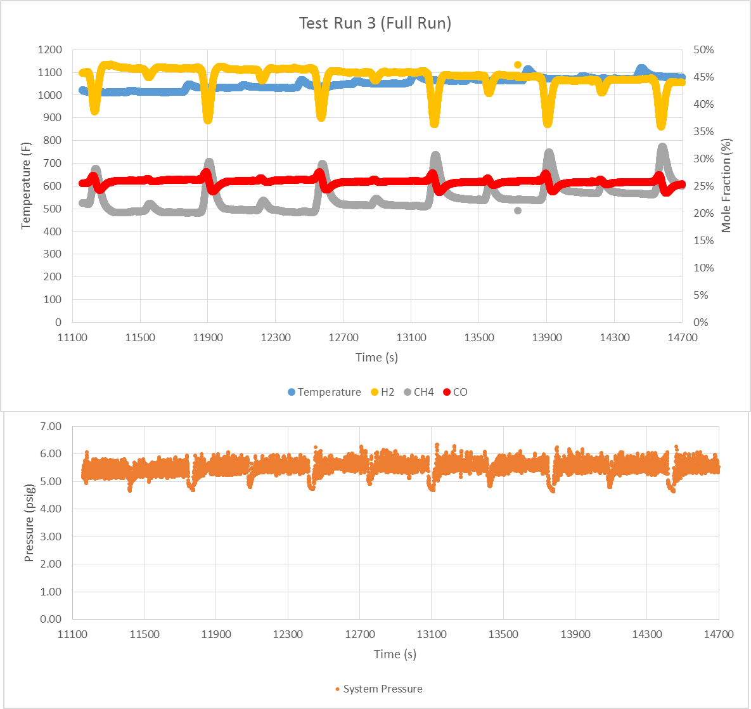
SMR Testing: Phase 3
Final test run – steady pressure flow, fluctuating H2 production

Slide 16
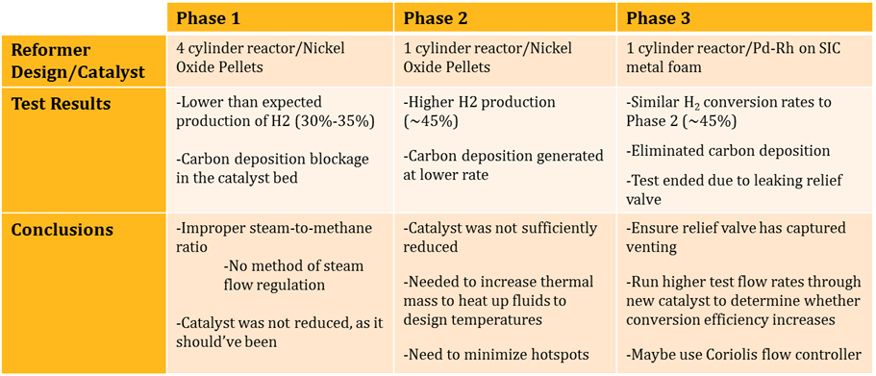
SMR Testing: Phase 3 & Test Summary
Testing Results:
Test prematurely ended due to leaking relief valve
Eliminated carbon deposition
Similar H2 conversion rates to Phase 2
Conclusions/Lessons Learned:
Ensure relief valve has captured venting
When possible, run higher flow rates in order to determine whether conversion efficiency increases
Potentially better to use water flow controller instead of syringe pumps
SMR Overall Test:

Slide 17
SMR Testing: Current Development
Goal:
Private vendor SolidCell, Inc. to develop new SMR system
Based on technical requirements and direction provided by JSC, generated by lessons learned from in-house testing
SMR system to be integrated with existing JSC 1 kW SOFC system
Why:
Develop more flight-like system, to include capacity for recirculation of SOFC product water and partial parasitic load capabilities
How:
Test Conditions include:
Water source: DI Water/SOFC Product water
Operating Temperature ≥ 600ºC
Operating Pressure: 0-15 psig
Steam-to-Methane Molar Mixture Ratio: ≥3

Slide 18
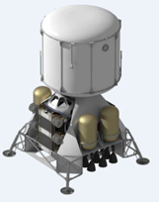
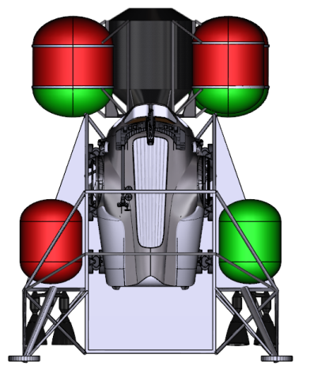
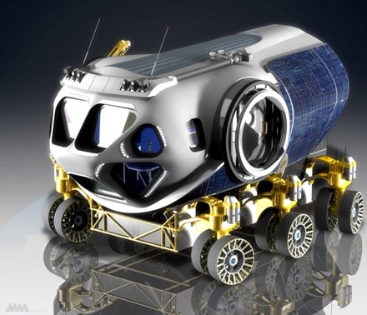
SMR Testing: What’s Next
Testing:
SMR System to be delivered at end of May
Integration & testing with SOFC to happen by end of September (FY’16)
Afterward, integrated testing with SOFC, CFM, and other ISRU architecture
Use CH4 from CFM boiloff
Develop More Flight Ready Design:
Recirculate product gases, along with H2O
Enable SMR and supporting components act as a fully parasitic loads on SOFC
Contain SMR & SOFC in same furnace

