Slide 1
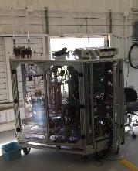
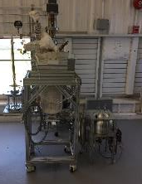
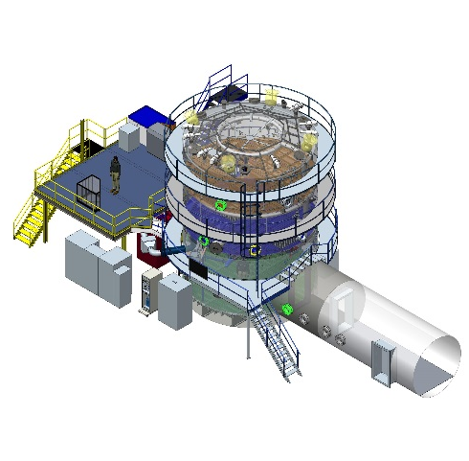
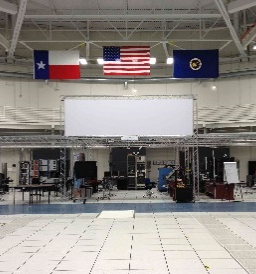
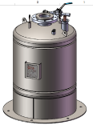
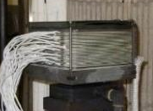
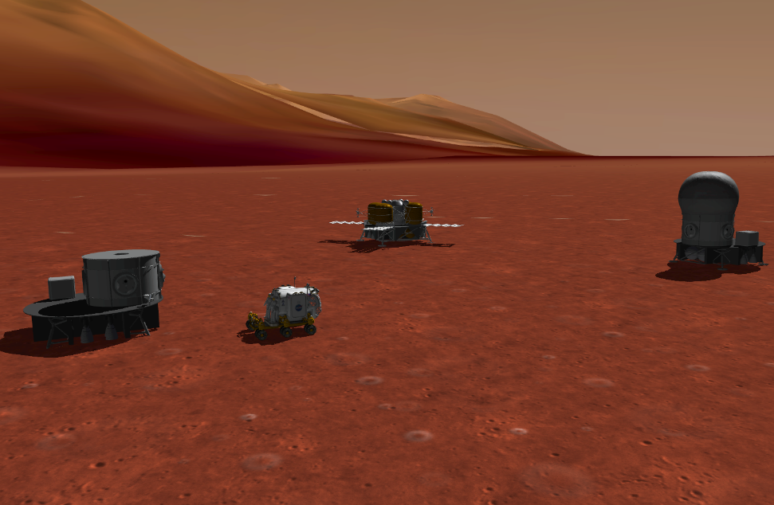
Human Exploration Spacecraft
Testbed for
Integration and
Advancement
ESTA
Picture of ESTA
20’ Chamber
iPAS
Physics-Based Simulation
Paul Bielski, Lui Wang, Bill Othon
JSC/EG
AIAA Technical Symposium - JSC
6 May 2016

Slide 2
How Do We Design for Mars?
NASA doesn’t get access to Exploration Mission Environment often
Simulation is required to develop, test, and operate spacecraft
Evaluate the coupled effects of the environment, the vehicle configurations, and crew activities as vehicles evolve throughout their life cycles
Provide insight to project systems engineers and subsystem teams on the integrated effects of design selections
Assess performance of hardware and software in environments and conditions that are expensive or impossible to recreate on the ground
Integrated Simulation allows early analysis of
Emergent Properties of spacecraft

Slide 3
Types of Simulations
Analysis
Single or multiple subsystem simulations that provide insight into vehicle design or operation, running on an engineer’s desktop
Robotics, GN&C, Mechanisms, Power, Thermal, Life Support
Hardware-in-the-loop Systems
Single or multiple subsystem simulation supplying a realistic environment to one or more hardware elements for analysis, testing, software development, or software verification purposes
Robotics, Avionics, GN&C
Human-in-the-loop Systems
Full team, single system, or scenario training in dedicated facilities with representations of crew and flight controller interfaces used for training and procedure verification
Robotics, Avionics, GN&C, Mechanisms, Power, Thermal, Life Support
Many simulations cross these boundaries
Begin life for analysis, and end up being used for hardware- or human-in-the-loop activities
A given simulation may be used throughout a program life cycle

Slide 4
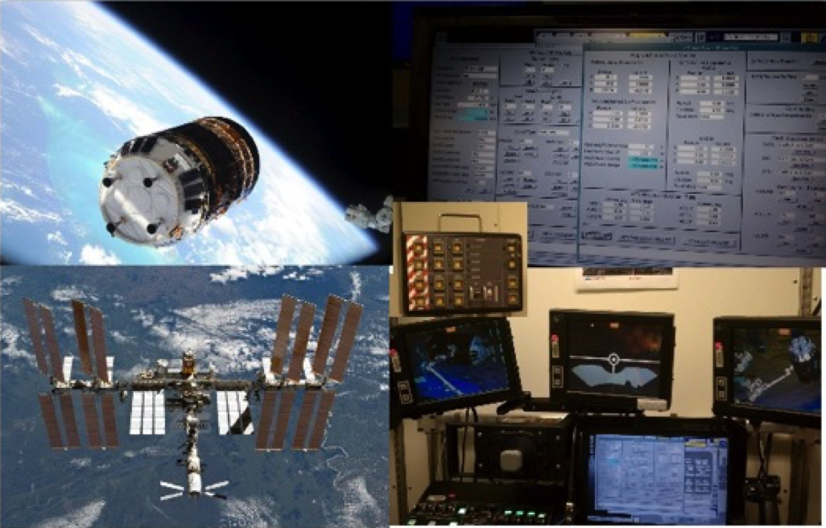
Analysis Simulations
Mobile Servicing System (MSS) sim - ISS robotics

Slide 5
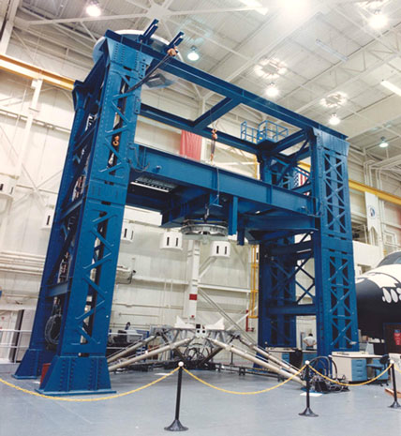
Hardware in the Loop
Six Degree of Freedom Dynamic Test System (SDTS) – Stewart platform used to validate docking and berthing mechanisms

Slide 6
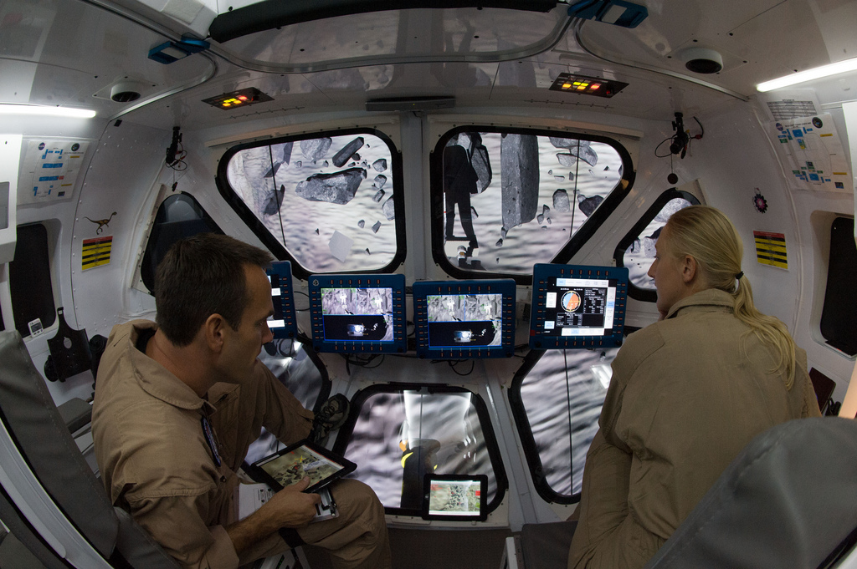
Human-in-the-Loop Simulation
Systems Engineering Simulator (SES) – Real-time, crew-in-the-loop simulation of the dynamic flight phases of Shuttle, ISS, Orion, and future vehicles

Slide 7
Integrated Vehicle Simulation Tools
Trick simulation environment provides model execution ordering, input processing, state integration, data recording, and post-processing capabilities
JSC Engineering Orbital Dynamics (JEOD) provides environment models and 6-DOF dynamics
General Use Nodal Network Solver (GUNNS) provides physics-based models of power, fluidic, and thermal systems
Multibody Dynamics (MBDyn) provides kinematic and dynamic modeling of complex mechanisms including robots
Pong and MechDyn provide modeling of complex contact surfaces, including terrain and mechanisms
TrickHLA provides IEEE 1516 High Level Architecture (HLA) interface mechanism for all Trick simulations
EDGE provides realtime graphics rendering capabilities
Develop a reusable set of tools, used by multiple NASA projects

Slide 8
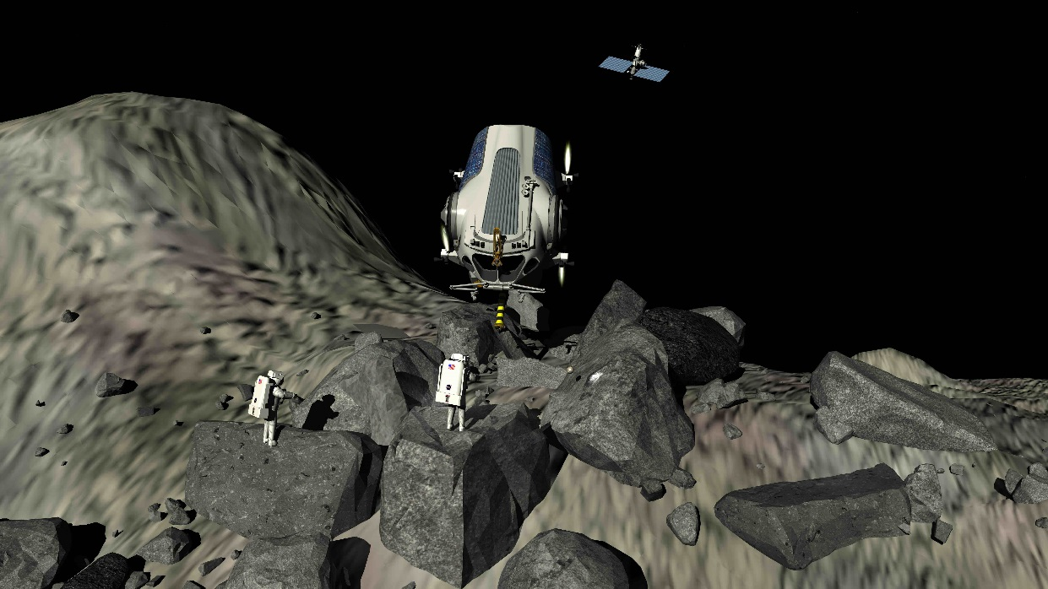
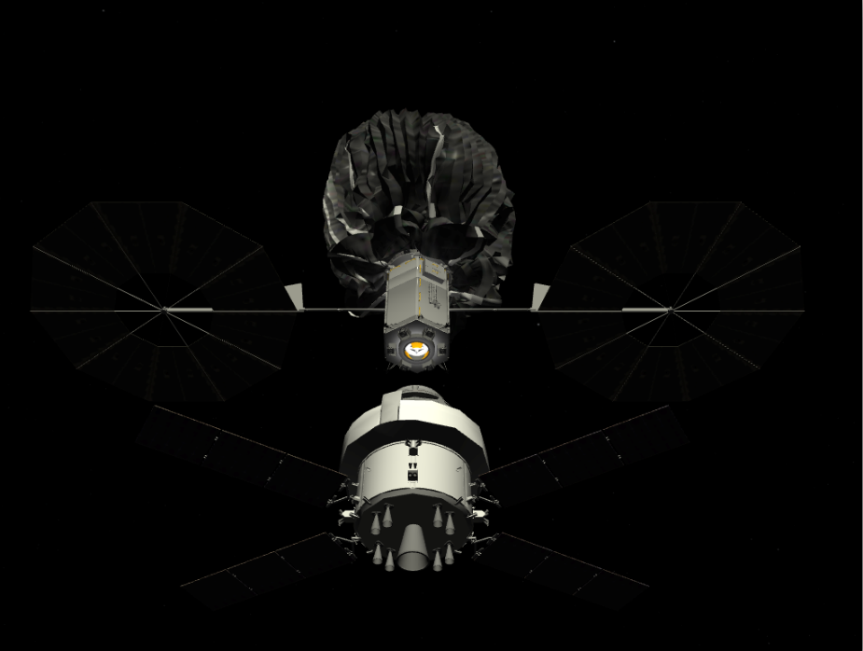
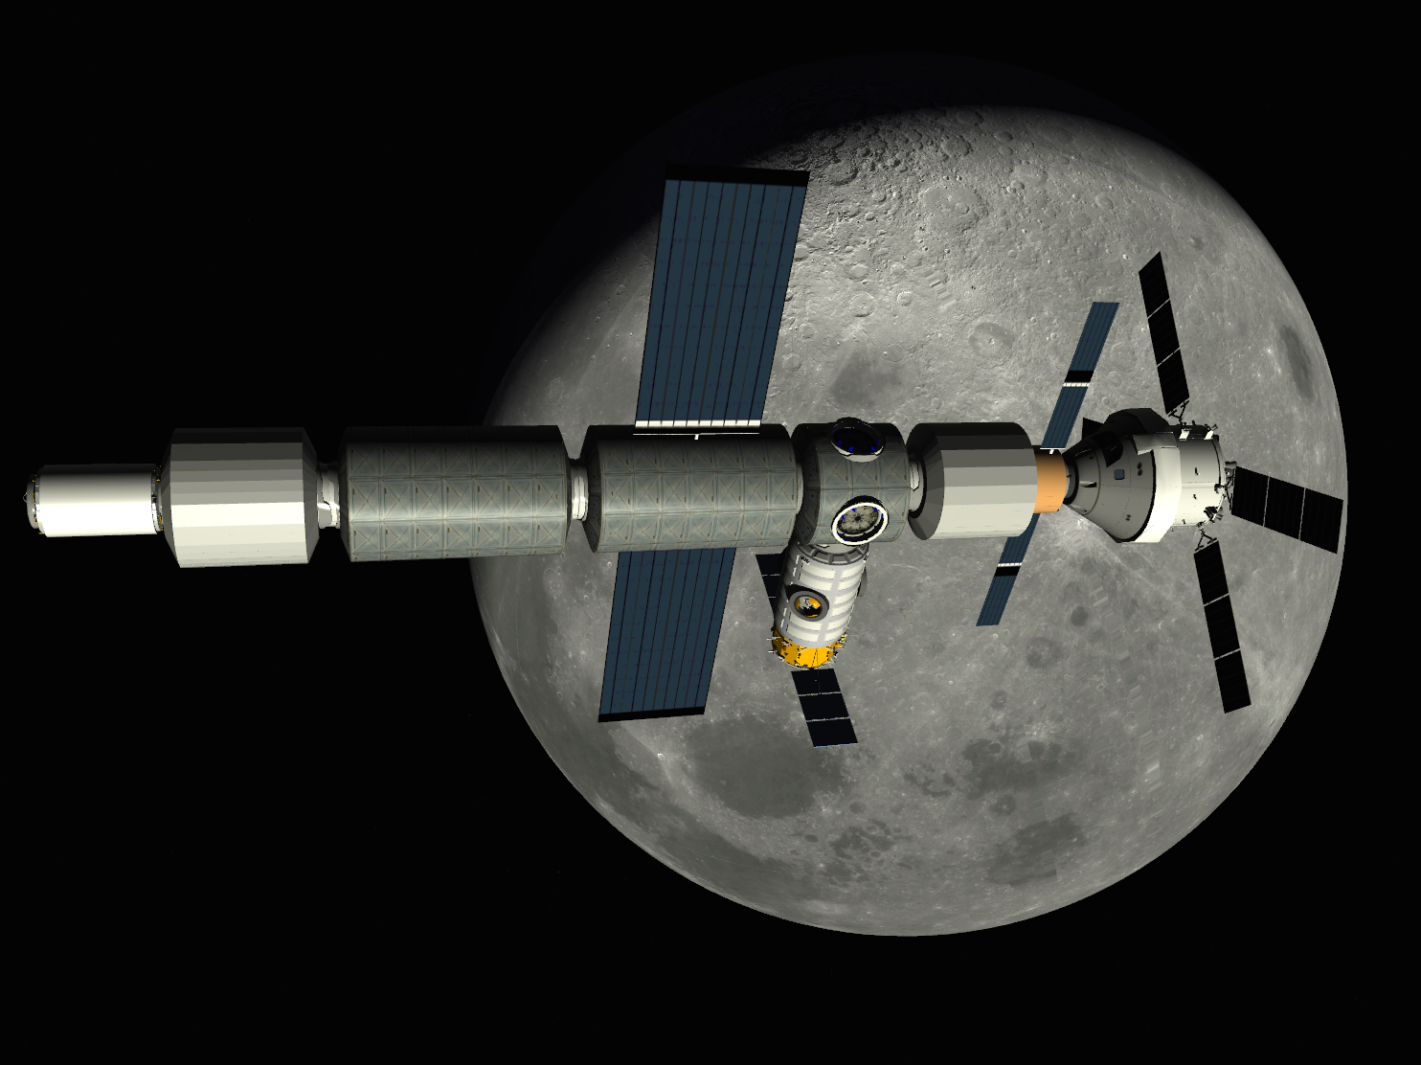
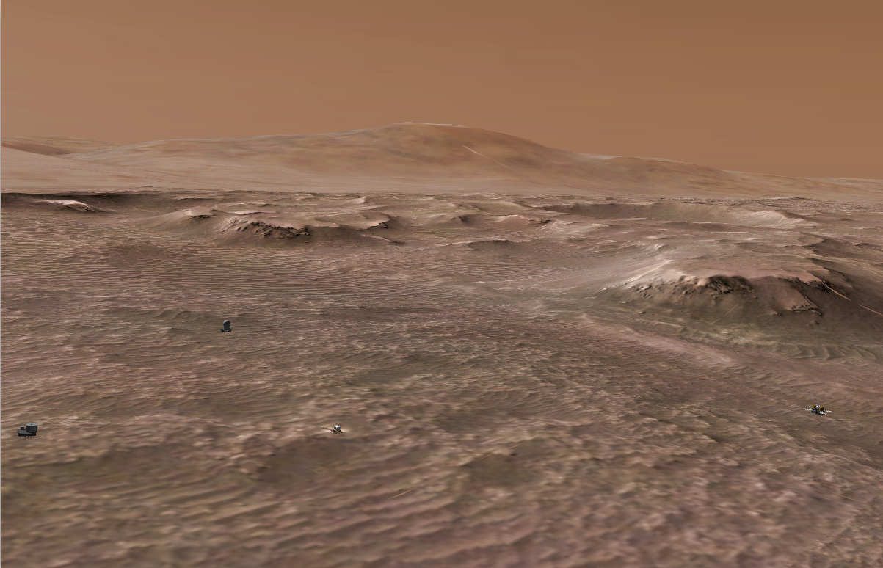
Environment Modeling (and cool Graphics!)
Simulation, not Animation

Slide 9
Vehicle Subsystems Modeling
GUNNS provides a common design and code generation development approach to three “aspects”
Fluidic (plumbing, life support systems, thermal control)
Electrical (generation, distribution, loads)
Thermal (structure temperatures, solar heating, albedo)
Data-driven component models are developed once and reused across modeled subsystem designs

Slide 10
Simulation through the Project Life Cycle
Producing simulations early in the development phase allows leverage of the investment throughout the life cycle
Simulation supports early design evaluation, with better accuracy
Model fidelity improves with design maturity and test results
Simulation support Flight Software verification and test
Simulation supports Hardware in the Loop, Spacecraft V&V
Supports operator training pre-flight
Ultimately can support crews in mission environment
Long comm delay
Loss-of-comm

Slide 11
Design, Analysis, and Test
Source: Lydia Davis/JSC

Slide 12
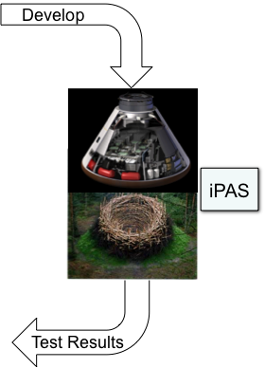
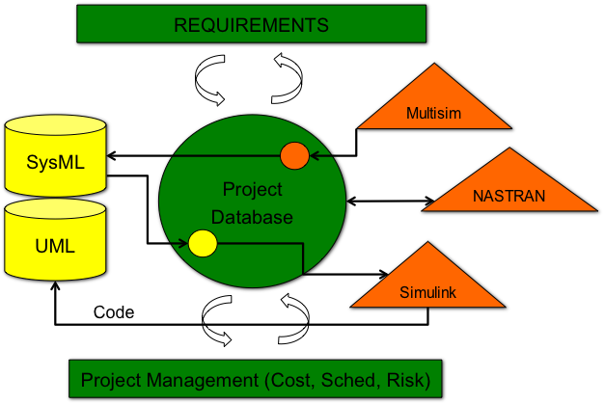
Future of Model Based Methods
Establish Iterative Loop Between Design, Analysis and Test

