Slide 1
AIAA Technical Symposium – NASA / JSC
06 May 2016

Slide 2
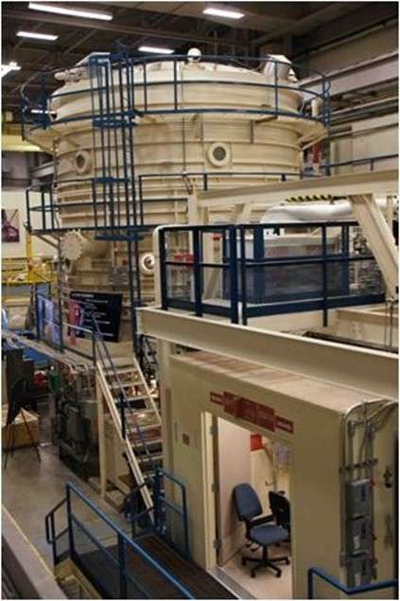
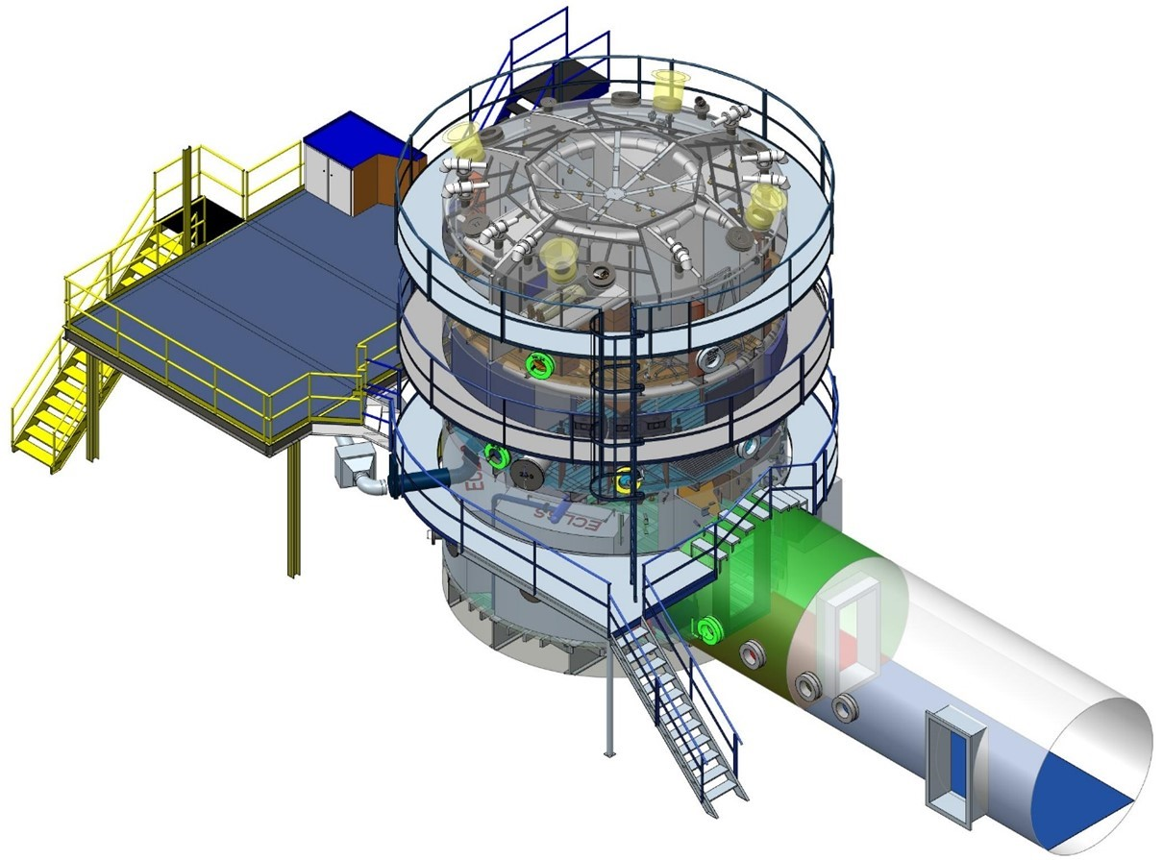
HESTIA Support of Future NASA Deep-Space Missions
NASA / JSC Building 7, 20-Foot Chamber Facility serves as the HESTIA Habitat. It has many unique capabilities unlike any other facility available to NASA.
NASA / JSC Building 7, 20-Foot Chamber Facility

Slide 3
HESTIA Support of Future NASA Deep-Space Missions
NASA / JSC Building 7, 20-Foot Chamber Facility serves as the HESTIA Habitat. It has many unique capabilities unlike any other facility available to NASA.
This Human-rated facility was used to support Gemini, Apollo, and SkyLab Programs. More recently, it was used to conduct 30-, 60-, and 90-day human ECLSS closed-loop testing in the 1990s to support the International Space Station (ISS) and life support technology development.
NASA / JSC Building 7, 20-Foot Chamber Facility

Slide 4
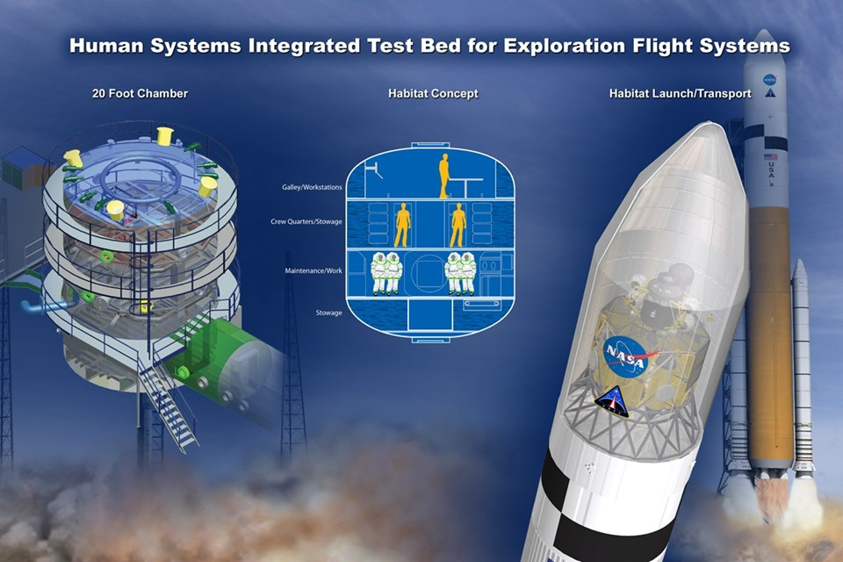
HESTIA Support of Future NASA Deep-Space Missions
NASA / JSC Building 7, 20-Foot Chamber Facility serves as the HESTIA Habitat. It has many unique capabilities unlike any other facility available to NASA.
This Human-rated facility was used to support Gemini, Apollo, and SkyLab Programs. More recently, it was used to conduct 30-, 60-, and 90-day human ECLSS closed-loop testing in the 1990s to support the International Space Station (ISS) and life support technology development.
Chamber geometry is consistent with habitability concepts for both translation and surface habitats (i.e., multi-storied cylindrical structure) driven by launch vehicle constraints.

Slide 5
HESTIA Support of Future NASA Deep-Space Missions
NASA / JSC Building 7, 20-Foot Chamber Facility serves as the HESTIA Habitat. It has many unique capabilities unlike any other facility available to NASA.
This Human-rated facility was used to support Gemini, Apollo, and SkyLab Programs. More recently, it was used to conduct 30-, 60-, and 90-day human ECLSS closed-loop testing in the 1990s to support the International Space Station (ISS) and life support technology development.
Chamber geometry is consistent with habitability concepts for both translation and surface habitats (i.e., multi-storied cylindrical structure) driven by launch vehicle constraints.
Chamber can operate at reduced pressure and elevated oxygen environments including those proposed for deep-space exploration by the Exploration Atmosphere Working Group (i.e., 8.2 psia & 34% O2).
NASA / JSC Building 7, 20-Foot Chamber Facility

Slide 6
HESTIA Support of Future NASA Deep-Space Missions
NASA / JSC Building 7, 20-Foot Chamber Facility serves as the HESTIA Habitat. It has many unique capabilities unlike any other facility available to NASA.
This Human-rated facility was used to support Gemini, Apollo, and SkyLab Programs. More recently, it was used to conduct 30-, 60-, and 90-day human ECLSS closed-loop testing in the 1990s to support the International Space Station (ISS) and life support technology development.
Chamber geometry is consistent with habitability concepts for both translation and surface habitats (i.e., multi-storied cylindrical structure) driven by launch vehicle constraints.
Chamber can operate at reduced pressure and elevated oxygen environments including those proposed for deep-space exploration by the Exploration Atmosphere Working Group (i.e., 8.2 psia & 34% O2).
Facility resources are available to support a wide range of research activities including data acquisition / monitoring / control, power, fluids, pressure & atmospheric control, and other key resources.
NASA / JSC Building 7, 20-Foot Chamber Facility

Slide 7
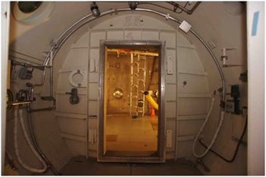
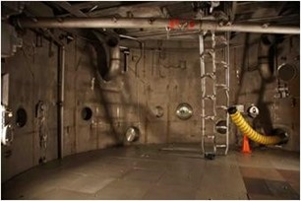
HESTIA Support of Future NASA Deep-Space Missions
NASA / JSC Building 7, 20-Foot Chamber Facility serves as the HESTIA Habitat. It has many unique capabilities unlike any other facility available to NASA.
This Human-rated facility was used to support Gemini, Apollo, and SkyLab Programs. More recently, it was used to conduct 30-, 60-, and 90-day human ECLSS closed-loop testing in the 1990s to support the International Space Station (ISS) and life support technology development.
Chamber geometry is consistent with habitability concepts for both translation and surface habitats (i.e., multi-storied cylindrical structure) driven by launch vehicle constraints.
Chamber can operate at reduced pressure and elevated oxygen environments including those proposed for deep-space exploration by the Exploration Atmosphere Working Group (i.e., 8.2 psia & 34% O2).
Facility resources are available to support a wide range of research activities including data acquisition / monitoring / control, power, fluids, pressure & atmospheric control, and other key resources.
Man- and Transfer-Locks allows the transfer of personnel and / or material into / out of the chamber without affecting the internal environment. These are mandatory for long-duration human testing of closed-loop ECLSS and other hardware.
NASA / JSC Building 7, 20-Foot Chamber Facility – Man-Lock
Transfer -Lock
NASA / JSC Building 7, 20-Foot Chamber Facility – Transfer -Lock
NASA / JSC Building 7, 20-Foot Chamber Facility – Transfer -Lock

Slide 8
HESTIA Support of Future NASA Deep-Space Missions

Slide 9
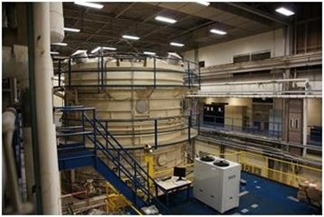
HESTIA Support of Future NASA Deep-Space Missions
NASA / JSC Building 7, 20-Foot Chamber Facility serves as the HESTIA Habitat. It has many unique capabilities unlike any other facility available to NASA.
This Human-rated facility was used to support Gemini, Apollo, and SkyLab Programs. More recently, it was used to conduct 30-, 60-, and 90-day human ECLSS closed-loop testing in the 1990s to support the International Space Station (ISS) and life support technology development.
Chamber geometry is consistent with habitability concepts for both translation and surface habitats (i.e., multi-storied cylindrical structure) driven by launch vehicle constraints.
Chamber can operate at reduced pressure and elevated oxygen environments including those proposed for deep-space exploration by the Exploration Atmosphere Working Group (i.e., 8.2 psia & 34% O2).
Facility resources are available to support a wide range of research activities including data acquisition / monitoring / control, power, fluids, pressure & atmospheric control, and other key resources.
Man- and Transfer-Locks allows the transfer of personnel and / or material into / out of the chamber without affecting the internal environment. These are mandatory for long-duration human testing of closed-loop ECLSS and other hardware.
External 2nd Floor platform allows flexibility for test and support hardware.
NASA / JSC Building 7, 20-Foot Chamber Facility – 2nd Floor Platform

Slide 10
HESTIA Support of Future NASA Deep-Space Missions
NASA / JSC Building 7, 20-Foot Chamber Facility serves as the HESTIA Habitat. It has many unique capabilities unlike any other facility available to NASA.
This Human-rated facility was used to support Gemini, Apollo, and SkyLab Programs. More recently, it was used to conduct 30-, 60-, and 90-day human ECLSS closed-loop testing in the 1990s to support the International Space Station (ISS) and life support technology development.
Chamber geometry is consistent with habitability concepts for both translation and surface habitats (i.e., multi-storied cylindrical structure) driven by launch vehicle constraints.
Chamber can operate at reduced pressure and elevated oxygen environments including those proposed for deep-space exploration by the Exploration Atmosphere Working Group (i.e., 8.2 psia & 34% O2).
Facility resources are available to support a wide range of research activities including data acquisition / monitoring / control, power, fluids, pressure & atmospheric control, and other key resources.
Man- and Transfer-Locks allows the transfer of personnel and / or material into / out of the chamber without affecting the internal environment. These are mandatory for long-duration human testing of closed-loop ECLSS and other hardware.
External 2nd Floor platform allows flexibility for test and support hardware.
Test operations follow stringent processes by a certified test team for both human and non-human testing.
NASA / JSC Building 7, 20-Foot Chamber Facility

Slide 11
HESTIA Support of Future NASA Deep-Space Missions
NASA / JSC Building 7, 20-Foot Chamber Facility serves as the HESTIA Habitat. It has many unique capabilities unlike any other facility available to NASA.
This Human-rated facility was used to support Gemini, Apollo, and SkyLab Programs. More recently, it was used to conduct 30-, 60-, and 90-day human ECLSS closed-loop testing in the 1990s to support the International Space Station (ISS) and life support technology development.
Chamber geometry is consistent with habitability concepts for both translation and surface habitats (i.e., multi-storied cylindrical structure) driven by launch vehicle constraints.
Chamber can operate at reduced pressure and elevated oxygen environments including those proposed for deep-space exploration by the Exploration Atmosphere Working Group (i.e., 8.2 psia & 34% O2).
Facility resources are available to support a wide range of research activities including data acquisition / monitoring / control, power, fluids, pressure & atmospheric control, and other key resources.
Man- and Transfer-Locks allows the transfer of personnel and / or material into / out of the chamber without affecting the internal environment. These are mandatory for long-duration human testing of closed-loop ECLSS and other hardware.
External 2nd Floor platform allows flexibility for test and support hardware.
Test operations follow stringent processes by a certified test team for both human and non-human testing.
Project management, analysis, design, acquisition, fabrication, assembly and test certification services are available for facility build-ups to support HESTIA research.
NASA / JSC Building 7, 20-Foot Chamber Facility

Slide 12
HESTIA Support of Future NASA Deep-Space Missions
NASA / JSC Building 7, 20-Foot Chamber Facility serves as the HESTIA Habitat. It has many unique capabilities unlike any other facility available to NASA.
This Human-rated facility was used to support Gemini, Apollo, and SkyLab Programs. More recently, it was used to conduct 30-, 60-, and 90-day human ECLSS closed-loop testing in the 1990s to support the International Space Station (ISS) and life support technology development.
Chamber geometry is consistent with habitability concepts for both translation and surface habitats (i.e., multi-storied cylindrical structure) driven by launch vehicle constraints.
Chamber can operate at reduced pressure and elevated oxygen environments including those proposed for deep-space exploration by the Exploration Atmosphere Working Group (i.e., 8.2 psia & 34% O2).
Facility resources are available to support a wide range of research activities including data acquisition / monitoring / control, power, fluids, pressure & atmospheric control, and other key resources.
Man- and Transfer-Locks allows the transfer of personnel and / or material into / out of the chamber without affecting the internal environment. These are mandatory for long-duration human testing of closed-loop ECLSS and other hardware.
External 2nd Floor platform allows flexibility for test and support hardware.
Test operations follow stringent processes by a certified test team for both human and non-human testing.
Project management, analysis, design, acquisition, fabrication, assembly and test certification services are available for facility build-ups to support HESTIA research.
HESTIA offers close proximity to key stakeholders including astronauts, Human Research Program (HRP) [who direct space human research for the agency], Mission Operations, Safety & Mission Assurance, and the Engineering Directorate.
NASA / JSC Building 7, 20-Foot Chamber Facility

Slide 13
HESTIA Support of Future NASA Deep-Space Missions
HESTIA 20-Foot Chamber Facility Project (FY ‘15)
HESTIA was formed in FY ‘15
FY ‘15 goal was to provide a demonstration of In-situ Resource Utilization (ISRU) and Environmental Control & Life Support System (ECLSS) cross-discipline technologies.
Test series conducted in September 2015. (Note: This will be further elaborated in the next presentation.)

Slide 14
HESTIA Support of Future NASA Deep-Space Missions
HESTIA 20-Foot Chamber Facility Project (FY ‘16)
FY ‘16 Goals
Begin to transform the 20-Foot Chamber Facility into a 4-person Mars Habitat analog capable of sub-atmospheric operation at elevated O2 concentrations
Work closely with ECLSS, Habitation, and HRP groups to plan and execute evaluations in the 20-foot chamber facility in support of deep-space research
Further build on the chamber facility capabilities of FY ‘15 in order to support more complex HESTIA and other customer evaluations. For example, the following are being integrated into the chamber:
Atmosphere Monitoring System (AMS) [integration & checkout]
Pressure Control System (PCS) [integration only; checkout to be performed in FY ’17]
Trace Contamination Injection System (TCIS) [integration only; checkout to be performed in FY ’17]
Participate in the HRP-sponsored Elevated CO2 Human Exposure Evaluation to study the effects of elevated CO2 on cognitive performance (April – June 2016)
FY ‘16 Products
Identify representative ECLSS System Schematic for 4-person Mars Habitat (use as ‘road map’)
Develop ECLSS System Schematic for 20-foot chamber build-up and support
Develop preliminary habitation outfitting plan to support both short & long-duration human evaluations
Develop Master Build Plan to aid in laying out future facility build-ups in the coming years
Provide additional test capability through select build-ups (e.g., meet depressurization & repressurization rates for upcoming FY ‘17 Exploration Atmosphere & EVA Prebreathe Protocol Validation)

Slide 15
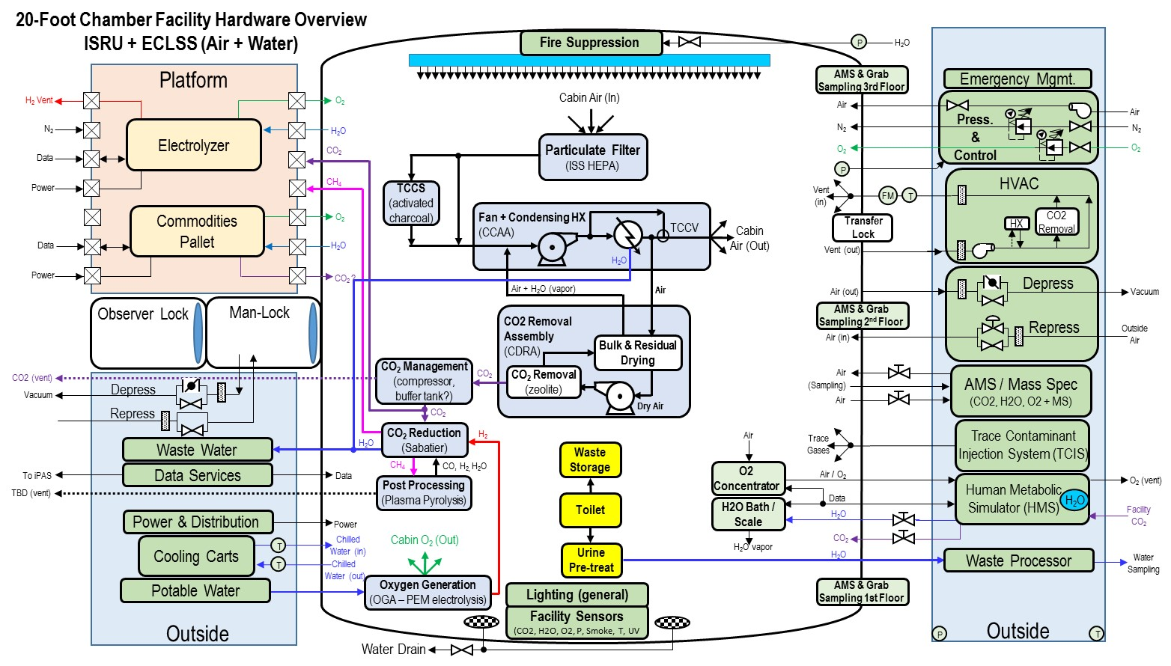

Slide 16
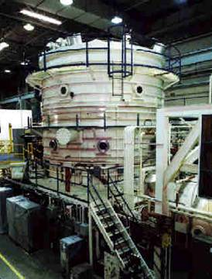
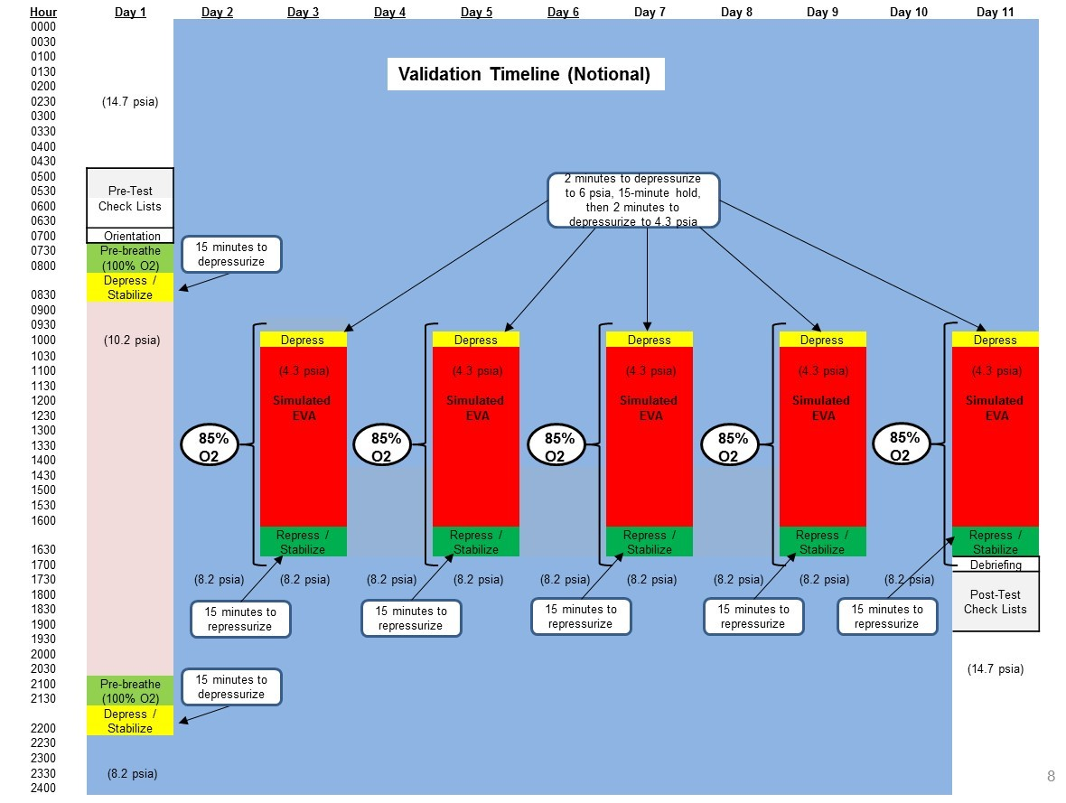
Ground Validation of 8.2 / 34 Exploration Atmosphere
Goal: Ground Chamber Validation of Exploration Atmosphere & Prebreathe Protocols (with Shortened Purge, evaluation of Hypoxia & Other Physiological Effects) to support future space vehicles & habitats (e.g., Earth-Moon L1, Mars, NEA, etc.) and extravehicular activity (EVA) events
Approach: Approximately 30 subjects (6 subjects per session) will conduct 5, 11-day saturation runs
in order to validate
the 8.2 psia /34% O2 Protocol, including the simulation of 5 EVA sorties (30 total).
NASA/JSC 20-foot Chamber

Slide 17
HESTIA Support of Future NASA Deep-Space Missions
Exploration Atmosphere & EVA Pre-breathe Protocol Validation
10f. Conduct EVA: EVA Operations
Main Chamber
Hatch: Open
Techs: Masks On (100% O2)
Subjects: Masks On (85% O2)
Man-lock
Hatch: Closed
Techs: Masks On (100% O2)
Subjects: N/A
Exterior Hatch: Open
Time: Day 3
1019 - 1610 hours (Time EV: 00:09 – 06:00 hours)
20-Foot Chamber
(4.3 psia)
Test Subject
Test Subject
Notes:
6-hour simulated EVA (max)
Microgravity EVA or Surface EVA simulation
Test Subject
Rescue Tech
(14.7 psia)
Test Subject
Rescue Tech
Test Subject
(4.3 psia)
Test Subject
Med Tech
Med Tech
Assumptions:
Rescue Techs (2) not swapped out during the simulated EVA. If this operation is necessary, the replacement Rescue Techs require a 4-hour prebreathe prior to chamber ingress.

Slide 18
HESTIA Support of Future NASA Deep-Space Missions
HESTIA 20-Foot Chamber Facility Project (FY ‘17)
FY ‘17 Goals / Products
Perform facility build-ups in support of the HRP-sponsored Exploration Atmosphere & EVA Prebreathe Protocol Validation including the following:
Demonstrate pressure profiles & O2 control to achieve 10.2 psia / 26% O2 and 8.2 psia / 34% O2
Demonstrate simulated EVAs at 4.3 psia
Provide Habitation provisions (5, 11-day human evaluations)
Clothing
Exercise
Food & nourishment
Hygiene & waste control
Lighting
Privacy communications
Sleep quarters
Certify Emergency Management System (EMS) meets performance requirements. These provide for sensor response, fire / smoke detection, fire / smoke suppression, emergency repressurization, etc.
Based on Mars 4-person ECLSS schematic identified in FY ‘16, use SysML performance model to ‘size’ chamber for projected ECLSS hardware to be tested in future system-level evaluations.
Demonstrate capabilities of Trace Contamination Injection System (TCIS).
Continue to work closely with ECLSS, Habitation, and HRP groups in support of deep-space research.
Execute HRP-sponsored Exploration Atmosphere & EVA Prebreathe Protocol Validation in late FY ’17 or early FY ’18.

Slide 19
HESTIA Support of Future NASA Deep-Space Missions
HESTIA 20-Foot Chamber Facility Project (FY ‘18 & beyond)
FY ’18 and beyond Goals
Perform facility build-ups in support of ECLSS technology performance and Habitat outfitting research
Builds to power, data, thermal, physical (e.g., racks), potable water, waste water, etc.
Unique builds to support specific Habitation research (long-duration stays, e.g., months)
Command & Control
Clothing and support functions
Entertainment
Exercise
Food & nourishment, including food preparation (galley)
Hygiene & waste control
Lighting
Privacy communications
Secondary structure
Sleep quarters
Integrate technology candidates into the chamber and begin to conduct system-level ECLSS, Habitation, and HRP evaluations in support of deep-space research.
Continue to improve the SysML performance model for the 20-foot chamber ECLSS system based on available test data.
Work to expand our customer participation to include academia, industry, and international partners
Product: In the end, the plan will be to perform long-duration (i.e., years) human, closed-loop research of
key Deep-Space technologies and scenarios, including reduced pressure and elevated O2.

Slide 20
HESTIA Support of Future NASA Deep-Space Missions
Backup Charts

Slide 21
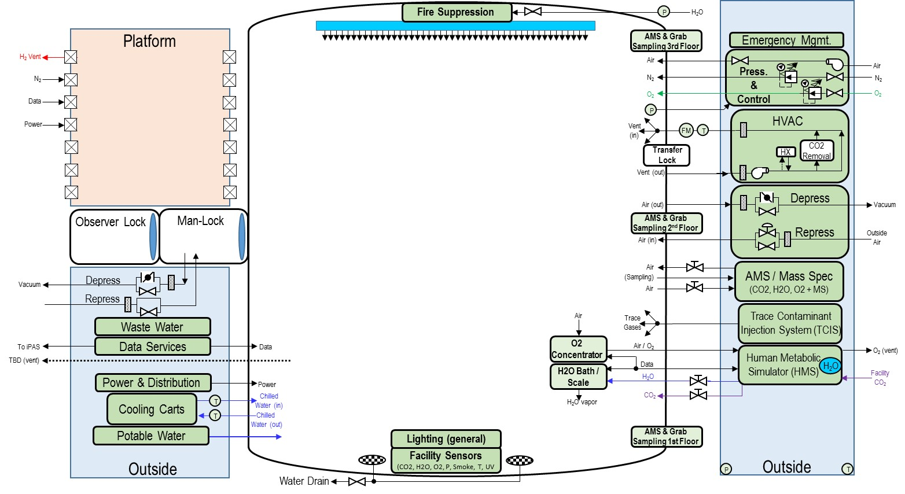
HESTIA Support of Future NASA Deep-Space Missions
20-FOOT CHAMBER FACILITY RESOURCES AVAILABLE

Slide 22
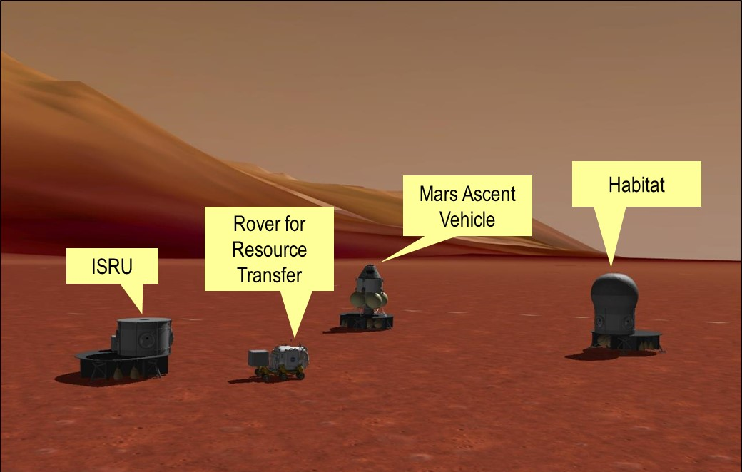
HESTIA Support of Future NASA Deep-Space Missions
OBJECTIVE
The Human Exploration Spacecraft Test-bed for Integration & Advancement (HESTIA) was established in FY ‘15 to develop an advanced Deep-Space targeted human spacecraft testbed with system integration between various space vehicle disciplines across the Center.
HESTIA Focus: Mars Surface Operations
HESTIA Focus: Mars Surface Operations

Slide 23
HESTIA Support of Future NASA Deep-Space Missions
OUR FOCUS IS CROSS DISCIPLINE SYSTEMS ENGINEERING …
HESTIA Focus: Mars Surface Operations
ESTA B353
B7 20-Ft Chamber
ER Rover
ESTA B353
O₂ (liq) → O₂ (gas)
O₂ (gas) → SOFC
CH₄ → SOFC
ECLSS (CO2 removal / reduction & Atm. Contr.)
O₂ → Humans
CO₂ + H₂ → CH₄ & H₂0 H₂0 processing & distr.
Soil → H₂O
H₂O → H₂ & O₂
Transport

Slide 24
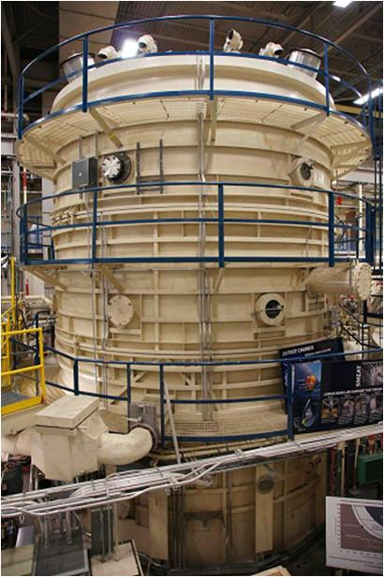
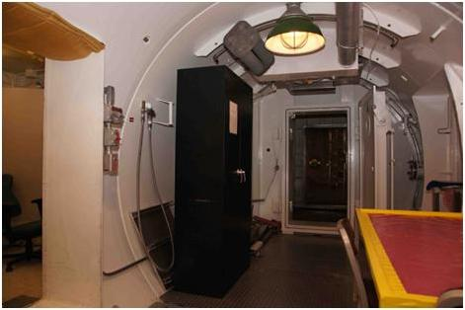
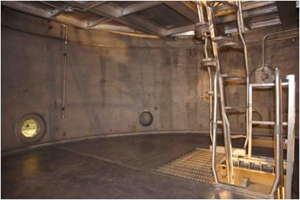
Some Key Facility Features
Chamber Cylinder
View Ports
Pass Throughs
Man-Lock
Observer Lock
Transfer Lock
Interior
Floor / Ceiling Support
Ladders
Floor Plates
2nd Floor Platform
3 stories
27.5’ x 20’ dia.
8,090 ft³ total volume
3

Slide 25
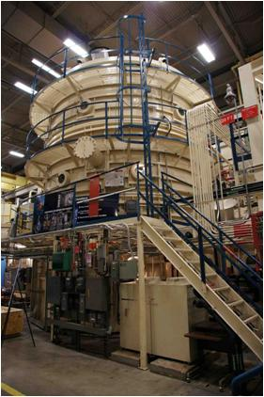
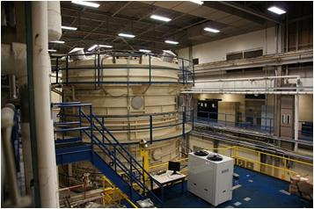
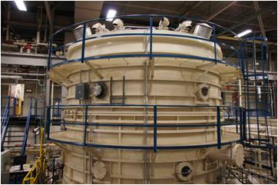
Various Facility Features
Exterior Hardware
2nd Floor Platforms and Stairs
2nd Floor Walkway
3rd Floor Walkway
Exterior Electrical Boxes (Breaker & Outlets)
Camera Locations
Vacuum Lines, Coolant Lines, etc.
Top of Chamber (Relief Valves, etc.)
4
1
7
6
3
2
5
1

Slide 26
Exterior Photos

Slide 27
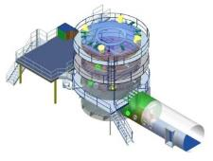
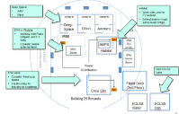
HESTIA Support of Future NASA Deep-Space Missions
B7
O₂
Humans
Air Circulation / Condensate Collection
Atmosphere Monitoring & Control
Urine Collection / Processing
H₂0
O₂
O₂ Gen.
H₂O
H₂
O2
Trace Contam. Control
H₂O Processing
& Distr.
CO₂ Removal
CO₂
CH₄
H₂
Sabatier
CH₄
Ullage
B29
iPAS
Ullage O2
B353
Sabatier
H₂
CH₄
CH₄
CH₄
H₂O
Soil
ISRU
O₂
Cryo Fluid Management
Solid Oxide Fuel Cells
O₂
O₂
O₂
CO₂
H₂O
(Gas)
(Liquid)

Slide 28
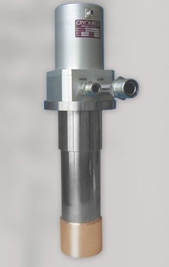
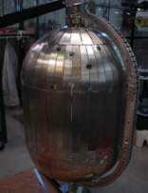
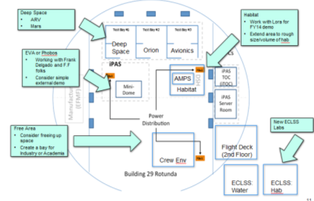
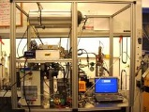
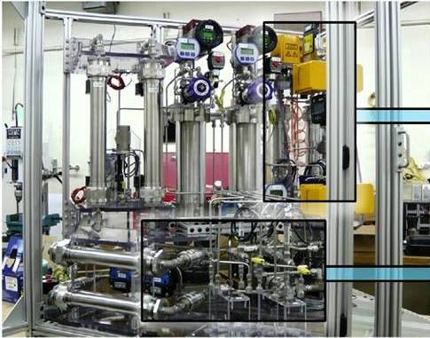
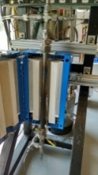
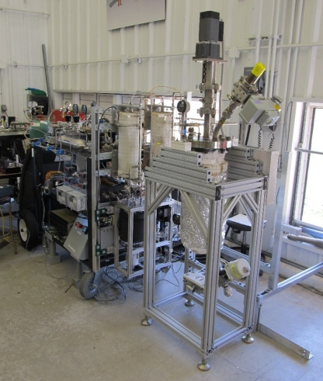
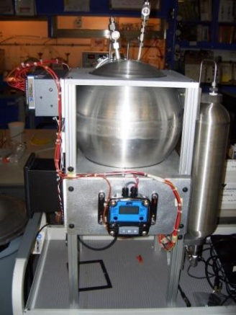
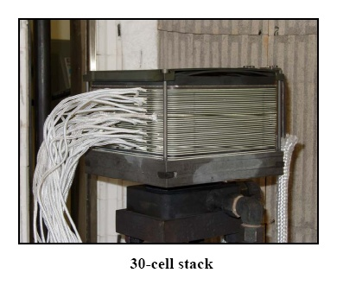
HESTIA Support of Future NASA Deep-Space Missions
OBJECTIVE
The Human Exploration Spacecraft Test-bed for Integration & Advancement (HESTIA) was established in FY ‘15 to develop an advanced Deep-space targeted human spacecraft testbed with system integration between various space vehicle disciplines across the Center.
H2O
O2
CO2
CH4
Cryo Fluid Management
Humans
CO2 Red.
O2
H2O
O2
Trace Contaminants
H2
H2O
CH4
CH4
(Gas)
(Liquid)
iPAS
ISRU
CH4
CO2
Solid Oxide Fuel Cells
O2
H20
Soil
H2O
O2
CH4
CO2
Energy

Slide 29
