Slide 1
HESTIA Phase I Results: The Air Revitalization System
Sarah E. Wright
NASA Johnson Space Center
Crew and Thermal Systems Division
Thermal Systems Branch
May 6, 2016

Slide 2
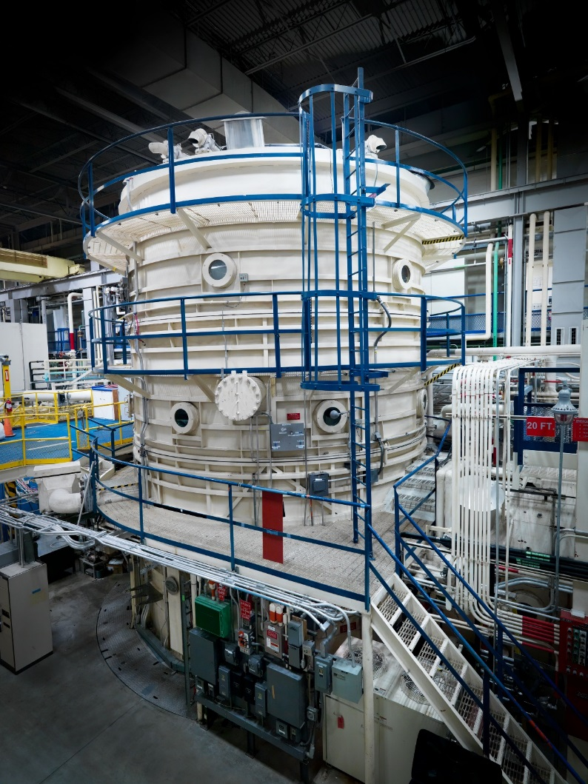
HESTIA Phase I Test Results: The Air Revitalization System
HESTIA: Human Exploration Spacecraft Testbed for Integration and Advancement
Integrated ECLSS/ISRU testing
Environmental Control & Life Support Systems
In-Situ Resource Utilization
Incorporated hardware from various groups in engineering
Portable CO2 and O2 sensors
Human Metabolic Simulator
Electrolyzer
Air Revitalization System (ARS)
More hardware to be added as technology matures

Slide 3
Environmental Control and Life Support System (ECLSS)
Processed Air
Temp & Humidity Control
Air
TCCS
Filtration & Heavy VOC Removal
CO₂ Removal
Recovered H₂O
Cabin Return
CO₂
Waste Mgmt
Condensate
Cabin Air
Fire Detection
& Suppression
CO₂ Reduction
Vented Waste Gas
Cabin Return
Brine & Urine Sensors
Waste
Particulate Monitor
Atmosphere Monitors
Urine Recovery
PT Urine
Oxygen
H₂
O₂/N₂ Control
Oxygen Generation
Brine Water Recovery
Brine
Acoustic Monitor
Processed Urine
Brine Product
Microbial Monitor
(Water & Surfaces)
High P O₂
Potable Water Processing
Nitrogen
Product Water
Product Water
Ag Biocide
Water
Crew Systems
Shower
Hand Wash/Shaving
Potable Water Dispenser
Waste Water
Water Quality Monitors
DOES NOT IMPLY SELECTION! PRE-DECISIONAL!

Slide 4
Air Revitalization System
Processed Air
Temp & Humidity Control
Air
TCCS
Filtration & Heavy VOC Removal
CO₂ Removal
Recovered H₂O
Cabin Return
CO₂
Waste Mgmt
Condensate
Cabin Air
Fire Detection
& Suppression
CO₂ Reduction
Vented Waste Gas
Brine & Urine Sensors
Waste
Particulate Monitor
Atmosphere Monitors
Urine Recovery
PT Urine
Oxygen
H₂
O₂/N₂ Control
Oxygen Generation
Brine Water Recovery
Brine
Acoustic Monitor
Processed Urine
Brine Product
Microbial Monitor
(Water & Surfaces)
High P O₂
Potable Water Processing
Nitrogen
Product Water
Product Water
Ag Biocide
Water
Crew Systems
Shower
Hand Wash/Shaving
Potable Water Dispenser
Waste Water
Water Quality Monitors
DOES NOT IMPLY SELECTION! PRE-DECISIONAL!

Slide 5
Air Revitalization System (ARS)
Shuttle Condensing Heat Exchanger (CHX)
Trace Contaminant Removal System (TCRS)
Shuttle Cabin Fan
Motorized Valves
LiOH Canisters (CO₂ Scrubber)
Shuttle Water Separator

Slide 6
HESTIA - ARS

Slide 7
Air Revitalization System
The ARS provided 4 main functions to the chamber:
Cooling the air
Condensing heat exchanger, chiller carts
Removing humidity from the air
Condensing heat exchanger
Removing trace contaminants
Trace Contaminant Removal System
Charcoal filter
Ambient Temperature Catalytic Oxidizer (ATCO) filter
Scrubbing Carbon Dioxide
Reactive Plastic Lithium Hydroxide canisters (RP LiOH)
My focus: the Condensing Heat Exchanger (CHX)

Slide 8
Condensing Heat Exchanger Performance
${{ Q}_{in}= Q}_{out}+Q_{stored}+Q_{loss}$
CHX Function: provide cooling ($Q_{in}$) which removes heat from air ($Q_{out})$
No $Q_{stored}$ for our test at steady state
Ideal Case: $Q_{in}=Q_{out}$
Liquid side is straight-forward:
$Q_{in}= \dot{m}c_{p}∆T$
Air side more involved
Latent heat (phase change – condensing)
Sensible heat (changes in temperature)

Slide 9
Methods of calculating Q_{air} (Q_{out})
Heat Removed from Air (Q air)
Psychometric chart | $$Q_{air}={\dot{m}}_{air} \left(h_{2} − h_{1}\right)$$ | Enthalpy values read from chart
Calculated Enthalpy | $$Q={\dot{m}}_{air} Δh_{2−3}+{\dot{m}}_{w} Δh_{3−1}$$ | Calculate enthalpy value for every specific temperature
Experimental | $$Q={\dot{m}}_{air} C_{p} ΔT_{2−1}+m ̇air x Δh2−1+\left(\frac{m_{cond}}{{time}_{tot}}\right) h_{fg}$$ | Curve fit enthalpy from recorded data
Average Enthalpy | $$Q={\dot{m}}_{air} Δ{\overline{h}}_{2−3}+{\dot{m}}_{air} h_{fg} Δ{HR}_{2−1}$$ | Average Enthalpy kept constant

Slide 10
Experimental Calculation method
Vary with temperature, need formula
All other terms available from experiment data
${Q_{air}= \dot{m}}_{air} C_{p} ΔT_{2−1}+{\dot{m}}_{air} x Δ{hg}_{2−1}+\left(\frac{m_{cond}}{{time}_{tot}}\right) h_{fg}$
Sensible heat of dry air
Sensible heat of water vapor
Latent heat of vaporization (condensation)
Term | Definition | Unit
$$\dot{m}$$ | $$mass flow rate$$ | $$kg/s$$
$$C_{p}$$ | $$specific heat of dry air$$ | $${kJ}/{\left(kg°C\right)}$$
$$ΔT_{2−1}$$ | $$change in temperature$$ | $$°C$$
$$h_{fg}$$ | $$specific enthalpy of evaporation$$ | $${kJ}/{kg}$$
$$h_{g}$$ | $$specific enthalpy of water vapor$$ | $${kJ}/{kg}$$
$$x$$ | $$humidity ratio$$ | $${{kg}_{H2O}}/{{kg}_{dryair}}$$
Notes:
Add hg to terms

Slide 11
Phase I Test Points
Test Point | Chiller Set Point (°C) | Coolant Inlet T (°C) | TCRS Air Flow Rate Set Point (CFM) | TCRS Air Flow Rate (CFM) | LiOH Air Flow Rate Set Point (CFM) | LiOH Air Flow Rate (CFM) | Exercise Profile | Humidity Injection rate set point (mL/min)
1 | 2 | 2.1 | 10.6 | 12.1 | 10.6 | 12.6 | 4 normal | 4.71
2 | 10 | 9.4 | 10.6 | 11.8 | 10.6 | 11.4 | 4 normal | 4.71
3 | 15 | 14.3 | 10.6 | 10.4 | 10.6 | 10.0 | 4 normal | 4.71
4 | 2 | 1.9 | 21.2 | 20.2 | 21.2 | 23.3 | 4 normal | 4.71
5 | 10 | 9.8 | 21.2 | 22.7 | 21.2 | 20.9 | 4 normal | 4.71
6 | 15 | 14.4 | 21.2 | 21.5 | 21.2 | 20.8 | 4 normal | 4.71
7 | 2 | 2.5 | 10.6 | 13.3 | 10.6 | 11.3 | 3 rest, 1 exercise | 21.38 (peak)

Slide 12
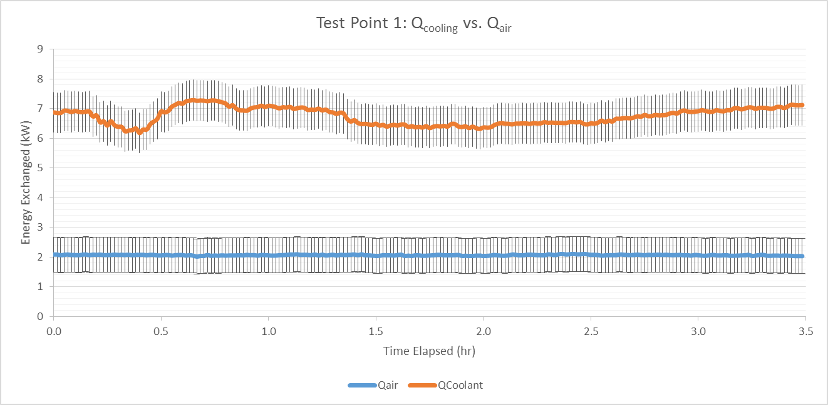
CHX Performance
${Q_{out}=Q_{air}= \dot{m}}_{air} C_{p} ΔT_{2−1}+{\dot{m}}_{air} x Δ{hg}_{2−1}+\left(\frac{m_{cond}}{{time}_{tot}}\right)h_{fg}$
$${Q_{in}=Q}_{cooling}= \dot{m}c_{p}∆T$$

Slide 13
CHX Performance
Figure 7: ARS Test Point 7 Energy Balance
*Spike in Qcoolant and Q air due to decrease in chiller cart temperature from 15°C to 2°C

Slide 14
Current Work
Perform post-test calibration, improve instrumentation for future tests
Run further tests to determine discrepancies between $Q_{in}$ and $Q_{out}$
Characterize potential $Q_{loss}$ sources
i.e. measure water storage capacity in separator for additional condensate
Tie in ARS and other subsystem data collection
Develop new CHX to “plug in” to HESTIA 20’ chamber

Slide 15
CHX Technology Development Problem & Need
CHX are a critical function of closed-loop life support
~50% of reclaimed water on ISS is from CHX condensate (up to 4lbs/hr)
Utilizes a hydrophilic coating to gather condensate
Three problems with current technology
Current CHX’s must be dried out on a monthly basis to mitigate bio-growth
Uses crew time and resources which may not be available on long duration spaceflight
Increases volume and mass with dual core “swingbed” approach
Coatings slough off with time, causing the CHX to lose its hydrophilicity
Current ISS CHX’s must be uninstalled and regenerated on earth on a regular basis
Current coatings react with contaminants which cause downstream impacts to water processing system
Chemical reaction between contaminants and coatings which produce DMSD’s that are difficult to remove from water
Currently on ISS, filters can remove compounds, but are degraded at an accelerated rate (replaced every ~6 months)
To enable long duration spaceflight and reduce upmass/downmass a more robust CHX is needed
Notes:
Upmass/downmass (minimize crew time
Add info for

Slide 16
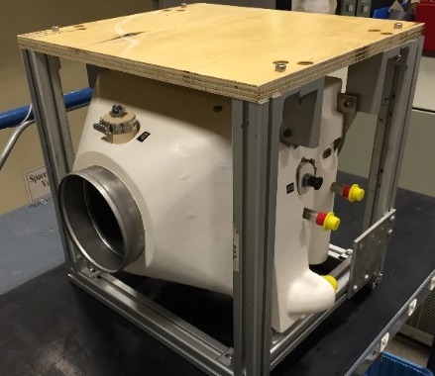
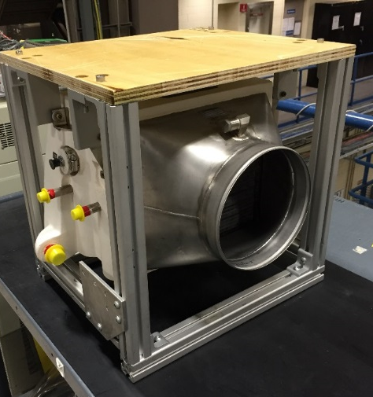
Condensing Heat Exchangers
Developing options for future CHX solutions
UNL
Orbitec
Oceaneering
Other SBIRs?
Integrated ECLSS testing will be used to verify technology
Will replace shuttle CHX in chamber

Slide 17
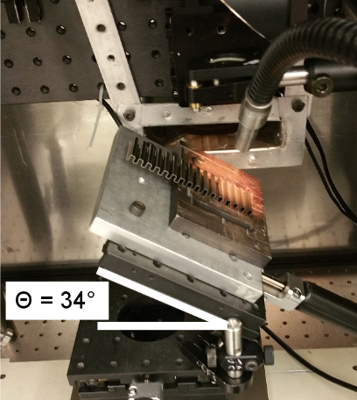
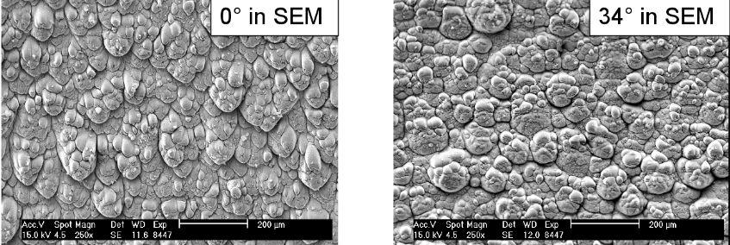
Current Partnership: UNL
Currently partnered with University of Nebraska-Lincoln (UNL)
Utilize a femtosecond laser to physically create a hydrophilic surface, thereby bypassing the need for a coating
Seedling project plan:
Investigate the manufacturability of laser processed surfaces (i.e. brazing, bending, and machining)
Identify the ideal pattern:
Bio-resistant
Hydrophilic
Not effected by siloxanes
Investigate a cleanable siloxane filter to be used upstream of CHX
Leveraging UNL’s work with the Nebraska Research Initiative to develop an antibacterial and antifouling metal surface for the medical industry
Laser processing of fins for brazing and flat sheets for microbial testing
Construction of a 4”x4” test coupon for testing
SEM Images of Finned Surface
Fins Undergoing Laser Processing
Notes:
Current TRL

Slide 18
Summary
HESTIA’s development as a beneficial integrated testbed is well underway
Phase I testing proved its capability and generated useful data, as well as brought groups together earlier in the design/integration process
The “plug and play” design allows HESTIA to continue expanding as technologies mature
The ARS has aided in the demonstration of the need for new CHX technology
Future CHX work is promising, and the 20’ chamber will verify CHX capabilities such as:
Cooling air
Removing humidity
Gathering condensate for regeneration
Manufacturability
There are several promising CHXs in development
Notes:
Without reparability, the system should be robust (easy to fix or hard to break balance)

Slide 19
Questions?

